Slide 1
Gathering Requirements
Michael Dempewolf

Slide 2
What are Requirements?
Dictionary.com defines a requirement as:
“A thing that is needed or wanted”
Merriam-Webster defines a requirement as:
“Something wanted or needed”
“Something essential to the existence or occurrence of something.”

Slide 3
What is a Software Requirement?
Extending the two definitions of requirements provides us with:
A thing that is needed or wanted which is essential to produce software
Our textbook states a requirement “is simply a statement of what the system must do or what characteristics it needs to have.” (Dennis, Wixom, & Roth, 2015)

Slide 4
Types of Requirements
Two types of requirements:
Functional – Process (what the system must do)
Nonfunctional – Behavior (attributes or qualities of the system)

Slide 5
How do we Acquire Software Requirements?
Part of the Systems Development Life Cycle (SDLC)
Gather Requirements or System Investigation
Design
Implement or Code
Testing
Deployment
Maintenance
System Concept Development
Planning
Requirements Analysis
Design
Development
Integration and Test
Operations and Maintenance
Disposition

Slide 6

From Whom do we Solicit Requirements?
Stakeholders!

Slide 7
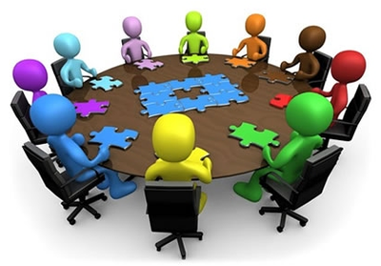
Who are our Stakeholders?
Business
Representative
User
Legal
IT
Financial
Developer

Slide 8

Process
Gather
Document
Review
Refine
Accept

Slide 9
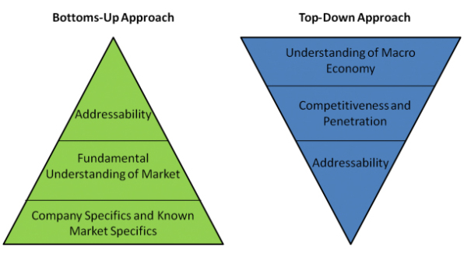
Approaches

Slide 10
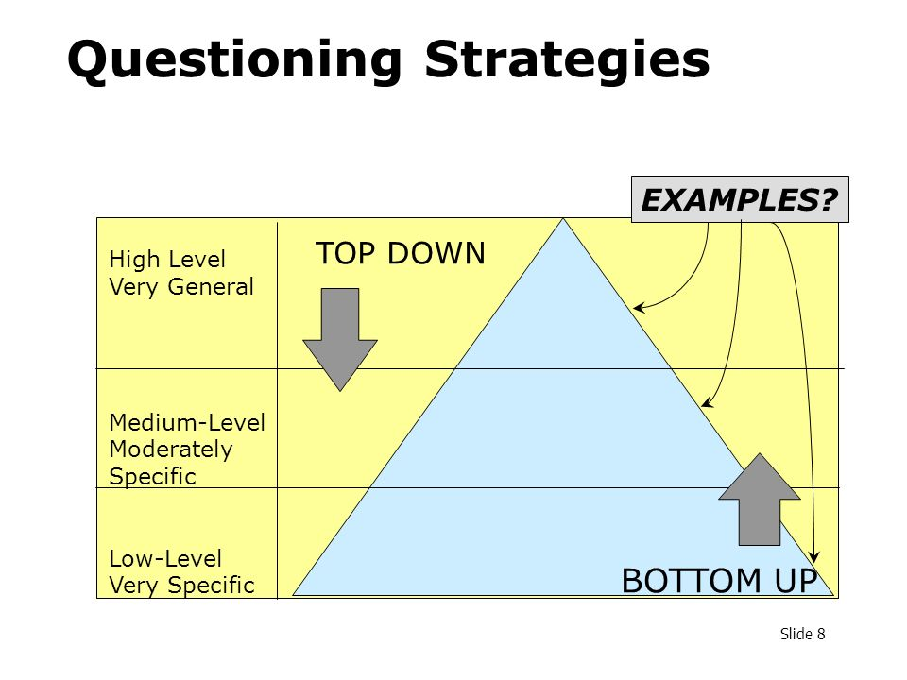
Approaches (cont)

Slide 11
Funny Requirements Gathering Video
Funny Video: https://www.youtube.com/watch?v=BKorP55Aqvg
Link available on Moodle

Slide 12
Discussion Questions
Break into your teams and discuss the following (15 minutes):
What is the difference in the requirements process for an Agile project vs a Waterfall project?
What artifact is produced from this process (for both SDLCs)?
Who is responsible for the requirements gathering, documentation, and acceptance?

Slide 13
Discussion Questions
Stay in your teams and discuss the following (15 minutes):
What SDLC are you going to use for your project?
How are you going to gather requirements for your project?
Who is doing what?
How are you documenting the requirements?
Who makes the final approve to accept and prioritize the requirements?

Slide 14

Questions

