Slide 1
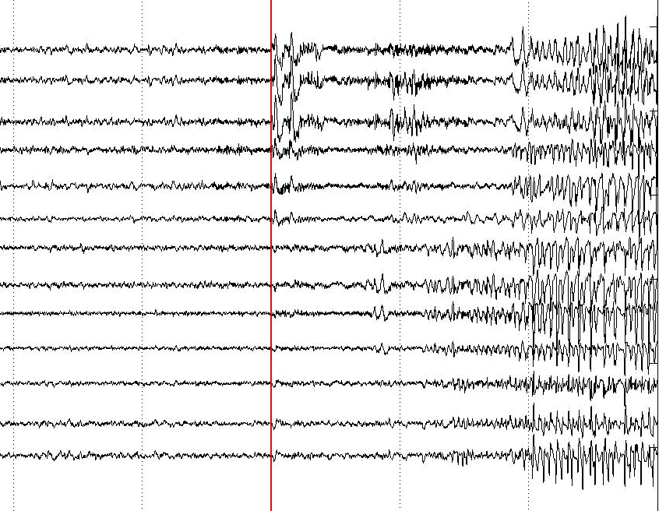
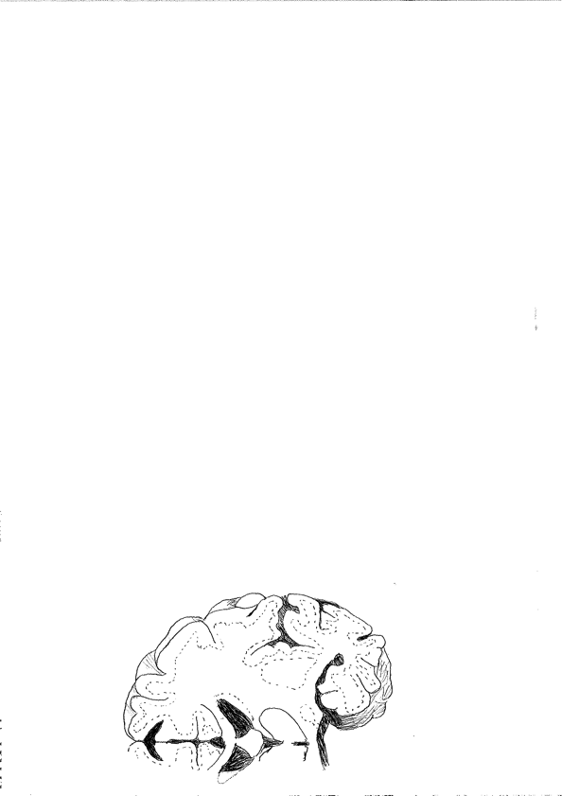
+
-
epileptic focus

Slide 2
✗
✗
✓
✗
✓
✓

Slide 3
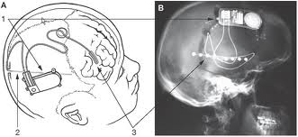
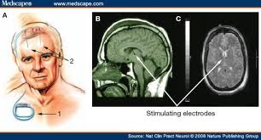
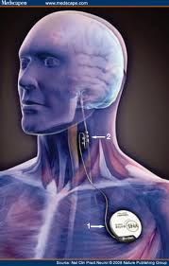

Slide 4
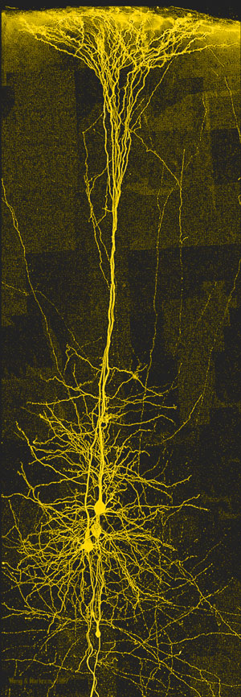
≈10,000 neurons
neural mass
+
-
epileptic focus

Slide 5
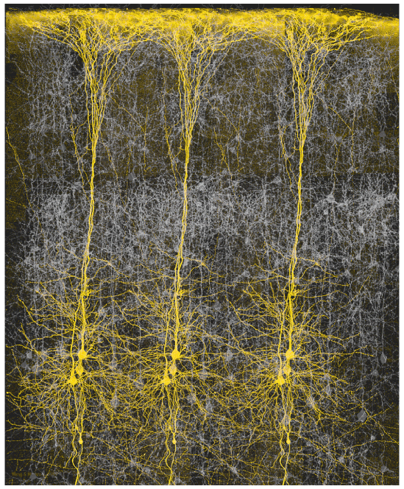
millions of neurons ≈∞
neural field
+
-
epileptic focus

Slide 6
+
-
observation system

