Slide 1
OWIN Open Web Server Interface for .Net
OWIN is a Standard Only
Defines a simple protocol that server components use to communicate with each other.
‘AppFunc’ is the primary interface of OWIN
using AppFunc = Func<
IDictionary<string, object>, // Environment
Task>; // Done
Notes:
Owin: http://owin.org/
Owin Specification: http://owin.org/spec/owin-1.0.0.html
Nancy: http://nancyfx.org/

Slide 2
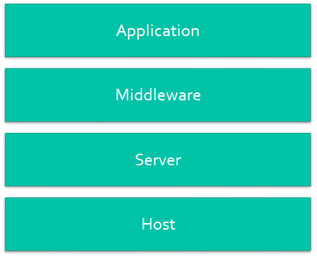
Katana
Katana is Microsoft’s Implementation of the OWIN Specification
Katana provides a library of components that implement the AppFunc delegate

Slide 3
Potential
Developers host business logic in OWIN pipeline
Lightweight host, decouple from IIS or Azure Emulator
Focus on developing business logic instead of infrastructure
SignalR – real time messaging with the browser using WebSockets
Katana packages are uploaded to EGGO as FCIBs.
Experimental ServiceSpace: ChannelSupport_Main (not ChannelSupportTools!)
How does it work with Gemini Runtime and deployment?

Slide 4
Katana
Host – manages the underlying win32 process and orchestrates construction of the pipeline
IIS/ASP.Net
OwinHost.exe
write your own host
Server – Opens the network socket, listens for connections, manages socket streams
Asp.Net (Microsoft.Owin.Host.SystemWeb) use Asp.Net pipeline
HttpListener (Microsoft.Owin.Host.HttpListener) use Http.sys directly
Middleware – Processes the request, passes control to the next AppFunc when it is done
Asp.net WebApi and MVC
Nancy
SignalR
Applications – Your application code.

Slide 5
Katana
IAppBuilder interface which is used to build the application pipeline.
Implements a rule set for finding and loading components
Implements OwinHost.exe which can be used to host/debug applications
http://www.asp.net/aspnet/overview/owin-and-katana/an-overview-of-project-katana
http://katanaproject.codeplex.com/

Slide 6
Demo
Katana Demo (VS2013)
WebApi
Nancy
OwinHost.exe or IIS Hosted
Demo sources: https://github.com/mikedice/KatanaDemoMar2014.git

