Slide 1


Civil Rights Yearly Assessment
Michael DiCicco

Slide 2

Who we are?
Extension agents and specialists have worked to improve the lives of Arkansans since 1905. We are part of the University of Arkansas System Division of Agriculture and are located in all 75 counties.
Our mission is to strengthen agriculture, communities, and families by connecting trusted research to the adoption of best practices.

Slide 3
Why a Civil Rights Yearly Assessment?
Quantify the gender/racial/ethnic balance of our programs across the entire state
Ensure the programs are available to all the eligible residents of the State of Arkansas.

Slide 4
Problems with the Current System
Written in classic ASP
Database not normalized
Database Controlled by 3rd Party Under Contract
Old data archived manually
Reset by hand annually
Unreliable Information

Slide 5
Proposed Solution
Web Application written in Python using the Django Framework
Normalized MS SQL Server Database that we control in house
No more manual resetting or archiving.
Approval Workflow
SSO using Active Directory

Slide 6
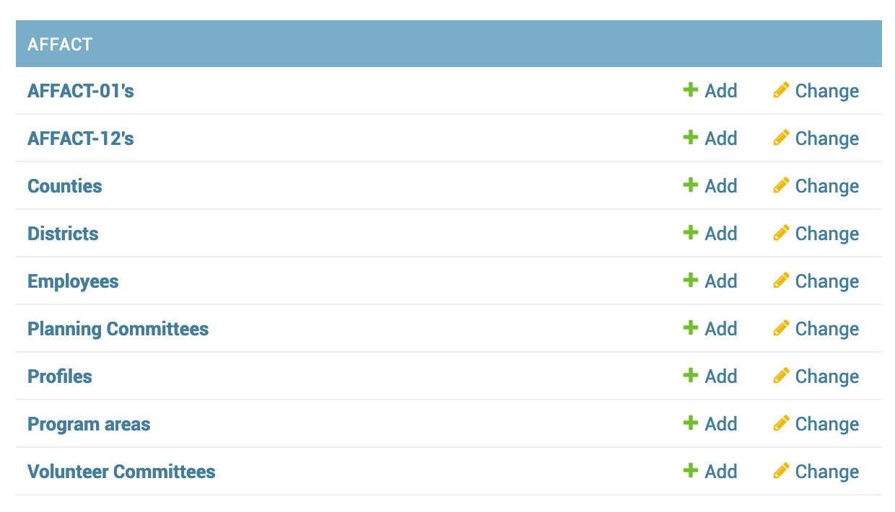
Data Models

Slide 7
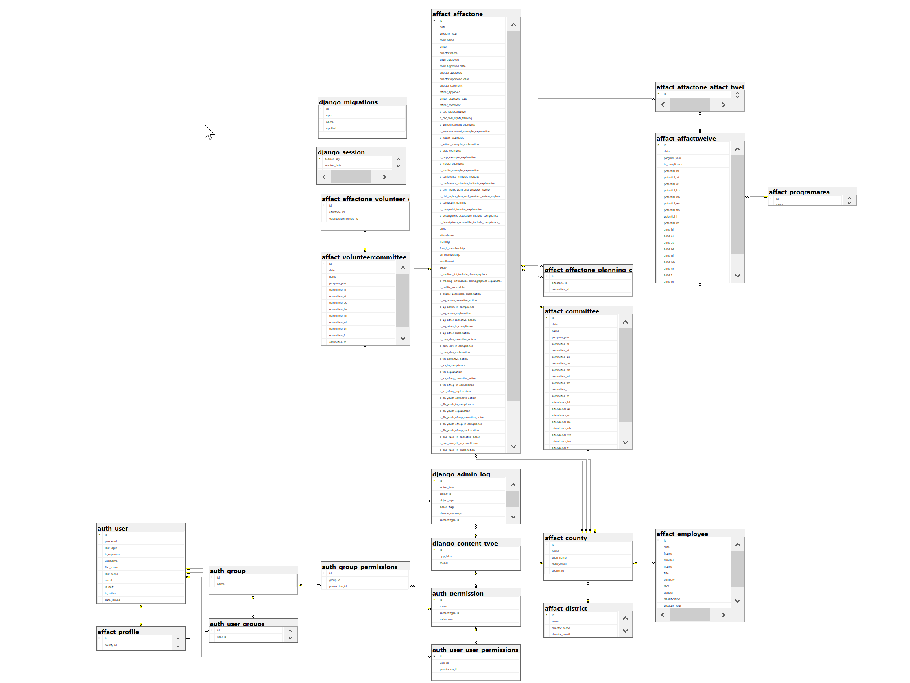
ER Diagram

Slide 8
Live Demo
https://civilrights.uaex.edu

