Slide 1
Github
A brief introduction
Sources: Klint Finley, Git, & github guides

Slide 2
What is it?
In GitHub’s words,
“GitHub is the best place to build software together. Over 12 million people use GitHub to share code and build amazing things with friends, co-workers, classmates, and complete strangers. With the collaborative features of GitHub.com, our desktop and mobile apps, and GitHub Enterprise, it has never been easier for individuals and teams to write better code, faster. Originally founded by Tom Preston-Werner, Chris Wanstrath, and PJ Hyett to simplify sharing code, GitHub has grown into the largest code host in the world.”

Slide 3
What is it?
Built over Git. What is Git?
An open source program for tracking changes in text files.
Written by the author of the Linux operating system, and is the core technology that GitHub, the social and user interface, is built on top of.
Written to help build the Linux OS.

Slide 4
What is it?
Git has a shell / command line coding platform.
Github uses a graphical user interface = Easy to get up and running fast.
Git = local machine
Github = Web platform

Slide 5
What is it?
Benefits of Github as a collaboration/ project management tool:
“Before GitHub, if you wanted to contribute to an open source project you had to manually download the project’s source code, make your changes locally, create a list of changes called a “patch” and then e-mail the patch to the project’s maintainer.
The maintainer would then have to evaluate this patch, possibly sent by a total stranger, and decide whether to merge the changes.”
-TechCrunch on Github

Slide 6
Goals
1. Get a basic understanding of key terms used by Github users
2. Start a Github account
3. Run through “Hello World” example
4. Learn the basics of how to contribute to a Github project

Slide 7
Github Overview
Let’s walk through some commonly used terms:
Repository
Issue
Master
Branch
Commit
Pull/Pull Request
Merge
Fork

Slide 8
Github Overview
Let’s walk through some commonly used terms:
Repository:
A repository is the most basic element of GitHub.
They're easiest to imagine as a project's folder.
A repository contains all of the project files (including documentation),
Stores each file's revision history.
Repositories can have multiple collaborators and can be either public or private.

Slide 9
Github Overview
Let’s walk through some commonly used terms:
Issue
Suggested improvements, tasks or questions related to the repository.
Issues can be created by anyone (for public repositories),
Moderated by repository collaborators.
Each issue contains its own discussion forum, can be labeled and assigned to a user.

Slide 10
Github Overview
Let’s walk through some commonly used terms:
Master / Branch
A branch is a parallel version of a repository.
Contained within the repository, but does not affect the primary or master branch.
Allows you to work freely without disrupting the "live" version (i.e.-the master branch).
When you've made the changes you want to make, you can merge your branch back into the master branch to publish your changes.

Slide 11
Github Overview
Let’s walk through some commonly used terms:
Commit
A commit, or "revision", is an individual change to a file (or set of files).
It's like when you save a file, except with Git, every time you save it creates a unique ID (a.k.a. the "SHA" or "hash")
Allows you to keep record of what changes were made when and by who.
Usually contain a commit message which is a brief description of what changes were made.

Slide 12
Github Overview
Let’s walk through some commonly used terms:
Pull/Push
Pull refers to when you are fetching in changes and merging them. For instance, if someone has edited the remote file you're both working on, you'll want to pull in those changes to your local copy so that it's up to date.
Pushing refers to sending your committed changes to a remote repository, such as a repository hosted on GitHub. For instance, if you change something locally, you'd want to then push those changes so that others may access them.

Slide 13
Github Overview
Let’s walk through some commonly used terms:
Pull Request
Pull requests are proposed changes to a repository submitted by a user and accepted or rejected by a repository's collaborators.
Like issues, pull requests each have their own discussion forum.

Slide 14
Github Overview
Let’s walk through some commonly used terms:
Merge
Merging takes the changes from one branch (in the same repository or from a fork), and applies them into another.
Often happens as a pull request (which can be thought of as a request to merge).
Can be done automatically via a pull request via the GitHub web interface if there are no conflicting changes,
Or can be done via the command line.

Slide 15
Github Overview
Let’s walk through some commonly used terms:
Fork
A fork is a personal copy of another user's repository that lives on your account.
Allow you to freely make changes to a project without affecting the original.
Forks remain attached to the original, allowing you to submit a pull request to the original's author to update with your changes.
You can also keep your fork up to date by pulling in updates from the original.

Slide 16
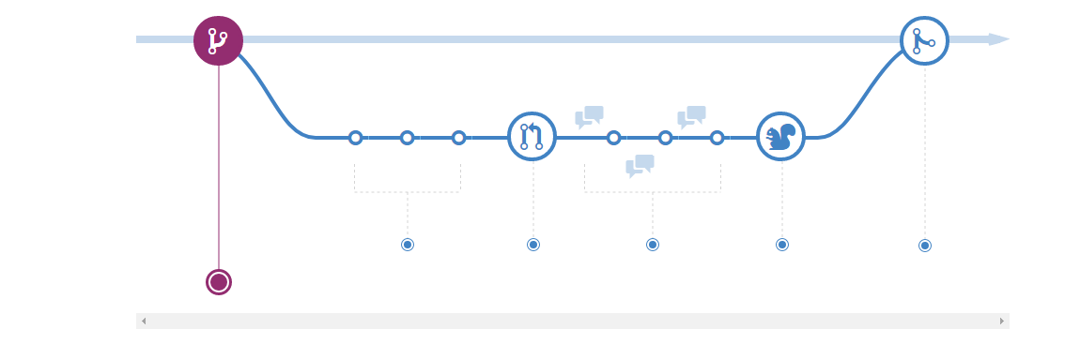
Github Workflow
Create Branch > Make updates > Merge back into Master Branch

Slide 17
Github Workflow
Create Branch from Master
When you create a branch in your project, you're creating an environment where you can try out new ideas.
Changes you make on a branch don't affect the master branch, so you're free to experiment and commit changes
Your branch won't be merged until it's ready to be reviewed by someone you're collaborating with.

Slide 18
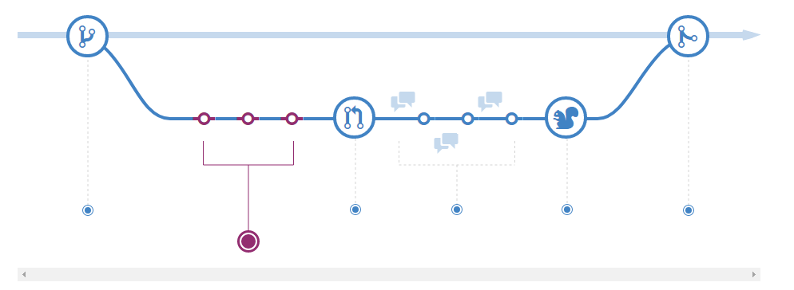
Github Workflow
Add commits
Whenever you add, edit, or delete a file, you're making a commit, and adding them to your branch.
This process of adding commits keeps track of your progress as you work on a feature branch.
Commits also create a transparent history of your work that others can follow to understand what you've done and why.
Lets you roll back changes if a bug is found, or if you decide to head in a different direction.

Slide 19
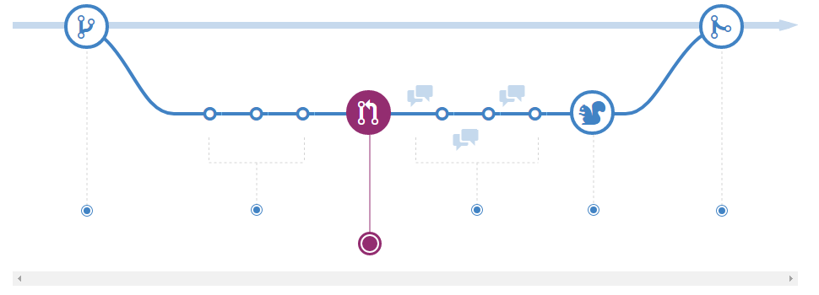
Github Workflow
Open a Pull Request
Pull Requests initiate discussion about your commits. Anyone can see exactly what changes would be merged if they accept your request.
You can open a Pull Request at any point during the development process: when you have little or no code but want to share some screenshots or general ideas, when you're stuck and need help or advice, or when you're ready for someone to review your work.

Slide 20
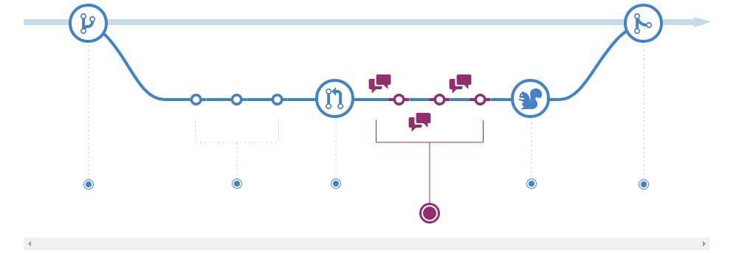
Github Workflow
Discuss and review code
Once a Pull Request has been opened, the person or team reviewing your changes may have questions or comments.
Perhaps the coding style doesn't match project guidelines, the change is missing unit tests, or maybe everything looks great and props are in order.
Designed to encourage and capture this type of conversation.

Slide 21
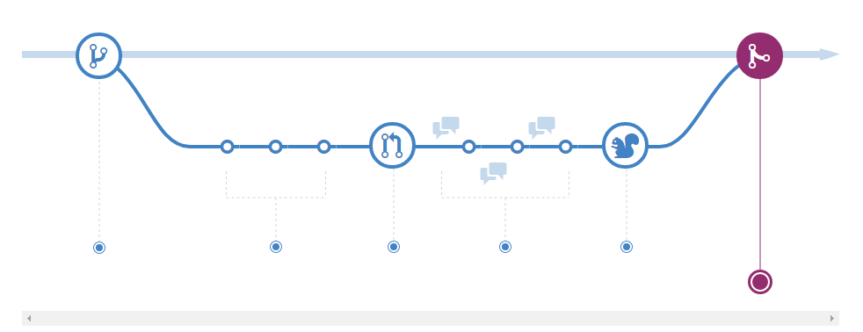
Github Workflow
Merge
Now that your changes have been verified in production, it is time to merge your code into the master branch.
Once merged, Pull Requests preserve a record of the historical changes to your code. Because they're searchable, they let anyone go back in time to understand why and how a decision was made.

Slide 22
GitHub – Hello World Example
Work through the following “Hello World” example on your own:
https://guides.github.com/activities/hello-world/
Goals:
Create an open source repository
Start and manage a new branch
Change a file and commit those changes to GitHub
Open and merge a Pull Request

