Slide 1
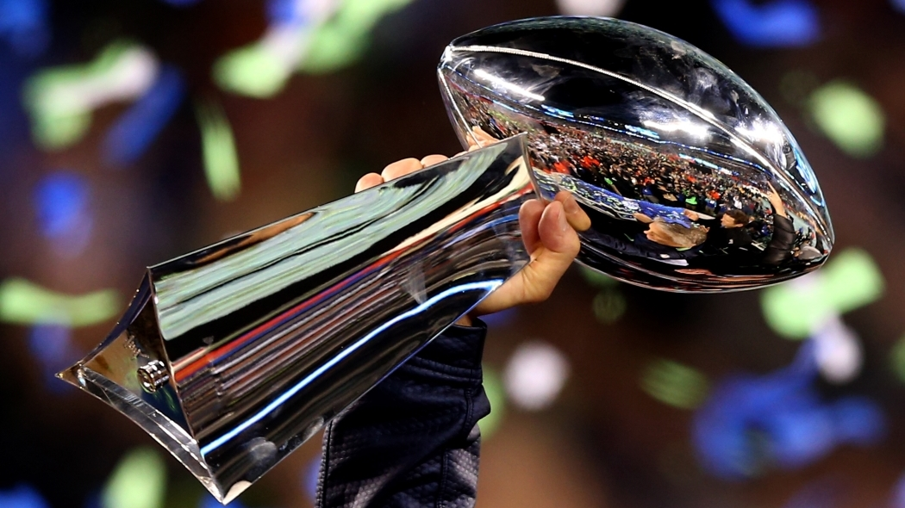
Super Bowl Ads
Stock performance
vs
S&P500
This Photo by Unknown Author is licensed under CC BY-NC-ND

Slide 2
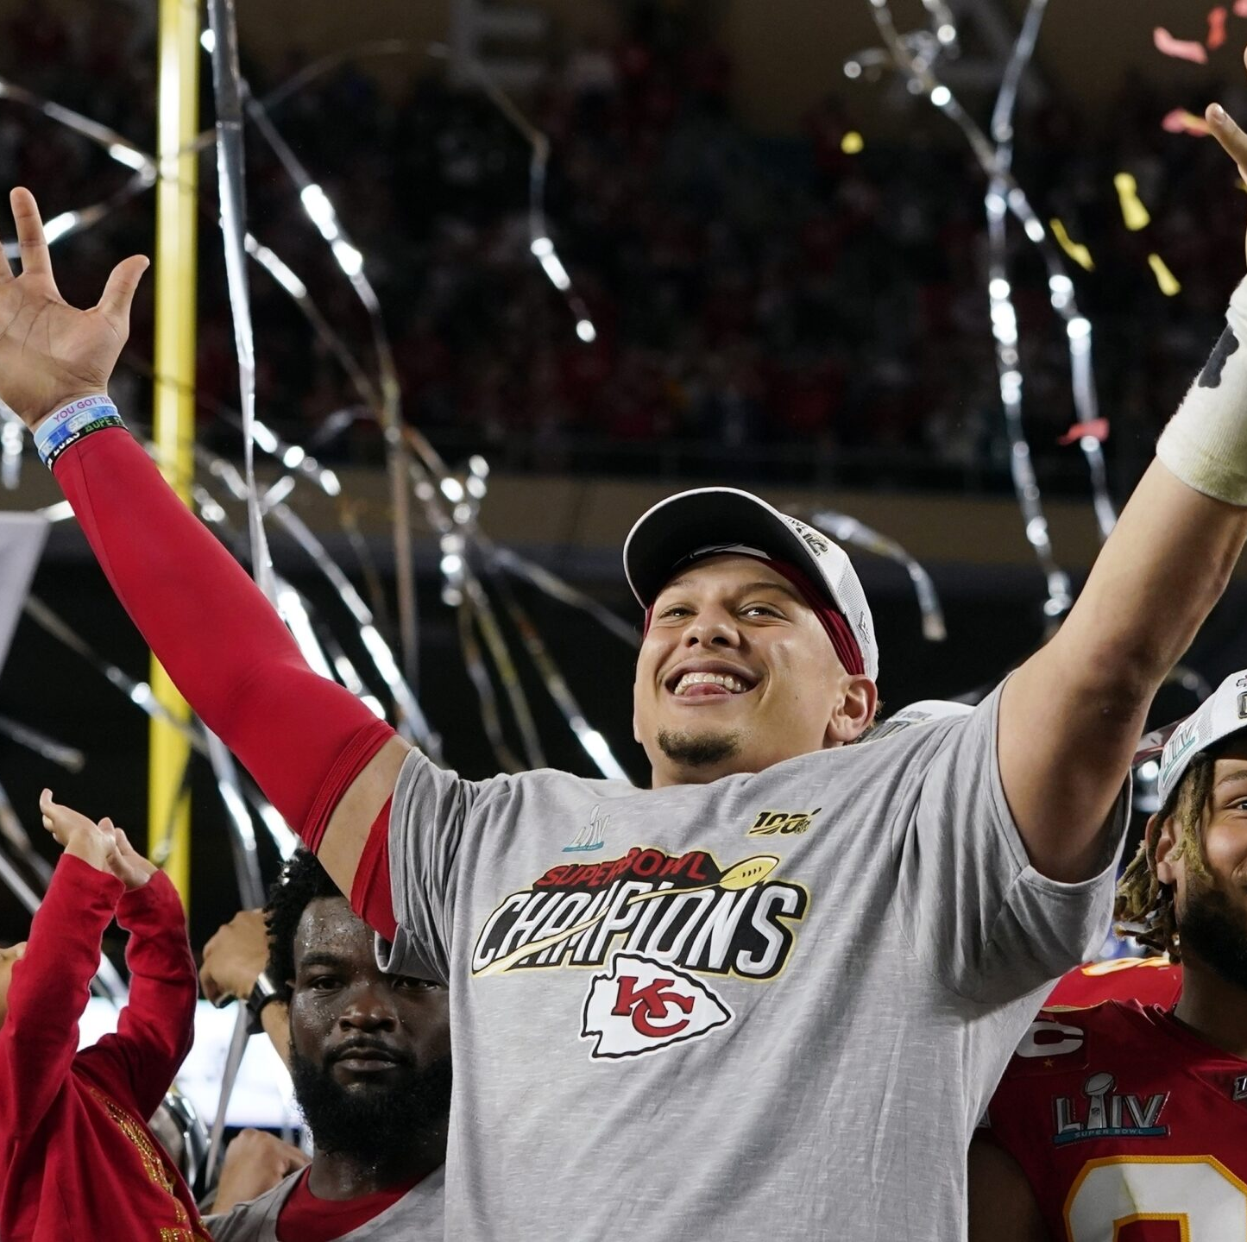
Can Super Bowl advertiser’s stock performance vs S & P 500 be predicted ?
Past research focused on short term performance
Previous studies used only a couple of years of data
Advertisers were more likely to beat the index than not
This Photo by Unknown Author is licensed under CC BY-ND

Slide 3
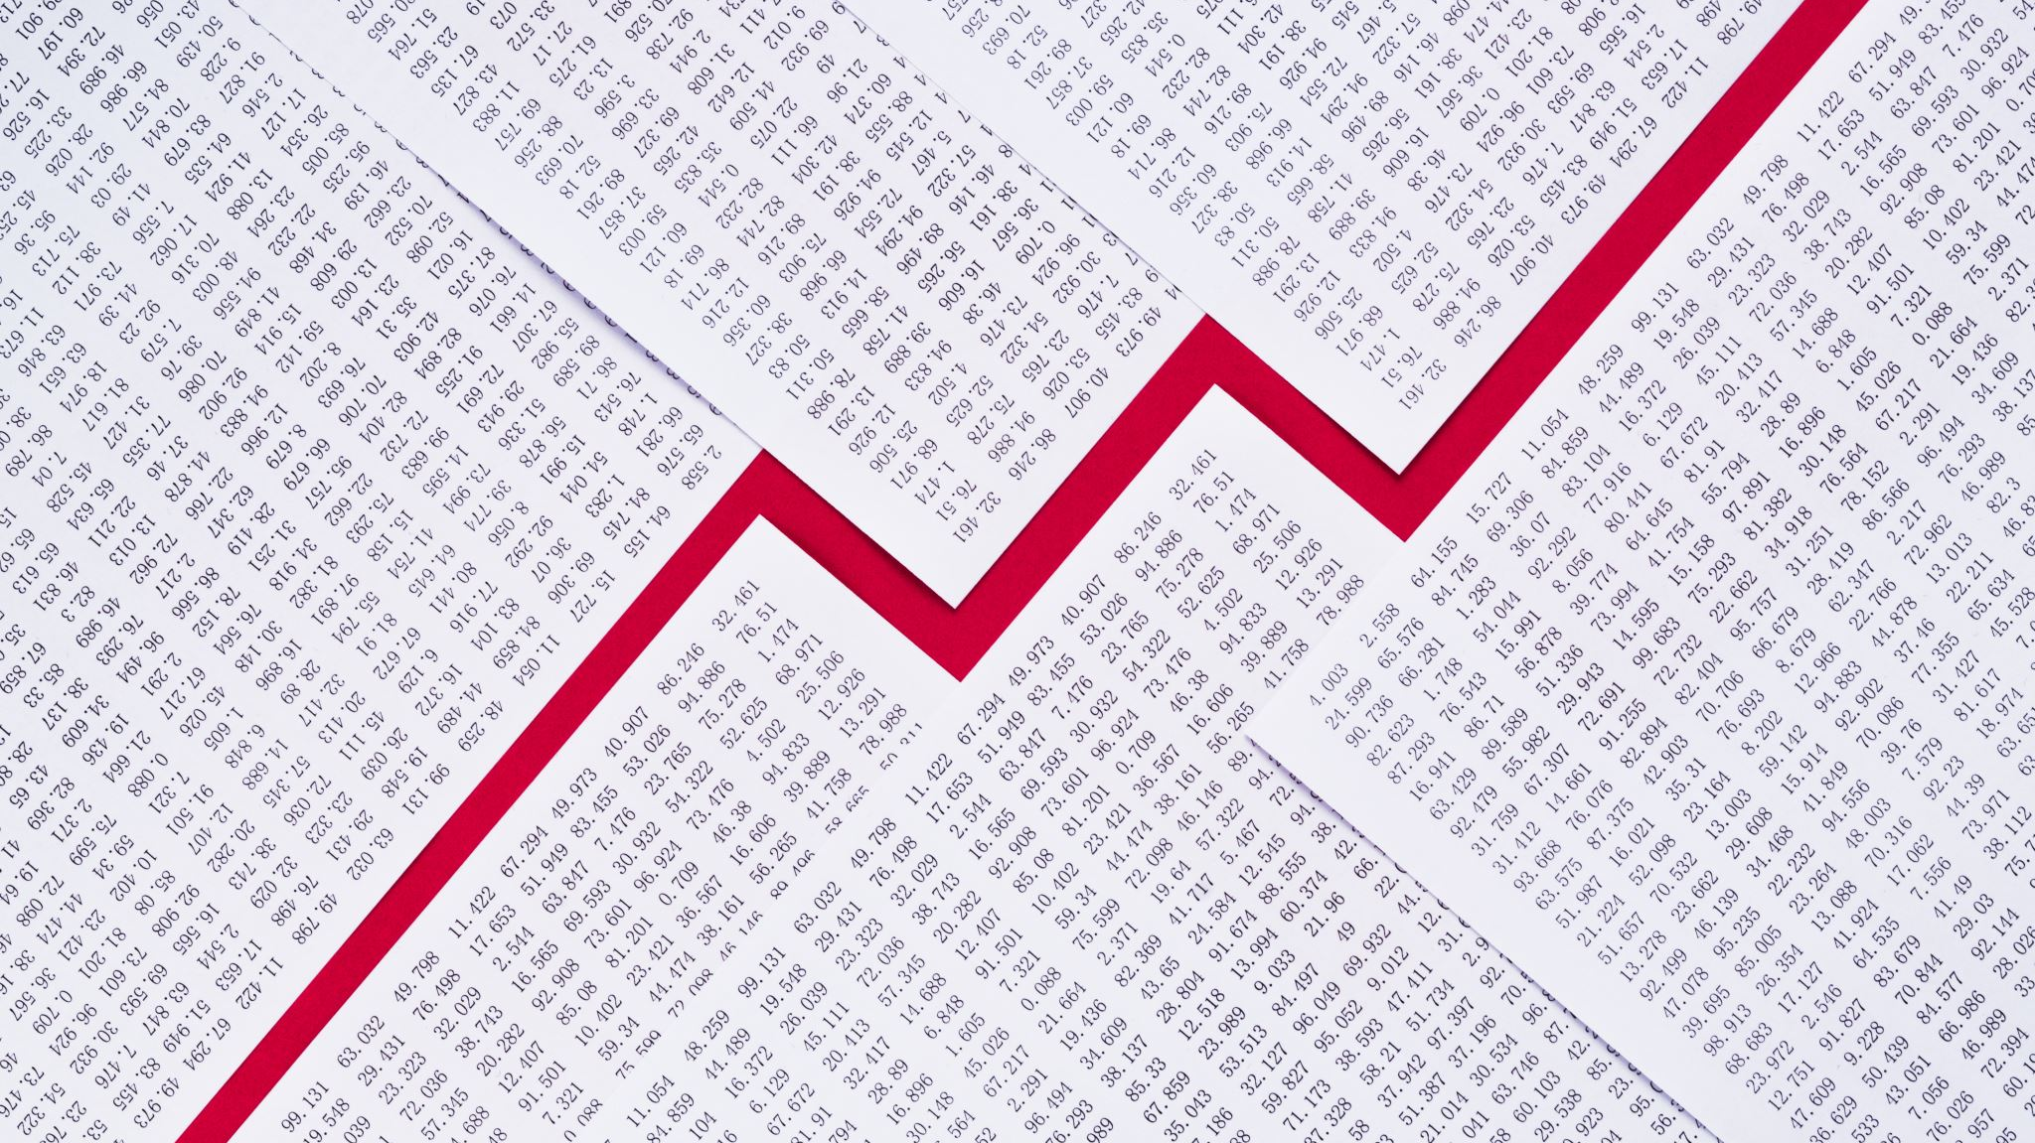
The Data
The data was merged from several data sets.
Text file scraped from https://www.pro-football-reference.com/super-bowl/ (mostly for dates)
From Kaggle https://www.kaggle.com/datasets/prondeau/superbowlads (main data set of 563 Superbowl commercials with the year, product type, product/commercial title, and sometimes a plot)
https://datahub.io/core/employment-us/datapackage.json (general economic information)
Additionally, ChatGPT was used to generate the stock tickers.

Slide 4
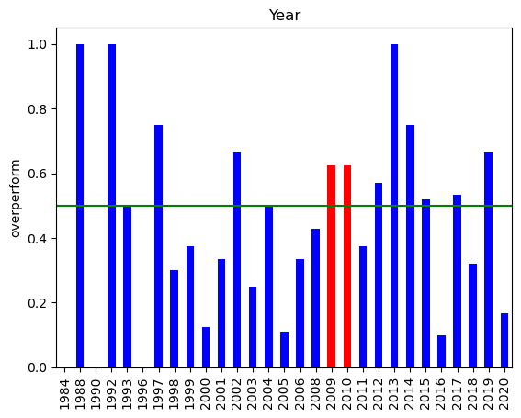
Interesting Turn
Surprisingly, the previous research did appear to have looked at some particularly lucky years, 2009 and 2010
Both years had a 62.5% chance of overperformance while the average of all years was only 43.5%

Slide 5
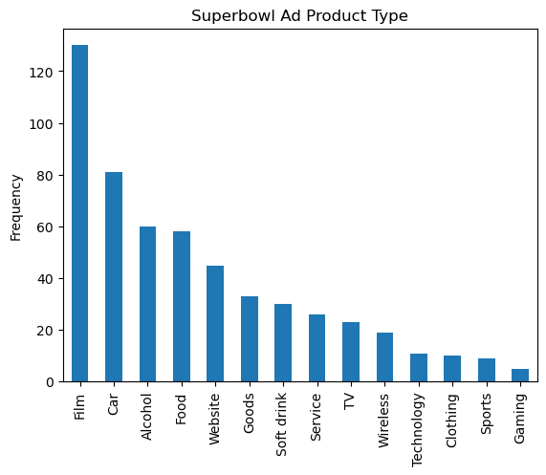
Product types
Note that ads are dominated by a few categories
Film, car , alcohol and food are about than 3 of every 5 ads
Add the similar categories TV and Soft Drink and it is closer to 3 in 4 ads

Slide 6
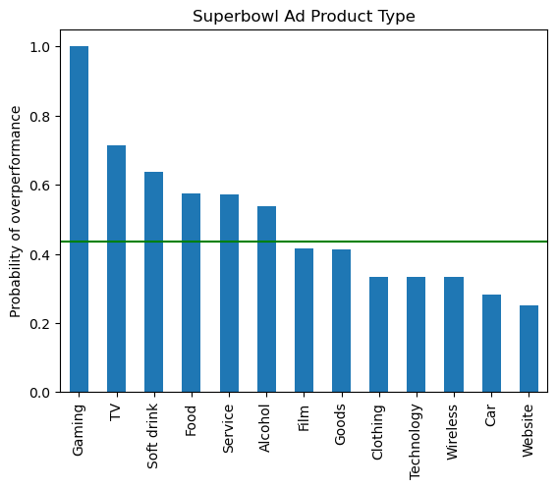
Overperformance by Product Type
Gaming is a very small sample of ads
There seem to be definite divisions by product type
Food, Soft drink and Alcohol are all above average
Film (but oddly not TV ) and Cars are generally below average

Slide 7

Model plan Try out several models to predict the target ‘overperform’: Logistic Regression KNN SVM Random Forest Gradient Boosting
Numeric features
Year market cap shares outstanding
year incorporated Previous Superbowl Ad
Yearly Ad Count New Advertiser Ave inflation rate
CPI USD per euro Annual change in GDP VIX
Change in businesses
Categorical features
Product type
Ticker

Slide 8
Model comparison
 | Algorithm | ROC-AUC train score | ROC-AUC test score | ROC-AUC test std
 | Logistic Regression | 0.609158 | 0.511905 | 0.111955
 | KNN | 0.510451 | 0.672619 | 0.144881
 | SVM | 0.575399 | 0.623333 | 0.138484
 | Random Forest | 0.570719 | 0.597619 | 0.084213
 | Gradient Boost | 0.582257 | 0.572619 | 0.101707
The best test score is with KNN but that is the most variable
Random Forest and Gradient Boosting seem to be the most consistent
Logistic regression may be overfitting

