Slide 1

Glass.Mapper.Sc
And Sitecore MVC
Michael Edwards
Hedgehog
@mikeedwards83

Slide 2

Serving Suggestions

Slide 3
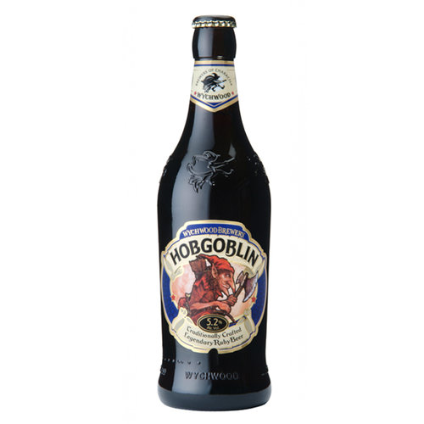
MVC vs WebForms
<%=Editable(x=>x.Home.DeveloperName) %>
<%=Editable(x=>x.Home.DeveloperImage, new {height=40}) %>
@Editable(x=>x.Home.DeveloperName)
@Editable(x=>x.Home.DeveloperImage, new {height=40})

Slide 4

MVC vs WebForms
public partial class Featured : GlassUserControl<Featured>
public class RateBaconController : GlassController
protected GlassController(ISitecoreContext sitecoreContext, IGlassHtml glassHtml)
public virtual T GetRenderingParameters<T>()
public virtual T GetControllerItem<T>(bool isLazy = false, bool inferType = false)

Slide 5

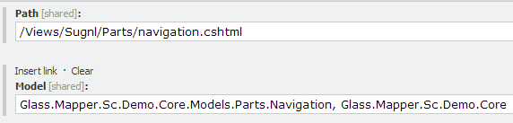

View Renderings (cshtml)
<mvc.getModel>
<processor type="Glass.Mapper.Sc.Pipelines.Response.GetModel, Glass.Mapper.Sc"/>
</mvc.getModel>
@inherits Glass.Mapper.Sc.Web.Mvc.GlassView<Glass.Mapper.Sc.Demo.Core.Models.Parts.Navigation>
Notes:
Show /sitecore/layout/Renderings/Sugnl/Parts/Navigation
Show Navigation.cshtml
Show Navigation.cs
Show http://sugnl.glass.demo

Slide 6

MVC CSHTML
@inherits Glass.Mapper.Sc.Web.Mvc.GlassView<Glass.Mapper.Sc.Demo.Models.Controllers.RateBacon.RateBaconIndex>

Slide 7
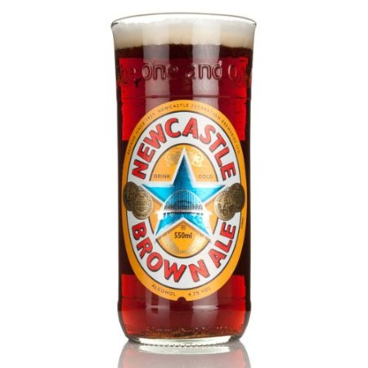
MVC CSHTML
@RenderImage(x=>x.Item.RateBaconImage1)
@Editable(Model.Item, x=>x.SearchFor) @using (BeginRenderLink(x => x.Home.DeveloperLink))
=
@GlassHtml.RenderImage(Model, x=>x.Item.RateBaconImage1)
@GlassHtml.Editable(Model.Item, x=>x.SearchFor) @using (GlassHtml.BeginRenderLink(x => x.Home.DeveloperLink))

Slide 8

MVC CSHTML
@Editable(Model.Item, x=>x.SearchFor,
x=>string.Format(x.SearchFor, Model.Query))
@RenderImage(x=>x.Item.SearchResultIcon, new {width=56, @class="icon"})
@using (BeginRenderLink(x => x.Home.DeveloperLink, isEditable:true))
{
@Editable(x=>x.Home.DeveloperName)
@Editable(x=>x.Home.DeveloperImage, new {height=40})
}
Notes:
Show the search page in edit mode and normal mode.

Slide 9

MVC Controllers
private readonly ISitecoreContext _context;
private readonly ISitecoreService _master;
public CommentsController(
ISitecoreContext context,
ISitecoreService master)
{
_context = context;
_master = master;
}
ControllerBuilder.Current.SetControllerFactory(
new WindsorControllerFactory(container.Kernel));

Slide 10
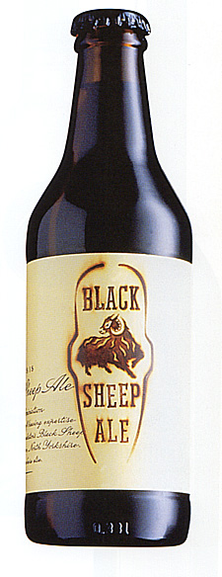
MVC Model Binding
[HttpPost]
public ActionResult Index(CommentsIndex index)
{
CommentsIndex model = null;
CommentForm form = index.Form;
[SitecoreType(TemplateId = ICommentConstants.TemplateIdString)]
public class CommentForm
{
[TypeConverter(typeof(IndexFieldIDValueConverter))]
[IndexField("_group")]
[SitecoreId]
public virtual Guid Id { get; set; }
[SitecoreInfo(SitecoreInfoType.Name)]
public virtual string Name { get; set; }

Slide 11
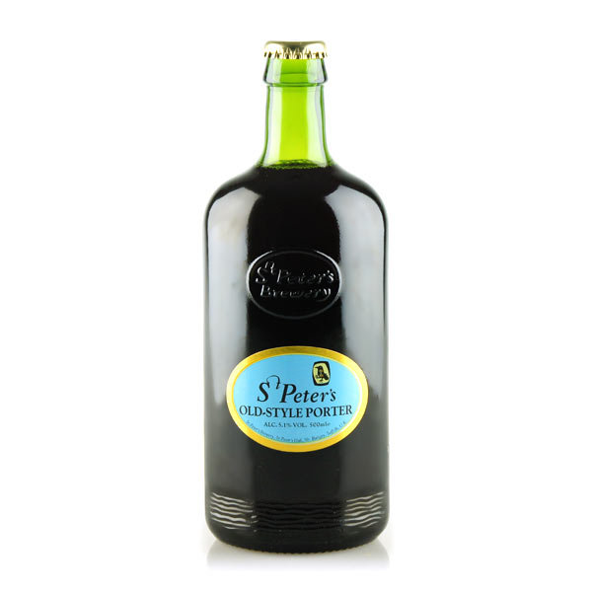
Sitecore 7 Search / JSON
var index = ContentSearchManager.GetIndex("sitecore_master_index");
using (var context = index.CreateSearchContext())
{
var results = context.GetQueryable<CommentResult>()
.Where(x => x.CommentName.Contains(name)
|| x.CommentMessage.Contains(name))
.Take(10)
.ToList()
.Select(x =>
{
_context.Map(x);
return x;
});
return Json(results, JsonRequestBehavior.AllowGet);
}

Slide 12

Partials
@foreach (var child in Model.Featured)
{
{Html.RenderPartial("/Views/Sugnl/Partials/PageSpot.cshtml", child);}
}
PageSpot.cshtml
@inherits Glass.Mapper.Sc.Web.Mvc.GlassView<Glass.Mapper.Sc.Demo.Core.Models.sitecore.templates.Sugnl.Concrete.Landing>
Notes:
HomePageSpots.cshtml

Slide 13

Unit Testing
[Test]
public void Rate_RatedImage1FirstRating_SetsRating()
{
//Arrange
var context = Substitute.For<ISitecoreContext>();
var service = Substitute.For<ISitecoreService>();
var controller = new RateBaconController(context, service);
var itemId = Guid.NewGuid();
var ratingNumber = 1;
var rating = 4;
var item = new RateBacon();
context.GetItem<RateBacon>(itemId).Returns(item);
service.Save(item);
//Act
var result = controller.Rate(itemId, ratingNumber, rating);
//Assert
Assert.AreEqual(rating, item.RateBaconRate1);
Assert.AreEqual(1, item.RateBaconCount1);
}

Slide 14

Unit Testing
public RateBaconController(
ISitecoreContext context,
ISitecoreService service
):base(context, new GlassHtml(context))
{
_service = service;
}

Slide 15

Glass.Mapper.Sc.Razor
It’s Razor Syntax
Works with WebForms
Works with MVC
Works with Glass
Sweet
OH NO BULLET POINTS!

Slide 16

Glass.Mapper.Sc.Razor
@inherits Glass.Mapper.Sc.Razor.Web.Ui.TypedTemplate<
Glass.Mapper.Sc.Demo.Core.Models.Parts.Navigation>
<div class="navigation-bar-content">
<a href="/" class="element">
@RenderImage(x=>x.Home.HomeSiteLogo, new {width=24})
@Model.Home.HomeSiteName
</a>
<span class="element-divider"></span>
<a class="pull-menu" href="#"></a>

Slide 17

Glass.Mapper.Sc.Razor
Different templates
Typed
Behind
Dynamic
Not compatible with MVC chstml
Not compatible with controllers

Slide 18

www.glass.lu
@mikeedwards83
Find me near one of these

Slide 19

















Thank you
19

