Slide 1
Cows! You can dress them up nicely, give them lovely hats and call them by pet names.
And they
Still become STEAK!

Slide 2
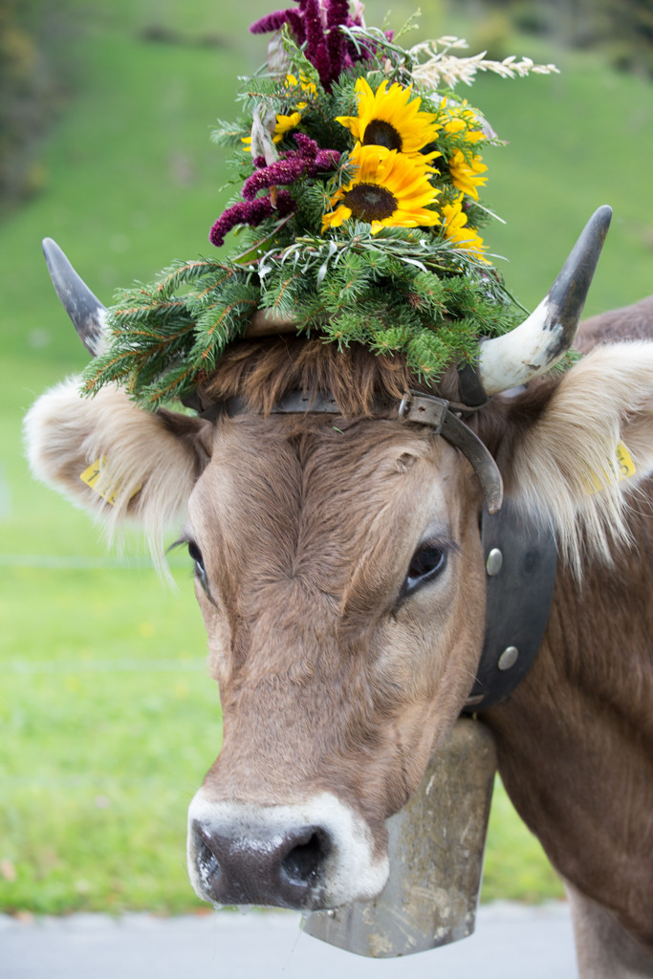
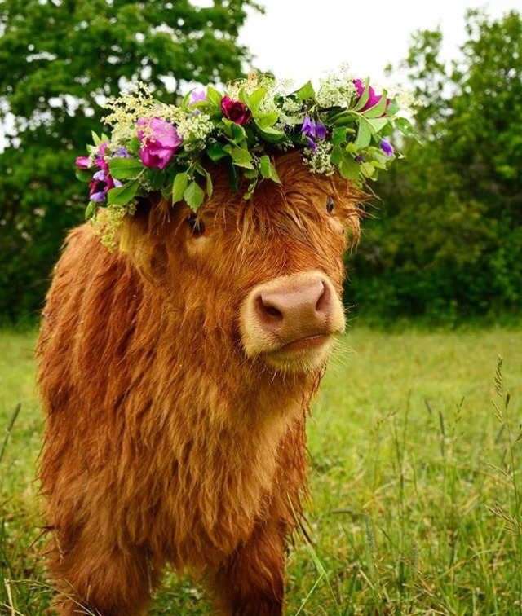
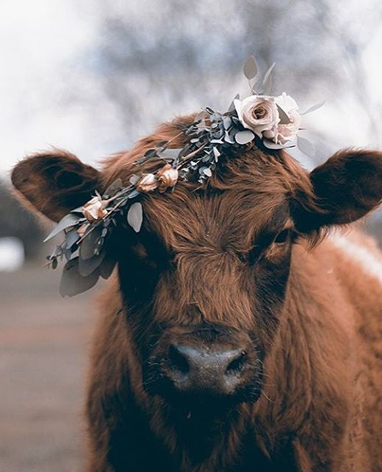
Joanne, Gertrude and Bert

Slide 3
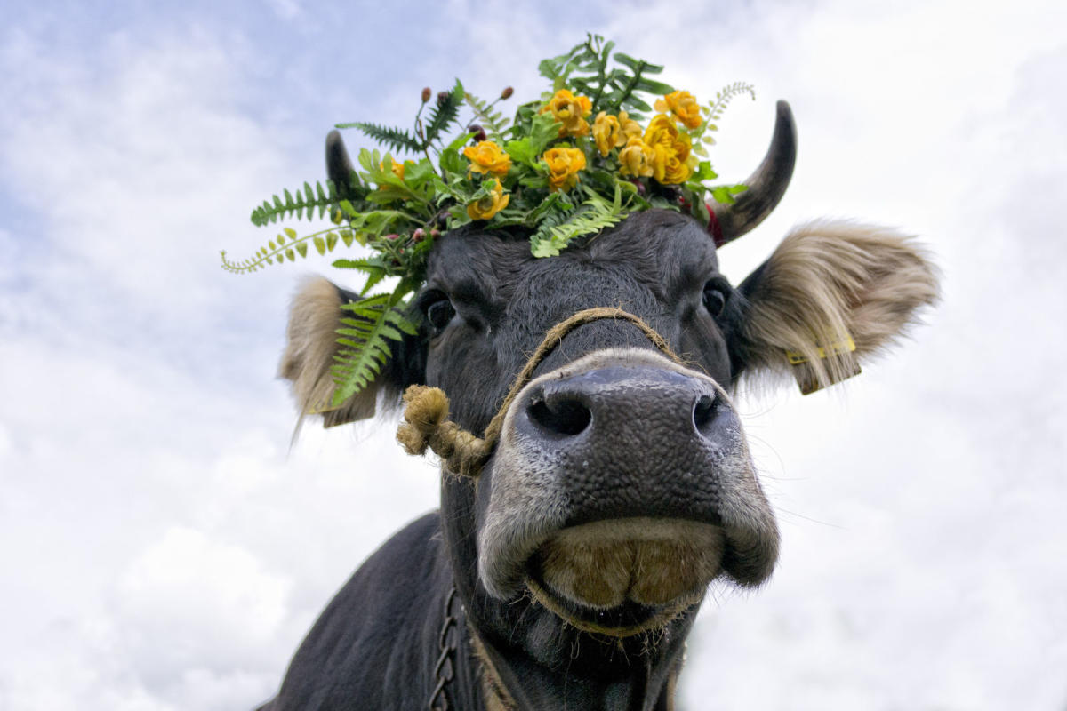
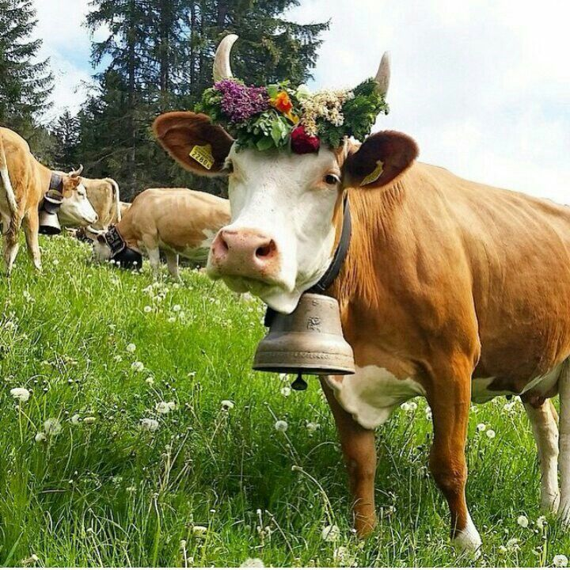
Daisy
and Bella
Future hamburgers, rib steaks and leather shoes!

