Slide 1
Packet Sniffing Using Wireshark
Mike Macancela & Justin Lyons
Notes:
10 mins

Slide 2
What is Packet Sniffing?
Packet sniffing is the process of gathering and logging of packets that pass through a devices network. For our project we used an application called Wireshark to analyze packets.

Slide 3

What is Wireshark?
Open source packet analyzer. Wireshark is also a packet sniffer and analysis tool it captures data of traffic on the local network and stores that data for offline analysis. This helpful tool could be used for
-network education
-analysis troubleshooting
-packet sniffing
Notes:
You can use it on window 32 bit and 64 bit linux, Ubuntu and Kali Linux

Slide 4
5-Layer Network Explanation
Layer 5 - Application layer - The application layer is closest to the end user. It is the layer that provides the interface between the applications used to communicate and the underlying network over which messages are transmitted. Application layer protocols are used to exchange data between programs running on source and destination hosts.
Layer 4 - Transport layer - (TCP) and (UDP). Both protocols break up a message that an application wants to send into packets to the intended recipient. At the recipient end of the communication, both take the payload from the received packets and pass those to the application layer.
Notes:
UDP -user datagram protocol
TCP - Transmission Control Protocol

Slide 5
5-Layer Network Explanation Continued
Level 3 - Network layer - responsible for transmitting and routing data packets on the network. The ip address of which is sent in forms of ip packets. Each packet can take different routes and some packets may get lost along the way. I
Level 2 - Data Link layer - The data link layer provides a network connection between hosts on a particular local network.
Level 1- Physical layer - The lowest layer of the five-layer network model that defines how the cables, network cards, wireless transmitters connect to the networks and the networks to the internet.

Slide 6
What is a Network Protocol?
A network protocol is an established set of rules that determine how data is transmitted between different devices on the same network.
It allows connected devices to communicate with each other, regardless of any differences in their internal processes, structure or design.

Slide 7
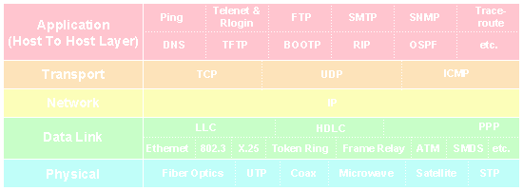
5-Layer Network Protocol Data Units (PDUs) Examples

Slide 8
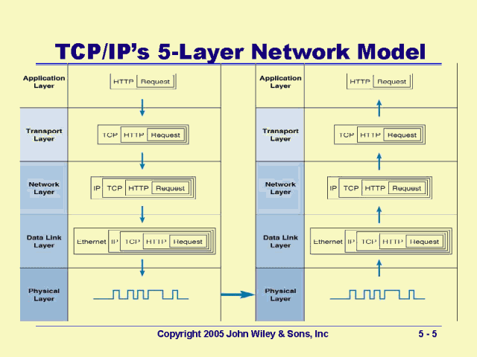

Slide 9
How we used Wireshark
Investigate traffic
Incorporated wireshark filters
Analyzing SYN flood attack
Successful logins over ftp
Analyzing source and target ip
Looked into emails sent

Slide 10
Analyzing Brute force attack and multiple SYN req
We analyzed a brute force attack that was captured with Wireshark.
We see that multiple SYN requests are being sent to the victims IP.
Thus causing a SYN flood.
The Victim replies with SYN ACK, however the attacker does not reply. .

Slide 11
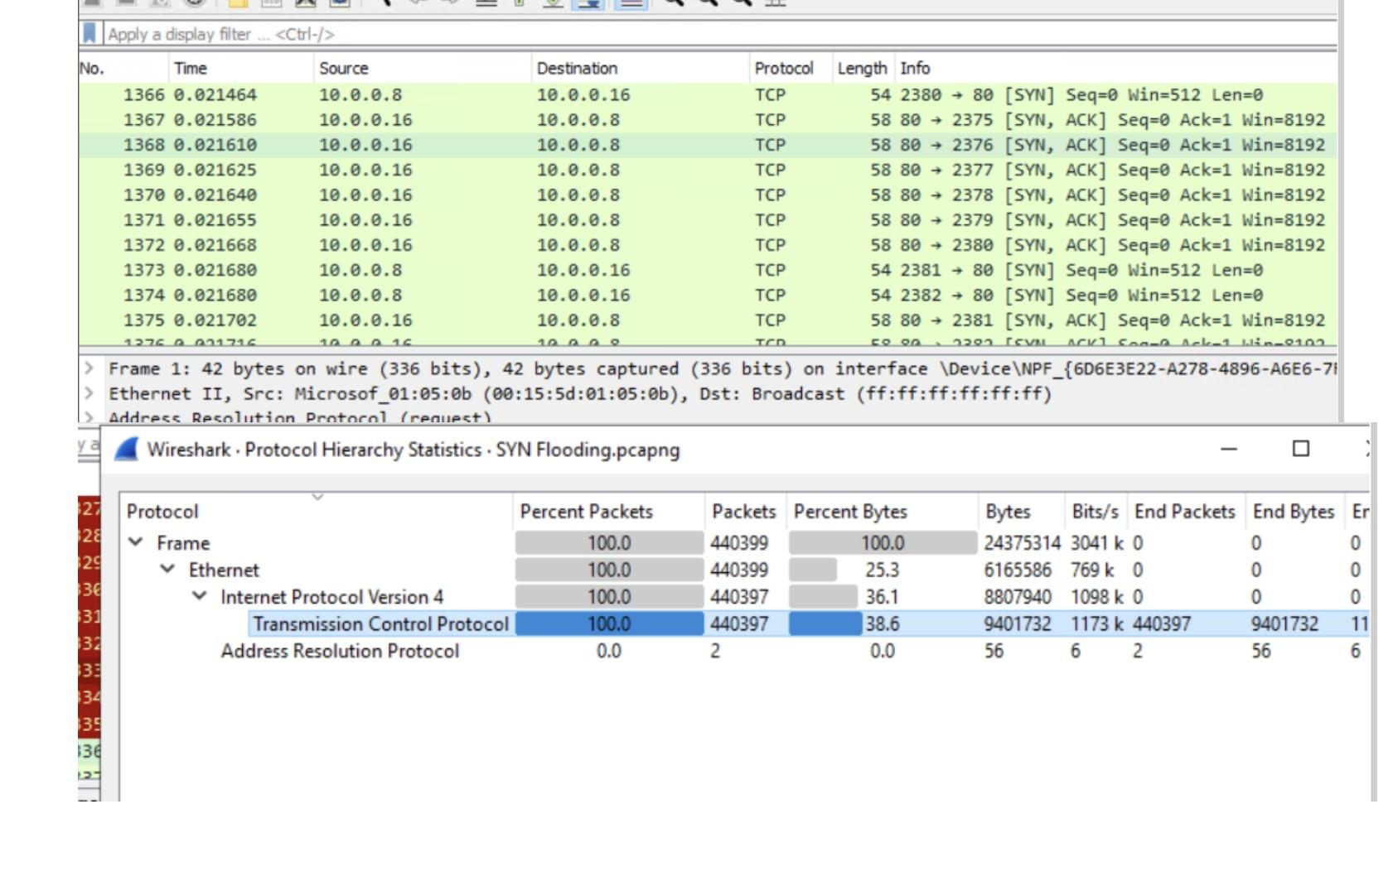
Analyzing Brute force attack and multiple SYN req

Slide 12
Analyzing Brute force attack and multiple SYN req
Thus causing a DDOS Denial of Service attack. These requests can cause a server to crash trying to acknowledge all these requests if the server is not meant to support the amount of oncoming traffic.
Thus causing it to crash, and go offline, causing any businesses to lose revenue

Slide 13
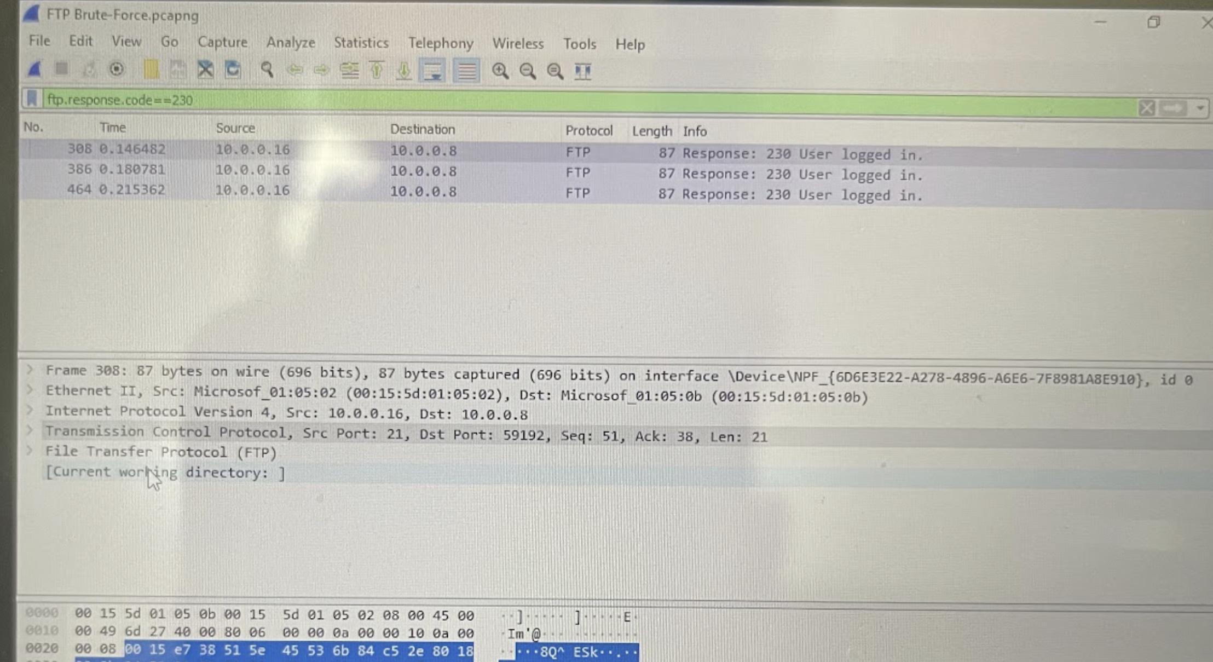
Wireshark filters used
ftp.response .code==230 (Login Brute Force login successful)

Slide 14

Using WireShark

Slide 15
Simple Mail Transfer Protocol (SMTP)
Used to send and receive email
Unencrypted/Unsecure
Messages are not deleted from the server when received
Compared to sending a postcard in the mail

Slide 16
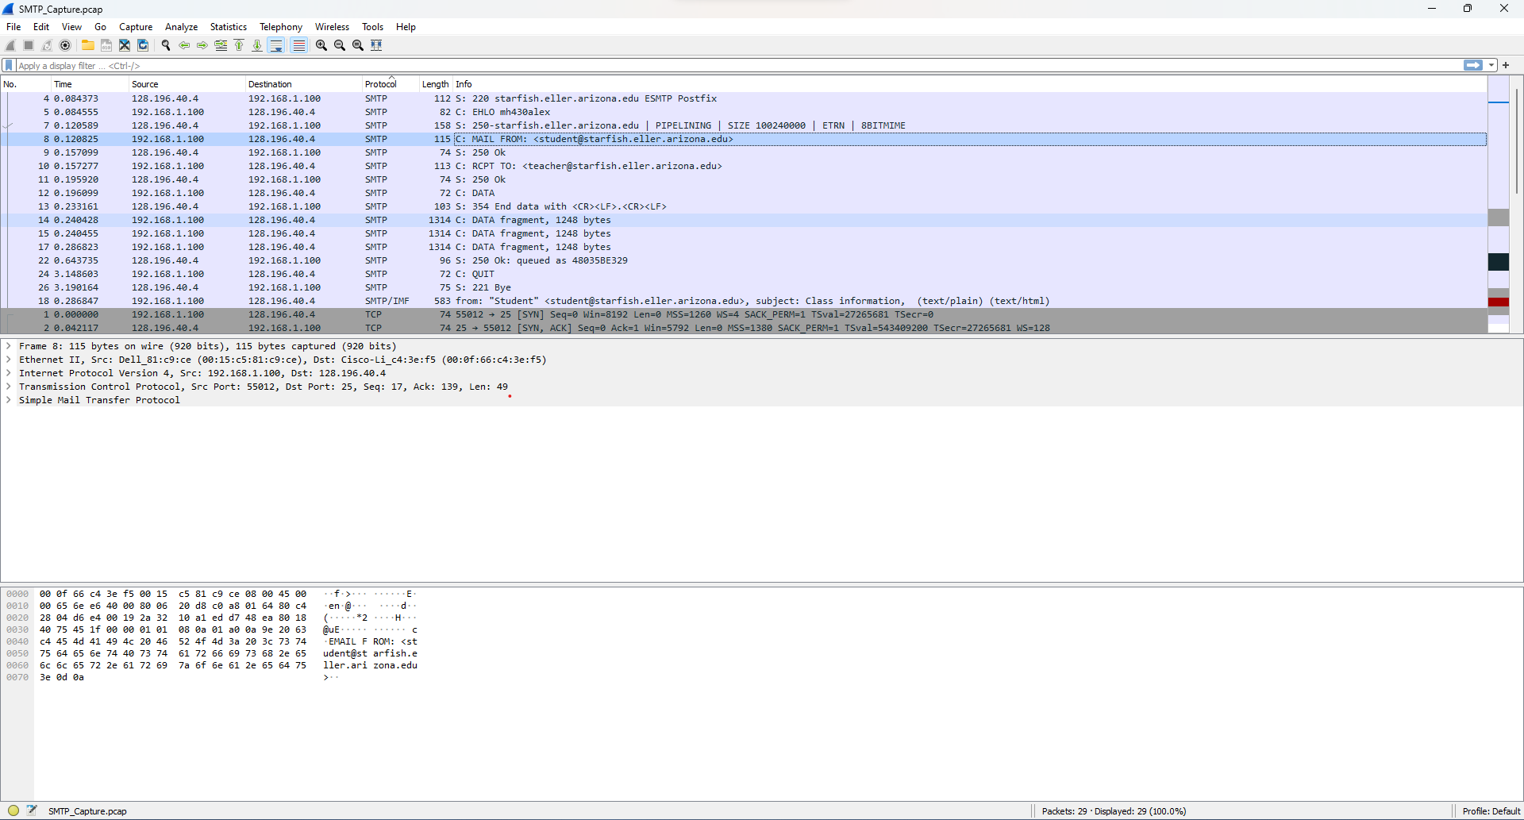
SMTP WireShark Example

Slide 17

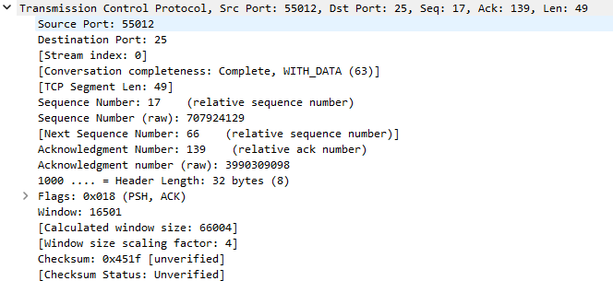
SMTP Example

Slide 18
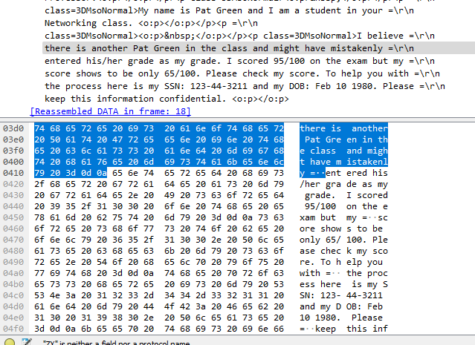
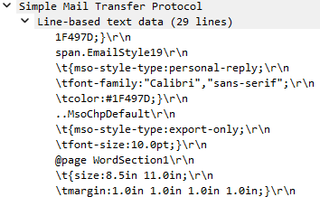
Reading the Message

Slide 19
Post Office Protocol (POP)
Used to receive emails, or download from server
Old and outdated
Emails and credentials are sent in plain text
Emails are deleted once downloaded from server
Meant for one computer

Slide 20
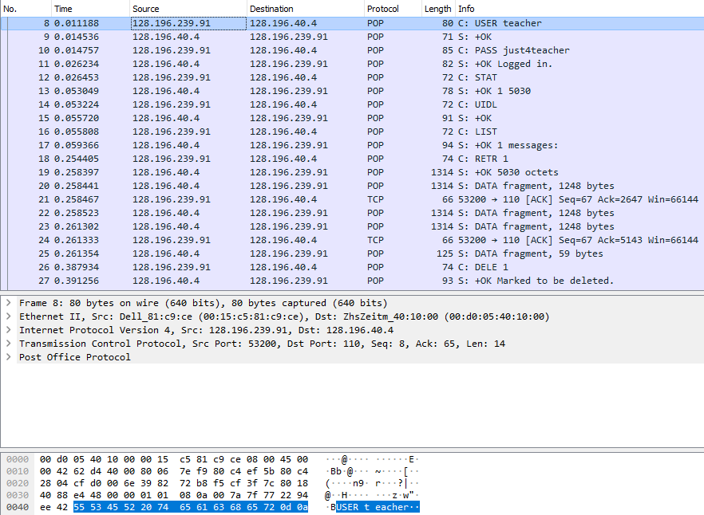
POP WireShark Example

Slide 21

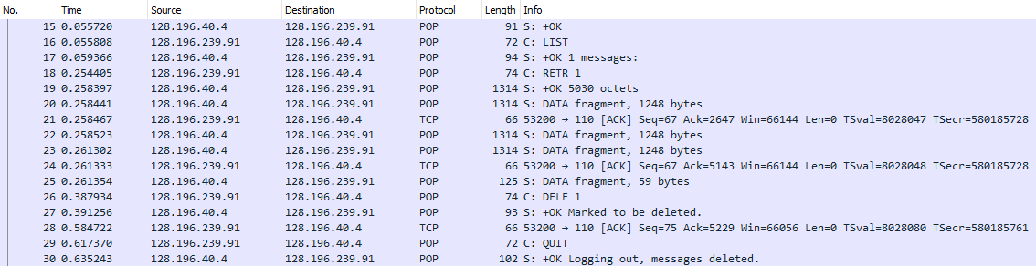
POP Example

Slide 22

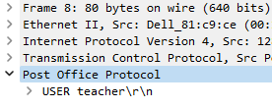
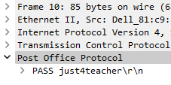
Reading Credentials

Slide 23
Conclusion
Ethical Hacking- An ethical hacker in a person who performs most of the same activities a hacker does, but with the owner or company's permission
All in all, knowledge on networking and protocol data units are important as they can be vital in maintaining security. Users should be aware of networking protocol standards so that insecure protocols can be avoided. POP and SMTP should not be completely disregarded as they can be partnered with secure protocols such as SSL. In this case, with appropriate security protocols attached, POP and SMTP can still be used securely.

Slide 24
Work cited
https://www.codecnetworks.com/blog/what-is-wireshark-and-how-does-it-work/

