Slide 1
L-Store Database
Milestone 2
Kaito Yoshida
Amber Lee
Vadzim Matsiushonak
Henghui He
Michael Ewing
Team M4A1

Slide 2
Overview of Milestone 2 Design
Durability and Bufferpool Extension
Data Reorganization - Merging
Indexing - Multi Column Lookup
Durability and Bufferpool Extension:
number of pages in bufferpool
bufferpool page eviction policy
dirty pages, pinning / unpinning pages
Data Reorganization (Contention-free Merging):
design of page range
merging timing criteria
merging process explained
threading implementation
Indexing:
multiple-column query capabilities
Bonus Section / Q & A / Live Demo

Slide 3
durability and bufferpool extension -
page replacement policy
1. design of fixed number of pages in bufferpool
2. bufferpool page eviction policy explanation
3. dirty pages, pinning/unpinning pages implementation

Slide 4
Page Range and addressing

Slide 5
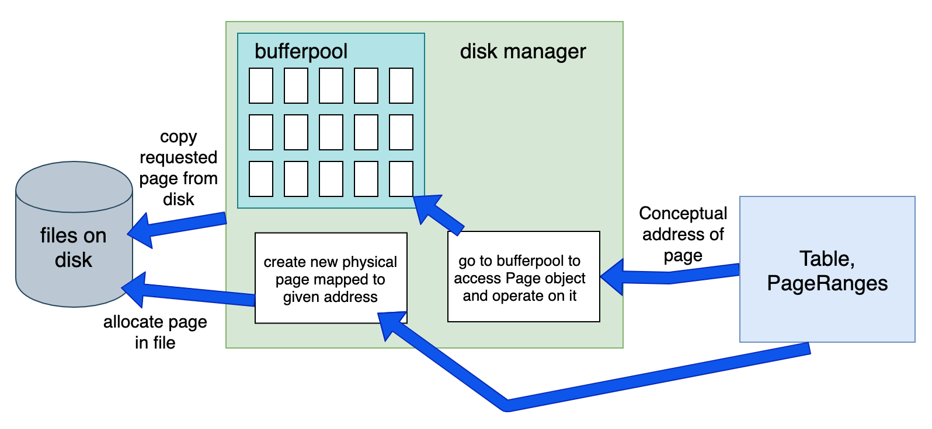
Bufferpool and non-volatile disk storage

Slide 6


Disk Memory File Structure
Table.bin
Stores Database record data in binary form
Each table is stored in a separate file
Table_pageDir.txt
stores the page directory mapping {RID : Address object}
Address object represents the conceptual address identifying a physical page
consists of pagerange, base/tail flag, page number, row_offset
Table_index.txt
Disk location of page data is stored in the Index File
Index File is on disk so that persistent access to the page’s location can be retrieved efficiently from file despite merges or page deletion.
Index File stores:
Bin file metadata
Page Address
File Offset
Current Page Record Number
Table.bin
Table_
pageDir.txt
Table_
index.txt
~/ECS165

Slide 7
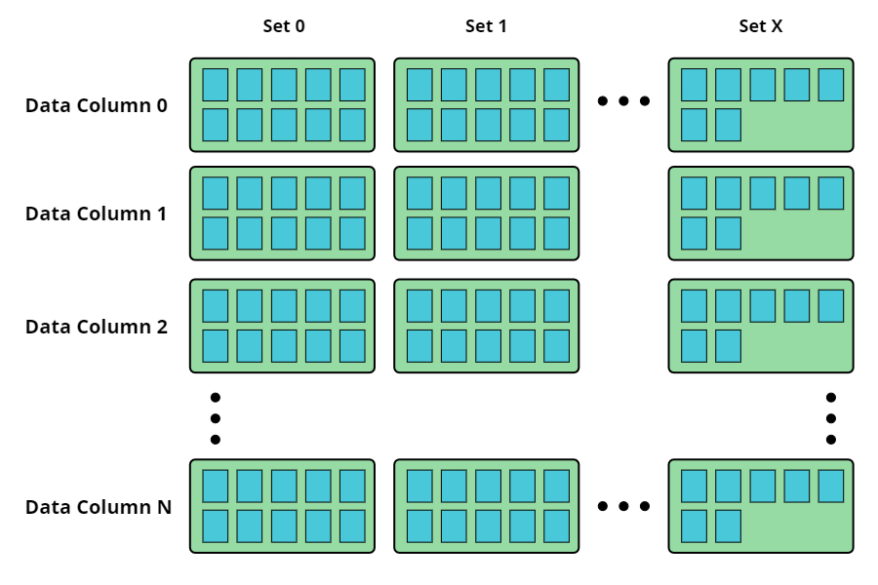
Table.bin File Structure
Stored in DiskManager class
Columns range from 0-N, N being the number of columns in the table.
Upon initialization, there is only one set. More sets are added as needed.
Pages are also added to the columns as needed.
Uninitialized pages in a block are allocated, but are considered Null until overwritten with a page.

Slide 8
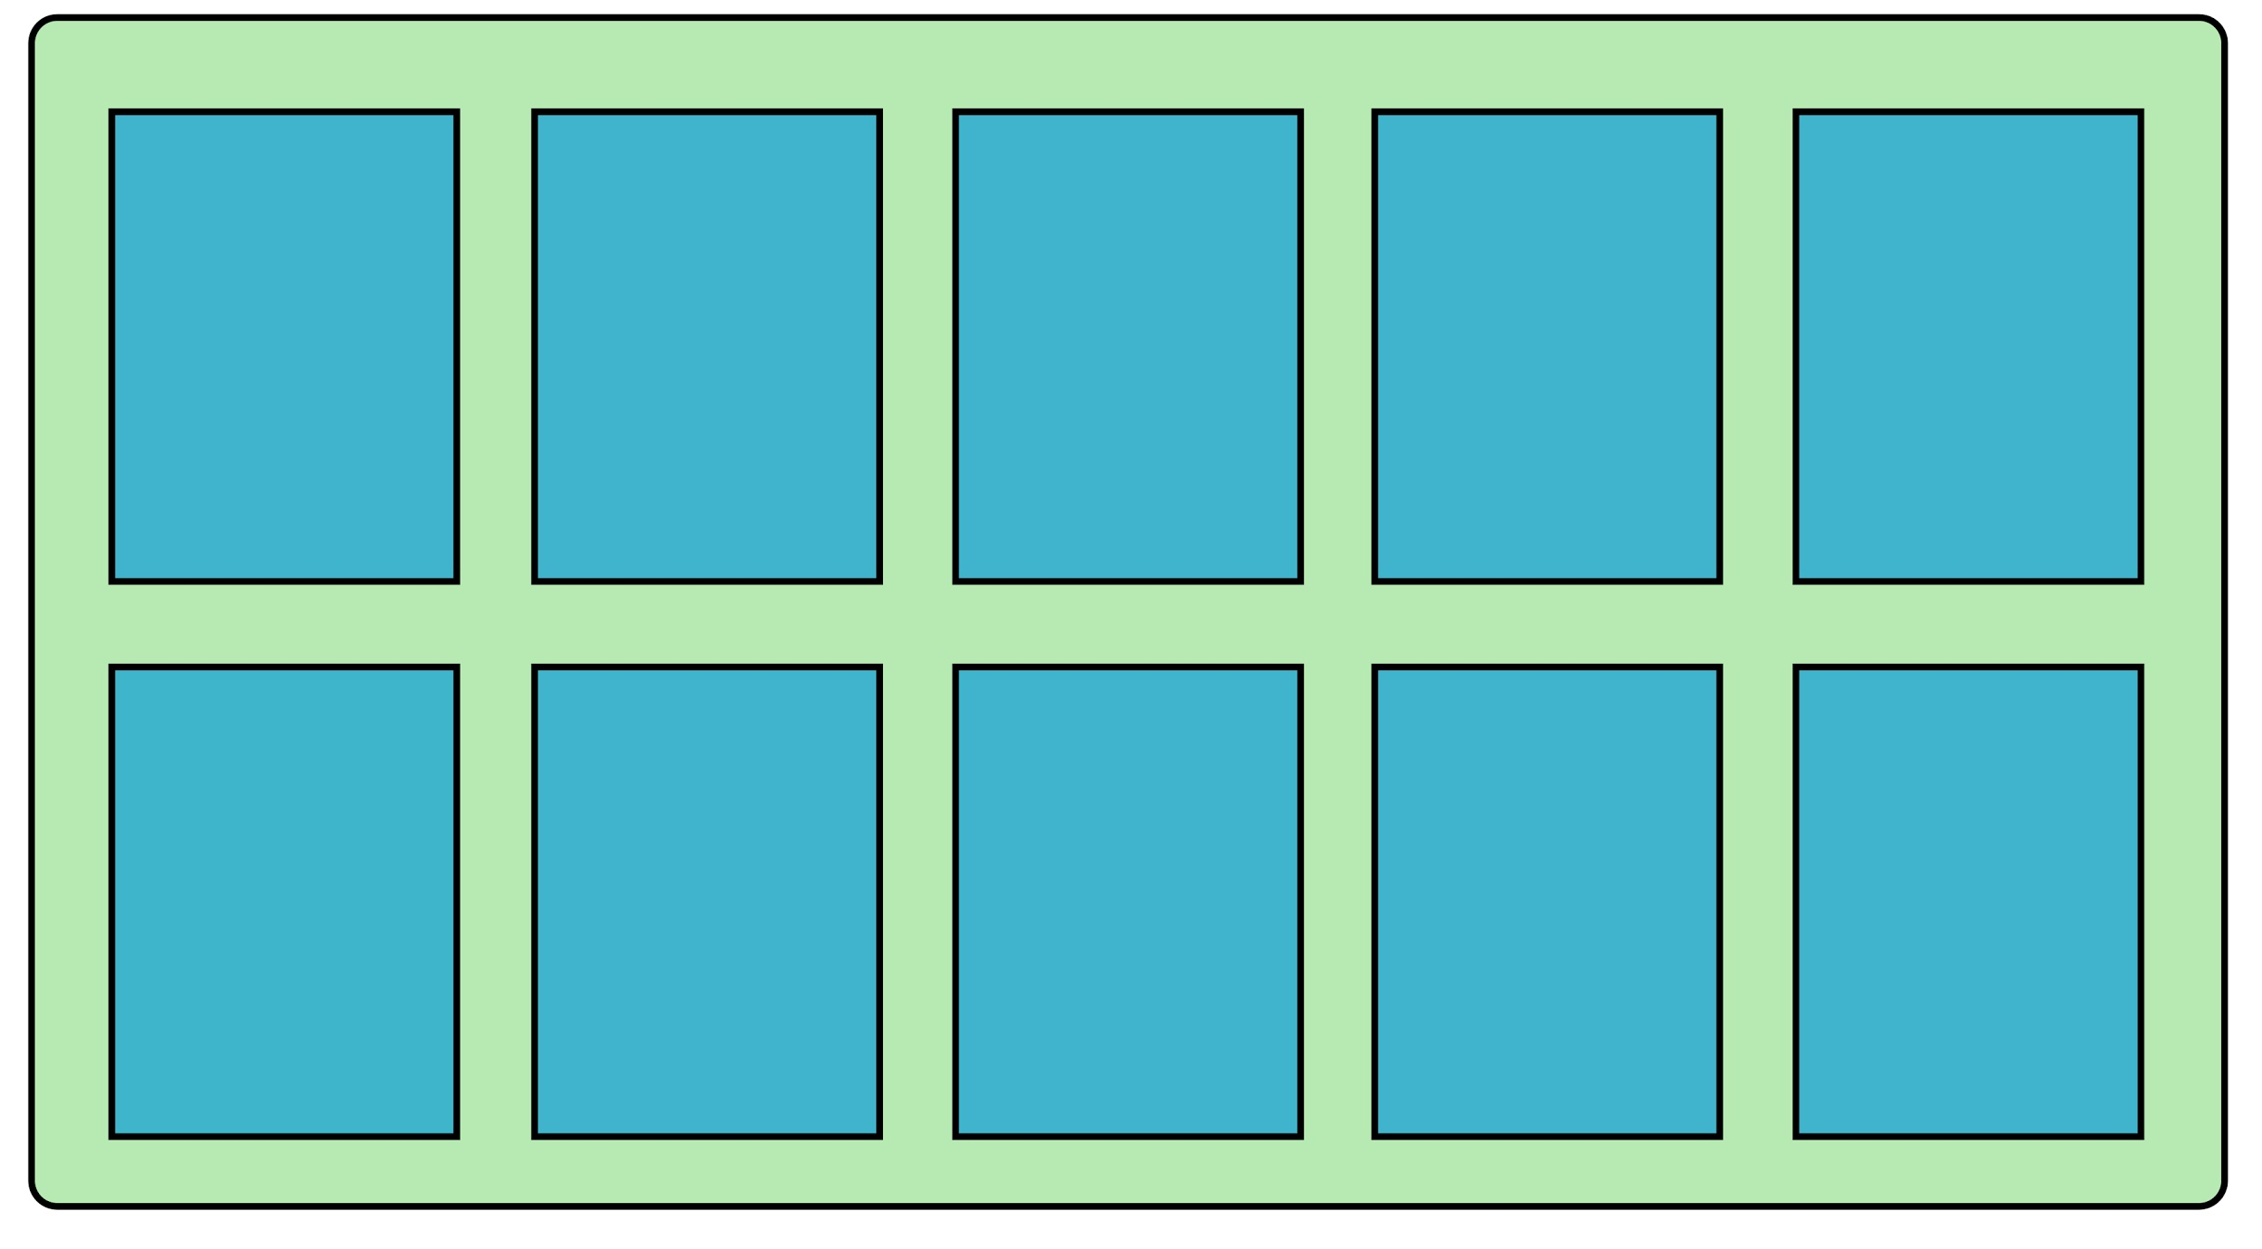
Column Block Structure
active_table_index
10 physical pages are stored in each Column Block
Pages in columns can be either Base or Tail pages
{ Table_Name : {Address: [File_Offset, Num_Records] }}
Address = (Page_Range, (Base/Tail_Flag, Page_Num))
File_Offset:
Used to offset through the Column and Set Blocks of the disk
Num_Records:
Indicates the current number of records in the page
Address Class:
Page Range Number
Base/Tail Flag
Page Number
Current Row Number

Slide 9
Non-primary key indexing
Index class keeps a dictionary mapping key to RID
create_index(): traverses the column and gets key values, mapping them to RID
{ key value : [RID list] }

Slide 10
Mike’s experimental data and graphs on optimization

Slide 11
data reorg - merging tail pages with base pages
implementation of page range concept ( 511 + 511 = 1022 )
2. frequency of merging - timing criteria
3. merging process explained ( copy base pages -> iterate tail
pages -> consolidate new base pages -> update page directory ( with locking )
4. threading implementation ( contention-free, separate
threads for user and merging )

Slide 12
Vadzim’s creative boolean algebra implementation :
check schema column by performing ( A & B ) , ( A & NOT B )
simple example:
base page schema column: 10000
tail page schema column: 10001
A & B = ( 10000 & 10001 ) = 10000 ( schema to update)
We will thus update the 1st column only
A & NOT B = ( 10000 & 01110 ) = 00000
( resulting schema after update)

Slide 13
Indexing:
multi-column query capabilities
any improvements / new design since milestone 1 ?

Slide 14
Bonus Section
Creative design ?
Extra functionalities ?
Experimental analysis ?
Extended query capability ?
Improved merging process / bufferpool management strategies ?
Did we address the “zombie base pages” which created “gaps” in the newly merged base page (bonus point) ? In other words, do we have any base page compression strategy ?
Anything else ?

Slide 15
Q/A ?

Slide 16
Live Demo

Slide 17
Thank you !

