Slide 1

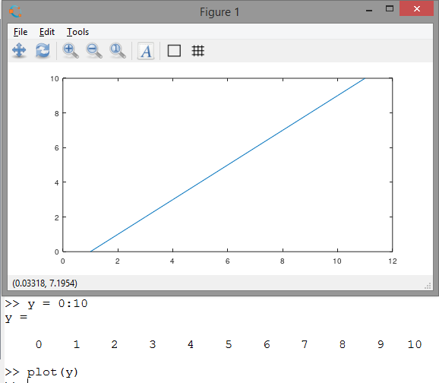
Plot IV A gotcha When plotting without a x axis vector, the starting x value is 1
Don’t try to
Change the x axis (don’t
Try to use xlim().
This is just how it works.
Use an x argument
To plot(), that starts at 0.
Started
at x = 1

Slide 2
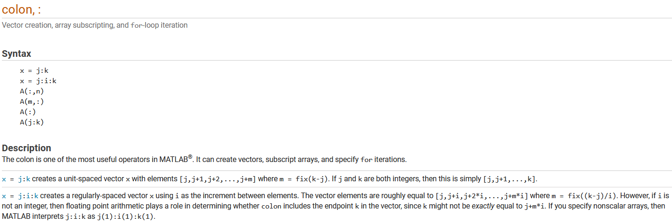
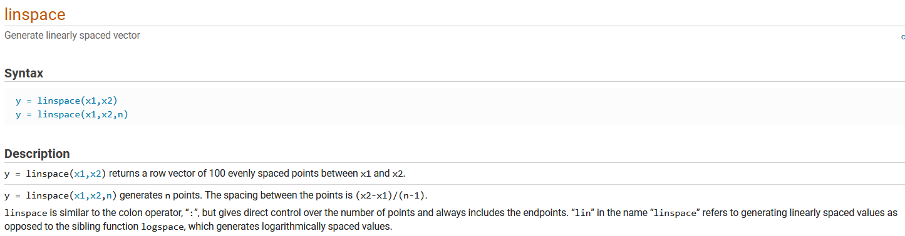
Linspace vs colon I
Linspace vs colon
Linspace trick

Slide 3
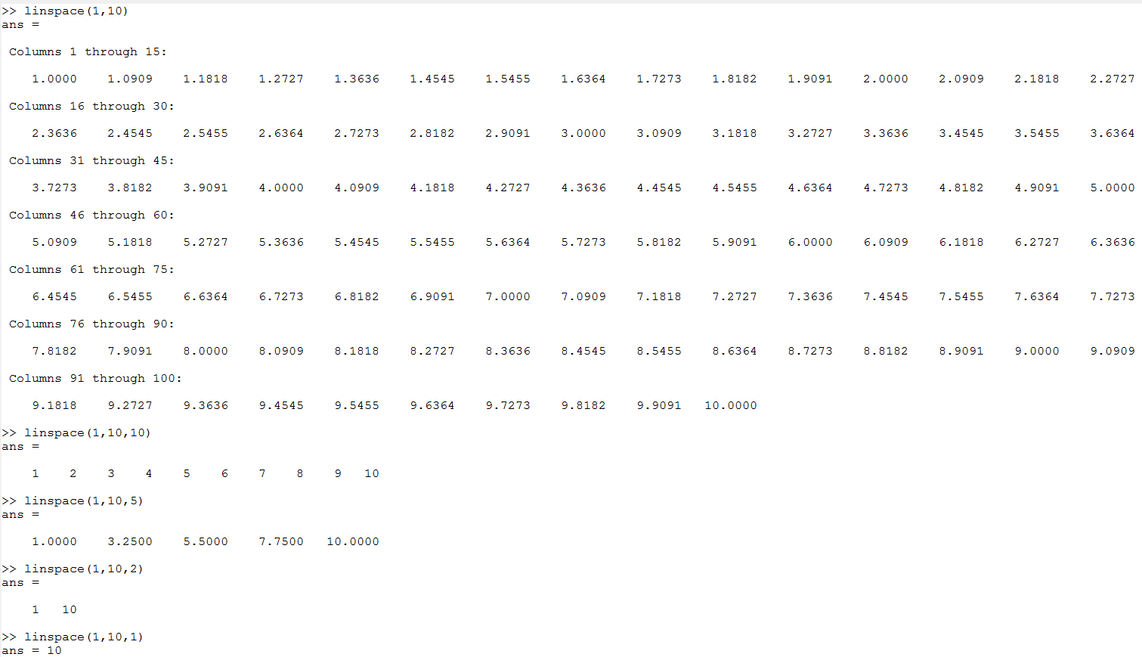
Linspace vs colon I linspace(start, end, number-points default=100)
y = linspace(x1,x2) returns a row vector of 100 evenly spaced points between x1 and x2.
y = linspace(x1,x2,n) generates n points. The spacing between the points is (x2-x1)/(n-1).

Slide 4
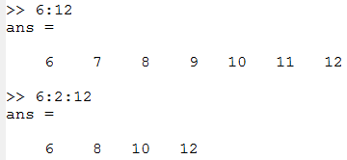
Linspace vs colon II
x= j:k creates a unit-spaced vector x a unit-spaced vector x
x = j:i:k creates a regularly-spaced vector x using i as the increment between elements.

Slide 5
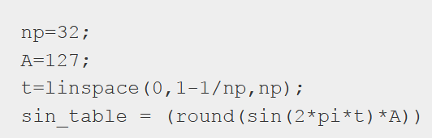
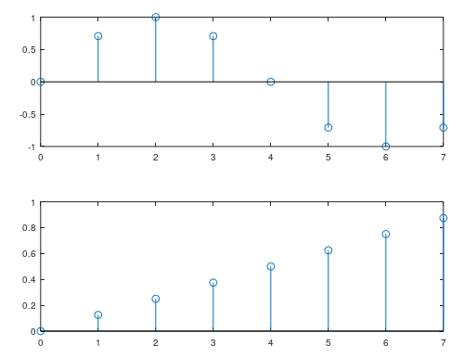

surf-vhdl/generate-sine-samples
The np-th (in this case 8) point does not
Loop all the around to 0. This way the next
Set of points does not overlap with prior.
This equation is a neat trick
8th point
1st point
.875
0
.125
.75
.25

