Slide 1
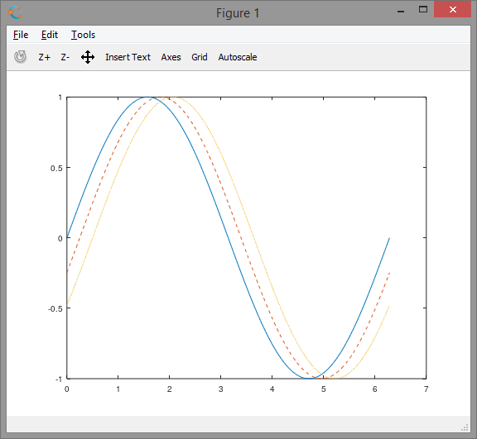
Plot I Specify Line Style
plot(X1,Y1,LineSpec1,...,Xn,Yn,LineSpecn) sets the line style, marker type,
and color for each line.
You can mix X, Y, LineSpec triplets with X, Y pairs.
x = 0:pi/100:2*pi;
y1 = sin(x);
y2 = sin(x-0.25);
y3 = sin(x-0.5);
figure
plot(x,y1,x,y2,'--',x,y3,':')

Slide 2
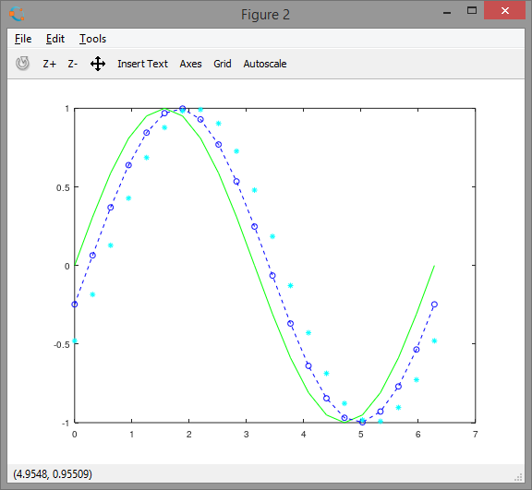
Plot II Specify Line Style Color and marker
Plot three sine curves with a small phase shift between each line.
First, green regular line, no markers
Second blue dashed line, circle markers.
Third cyan regular line, star markers
x = 0:pi/10:2*pi;
y1 = sin(x);
y2 = sin(x-0.25);
y3 = sin(x-0.5);
figure
plot(x,y1,'g',x,y2,'-ob',x,y3,'c*')

Slide 3
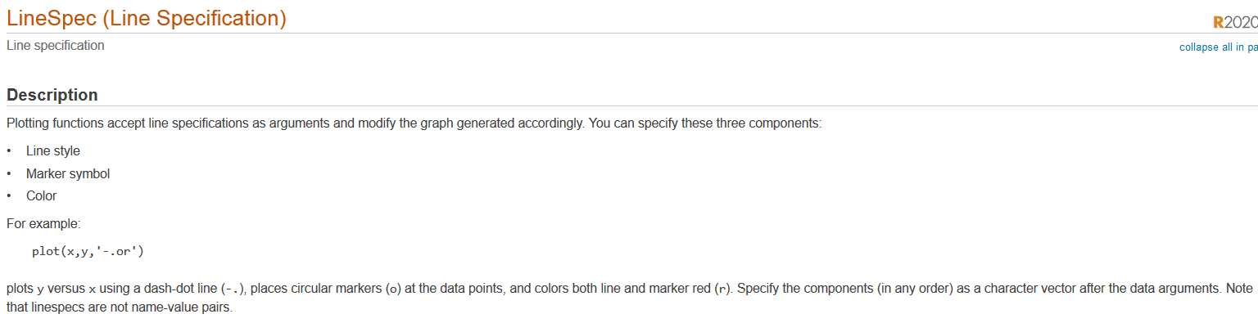
Plot III
figure
t = 0:pi/20:2*pi;
plot(t,sin(t-.25),'d')
plot(t,sin(t-.5),'dr')
plot(t,sin(t-.75),'dc')
plot(t,sin(t-1),'-.r*')
plot(t,sin(t-1.25),'-.r*')
plot(t,sin(t-1.5),'-.r+')
plot(t,sin(t-1.75),'-.r*')
plot(t,sin(t-2),'-.rx')
plot(t,sin(t-2.25),'-.r')
plot(t,sin(t-2.5),'-.')

Slide 4
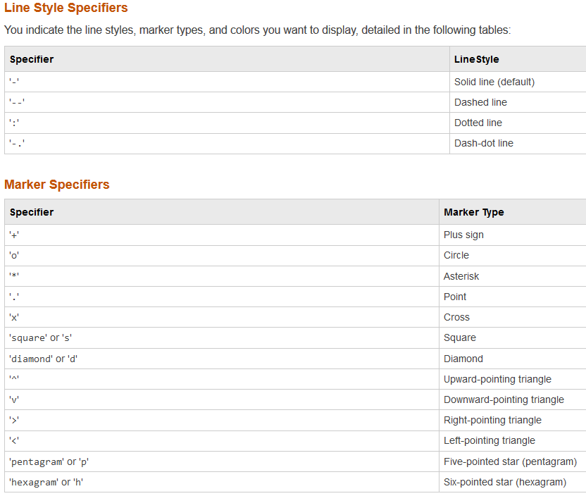
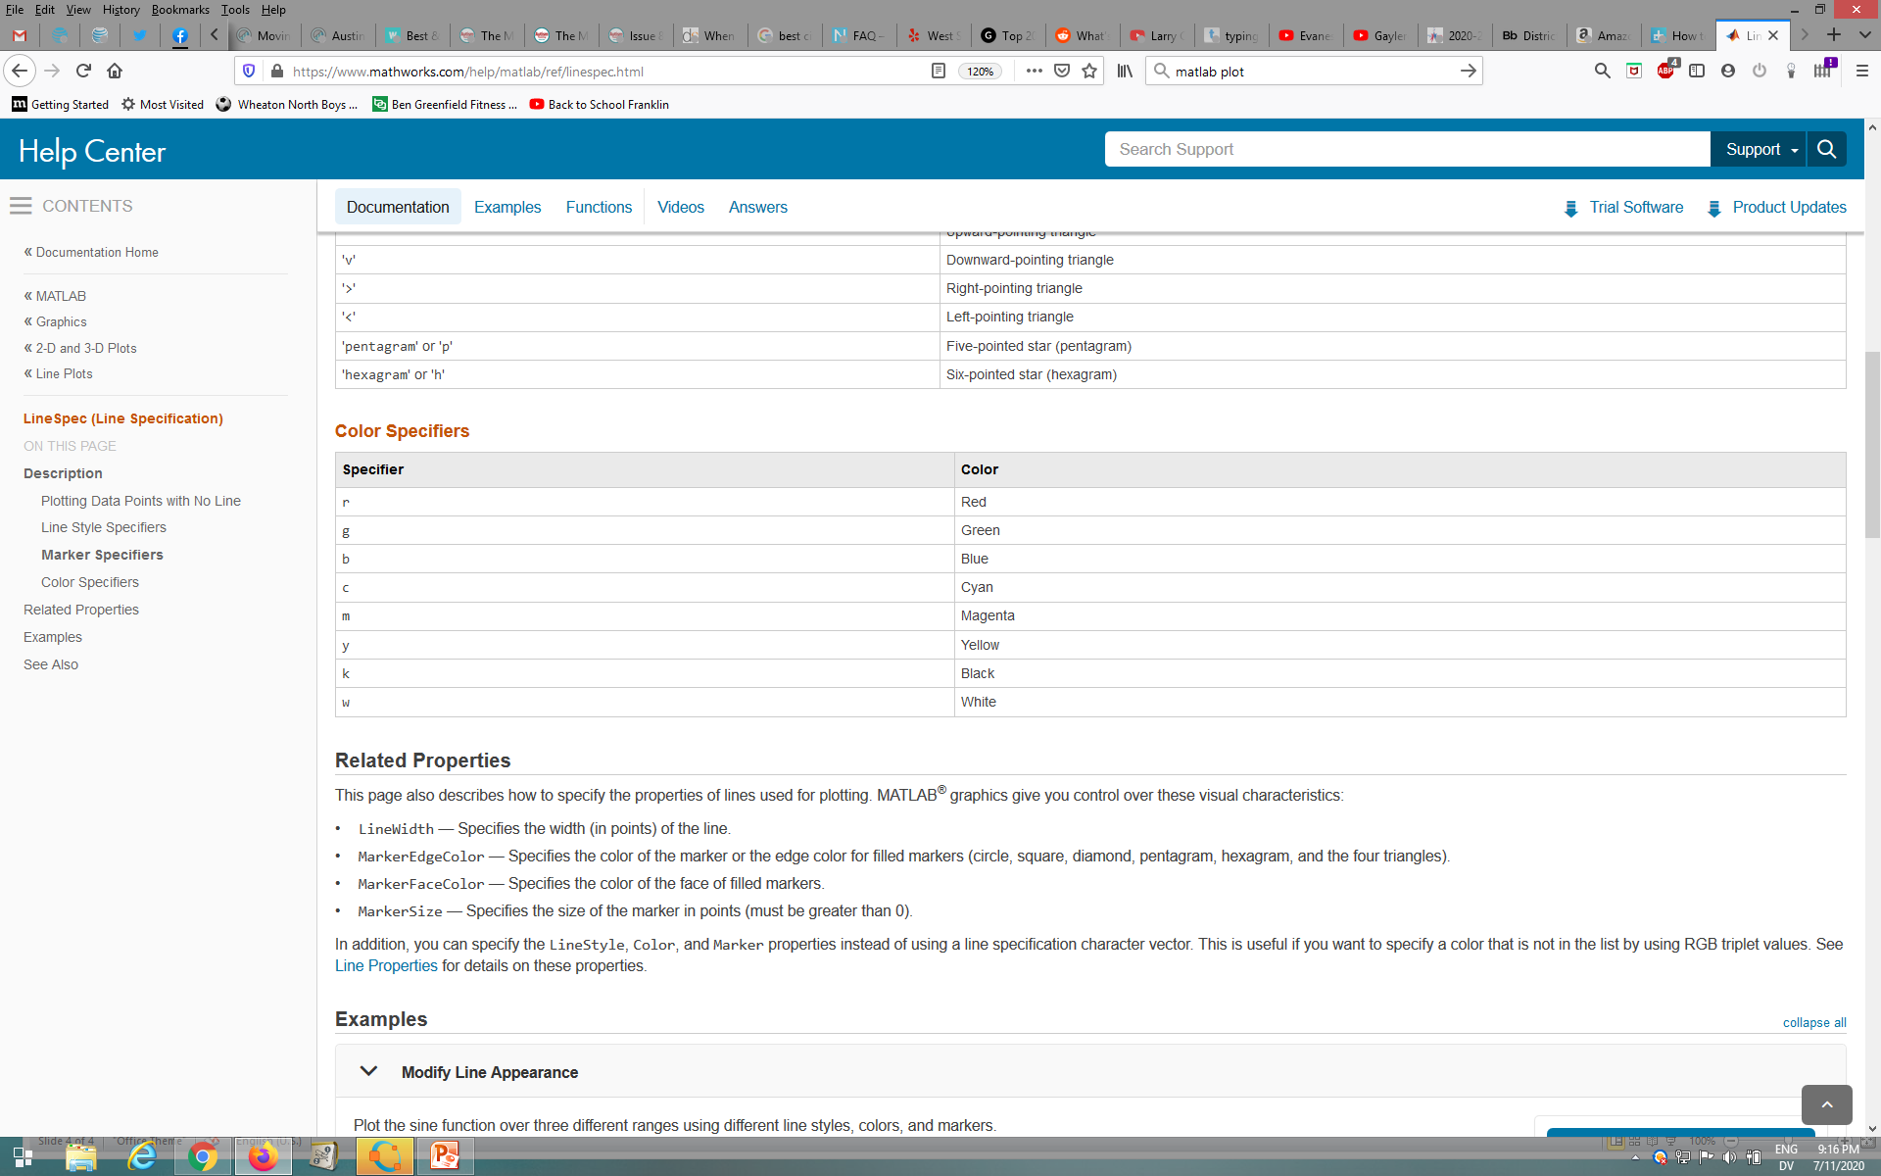
Plot IV Line Style Markers, and Color
t = 0:pi/20:2*pi;
plot(t,sin(t),'-.r*')
plot(t,sin(t-pi/2),'--mo')
plot(t,sin(t-pi),':bs')

Slide 5
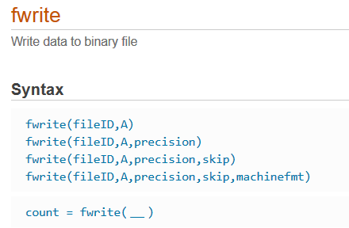
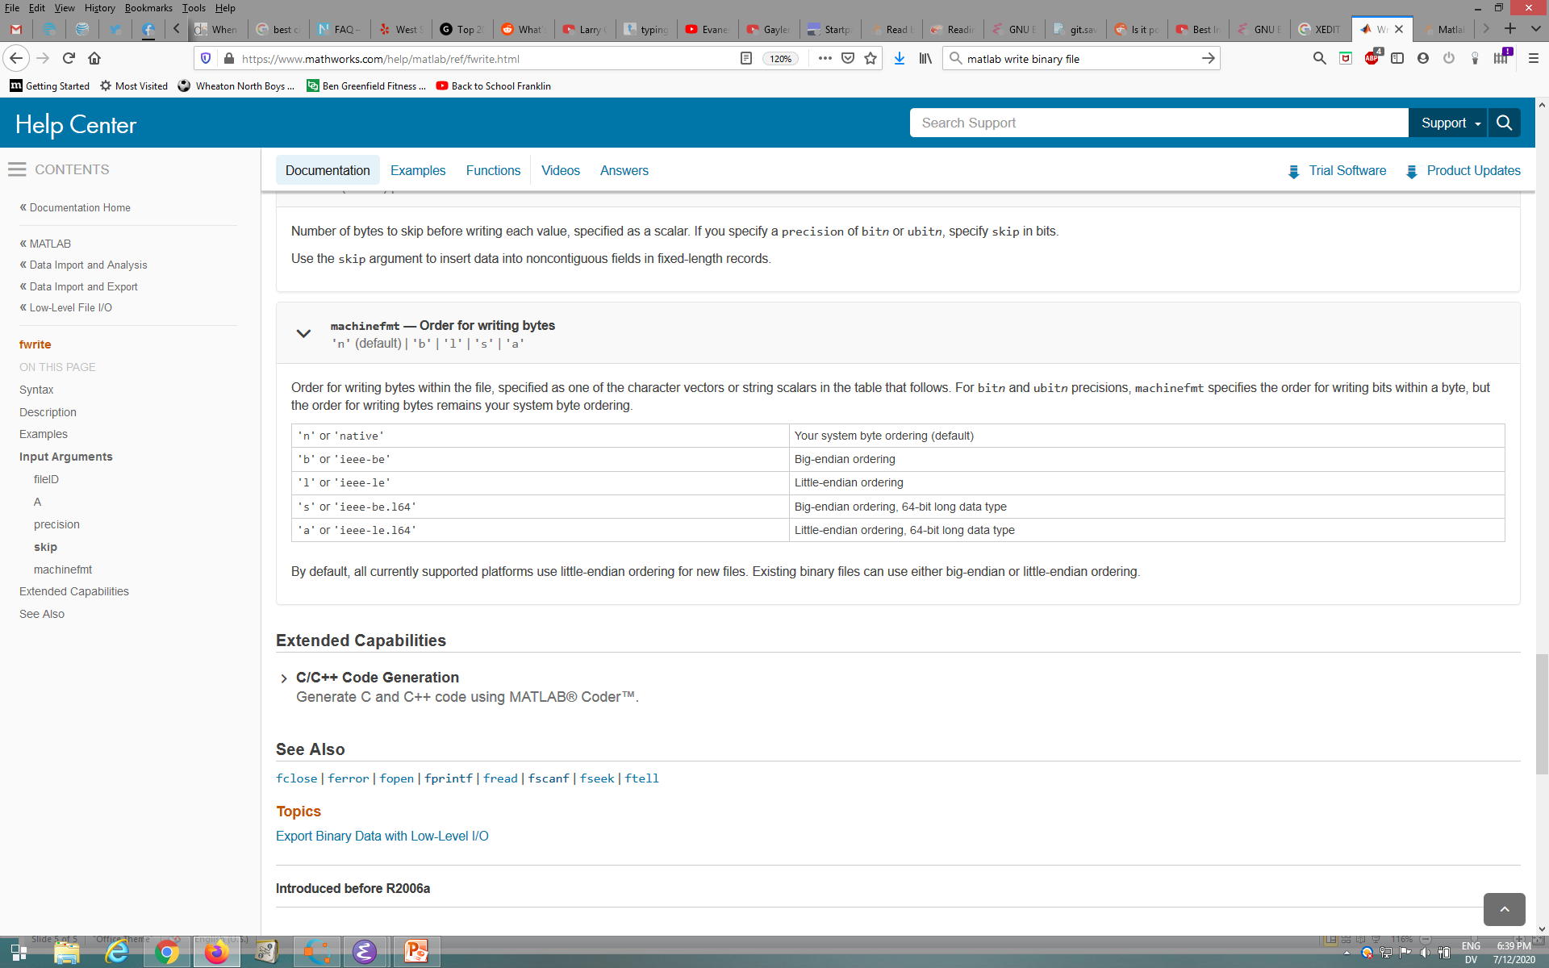
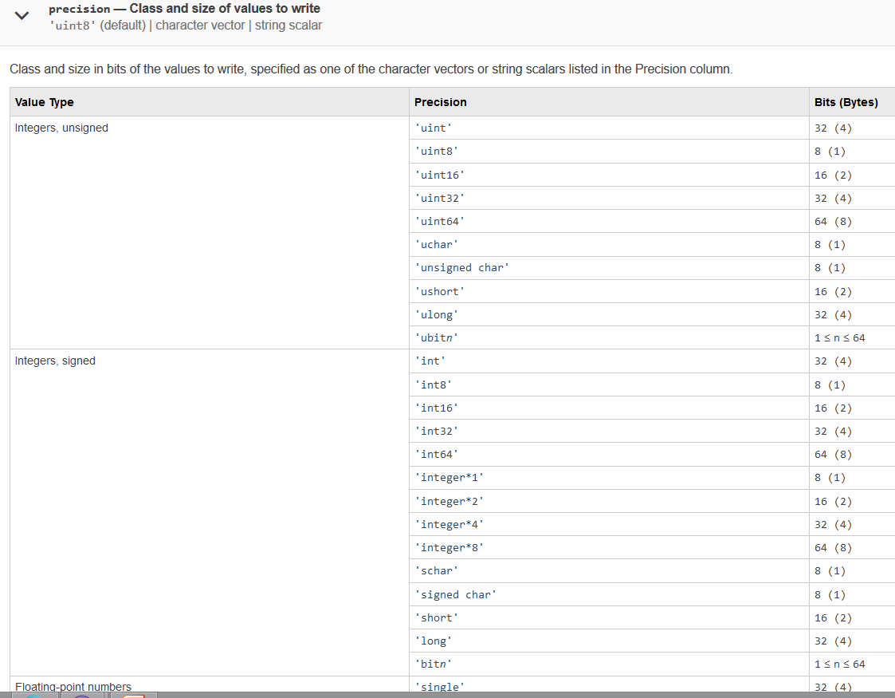
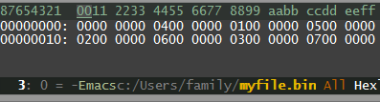
Writing Binary file
https://www.mathworks.com/help/matlab/ref/fwrite.html
a =
0 1 2 3
4 5 6 7
fileID = fopen('myfile.bin','w') fwrite(fileID,a,'uint32','ieee-le');
fclose(fileID);

