Slide 1
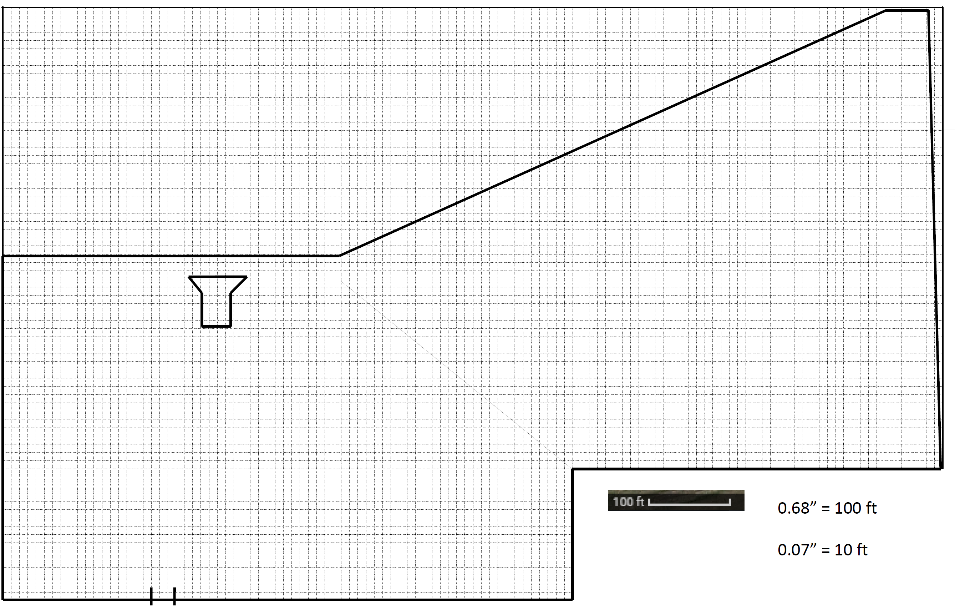
220x25 Finish Chute
PAINT YOUR THICK LINES ON ME
Paddock

Slide 2
Rule #1
Does it suck?

Slide 3

Rule #1
Does it suck?

Slide 4
Before You Build: Distances
Rule | Rule Minimum | Best Practice | Comments
Distance to physical objects (external boundary) | 25’ | 50’ | We use the 50’ “karting” recommended distance even though we don’t have karts. This allows for cushion in bad weather and keeps Pitt Race happy they don’t have to periodically replace guardrails as frequently. This is also the “exterior” limits, meaning the driving line should be 75’ since the “outside of the course boundary” would be an extra 25’ closer to the object.
Distance from spectators | 75’ | 75’ | <-in roped off and/or unprotected areas. Guardrails, concrete barriers are “protected” and ok to be less.
Course Width | 15’ | 25’ | Give people width, even ‘25 is “tight” – give people line choice
Slalom distances | 45’ | 75’ | 75’ is the most common distance used at national events. We can go less, but anything under 60’ will bring out pitchforks. No reason to go above 75’ as it starts leading to potentially unsafe speeds

Slide 5
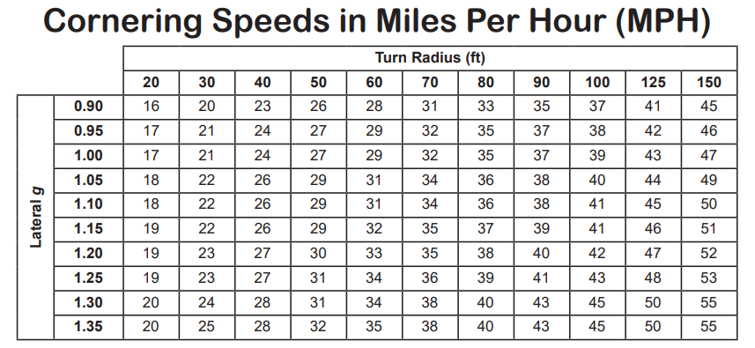
Before You Build: Speeds
Street
Radius =/= Diameter. Should not exceed 150’ radius ever (as if we had the space)
Street Touring
Minimum cornering speeds ideally should stay above 30 MPH, but above 25 is acceptable as well
No turn should require going back to 1st gear (though it’s ok to have some tighter stuff in the beginning that changes the normal 1 to 2 shift point)
Top speeds in Street or Street Touring shouldn’t exceed 65 MPH based on the SCCA recommendations

Slide 6
Before You Build: Placement of Key Items
Consider the 2nd car “send” point
Should optimally be within 15-20 seconds of the start but up to 25-30 is OK
Part of the course after the 2nd car send spot should not come within 75’ of another part of the course’s driving line
Grid:
60’ x 270’ covers the typical grids we’ve been doing where cars are double stacked
This allows for a 15’ travel lane both forward and rear of the cars, as well as 2 15’ long grid spots
Transitional Elements
People outside of street class will murder your entire family if you don’t include transitional sections in courses
A standard 5 cone ’75 paced slalom is 300’ long, so figure out early where you plan to put any transitions
Finish chute
Should be roughly 25’ wide by 220’ long
200’ is standard distance, but given our fast finishes and sometimes downhill sections, 20’ is typically added to be “safer”
Hard turns into a finish sucks, but so do “gotchya cones”
Things like the Start, Trailer Location, and Worker Stations can come later IF you use common sense

Slide 7
Other Considerations
Plan for bad weather. Most of the spacing we follow is good but think about how the Sandbox and Dumpster turns collect water. Think about the sewer grates. Think about what might be high risk areas.
The lot shape is awkward and limits “fun” course sizes. You can only fit so many elements.
You are not creating a piece of art. You need to understand what your “customers” want and deliver.
“Why do you want to design courses? The only acceptable answer is: To put out a high-quality product for all of the attendees to enjoy.”
-Vivek Goel (2018 SCCA Solo Nationals West Course Designer)

Slide 8
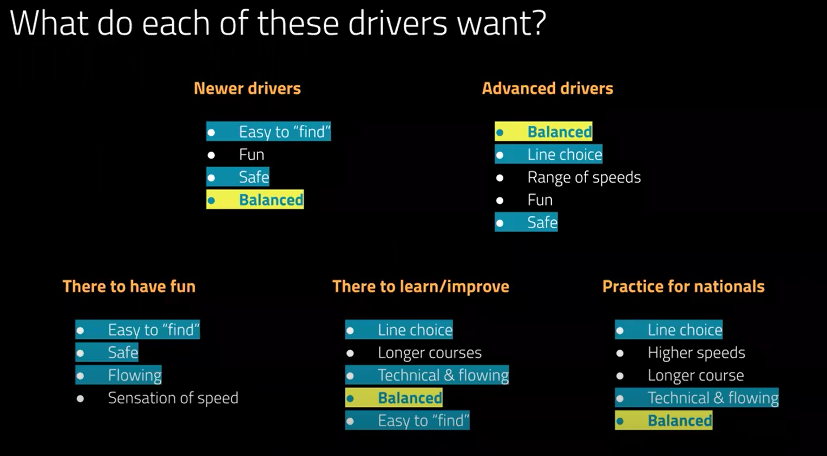
I stole this from Vivek’s video. You should watch it at https://www.youtube.com/watch?v=j2Nl1s4cq3o.

Slide 9
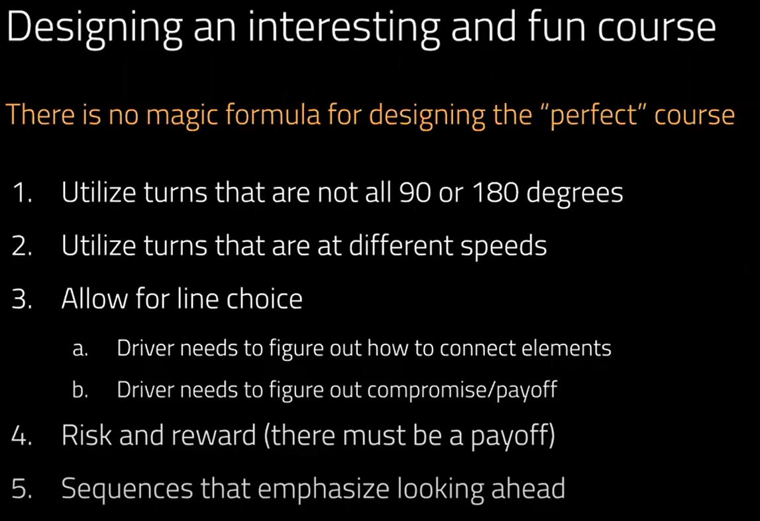
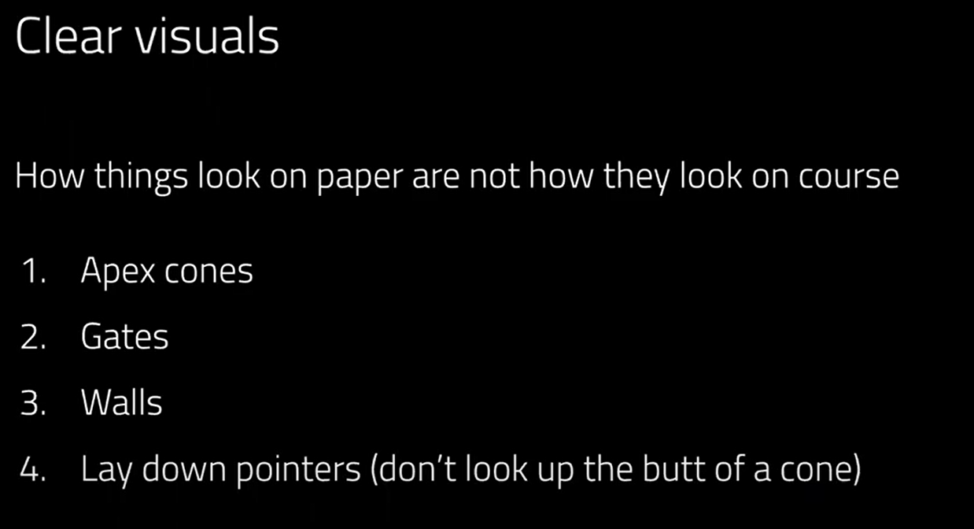
Most of this should be addressed during design
Most of this can be addressed during build, but should be considered in design
I also stole this from Vivek’s video.
You should REALLY watch it at https://www.youtube.com/watch?v=j2Nl1s4cq3o.

Slide 10

Will you please shut the fuck up and get to the course design part?
You right now:

Slide 11
Example: STC 8 from 2020
Usually best to be detailed
Paddock
Grid (270’ x 60’)
220x25 Finish Chute

Slide 12
Example: STC 10 from 2020
But sometimes you can be lazy
Transitions or some shit? No slow finishes though.
Transitions
Grid (270’ x 60’)
Paddock
75’ Buffer
Slalom
Lane Change
Transitions
Transitions

Slide 13
220x25 Finish Chute
PAINT YOUR THICK LINES ON ME
Paddock

Slide 14
1
2
Paddock
Grid

Slide 15
1
Paddock
2
Grid

Slide 16
1
1
Paddock
2
2

Slide 17
Paddock
Start
Staging
Grid

Slide 18
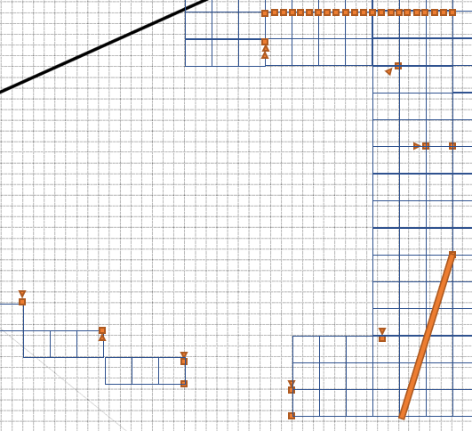
Paddock
220x25 Finish Chute
Grid

Slide 19

150’
220x25 Finish Chute
210’
Grid (270’ x 60’)
Paddock

Slide 20
On Camber
Finish
Paddock
Off Camber
Grid (270’ x 60’)
Start
Off Camber
Staging

Slide 21
Paddock
Grid (270’ x 60’)

