Slide 1
Business case analysis - SMART KEY -
Michael Fetick, Yuxuan Guan, Bobby Hurd, Sheraz Karim, Nithin Kumar, Weilong Qu

Slide 2
Roles & Responsibilities
Michael Fetick – Project Manager
Nithin Kumar – Project Coordinator
Weilong Qu – Business Analyst
Yuxuan Guan – Product Developer
Sheraz Karim – Product Engineer
Bobby Hurd – Marketing Manager

Slide 3

About the Client
Not satisfied with your business activity?
You need a better Marketing Strategy!
Notes:
Information Systems Solutions
-Well-respected software development firm
-Develops a range of web software
-Although develops a good product, has declining amount of new clients
-Apparently, the proposal process is what turns off clients

Slide 4

The Solution!
Best Consulting Firm ( It’s What People Want )
Delivers Improved Market Research:
Notes:
Two possible solutions:
-Hire more staff
-Automate processes to increase efficiency
ISS chose to automate using an Online Proposal Generator

Slide 5

The Major Benefit
Notes:
By putting an efficient, user-friendly process in place:
-Prospective customers are more likely to become customers
-Those customers would be happy with their experience

Slide 6

Cost-Benefit Data
Development Cost – $ 70,000 – two months
Operational Expenses – $265,000 – annually
Notes:
Salaries. (fixed, direct) 5 personnel:
1- Office Manager $30K,
1- Project Manager $60K,
1- Project Facilitator $55K, 1- End-User Training/Security Expert $50K, 1- Project Coordinator $45K. = $240K Annual
/ Two-Month Project (1/6 Yr) = $40,000

Slide 7
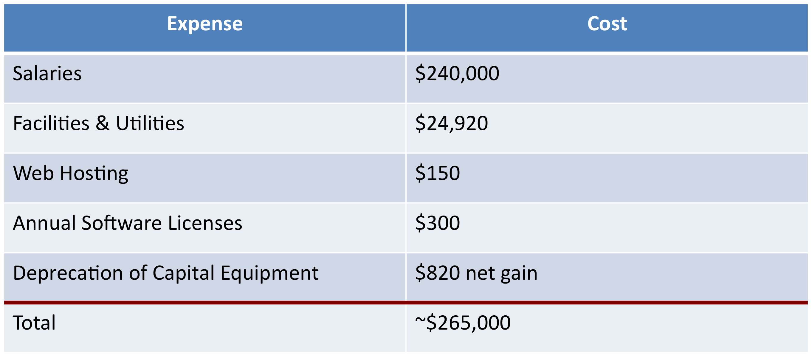
Operational Expenses

Slide 8
Revenue Estimates
Revenue Estimates¹ ( Assume: Average Two-Month Projects )
Projected Data | System Requests² per Month | Project Proposals Not Finished On-time³ | Project Proposals Finished On-time^{4,6} | Average Fee Two-Month Project $2K⁵ | Projected Revenue (12-months)
Year 1 | 4 | 1 (25%) | 3 | $6,000 | $72,000
Year 2 | 12 | 2 (13%) | 10 | $20,000 | $240,000
Year 3 | 18 | 1 (6%) | 17 | $34,000 | $408,000
Year 4 | 20 | 1 (5%) | 19 | $38,000 | $456,000
CUSTOMER SERVICE
Notes:
Assumptions:
1. Revenue Estimates per year. Revenue estimates begin when the system is in the Operational Phase. This is after the two month Development Phase. A break-even analysis will include the recovery of the costs for development.
2. System Requests per Month. Count only the System Requests qualified as ‘accepted’ project proposals, by the client to pay for and proceed with the system development.
3. Project Proposals Not Finished (Sub-Standard Work – Not On-Time) Some Project Proposals do not get finished on-time for valid and invalid reasons. There are some legitimate cases where a Project Proposal will not be accepted by the client. There are other legitimate cases that cannot be finished on-time due to factors like workload, system complexity/scope, or withdrawn system requests.
4. Workload. The workload is ‘open projects’ work-in-progress, which generally lasts for two months. So the accumulative amount is about twice the amount of projects finished per month.
For example, Year 4 shows: 19 projects finished per month, so the three System Analysts are working on 38 open projects, at a time, per month.
5. Project Proposals Finished (Deliverables). A Client is billed by the ISIS Company for services to provide a Project Proposal that is finished on-time and to their satisfaction. The Client’s satisfaction is afforded by the work agreed with the ISIS Company, in compliance to all the specified requirements.
6. Average Fee (Typical Project Proposal). A ‘typical’ Project Proposal is defined to cost a fee of $2,000 and schedule of two-months for the Client. The purpose of establishing a baseline Project Proposal (unit) is to have ‘average values’ to quantify and compute the financial analysis of the business process. The budget and schedule values of actual projects vary, based on difficulty, complexity and size.

Slide 9
Revenue Estimates
Revenue Estimates¹ ( Assume: Average Two-Month Projects )
Projected Data | System Requests² per Month | Project Proposals Not Finished On-time³ | Project Proposals Finished On-time^{4,6} | Average Fee Two-Month Project $2K⁵ | Projected Revenue (12-months)
Year 1 | 4 | 1 (25%) | 3 | $6,000 | $72,000
Year 2 | 12 | 2 (13%) | 10 | $20,000 | $240,000
Year 3 | 18 | 1 (6%) | 17 | $34,000 | $408,000
Year 4 | 20 | 1 (5%) | 19 | $38,000 | $456,000
Notes:
Assumptions:
1. Revenue Estimates per year. Revenue estimates begin when the system is in the Operational Phase. This is after the two month Development Phase. A break-even analysis will include the recovery of the costs for development.
2. System Requests per Month. Count only the System Requests qualified as ‘accepted’ project proposals, by the client to pay for and proceed with the system development.
3. Project Proposals Not Finished (Sub-Standard Work – Not On-Time) Some Project Proposals do not get finished on-time for valid and invalid reasons. There are some legitimate cases where a Project Proposal will not be accepted by the client. There are other legitimate cases that cannot be finished on-time due to factors like workload, system complexity/scope, or withdrawn system requests.
4. Workload. The workload is ‘open projects’ work-in-progress, which generally lasts for two months. So the accumulative amount is about twice the amount of projects finished per month.
For example, Year 4 shows: 19 projects finished per month, so the three System Analysts are working on 38 open projects, at a time, per month.
5. Project Proposals Finished (Deliverables). A Client is billed by the ISIS Company for services to provide a Project Proposal that is finished on-time and to their satisfaction. The Client’s satisfaction is afforded by the work agreed with the ISIS Company, in compliance to all the specified requirements.
6. Average Fee (Typical Project Proposal). A ‘typical’ Project Proposal is defined to cost a fee of $2,000 and schedule of two-months for the Client. The purpose of establishing a baseline Project Proposal (unit) is to have ‘average values’ to quantify and compute the financial analysis of the business process. The budget and schedule values of actual projects vary, based on difficulty, complexity and size.

Slide 10
Revenue Estimates
Profitable in 5 years…
Notes:
It shows that in Year 4, the break-even point for profitability will be reached for the ISS Company.

Slide 11
Revenue Estimates
Return On Investment: 30.1 %
Year | Costs | Cumulative | Benefits | Cumulative
 |  | Costs |  | Benefits
0 | 70,000 | 70,000 |  | -
1 | 265,000 | 335,000 | 72,000 | 72,000
2 | 265,000 | 600,000 | 240,000 | 312,000
3 | 265,000 | 865,000 | 408,000 | 720,000
4 | 265,000 | 1,130,000 | 456,000 | 1,176,000
5 | 265,000 | 1,395,000 | 480,000 | 1,656,000
6 | 265,000 | 1,660,000 | 504,000 | 2,160,000
Total | 1,660,000 |  | 2,160,000

Slide 12
Valuation Estimates
Net Present Value: $105,275
 | Year 0 | Year 1 | Year 2 | Year 3 | Year 4 | Year 5 | Total
Benefits | 1 | 72,000 | 240,000 | 408,000 | 456,000 | 480,000
Factor | 1.000 | 0.909 | 0.826 | 0.751 | 0.683 | 0.621
PV of Benefits | 1 | 65,448 | 198,240 | 306,408 | 311,448 | 298,080 | 1,179,625
Costs | 70,000 | 265,000 | 265,000 | 265,000 | 265,000 | 265,000
Factor | 1.000 | 0.909 | 0.826 | 0.751 | 0.683 | 0.621
PV of Costs | 70,000 | 240,885 | 218,890 | 199,015 | 180,995 | 164,565 | 1,074,350

Slide 13




Development Roadblocks
Notes:
In developing this program, we encountered a number of roadblocks:
-Learning curve from new technologies
-Restrictions in network settings
-unable to log into shell
-Server difficulties
-2 team members developed on PC, the other 2 on Mac
-Scheduling issues for the team
-But we kept a good sense of humor
And…

Slide 14

Successes
Greatly Increases Our Knowledge of Marketing
Develops Partnerships and Return Business
Develops Competitive Advantages
Notes:
As a result, we
-Succeeded in learning more about MVC frameworks in PHP
-Gained a better understanding of the development process
-Increased our knowledge of PHP
-Accomplished some of our major objectives
-Kept our sense of humor

Slide 15

Any Questions?

