Slide 1
Arborist Elite of Garden State Manor
New Jersey’s Premier Log Cabin Suppliers
Michael Flanagan & Andrew Morales

Slide 2

Mission Statement:
“Our mission is to curate log cabins that speaks to the refined tastes of those who demand nothing less than perfection. Together, we shape a future imbued with enduring elegance, sophistication, and unmatched craftsmanship."
Notes:
“Our mission is to curate log cabins that speaks to the refined tastes of those who demand nothing less than perfection. Together, we shape a future imbued with enduring elegance, sophistication, and unmatched craftsmanship."

Slide 3

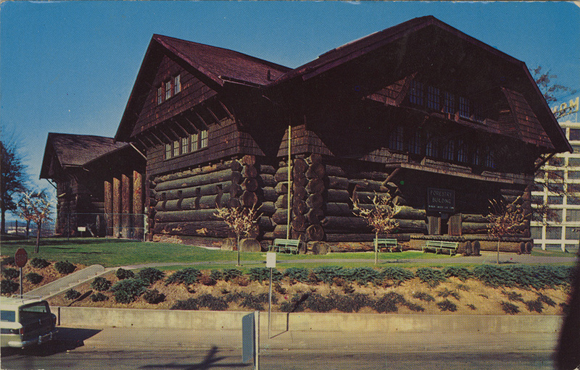
The Company
Founded in 1991 by CEO Tim Burr
Felling trees the old fashioned way
Modern technology and a time honored tradition
Notes:
Founded in 1991 by CEO Time Burr, Arborist Elite has grown into a premier supplier of high-quality pine logs, rooted in tradition and innovation. As a fourth-generation lumberjack, Burr inherited a deep appreciation for the art of forestry, learning to wield an axe with precision from an early age.
In the early 1990s, he turned his passion into a business, setting out to source the finest pine trees from the New Jersey Pinelands. Armed with his iconic gold-plated axe, Burr felled 100 pine trees in the company’s first year, building Arborist Elite’s foundation and constructing its first warehouse, the "Garden State Manor."
Over the past 33 years, the company has branched out across New Jersey and now proudly supplies pine logs to all 48 continental states. To meet the demands of a growing market, Burr introduced data-driven systems to streamline and optimize the supply chain, ensuring efficiency without compromising quality. Despite embracing modern technological advancements, Arborist Elite honors its heritage by felling trees the old-fashioned way—with an arsenal of gold-plated axes.

Slide 4



Data:
USDA FIA Datamart (1987-2021)
iNaturalist (1998-2025)
Mockaroo
Mike & Andrew’s made up data
Notes:
Data
Gathering data:
Includes sources and the types of data collected
Speaker notes:
Arborist Elite inventory is comprised of trees sourced from iNaturalist and the USDA FIA Datamart. iNaturalist trees consist of research grade pine trees located within the state of New Jersey between 1998-2025. USDA trees consist New Jersey pine trees inventoried by the USDA FIA between 1987-2021. We combined elements of each dataset to create our company’s inventory of 8790 pine trees.
Each inventoried tree has its own unique ID, a timestamp and coordinates of when and where it was harvested, county where it is being held, and its species, diameter, and total net volume of board feet (uesd to calculate the trees cost.
The data that we completely made up for the use of this project were pricing information for each species of wood and the customer dataset which was generated using mockaroo.

Slide 5
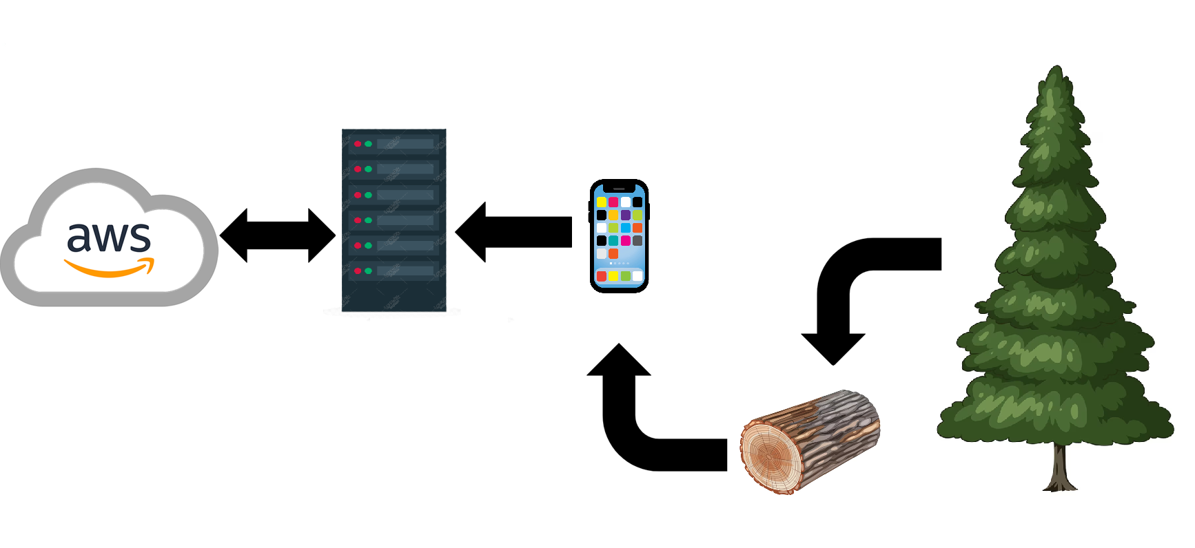
Data Cleaning
Notes:
Data
Data cleaning:
Data accuracy is ensured with mentioned quality checks at specific stages
Additional data cleaning details including handling duplicates, when the data is cleaned (ETL/ELT), rules, etc.
The front end software used by loggers has built-in checks to ensure data quality. For example date fields are yyyy-mm-dd, fields like county or scientific name are picked from a drop down to avoid typos, or currency amounts are listed in ‘0.00’ format. This helps ensure consistency in formatting
Data is gathered on-site when trees are felled. Loggers take count of the tree’s diameter and height and upload this data, along with a timestamp and GPS coordinates, to our company servers via smartphones. Python is then used to calculate the volume of wood within each tree and verify data entries are complete. Data is integrated into the warehouse following an ETL (extract, transform, load) method. Since the data itself is manageable to evaluate, our inhouse data scientist reviews the data inflow daily. Once the data is verified complete, it is uploaded to our cloud based data warehouse using Amazon web services.

Slide 6
Database overview:
Locally stored on the company server, accessed via MySQL Workbench, with cloud-based archived files maintained for backup.
The Backups are done from the MySQL workbench to an AWS cloud service. This is done by automation at the end of the day.
Data can be recovered from the cloud to the MySQL server.
Notes:
Locally stored on the company server, on a MySQL database and accessed on MySQL Workbench, with cloud based archived files for backup.
The Backups are done from the MySQL workbench to an AWS cloud service. This is done by automation at the end of the day.
If the data ever needs to be recovered it can be downloaded from the cloud and restored onto the MySQL server. Since the backups are done daily in the event of a recovery only the current day data would be lost/need re-entering.
User access includes:
Loggers- access to data entry only
Sales Department- access to database for querying
Data Scientist/Tim Burr- full access to database for manipulation, editing, and analysis

Slide 7
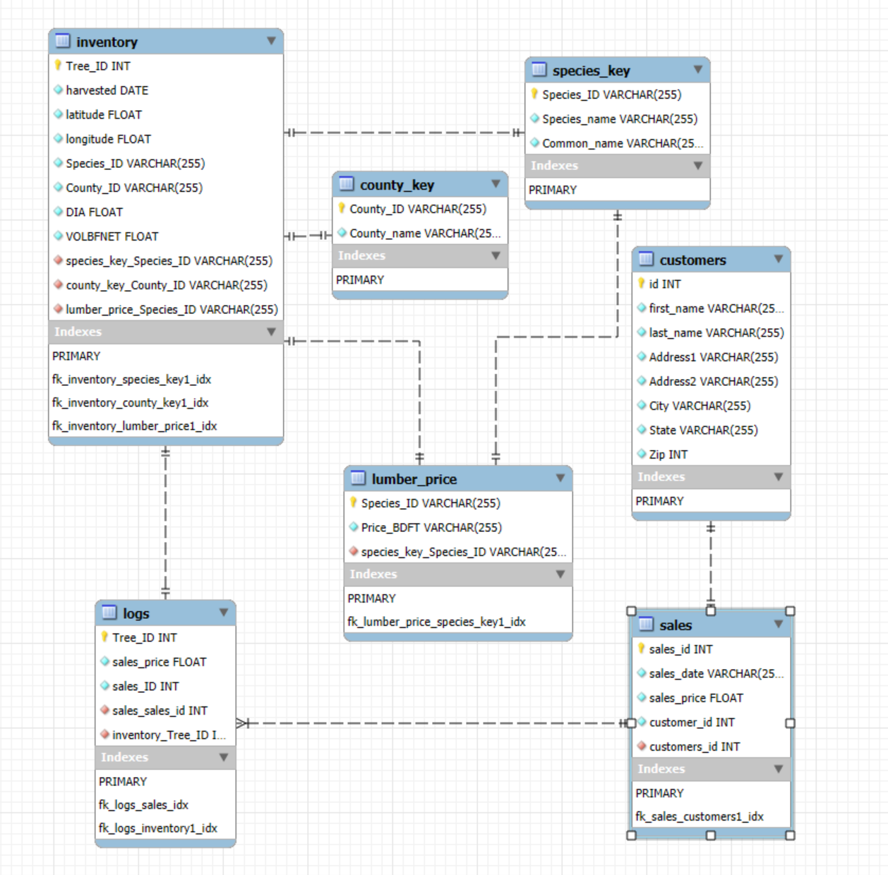
Schema:
Notes:
Database Design
Database Schema model
Fact/dimension tables, primary keys, foreign keys, relationships between entities are defined in the diagram

Slide 8
Analysis:
Questions:
What year did Arborist Elite have the highest revenue?
In the past 5 years, Which 3 States had the highest sales. How are those states trending
Which type of inventory do we have on hand in each warehouse/county
Notes:
Database Storage, Access and Analysis
Database storage and management discussed such as users, back up, recovery plans, encryption, etc.
Data question example and query relevant to your mission
What year did Arborist Elite have the highest revenue?
select
right(s.sales_date,4) as sales_year,
sum(s.sales_price) as Total_Sales
from sales s
group by right(s.sales_date,4)
order by sales_year desc;
Which State has the most in sales over the past 5 years.
Which inventory do we have on hand in each warehouse

Slide 9
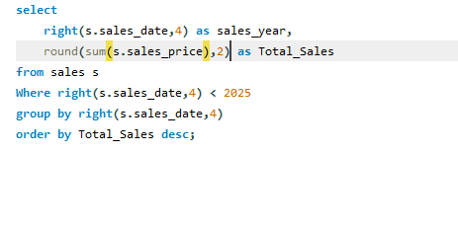
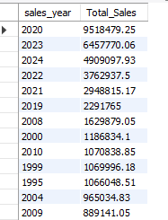
Question 1
Notes:
Database Storage, Access and Analysis
Database storage and management discussed such as users, back up, recovery plans, encryption, etc.
Data question example and query relevant to your mission
What year did Arborist Elite have the highest revenue?
select
right(s.sales_date,4) as sales_year,
sum(s.sales_price) as Total_Sales
from sales s
group by right(s.sales_date,4)
order by sales_year desc;
Which State has the most in sales over the years.
Which inventory do we have on hand in each county

Slide 10
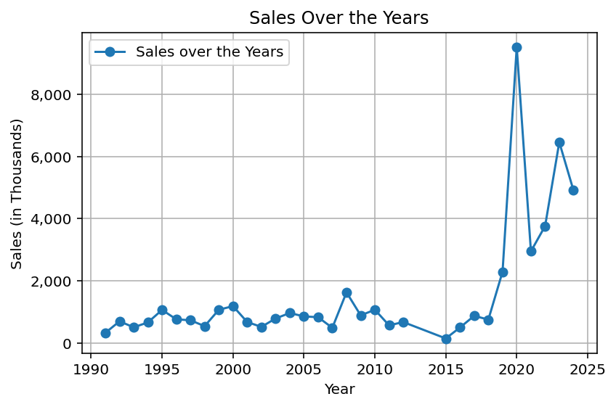

Slide 11
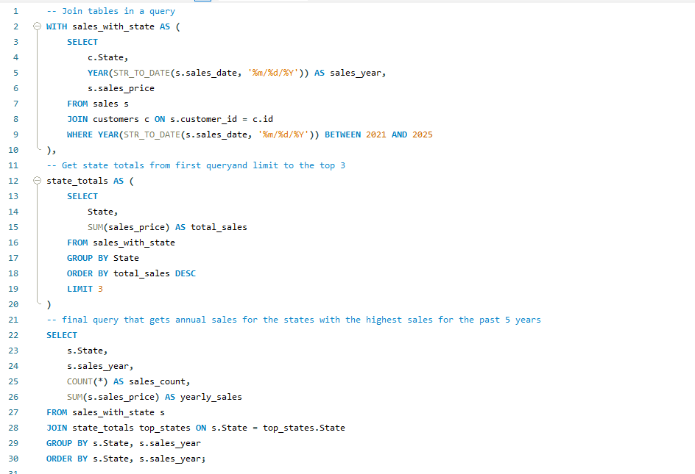
Question 2
Notes:
Database Storage, Access and Analysis
Database storage and management discussed such as users, back up, recovery plans, encryption, etc.
Data question example and query relevant to your mission
What year did Arborist Elite have the highest revenue?
select
right(s.sales_date,4) as sales_year,
sum(s.sales_price) as Total_Sales
from sales s
group by right(s.sales_date,4)
order by sales_year desc;
Which State has the most in sales over the years.
Which inventory do we have on hand in each county

Slide 12
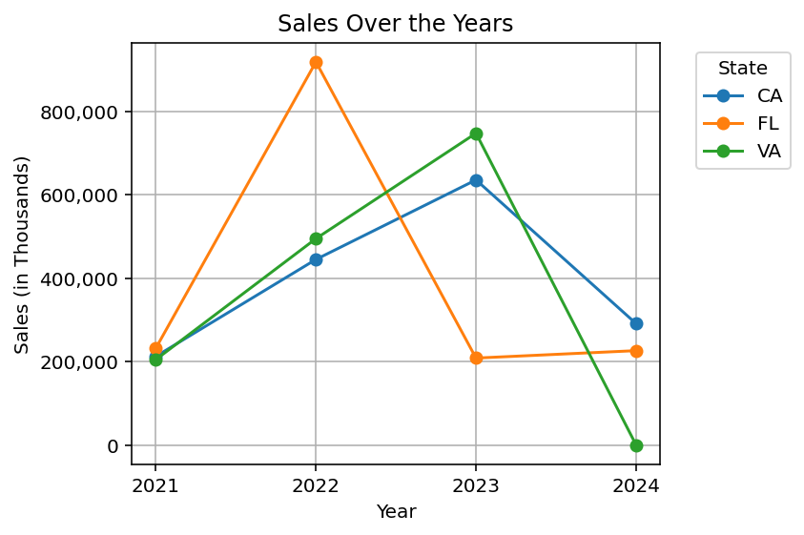

Slide 13
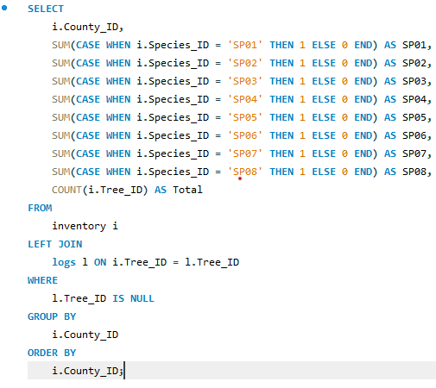
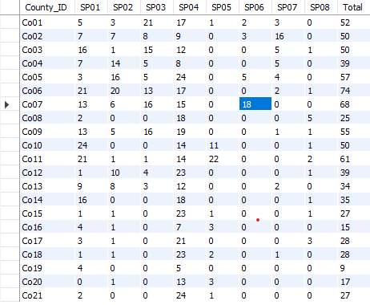
Question 3
Notes:
Database Storage, Access and Analysis
Database storage and management discussed such as users, back up, recovery plans, encryption, etc.
Data question example and query relevant to your mission
What year did Arborist Elite have the highest revenue?
select
right(s.sales_date,4) as sales_year,
sum(s.sales_price) as Total_Sales
from sales s
group by right(s.sales_date,4)
order by sales_year desc;
Which State has the most in sales over the years.
Which inventory do we have on hand in each county

Slide 14
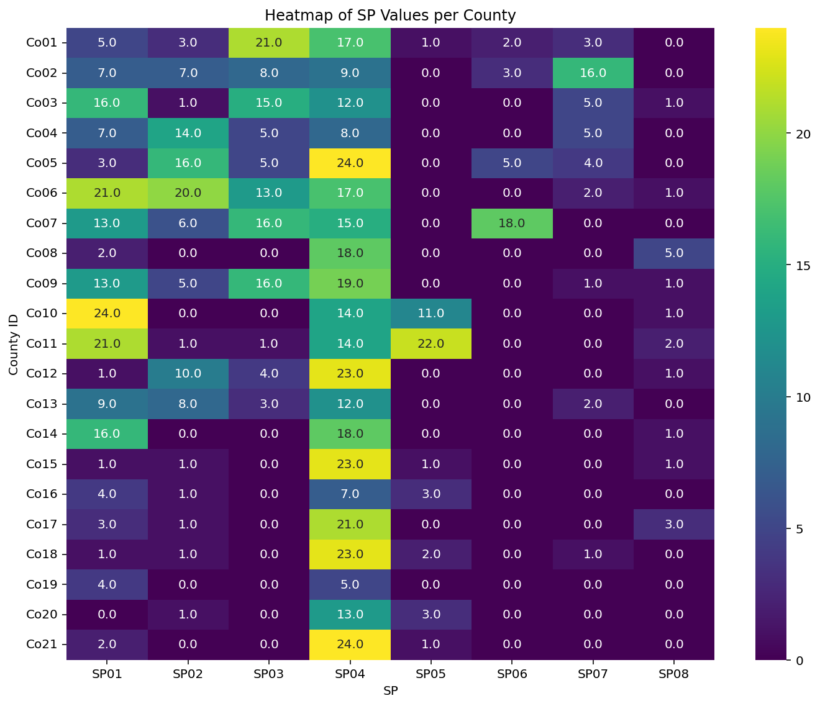

Slide 15

Arborist Elite GitHub

