Slide 1

Understanding Git and the GitHub Workflow

Slide 2
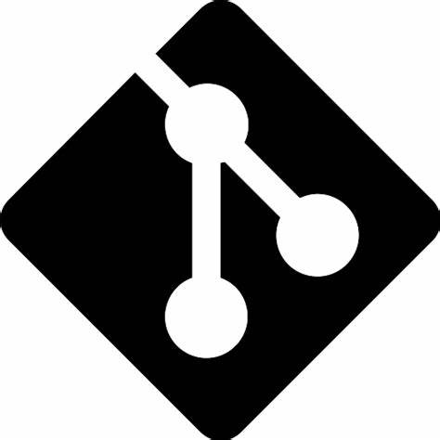

What is Git and GitHub
What is Git?
A distributed version control system
Tracks the history of changes from multiple contributors
Any earlier version of the project can be recovered at any time.
Each contributor has a full copy of the project and project history
DVCSs don’t need a constant connection to a central repository
What is GitHub?
GitHub hosts Git repositories
Provides issues (threaded discussions), pull requests, and code review
Builds collaboration directly into the development process
The GitHub flow process ensure contributors can collaborate consistently
(source: GitHub Docs)

Slide 3
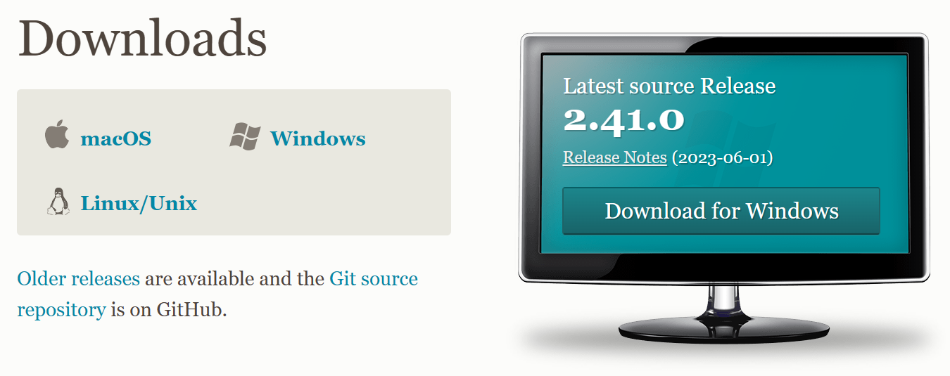
Setting up Git for PowerShell
Installing and configuring git - https://git-scm.com/downloads
git config --global user.name "FirstName LastName"
git config --global user.email "githubusername@users.noreply.github.com"
git config --global init.defaultBranch main
git config --global credential.helper store
Install posh-git - https://github.com/dahlbyk/posh-git
Install from the PowerShell Gallery
Add to profile - automatically get new prompt

Slide 4
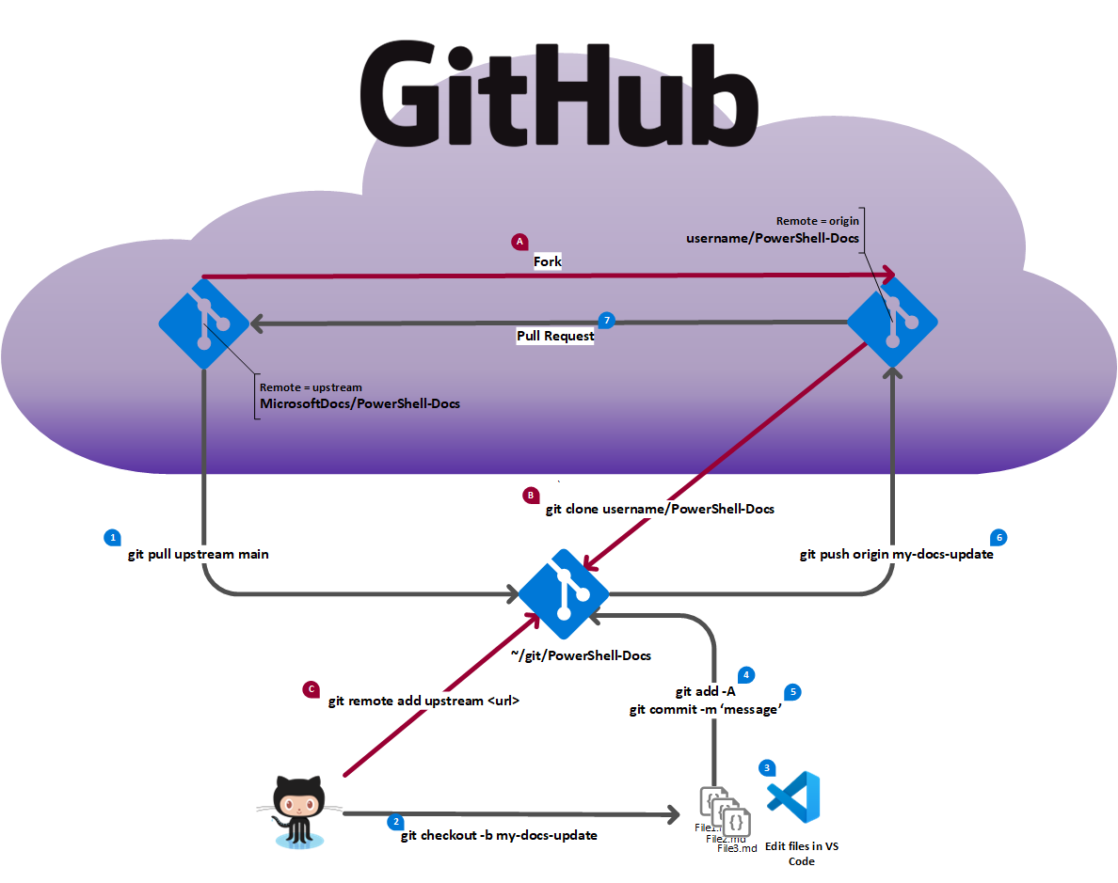
GitHub workflow for a forked repository

Slide 5
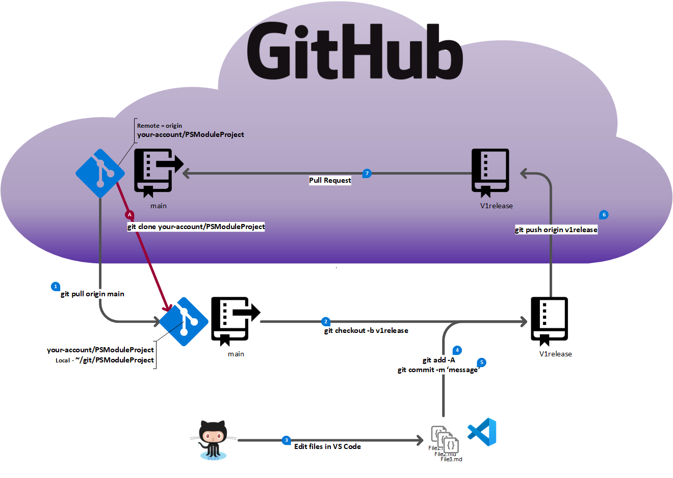
GitHub workflow for a single repository

