Slide 1

Unlocking the secrets of PowerShell Help

Slide 2

Sources of help
Order of precedence
.NET reflection
Gives basic syntax and parameter information when no help available
Comment-based help for scripts
Documentation lives in the source code of the script
MAML-based help
Static XML files that ship with the module
Can be updateable if you design for it
Only way to document cmdlets in compiled modules
Difficult to create

Slide 3

Features of Help
Search and filter
Control display verbosity
-Examples
-Detailed
-Full
by topic, parameter, component, role, functionality, category
Update-Help
Open in a browser
-Online
Get new content

Slide 4

Supporting –Online
Defined by the HelpUri property of the CmdletBinding attribute for your function
Value is a URL that points to the webpage containing the documentation
Becomes metadata in the markdown documentation
Compiled into the MAML
See about Functions CmdletBindingAttribute

Slide 5

Supporting Update-Help
Got to have the right combination
Difficult to create assets
MAML files containing help content and metadata
Package MAML files in a CAB/ZIP
Create a HelpInfo Xml file to match CAB/ZIP package
Host the files in a web service
Web service endpoint defined in HelpInfoUri property of the module manifest (.psd1)

Slide 6
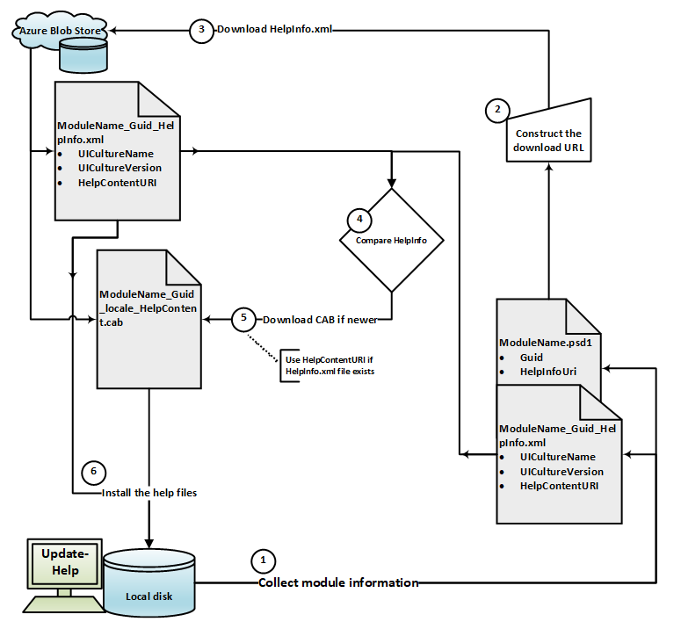
Update-Help process
Update-Help Logic flow
Get module information from module manifest and HelpInfo.xml (if available).
Construct the download URLs from the module info.
Download the HelpInfo.xml
Compare local help version to downloaded version.
If local version is older, download the HelpContent.cab.
Unpack the CAB and install the help files

Slide 7

Platypus – a strange looking mammal
One of five monotremes - mammals that lay eggs instead of giving birth to live young
One of the few species of venomous mammals - venomous spur on hind foot
It senses prey through electrolocation

Slide 8

PlatyPS – A tool for PowerShell MAML
History
Started as a hackathon project
Used in production but no code owner for years
Lots of bugs and quirks
Working on a rewrite but progress is slow
Why use it?
Easiest way to create and author help
Write in markdown – compile to MAML
Create package for Update-Help

Slide 9
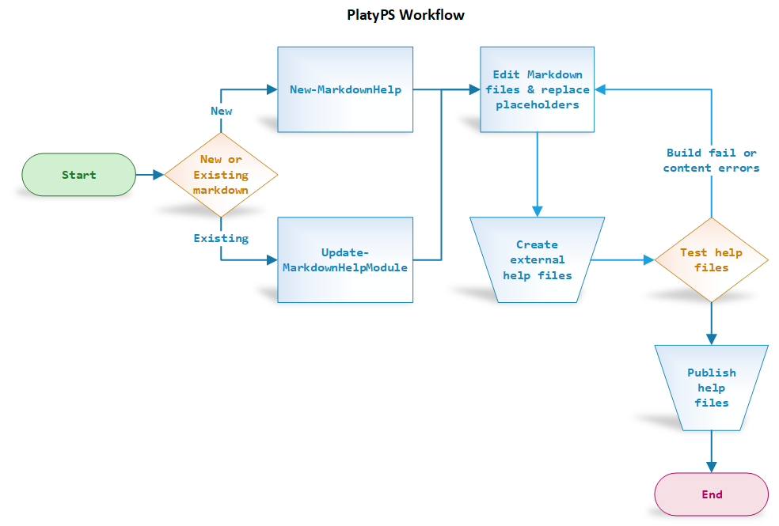
PlatyPS Workflow
Import-Module
Create new markdown files (cmdlet and module)
Edit markdown files to add descriptions, examples, links, notes, etc.
Compile markdown into MAML
Test the MAML
Create the module help CAB/ZIP and HelpInfo XML files.
Publish CAB and XML to web service

