Slide 1
C Programming:Part 3
Characters and Strings
File Processing
Exercise

Slide 2
Characters and Strings
A single character defined using the char variable type
Character constant is an int value enclosed by single quotes
  E.g. ‘a’ represents the integer value of the character a
A string is a series of characters
  String, string literals and string constants enclosed by double quotes

Slide 3
Defining characters and strings
Declaring and assigning a single character
  char c=‘a’;
Strings are arrays of characters
  A pointer to the first character in the array
  The last element of the string character array is the null termination charcter ‘\0’
  ‘\0’ Denotes theend of a string

Slide 4
Defining Strings
char node[]=“iceberg”;
char *nodeptr=“iceberg”;
char nodename[180];
For the first two definitions the null termination is added by the compiler

Slide 5
Character Input and Output
include <stdio.h>
int getchar(void)
  Input the next character from standard input, return it as an integer.
int putchar(int c)
  Display character stored in c
Also use printf and scanf with the %c format specifier

Slide 6
String Input and Output
char *gets(char *s)
  Input characters from standard inout in to the array s until newline or EOF character is reached. A NULL termination character is placed at the end of the string.
int puts(char *s)
  Display array of characters in s follow with a newline.
Also use printf and scanf with the %s format specifier

Slide 7
Code Example Using puts and getchar
char c, nodename1[80], nodename2[80];
int i=0;
puts("Enter a line of text");
while((c=getchar())!='\n')
nodename1[i++]=c;
nodename1[i]='\0';

Slide 8
Formatted String input and output
sprintf(char *s, const char *format, …..)
  Equivalent to printf with the exception that its output is stored in the array s specified in the sprintf function. The prototype for sscanf is ;
sscanf(char *s, const char *format, …).
  Equivalent to scanf reads input from the string s specified in the sscanf function.

Slide 9
sprintf and sscanf examples
char node[20], s2[80];
char s1[] ="Titania 3.78 7";
float fload, floadout;
int nusers, nusersout;
/*Using sscanf to read data from a string*/
sscanf(s1, "%s%f%d", node, &floadout, &nusersout);
sprintf(s2, "%s %f %d", node, fload, nusers);

Slide 10
Functions for Character Manipulation
library ctype.h
isdigit, isalpha, islower, isupper, toupper, tolower and isspace.
These functions can be used to perform conversions on a single character or for testing that a character is of a certain type.

Slide 11
String Conversion Functions
String conversion functions from the general utilities library stdlib
convert strings to float, int long int, double, long, and unsigned long data types respectively.
atof, atoi, atol, strtod, strtol, strtoul

Slide 12
String Manipulation
The string handling library string.h
provides a range of string manipulation functions for copying, concatenating, comparison, tokenizing and for identifying the occurrence and positions of particular characters in a string.
E.g. strcpy, strlen, strcmp and strtok.
See the examples

Slide 13
File Processing
file as a sequential stream of bytes with each file terminated by an end-of file marker
When a file is opened a stream is associated with the file
Streams open during program execution
  stdin
  stdout
  stderr

Slide 14
Sequential file management
Streams
  channels of communication between files and programs.
Range of functions for streaming data to files
  fprintf
  fscanf
  fgetc
  fputc

Slide 15
Opening a FILE
When opening a file it is necessary to declare a variable that will be used to reference that file, the standard library provides the FILE structure.
So a pointer to a FILE is declared using:
  FILE *myfile;
File opened using the function fopen
  returns a pointer to the opened file

Slide 16
fopen usage
if((myfile=fopen("myfilename", "w"))==NULL)
printf("The file could not be opened!\n");
else
{
file was opened and is read or written here
}

Slide 17
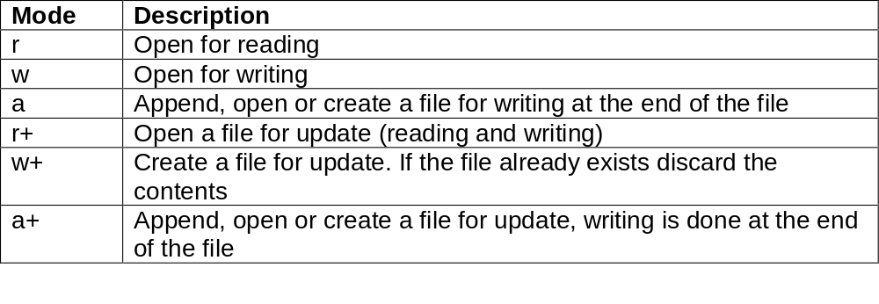
File open modes

Slide 18
Writing data using fprintf
fprintf(fileptr, “format specifiers”, data list);
  fprintf(mfptr, "%6d %20s %6d\n", iRunid, sName, iNode);
Closing the file
  fclose(mfptr);

Slide 19
Reading data using fscanf
fscanf(fileptr, “format specifiers”, data list);
while(!feof(mfptr))
{
printf("%6d %20s %6d\n", sim.id, sim.name, sim.node);
fscanf(mfptr, "%d%s%d", &sim.id, sim.name, &sim.node);
}

Slide 20
Random Access Files
Transaction processing systems
Individual records of same length accessed at random
fwrite
  Write fixed number of bytes to a file
fread
  Read fixed number of bytes from a file

Slide 21
Data declaration
Example data structure
  struct mydata
{ int index; float data;}
Typical declaration
  struct mydata blankdata={0, 3.141};

Slide 22
fwrite – Example call
fwrite(&blankdata, sizeof(struct mydata), 1, fileptr)
  Write data structure myblankdata
  Specify correct field size
  Specify number of data items to write (in this case 1)
  Provide a valid pointer to the file that is opened for writing

Slide 23
fread – Example call
fread(&blankdata, sizeof(struct mydata), 1, fileptr)
  Read data structure myblankdata
  Specify correct field size
  Specify number of data items to read (in this case 1)
  Provide a valid pointer to the file that is opened for reading

Slide 24
Practical Coding Example
Method for solving 1st order ODEs with well defined BC’s
Shooting Method
  Compile and run the code
  startshooting.c

Slide 25
fseek
Fseek sets file pointer to specific position in file
int fseek(FILE *stream, long int offset, int whence)
Offset is number of bytes from location whence
Whence has one of three values
  SEEK_SET (beginning of file)
  SEEK_CUR (current location)
  SEEK_END (end of file)
Example call
  fseek(myfileptr, sizeof(struct mydata)*(index-1),SEEK_SET);

