Slide 1
Introduction to Matlab
Deniz Savas and Mike Griffiths
Corporate Information and Computing Services
The University of Sheffield, U.K.
January 2015
d.savas@sheffield.ac.uk
m.griffiths@sheffield.ac.uk

Slide 2
Course Outline
Matlab Overview
Graphics and Data Visualisation
Debugging and Improving performance
Graphical User Interfaces

Slide 3
Matlab Overview
Introducing MATLAB
Supported Platforms
Introducing MATLAB data types
Working with matrices
MATLAB Scripts and Functions

Slide 4
What is Matlab?
MATrix LABoratory
State of the art Scientific Computation and Visualisation Tool,
Matlab has its own high level programming language,
It can be used as an application builder,
It is extendible via freely or commercially available Toolboxes.

Slide 5
Supported Platforms
Windows
Apple/Mac OSX
Unix/Linux platforms
MATLAB documentation is freely available at:
http://uk.mathworks.com/help/index.html
Other open-source Matlab clones are ;
  Octave http://octave.sourceforge.net/
  SciLab http://www.scilab.org/

Slide 6
Obtaining Matlab
Free for Students and Staff at The University of Sheffield through the Campus Matlab Site License
  Via Managed Windows Service
  Central HPC service (Iceberg)
Research staff and research students can down load and install the desktop version
  http://www.shef.ac.uk/cics/software/slmatlab/
Matlab Student version. Online purchasing or from Blackwell bookshop on campus for taught students and taught postgraduates
Further information at
  http://www.shef.ac.uk/wrgrid/software/matlab/overview

Slide 7
Introducing the Language Syntax
MATLAB Commands Syntax
Variables in MATLAB
Arrays & Matrices
Array Operations
Array Addressing
Built-in Functions
Data Types in MATLAB

Slide 8
Starting Matlab
On Windows
  Load Applications
  Start->Programs->Matlab->Matlab_xxx->Matlab_xxx
  ( where xxx is the version name )
On the Sheffield HPC cluster iceberg
  Open a secure shell client to iceberg and login
  Start an interactive session using, qsh
  Type matlab
Note: See http://www.shef.ac.uk/cics/research/hpc/using/access/browser for details of logging into iceberg.

Slide 9
The Matlab Desktop - Workspace
Main Workspace
  Command Window
  Command History
  Current Directory
  Variables Workspace
Help Window
Editor and debugging Window
Profiling Window
Graphics Editor Window

Slide 10
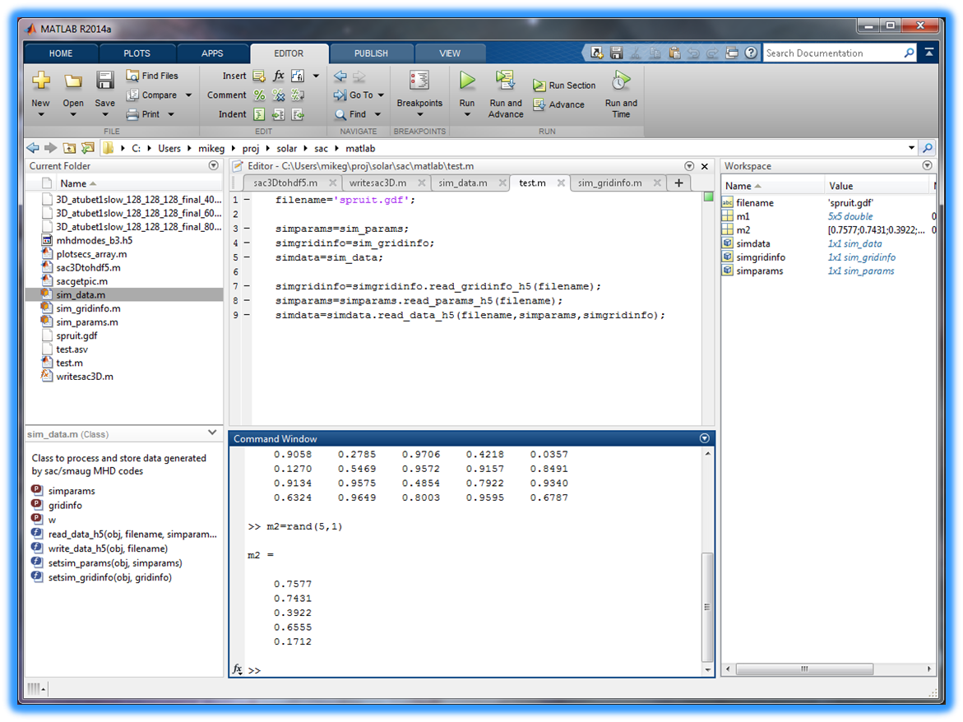

Directory Navigation
Search Help
Workspace

Slide 11
Startup Options for Matlab
Command-line Startup Options
  Interactive without display
    matlab –nodisplay
  Don’t display splash on startup
    matlab –nosplash
  Start without Java interface ( GUI's will not work )
    matlab -nojvm
Customizing actions to take when starting/stopping
  Customise using template files named startupsav.m and finishsav.m in the directory ../toolbox/local

Slide 12
General Syntax Rules
Matlab is case sensitive.
COMMENTS: Any line starting with % is a comment line and not interpreted. Similarly comments can be added to the end of a line by preceding them with the % sign
CONTINUATION LINES: A statement can be continued onto the next line by putting … at the end of the line
More than one statement can be put into a single line by separating them with commas , or semicolons ; .

Slide 13
scalar variables
4.0*atan(1.0) ----> displays result
pi ----> pi is a built in constant
a = 1.234 ----> define (a) and display result
b = 2.345 ; ---> define (b), but do not display
c = a*b; ---> multiplication
d = 1.2+3.4i ----> d is a complex number
e = a+j*b ----> e “ “
A = 4.55 -----> case is significant (A is not a )
who or whos get a list of so far defined vars.
Note: Avoid names longer than 31 chars.

Slide 14
Built in Scalar variables
pi
i and j : sqrt(-1) these are used for complex numbers notation
eps : floating point smallest positive non-zero number
realmin : smallest floating point number
realmax : largest floating point number
Inf : infinity
NaN : Not-a-number
It is important to note that these are not reserved words therefore it is possible to re-define their values by mistake.
DO NOT RE-DEFINE THESE VARIABLES

Slide 15
Practice Session 1
Getting Started
  Starting matlab
  Familiarisation with the layout
  Investigate help features.
Follow “Getting Started” instructions on the exercises sheet.
Investigate each variable on the Workspace Window
Now keep your Matlab session on so as to practice new concepts as they are presented.

Slide 16
Arrays & Matrices
r = [ 1 6 9 2 ] → a row vector
c = [ 3 ; 4 ; 5 ; 7 ] → a column vector
d = [ 4 5 6 ; 7 8 9 ; 5 3 2; 1 2 3 ] →4by3 matrix
A= rand(1,5) → 1 row of 5 columns containing random numbers.

Slide 17
Array Operations
Given r as (1 by n) (row vector) and c as
(n by 1) (column vector).
r*c --------> inner product ( single number )
c*r --------> a full matrix
constant*matrix is an array of same
or -------> dimensions where each
matrix*constant element is multiplied
by a constant

Slide 18
Maths Operations
Symbols + , - , * , / , \ , ^
are all matrix operation-symbols.
Sometimes we need to perform arithmetic ‘array’ rather than matrix operations between the corresponding elements of arrays treating them as sets of numbers rather than matrices.
This can be achieved by using the . (dot) symbol before the operation symbol
such as .* or ./ .

Slide 19
Operations continued …
If c and d are two vectors of same dimensions
then;
e = c.*d defines a vector e of same size ‘as c and d’ with its elements containing the result of the multiplication of the corresponding elements.
e= c./d is the same but division of elements.
e=c.\d (left division) (d divided by c)

Slide 20
Matrix Constructs
Explicit:
A =[ 1 2 3;4 5 6 ; 7 8 9]
Constructed from vectors:
A = [ a ;b ;c ] where a,b,c are row vectors
of same length or column vectors
A = [ a b c ] where a,b,c are column vectors
of same length or row vectors
Constructed via Colon Notation:
A = [(1:3);(4:6);(7:9) ]

Slide 21
Matrix Constructs continued ...
Generated via a standard function call
N = 10 ;
B = ones(N); N by N matrix of all 1’s
ID = eye(N); N by N identity matrix
D = magic(7); magic squares matrix
E = rand(4,6); 4 by 6 matrix with random
distributed elements
between 0.0 and 1.0

Slide 22
Matrix Subsections
Let A be a 4 by 6 full matrix:
A( 1:3 , 2:4 ) -----> subsection with row 1 ,2, 3
and columns 2,3,4. I.e. a 3by 3 matrix.
A( 1:3 , : ) a 3 by 6 matrix which is the first
3 row of A matrix
A( 4:-1:1 , : ) same size as A but rows are
arranged in reverse order.
QUESTION:
What is A( : , 6:-1:1 ) ?

Slide 23
Matrix Assignments
Examples: Let A be 4 by 6 matrix
B = A(1:4,6:-1:4) ----> B becomes 4 by 3
A = A’ A is replaced by its transpose.
A = [ B C] B and C must have the same number of rows.
A = [ B ; C] B and C must have the same number of columns

Slide 24
Matrix Assignments continued ...
Examples: Let A be 4 by 6 matrix
A(4,:) = [ 1 2 3 4 5 6 ] ---> redefine 4th row
A(5,:) = [ 5 4 6 7 8 9 ] ---> add a 5th row
A(:,3) = [ 1 ; 2 ; 3 ; 4] ----> redefine 3rd column

Slide 25
shape of matrices
What is the size of my matrix ?
whos variable_name will give details.
size function will return the dimensions
size (A ) will return the dimensions of matrix
A as two integers.
example usage; [ m n ] = size ( A)
reshape function can be used to re-shape a matrix. I.e. reshape(A,m,n) will reorganize elements of A into a new m-by-n matrix
example: B = reshape( A , 4 , 6 )

Slide 26
Matrix Division
Matrix inversion function is inv( )
If A is a non-singular square matrix then
A\B means inv(A)*B
A/B means A*inv(B)
Therefore ;
Solution of A*X = B is A\B
Solution of X*A = B is B/A

Slide 27
Solution of Linear equations
Example: Solve the following set of linear
equations;
2x + 3y + z = 17
x + 4y +2z = 22
x + y +5z = 25

Slide 28
Linear Eqn. cont..
A = [ 2 3 1 ; 1 4 2 ; 1 1 5 ] ;
b = [17 ; 22 ; 25] ;
x = A\b ----> will yield the answer as 2;3;4
C=inv(A)
x = C*b will also work.
you may make sure that the A matrix is not ill
conditioned by finding out its determinant
first: det(A)
Notes:
Zero value for determinant occurs when matrix is ill conditioned occurs for so called singular matrices or matrices with very small values and requiring much higher precision

Slide 29
Exercises
From the handout solve the following problems
1.1-1.8
2.1-2.5

Slide 30
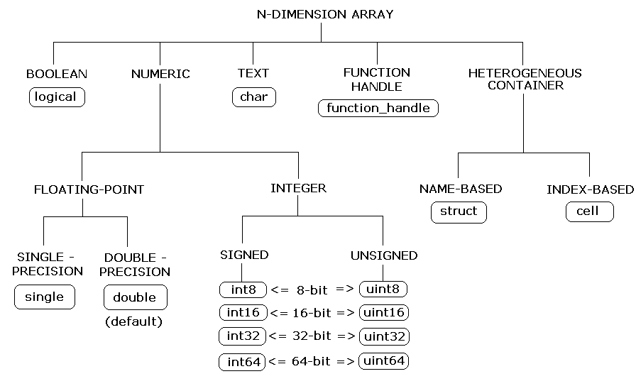
Matlab data types

Slide 31
Character Strings
A Character string is simply a 1 by n array of characters.
Example: name=‘tommy’
friends = [ ‘tommy’ ; ’billy’ ; ‘tim ‘ ]
Note that all items must have the same length by padding them with blanks where necessary. This ensures that the matrix convension is not violated.
Where as;
friend = [ ‘Alexandra’ , ‘jim’ ]
is a valid construct as the resultant structure is simply an array. In this case friend(3) is ‘e’ for example.

Slide 32
Multi-dimensional arrays
These are arrays with more than 2 subscripts
They can be generated by using one of the following functions;
zeros , ones , rand , randn
Example: R = zeros ( 10,20,20)
A = ones( 10,20)
R(:,:,1) = A

Slide 33
Structures
These are Matlab arrays with elements accessed by field names. They are useful for organizing complex data with a known structure. Structures can be nested.
Examples:
Creating a structure:
order.number= 105; order.year=2003; Order.title=‘Smith’;
order(2)= struct( ‘number’,207,’year’,2003, …
‘title’,’Jeff Brown’)
Deleting fields:
modorder = rmfield( order , ‘year’ );

Slide 34
Cell Arrays
Cell arrays are Matlab arrays whose individual elements are free to contain different types & classes of data. These elements need not ‘and usually are not’ of same type, size or shape.
They are useful for storing data that can not otherwise be organized as arrays or structures. Cell arrays can be nested.
Example
Create a 4by2 cell matrix. Each cell can contain any type and size of data:
C = cell(4,2)
Create (4by1)cell array B and assign values:
B = { [1,2] , [ 4 5 ; 5 6] , 0.956 , ‘range values’}
Build a (1by5) cell-array M containing 5 elements, one cell at a time:
M{1} = 1 ; M{2}= [1 2 3] ; M{3} =[1 2;34] ;
M{4} = rand(10,10) ; M{5}=‘title’ ;

Slide 35
Practice Session
Structures & Cell Arrays
Perform exercises 3
on the exercises sheet.

Slide 36
Outline
Writing MATLAB Functions and Scripts
Relational Operations
Program Control Statements

Slide 37
Matlab Scripts and Functions
A sequence of matlab commands can be put into a file which can later be executed by invoking its name. The files which have .m extensions are recognised by Matlab as Matlab Script or Matlab Function files.
If an m file contains the keyword function at the beginning of its first line it is treated as a Matlab function file.
Functions make up the core of Matlab. Most of the Matlab commands “apart from a few built-in ones” are in fact matlab functions.

Slide 38
Scripts vs Functions
Script | Function
Works in Matlab Workspace ( all variables available) | Works in own workspace (only the variables passed as arguments to functions are available ) ( exception: global )
Any variable created in a script remains available upon exit | Any variable created in a function is destroyed upon exit exception: persistent
As Matlab workspace is shared communication is possible via the values of variables in the workspace. | Only communications is via parameters passed to functions and value(s) returned via the output variables of functions.
Any alteration to values of variables in a script remains in effect even after returning from that script. | Parameters are passes by reference but any alterations made to these parameters in the called function initiates creation of a copy. This ensures that input parameters remain unaltered in the calling function.

Slide 39
Variables in Functions
Function returns values (or alters values) only via their return values or via the global statement.
Functions can not alter the value of its input arguments. For efficiency reasons, where possible, arguments are passed via the address and not via value of the parameters.
Variables created within the function are local to the function alone and not part of the Matlab workspace ( they reside in their own function-workspace)
Such local variables cease to exist once the function is exited, unless they have been declared in a global statement or are declared as persistent.
Global variables: Global statement can be used in a function .m file to make variables from the base workspace available. This is equivalent to /common/ features of Fortran and persistent features of C.
Global statement can be used in multiple functions as well as in top level ( to make it available to the workspace )
Notes:
58

Slide 40
The function-definition line
General Format:
function return_vars = name ( input_args )
Matlab functions can return no value or many values, each of the values being scalars or general matrices.
If a function returns no value the format is;
function name ( input_args)
If the function returns multiple values the format is;
function [a,b,c ] = name ( input_args )
If the function name and the filename ‘where the function resides are not the same the filename overrides the function name.

Slide 41
The H1 ( heading line) of function files
Following the function definition line, the next line, if it is a comment is called the H1 line and is treated specially.
Matlab assumes it to be built-in help on the usage of that function.
Comment lines immediately following the H1 comment line are also treated to be part of this built-in help ( until a blank line or an executable statement is encountered)
help function-name command prints out these comment lines, but the lookfor command works only on the first (H1) comment line.

Slide 42
An example function file.
function xm = mean(x)
% MEAN : Calculate the mean value.
% For vectors: returns mean-value.
% For matrices: returns the mean value of
% each column.
[ m , n ] = size ( x );
if m = = 1
m = n ;
end
xm = sum(x)/m;
Notes:
57

Slide 43
Function Arguments
Functions can have variable numbers of input and output arguments. As well as each argument being a multi-dimensional array.
Size of the input argument arrays can be found by the use of the size function.
The actual numbers of input arguments when the function was called can be found by using the nargin function
Similarly the actual number of output arguments expected at the time of the call can be deduced by using the nargout function.

Slide 44
Summary of Program Control Statements
Conditional control:
  if , else , elseif statements
  switch statement
Loop control :
  for loops
  while loops
  break statement
  continue statement
Error Control: try … catch … end
return statement
Notes:
40

Slide 45
Relational & Logical Operations
RELATIONAL OPERATIONS
Comparing scalars, vectors or matrices.
< less than
<= less than or equal to
> greater than
>= greater than or equal to
= = equal to
~ = not equal to
Result is a scalar, vector or matrix of of same size and shape whose each element contain only 1 ( to imply TRUE) or 0 (to imply FALSE ) .

Slide 46
RELATIONAL OPERATIONS
CONTINUED
Example 1:
A = magic(6) ; A is 6x6 matrix of magic numbers.
P = ( rem( A,3) = = 0 ) ; Elements of P divisible by 3 are set to 1
while others will be 0.
Example 2: Find all elements of an array which are greater than 0.7 and set them to 0.5.
A = rand(12,1) ; ---> a vector of random no.s
p = a >= 0.7 ; ----> p will be 1’s and 0’s .
b = A(find(p>0))=0.5; ----> only the elements of A which
are >=0.7 will be set to 0.5.
Notes:
37

Slide 47
Logical Operations
These are : & (meaning AND) | (meaning OR) ~ (meaning NOT)
Operands are treated as if they contain logical variables by assuming that 0=FALSE NON-ZERO=TRUE
Example : a = [ 0 1 2 0 ] ; b = [ 0 -1 0 8 ] ;
c=a&b will result in c = [ 0 1 0 0 ]
d=a|b will result in d= [ 0 1 1 1 ]
e=~a will result in e= [ 1 0 0 1 ]
There is one other function to complement these operations which is xor meaning “Exclusive-OR”. Therefore;
f = xor( a , b ) will return f= [ 0 0 1 1 ]
( Note: any non-zero is treated as 1 when logical operation is applied)

Slide 48
if statements
if logical_expression
statement(s)
end
or
if logical_expression
statement(s)
else
statement(s)
end
or ...
Notes:
41

Slide 49
if statement examples
if a < 0.0
disp( 'Negative numbers not allowed ');
disp(' setting the value to 0.0 ' );
a = 0.0 ;
elseif a > 100.0
disp(' Number too large' ) ;
disp(' setting the value to 100.0 ' );
a = 100;
end
NOTES: In the above example if ‘a’ was an array or matrix then the condition will be satisfied if and only if all elements evaluated to TRUE

Slide 50
Conditional Control
Logical operations can be freely used in conditional statements.
Example:
  if (attendance >= 0.90) & (grade_average >= 50)
  passed = 1;
  else
  failed = 1;
  end;
To check the existence of a variable use function exist.
  if ~exist( ‘scalevar’ )
  scalevar = 3
  end

Slide 51
for loops
this is the looping control (similar to repeat, do or for constructs in other programming languages):
SYNTAX:
for v = expression
statement(s)
end
where expression is an array or matrix.
If it is an array expression then each element is assigned
one by one to v and loop repeated.
If matrix expression then each column is
assigned to v and the loop repeated.
for loops can be nested within each other
Notes:
43

Slide 52
for loops continued ...
EXAMPLES:
sum = 0.0
for v = 1:5
sum = sum + 1.0/v
end
below example evaluates the loop with
v set to 1,3,5, …, 11
for v = 1:2:11
statement(s)
end
Notes:
44

Slide 53
for loops examples
w = [ 1 5 2 4.5 6 ]
% here a will take values 1 ,5 ,2 so on..
for a = w
statement(s)
end
A= rand( 4,10)
% A is 4 rows and 10 columns.
% Below the for loop will be executed 10 times ( once for each column) and during each iteration v will be a column vector of length 4 rows.
for v = A
statement(s)
end
Notes:
45

Slide 54
Importing data into Matlab
work with an anonymised biomedical data set from the 2007-2008 US National Health and Nutrition Examination Survey (NHANES). This data is freely available at: http://www.cdc.gov/nchs/nhanes/nhanes_questionnaires.htm
  Using the scenario casestudies/health
Use the import tool
  Import data button from the home panel of the workbench
  uiimport command
Use edit to inspect the file
Import commands for tabular data
  load, csvread, readtable, xlsread
Notes:
40
The idea behind choosing this dataset is that delegates from all cultural and language backgrounds should be able to relate to this data. Measurements such as arm circumference, height, weight, age are applicable to everyone.

Slide 55
Importing data into Matlab: example
% Inspect the data file:
  edit(‘casestudies/health/MedicalData.txt')
Read the data
  medData = readtable('casestudies/health/MedicalData.txt', 'Delimiter', '\t');
Why are people so old? They're not really, it's just that Age is recorded in months. So we might want to convert the data.
Table variables are accessed using the dot syntax (similar to structures).
  medData.Age = medData.Age/12; % Note: age is recorded in months.
Plot some data
  scatter(medData.Age, medData.Pulse)
Example try importing the field.dat file in the course directory
  Hint: use import tool or use load from the command line
Notes:
40
The idea behind choosing this dataset is that delegates from all cultural and language backgrounds should be able to relate to this data. Measurements such as arm circumference, height, weight, age are applicable to everyone.

Slide 56
while loops
while loops repeat a group of statements under the control of a logical condition.
SYNTAX:
while expression
:
statement(s)
:
end
Notes:
46

Slide 57
while loops continued ..
Example:
n = 1
while prod(1:n) < 1E100
n= n + 1
end
The expression controlling the while loop can be an array or even a matrix expression in which case the while loop is repeated until all the elements of the array or matrix becomes zero.
Notes:
47

Slide 58
Practice Session 5
Try exercise 5 on the handout.
Notes:
38

