Slide 1
MATLAB
Mex and the Matlab Compiler
UNIVERSITY OF SHEFFIELD
CiCS DEPARTMENT
Deniz Savas & Mike Griffiths
JULY.2008

Slide 2
PART 6TOPICS
Using Mex
The Matlab Compiler

Slide 3
Using MEX to Build Faster Applications
Motivation
  Matlab excellent for prototyping
  For raw speed not as good
Set up MEX
  mex -setup
Compile c routines using mex
  Simple examples
Basics of Mex programming
  Need to be a C programmer

Slide 4
Example - timestwo
Example to multiply a scalar by 2, timestwo.c
Compile the mex file
  mex timestwo.c
Run the mex file takes as input one scalar
  timestwo(3)

Slide 5
Example xtimesy
Example multiply a matrix by a scalar
Compile
  mex xtimesy.c
Run the example the matlab function takes as input a scalar and a matrix
  v1=rand(2,2)
  v2=xtimesy(5.0,v1)

Slide 6
Example demo.cpp
Take as input two matrices
  Add a scalar fixed scalar to one (not input)
  Take the square of the second matrix
  Display each of the elements of the first matrix
Compile
  mex demo.cpp
Run the demo
  v1=rand(2,2)
  v2=rand(3,3)
  [vo1,vo2]=demo(v1,v2)

Slide 7
What does Matlab Compiler do ?
Compiles ‘builds’ a Matlab application into a stand alone software.
It can be used to ;
  Package Matlab applications as a stand-alone executable (.exe) or dynamic link library (.dll or .so )
  Distribute these applications as independent ( free to use) software that does not require installing Matlab at the destination computer.
  Incorporate Matlab developed code into programs written in other languages.
  Internally, Matlab Compiler makes use of the MEX ‘external-interface’ features of Matlab that are used for linking external Fortran and C programs with Matlab.

Slide 8
How do I use the Matlab Compiler ?
COMMAND LINE: Matlab compiler can be accessed by using the mcc ( Matlab Compiler Command ) from the Matlab command line.
GUI : It can also be used in a GUI environment by using the deployment tool. Via Desktop → Deployment Tool
or
by typing deploytool at the command line.
GUI method is recommended as it is intuitive and easier to use.
The GUI method, invokes the mcc command-line methods in the background as and when it is needed.

Slide 9
Compiler Deployment
Terminology:
Matlab Compiler (mcc) : Matlab utility that automatically converts a Matlab script (.m file ) into a C/C++ source file ( .c / .c++ / .cpp )
Compiler : A platform dependent C/C++ compiler compatible with Matlab, such as Lahey, g++, Intel or Microsoft compilers.
Building an Application: The act of generating a stand-alone (.exe) or Dynamic Link Library (.dll or .so ) from one or more .m or .c or .c++ source files.
Deployment : Running the built application on another machine that uses the same platform ( ie. Windows/Linux/Mac 64bit/32bit )
MCR : Matlab Compiler Runtime. Software components needed to run mcc generated software. This is independent of your own software but dependent on platform.

Slide 10
Overview
Your Matlab Script (.m)
The Matlab Compiler
Stand Alone executable (.exe)
Shared Library ( .dll or .so )

Slide 11
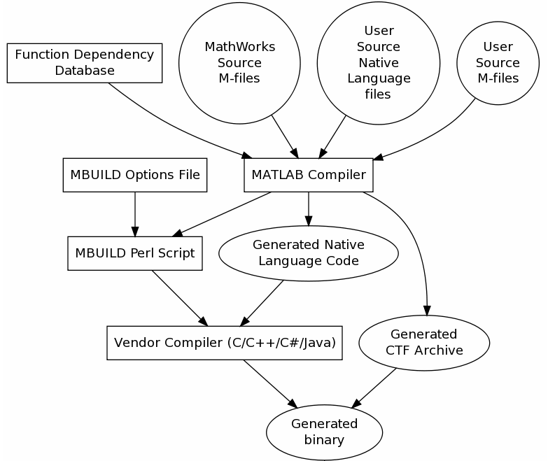
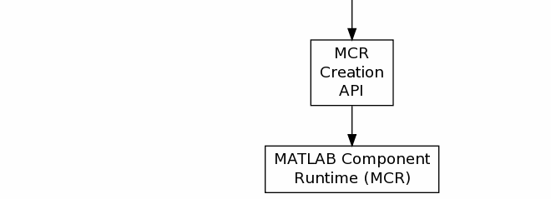
How does the Matlab Compiler Work

Slide 12
Tasks performed internally by the Matlab Compiler
Parse the command line
Performs dependency analysis to create a CTF ( Component Technology File Archive )
Check to ensure all dependencies are satisfied
Auto generates C/C++ code by translating the users Matlab script file(s).
Auto generates target specific wrapper code files
Passes all files that needs to be compiled ‘including any MEX files that are provided’ to the native compiler.
Generates the required software item ( i.e. .exe , .dll , .so , .jar file )
Note that most of the internal Matlab functions are not translated but simply referenced from the Matlab Compiler Runtime Library (MCR) (in the form of .DLL or .so) . That is why MCR is needed.

Slide 13
Practice – using the matlab compiler
Using mex compile and run the example c programs
  xtimesy.c
  demo.cpp
  timestwo.c
The examples are in the mex folder of the matlab_examples
Adapt the program timestwo.c so that it adds two scalar values

