Slide 1

Introduction to Matlab
Deniz Savas and Mike Griffiths
Corporate Information and Computing Services
The University of Sheffield, U.K.
d.savas@sheffield.ac.uk
m.griffiths@sheffield.ac.uk

Slide 2
Part 1 - Contents
Introducing Matlab
Supported Platforms
Introducing Matlab data types
Working with matrices
Matlab Scripts and functions

Slide 3
What is Matlab?
MATrix LABoratory
State of the art Scientific Computation and Visualisation Tool,
Matlab has its own high level programming language,
It can be used as an application builder,
It is extendible via freely or commercially available Toolboxes.

Slide 4
Supported Platforms
Windows ( All flavours)
Apple/Mac OSX
Unix/Linux platforms
Matlab documentation is freely available at:
http://www.mathworks.com/access/helpdesk/help/helpdesk.html
Other open-source Matlab clones are ;
  Octave http://octave.sourceforge.net/
  SciLab http://www.scilab.org/

Slide 5
Starting Matlab
From Windows
  Load Applications
  Start->Programs->Matlab->Matlab_xxx->Matlab_xxx
  ( where xxx is the version name )
On the HPC cluster
  Open a web browser and open
    http://www.shef.ac.uk/wrgrid/using/access
    follow the link “Connect to Iceberg Now”
  Start the Sun Global Desktop (click yes when asked for permissions)
  Select matlab from the Iceberg Applications Menu

Slide 6
The Matlab Desktop - Workspace
Main Workspace
  Command Window
  Command History
  Current Directory
  Variables Workspace
Help Window
Editor Window
Profiling Window
Graphics Editor Window

Slide 7
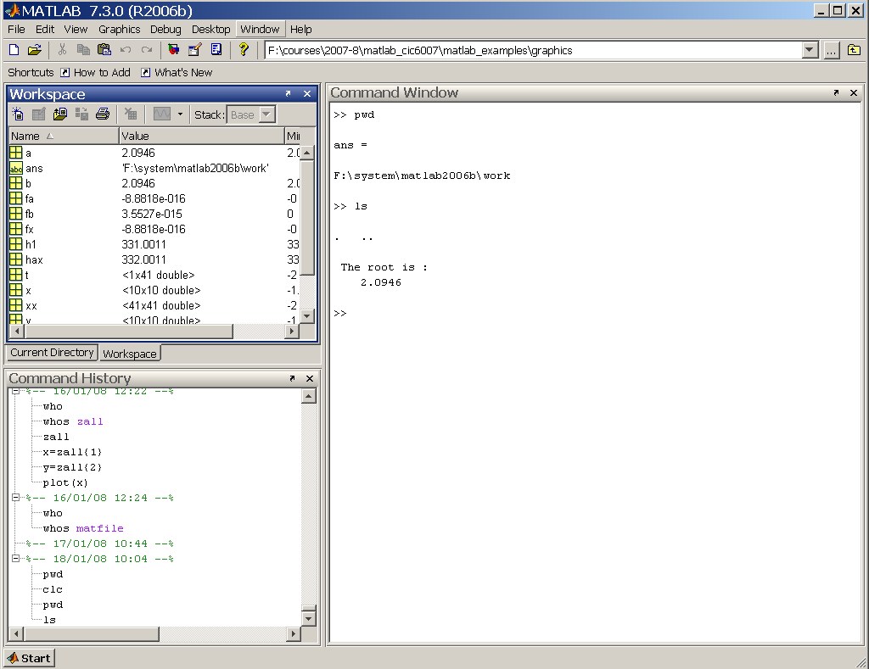
Get Help
View/Change Directory
Undock Window
Use Tabs
To switch
Quick Access

Slide 8
Starting up Matlab
Startup Options
  Interactive without display
    matlab –nodisplay
  Don’t display splash on startup
    matlab –nosplash
  Start without Java interface ( GUI's will not work )
    matlab -nojvm
Customisation
  Customise using template files named startupsav.m and finishsav.m in the directory ../toolbox/local

Slide 9
Introducing the language syntax
Variables
Matrices , Vectors
Built-in functions
Control Statements
Program Scripts, m-files

Slide 10
General Syntax Rules
Matlab is case sensitive.
COMMENTS: Any line starting with % is a comment line and not interpreted. Similarly comments can be added to the end of a line by preceding them with the % sign
CONTINUATION LINES: A statement can be continued onto the next line by putting … at the end of the line
More than one statement can be put into a single line by separating them with commas , or semicolons ; .

Slide 11
scalar variables
4.0*atan(1.0) ----> displays result
pi ----> pi is a built in constant
a = 1.234 ----> define (a) and display result
b = 2.345 ; ---> define (b), but do not display
c = a*b; ---> multiplication
d = 1.2+3.4i ----> d is a complex number
e = a+j*b ----> e “ “
A = 4.55 -----> case is significant (A is not a )
who or whos get a list of so far defined vars.
Note: Avoid names longer than 31 chars.

Slide 12
Built in Scalar variables
pi
i and j : sqrt(-1) these are used for complex numbers notation
eps : floating point smallest positive non-zero number
realmin : smallest floating point number
realmax : largest floating point number
Inf : infinity
NaN : Not-a-number
It is important to note that these are not reserved words therefore it is possible to re-define their values by mistake.
DO NOT RE-DEFINE THESE VARIABLES

Slide 13
A scalar variables is really a (1by1) matrix
Matlab is a matrix orientated language. What we can think of as a scalar variable is stored internally simply as a (1 by 1) matrix. Also Matlab matrices can take on complex values if the assignment necessitates it.

Slide 14
Practice Session 1
Getting Started
  Starting matlab
  Familiarisation with the layout
  Investigate help features.
Follow “Getting Started” instructions on the exercises sheet.
Investigate each variable on the Workspace Window
Now keep your Matlab session on so as to practice new concepts as they are presented.

Slide 15
Arrays & Matrices
r = [ 1 6 9 2 ] → a row vector
c = [ 3 ; 4 ; 5 ; 7 ] → a column vector
d = [ 4 5 6 ; 7 8 9 ; 5 3 2; 1 2 3 ] →4by3 matrix
A= rand(1,5) → 1 row of 5 columns containing random numbers.

Slide 16
Array Operations
Given r as (1 by n) (row vector) and c as
(n by 1) (column vector).
r*c --------> inner product ( single number )
c*r --------> a full matrix
constant*matrix is an array of same
or -------> dimensions where each
matrix*constant element is multiplied
by a constant

Slide 17
Array Addressing
Direct Index Addressing
x(3) → reference to 3rd element of x
x( [6 1 2] ) → 6th , 1st and 2nd
elements of x array.
Array Section Referencing (Colon notation)
array( first:last) or array(first:increment:last)
e.g. x(1:5) → elements 1, 2, 3, 4 and 5 of x
x(4:-1:1) → elements 4 , 3 , 2 and 1 of x

Slide 18
Array Addressing Continued
Addressing via an index array
d = [ 11.1 12.2 13.3 14.4 15.5 16.6 ];
e = [ 4 2 6] ;
f = d(e)
will result in setting f =[ 14.4 12.2 16.6 ]

Slide 19
Find function
Find returns the indices of the vector that are non-zero. When used with relational operators it will return the indices of a vector satisfying a given condition.
EXAMPLE:
ind = find( A > pi )

Slide 20
The use of find function
If a = [ 1.3 5.6 7.8 2.0 4.0 3.8 2.5]
k = find(a < 3.0) will return k=[1 4 7]
and c=a(k) will be a new vector made up of the 1st ,4th and 7th elements of a in that order.
Conclusion: Results of the find() function can be used as an index vector to select or eliminate data which meets a certain criteria.
Notes:
39

Slide 21
Array Constructs
Explicit :
x = [ 0.1 0.5 6.3 3.2 5.6 ];
Colon notation:
(first_value:increment:last_value)
x = 0 : 0.1 : 5.0;
Via the linspace function:
linspace(first,last,number_of_elements)
x = linspace( 1.0 , 20.0 , 10 );

Slide 22
Operations
Symbols + , - , * , / , \ , ^
are all matrix operation-symbols.
Sometimes we need to perform arithmetic ‘array’ rather than matrix operations between the corresponding elements of arrays treating them as sets of numbers rather than matrices.
This can be achieved by using the . (dot) symbol before the operation symbol
such as .* or ./ .

Slide 23
Operations continued …
If c and d are two vectors of same dimensions
then;
e = c.*d defines a vector e of same size ‘as c and d’ with its elements containing the result of the multiplication of the corresponding elements.
e= c./d is the same but division of elements.
e=c.\d (left division) (d divided by c)

Slide 24
Matrix Constructs
Explicit:
A =[ 1 2 3;4 5 6 ; 7 8 9]
Constructed from vectors:
A = [ a ;b ;c ] where a,b,c are row vectors
of same length or column vectors
A = [ a b c ] where a,b,c are column vectors
of same length or row vectors
Constructed via Colon Notation:
A = [(1:3);(4:6);(7:9) ]

Slide 25
Matrix Constructs continued ...
Generated via a standard function call
N = 10 ;
B = ones(N); N by N matrix of all 1’s
ID = eye(N); N by N identity matrix
D = magic(7); magic squares matrix
E = rand(4,6); 4 by 6 matrix with random
distributed elements
between 0.0 and 1.0

Slide 26
Matrix Subsections
Let A be a 4 by 6 full matrix:
A( 1:3 , 2:4 ) -----> subsection with row 1 ,2, 3
and columns 2,3,4. I.e. a 3by 3 matrix.
A( 1:3 , : ) a 3 by 6 matrix which is the first
3 row of A matrix
A( 4:-1:1 , : ) same size as A but rows are
arranged in reverse order.
QUESTION:
What is A( : , 6:-1:1 ) ?

Slide 27
Matrix Assignments
Examples: Let A be 4 by 6 matrix
B = A(1:4,6:-1:4) ----> B becomes 4 by 3
A = A’ A is replaced by its transpose.
A = [ B C] B and C must have the same number of rows.
A = [ B ; C] B and C must have the same number of columns

Slide 28
Matrix Assignments continued ...
Examples: Let A be 4 by 6 matrix
A(4,:) = [ 1 2 3 4 5 6 ] ---> redefine 4th row
A(5,:) = [ 5 4 6 7 8 9 ] ---> add a 5th row
A(:,3) = [ 1 ; 2 ; 3 ; 4] ----> redefine 3rd column

Slide 29
shape of matrices
What is the size of my matrix ?
whos variable_name will give details.
size function will return the dimensions
size (A ) will return the dimensions of matrix
A as two integers.
example usage; [ m n ] = size ( A)
reshape function can be used to re-shape a matrix. I.e. reshape(A,m,n) will reorganize elements of A into a new m-by-n matrix
example: B = reshape( A , 4 , 6 )

Slide 30
Matrix Division
Matrix inversion function is inv( )
If A is a non-singular square matrix then
A\B means inv(A)*B
A/B means A*inv(B)
Therefore ;
Solution of A*X = B is A\B
Solution of X*A = B is B/A

Slide 31
Solution of Linear equations
Example: Solve the following set of linear
equations;
2x + 3y + z = 17
x + 4y +2z = 22
x + y +5z = 25

Slide 32
Linear Eqn. cont..
A = [ 2 3 1 ; 1 4 2 ; 1 1 5 ] ;
b = [17 ; 22 ; 25] ;
x = A\b ----> will yield the answer as 2;3;4
C=inv(A)
x = C*b will also work.
you may make sure that the A matrix is not ill
conditioned by finding out its determinant
first: det(A)
Notes:
Zero value for determinant occurs when matrix is ill conditioned occurs for so called singular matrices or matrices with very small values and requiring much higher precision

Slide 33
Functions -applied to Matrices
Most of built-in, ‘what looks like scalar’ functions
can also be applied to vectors or matrices;
For example if A is a matrix then sin(A)
will return a new matrix of same dimensions
with its elements being the sin( ) of the
corresponding elements of A.

Slide 34
Practice Session-2
Perform exercises using matrices
on the exercise sheet ( 2A and 2B).

Slide 35
Other Matlab Data types
DATA TYPES
Numeric
  Complex,
  double precision
  Single precision
  Integer
Boolean
Character String
Java Classes
User Defined Matlab Classes
ORGANIZATIONAL ATTRIBUTES
Multi-dimensional Matrices
Sparse Matrices
Cell Arrays
Structures & Objects

Slide 36
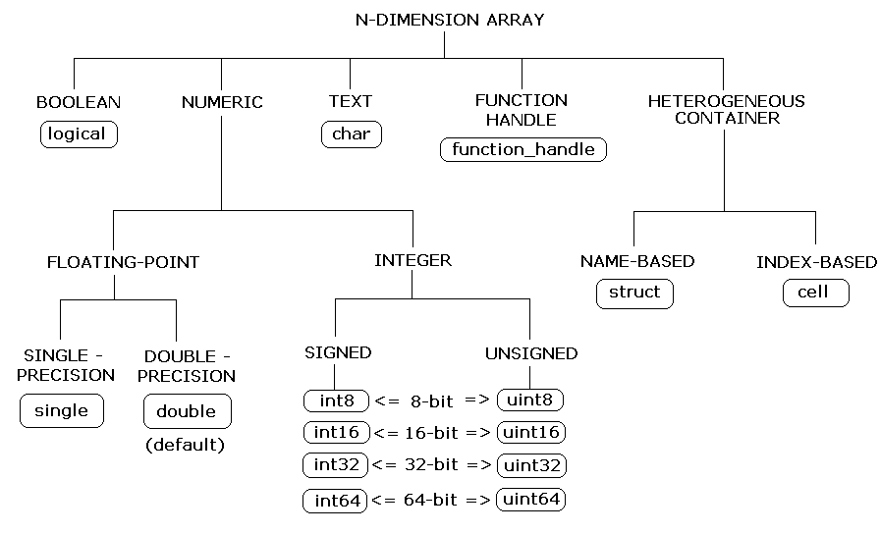
Matlab data types

Slide 37
Complex double precision matrices
This is the default storage mode.
A scalar is really a 1x1 matrix with the imaginary part set to zero.
Any expression which evaluates to a complex value returns complex results automatically
The following are two methods of expressing a complex number;
  X = complex( 1.2 , 3.4 )
  X = 1.2+3.4i
  Warning i and j has this special meaning which will be lost if you name your variables as i and j . So don’t !
Matlab keeps track of complex vs real issues and does the necessary conversions. Therefore you need not worry about it.

Slide 38
Logical Matrices
Results of relational operations return logical matrices ( with 1’s and 0’s only )
These matrices are primary useful for program control structures and they can implicitly be used as masks in vectorisation
Example : a = rand (1,10);
b = rand(1,10); d= 1:10;
c = a < b % c is a logical matrix.
a(c) = [ ] % eliminate elements where a<b

Slide 39
Sparse matrices
These are the same as complex double precision matrices we defined earlier except that only the non-zero elements are stored by keeping extra sets of pointers.
Try these exercises;
A=eye(40);
SA = sparse(A);
spy(SA)
r1 = randi( 40 , 1 , 9 )
r2 = randi(40 , 1 , 9 )
SA(r1,r2) = 7 ;
spy (SA)
Note: randi above returned a row vector of 9 elements containing random integers from the range of 0 to 39.

Slide 40
Character Strings
A Character string is simply a 1 by n array of characters.
Example: name=‘tommy’
friends = [ ‘tommy’ ; ’billy’ ; ‘tim ‘ ]
Note that all items must have the same length by padding them with blanks where necessary. This ensures that the matrix convention is not violated.
Where as;
friend = [ ‘Alexandra’ , ‘jim’ ]
is a valid construct as the resultant structure is simply an array. In this case friend(3) is ‘e’ for example.

Slide 41
Multi-dimensional arrays
These are arrays with more than 2 subscripts
They can be generated by using one of the following functions;
zeros , ones , rand , randn
Example: R = zeros ( 10,20,20)
A = ones( 10,20)
R(:,:,1) = A

Slide 42
Structures
These are Matlab arrays with elements accessed by field names. They are useful for organizing complex data with a known structure. Structures can be nested.
Examples:
Creating a structure:
order.number= 105; order.year=2003; Order.title=‘Smith’;
order(2)= struct( ‘number’,207,’year’,2003, …
‘title’,’Jeff Brown’)
Deleting fields:
modorder = rmfield( order , ‘year’ );

Slide 43
Cell Arrays
Cell arrays are Matlab arrays whose individual elements are free to contain different types & classes of data. These elements need not ‘and usually are not’ of same type, size or shape.
They are useful for storing data that can not otherwise be organized as arrays or structures. Cell arrays can be nested.
Examples
Create a 4by2 cell matrix. Each cell can contain any type and size of data:
C = cell(4,2)
Create (4by1)cell array B and assign values:
B = { [1,2] , [ 4 5 ; 5 6] , 0.956 , ‘range values’}
Build a (1by5) cell-array M containing 5 elements, one cell at a time:
M{1} = 1 ; M{2}= [1 2 3] ; M{3} =[1 2;34] ;
M{4} = rand(10,10) ; M{5}=‘title’ ;

Slide 44
Matlab Scripts and Functions
A sequence of matlab commands can be put into a file which can later be executed by invoking its name. The files which have .m extensions are recognised by Matlab as Matlab Script or Matlab Function files.
If an m file contains the keyword function at the beginning of its first line it is treated as a Matlab function file.
Functions make up the core of Matlab. Most of the Matlab commands “apart from a few built-in ones” are in fact matlab functions.

Slide 45
Accessing the Matlab Functions and Scripts
Most Matlab commands are in fact functions (provided in .m files of the same name) residing in one of the Matlab path directories. See path command.
Matlab searches for scripts and files in the current directory first and then in the Matlab path going from left to right. If more than one function/script exists with the same name, the first one to be found is used. “name-clash”
To avoid inadvertent name-clash problems use the which command to check if a function/script exists with a name before using that name as the name of your own function/script or to find out that the function you are using is really the one you intended to use!
Example : which mysolver
lookfor and what commands can also help locate Matlab functions.
Having located a function use the type command to list its contents.

Slide 46
Practice Session 3
Structures & Cell Arrays
Perform exercise 3
on the exercises sheet.

Slide 47
Differences between scripts and functions
Matlab functions do not use or overwrite any of the variables in the workspace as they work on their own private workspace.
Any variable created within a function is not available when exited from that function. ( Exception to this rule are the Global and Persistent variables)
Notes:
56

Slide 48
Scripts vs Functions
Script | Function
Works in Matlab Workspace ( all variables available) | Works in own workspace (only the variables passed as arguments to functions are available ) ( exception: global )
Any variable created in a script remains available upon exit | Any variable created in a function is destroyed upon exit exception: persistent
As Matlab workspace is shared communication is possible via the values of variables in the workspace. | Only communications is via parameters passed to functions and value(s) returned via the output variables of functions.
Any alteration to values of variables in a script remains in effect even after returning from that script. | Parameters are passes by reference but any alterations made to these parameters in the called function initiates creation of a copy. This ensures that input parameters remain unaltered in the calling function.

Slide 49
The function-definition line
General Format:
function return_vars = name ( input_args )
Matlab functions can return no value or many values, each of the values being scalars or general matrices.
If a function returns no value the format is;
function name ( input_args)
If the function returns multiple values the format is;
function [a,b,c ] = name ( input_args )
If the function name and the filename ‘where the function resides are not the same the filename overrides the function name.

Slide 50
The H1 ( heading line) of function files
Following the function definition line, the next line, if it is a comment is called the H1 line and is treated specially.
Matlab assumes it to be built-in help on the usage of that function.
Comment lines immediately following the H1 comment line are also treated to be part of this built-in help ( until a blank line or an executable statement is encountered)
help function-name command prints out these comment lines, but the lookfor command works only on the first (H1) comment line.

Slide 51
About Functions
Function files can be used to extend Matlab’s features. As a matter of fact most of the Matlab commands and many of the toolboxes are essentially collections of function files.
When Matlab encounters a token ‘i.e a name’ in the command line it performs the following checks until it resolves the action to take;
  Check if it is a variable
  Check if it is a sub-function
  Check if it is a private function
  Check to see if it is a p-code or .m file in the Matlab’s search path
When a function is called it gets parsed into Pseudo-Code and stored into Matlab’s memory to save parsing it the next time.
Pre-parsed versions of the functions can be saved as Pseudo-Code (.p) files by using the pcode command.
Example : pcode myfunc

Slide 52
Variables in Functions
Function returns values (or alters values) only via their return values or via the global statement.
Functions can not alter the value of its input arguments. For efficiency reasons, where possible, arguments are passed via the address and not via value of the parameters.
Variables created within the function are local to the function alone and not part of the Matlab workspace ( they reside in their own function-workspace)
Such local variables cease to exist once the function is exited, unless they have been declared in a global statement or are declared as persistent.
Global variables: Global statement can be used in a function .m file to make variables from the base workspace available. This is equivalent to /common/ features of Fortran and persistent features of C.
Global statement can be used in multiple functions as well as in top level ( to make it available to the workspace )
Notes:
58

Slide 53
An example function file.
function xm = mean(x)
% MEAN : Calculate the mean value.
% For vectors: returns mean-value.
% For matrices: returns the mean value of
% each column.
[ m , n ] = size ( x );
if m = = 1
m = n ;
end
xm = sum(x)/m;
Notes:
57

Slide 54
Function arguments
Functions can have variable numbers of input and output arguments. As well as each argument being a multi-dimensional array.
Size of the input argument arrays can be found by the use of the size function.
The actual numbers of input arguments when the function was called can be found by using the nargin function
Similarly the actual number of output arguments expected at the time of the call can be deduced by using the nargout function.

Slide 55
END OF PART-1

