Slide 1
Introduction to Matlab
Deniz Savas and Mike Griffiths
Corporate Information and Computing Services
The University of Sheffield, U.K.
January 2015
d.savas@sheffield.ac.uk
m.griffiths@sheffield.ac.uk

Slide 2
Part 1 - Contents
Introducing MATLAB
Supported Platforms
Introducing MATLAB data types
Working with matrices
MATLAB Scripts and Functions

Slide 3
What is Matlab?
MATrix LABoratory
State of the art Scientific Computation and Visualisation Tool,
Matlab has its own high level programming language,
It can be used as an application builder,
It is extendible via freely or commercially available Toolboxes.

Slide 4
Supported Platforms
Windows
Apple/Mac OSX
Unix/Linux platforms
MATLAB documentation is freely available at:
http://uk.mathworks.com/help/index.html
Other open-source Matlab clones are ;
  Octave http://octave.sourceforge.net/
  SciLab http://www.scilab.org/

Slide 5
Obtaining Matlab
Free for Students and Staff at The University of Sheffield through the Campus Matlab Site License
  Via Managed Windows Service
  Central HPC service (Iceberg)
Research staff and research students can down load and install the desktop version
  http://www.shef.ac.uk/cics/software/slmatlab/
Matlab Student version. Online purchasing or from Blackwell bookshop on campus for taught students and taught postgraduates
Further information at
  http://www.shef.ac.uk/wrgrid/software/matlab/overview

Slide 6
Starting Matlab
On Windows
  Load Applications
  Start->Programs->Matlab->Matlab_xxx->Matlab_xxx
  ( where xxx is the version name )
On the Sheffield HPC cluster iceberg
  Open a secure shell client to iceberg and login
  Start an interactive session using, qsh
  Type matlab
Note: See http://www.shef.ac.uk/wrgrid/using/access/browser for details of logging into iceberg.

Slide 7
The Matlab Desktop - Workspace
Main Workspace
  Command Window
  Command History
  Current Directory
  Variables Workspace
Help Window
Editor and debugging Window
Profiling Window
Graphics Editor Window

Slide 8
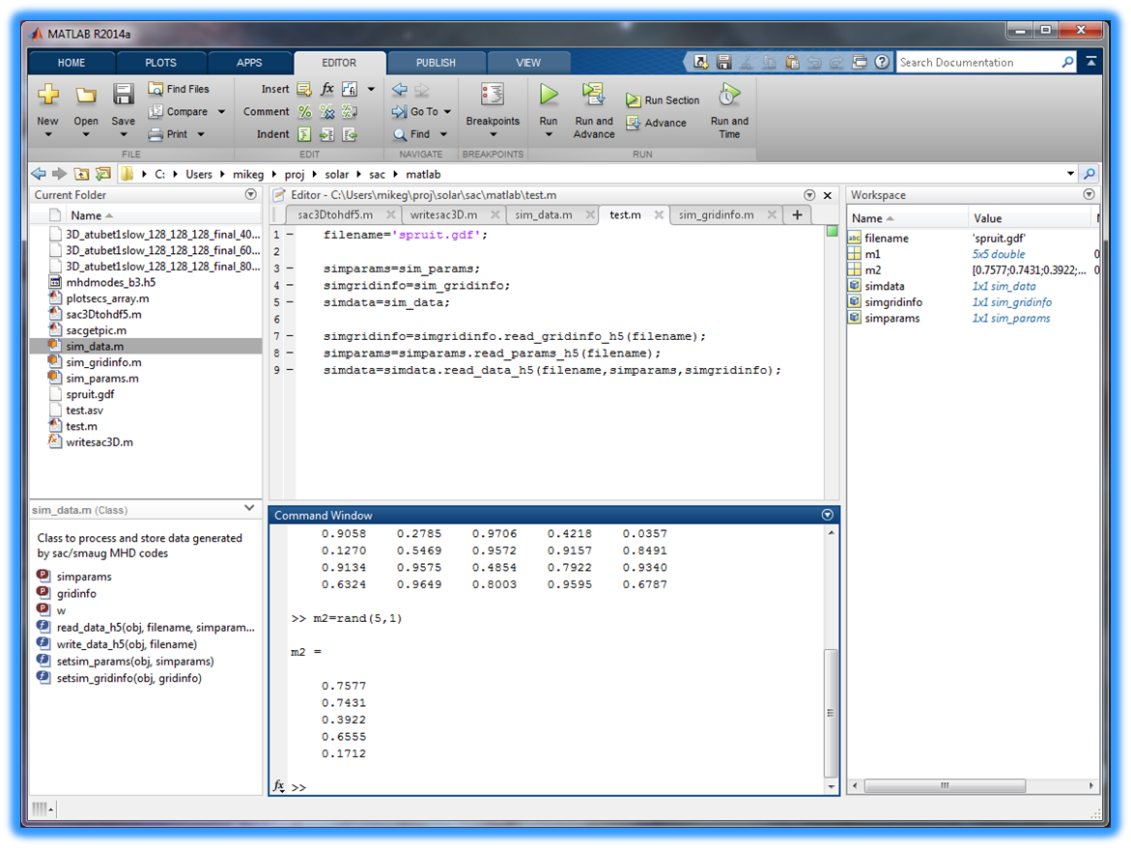

Directory Navigation
Search Help
Workspace

Slide 9
Startup Options for Matlab
Command-line Startup Options
  Interactive without display
    matlab –nodisplay
  Don’t display splash on startup
    matlab –nosplash
  Start without Java interface ( GUI's will not work )
    matlab -nojvm
Customizing actions to take when starting/stopping
  Customise using template files named startupsav.m and finishsav.m in the directory ../toolbox/local

Slide 10
Introducing the Language Syntax
MATLAB Commands Syntax
Variables in MATLAB
Arrays & Matrices
Array Operations
Array Addressing
Built-in Functions
Data Types in MATLAB

Slide 11
General Syntax Rules
Matlab is case sensitive.
COMMENTS: Any line starting with % is a comment line and not interpreted. Similarly comments can be added to the end of a line by preceding them with the % sign
CONTINUATION LINES: A statement can be continued onto the next line by putting … at the end of the line
More than one statement can be put into a single line by separating them with commas , or semicolons ; .

Slide 12
scalar variables
4.0*atan(1.0) ----> displays result
pi ----> pi is a built in constant
a = 1.234 ----> define (a) and display result
b = 2.345 ; ---> define (b), but do not display
c = a*b; ---> multiplication
d = 1.2+3.4i ----> d is a complex number
e = a+j*b ----> e “ “
A = 4.55 -----> case is significant (A is not a )
who or whos get a list of so far defined vars.
Note: Avoid names longer than 31 chars.

Slide 13
Built in Scalar variables
pi
i and j : sqrt(-1) these are used for complex numbers notation
eps : floating point smallest positive non-zero number
realmin : smallest floating point number
realmax : largest floating point number
Inf : infinity
NaN : Not-a-number
It is important to note that these are not reserved words therefore it is possible to re-define their values by mistake.
DO NOT RE-DEFINE THESE VARIABLES

Slide 14
A scalar variables is really a (1by1) matrix
Matlab is a matrix orientated language. What we can think of as a scalar variable is stored internally simply as a (1 by 1) matrix. Also Matlab matrices can take on complex values if the assignment necessitates it.

Slide 15
Practice Session 1
Getting Started
  Starting matlab
  Familiarisation with the layout
  Investigate help features.
Follow “Getting Started” instructions on the exercises sheet.
Investigate each variable on the Workspace Window
Now keep your Matlab session on so as to practice new concepts as they are presented.

Slide 16
Arrays & Matrices
r = [ 1 6 9 2 ] → a row vector
c = [ 3 ; 4 ; 5 ; 7 ] → a column vector
d = [ 4 5 6 ; 7 8 9 ; 5 3 2; 1 2 3 ] →4by3 matrix
A= rand(1,5) → 1 row of 5 columns containing random numbers.

Slide 17
Array Operations
Given r as (1 by n) (row vector) and c as
(n by 1) (column vector).
r*c --------> inner product ( single number )
c*r --------> a full matrix
constant*matrix is an array of same
or -------> dimensions where each
matrix*constant element is multiplied
by a constant

Slide 18
Array Addressing
Direct Index Addressing
x(3) → reference to 3rd element of x
x( [6 1 2] ) → 6th , 1st and 2nd
elements of x array.
Array Section Referencing (Colon notation)
array( first:last) or array(first:increment:last)
e.g. x(1:5) → elements 1, 2, 3, 4 and 5 of x
x(4:-1:1) → elements 4 , 3 , 2 and 1 of x

Slide 19
Array Addressing Continued
Addressing via an index array
d = [ 11.1 12.2 13.3 14.4 15.5 16.6 ];
e = [ 4 2 6] ;
f = d(e)
will result in setting f =[ 14.4 12.2 16.6 ]

Slide 20
Find function
Find returns the indices of the vector that are non-zero. When used with relational operators it will return the indices of a vector satisfying a given condition.
EXAMPLE:
ind = find( A > pi )

Slide 21
The use of find function
If a = [ 1.3 5.6 7.8 2.0 4.0 3.8 2.5]
k = find(a < 3.0) will return k=[1 4 7]
and c=a(k) will be a new vector made up of the 1st ,4th and 7th elements of a in that order.
Conclusion: Results of the find() function can be used as an index vector to select or eliminate data which meets a certain criteria.
Notes:
39

Slide 22
Array Constructs
Explicit :
x = [ 0.1 0.5 6.3 3.2 5.6 ];
Colon notation:
(first_value:increment:last_value)
x = 0 : 0.1 : 5.0;
Via the linspace function:
linspace(first,last,number_of_elements)
x = linspace( 1.0 , 20.0 , 10 );

Slide 23
Maths Operations
Symbols + , - , * , / , \ , ^
are all matrix operation-symbols.
Sometimes we need to perform arithmetic ‘array’ rather than matrix operations between the corresponding elements of arrays treating them as sets of numbers rather than matrices.
This can be achieved by using the . (dot) symbol before the operation symbol
such as .* or ./ .

Slide 24
Operations continued …
If c and d are two vectors of same dimensions
then;
e = c.*d defines a vector e of same size ‘as c and d’ with its elements containing the result of the multiplication of the corresponding elements.
e= c./d is the same but division of elements.
e=c.\d (left division) (d divided by c)

Slide 25
Matrix Constructs
Explicit:
A =[ 1 2 3;4 5 6 ; 7 8 9]
Constructed from vectors:
A = [ a ;b ;c ] where a,b,c are row vectors
of same length or column vectors
A = [ a b c ] where a,b,c are column vectors
of same length or row vectors
Constructed via Colon Notation:
A = [(1:3);(4:6);(7:9) ]

Slide 26
Matrix Constructs continued ...
Generated via a standard function call
N = 10 ;
B = ones(N); N by N matrix of all 1’s
ID = eye(N); N by N identity matrix
D = magic(7); magic squares matrix
E = rand(4,6); 4 by 6 matrix with random
distributed elements
between 0.0 and 1.0

Slide 27
Matrix Subsections
Let A be a 4 by 6 full matrix:
A( 1:3 , 2:4 ) -----> subsection with row 1 ,2, 3
and columns 2,3,4. I.e. a 3by 3 matrix.
A( 1:3 , : ) a 3 by 6 matrix which is the first
3 row of A matrix
A( 4:-1:1 , : ) same size as A but rows are
arranged in reverse order.
QUESTION:
What is A( : , 6:-1:1 ) ?

Slide 28
Matrix Assignments
Examples: Let A be 4 by 6 matrix
B = A(1:4,6:-1:4) ----> B becomes 4 by 3
A = A’ A is replaced by its transpose.
A = [ B C] B and C must have the same number of rows.
A = [ B ; C] B and C must have the same number of columns

Slide 29
Matrix Assignments continued ...
Examples: Let A be 4 by 6 matrix
A(4,:) = [ 1 2 3 4 5 6 ] ---> redefine 4th row
A(5,:) = [ 5 4 6 7 8 9 ] ---> add a 5th row
A(:,3) = [ 1 ; 2 ; 3 ; 4] ----> redefine 3rd column

Slide 30
Exercises
Perform Exercises 1.1 to 1.6 from the exercises sheet

Slide 31
shape of matrices
What is the size of my matrix ?
whos variable_name will give details.
size function will return the dimensions
size (A ) will return the dimensions of matrix
A as two integers.
example usage; [ m n ] = size ( A)
reshape function can be used to re-shape a matrix. I.e. reshape(A,m,n) will reorganize elements of A into a new m-by-n matrix
example: B = reshape( A , 4 , 6 )

Slide 32
Matrix Division
Matrix inversion function is inv( )
If A is a non-singular square matrix then
A\B means inv(A)*B
A/B means A*inv(B)
Therefore ;
Solution of A*X = B is A\B
Solution of X*A = B is B/A

Slide 33
Solution of Linear equations
Example: Solve the following set of linear
equations;
2x + 3y + z = 17
x + 4y +2z = 22
x + y +5z = 25

Slide 34
Linear Eqn. cont..
A = [ 2 3 1 ; 1 4 2 ; 1 1 5 ] ;
b = [17 ; 22 ; 25] ;
x = A\b ----> will yield the answer as 2;3;4
C=inv(A)
x = C*b will also work.
you may make sure that the A matrix is not ill
conditioned by finding out its determinant
first: det(A)
Notes:
Zero value for determinant occurs when matrix is ill conditioned occurs for so called singular matrices or matrices with very small values and requiring much higher precision

Slide 35
Exercises
Perform Exercises 1.7 and 1.8 from the exercise sheet

Slide 36
Functions -applied to Matrices
Most of built-in, ‘what looks like scalar’ functions
can also be applied to vectors or matrices;
For example if A is a matrix then sin(A)
will return a new matrix of same dimensions
with its elements being the sin( ) of the
corresponding elements of A.

Slide 37
Exercises
Perform Exercises 2.1 to 2.5 from the exercise sheet

Slide 38
Other Matlab Data types
DATA TYPES
Numeric
  Complex,
  double precision
  Single precision
  Integer
Boolean
Character String
Java Classes
User Defined Matlab Classes
ORGANIZATIONAL ATTRIBUTES
Multi-dimensional Matrices
Sparse Matrices
Cell Arrays
Structures & Objects

Slide 39
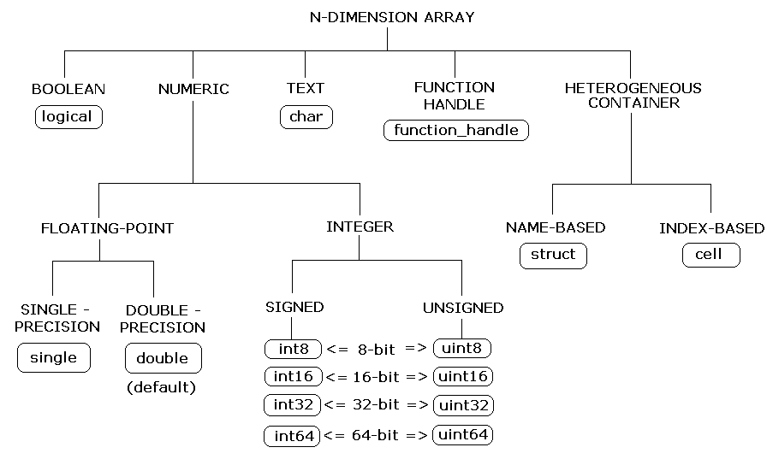
Matlab data types

Slide 40
Complex double precision matrices
This is the default storage mode.
A scalar is really a 1x1 matrix with the imaginary part set to zero.
Any expression which evaluates to a complex value returns complex results automatically
The following are two methods of expressing a complex number;
  X = complex( 1.2 , 3.4 )
  X = 1.2+3.4i
  Warning i and j has this special meaning which will be lost if you name your variables as i and j . So don’t !
Matlab keeps track of complex vs real issues and does the necessary conversions. Therefore you need not worry about it.

Slide 41
Logical Matrices
Results of relational operations return logical matrices ( with 1’s and 0’s only )
These matrices are primary useful for program control structures and they can implicitly be used as masks in vectorisation
Example : a = rand (1,10);
b = rand(1,10); d= 1:10;
c = a < b % c is a logical matrix.
a(c) = [ ] % eliminate elements where a<b

Slide 42
Character Strings
A Character string is simply a 1 by n array of characters.
Example: name=‘tommy’
friends = [ ‘tommy’ ; ’billy’ ; ‘tim ‘ ]
Note that all items must have the same length by padding them with blanks where necessary. This ensures that the matrix convension is not violated.
Where as;
friend = [ ‘Alexandra’ , ‘jim’ ]
is a valid construct as the resultant structure is simply an array. In this case friend(3) is ‘e’ for example.

Slide 43
Multi-dimensional arrays
These are arrays with more than 2 subscripts
They can be generated by using one of the following functions;
zeros , ones , rand , randn
Example: R = zeros ( 10,20,20)
A = ones( 10,20)
R(:,:,1) = A

Slide 44
Structures
These are Matlab arrays with elements accessed by field names. They are useful for organizing complex data with a known structure. Structures can be nested.
Examples:
Creating a structure:
order.number= 105; order.year=2003; Order.title=‘Smith’;
order(2)= struct( ‘number’,207,’year’,2003, …
‘title’,’Jeff Brown’)
Deleting fields:
modorder = rmfield( order , ‘year’ );

Slide 45
Cell Arrays
Cell arrays are Matlab arrays whose individual elements are free to contain different types & classes of data. These elements need not ‘and usually are not’ of same type, size or shape.
They are useful for storing data that can not otherwise be organized as arrays or structures. Cell arrays can be nested.
Example
Create a 4by2 cell matrix. Each cell can contain any type and size of data:
C = cell(4,2)
Create (4by1)cell array B and assign values:
B = { [1,2] , [ 4 5 ; 5 6] , 0.956 , ‘range values’}
Build a (1by5) cell-array M containing 5 elements, one cell at a time:
M{1} = 1 ; M{2}= [1 2 3] ; M{3} =[1 2;34] ;
M{4} = rand(10,10) ; M{5}=‘title’ ;

Slide 46
Practice Session
Structures & Cell Arrays
Perform exercises 3
on the exercises sheet.

Slide 47
END OF PART-1

