Slide 1
MATLAB
Building and Running Faster Matlab
UNIVERSITY OF SHEFFIELD
CiCS DEPARTMENT
Deniz Savas & Mike Griffiths
JULY.2008

Slide 2
Improving Performance of Matlab
Using profiler – to check for bottlenecks
Built in functions
Vectorisation
Pre loading
Multi core
Running Matlab on Iceberg
Running Matlab on GPUs

Slide 3
The profiler
This facility is enhanced recently at version 6.x, which enables the user to investigate the time take taken to run a matlab task or a script. The profiling reports help us to improve the efficiency of the code by pin-pointing the parts of the code that takes most of the time.
Type profile viewer to start the profiler up and
In the run this code field enter the name of your script file, or keep that field clear and just click on Start profiling followed by running your task as usual from the Matlab Command Window and when finish click on the stop profiling icon.
Clicking on the profiling summary icon will display a profile summary which can be expanded by clicking on the routine names on the list.

Slide 4
Measuring Performance: Stopwatch Timer
Start the timer
  tic
Stop the timer
  toc
t = zeros(1,100);
for n = 1:100
A = rand(n,n);
b = rand(n,1);
tic;
x = A\b;
t(n) = toc;
end
plot(t)

Slide 5
Built In Functions
Some matlab routines are *.m files, others are compiled into matlab (built-in) and are much faster. Try to use built-ins where possible. Use type functionname to see if a function is a built-in.

Slide 6
Vectorisation
Matlab scripts can be written using fortran/C-style "for" loops, but to make the most of matlab's abilities you should try whenever possible to treat matrices as a single entity rather than a bundle of elements.
Vectorisation functions
  arrayfun
  repmat
  cumsum
  bsxfun (Binary Singleton eXpansion FUNction)
Notes:
Optim directory has two scripts genarrayfun and genar which call mynewfun and mynewfun1
Difference in time when using for loops is illustrated a factor of 10!

Slide 7
Vectorisation Example 1:
for i = 1:100
for j = 1:100
r(i,j) = sqrt(i^2+j^2);
end
end
Vectorised this becomes
[i,j]=meshgrid(1:100,1:100);
r = sqrt(i.^2+j.^2);

Slide 8
Vectorisation Example 2:
Vectorise the following, where elements depend on previous ones
n=1000; x(1)=1;
for j=1:n-1,
x(j+1) = x(j) + n - j;
end
Vectorised this becomes
n=1000; x(1)=1;
j=1:n-1;
x(j+1) = n - j;
cumsum(x);

Slide 9
arrayfun : Vectorization for the user
Apply function to each element of array
[B1,...,Bm] = arrayfun(func,A1,...,An)
Example
X=-pi:pi/1000:pi;
arrayfun(@sin,x);

Slide 10
Practice Session Session P2 on the worksheet)
Profiling
  Write a script which uses tic and toc to compare the time taken to compute the sin of a vector of n values. Compare three methods
    Use a for loop to compute the sin of each element of the vector
    Use arrayfun to compute the sin of each element of the vector
    Passing the vector directly into the sine function
  In the folder matlab/vectorize run the scripts genar.m and genarray.m. Compare the performance and compare the scripts.

Slide 11
Types of Distributed Computing
Coarse grained
  Multiple tasks
  High throughput computing
Fine grained
  Distributed computing
  MPI programming distributed matrices
  GPU Arrays

Slide 12
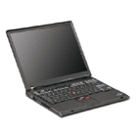
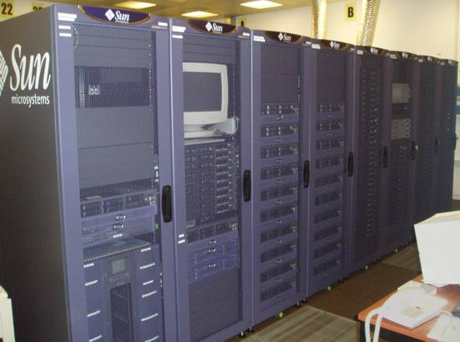


CPU
Worker
CPU
Worker
Scheduler
CPU
TOOLBOXES
Distributed
Computing
Toolbox
Worker
BLOCKSETS
CPU
Worker

Slide 13
Access to More Compute Resources
HPC
  Sheffield Advanced Research Computer, Iceberg, Polaris
Benefits
  Access to data
  More compute resources
  Share applications with collaboration partners
    Example lensless microscopy project at Sheffield

Slide 14
Making Matlab Use More Compute Resource
Compute Cluster e.g. Iceberg
Uses a scheduler e.g. Sun Grid Engine
Break a matlab job in to many independent tasks
  E.g. cycle of a for loop might run independently
Array of matlab tasks running on compute cluster
Can run 1000’s of tasks
Good for
  parametric sampling
  Genetic algorithms
  Model ensembles

Slide 15
Submitting a matlab job to Sun Grid Engine on Iceberg
qsub mymatlabjob.sh
Where mymatlabjob.sh is:
#!/bin/sh
#$ -cwd
#$ -l h_rt=hh:mm:ss
#$ -l mem=12G
module load apps/matlab/2015a
matlab -nojvm -nosplash -nodisplay < matlabscriptfile > outputfile
There is also a command named runmatlab
Typing runmatlab on its own will give information on using it.

Slide 16
Final Remarks
Task arrays are a powerful method utilising large pools of compute resources e.g. clusters
Mainly use batch submission mode not interactive use of matlab
Challenging to utilise compute resource outside adminstrative domain
  Difficulty alleviated using geodise toolkit
Parallel computing toolbox enables researchers to develop interactive matlab applications able to exploit a pool of compute resources

Slide 17
Compute Architectures for Parallel Computing
What architectures available
  Shared memory
  Distributed memory
  Vectorisation

Slide 18
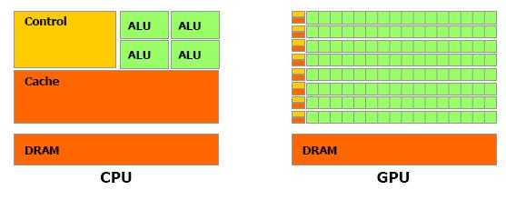
Massive Parallelism!
Notes:
The GPU Devotes More Transistors to Data Processing

Slide 19
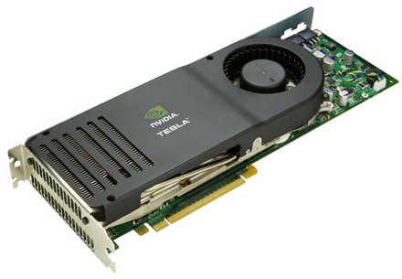
NVIDIA Tesla GPU
Desktop supercomputing
Who needs the cloud?

Slide 20
CUDA Programming
The nvidia CUDA toolkit
  Compiler nvcc, profiler and debugger
Multithreaded programming using kernels
Allocating data on the GPU
Moving data to and from GPU memory
Reduction techniques for global maxima
Notes:
Concept of a kernel

Slide 21
GPU Computing Using Matlab
How to utilise a GPU using Matlab
How to utilise GPU’s using Matlab on Iceberg

Slide 22
Transferring data between Matlab and the GPU
Evaluate built in functions using a GPU
Run matlab code on a GPU

Slide 23
Transferring Data – Using GPU Array
Example using gpuArray function
  M=rand(6,6);
  G=gpuArray(M);
Retrieve the matrix
  M2=gather(G);
Other examples (specifying precision)
  G1=gpuArray(ones(100,’uint32’))
  X=rand(1000);
  G2=gpuArray(single(X));
Use the who’s command to determine where data is stored

Slide 24
GPU Array Functions
Many functions e.g. sin,cos, tan and many more..
To find a list of functions
  methods(‘parallel.gpu.GPUArray’);
To get help
  help parallel.gpu.GPUArray/functionname
Example, create array directly on the GPU
  Z1=parallel.GPUArray(8192,1);
  Z2=parallel.GPUArray.ones(100,100,50);

Slide 25
Calling Functions on gpuArray
Computation of an FFT on a GPU the computation uses arithmetic operators such as + and * which are also performed on the GPU
  Ga=gpuArray(rand(1000,’single’));
  Gfft=fft(Ga);
  Gb=(real(Gfft)+Ga)*6;
  G=gather(Gb);

Slide 26
GPU’s Available for General Use on Iceberg
8 Fermi M2070 GPU’s available
  448 cores
  6 GB GPU memory
Request access to GPU’s from Iceberg admins (once only)
  Users will be added to the gpu project group
On iceberg, following commands required to access and use nodes
  Qsh –l arch=intel* -l gpu=1 –P gpu –l mem=16G
  module add libs/cuda/4.0.17
Matlab code using the gpu functionality needs to request a job by including the following lines
#$ -l h_rt=hh:mm:ss
#$ -l arch=intel*
#$ -l gpu=1
#$ -l mem=16G
#$ -P gpu

Slide 27
Limitations apply to the code within the function that arrayfun is evaluating on a GPU.
The arrayfun function argument must be a handle to a MATLAB function, whose function file (not a script) defines a single function.
The code can call only those supported functions listed in the documentation, and cannot call scripts. Overloading the supported functions is not allowed.
Indexing (subsasgn, subsref) is not supported.
The following language features are not supported: persistent or global variables; parfor, spmd, switch, and try/catch.
All double calculations are IEEE-compliant, but because of hardware limitations, single calculations are not.
The only supported data type conversions are single, double, int32, uint32, and logical.
Functional forms of arithmetic operators are not supported, but symbol operators are. For example, the function cannot contain a call to plus, but it can use the + operator.
Like arrayfun in MATLAB, matrix exponential power, multiplication, and division (^, *, /, \) perform element-wise calculations only.
There is no ans variable to hold unassigned computation results. Make sure to explicitly assign to variables the results of all calculations that you are interested in.

Slide 28
Useful functions
gpuDeviceCount
  Returns number of GPU’s
gpuDevice
  Display device characteristics
Select a specific gpuDevice to run on using
  gpuDevice(2)
  Selects device 2

Slide 29
Running your Matlab functions on the GPU
Can either transfer/create data and use the GPU functions or run your own as follows
Use the arrayfun function
  Result=arrayfun(@myfunction,arg1,arg2);
  @myfunction is the handle to the function
  arg1 and arg2 are arguments passed into the function
Run the script mycaltest.m in the gpu folder of the course examples
These computations will be run elementwise by each GPU core
Convert the example genarrayfun.m in the vectorize folder so that it runs using the GPU. Compare the preformance of the two versions

Slide 30
Demonstration/Practice session
Open the folder parallel
  Investigate the files beats.m, beat_wave.m
Submit the job as a batch job
Investigate sgetasks.m compare with beats.m
  Use a task array to run each part of the loop on a different machine
Submit the beats job as an SGE task array
Open an interactive session using qsh and use the command
  qsub beats.sh

Slide 31
Practice and demonstration
Using the following matlab functions
  gpuarray
  gather
  Arrayfun
Re-write the beats.m example so that the wave superposition is computed on the GPU

Slide 32
Running a CUDA Kernel from Matlab
Compile PTX file using CUDA compiler
  nvcc –ptx myfun.cu
Construct a kernel object in matlab
  K=parallel.gpu.CUDAkernel(‘myfun.ptx,’myfun.cu’);
Use the feval function to run the kernel
  e.g. myfun takes as input two arguments i1 and i2
  Allocate on the GPU
    I1=gpuArray(rand(100,1,’single’));
    I2=gpuArray(rand(100,1,’single’));
    o1=feval(k,i1,i2);
    o2=feval(k,o1,i2)
  Note in latter case the object o1 was created on the GPU and could be reused in a further GPU computation
  Gather the results
    R1=gather(o1);
    R2=gather(o2);

