Slide 1
MATLAB
Parallel Computing
UNIVERSITY OF SHEFFIELD
CiCS DEPARTMENT
Deniz Savas & Mike Griffiths
August 2016

Slide 2
SUMMARY OF TOPICS
Concepts of Parallel Programming
  Task parallelism
  Data distribution to parallel tasks
Parallel MATLAB on your workstation
Parallel MATLAB on iceberg

Slide 3
Parallel Computing Toolbox
Perform parallel MATLAB computations on
  multicore computers
  computer clusters
  GPUs
Notes:
Parallel Computing Toolbox™ lets you solve computationally and data-intensive problems using multicore processors, GPUs, and computer clusters. High-level constructs—parallel for-loops, special array types, and parallelized numerical algorithms—let you parallelize MATLAB® applications without CUDA or MPI programming.

Slide 4
Key Features
Parallel for-loops (parfor)
Support for CUDA-enabled NVIDIA GPUs
multicore processors
Computer cluster and grid support
Interactive and batch execution of parallel applications
Distributed arrays and spmd
Notes:
Parallel for-loops (parfor) for running task-parallel algorithms on multiple processors
Support for CUDA-enabled NVIDIA GPUs
Full use of multicore processors on the desktop via workers that run locally
Computer cluster and grid support (with MATLAB Distributed Computing Server)
Interactive and batch execution of parallel applications
Distributed arrays and single program multiple data (spmd) construct for large dataset handling and data-parallel algorithms

Slide 5
TYPES OF PARALLEL WORKING
IMPLICIT PARALLELISM
MATLAB automatically runs the code using multiple processes by using the default parallel profile.
Example : parfor loops
EXPLICIT PARALLELISM
User starts a type of parallel working environment explicitly by using one of these commands below
parpool , spmd or pmode

Slide 6
IMPLICIT PARALLELISIM
Using The Parallel Computing Toolbox on your workstation ( local pool )
It is possible to use parallel processing implicitly by simply using the parfor syntax.
Note: The first time you run MATLAB in parallel, you may get firewall exemptions messages for programs such as spmd.exe and mpiexec. You should allow these exemptions.
Example:
parfor i=1:1024
A(i) = sin(i*2*pi/1024);
end
When running this code, Matlab will automatically startup a set of workers that will share the parfor task amongst themselves.
By default MATLAB will use as many workers as there are cores on the workstation. For example on a quad-core machine MATLAB will use 4 workers to tackle the above parfor loop.
Note: The original Matlab process remains in place and makes use of these extra workers. Hence it is sometimes refered to as the ’Client’ process. Therefore a Matlab parallel job will have one client + number of workers instances of MATLAB.

Slide 7
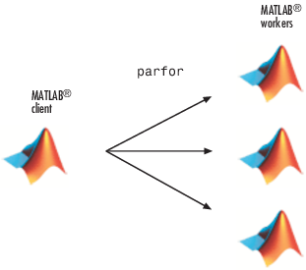
Run a Loop in Parallel
SERIAL RUN:
Create a sine wave and plot the waveform
for i = 1:1024
A(i) = sin(i*2*pi/1024);
end
plot(A)
PARALLEL RUN the same task
parfor i = 1:1024
A(i) = sin(i*2*pi/1024) ;
end
plot(A)
Notes:
You can execute parallel applications interactively and in batch using Parallel Computing Toolbox. Using the parpool command, you can connect your MATLAB session to a pool of MATLAB workers that can run either locally on your desktop (using the toolbox) or on a computer cluster (using MATLAB Distributed Computing Server) to setup a dedicated interactive parallel execution environment. You can execute parallel applications from the MATLAB prompt on these workers and retrieve results immediately as computations finish, just as you would in any MATLAB session.

Slide 8
Practical 1
edit parexample1.m in your matlab examples directory to see what it contains.
Run this example by typing parexample1
you may have to wait patiently for the parallel pool to start
After the script runs observe workspace and type type plot(A) to see the results.
Click on the bottom LH corner of MATLAB desktop and check parallel preferences.

Slide 9
EXPLICIT PARALLEL WORKING MODES
PARPOOL COMMAND
One client multiple workers model
User talks to client via MATLAB commands
and client sends tasks to workers via parallel
prog. constructs such as parfor, parfeval.
( i.e indirect control of workers)
worker1
CLIENT
worker2
worker3
workerN

Slide 10
Starting a Parallel Pool
As we have already seen, a parfor statement can implicitly and ‘automatically’ start a parallel pool using the default profile.
We can explicitly start up a parallel pool by using either of the commands parpool or gcp .
gcp command opens a parallel pool using the default profile.
parpool command allow us to control the characteristics of the pool during its creation.
For example: parpool ( 8 ) will startup a parallel pool with 8 workers.
Having opened a parallel pool we can check on its details and also return its handle via the call: phandle = gcp( ‘nocreate’ )
Once a parallel pool is open, it remains open in the background waiting to service parallel tasks ( such as another parfor loop ) or until it times out ( by default in 30 minutes ) due to no other parallel activity.
It is possible to explicitly close down the current parallel pool by issuing a the following command: delete(gcp)
If the handle of the pool was obtained during creation, the following command can also be used delete(phandle )

Slide 11
parpool command details
parpool command enables the full functionality of the parallel language features such as spmd, parfor, parfeval by starting a pool of workers and attaching them to the current session of MATLAB (‘the client’ ). This is an explicit way of starting a MATLAB pool which has the advantage of greater control on the number of workers etc.
parpool % start default profile pool with maximum workers
parpool ( n ) %start default profile with n workers
p= parpool ( ‘profile’ , n ) % start profile with n workers, also return
% handle of pool .
Examples:
parpool ( 3 )
parpool ( ‘local’ , 4 )
parpool ( ‘bigpool’ , 16 )

Slide 12
parpool example
parpool ( ‘local’ , 4 ) % parallel region starts with 4 workers.
parfor i = 1:4096
R(i) = myfunction( i ) ;
end
plot( R ) ;
delete ( cgp ) % this command closes the parallel pool
% from now on serial working.
% Note that parfor would also automatically start a pool if there was
% not one already open but only with default specifications.

Slide 13
Parfor Exercises
Study the matlab scripts beats.m and run it to see what it produces.
This script can be parallelized by using a parfor loop.
The scripts beats_parf1 and beats_parf2 are two alternative ways of parallelizing the script beats.m
Study and run beats_parf1 and beats_parf2 to see what happens.

Slide 14
Parallel Working by using the parfeval function
Syntax: R = parfeval( pool , @function,nout, in1,in2, … )
When invoked this way each worker in the pool evaluates –
[ results ] = function( in1 , in2 , … )
,where results has nout number of output arguments.
For example if nout=2 then the expected syntax of the function definition is:
[a b] = function(in1,in2 ,… )
R is the handle to the actual returned results needed for subsequent fetchOutputs or fetchNext calls.
The results can be retrieved by supplying R to a following fetchOutputs call or by a sequence of fetchNext calls.
When multiple calls are made to parfeval “as is usually the case”, MATLAB automatically organizes the distribution of each of these tasks to workers , forming a queue if there are less workers than tasks.

Slide 15
Practical - 2
Study the script beats_pfeval which paralelizes the now familiar beats problem this time using parfeval function calls.
Study the script parexample2a.m which gives a demonstration of the use of the parfeval function to distribute tasks to the workers in the parallel pool and to receive the results by using the fetchOutputs function. Run this script and observe what happens.
Repeat this for the script parexample2b.m which performs the same task but uses the fetchNext calls instead of fetchOutputs call.

Slide 16
gcp command and keyword.
gpc is a MATLAB command and also a keyword.
The command can be used either to start a default pool in a similar manner to using parpool or find out the handle of the pool.
p=gcp % start the default cluster or return the
% currently open pools object handle
Once we have the handle we can find out its characteristics as well as be able to close it by typing -
delete ( p )
By default the keyword gcp contains the currently open pool’s handle.
So, delete(gcp) will always close the currently open pool.

Slide 17
Practical-3
Type - gcp and observe the output.
How many workers are in the parallel pool ?
Type - delete(gcp ) and observe that the parallel pool closed.
Type - parpool ( ‘local’ , 4 )
Has a pool started ?
Using gcp find the number of workers in the pool.

Slide 18
Cluster Profiles
So far, we had no control over the profile of the parallel cluster. Therefore we have been using the default cluster profile in all our examples.
We will now look into defining our own bespoke cluster profiles.
A cluster is simply a predefined collection of MATLAB processes in the form of one client and a number of workers serving that client.
There are two types of clusters ( local ) and ( scheduler )
local clusters : use the processors on your machine.
job Scheduler clusters (e.g. sge): Submit jobs to remote machines.
A cluster profile named ‘local’ is predefined by MATLAB after it detects the number of cores on the host computer.
A GUI window named Cluster Profile Manager allows us to define a new cluster or customize and existing cluster profile.
We can then use this new cluster profile for our parallel jobs.

Slide 19
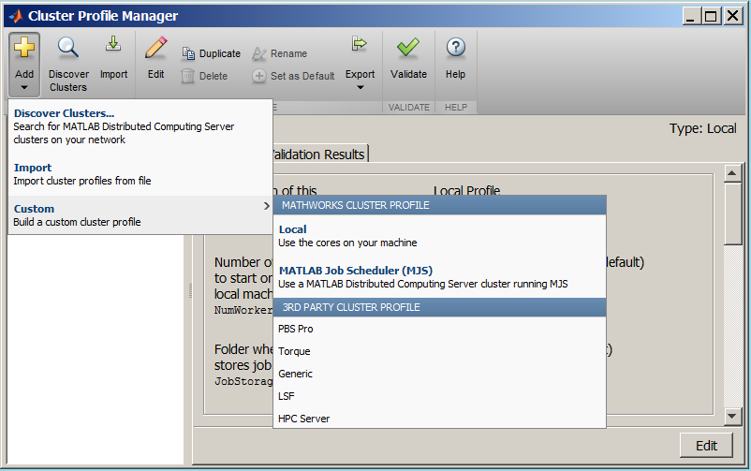
Defining new cluster profiles
Example Select Add > Custom > Local
to add a new local cluster profile.
In the resulting window click on Edit

Slide 20
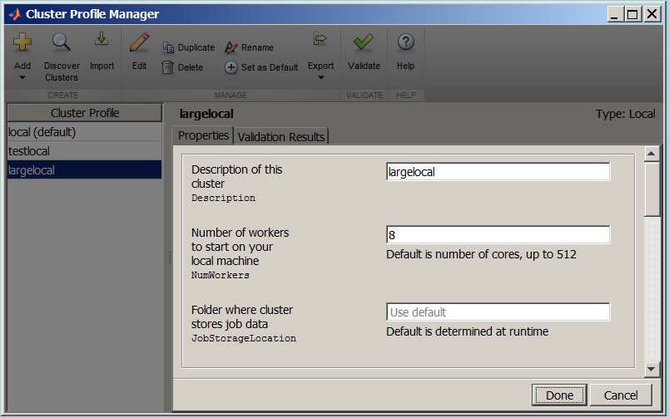
Defining new Cluster Profiles
The edit Cluster Profile window allows us to specify the number of workers to be used in the cluster. If left as ‘Use Default’ the number of workers to create will be the number of physical cores available at the time of running.

Slide 21
Practical - 4
By using the “Cluster Profile Manager” define a new cluster profile that contains 6 workers.
Make this new cluster profile the default one.
Shut down the current parallel pool ( if it is running )
delete(gcp)
Start a new parallel pool using parpool
Type newpool=gcp to find out about this pools properties.

Slide 22
Parallel Pool Preferences
Preferences for the parallel pool can be set via the preferences icon.
Having defined different “Cluster Profiles” via the “Cluster Profile Manager” , “Parallel Computing Toolbox Preferences window” allows designating one of these profiles as the default profile ( to be used when starting a parallel pool automatically ).
As well as parpool ‘without any parameters’ the statements parfor, spmd, distributed, Composite, parfeval statements will also attempt to automatically start the default profile pool of workers.
Parallel Pool Preferences also allows control of the following:
  Maximum number of workers allowed in a parallel pool,
  Allow/Disallow automatic starting of a parallel pool,
  Set default idle time before a parallel pool closes itself.

Slide 23
Practical 5
Using the Parallel Computing Toolbox Preferences window alter the idle time setting of your new cluster profile.

Slide 24
Selecting the Cluster Profile to use
Example
Having defined a cluster profile named largelocal which can have 8 workers, a parallel pool that uses these 8 workers can now be started by typing;
parpool ( ‘largelocal’ )
If less number of workers is needed then it can be specified for the parpool invocation.
e.g. parpool (‘largelocal’ , 6 )
It is always possible to check the number of workers available in the currently open cluster via the following commands;
p=gcp(‘nocreate’) ;
p.NumWorkers
The current parallel pool can be closed by using the command: delete(gcp)

Slide 25
Running Communicating parallel jobs interactively
Parfor construct allows automatic sharing of tasks between the workers without the need for further intervention.
For a greater control of the parallel working, there are two further modes of operation namely;
spmd
pmode
When working in spmd mode, a block of statements are executed in parallel on the workers and only when the spmd block execution is completed the control returns to the matlab command window.
Whereas when working in pmode the user have separate control of the MATLAB command window ‘i.e. the client window’ as well as the worker-pool ‘i.e. the parallel command window’ .

Slide 26
SPMD MODEL
SPMD model : Single Program/Multiple Data
Same block of code runs simultaneously on all workers
CLIENT
spmd
Program flow
worker1
worker2
worker3
worker4
end
CLIENT

Slide 27
Single Program Multiple Data (spmd)
Syntax: spmd , spmd (n ) or spmd(m,n )
MATLAB commands
end
The single program multiple data (spmd) construct lets you define a block of code that runs in parallel on all the workers in the parallel pool. The spmd block can run on some or all the workers in the pool.
(n) is number of workers to start.
(m,n) is minimum and maximum number of workers to start.
spmd % starts the default pool of workers (usually ‘local’ )
R = rand(8);
end
The code above creates an individual 8-by-8 matrix, R, of random numbers on each worker in the pool.Following the execution of this spmd block these individual matrices can be accessed as R{1} , R{2} , … so on
Normally we refer to labindex variable in an spmd block to do any useful work ( i.e not to replicate work ).
On each worker labindex will contain a unique value (between 1 and n, where n is the total number of workers). Without this feature spmd constructs would be practically useless !

Slide 28
Accesssing data from the spmd workers
(Composites)
Following an SPMD block execution, in the client context, the data generated within the SPMD block are available, even though this data is actually stored on the workers.
On the client, these variables are called Composite objects. Each element of a composite is a symbol referencing the value (data) on a worker in the pool. Note that because a variable might not necessarily have been defined on every worker, a composite might have undefined elements.
Continuing with the example from above, on the client, the Composite R has one element for each worker:
X = R{3}; % Set X to the value of R from worker 3.

Slide 29
spmd examples
The following example runs an spmd cluster of 4 workers. Each worker reads input from a different file and calls a function to perform operations using the data it has just read.
spmd (4)
datafile = [ ‘mydata' , num2str(labindex) ]
labdata = load( datafile )
result = MyFunction(labdata)
end
Making use of the results:
In this example variables datafile, labdata and result are unique to each worker and within the spmd block it can be accessed as any MATLAB variable.
However, these arrays are reflected to the client as composite objects.
A composite object has the same syntax as the cell array where each cell contains the value of the object on each worker.
For example result{1} contains the result array for worker number 1. ( i.e. the worker with labindex=1 )

Slide 30
Practical-6
SPMD exercises
Try running parexample3
Run script beats_spmd to solve the beats problem by using a spmd construct.

Slide 31
PMODE EXPLICIT PARALLEL
WORKING MODE
PMODE is also known as interactive parallel development mode.
multiple communicating workers model
Each command on parallel command window is executed by all workers.
Client window continues to operate as normal.
Each worker has its own separate workspace.
A variable named labindex is unique to each worker.
Workers do not have graphics capabilities.
CLIENT
worker1
worker2
worker3
workerN
CLIENT COMMAND WINDOW >>
PARALLEL COMMAND WINDOW >>

Slide 32
Starting & stopping parallel mode
Starting the parallel mode
pmode ( ‘start’ , ‘profile_name’ , nworkers )
Example: pmode ( ‘start’ ,’local’ , 4 )
Stopping the parallel mode
pmode ( ‘exit’ ) or pmode( ‘quit’ )
Notes:
Each worker has its own workspace.
Workers do not have graphics capabilities.
Therefore all variables for plotting must be transferred to the client.

Slide 33
Major differences between
PMODE and SPMD modes
When an SPMD block is entered data that exists on the client is automatically made available ‘by replicating’ on each worker.
However this does not happen when operating in PMODE. When PMODE is entered the workspace of each worker is empty.
Any data that needs to be accessed on the workers will have to be transferred from the client to the workers by using the pmode client2lab command.
When an SPMD block terminates, the variables that are created on each worker is automatically made accessible from the client as composite objects, being able to reference each worker’s instance using the syntax
composite_variable{labindex}
However this does not happen when operating in PMODE. Any data that is needed in the client window will have to be transferred manually by using the pmode lab2client command.

Slide 34
Using the PMODE command to transfer data between the client and the workers.
When working in pmode each worker and also the client has its own unique workspace.
If we need to transfer data between the workers and the client we must use the following commands:
To transfer from the client to workers:
pmode client2lab client_var workers worker_var
Note that worker_var is optional if not specified it is the same as client_var
Example: pmode client2lab myinitar 1:8
To transfer from workers to client:
pmode lab2client worker_var workers client_var
Note that worker_var is optional if not specified it is the same as client_var
Example: pmode lab2client y 1 mynewy
This example copies worker 1’s variable y into client workspace under the name mynewy .

Slide 35
Practical 7 pmode exercises
As the workspaces of MATLAB client and the worker processes are separate, transferring data between them needs to be initiated by the user.
The commands for doing this are ;
pmode client2lab ….
&
pmode lab2client ….
Investigate parexample4a and parexample4b scripts and perform the required exercises.

Slide 36
Handling large data while working with SPMD model of parallelizing
Arrays in SPMD context are classified as
  Non-distributed
  Distributed
The Non-distributed arrays can be;
  Replicated ( same on all workers )
  Variant ( different size or values on all workers)
  Private ( only exist on some workers )
Distributed Arrays
  These array is partitioned and each partition stored in a different worker
EXAMPLES: Study script parexample5a for examples of each of these types of arrays.

Slide 37
distributed vs codistributed arrays
These are arrays that straddle across the workers.
Distributed arrays/object can only be created in the client context ( i.e. outside the parallel region ) .
Codistributed arrays are created in the spmd or pmode workers ( i.e within an spmd or pmode block ).
This way of working may be of value when working with very large arrays where the data is too big to fit into the memory of the MATLAB client and hence have to be broken into sections each of which is stored in the memory of a worker.

Slide 38
Distributing data to SPMD workers
Variables created in the client context remain available only on the client worker.
e.g A=rand(30,30);
Having created an array in the client context we can distribute it to the workers;
e.g. B = distributed( A ) ;
If we need to create a large array that will not fit the memory of a single worker then we can create it as a distributed array directly by defining its class as ‘distributed’ during the creation.
e.g C=rand(30,30,’distributed’ ) ;
Performing operations on distributed arrays yield distributed results
A distributed array can be ‘undistributed’ i.e. moved completely into the client by a gather operation;
e.g. CC = gather( C ) ;
If gather is executed inside an spmd statement, pmode, or communicating job, the data is replicated in its entirety on every worker.

Slide 39
Practical 8
SPMD distributed array examples
Try running parexample6a to find the maximum of an array of values.
Study and run parexample6b and parexample6c that also finds the maximum but in a long-winded way by finding the maximum value of each local part first and then searching through them to find the maximum value of the complete.
This script can be used as a template for working with localized arrays on the individual workers.
Correct the mistakes in script parexample6d

Slide 40
Gathering together data from the workers
  The gather command collects data from the workers into the location specified by the intended destination.
  If you execute this inside an spmd statement, pmode, or communicating job, X is a replicated array with all the elements of the array on every worker.
  If you execute this outside an spmd statement, X is an array in the local workspace, with the elements transferred from the multiple workers.
  X = gather(distributed(X)) or X = gather(codistributed(X)) returns the original array X.
  X = gather(C,lab) converts a codistributed array C to a variant array X, such that all of the elements are contained on worker lab, and X is a 0-by-0 empty double on all other workers.

Slide 41
Practical 9
Examples of gather operation
Study and run parexample6e , examine the variables in the workspace.

Slide 42
Example: Find a Particular Element in a Codistributed Array
Suppose you have a row vector of 1 million elements, distributed among several workers, and you want to locate its element number 225,000.
That is, you want to know what worker contains this element, and in what position in the local part of the vector on that worker.
The globalIndices function provides a correlation between the local and global indexing of the codistributed array.
D = rand(1,1e6,'distributed');
%Distributed by columns
spmd
globalInd = globalIndices(D,2);
pos = find(globalInd == 225e3);
if ~isempty(pos)
fprintf(... 'Element is in position %d on worker %d.\n', pos, labindex);
end
end
If you run this code on a pool of four workers you get this result:
Lab 1: Element is in position 225000 on worker 1.
If you run this code on a pool of five workers you get this result:
Lab 2: Element is in position 25000 on worker 2.

Slide 43
PART 2
Running MATLAB on the iceberg cluster
Topics
Running MATLAB interactively on iceberg
Running Parallel interactive jobs in MATLAB
Submitting MATLAB jobs to iceberg cluster
  By using the runmatlab command
  By using your own MATLAB job script
Submitting array of MATLAB jobs to the iceberg cluster
Using DCE to submit parallel MATLAB jobs from within interactive MATLAB jobs

Slide 44
Running interactive MATLAB jobs on iceberg cluster
If you are on the iceberg headnode, you must first start up an interactive session on one of the workers by using the qsh command.
Qsh command can take on a number of parameters mainly to specify the resource requirement, the most important ones from MATLAB point of view are the the following;
–l mem ( to specify virtual memory needs )
–l rmem ( to specify the physical memory needs )
and finally
-pe openmp n (if you with to use MATLAB in parallel mode )
An average MATLAB job may need more memory than the 6G of virtual memory and 2G of physical memory allocated to an interactive job by default. For example the following command will startup an interactive job with 32G of virtual memory and 6G of physical ‘real’ memory to make sure that your MATLAB session has sufficient memory to run.
Qsh -l mem=32G -l rmem=6G

Slide 45
Running parallel interactive MATLAB jobs on iceberg
If you do not have MATLAB on your own workstation then the best way to develop parallel MATLAB code on iceberg is to run MATLAB interactively by using multiple cores on an iceberg worker.
To start up an interactive session using n cores on an iceberg worker node you need to invoke qsh command with the following parameter;
qsh –pe openmp n where currently n can be anything between 2 and 6
You will also still need to specify the virtual and real memory requirements but it is very important to note that the specified limits are not for the job but per core.
For example : qsh –pe openmp 6 -l rmem=3G -l mem=8G would allocate six cores for your job and also 3*6=18G of real memory and 8*6 = 48G of virtual memory.
Demanding excessive amount of memory may render your job waiting in the queues forever to start running !!!

Slide 46
Running Interactive MATLAB jobs on iceberg (cont…)
Having started an interactive session with suitable memory ( and core ) resources on iceberg, you will next need to select the version of MATLAB you want to run and make it available.
We tend to keep a number of previous versions of MATLAB available to ensure that any version dependent code continues to run when a new version arrives.
To check which versions are available type;
module avail apps/matlab on the shell command prompt.
Now select a version you wish to use;
module load apps/matlab/2016a
At any stage of working, if you are not sure which modules you are using simply type module list to find out.
Finally if you are not happy with the version you are using and wish to choose another one use the module unload command.
Example: module unload apps/matlab/2016a
module load apps/matlab/2015a

Slide 47
Running interactive MATLAB jobs on iceberg (cont..)
Having started a suitable interactive session and selected the version of MATLAB to run you can now simply type matlab to start running MATLAB interactively.
To check which toolboxes are available with the version you are running type ver on the MATLAB command window
To run MATLAB in command-mode ( i.e. with no graphics and GUI involved you can start MATLAB up by typing matlab –nodisplay .
SUMMARY : qsh –l mem=32G –l rmem=4G
module load apps/matlab
matlab
Note that the above module load command without specifying the version of MATLAB will load the default version, which is usually the latest.

Slide 48
Practical Session 10
Log into iceberg using your account name.
Start up an interactive session that requests for 32G or virtual memory and 4G of real memory.
Check which versions of MATLAB is available
Load the module for the latest version of MATLAB
Run matlab and within MATLAB find what toolboxes are installed on iceberg

Slide 49
Running batch MATLAB jobs on iceberg
For computer intensive tasks, the advantage of a compute cluster, such as iceberg, over workstations is that you can run many jobs simultaneously. The batch system on such clusters allow you to submit your jobs to be run when the cluster is free to do so, which can be overnight.
Therefore such batch jobs do not expect any intervention by you once they start running. All the input for your job must be contained in a file (or files) that will be executed when the job starts.
All the output from your jobs will subsequently be saved into files to be examined later.
Another important point to note is that unlike typed commands ( i.e. text) that can be saved into command input files, there is no mechanism for saving mouse-clicks or movements. Therefore any program that will be run in batch must be entirely command-line driven.

Slide 50
How does a batch job differ from an interactive job ?
  You can not interact with it via a mouse or keyboard.
  Instead you present MATLAB with a file of your commands ( i.e. a MATLAB script to be executed )
  There can be no graphics output onto the monitor ( but you can save your graphs into files via the MATLAB print command )
  Output which would have appear on your monitor when running MATLAB interactively will instead be saved into a job output file when running in batch mode.

Slide 51
Steps for running a MATLAB batch job on iceberg
Prepare a MATLAB commands script,
Test it interactively,
For easy method: use the runmatlab command
or write your own shell script to submit the job and use the qsub command.

Slide 52
Prepare a MATLAB commands script
When preparing a MATLAB batch job, you should aim to write a MATLAB script that will contain all the necessary MATLAB commands to complete your task. Usually such a script will invoke your other MATLAB scripts and functions. This does not present a problem providing that either those scripts are in the working directory or the directory containing those scripts/functions is in the MATLAB path.
You should also avoid graphical output related commands in your script ( However please see the slide on obtaining graphical output from MATLAB batch jobs later as an exception to this rule)
One way of capturing the set of commands for your MATLAB task is to use the diary command while experimenting with MATLAB. Unfortunately the diary command captures also the output from each command and therefore will need to be edited later to remove those unwanted outputs and just leave the set of command in the diary file.
Another way is to select the block of commands on the command history window ( ie. left-click one first line, shift-left-click last line to highlight, right-click on highlight and select create_script )

Slide 53
Test your MATLAB commands script
An excellent way of checking if your set of MATLAB commands will work without any problems in a batch job is to start matlab as
matlab –nodisplay.
Example: matlab -nodisplay
and on the matlab command prompt …
>> mymatlabscript
You can also do everything in one go by passing the name of your script as a parameter to the command line.
Example: matlab -nodisplay –r mymatlabscript
Note: Your matlab commands script must have the .m suffix but when passed to matlab with the –r parameter you must only use the filename part ( i.e without the .m )

Slide 54
Using the runmatlab command
Having prepared the MATLAB commands script file you can submit it to be run in batch mode by using the runmatlab command.
Example : runmatlab mymatlabscript.m
Runmatlab script can take a large set of parameters and it will also accept all the parameters that the qsub command takes. Type runmatlab without any parameters to get further information.
Example:
runmatlab mymatlabscript -time 90:00:00 –l rmem=4G –l mem=32G
You can monitor the progress of your job by using the Qstat command.
When the job runs the output from MATLAB will be saved into a file named matlabjob.onnnnn where nnnnn is the job number.

Slide 55
Practical session 11
Study the scripts hpcexample1.m and hpcexample2.m and myfunct.m
Request to run either hpcexample1.m or hpcexample2.m in batch mode by using the runmatlab command.
Check the progress of your job.
Find and list the job-output file(s).

Slide 56
Submitting a MATLAB job to the batch system
On iceberg if we wish to run a set of Linux commands in batch-mode we simply put these commands into a file ( called a shell_script file) and then use the qsub command to submit it to the scheduler.
We refer to this act as submitting a job.
Having received the submitted job, the job scheduler (SGE) finds a suitable machine on the iceberg cluster and starts running your job on it.
Output from the job (which would have been destined for the terminal ) is saved into job_output files instead.

Slide 57
An example of MATLAB batch job submission
This job will run the matlab script mymatlabscript.m in batch.
Create the job shell-script using a text editor ( such as gedit ) enter the following lines into a file named myfirstjob.sh:
#!/bin/bash
#$ -j yes
module load apps/matlab/2015a
matlab -nodisplay < mymatlabscript.m
2. Submit the job to the scheduler:
qsub myfirstjob.sh
3. Follow the progress of the job by typing: Qstat
4.When the job finishes the job-output can be viewed -
in a file named: myfirstjob.o12345678
where 12345678 stands for the actual job number, which is unique to the job.

Slide 58
Cluster computing with MATLAB on iceberg
Most of our previous examples have assumed that all the compute resources we needed for running a parallel MATLAB code were available on the very computer we are working on.
Iceberg being an HPC cluster, it would be great if we can somehow take advantage of the other computers in the cluster while using MATLAB.
We will next see how we can achieve this by using the MATLAB’s Distributed Compute Engine.
On iceberg, we have already configured a cluster profile named sge2016 that will can take advantage of the iceberg cluster while running MATLAB in parallel.
To import this profile into your own MATLAB session, all you need to do is to type iceberg on the MATLAB command window.
This is a once only task and MATLAB will remember it for the subsequent sessions, unless you delete your MATLAB profile.

Slide 59
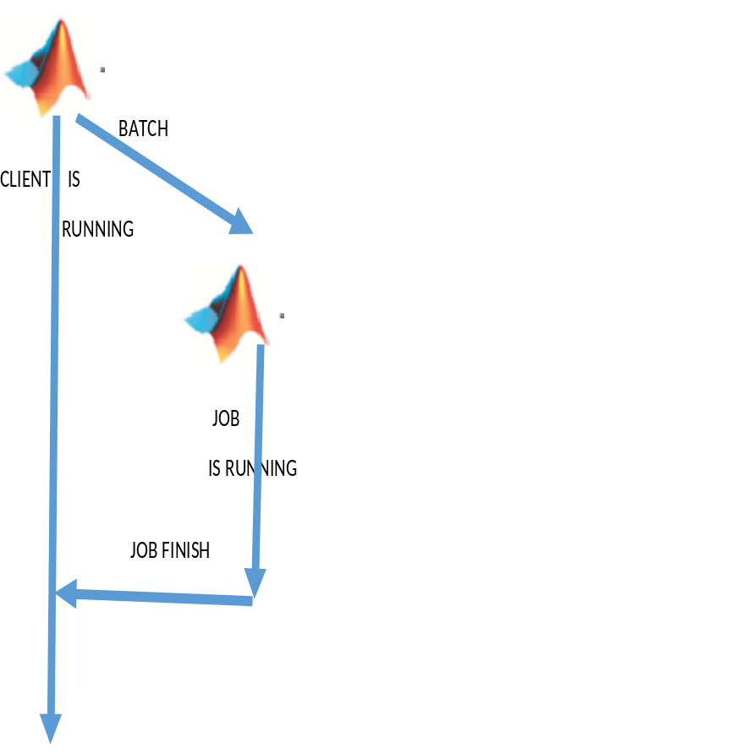
Taking advantage of MATLAB DCE
Submitting batch work from within MATLAB
During a MATLAB session, it is possible to submit MATLAB jobs to be run by another MATLAB session in the background.
Used in this way, MATLAB -
starts running tasks in another background MATLAB session ( i.e job ) ,
This background job executes the specified function or script to completion,
When the job finishes, the output from it can be retrieved to be viewed in the client space.
If you are using the local cluster profile the background job will run immediately on the computer where the MATLAB client is running.
However, if you use the sge2016 cluster the job will be submitted to the icebergs batch queues and run on an available worker node.

Slide 60
MATLAB batch command
Syntax:
j = batch('aScript')
j = batch(myCluster,'aScript')
j = batch(function,N,{x1, ..., xn})
j = batch(myCluster,fcn,N,{x1,...,xn})
j= batch( …, ‘property’ ,’value’ )
This command runs the specified MATLAB script or function on a worker in the default or specified cluster. On iceberg this will be ‘local’ or ‘sge2016’
N is the number of output arguments for function.
{x1,..xn} is a cell array containing the input arguments
In all forms, desired property values of the job can be passed as extra arguments to the batch command.
Most commonly used property/value pairs on iceberg will be ;
  ‘CaptureDiary’ , true
  ‘Profile’ , ‘sge2016’
  ‘Pool’ , nnn

Slide 61
Exercises of using the MATLAB batch command
Study the batchbeats.m script file
Run this script on iceberg using-
  The ‘local’ profile
  The ‘sge2016’ profile
Try to start up a parallel computing pool using the sge2016 profile which uses one worker only.

Slide 62
Running MATLAB Batch Jobs
(an alternative to batch command)
More organized and better controlled method of submitting batch jobs from within MATLAB is to use the createJob and createTask commands.
Once a job is submitted each MATLAB task becomes an independent SGE job. Hint: Use Qstat to observer this.
Once the tasks finish running fetchOutputs command can be used to copy results of these tasks into the MATLAB client.
Submit(job)
SGE JOB1.TASK1
MATLAB JOB
SGE JOB1.TASK2
Task 1
SGE JOB1.TASK3
Task 2
Task 3

Slide 63
Exercises for jobs and tasks
An example of a job with a single task.
Study the script batchtaskbeats1.m and run it.
An example of a job with multiple tasks
Study he script batchtaskbeats2.m and run it.
While waiting for the jobs to complete, on another iceberg terminal type Qstat to observe what is going on

Slide 64
Createcommunicationgjob

Slide 65
Obtaining graphical output from
MATLAB batch jobs
There are no interactive graphics capabilities for MATLAB batch jobs. Never-the- less it is still possible to obtain graphical output from such jobs by using the following tricks:saving pictures into files by means of the MATLAB print command.
Simply save the variables to be plotted by using the save command and later use the load command during an interactive session to plot that data.
Another method is to issue the plotting commands during the batch job itself but save the output into graphics format files by using the MATLAB print command.
Study the files batchplot1.m and batchplot2.m for the examples of these two methods.

Slide 66
Using the SGE task arrays for embarrassingly parallel tasks
Example shell script using the –t parameter.

Slide 67
How to take advantage of task arrays while running MATLAB batch jobs
SGE_TASK_ID ( explain )
Use in shell script
Use in MATLAB script

Slide 68
Practice session- P2
Open the folder ex3a_vectorizetest
Run parfordemo.m
Look at the example
  Change the pool from default profile to sge
  Change the number of workers
  Determine size of current pool

Slide 69
Apply Cluster Profiles in Client Code
Select a Default Cluster Profile
parallel.defaultClusterProfile('MyMJSprofile1')
Create Cluster Object
c = parcluster('myMJSprofile')
Create Jobs and Tasks
c = parcluster('myProfile1');
job1 = createJob(c); % Uses profile of cluster object c. createTask(job1,@rand,1,{3}) % Uses profile of cluster object c.
Notes:
In the MATLAB client where you create and define your parallel computing cluster, job, and task objects, you can use cluster profiles when creating these objects.
Select a Default Cluster Profile
Some functions support default profiles, so that if you do not specify a profile for them, they automatically apply the default. There are several ways to specify which of your profiles should be used as the default profile:
On the Home tab in the Environment section, click Parallel > Default Cluster, and from there, all your profiles are available. The default profile is indicated. You can select any profile in the list as the default.
The Cluster Profile Manager indicates which is the default profile. You can select any profile in the list, then click Set as Default.
You can get or set the default profile programmatically by using the parallel.defaultClusterProfile function. The following sets of commands achieve the same thing:
parallel.defaultClusterProfile('MyMJSprofile1') parpoolor
parpool('MyMJSprofile1')
Create Cluster Object
The parcluster function creates a cluster object in your workspace according to the specified profile. The profile identifies a particular cluster and applies property values. For example,
c = parcluster('myMJSprofile')
This command finds the cluster defined by the settings of the profile named myMJSprofile and sets property values on the cluster object based on settings in the profile. By applying different profiles, you can alter your cluster choices without changing your MATLAB application code.
Create Jobs and Tasks
Because the properties of cluster, job, and task objects can be defined in a profile, you do not have to explicitly define them in your application. Therefore, your code can accommodate any type of cluster without being modified. For example, the following code uses one profile to set properties on cluster, job, and task objects:
c = parcluster('myProfile1'); job1 = createJob(c); % Uses profile of cluster object c. createTask(job1,@rand,1,{3}) % Uses profile of cluster object c.

Slide 70
Practice session- P3
Open the folder ex3_parmatlab_qscatter
Run qscattersigma_dct1.m
Look at the example
  Find the cluster identified by the default parallel computing cluster profile
  create an independent job on the cluster

Slide 71
Making Matlab Use More Compute Resource
Compute Cluster e.g. Iceberg
Uses a scheduler e.g. Sun Grid Engine
Break a matlab job in to many independent tasks
  E.g. cycle of a for loop might run independently
Array of matlab tasks running on compute cluster
Can run 100’s of tasks
Good for
  parametric sampling
  Genetic algorithms
  Model ensembles

Slide 72
Practice session- P4
Task arrays
  Using ex1_taskarray
  Run an array of tasks for the beats program
  Your rask should run 4 instances of the beats function
  Plot the results

Slide 73
References
  See: http://uk.mathworks.com/help/distcomp/parallel-for-loops-parfor.html
  http://uk.mathworks.com/help/distcomp/functionlist.html

