Slide 1

MATLAB
Parallel Computing
UNIVERSITY OF SHEFFIELD
CiCS DEPARTMENT
Deniz Savas & Mike Griffiths
Feb.2015

Slide 2
SUMMARY OF TOPICS
Concepts of Parallel Programming
  Task parallelism
  Data distribution to parallel tasks
Parallel MATLAB on your workstation
Parallel MATLAB on iceberg
Distributed Computing Engine

Slide 3
Parallel Computing Toolbox
Perform parallel MATLAB computations on
  multicore computers
  computer clusters
  GPUs
Notes:
Parallel Computing Toolbox™ lets you solve computationally and data-intensive problems using multicore processors, GPUs, and computer clusters. High-level constructs—parallel for-loops, special array types, and parallelized numerical algorithms—let you parallelize MATLAB® applications without CUDA or MPI programming.

Slide 4
Key Features
Parallel for-loops (parfor)
Support for CUDA-enabled NVIDIA GPUs
multicore processors
Computer cluster and grid support
Interactive and batch execution of parallel applications
Distributed arrays and spmd
Notes:
Parallel for-loops (parfor) for running task-parallel algorithms on multiple processors
Support for CUDA-enabled NVIDIA GPUs
Full use of multicore processors on the desktop via workers that run locally
Computer cluster and grid support (with MATLAB Distributed Computing Server)
Interactive and batch execution of parallel applications
Distributed arrays and single program multiple data (spmd) construct for large dataset handling and data-parallel algorithms

Slide 5
TYPES OF PARALLEL WORKING
IMPLICIT PARALLELISM
MATLAB automatically runs the code using multiple processes by using the default parallel profile.
Example : parfor loops
EXPLICIT PARALLELISM
User starts a type of parallel working environment explicitly by using the commands –
parpool , spmd or pmode

Slide 6
IMPLICIT PARALLELISIM
Using The Parallel Computing Toolbox on your workstation ( local pool )
It is possible to use parallel processing implicitly by simply using the parfor syntax.
Note: The first time you run MATLAB in parallel, you may get firewall exemptions messages for programs such as spmd.exe and mpiexec. You should allow these exemptions.
Example:
parfor i=1:1024
A(i) = sin(i*2*pi/1024);
end
When running this code, Matlab will automatically startup a set of workers that will share the parfor task amongst themselves.
By default MATLAB will use as many workers as there are cores on the workstation. For example on a quad-core machine MATLAB will use 4 workers to tackle the above parfor loop.
Note: The original Matlab process remains in place and makes use of these extra workers. Hence it is sometimes refered to as the ’Client’ process. Therefore a Matlab parallel job will have one client + number of workers instances of MATLAB.

Slide 7
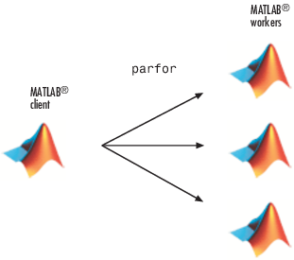
Run a Loop in Parallel
SERIAL RUN:
Create a sine wave and plot the waveform
for i = 1:1024
A(i) = sin(i*2*pi/1024);
end
plot(A)
PARALLEL RUN the same task
parfor i = 1:1024
A(i) = sin(i*2*pi/1024) ;
end
plot(A)
Notes:
You can execute parallel applications interactively and in batch using Parallel Computing Toolbox. Using the parpool command, you can connect your MATLAB session to a pool of MATLAB workers that can run either locally on your desktop (using the toolbox) or on a computer cluster (using MATLAB Distributed Computing Server) to setup a dedicated interactive parallel execution environment. You can execute parallel applications from the MATLAB prompt on these workers and retrieve results immediately as computations finish, just as you would in any MATLAB session.

Slide 8
Practical 1
edit pexample1.m in your matlab examples directory to see what it contains.
Run this example by typing pexample1
you may have to wait patiently for the parallel pool to start
After the script runs observe workspace and type type plot(A) to see the results.
Click on the bottom LH corner of MATLAB desktop and check parallel preferences.

Slide 9
EXPLICIT PARALLEL WORKING MODES
PARPOOL COMMAND
One client multiple workers model
User talks to client via MATLAB commands
and client sends tasks to workers via parallel
prog. constructs such as parfor, parfeval.
( i.e indirect control of workers)
worker1
CLIENT
worker2
worker3
workerN

Slide 10
Starting a Parallel Pool
As we have already seen, a parfor statement can implicitly and ‘automatically’ start a parallel pool using the default profile.
We can explicitly start up a parallel pool by using either of the commands parpool or gcp .
gcp command opens a parallel pool using the default profile.
parpool command allow us to control the characteristics of the pool during its creation.
For example: parpool ( 8 ) will startup a parallel pool with 8 workers.
Having opened a parallel pool we can check on its details and also return its handle via the call: phandle = gcp( ‘nocreate’ )
Once a parallel pool is open, it remains open in the background waiting to service parallel tasks ( such as another parfor loop ) or until it times out ( by default in 30 minutes ) due to no other parallel activity.
It is possible to explicitly close down the current parallel pool by issuing a the following command: delete(gcp)
If the handle of the pool was obtained during creation, the following command can also be used delete(phandle )

Slide 11
parpool command details
parpool command enables the full functionality of the parallel language features such as spmd, parfor, parfeval by starting a pool of workers and attaching them to the current session of MATLAB (‘the client’ ). This is an explicit way of starting a MATLAB pool which has the advantage of greater control on the number of workers etc.
parpool % start default profile pool with maximum workers
parpool ( n ) %start default profile with n workers
p= parpool ( ‘profile’ , n ) % start profile with n workers, also return
% handle of pool .
Examples:
parpool ( 3 )
parpool ( ‘local’ , 4 )
parpool ( ‘bigpool’ , 16 )

Slide 12
parpool example
parpool ( ‘local’ , 4 ) % parallel region starts with 4 workers.
parfor i = 1:4096
R(i) = myfunction( i ) ;
end
plot( R ) ;
delete ( cgp ) % this command closes the parallel pool
% from now on serial working.
% Note that parfor would also automatically start a pool if there was
% not one already open but only with default specifications.

Slide 13
Parallel Working by using the parfeval function
Syntax: R = parfeval( pool , @function,nout, in1,in2, … )
When invoked this way a worker in the pool evaluates –
[ results ] = function( in1 , in2 , … )
,where results is nout number of output arguments.
For example if nout=2 then [a b] = function(in1,in2 ,… )
The results can be retrieved by a subsequent fetchNext or fetchOutputs call.
See exercise parexample2.m
When multiple calls are made to parfeval, as is usually the case, Matlab automatically organizes the distribution of each of these tasks to workers , forming a queue if there are less workers than tasks.

Slide 14
Practical - 2
Study the script parexample2.m which gives a demonstration of the use of the parfeval function to distribute tasks to the workers in the parallel pool.
Run this script and observe what happens.

Slide 15
gcp command and keyword.
gpc is a MATLAB command and also a keyword.
The command can be used either to start a default pool in a similar manner to using parpool or find out the handle of the pool.
p=gcp % start the default cluster or return the
% currently open pools object handle
Once we have the handle we can find out its characteristics as well as be able to close it by typing -
delete ( p )
By default the keyword gcp contains the currently open pool’s handle.
So, delete(gcp) will always close the currently open pool.

Slide 16
Practical-3
Type - gcp and observe the output.
How many workers are in the parallel pool ?
Type - delete(gcp ) and observe that the parallel pool closed.
Type - parpool ( ‘local’ , 4 )
Has a pool started ?
Using gcp find the number of workers in the pool.

Slide 17
Cluster Profiles
So far, we had no control over the profile of the parallel cluster. Therefore we have been using the default cluster profile in all our examples.
We will now look into defining our own bespoke cluster profiles.
A cluster is simply a predefined collection of MATLAB processes in the form of one client and a number of workers serving that client.
There are two types of clusters ( local ) and ( scheduler )
local clusters : use the processors on your machine.
job Scheduler clusters (sge): Submit jobs to remote machines.
A cluster profile named ‘local’ is predefined by MATLAB after it detects the number of cores on the host computer.
A GUI window named Cluster Profile Manager allows us to define a new cluster or customize and existing cluster profile.
We can then use this new cluster profile for our parallel jobs.

Slide 18
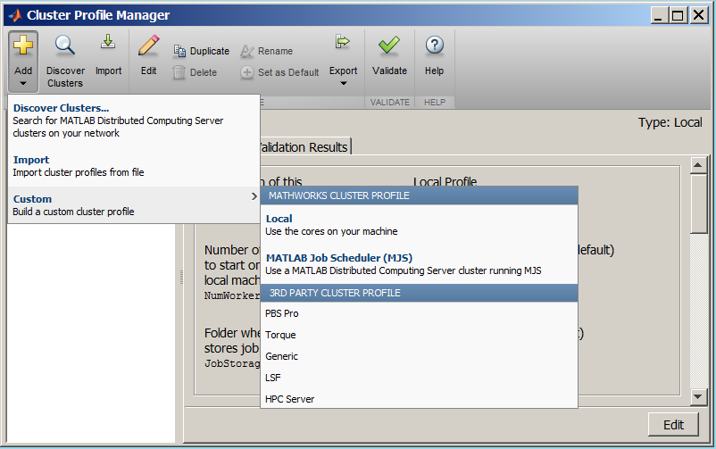
Defining new cluster profiles
Example Select Add > Custom > Local
to add a new local cluster profile.
In the resulting window click on Edit

Slide 19
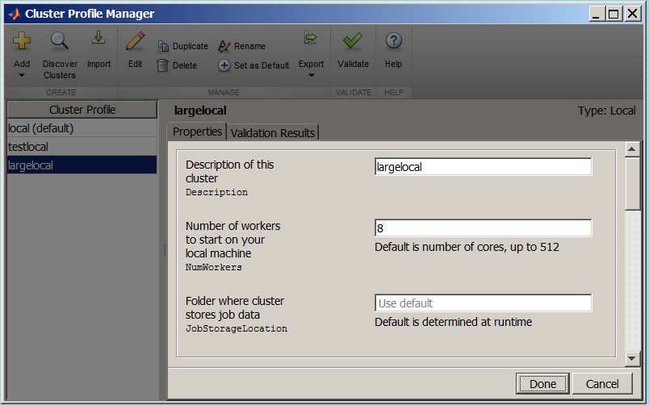
Defining new Cluster Profiles
The edit Cluster Profile window allows us to specify the number of workers to be used in the cluster. If left as ‘Use Default’ the number of workers to create will be the number of physical cores available at the time of running.

Slide 20
Practical - 4
By using the “Cluster Profile Manager” define a new cluster profile that contains 6 workers.
Make this new cluster profile the default one.
Shut down the current parallel pool ( if it is running )
delete(gcp)
Start a new parallel pool: parpool
Type newpool=gcp to find out about this pools properties.

Slide 21
Parallel Pool Preferences
Preferences for the parallel pool can be set via the preferences icon.
Having defined different “Cluster Profiles” via the “Cluster Profile Manager” , “Parallel Computing Toolbox Preferences window” allows designating one of these profiles as the default profile ( to be used when starting a parallel pool automatically ).
As well as parpool ‘without any parameters’ the statements parfor, spmd, distributed, Composite, parfeval statements will also attempt to automatically start the default profile pool of workers.
Parallel Pool Preferences also allows control of the following:
  Maximum number of workers allowed in a parallel pool,
  Allow/Disallow automatic starting of a parallel pool,
  Set default idle time before a parallel pool closes itself.

Slide 22
Practical 5
Using the Parallel Computing Toolbox Preferences window alter the idle time setting of your new cluster profile.

Slide 23
Selecting the Cluster Profile to use
Example
Having defined a cluster profile named largelocal which can have 8 workers, a parallel pool that uses these 8 workers can now be started by typing;
parpool ( ‘largelocal’ )
If less number of workers is needed then it can be specified for the parpool invocation.
e.g. parpool (‘largelocal’ , 6 )
It is always possible to check the number of workers available in the currently open cluster via the following commands;
p=gcp(‘nocreate’) ;
p.NumWorkers
The current parallel pool can be closed by using the command: delete(gcp)

Slide 24
SPMD COMMAND
SPMD model : Single Program/Multiple Data
Same block of code runs simultaneously on all workers
CLIENT
spmd
Program flow
worker1
worker2
worker3
worker4
end
CLIENT

Slide 25
Single Program Multiple Data (spmd)
Syntax: spmd , spmd (n ) or spmd(m,n )
The single program multiple data (spmd) construct lets you define a block of code that runs in parallel on all the workers in the parallel pool. The spmd block can run on some or all the workers in the pool.
spmd % By default creates pool and uses all workers
R = rand(8);
end
This code creates an individual 8-by-8 matrix, R, of random numbers on each worker in the pool.
Normally we refer to labindex variable in an spmd block to do any useful work ( i.e not to replicate work ).
On each worker labindex will contain a unique value (between 1 and n, where n is the total number of workers). Without this feature spmd constructs would be practically useless !

Slide 26
spmd examples
The following example runs an spmd cluster of 4 workers. Each worker reads input from a different file and calls a function to perform operations using the data it has just read.
spmd (4)
datafile = [ ‘mydata' , num2str(labindex) ]
labdata = load( datafile )
result = MyFunction(labdata)
end
Making use of the results:
The labdata array and the result array is unique to each worker and within the spmd block it can be accessed as any MATLAB array.
However, these arrays are reflected to the client as composite objects.
A composite object has the same syntax as the cell array where each cell contains the value of the object on each worker.
For example result{1} contains the result array for worker number 1. ( i.e. the worker with labindex=1 )

Slide 27
pmode command
Starting the parallel mode:
pmode ( ‘start’ , ‘profile_name’ , nworkers )
Example: pmode ( ‘start’ ,’local’ , 4 )
Stopping the parallel mode:
pmode ( ‘exit’ ) or pmode( ‘quit’ )
Notes:
Each worker has its own workspace.
Workers do not have graphics capabilities.
All variables for plotting must be transferred to the client.

Slide 28
PMODE EXPLICIT PARALLEL
WORKING MODE
PMODE is also known as interactive parallel development mode.
multiple communicating workers model
Each command on parallel command window is executed by all workers.
The workers can communicate with the client and each other.
a variable named labindex is unique to each worker.
Useful commands: gather, distributed, lab2client, client2lab
CLIENT
worker1
worker2
worker3
workerN
CLIENT COMMAND WINDOW >>
PARALLEL COMMAND WINDOW >>

Slide 29
Where is data stored when working in parallel ?
Composites
Distributed/Co-distributed Arrays

Slide 30
distributed and codistributed arrays
These are arrays that straddle across the workers.
Distributed arrays/object can only be created in the client context ( i.e. outside the parallel region ) .
Codistributed arrays are created in the spmd or pmode workers ( i.e within an spmd or pmode block ).
This way of working may be of value when working with very large arrays where the data is too big to fit into the memory of the MATLAB client and hence have to be broken into sections each of which is stored in the memory of a worker.

Slide 31
Distributing data to parallel tasks
Variables created in the client context remain available only on the client worker.
e.g A=rand(30,30);
Having created an array in the client context we can distribute it to the workers;
e.g. B = distributed( A ) ;
If we need to create a large array that will not fit the memory of a single worker then we can create as a distributed array directly by defining its class as ‘distributed’ during the creation.
e.g C=rand(30,30,’distributed’ ) ;
Performing operations on distributed arrays yield distributed results
A distributed array can be ‘undistributed’ i.e. moved completely into the client by a gather operation;
e.g. CC = gather( C ) ;
If gather is executed inside an spmd statement, pmode, or communicating job, the data is replicated in its entirety on every worker.

Slide 32
Data on workers
Composites
Following an spmd statement, in the client context, the values from the block are accessible, even though the data is actually stored on the workers.
On the client, these variables are called Composite objects. Each element of a composite is a symbol referencing the value (data) on a worker in the pool. Note that because a variable might not be defined on every worker, a Composite might have undefined elements.
Continuing with the example from above, on the client, the Composite R has one element for each worker:
X = R{3}; % Set X to the value of R from worker 3.

Slide 33
Example distributed and codistributed arrays

Slide 34
Examples of gather, lab2client, client2lab, distributed, composite

Slide 35
Running MATLAB batch jobs
How does a batch job differ from an interactive job ?
  You can not interact with it via a mouse or keyboard.
  Instead you present MATLAB with a file of your commands ( i.e. a MATLAB script to be executed )
  There can be no graphics output onto the monitor ( but you can save your graphs into files via the MATLAB print command )
  Output which would have appear on the screen if working interactively will be saved into a job output file when running in batch mode.
Example shell script

Slide 36
Submitting a MATLAB job to the batch system
On iceberg if we wish to run a set of Linux commands in batch-mode we simply put these commands into a file ( called a shell_script file) and then use the qsub command to submit it to the scheduler.
We refer to this act as submitting a job.
Having received the submitted job, the job scheduler (SGE) finds a suitable machine on the iceberg cluster and starts running it.
Output from the job (which would have been destined for the terminal ) is saved into job_output files instead.

Slide 37
An example of MATLAB batch submission
This job will run the matlab script mymatlabscript.m in batch.
Create the job shell-script using a text editor ( such as gedit ) enter the following lines into a file named myfirstjob.sh:
#!/bin/bash
#
#
#$ -j y
module load apps/matlab/2015a
matlab -nodisplay < mymatlabscript.m
2. Submit the job to the scheduler:
qsub myfirstjob.sh
3. Follow the progress of the job by typing: Qstat
4.When the job finishes the job-output can be viewed -
in a file named: myfirstjob.o12345678
where 12345678 stands for the actual job number, which is unique to the job.

Slide 38
Obtaining graphical output from
MATLAB batch jobs
There are no interactive graphics capabilities for MATLAB batch jobs. Never-the- less it is still possible to obtain graphical output from such jobs by using the following tricks:saving pictures into files by means of the MATLAB print command.
Simply save the variables to be plotted by using the save command and later use the load command during an interactive session to plot that data.
Another method is to issue the plotting commands during the batch job itself but save the output into graphics format files by using the MATLAB print command.
Study the files batchplot1.m and batchplot2.m for the examples of these two methods.

Slide 39
Using the SGE task arrays for embarrassingly parallel tasks
Example shell script using the –t parameter.

Slide 40
How to take advantage of task arrays while running MATLAB batch jobs
SGE_TASK_ID ( explain )
Use in shell script
Use in MATLAB script

Slide 41
Practice session- P2
Open the folder ex3a_vectorizetest
Run parfordemo.m
Look at the example
  Change the pool from default profile to sge
  Change the number of workers
  Determine size of current pool

Slide 42
Apply Cluster Profiles in Client Code
Select a Default Cluster Profile
parallel.defaultClusterProfile('MyMJSprofile1')
Create Cluster Object
c = parcluster('myMJSprofile')
Create Jobs and Tasks
c = parcluster('myProfile1');
job1 = createJob(c); % Uses profile of cluster object c. createTask(job1,@rand,1,{3}) % Uses profile of cluster object c.
Notes:
In the MATLAB client where you create and define your parallel computing cluster, job, and task objects, you can use cluster profiles when creating these objects.
Select a Default Cluster Profile
Some functions support default profiles, so that if you do not specify a profile for them, they automatically apply the default. There are several ways to specify which of your profiles should be used as the default profile:
On the Home tab in the Environment section, click Parallel > Default Cluster, and from there, all your profiles are available. The default profile is indicated. You can select any profile in the list as the default.
The Cluster Profile Manager indicates which is the default profile. You can select any profile in the list, then click Set as Default.
You can get or set the default profile programmatically by using the parallel.defaultClusterProfile function. The following sets of commands achieve the same thing:
parallel.defaultClusterProfile('MyMJSprofile1') parpoolor
parpool('MyMJSprofile1')
Create Cluster Object
The parcluster function creates a cluster object in your workspace according to the specified profile. The profile identifies a particular cluster and applies property values. For example,
c = parcluster('myMJSprofile')
This command finds the cluster defined by the settings of the profile named myMJSprofile and sets property values on the cluster object based on settings in the profile. By applying different profiles, you can alter your cluster choices without changing your MATLAB application code.
Create Jobs and Tasks
Because the properties of cluster, job, and task objects can be defined in a profile, you do not have to explicitly define them in your application. Therefore, your code can accommodate any type of cluster without being modified. For example, the following code uses one profile to set properties on cluster, job, and task objects:
c = parcluster('myProfile1'); job1 = createJob(c); % Uses profile of cluster object c. createTask(job1,@rand,1,{3}) % Uses profile of cluster object c.

Slide 43
Practice session- P3
Open the folder ex3_parmatlab_qscatter
Run qscattersigma_dct1.m
Look at the example
  Find the cluster identified by the default parallel computing cluster profile
  create an independent job on the cluster

Slide 44
Making Matlab Use More Compute Resource
Compute Cluster e.g. Iceberg
Uses a scheduler e.g. Sun Grid Engine
Break a matlab job in to many independent tasks
  E.g. cycle of a for loop might run independently
Array of matlab tasks running on compute cluster
Can run 100’s of tasks
Good for
  parametric sampling
  Genetic algorithms
  Model ensembles

Slide 45
Practice session- P4
Task arrays
  Using ex1_taskarray
  Run an array of tasks for the beats program
  Your rask should run 4 instances of the beats function
  Plot the results

Slide 46
References
  See: http://uk.mathworks.com/help/distcomp/parallel-for-loops-parfor.html
  http://uk.mathworks.com/help/distcomp/functionlist.html

