Slide 1
CSEN160
Fall 2026
Object-Oriented Analysis, Design and Programming
Michael Schimpf, PhD
Department of Computer Science and Engineering

Slide 2
Why Object Oriented Software Development?

Slide 3
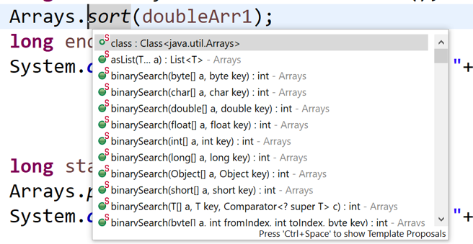
Why Object Oriented?
OO is actual amazing because:
Classes/object dot notation:
Information Hiding
Write code only once (no duplicates)
In general, it is easier to understand/design/analyze
Without OO, it would be only C

Slide 4
OOA, OOD & OOP

Slide 5
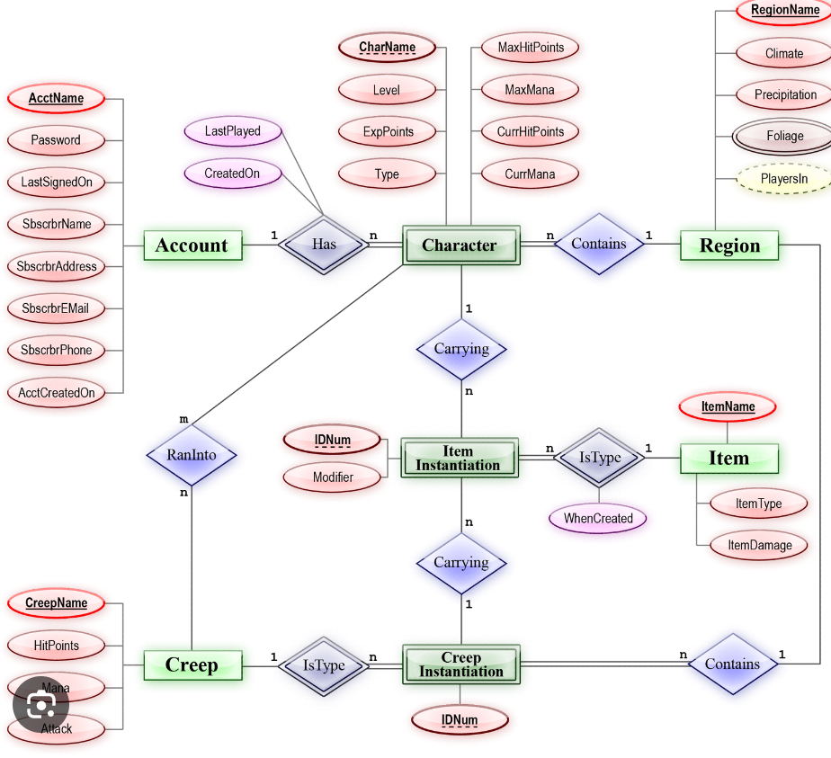
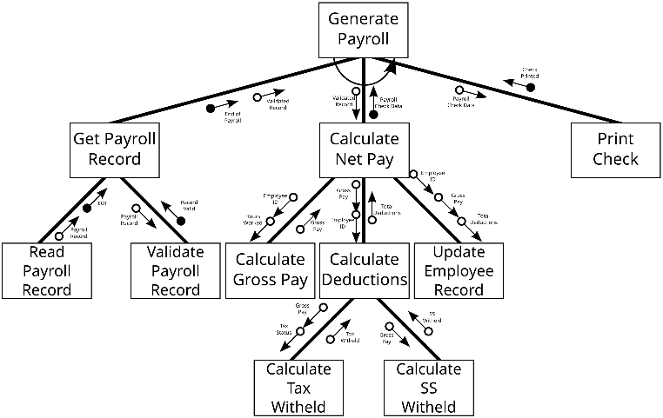
OO Analysis:
To create a model of the system
Independent of implementation details
Use cases
Entity Relationship (ER) diagram
Structure charts
Memorize: OOA => use cases

Slide 6
OO Design:
Decompose complex systems
Add implementation constrains
Class diagram
Sequence diagram
State diagram
…
Memorize: OOD => use cases to rest of UML

Slide 7
OO Programming (Java):
Implement everything
Classes
Objects
Interfaces
Abstract classes
Inheritance
etc.
Memorize: Implement object oriented…

Slide 8
… to here …

Slide 9
Why are we doing OOA and OOD?

Slide 10
  Waterfall Software Development
  Do everything in steps
  Requirement analysis
  Design
  Implementation
  Done

Slide 11
  Agile Software Development
  Do everything in small iterations/cycles
  Every cycle includes:
    Requirements analysis (change request)
    Update design
    Continue implementation
  Done

Slide 12
Basics of Object-Oriented Programming

Slide 13
Key phases in OO application development
OO Analysis: Gather requirements, discovers classes, objects, etc.
OO Design:
  Structuring a complex system using OO decomposition.
  Express in different models (state, class, sequence, …)
OO Programming:
  Implementation using classes and objects.
  Objects with interface + hidden local state.
  Objects have types.
  Types are arranged in hierarchies

Slide 14
Object-Oriented Principles
Encapsulation and Information Hiding
Abstraction
Inheritance (an is-a hierarchy)
Polymorphism

Slide 15
Major components of an Object Model
Object Model Concepts
  Structural and behavioral aspects.
Notation
  The language for expressing the model.
Process
  Activities to construct the system’s models.
Tools
  Support for specific notations, syntax and semantic checking and code generation.
Quality Criteria
  A set of criteria to determine the quality of the system.

Slide 16
Evolution Of Object Model
Object-based and Object-Oriented Programming languages:
Logical building blocks – Classes and Objects.
Physical Building Block - Module
Objects can be arranged in layers of clusters

Slide 17
Benefits of the Object Model
A better management of complexity… (big code base)
… provides a “better model of reality” (think in objects).
Encourages reuse.
Systems are more resilient to change and evolve easier.

Slide 18
More Vocabulary of OO systems
Instantiation: Creating objects from classes
Methods: A procedure associated with an object class.
Messages: Binding of procedure names to behavior.

Slide 19
Basic IntelliJ examples:
Class
Extends
Constructor

Slide 20
Object-Oriented
Bank Account Example

Slide 21
An Object-Oriented (OO) System
To understand object-oriented concepts and OO design
example: banking
A simple bank:
A bank has customers.
A bank has bank accounts.
A bank customer has bank accounts.
A bank account can be a:
  CheckingAccount
  SavingsAccount
  PerformanceSavingsAccount
A customer:
  Get balance (of an account)
  Get interest rate (of an account)
  Deposits money
  Withdraws money.

Slide 22
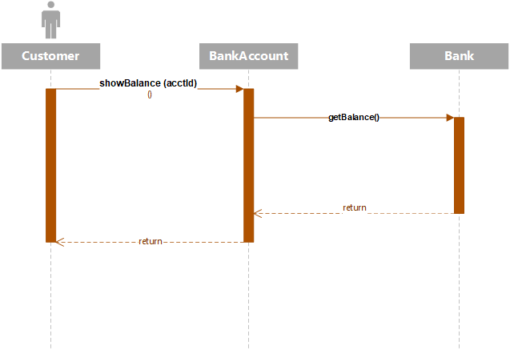
An Object-Oriented System
A customer calls a showBalance() function on a bank object;
a bank object calls getBalance() function on a bank account object.

Slide 23
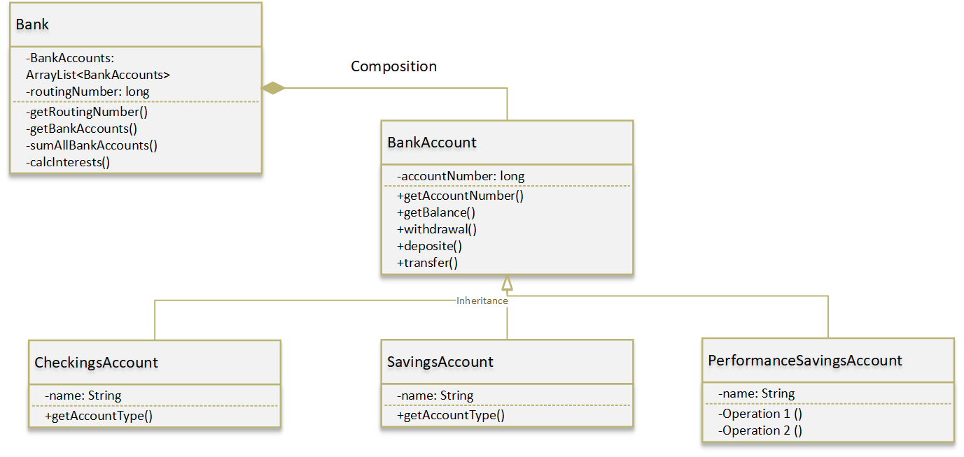
An Object-Oriented System
An object-oriented system consists of a network of objects
Objects store data and perform actions.

Slide 24
Objects
Objects are instances of classes.
A class is a template that describes the structural and behavioral
properties of a set of objects.
An object contains values.
An object has a state.

Slide 25

What are Objects?
Objects are “things” that encapsulate data and behavior (actions called methods).
Objects can be “physical” things
(eg: teacher, book, fish).
Objects can be “conceptual” things
(eg: registration, payment, bank account).
Objects correspond to “nouns” in problem description.

Slide 26
What are objects?
Objects encapsulate data and behavior.
A Bank Account object has:
  accountNumber
  ballance
  deposit ()
  withdraw ()
  getBalance()
data
methods (functions)
(behavior)

Slide 27
What are objects?
Objects may have an internal structure (private).
  Eg: A bank account store data:
    accountNumber
    ballance
    etc.
Objects reveal themselves by their external behavior (public methods).
  Eg: A back account public methods, like:
    deposit
    withdraw
    etc.

Slide 28
What are objects?
Objects reveal their “public behavior” but keep their
"inside" (or implementation) hidden.
The “public behavior” of objects is through a set of methods (functions) that are offered to clients of objects.
The methods (functions) can be invoked by clients.
A client is an object that invokes the methods of an object.

Slide 29
Objects = data + methods
An object of type BankAccount
private
public
Client
deposit()
acctId
A client can call any public methods
data
withdraw()
balance
getBalance()
calcInterest()
methods

Slide 30
Class and inheritance

Slide 31
What is a class
A class is a blueprint that defines variables and methods
A class can be used many times to create many objects.
Objects are created as instances of a class.

Slide 32
Class vs Object
private
public
private
public
deposit()
deposit()
acctId
acctId=A12
withdraw()
balance
Balance=100.00
withdraw()
getBalance()
getBalance()
calcInterest()
calcInterest()
myAccount – an object
of type BankAccount
BankAccount – a class

Slide 33
Encapsulation
Information Hiding

Slide 34
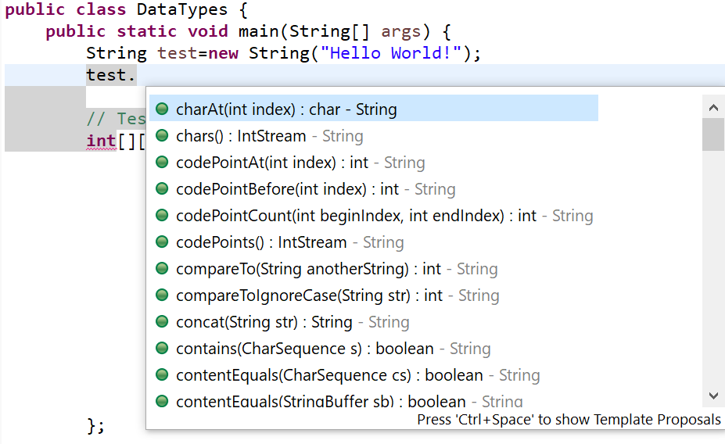
Information hiding
In a class:
public features can be seen and manipulated by anybody –
they are the external (interface) view.
private features can be manipulated by only the other members of that class.
They are the internal (implementation) view.
Good OO design recommends that
  methods are public and
  data fields are private.

Slide 35
Encapsulation
Encapsulation: process of packaging related code and data as a single unit.
Encapsulation supports information hiding.
Hides the complexity of implementation details.
It focuses on the observable behavior (interface) of an object.

Slide 36
Class Diagram
(continue)

Slide 37
Hierarchy
Has-A component(s)
  has_A or containment:
  Division into component parts
  Characterized by sentences that have the words “has-a”:
    A car has-a engine
    A bicycle has-a wheel(s )
    A window has-a menu bar
  Drop down level of complexity.

Slide 38
Inheritance (is-a hierarchy)
Is-A inherited feature
Inheritance: complex system viewed as an instance of a more general abstraction.
Characterized by “is-a” (extends):
  A car is-a wheeled vehicle, which is-a means of transportation
  A bicycle is-a wheeled vehicle
  A pack horse is-a means of transportation

Slide 39
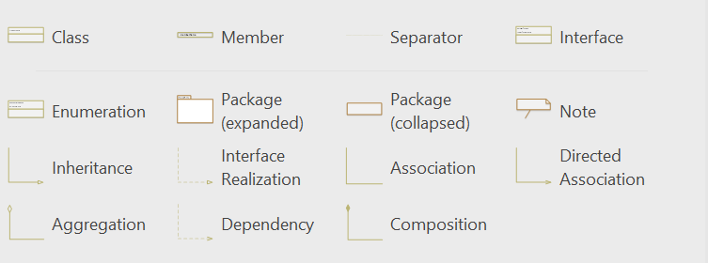
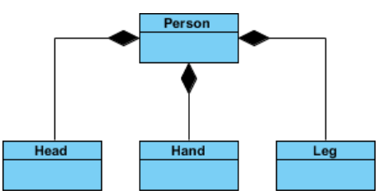
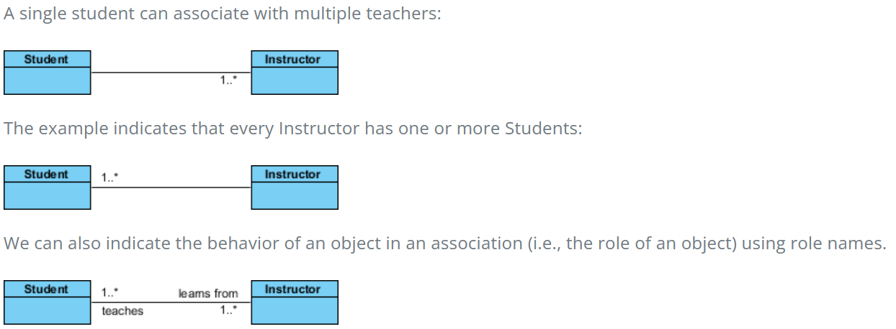
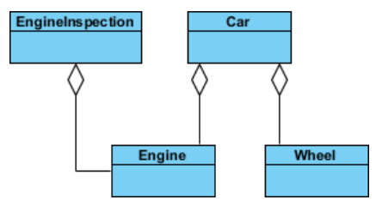
Class diagram (Visio)
one element depends on another element.
to indicate that a change of one might require
a change to the other.
A server knows a customer,
but a customer does not know
the server
Needs at least one person
doesn't state in any way that Class A
owns Class B nor that there's a
parent-child relationship
strong lifecycle dependency between the
two: meaning that when Person is deleted
then Head, Hand, Leg will also be deleted!

Slide 40
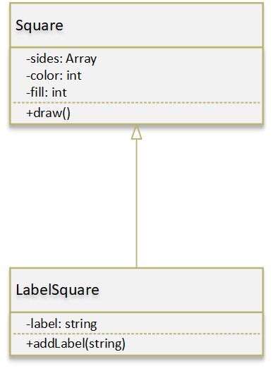
Inheritance
Wording is Important!
Super class
Base class
Parent class
Visibility:
+ Public
- Private
# Protected
~ Package/Internal
A super class is a generalization of a subclass
A derived class is an extension of a base class
A parent class is extended by a child class
Subclass
Derived class
Child class

Slide 41
Inheritance
Visibility:
+ Public:
Access everywhere.
Accessed from within the class, outside the class, within the package
and outside the package.
- Private:
Access is only within the class.
It cannot be accessed from outside the class.
# Protected:
Access is within the package and outside the package through child class.
If you do not make the child class, it cannot be accessed from outside the package.
~ Package/Internal/default:
Access is only within the package.
It cannot be accessed from outside the package.

Slide 42
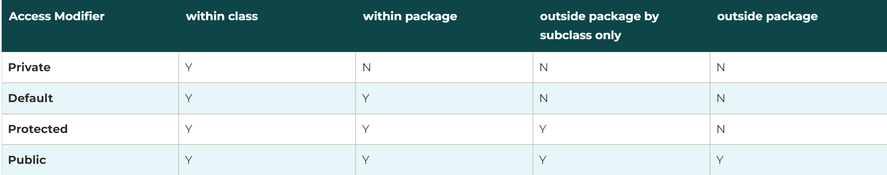
Inheritance
Personal: I use in general public/private and if need to …

Slide 43
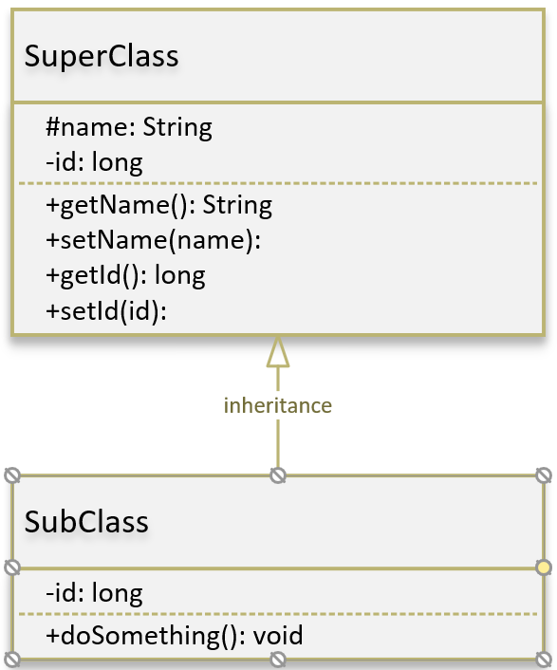
Inheritance
this and super
“this”:
Access everything from this current class
Recommend to use it often
“super”:
Access everything in superclass
Careful when using it

Slide 44
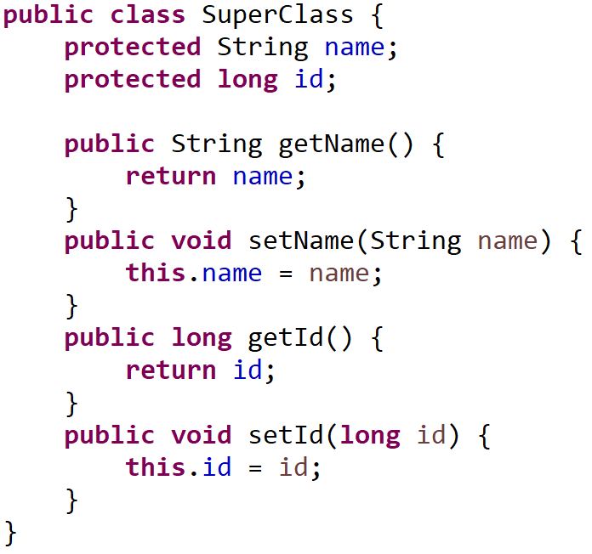
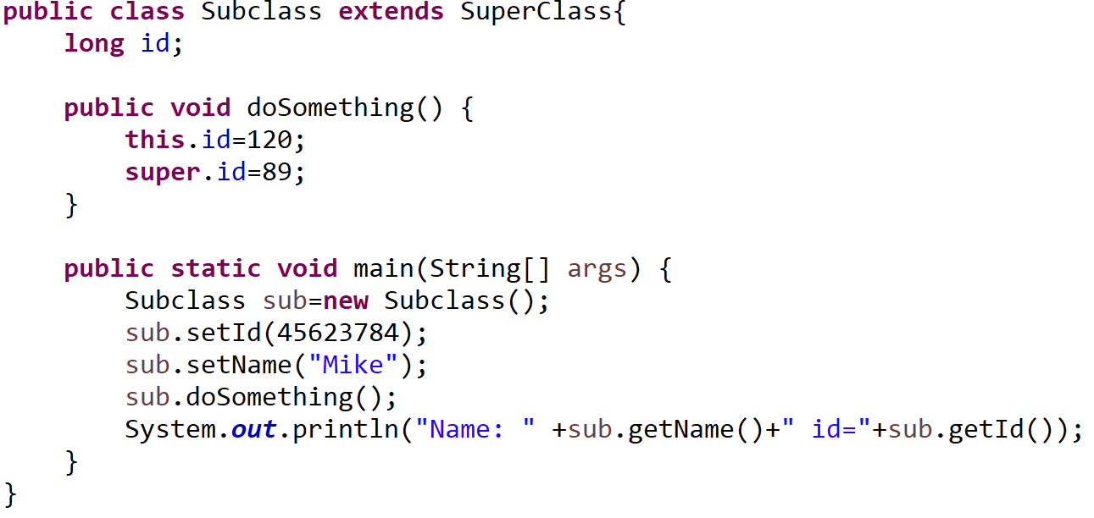
Inheritance
this and super
What is the outcome?

Slide 45
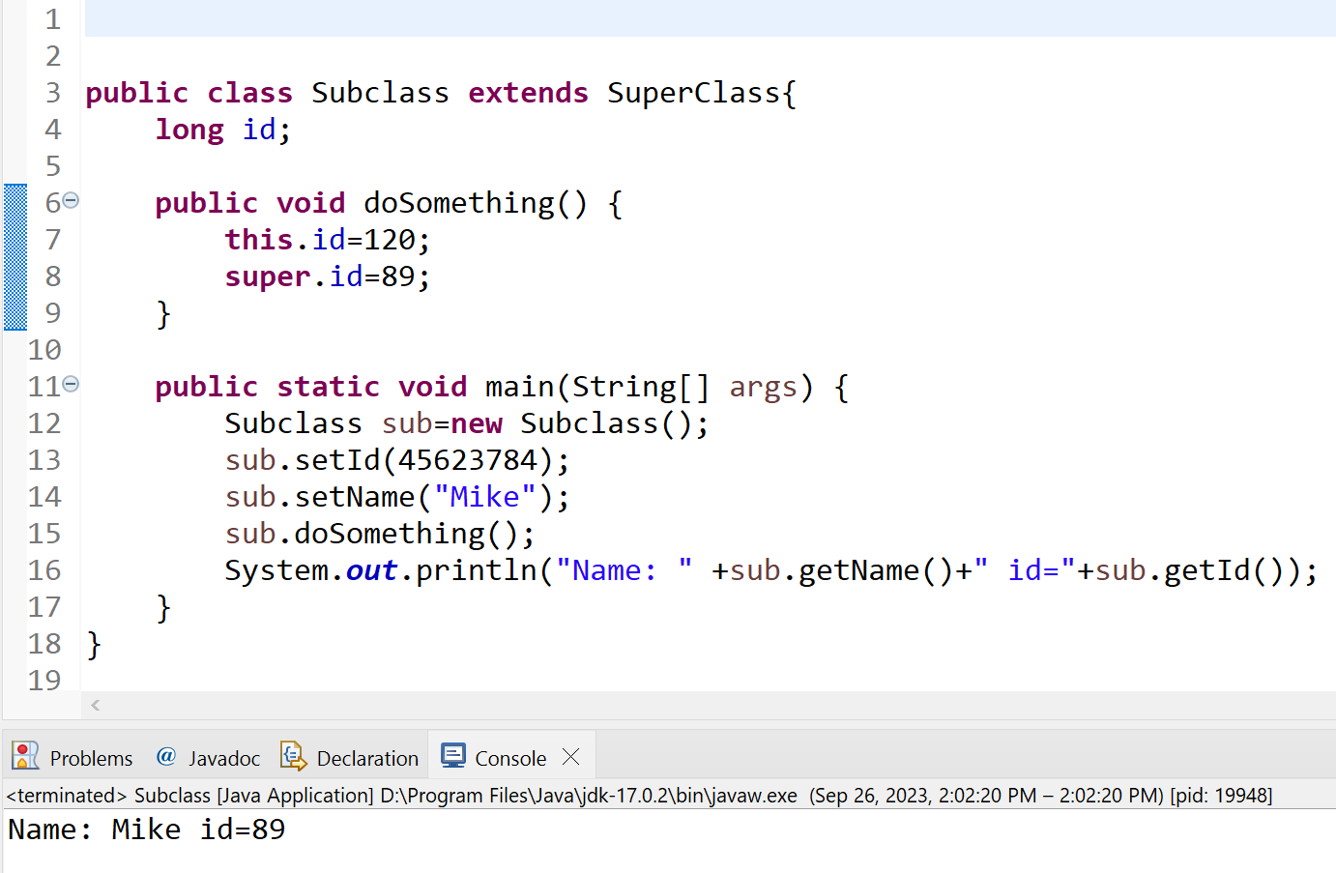
Inheritance
this and super
What is the outcome?
id again, creates confusion!

Slide 46
Inheritance
this and super
Be carful with member variables and inheritance:
Easy to make a mistake
Redefinition of members (child) => no error
Mixing up “this” and “super”
Methods in different inheritance levels access member vars, but:
  Maybe “this” member vars in one method but “super” in other methods
  Be consistent

Slide 47
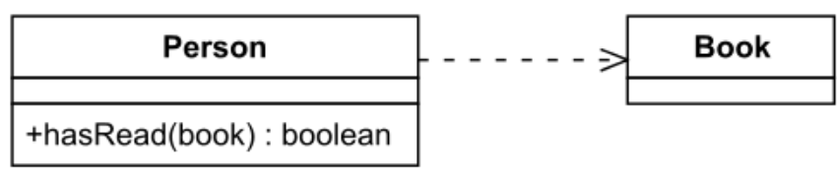
Dependency
one element depends on another element.
to indicate that a change of one might require
a change to the other.
Object of one class use an object of another class, but not obvious!
If the object is not stored in any field, then this is modeled as a dependency relationship.
But only if it is important because it is redesigned a lot and created errors in the past.
Person has no member “Book”!

Slide 48
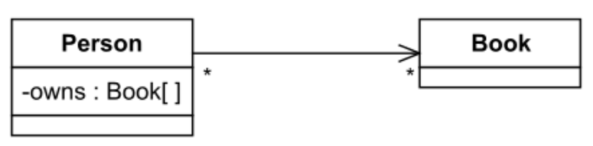
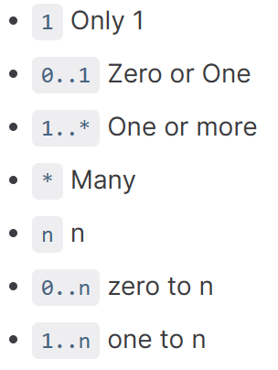
Unidirectional Association
One way association
An object store another object in a field.
For example: people own books,
modeled by an owns field in Person objects.
A book be owned by many people,
so reverse direction is not modeled.
Cardinality:

Slide 49
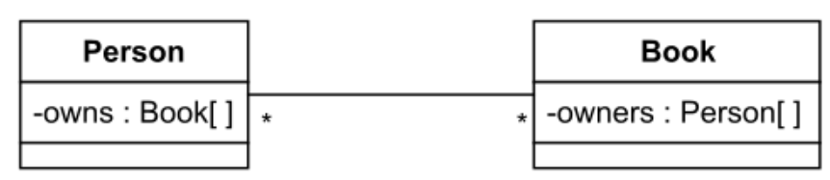
Bidirectional Association
Both classes/objects knows each other
Old library example where the previous
renters been listed in a table
How many?

Slide 50
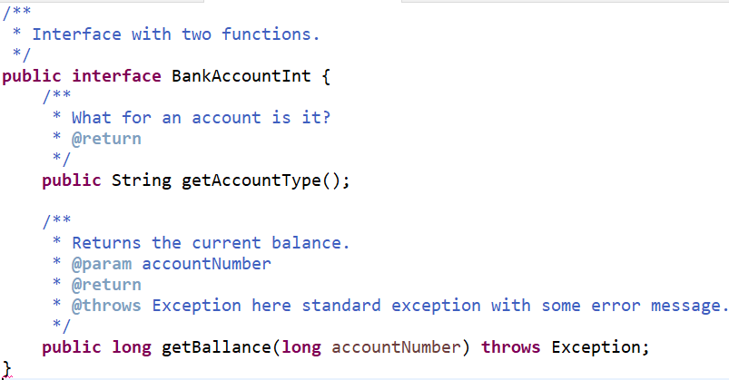
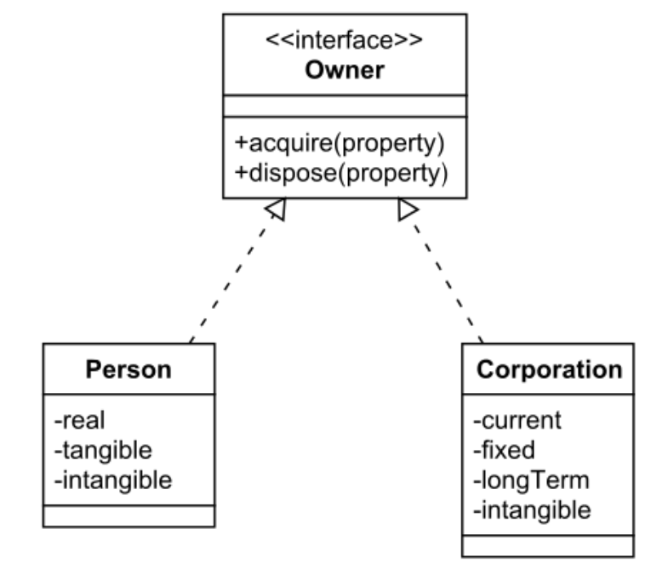
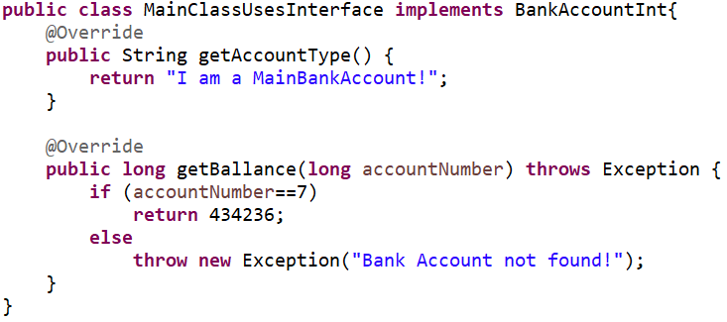
Interface (Java)
Interface:
Contract to implement
certain functions
Multiple interfaces can
be used
Cannot create an
object with it
Methods -> no body
No constructor
Attributes are by default:
  public
  static
  final
Can simulate multi-inheritance
Little Exceptions introduction:

Slide 51
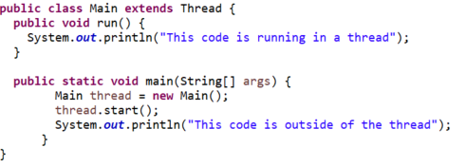

Interface Example:

Slide 52
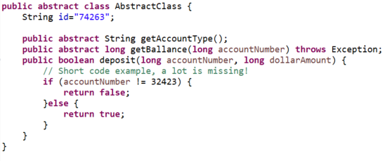
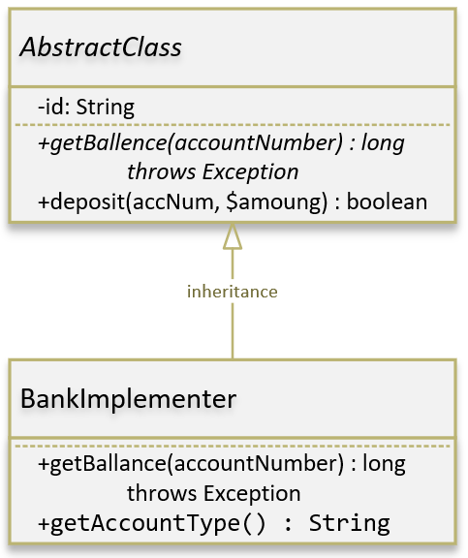
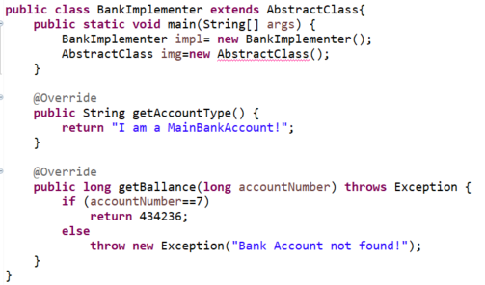
Abstract Class (Java)
Abstract class:
Contract to implement
certain functions
Cannot create an
object with it
Some methods ->
no body
UML Italic
Can have constructor
Can contain (members):
  instance
  static
  constant

Slide 53
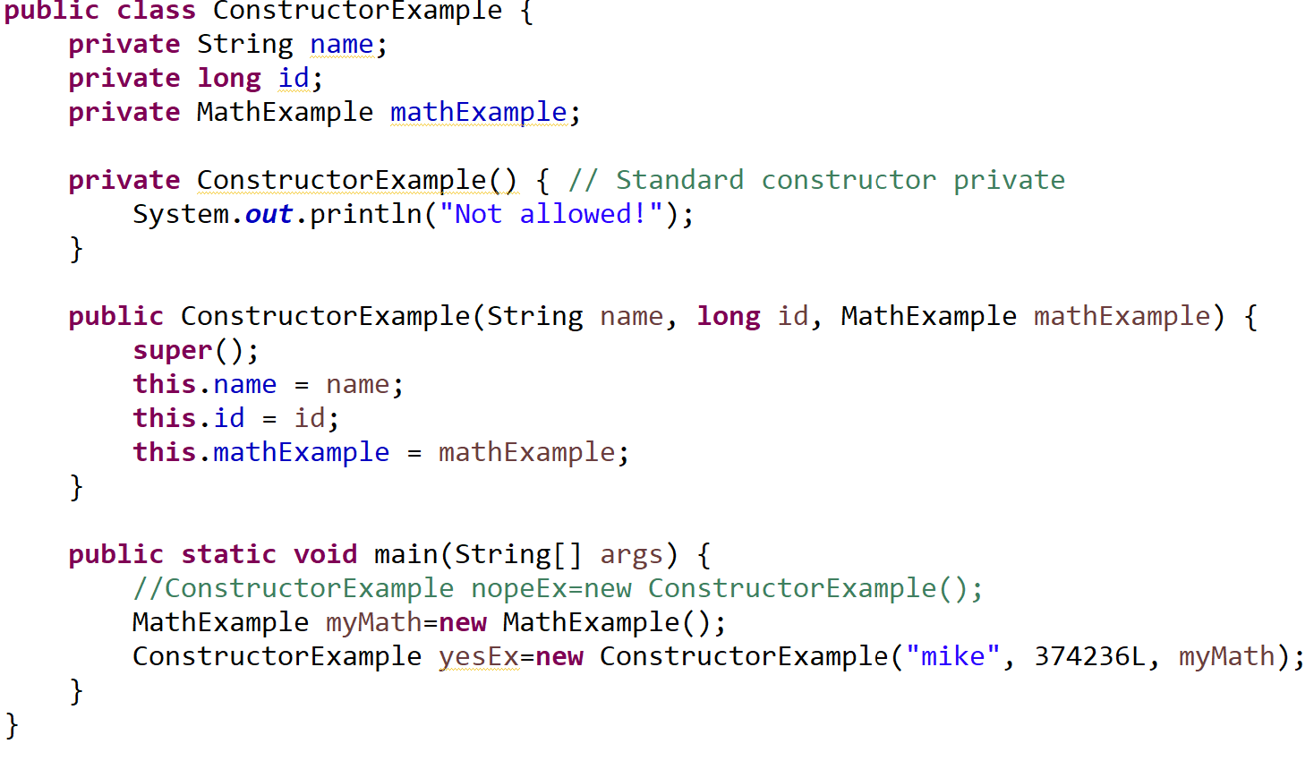
Constructors (by the way …)
Not public!
Call parent
constructor
first

Slide 54
Group exercise:
15 to 20 minutes
Create classes
Use the banking example

Slide 55
Polymorphism

Slide 56
Polymorphism
Polymorphism is the ability of an object to take on many forms.
Most common use in OOP when a parent class reference to a child.
It allows treating objects of a derived (child) class as objects
of its base (parent) class.
Late binding, runtime binding, …

Slide 57
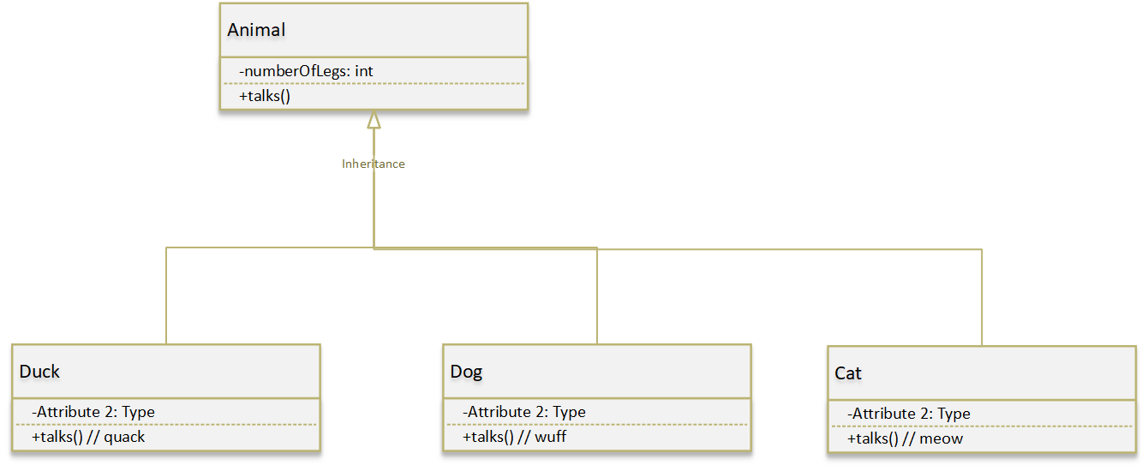
Polymorphism – Standard example!

Slide 58
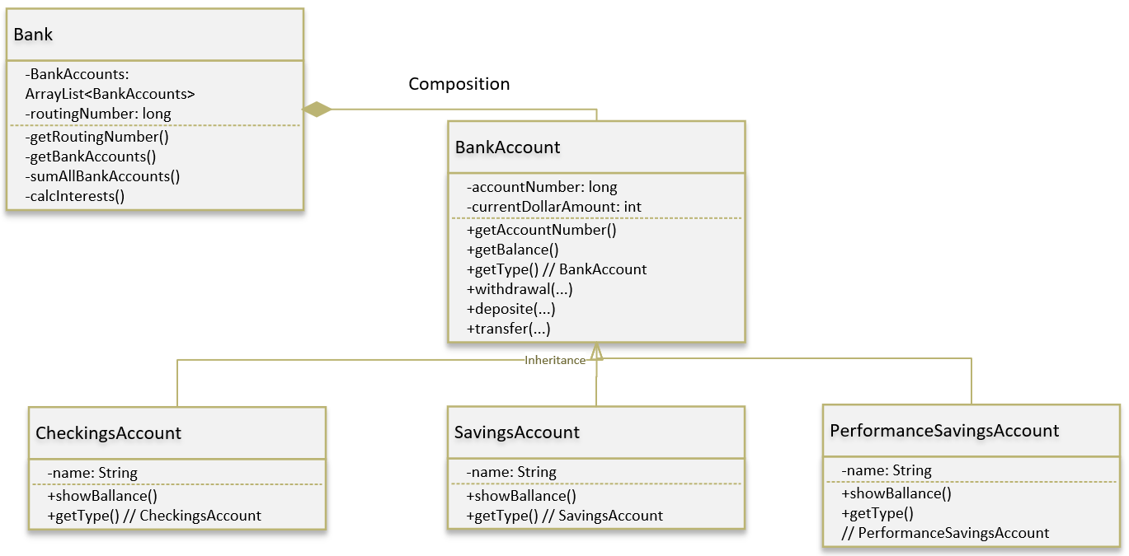
Polymorphism – Bank Example

Slide 59
Exercise:
Give an useful polymorphism example …

Slide 60
Done

