Slide 1
CSEN160
Fall 2026
Object-Oriented Analysis, Design and Programming
Michael Schimpf, PhD
Department of Computer Science and Engineering

Slide 2
Java Input

Slide 3
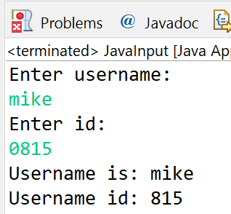
Java Input
Important later for some labs
import java.util.Scanner;
public class JavaInput1 {
public static void main(String[] args) {
// Create a Scanner object
Scanner myObj = new Scanner(System.in);
System.out.println("Enter username: ");
String userName = myObj.nextLine();
System.out.println("Enter id: ");
int id = myObj.nextInt();
System.out.println("Username is: " + userName);
System.out.println("Username id: " + id);
}
}
Interesting:
Delimiter is ‘ ‘ (space)
nextLine() reads a
whole line (delimiter is ‘\n’)
Error:
Reading characters as int
Throws an:
InputMismatchException

Slide 4
Java Input (with exception)
import java.util.Scanner;
public class JavaInput2 {
public static void main(String[] args) {
// Create a Scanner object
Scanner myObj = new Scanner(System.in);
System.out.println("Enter id: ");
int id = -1;
try {
id = myObj.nextInt();
} catch (InputMismatchException ex) {
System.out.println("Error enter only numbers: "+ex.toString());
}
System.out.println("id: " + id);}
}

Slide 5
Exercise
Write:
if then else
do while
while
for loop
try and catch
To make sure an integer is entered and not some characters/strings:
int id = myObj.nextInt(); // throws InputMismatchException
System.out.println("Enter id: ");
int id = myObj.nextInt();
System.out.println("Username is: " + userName);
System.out.println("Username id: " + id);

Slide 6
Java Input
System.out.println("Enter id: ");
boolean idEntered=false;
int id=-1;
do {
try {
id = myObj.nextInt();
idEntered=true;
}
catch (InputMismatchException ex) {
myObj.next();
System.out.println("Error enter only numbers: ");
}
} while (idEntered==false);
System.out.println("Username is: " + userName);
System.out.println("Username id: " + id);
The Scanner does not advance
until the item is being read. This
is mentioned in Scanner JavaDoc.
Hence, you may just read the
value off using .next() method or
check if hasInt() before reading
int value.
Source: https://stackoverflow.com/questions/32592922/java-try-catch-with-scanner

Slide 7
Math

Slide 8
The Math Class
The Math class contains only static fields and methods.
Cannot create an instance because
this class contains only private constructors.
No import needed

Slide 9
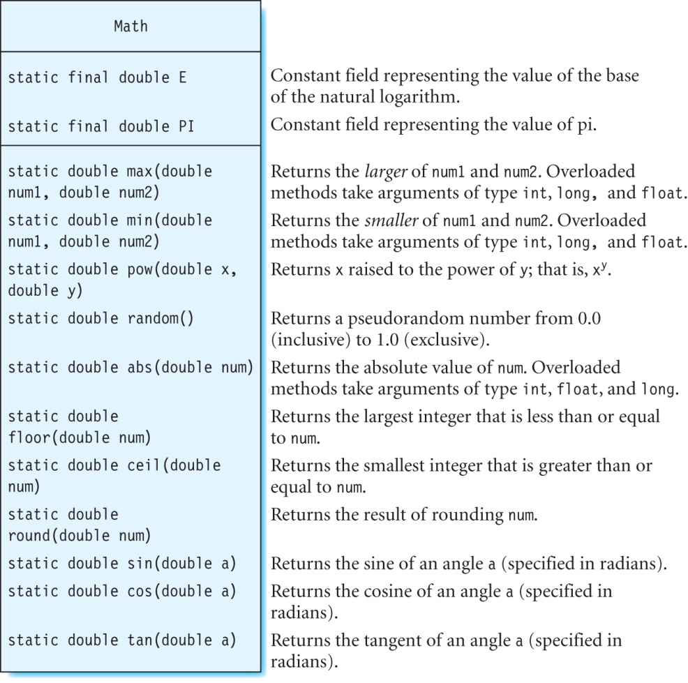
The Math Class

Slide 10
Math
Important later for some labs
public class MathExample {
public static void main(String[] args) {
System.out.println("pi = " + Math.PI);
System.out.println("E = " + Math.E);
System.out.println("abs(-123.98) = " + Math.abs(-123.98f));
System.out.println("tan(2.0) = " + Math.tan(2.0));
}
}

Slide 11
Random Numbers

Slide 12
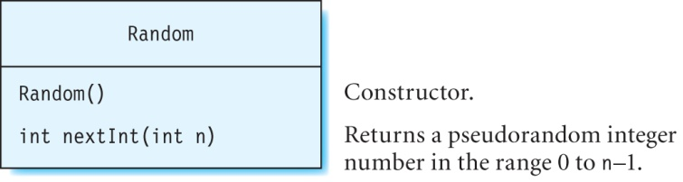
Class Random
The class Random is defined in java.util.
An instance of this class is used to generate pseudorandom numbers.
Example:
  Random rand = new Random();
  // magicColor gets a random integer value of 0, 1 or 2
  int magicColor = rand.nextInt(3);

Slide 13
Exercise BreakDemo:
Write a program to generate 50 random numbers in the range 0 to 10.
However, if the number 5 is generated, break!
Solution: The random numbers are generated inside a for loop.
A break statement is used to terminate the iteration if 5 is generated.
  import java.util.*;
  public class BreakDemo {
  public static void main(String[] args) {
  // implement me
  int a=10;
  System.out.println(“Hello:”+a+“number”);
  }
  }
  Random rand = new Random();
  // magicColor gets a random integer value of 0, 1 or 2
  int magicColor = rand.nextInt(3);

Slide 14
Exercise BreakDemo:
  import java.util.*;
  public class BreakDemo {
  public static void main(String[] args) {
  int number, x = 10, y = 50;
  for (int i = 0; i < 50; i++) {
  Random r = new Random();
  number = r.nextInt(11);
  System.out.println(number);
  if (number == 5)
  break;
  }
  }
  }

Slide 15
Math.random():
Math.random() returns a double:
  0.8061424100488573
  0.14380699123258012
  0.6019223501191691
  0.16022079346356033
  0.4110612020554283
  6.04614526963932
  9.774409693353928
  8.456638292430338
  3.7963003630516265
  8.015820268396157
  Math.random() * 10; // * 10 for the range

Slide 16
Exercise: Random numbers in a range
For example: between 10 to 40
Min = 10
Max = 40

Slide 17
Exercise: Random numbers in a range
  import java.util.Random;
  public class Randoms {
  public static int getRandomNumber_Math(int min, int max) {
  return (int)( Math.random() * (max-min) ) + min;
  }
  public static int getRandomNumber_Util(int min, int max) {
  return new Random().nextInt(max - min) + min;
  }
  public static void main(String[] args) {
  // java.util.random
  for (int i=0;i<10;i++) {
  int myRInt=Randoms.getRandomNumber_Util(10, 40);
  System.out.println("Random int = "+myRInt);
  }
  // Math.random
  for (int i=0;i<10;i++) {
  int res=Randoms.getRandomNumber_Math(10, 40);
  System.out.println("Randoms between 10 and 40 = "+ res);
  }}}

Slide 18
Strings

Slide 19
String Literals
A string literal is a set of characters which is enclosed within double-quotes.
Examples:
  “Hello!”
  “Current Score: 100”
  “5 % 3”
Strings
A string is an instance of class String.
Can initialize a String object with a string literal:
  String firstName = "Joan";
  String lastName = "Wright";

Slide 20
Strings
A string is an instance of the String class defined in java.lang
2 ways to create a string:
  Using a string literal
    Creates a string called s1 by using a string literal:
    String s1 = "This is a string literal";
  Using a constructor.
    Create strings by using the constructor:
      String s2 = new String("This is another string");
      char[] charArray = {'J', 'u', 'l', 'y'};
      String s4 = new String(charArray);

Slide 21
Strings
A String object cannot be “edited” -> immutable!
  String s1 = “A string”;
  String s2 = “A string”;
  Modify s2:
    s2 = s2 + " that has been modified";
  Check whether s1 has changed:
    System.out.println(s1); // prints out "A string"
  However, s2 is now assigned to a new object :
    System.out.println(s2); // prints out "A string that has been modified"
Notes:
Strings are immutable for thread safety (behavior is similar to primitives).

Slide 22
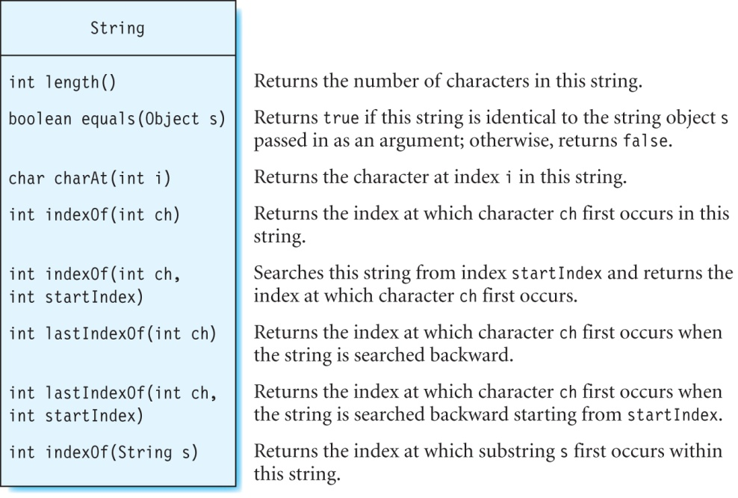
Some Methods in Class String

Slide 23
Length of a String
The length method print out the length of a string.
This is different from the field length used to print out the length of an array.
For example, print the length of the string city:
  String city = "New York";
  System.out.println(city.length()); // prints out 8

Slide 24
Comparing Strings
Use the equals method to determine if two strings are identical.
The equals sign should not be used to compare strings.
Example:
  Two strings str1 and str2
    The equals methodString str1 = new String("How now brown cow?");
    String str2 = new String("How now brown cow?");
  Since the string literals are identical, the equals method returns true:
    str1.equals(str2); // returns true
  Using equals sign returns false:
    str1 == str2 // condition is false
will return false if the argument passed to it is not of type String.
Notes:
Don’t use String constructor

Slide 25
Methods Retrieve an Index
Use charAt method to find out which character occurs at a particular index in a string:
Finding the index of the specified character in a string:
  String city = "New York";
  char ch = city.charAt(2); // ch is assigned the value ‘w’
  String ocean = "Atlantic Ocean";
  int index1 = ocean.indexOf('a'); // index1 = 3
  int index2 = ocean.lastIndexOf('a'); // index2 = 12
  int index3 = ocean.indexOf('a', 4); // index3 = 12
  int index4 = ocean.lastIndexOf('a', 0);// index4 = -1

Slide 26
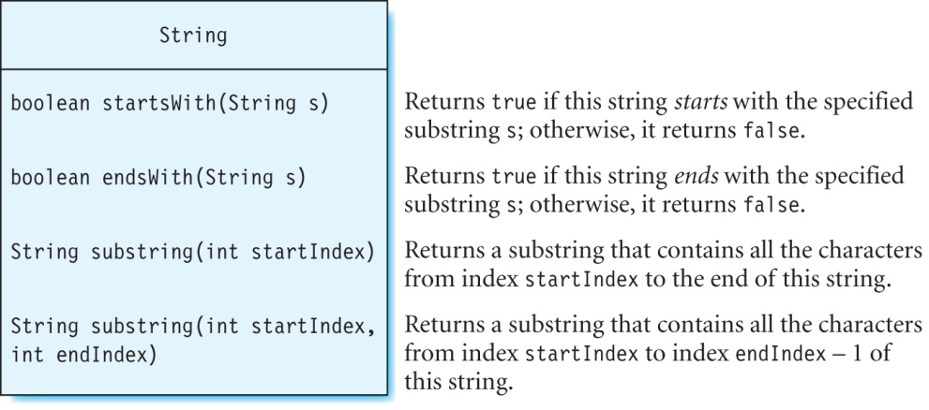
Methods For Substrings
Examples:
  String city = "San Francisco";
  city.startsWith("San F"); // returns true
  city.startsWith("Francisco"); // returns false
  city.endsWith("sco"); // returns true
  city.endsWith("esco"); // returns false
  city.startsWith("San Francisco"); // returns true
  city.endsWith("San Francisco"); // returns true

Slide 27
Exercise
What is returned by each call to method substring?
  String word = "meteorological";
  System.out.println(word.substring(7));
  System.out.println(word.substring(0, 6));
  System.out.println(word.substring(5, 0));

Slide 28
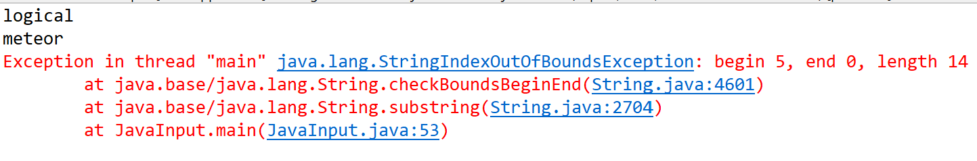
Solution

Slide 29
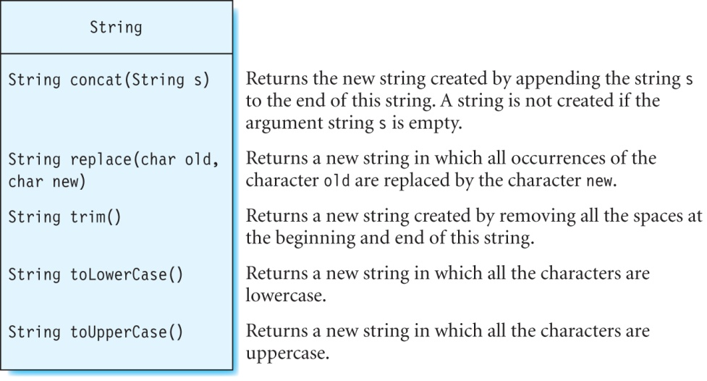
More Methods in Class String

Slide 30
Concatenation Operator
Concatenation operator (+) combines multiple strings:
Example:
Use + when a string does not fit on a single line:
  String firstName = "Joan";
  String lastName = "Wright";
  String fullName = firstName + " " + lastName;
  System.out.println(fullName); // prints out: Joan Wright
  String fearOfLongWords = "Hippopotomonst" + "rosesquipedaliophobia";

Slide 31
Concatenating Strings
Use method concat to combine strings.
Examples:
  String s1 = "Par";
  String s2 = s1.concat("is");
  System.out.println(s2); // prints out “Paris”
  String s3 = " is the capital of France.";
  String s4 = s2.concat(s3);
  System.out.println(s4); // prints “Paris is the capital of France”

Slide 32
Replacing/Removing Characters
The replace and trim methods substitute and remove particular characters, from the string.
Example:
  word1 references the new string “binyin”, and word2 references “pinyin”.
Use method trim to remove spaces at the beginning and the end of a string :
  String pie = " apple pie ".trim();
  String word1 = "banyan".replace('a', 'i');
  String word2 = "word1.replace('b', 'p');

Slide 33
Converting to Uppercase or Lowercase
Use methods toLowerCase and toUpperCase.
Examples:
  "frieNd".toLowerCase(); // returns the string "friend"
  "frieNd".toUpperCase(); // returns the string "FRIEND"

Slide 34
String.format
(for the friends of printf)

Slide 35
String.format
A static method in the String class used for formatting data.
It can have any number of arguments, but the first argument is always a format string containing format specifiers.
The format specifier %f acts as a placeholder in the format string for the second argument val1.
When the program is run, the value of val1 will be substituted in the place of %f.
format specifier
String s = String.format("Value is = %f", val1);
format string

Slide 36
Format Specifiers
A format specifier starts with the symbol % and is followed by a conversion character such as:
  d (for decimal numbers),
  f (for floating-point numbers)
  c (for character data)
  s (for strings)

Slide 37
Examples of String.format
Given: double val1 = 10.5678; int val2 = 15;
  String s1 = String.format("Val 1 = %f, Val 2 = %d", val1, val2);
  System.out.println(s1);
  The output is:
  Val 1 = 10.567800, Val 2 = 15
Or use: System.out.format(…)
  var val1=3436.45f;
  System.out.format("Value is = %10.1f", val1);

Slide 38
Examples of String.format
Explain why each of the following result in errors:
  float val1 = 10.567800f;
  int val2 = 15;
  String.format("val1 = %d, val2 = %f", val1, val2);
  String.format("val1 = %f, val2 = %d %c", val1, val2);
  String.format("val1 = , val2 = ", val1, val2);

Slide 39
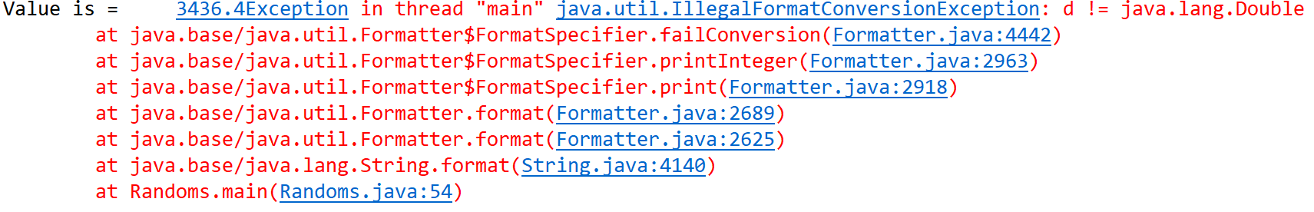
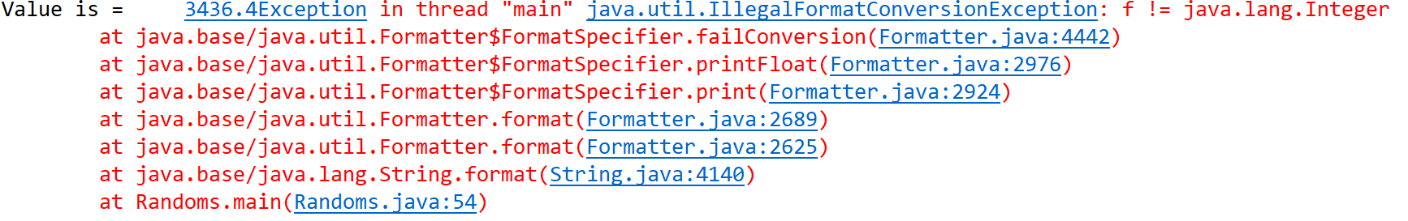
Examples of String.format
Explain why each of the following result in errors:
  String.format("val1 = %d, val2 = %f", val1, val2);
  String.format("val1 = %f, val2 = %d %c", val1, val2);
  String.format("val1 = , val2 = ", val1, val2);

Slide 40
Examples of String.format
Explain why each of the following result in errors:
  String.format("val1 = %d, val2 = %f", val1, val2);
  String.format("val1 = %f, val2 = %d %c", val1, val2);
  String.format("val1 = , val2 = ", val1, val2);
Two!

Slide 41
Using Field Width and Precision in String.format
For float specify the field width and precision: %n.mf.
  n = minimum number of characters to display the number (field width)
  m = number of decimal spaces (precision) in the number.
  The value of n cannot be 0; otherwise, a runtime error will occur.
Example:
  String s2 = String.format("val1 = %10.2f", val1);
  System.out.println(s2);
  The output is:
  val1 = 10.57

Slide 42
StringBuilder & StringBuffer

Slide 43
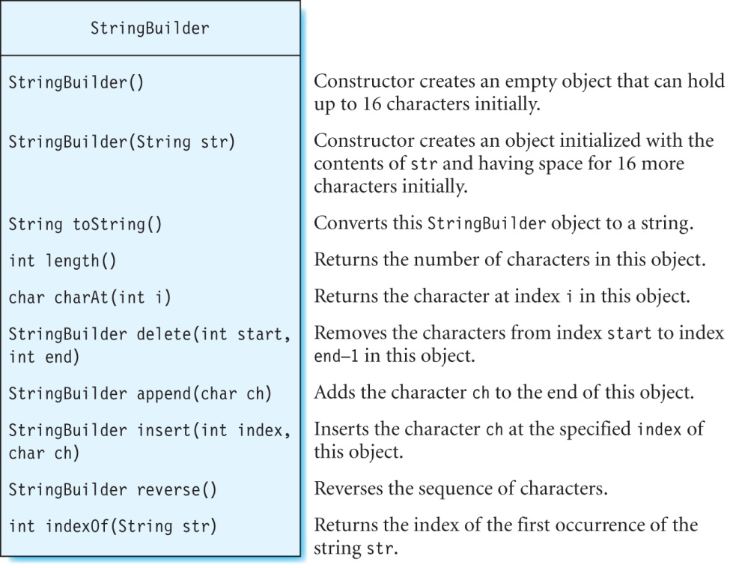
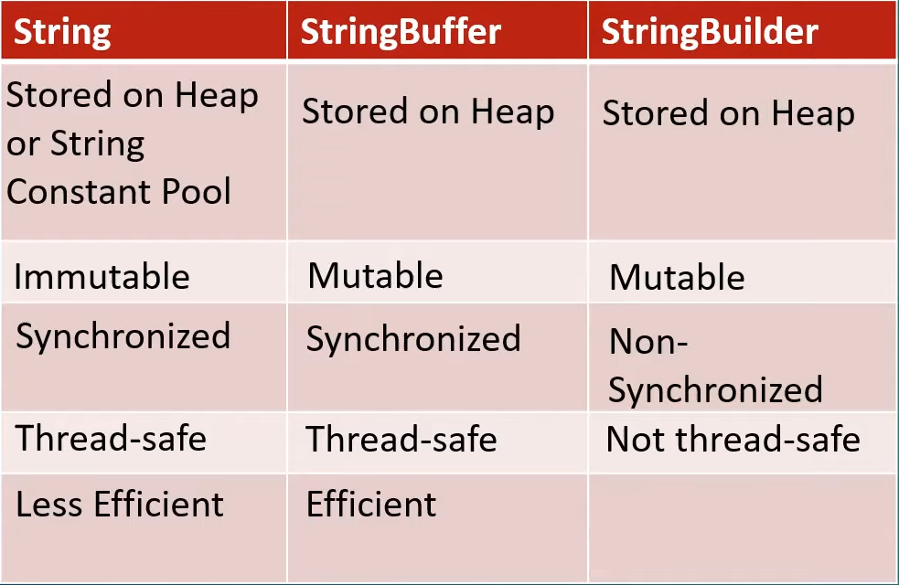
The StringBuilder & StringBuffer Class
Java 1.0 Java 5
Fastest

Slide 44
The StringBuilder Class
Examples:
  StringBuilder sb = new StringBuilder("warts");
  sb.reverse(); // sb contains "straw"
  sb.length(); // returns 5
  sb.charAt(3); // returns 'a'
  sb.insert(0, 'l'); // sb contains "lstraw"
  sb.insert(1, 'a'); // sb contains "lastraw"
  sb.insert(2, 's'); // sb contains "lasstraw"
  sb.insert(3, 't'); // sb contains "laststraw"
  sb.insert(4, ' '); // sb contains "last straw"
  sb.indexOf("raw"); // returns 7
  sb.delete(1, 8); // sb contains "law"

Slide 45
Exercise
What is the output of the following statements?
  double n1 = -85.6, n2 = 70.4;
  System.out.format("The larger of %.2f and %.2f is %.2f\n",n1,n2,+Math.max(n1, n2));
  System.out.format("The smaller of %.2f and %.2f is %.2f\n",n1,n2,+Math.min(n1, n2));
  System.out.format("The value of %.2f raised to the power of 5 is %.2f\n",n2,+Math.pow(n2, 5));
  System.out.format("abs(%.2f) = %.2f\n", n1, +Math.abs(n1));
  System.out.format("floor(%.2f) = %.2f\n", n1, +Math.floor(n1));

Slide 46
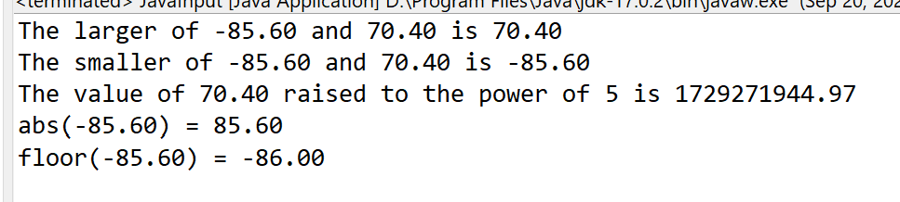
Exercise
What is the output of the following statements?
  double n1 = -85.6, n2 = 70.4;
  System.out.format("The larger of %.2f and %.2f is %.2f\n",n1,n2,+Math.max(n1, n2));
  System.out.format("The smaller of %.2f and %.2f is %.2f\n",n1,n2,+Math.min(n1, n2));
  System.out.format("The value of %.2f raised to the power of 5 is %.2f\n",n2,+Math.pow(n2, 5));
  System.out.format("abs(%.2f) = %.2f\n", n1, +Math.abs(n1));
  System.out.format("floor(%.2f) = %.2f\n", n1, +Math.floor(n1));

Slide 47
Simple arrays

Slide 48
Simple arrays:
Based on elementary datatypes:
int
byte
long
float
double
char
boolean
string

Slide 49
Simple arrays:
Basics:
Declaration
Initialization
Access read/write
Declaration:
double[] randoms;
Initialization:
randoms = new double[10];
Access write:
randoms[0] = Math.random();
randoms[1] = randoms[0]*2;
…
randoms[9] = Math.random()*Math.PI;

Slide 50
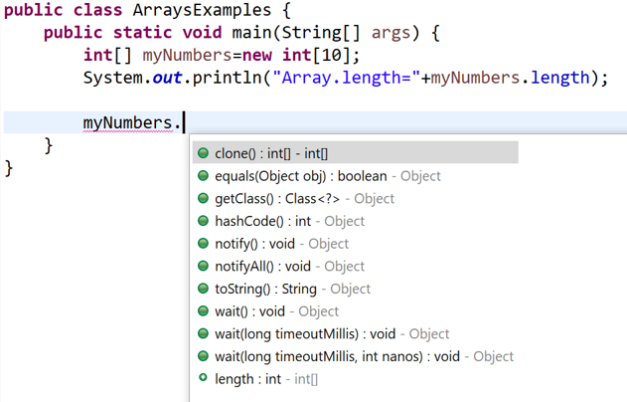
Simple arrays:
Arrays of references:
String[] names;
Point[] locations;
Array:
Array reference has methods

Slide 51
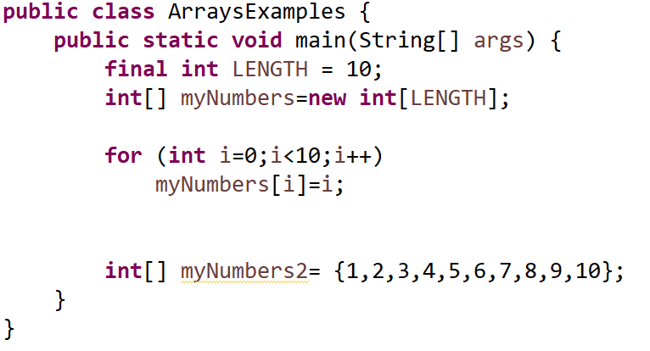
Simple arrays:
Array:
Two ways to initialize

Slide 52
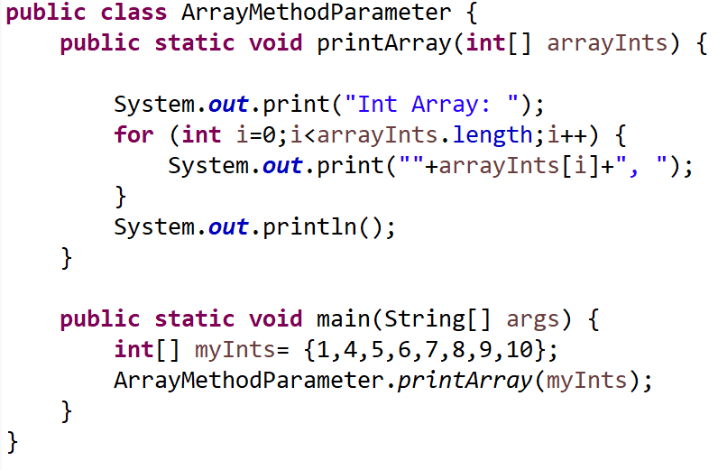
Array as method parameter:

Slide 53
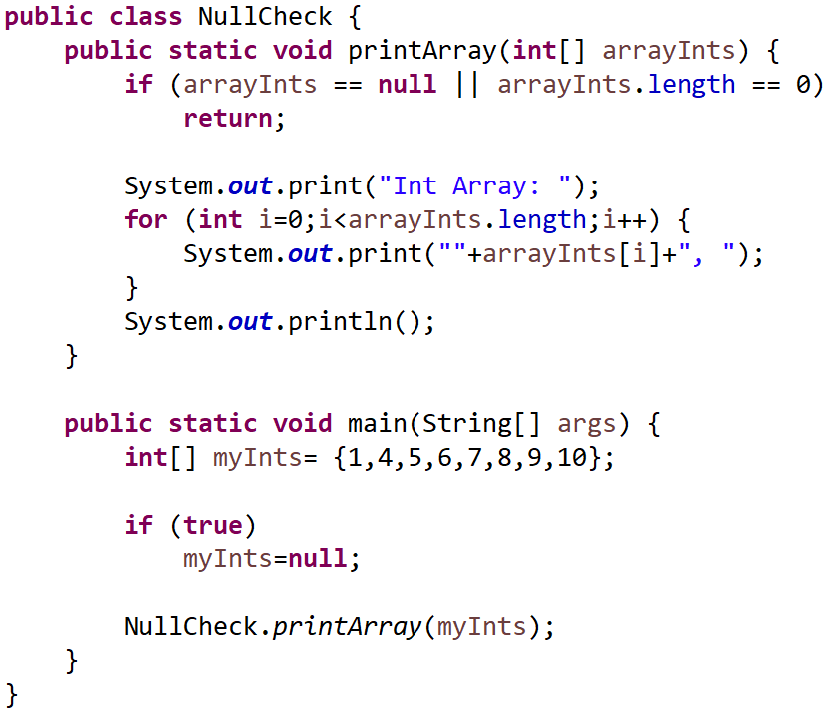
Simple arrays:
Check for null:

Slide 54
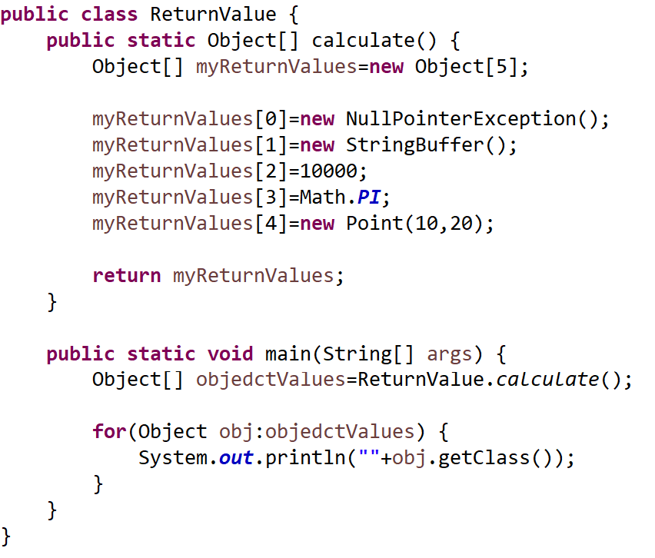
As return value:

Slide 55
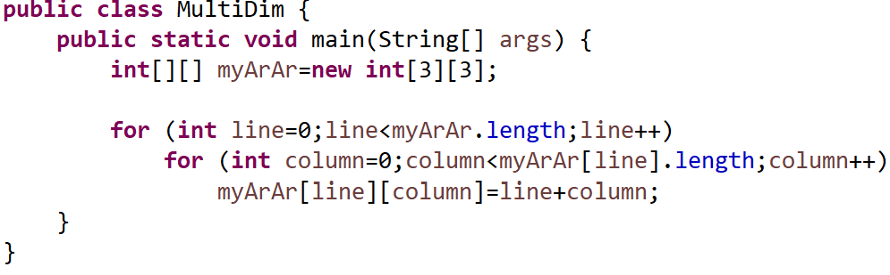
Multidimensional arrays:

Slide 56
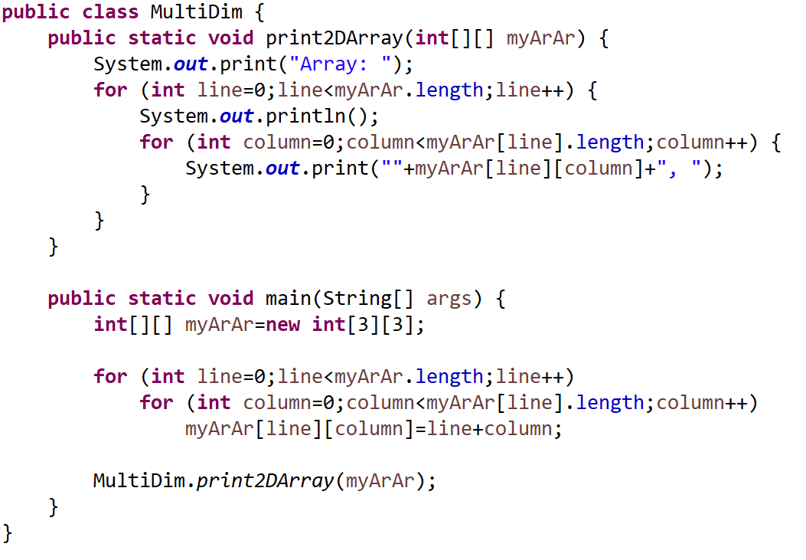
Multidimensional arrays as method parameter (Java):

Slide 57
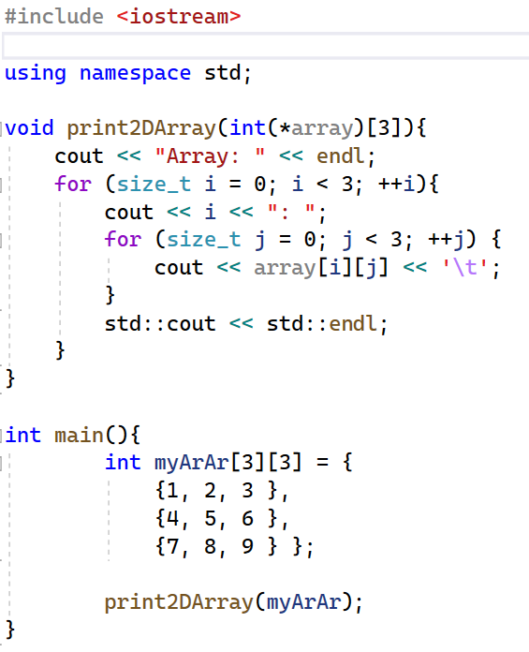
Multidimensional arrays as method parameter C++:
Java is so much better than C++

Slide 58
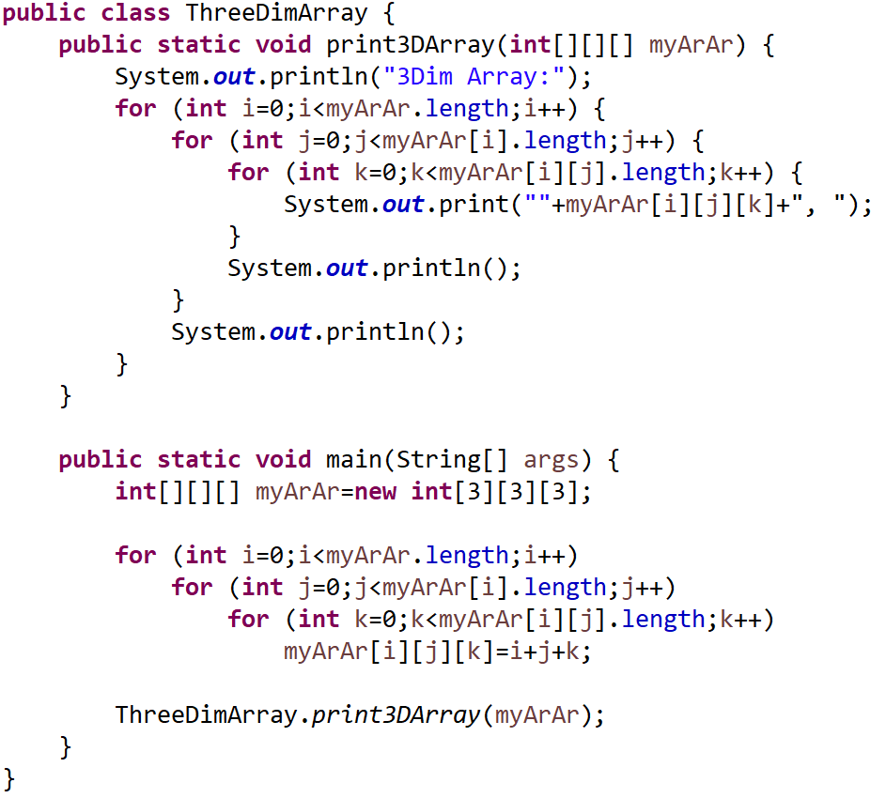
Multidimensional arrays as method parameter (Java):
Don’t ask for the C++ version !!! ☹

Slide 59
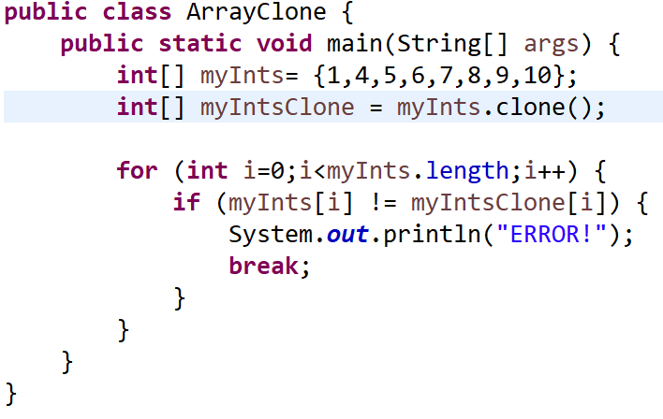
Clone() arrays:
Basic types clone, is uncomplicated!

Slide 60
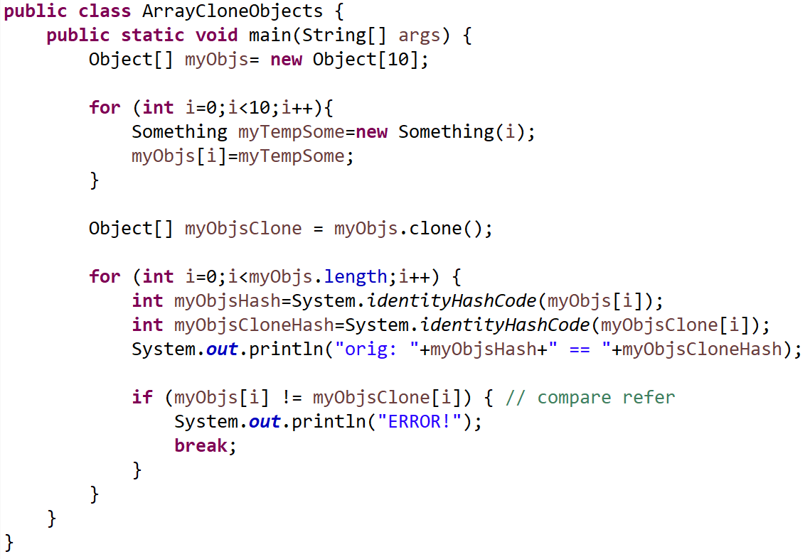
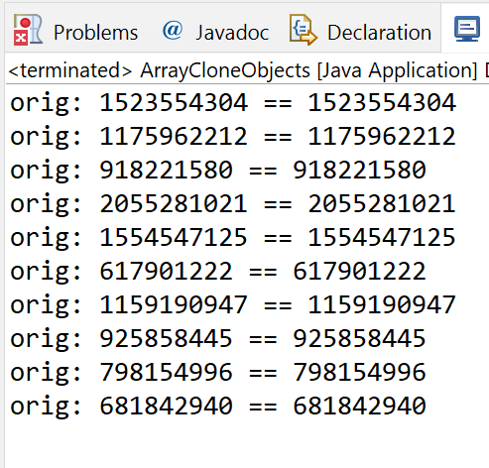
Clone() arrays: But it is a shallow copy!
Shallow means: clone, copies only the references!
References are the same!

Slide 61
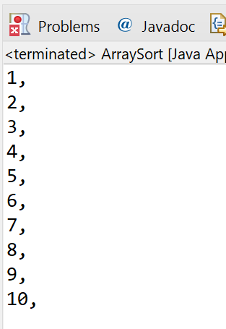
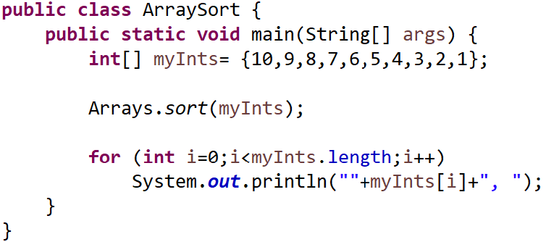
java.util.Arrays:
Standard sort:

Slide 62
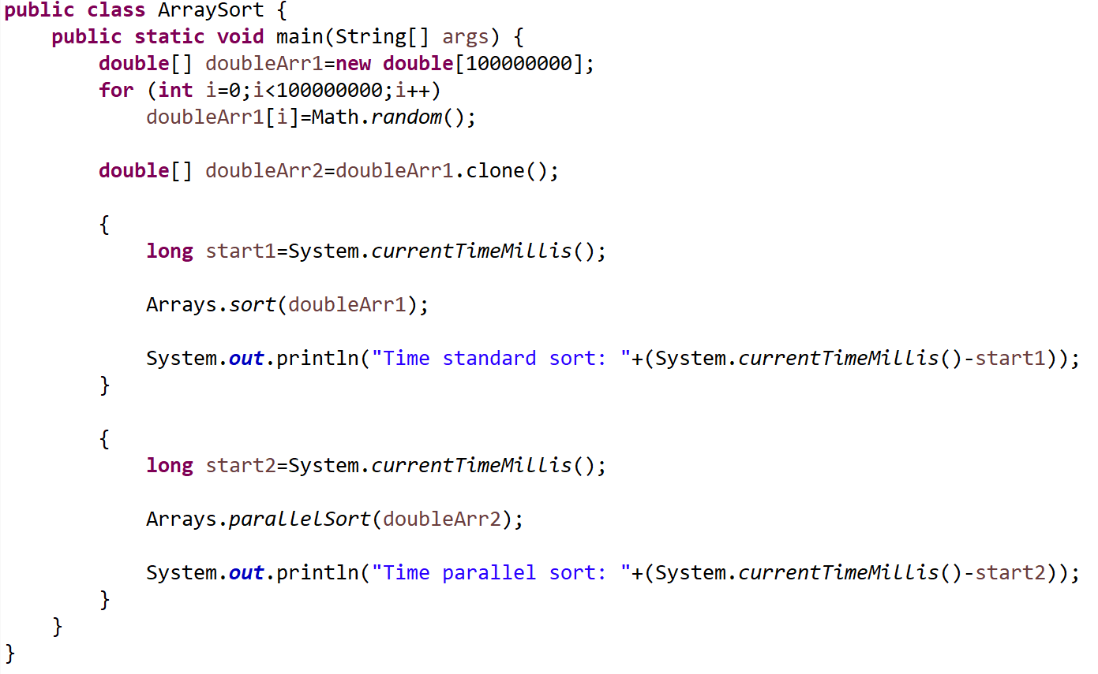
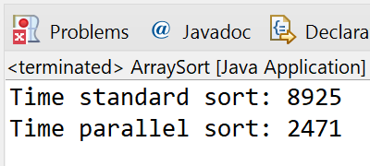
java.util.Arrays:
Sort versus parallel sort:

Slide 63
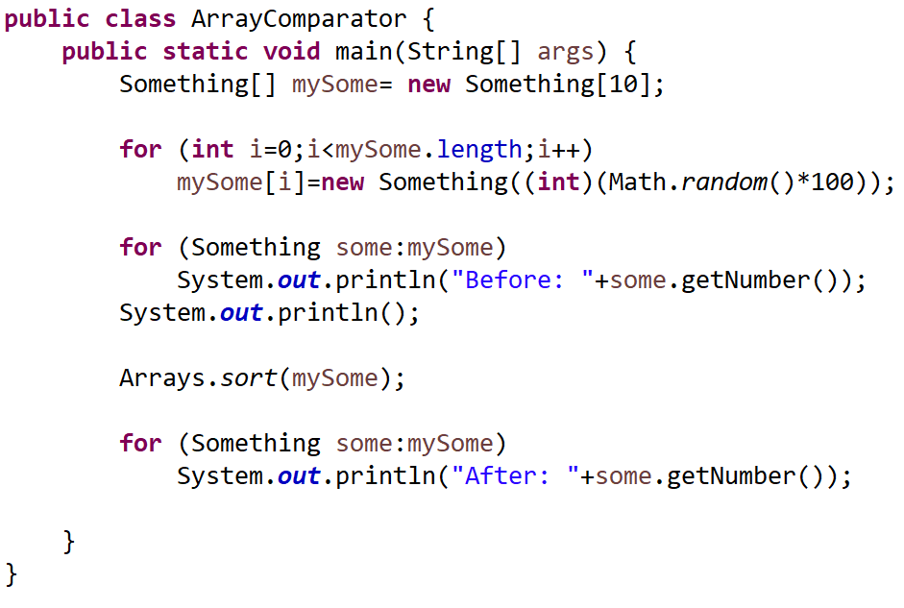
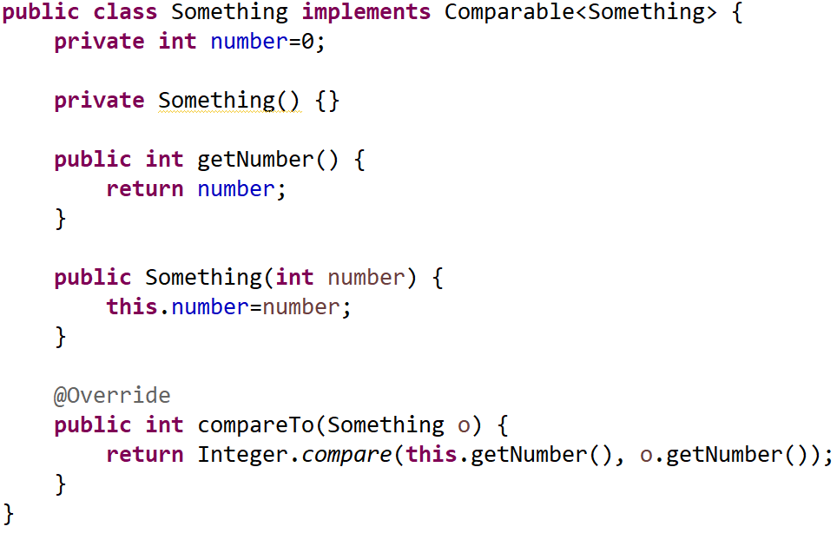
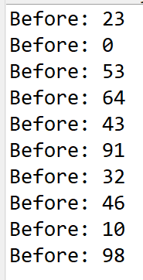
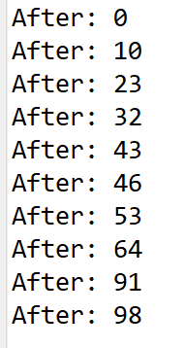
java.util.Arrays:
Sort objects:
(Basically, an Integer wrapper)

Slide 64
Errors

Slide 65
Errors in Programs
Compiler Errors
Run-time errors and
Logic errors
Compiler Errors
  Incorrect punctuation
  missing semicolon
  Comments formed incorrectly
  Misspelled keywords
  class and method names

Slide 66
Run-time Errors
Error while program is running
Examples:
  Files are missing (reading).
  You forget to insert the square brackets:
    public static void main(String[] args)

Slide 67
Logic Errors
Algorithm is incorrect.
Program executes normally but output is wrong.
Detectable: comparing expected vs manual results.
To identify where the error occurs:
  use a debugger
  print out intermediate results at different points in the program
  logfile analysis (i.e. Splunk)
The worst:
Some logic errors occurs seldom (once a month, once a year, …)

Slide 68
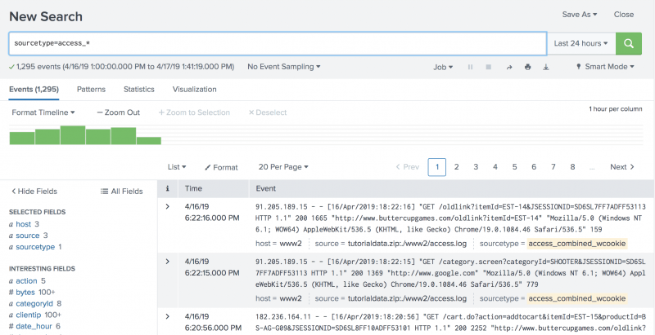
Logic Errors
Logfile analysis:

Slide 69
Exercise Program With Errors
/ * Program with errors */
import javax.swing.*;
public class HelloWorld {
public static void main(String[] args) {
JFrame frame = new JFrame(My First Program");
frame.getContentPane().add(new JLabel(new ImageIcon("blimp.jpg")))
frame.pack();
frame.setVisible(true);
}

Slide 70
Compiler Output 1
src\HelloWorld.java:1: class, interface, or enum expected
/ * Program with errors */
What you should do:
Correct the open-comment sequence that has been mistyped with a space between the / and *.

Slide 71
Compiler Output 2
src\HelloWorld.java:6: ')' expected
JFrame frame = new JFrame(My First Program");
src\HelloWorld.java:6: unclosed string literal
JFrame frame = new JFrame(My First Program");
src\HelloWorld.java:6: not a statement
JFrame frame = new JFrame(My First Program");
What you should do:
Insert a pair of quotes needed to begin the words
“My First Program” is missing.

Slide 72
Compiler Output 3
src\HelloWorld.java:7: ';' expected
frame.getContentPane().add(new JLabel(new ImageIcon("blimp.png")))
What you should do:
Insert a semi-colon at the end of line 7.

Slide 73
Compiler Output 4
src\HelloWorld.java:10: reached end of file while parsing
}
What you should do:
Insert a closing brace after the last line of the program.

Slide 74
Program With Errors
/ * Program with errors */
import javax.swing.*;
public class HelloWorld {
public static void main(String[] args) {
JFrame frame = new JFrame(My First Program");
frame.getContentPane().add(new JLabel(new ImageIcon("blimp.jpg")))
frame.pack();
frame.setVisible(true);
}

Slide 75
Done

