Slide 1
COEN160
Fall 2026
Object-Oriented Analysis, Design and Programming
Michael Schimpf, PhD
Department of Computer Science and Engineering

Slide 2
Introduction

Slide 3
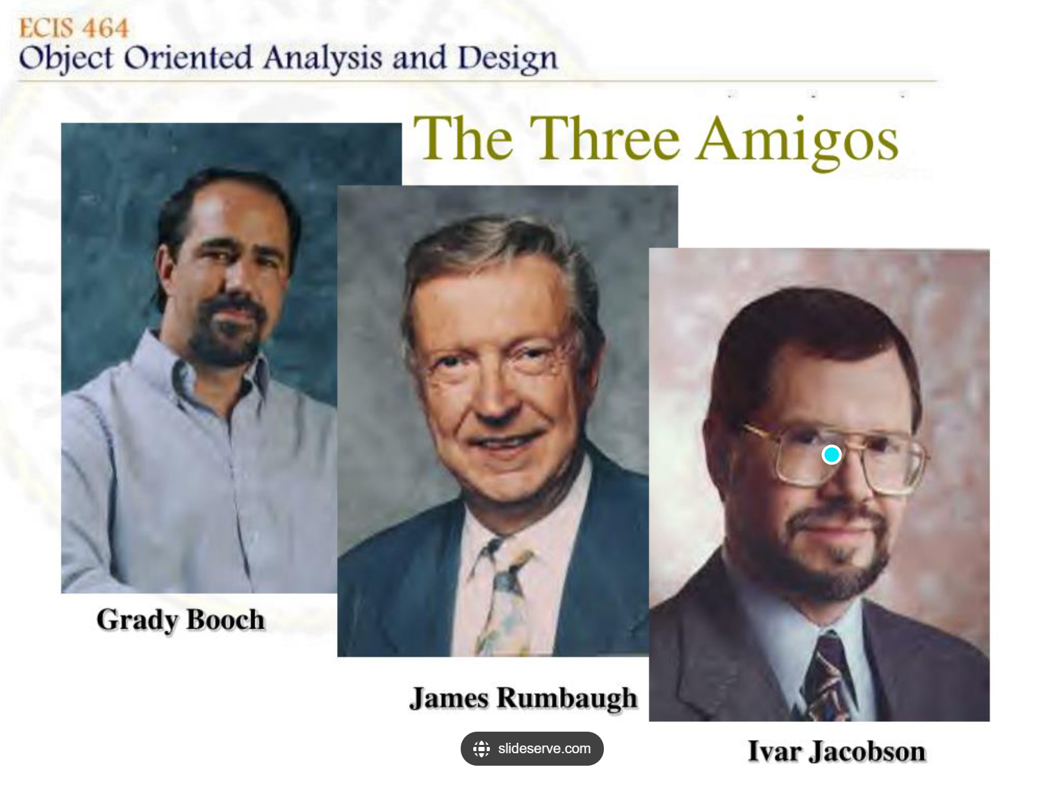
UML three amigos
Three Amigos:
Grady Booch
Ivar Jacobson
James Rumbaugh
They created the Unified Modeling Language in 1995
(while working at Rational software. )
In 1997, the Object Management Group adopted UML
as a standard, which includes:
  Apple Computer
  Hewlett-Packard
  IBM
With interoperability in mind:
UML would be a shared visual language for years to come.
2005 International Organization for Standardization (ISO/IEC 19501)

Slide 4
UML principles:
Case driven
Architecture-centric
Standard language for software blueprints
Start easy use what you know
But you can go very very very complicated!
UML is a very expressive language
“The rules of the UML encourage you
BUT does not force you” (Three Amigos cite)
“A shitty diagram is better than none” (Michael)
Iterative/incremental
All UML elements (of different diagrams)
can be mixed together
UML can be extended by you
(Stereotypes, Adornments…)

Slide 5
It starts with an
Use Case Diagram

Slide 6
OO Analysis:
Brainstorming sessions
“Use cases are stories, widely used to discover and record requirements”
(Book “Applying UML and Patterns” Craig Larman)
Use cases text version
Use cases diagram
Why use cases?

Slide 7
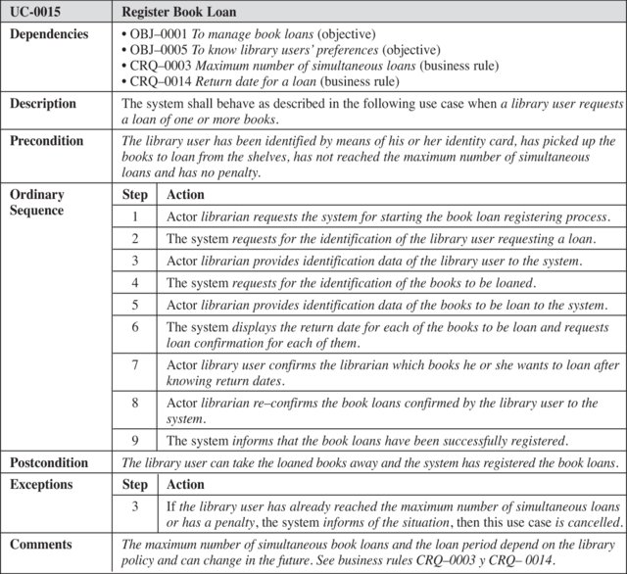
Use Cases:
Text version
Created
by a business
department
Business
Analyst …

Slide 8
Use cases:
Provide a way for developers to come to a common understanding
with the systems end user and domain experts.
Describes a set of sequences, and each sequence represents
things outside the system

Slide 9
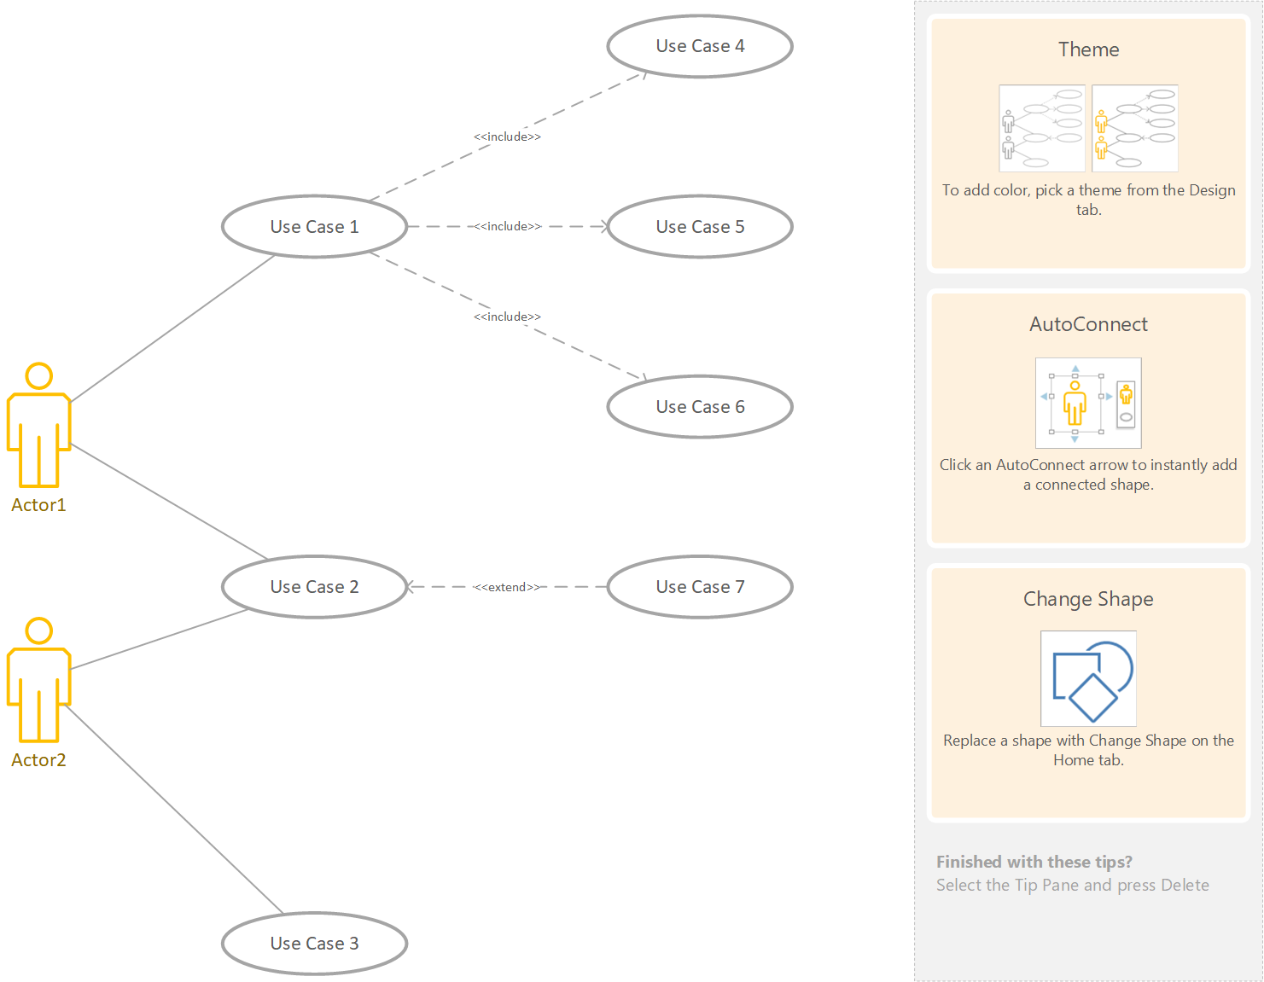
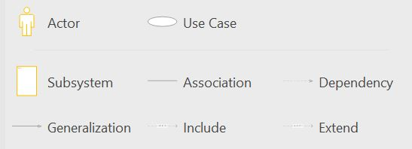
<<includes>> <<uses>>
Includes the functionality of another use case
supports reuse of functionality.
Putting common behavior in its own use case.
Included case never stands alone.
Use Case Diagram (Visio)
<<uses>>
Actor:
Can be Human or machine
Primary Actor: user -> cashier
Supporting Actor: service -> payment auth.
Offstage Actor: has an interest, IRS
<<extends>>
Extends the behavior of another use case
Reveals details about a system that are typically hidden
User may see optional system behavior.
Exceptional behavior

Slide 10
<<uses>> <<include>>
Use case
Use case
The base use case includes the functionality of another use case.
supports the reuse of
functionality in a use-case model.
Putting common behavior in its own use case.
Included case never stands alone.
Actor
<<uses>>
Use case
Use case
Actor
Stereotype:
<<uses>> (aka <<include>>) one use case is needed by another.

Slide 11

<<extends>>
Extends the behavior of another use case (base).
Reveals details about a system that are typically hidden.
User may see optional system behavior.
Exceptional behavior.
“Fill a form” is extended by
“Get help to fill a form”
(hidden use case)
<<extends>>
Get help to fill a form
Fill a form

Slide 12
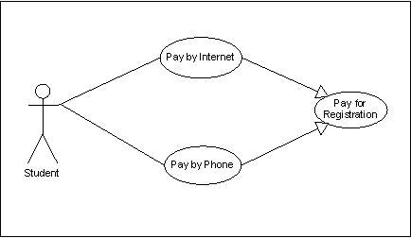



Generalization
Just like generalization with classes
General use case
Specialized use cases
Registration
General use case
Specialized use cases
The child inherits the behavior and meaning of
the parent use case
The child may add or override the behavior of its
parents
Graduate registration
Undergraduate registration
Specialized use cases

Slide 13
Generalization vs Include vs Extend
Generalization relationships
One model element (the child) is based on another model element (the parent).
The child receives all attributes & operations & relationships, from the parent.
Include relationships
The base use case includes the functionality of another use case(s).
The include relationship supports the reuse of functionality.
Extend relationships
The extension use case extends the behavior of another use case (base).
Reveals details about a system or application that are typically hidden in a use case.
Based on:
https://www.ibm.com/docs/en/rational-soft-arch/9.5?topic=diagrams-relationships-in-use-case

Slide 14












Example: Use Case Diagram for Elevator
Close door
Floor request
Open door
Emergency stop
Technician
Passenger
Service elevator

Slide 15








Example: Reservation System
Excess baggage fee
<<uses>>
<<uses>>
Check In
Assign seat
<<uses>>
Record passenger info
Add reservation
Cancel reservation
<<uses>>
Delete passenger info
Ticket clerk
<<uses>>
Update seating chart

Slide 16
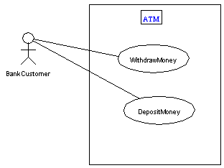
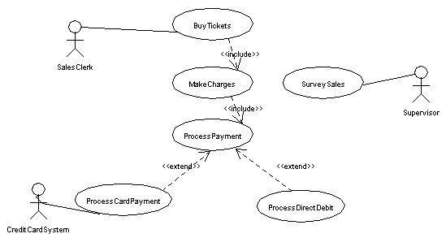
Bank Use Case Diagrams

Slide 17
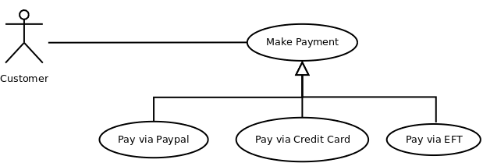
Generalization

Slide 18
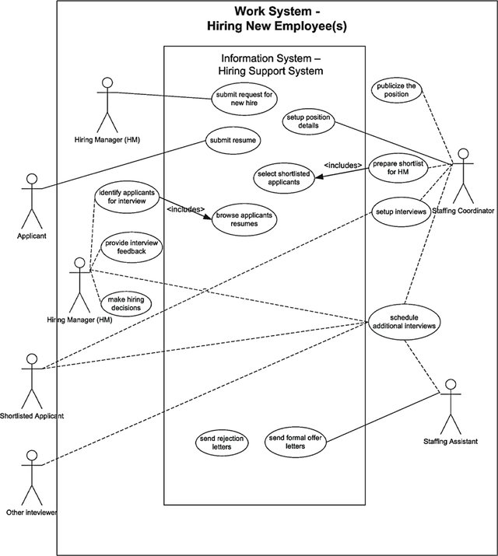

Slide 19
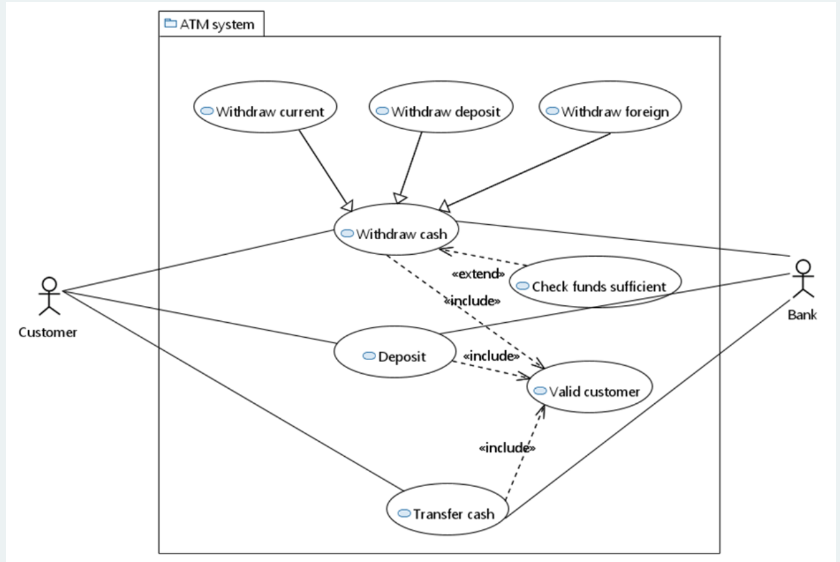
Probably a polymorph approach
At runtime it will be decided which withdraw is used
<<extends>>
Add methods
Add behavior
Generalize
Or how does an isolates
use case call some other
use case?!

Slide 20
The overall structure is shown in a
Class Diagram

Slide 21
OO Design:
  Decompose complex systems
  Add implementation constrains
  Create more UML diagrams:
    State
    Class
    Sequence
    …

Slide 22
Steps:
  Check your use cases …
  Create class diagram …
  Think about technical details …

Slide 23
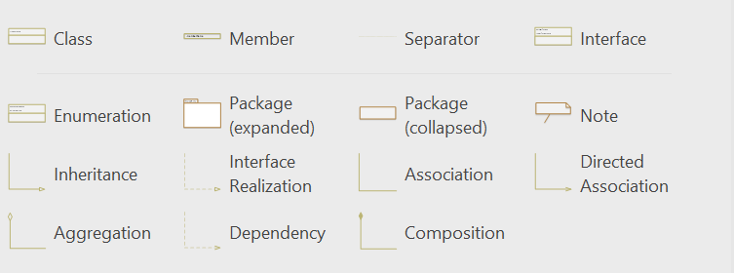
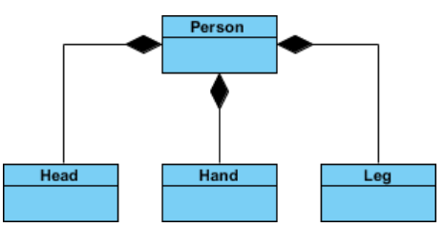
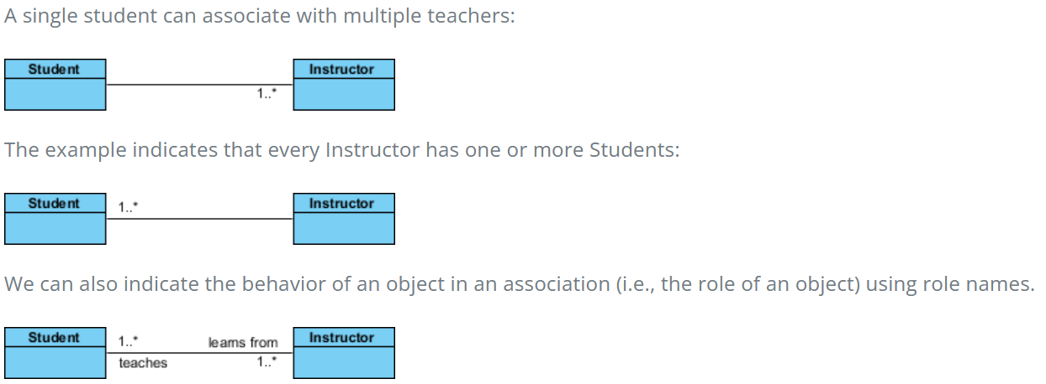
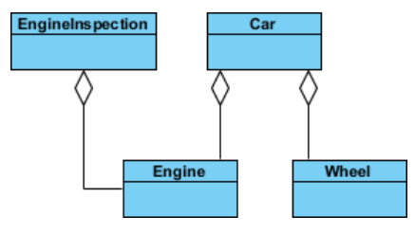
Class diagram (Visio)
one element depends on another element.
to indicate that a change of one might require
a change to the other.
A server knows a customer,
but a customer does not know
the server
Needs at least one person
doesn't state in any way that Class A
owns Class B nor that there's a
parent-child relationship
strong lifecycle dependency between the
two: meaning that when Person is deleted
then Head, Hand, Leg will also be deleted!

Slide 24
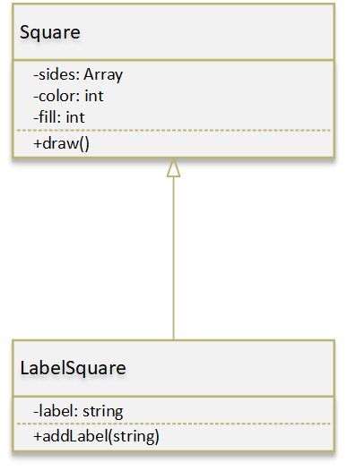
Inheritance
Wording is Important!
Super class
Base class
Parent class
Visibility:
+ Public
- Private
# Protected
~ Package/Internal
A super class is a generalization of a subclass
A derived class is an extension of a base class
A parent class is extended by a child class
Subclass
Derived class
Child class

Slide 25
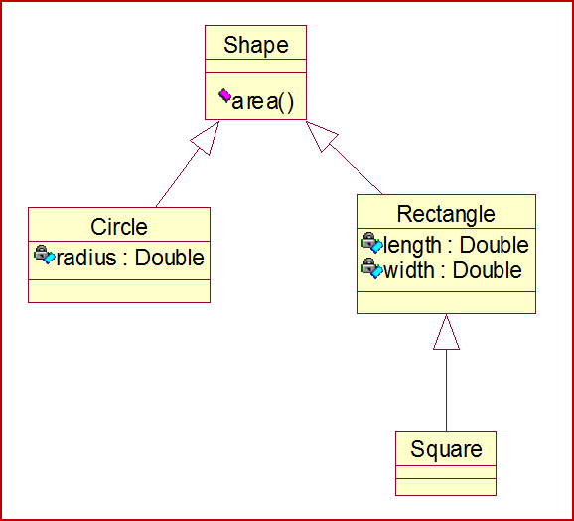
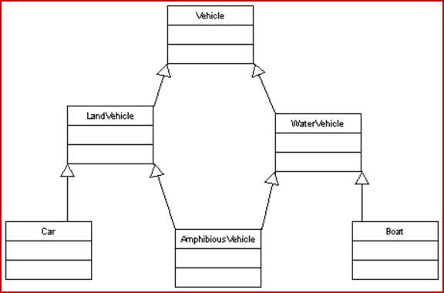
Single vs Multiple inheritance
Single inheritance, each subclass has exactly one super-class.
Multiple inheritance, a subclass may inherit from more than one super-class.
Which one?!?!
+drive()
+drive()

Slide 26
Multiple Inheritance - Repeated Inheritance

Slide 27
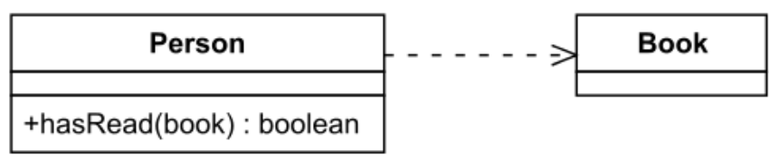
Dependency
one element depends on another element.
to indicate that a change of one might require
a change to the other.
An object of one class might use an object of another class.
If the object is not stored in any field, then this is modeled as a dependency relationship.
“Person” is using “book” in a method call -> “Person” has no member “book”
“Book” class changes -> Person needs to be checked, if it needs an update too.

Slide 28
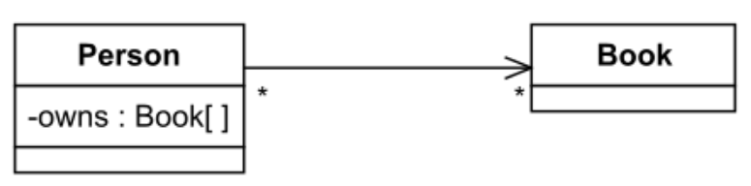
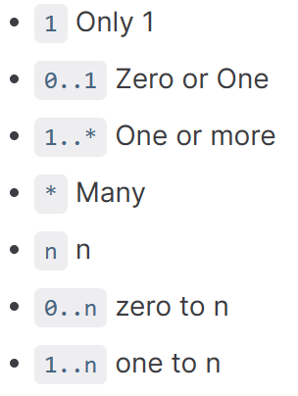
Unidirectional Association
An object store another object in a field.
For example: people own books,
modeled by an owns field in Person objects.
A book be owned by many people,
so reverse direction is not modeled.
Cardinality:
(0..*)

Slide 29
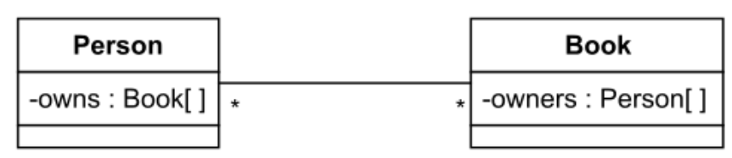
Bidirectional Association
Both classes/objects knows each other
How many?

Slide 30
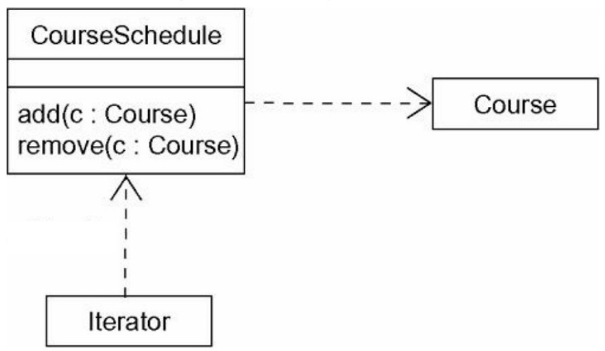
Dependency
Aggregation
Composition
CourseSchedule
depends on Course
Car
School
Iterator depends
on CourseSchedule
Seat
Department
Iterates over all CourseSchedules
Iterator goes over a lot of Courses
Diamond points
to the whole part
If CourseSchedule changes, Iterator needs to be checked/updated
CourseSchedule has two functions which have a Course object
Arrow points to Course
If Course changes, CourseSchedule needs to be checked/updated
Seat is a part of the car
Diamond points
to the whole part
Seat can survive without a car
Department is a part of the school
Diamond points
to the whole part
Department cannot survive without
School

Slide 31
Generalization
Unidirectional Association
Bidirectional
Association
BankAccount
Person
Book
Person
Book
SavingsAccount
A Person can have zero, one or many Book(s). A Book knows the current and all former renters (Person).
Person knows Book, Book(s) also knows Persons (rental list)
BankAccount is a generalization of a SavingsAccount
Arrow points to the general
A Person can have one or many Books
Person knows Book, but Book does not know Person

Slide 32
Object Diagram

Slide 33
Object diagram cont.
Object name : Class
Named object
: Class
Unnamed object
Object name : Class
Attribute type = ‘Value’
Attribute type = ‘Value’
Object attributes
Object name : Class
Active object (thicker border)

Slide 34
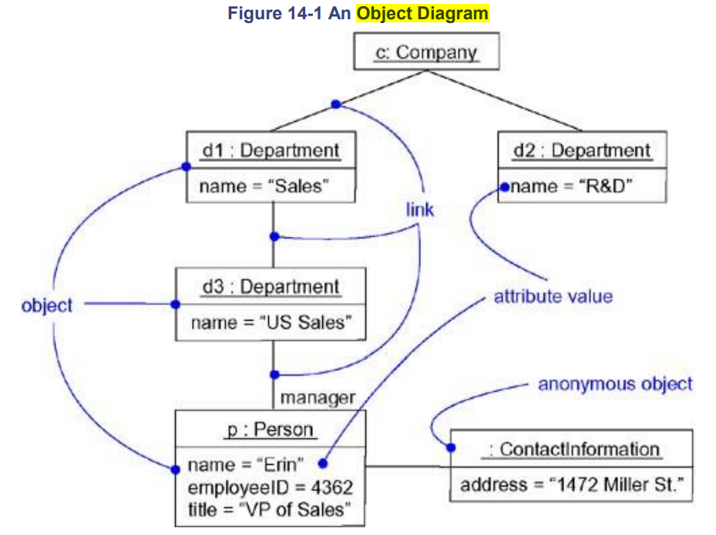
Object Diagram
Object name : Class name
State of the object
Grady Booch, James Rumbaugh, and Ivar Jacobson. 2005. Unified Modeling Language User Guide, The (2nd Edition) (Addison-Wesley Object Technology Series). Addison-Wesley Professional.

Slide 35
Sequence Diagram

Slide 36
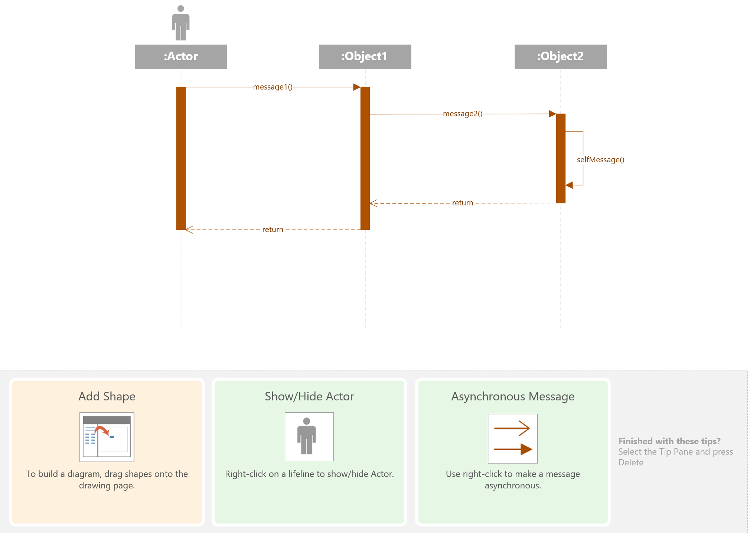
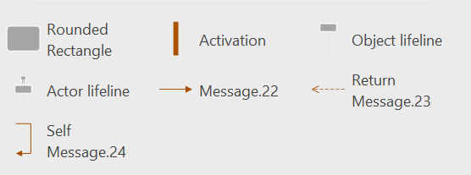
Sequence Diagram (Visio)
Message is method call
Bar size
matters
Return = method is done and returns a value
Call a function of the object (itself)

Slide 37
Sequence Diagrams
UML Object symbol
Object : Class
Object : Class
Actor
Lifelines
Messages
Activations

Slide 38
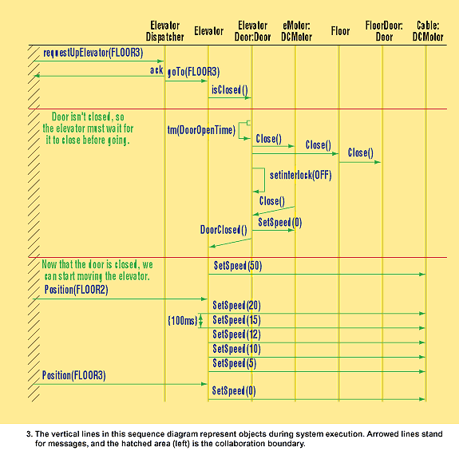
Sequence Diagram for Elevator
Source: Douglass. UML Lite Offers Simple Yet Powerful Tool Set For Even Complex Designs. Electronic Design, 2002.

Slide 39
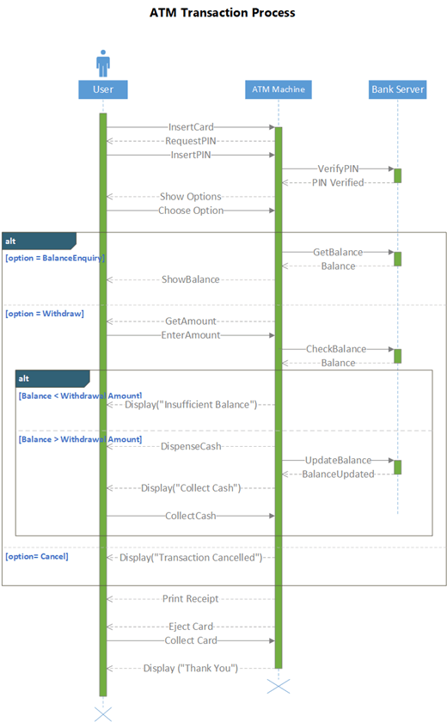
Sequence Diagram
You create sequence diagrams only for important parts of your system
For everything would be overkill
Good to visualize a protocol
Good to visualize Client vs Server communication
Dotted line = return
Straight line = method call

Slide 40
Sequence Diagram
Object 1
Object 2
Object 3
Message ID
Message ID
{ 500 ms }
Timing constraint
Peer-to-peer messaging
Message ID
c
Event ID
d
{ d – c < 2 s }
Message ID
e
Message ID
Broadcast messaging
Time
State ID
Message ID
State marks
f
State ID

Slide 41
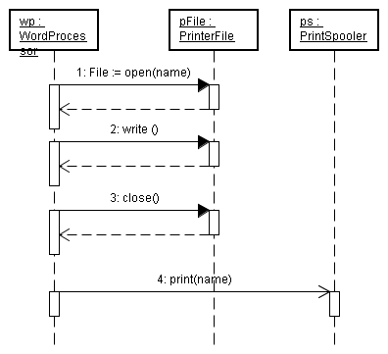
Sequence Diagram
Showing Synchronous and Asynchronous messages
(Fire & Forget)
Synchronous message
Asynchronous

Slide 42
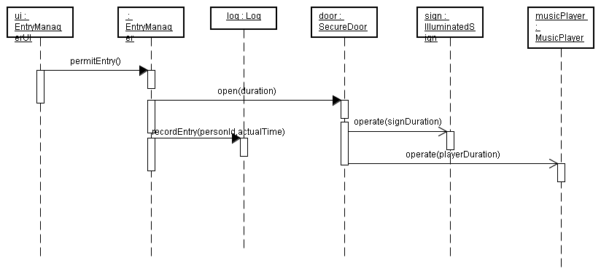
Asynchronous Messages and
Concurrent Execution
Concurrent

Slide 43
Package Diagram

Slide 44
Package diagram:
Arrange your elements into larger chunks
A package is a general-purpose mechanism to organize elements
Package is destroyed, elements are destroyed too
Without packages, you get big flat models

Slide 45
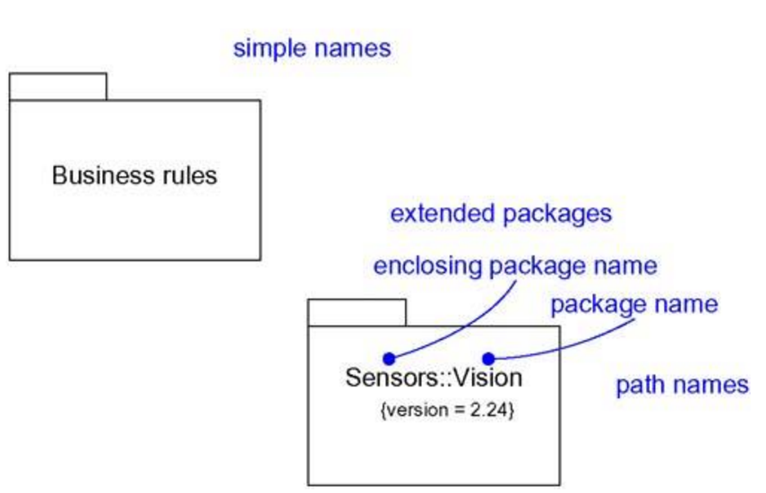
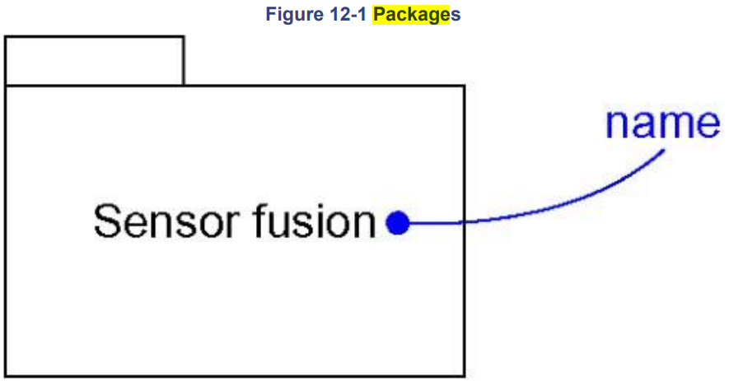
Package Diagram
Grady Booch, James Rumbaugh, and Ivar Jacobson. 2005. Unified Modeling Language User Guide, The (2nd Edition) (Addison-Wesley Object Technology Series). Addison-Wesley Professional.

Slide 46
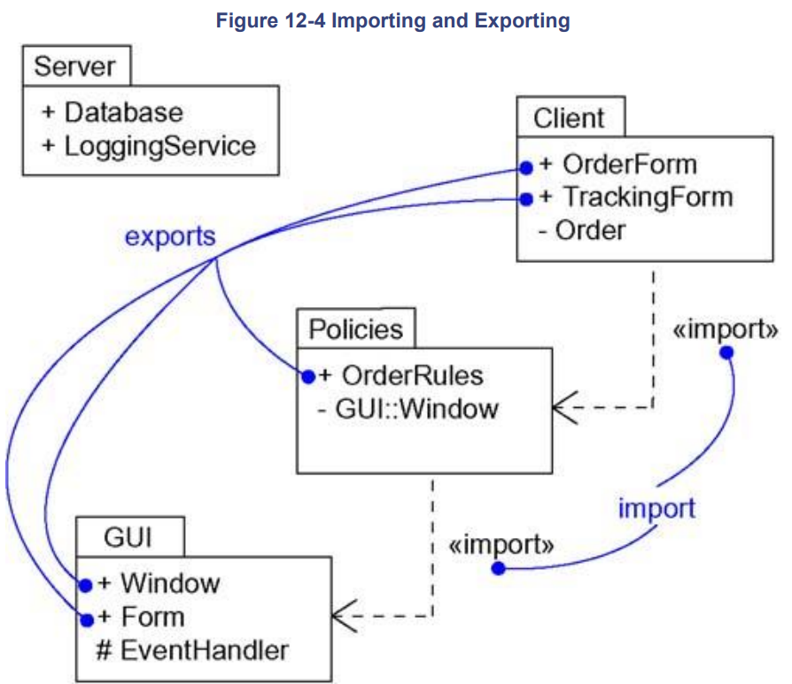
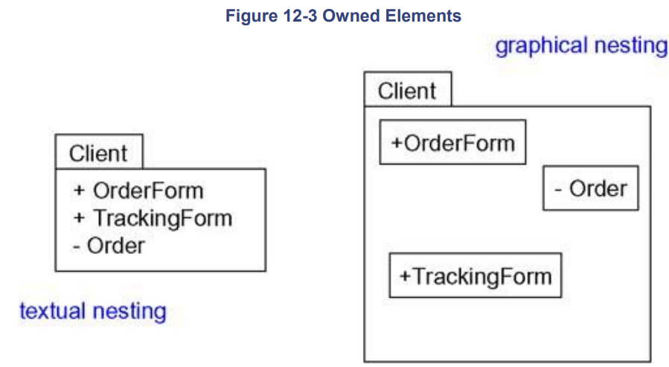

Package Diagram
Classes
same
Imports adds the contents of the
target to the source
Grady Booch, James Rumbaugh, and Ivar Jacobson. 2005. Unified Modeling Language User Guide, The (2nd Edition) (Addison-Wesley Object Technology Series). Addison-Wesley Professional.

Slide 47
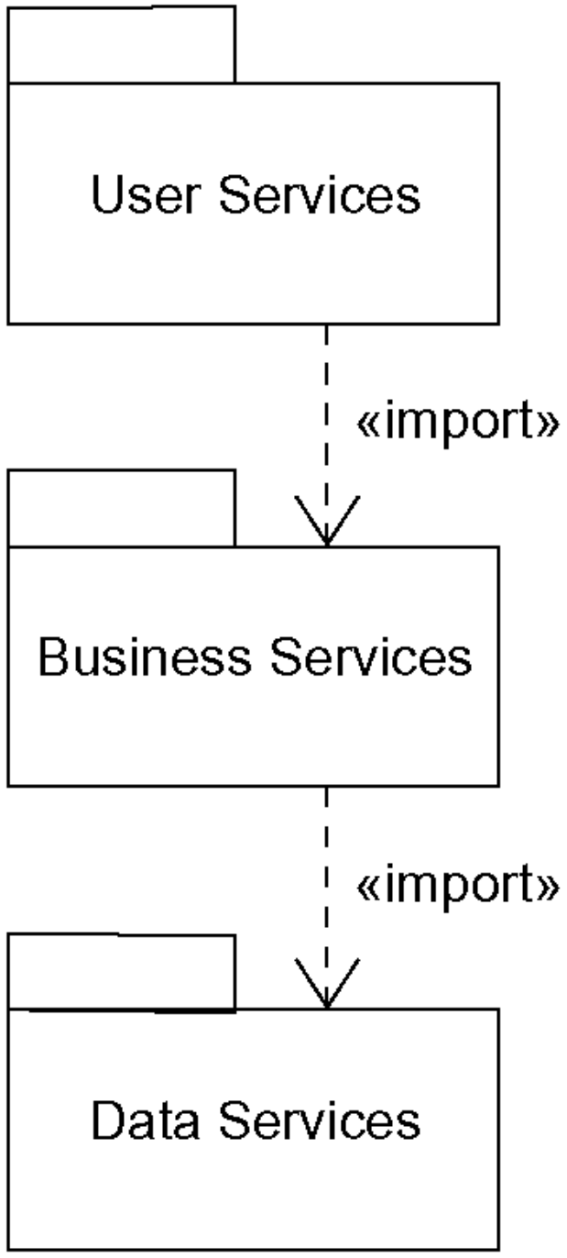
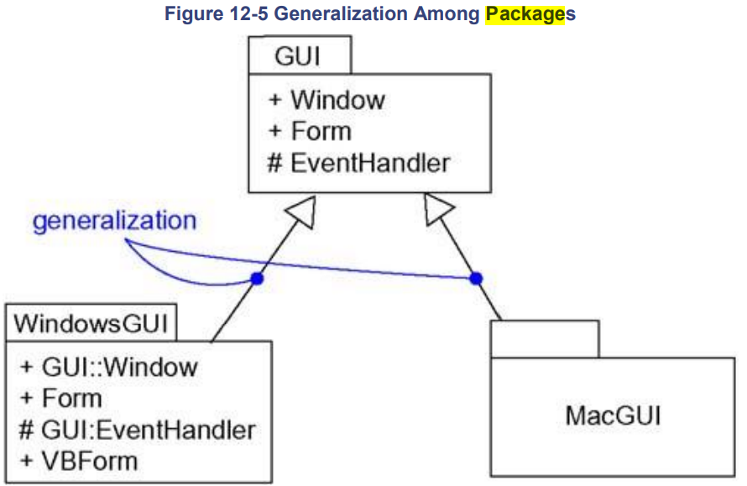
Package Diagram
3 tier
architecture
Visual
Interface
Control
Data
Grady Booch, James Rumbaugh, and Ivar Jacobson. 2005. Unified Modeling Language User Guide, The (2nd Edition) (Addison-Wesley Object Technology Series). Addison-Wesley Professional.

Slide 48
Component Diagram

Slide 49
Components:
Well-defined interface
Replaceable part of the system
Build components from smaller ones
Important for COM+, CORBA, EJB
Seldom stands alone
“Some bought library or tool”

Slide 50
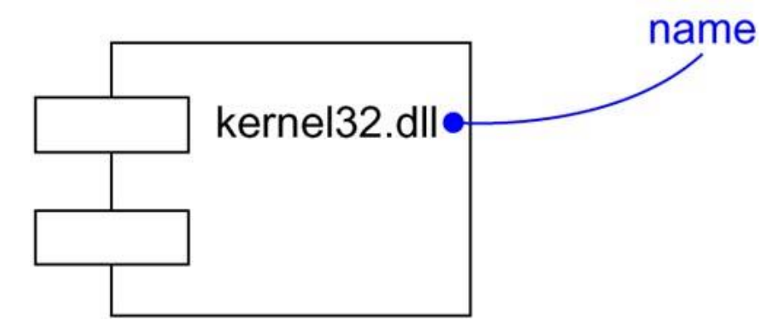
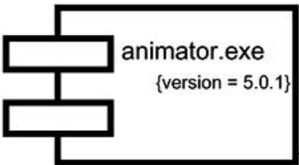
Component Diagram
Component (physical building block)
Interface (collection of one or more methods and zero or more attributes)
Offers Interface
Dependency (shown in dotted lines)

Slide 51
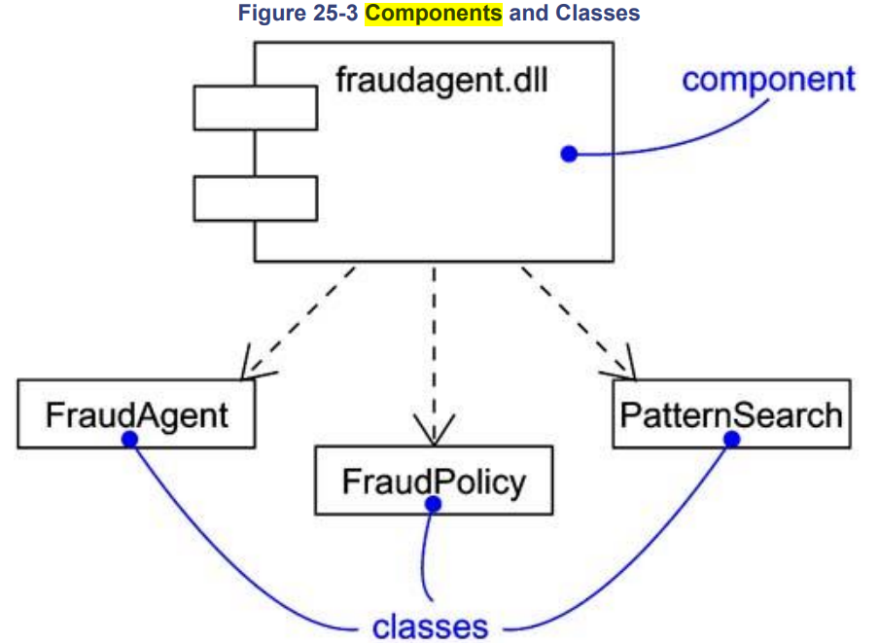
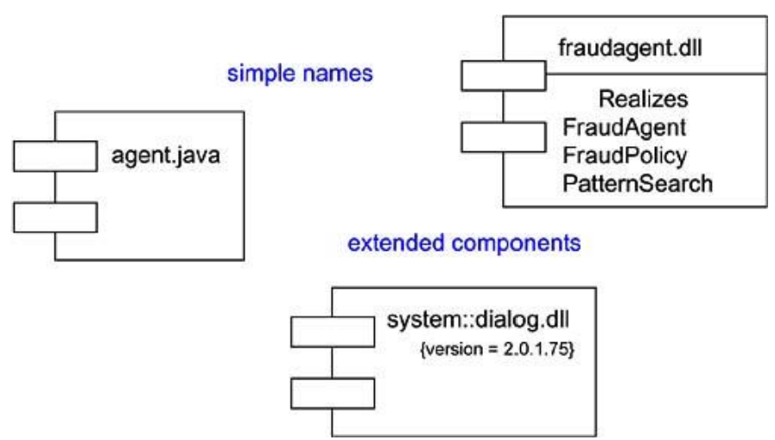
Component Diagram
Grady Booch, James Rumbaugh, and Ivar Jacobson. 2005. Unified Modeling Language User Guide, The (2nd Edition) (Addison-Wesley Object Technology Series). Addison-Wesley Professional.

Slide 52
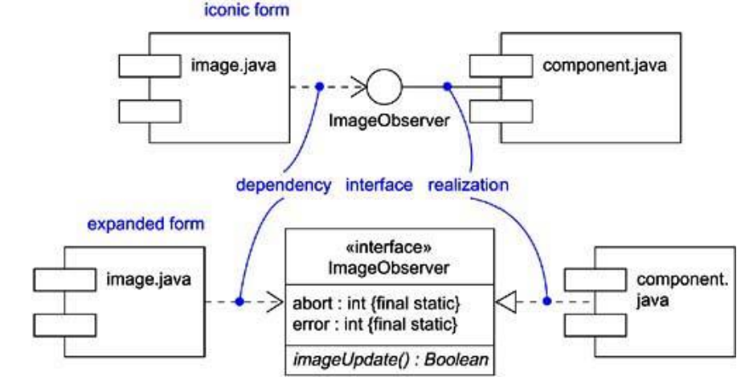
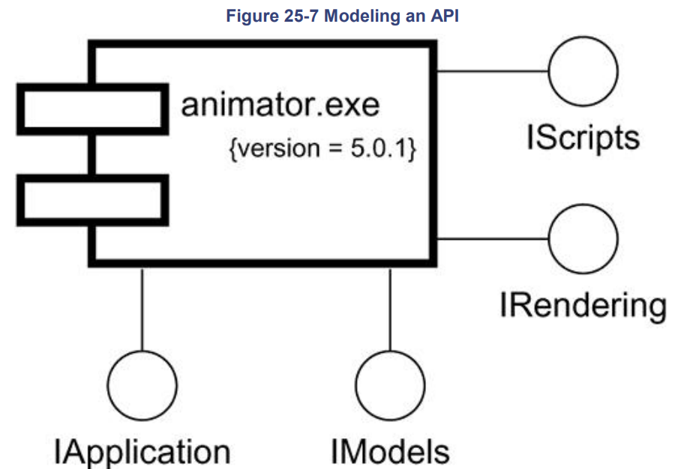
Component Diagram
Offers Interface
Same as above
Below one shows expanded view
Grady Booch, James Rumbaugh, and Ivar Jacobson. 2005. Unified Modeling Language User Guide, The (2nd Edition) (Addison-Wesley Object Technology Series). Addison-Wesley Professional.

Slide 53
State Diagram

Slide 54
State Diagram
State
State
Initial State
Pseudo
States
Show systems behavior
Systems behave in response
to some external stimulus
Does not have variables
or activities
Illustrate the systems behavior
across different use cases
event/action
Final State
Transition
event/action
Synchronization and Splitting of control
Synchronization
Splitting

Slide 55
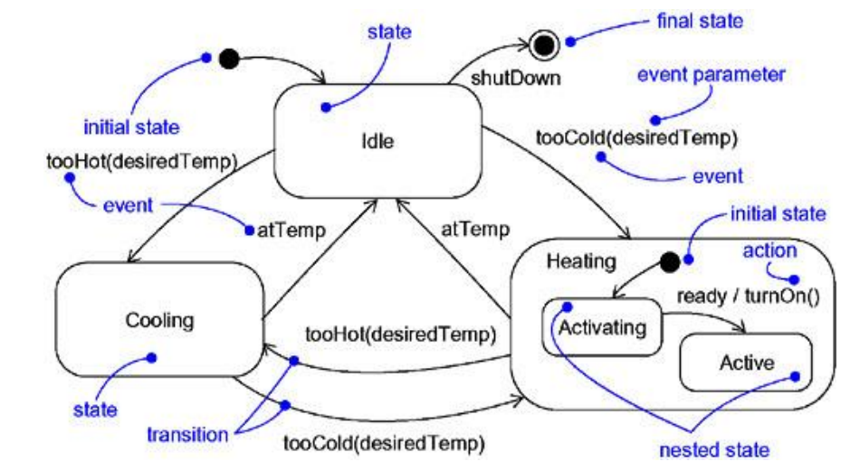
Statechart Diagram
Grady Booch, James Rumbaugh, and Ivar Jacobson. 2005. Unified Modeling Language User Guide, The (2nd Edition) (Addison-Wesley Object Technology Series). Addison-Wesley Professional.
Notes:
Transition from H* shown if there is no history yet.

Slide 56
Toaster Oven Statechart
doorClosed
heating
H*
CLOSE
entry/heaterOn();
exit/heaterOff();
doorOpen
entry/lampOn();
OPEN
off
exit/lampOff();
toasting
baking
entry/
entry/
entry/
OFF, tm(TIME_OUT)
TOAST
BAKE
Notes:
Transition from H* shown if there is no history yet.

Slide 57
Activity Diagram

Slide 58
Activity Diagram Symbols and Notations
Activity diagram:
dynamic View of the system
Similar to flow charts:
  Workflow
  Business processes
  Procedural
Activity = Actions
Arrows = control flow = show direction
Decision points
Fork and rejoin

Slide 59
Activity Diagram Symbols and Notations
Activity
Activity
Activity flow
Object flow
Activity
Object name : Class
Activity diagram:
dynamic View of the system
Similar to flow charts:
  Workflow
  Business processes
  Procedural
Activity = Actions
Arrows = control flow = show direction
Decision points
Fork and rejoin

Slide 60
Activity Diagram Symbols and Notations
Activity
Activity
Branching
Fork
[condition]
Synchronization
Activity
Activity
Activity
[condition]
Rejoin
Activity
Activity

Slide 61
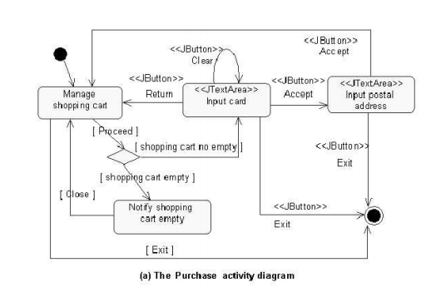
Activity Diagram for Purchase
Source: Designing GUI components from UML use cases.

Slide 62
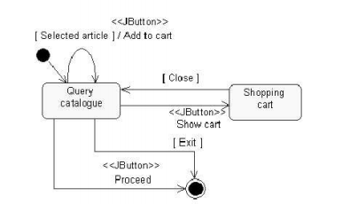
Activity Diagram to Manage Shopping Cart
Source: Designing GUI components from UML use cases.

Slide 63
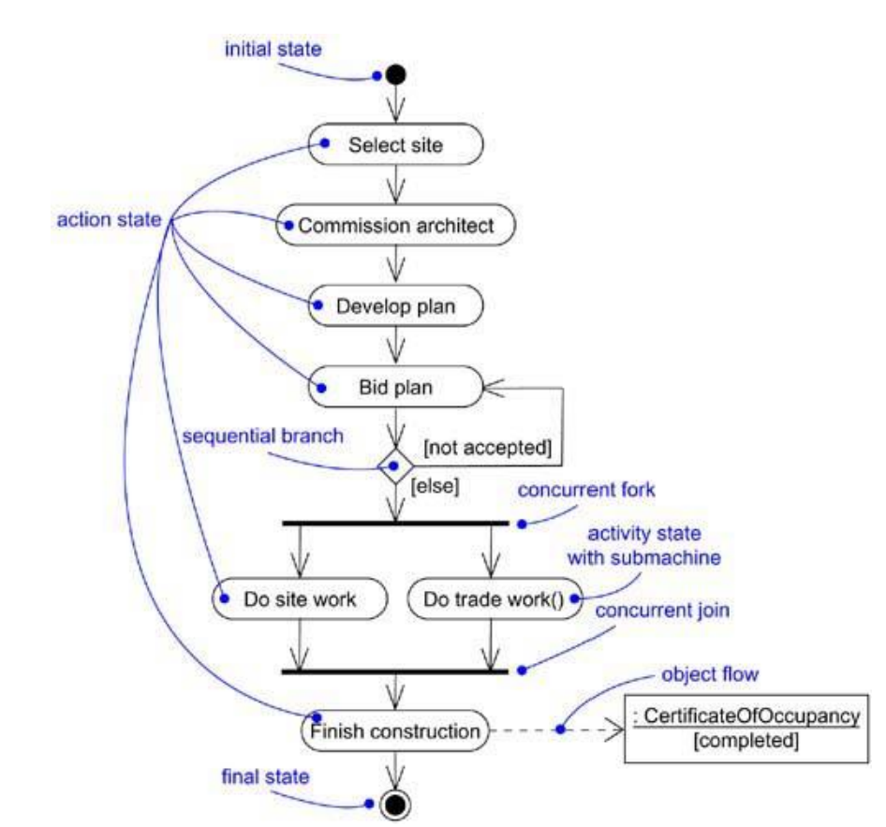
Activity Diagram
Fork
Rejoin
Grady Booch, James Rumbaugh, and Ivar Jacobson. 2005. Unified Modeling Language User Guide, The (2nd Edition) (Addison-Wesley Object Technology Series). Addison-Wesley Professional.

Slide 64
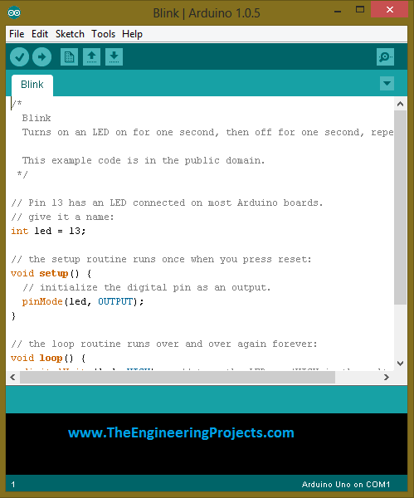
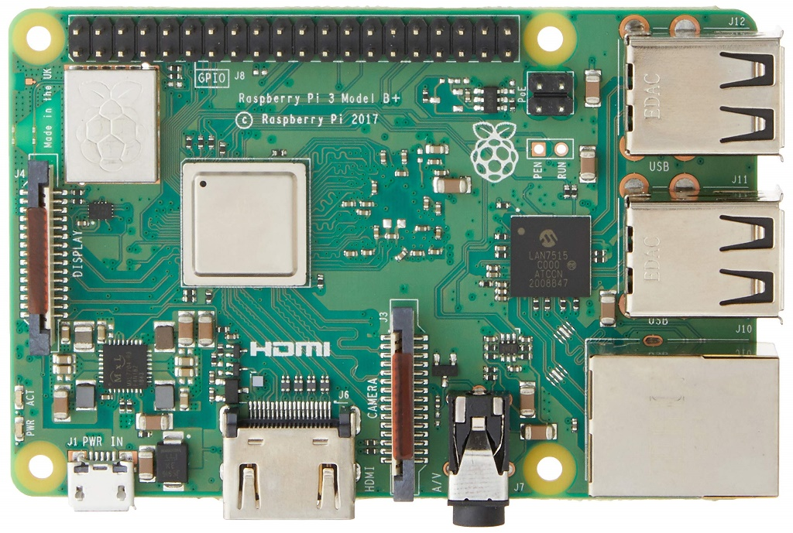
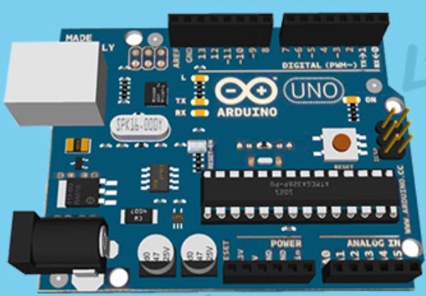
Difference between activity vs state diagram
Like between Arduino vs Raspberry Pi
Some kind of
state machine
Grady Booch, James Rumbaugh, and Ivar Jacobson. 2005. Unified Modeling Language User Guide, The (2nd Edition) (Addison-Wesley Object Technology Series). Addison-Wesley Professional.

Slide 65
Deployment Diagram

Slide 66
Deployment Diagram
Shows the:
hardware
installed software
the middleware
used to connect
machines to
each other.
Static deployment
view of a system
Physical allocation of components to computational units
Node = computational unit
Edge = communication
Node name
Node (physical resource that executes code components)
Association (physical connection between nodes such as Ethernet)
Node
Node
Node
Components and nodes (components are put inside the node that deploys them)
<<component>>

Slide 67
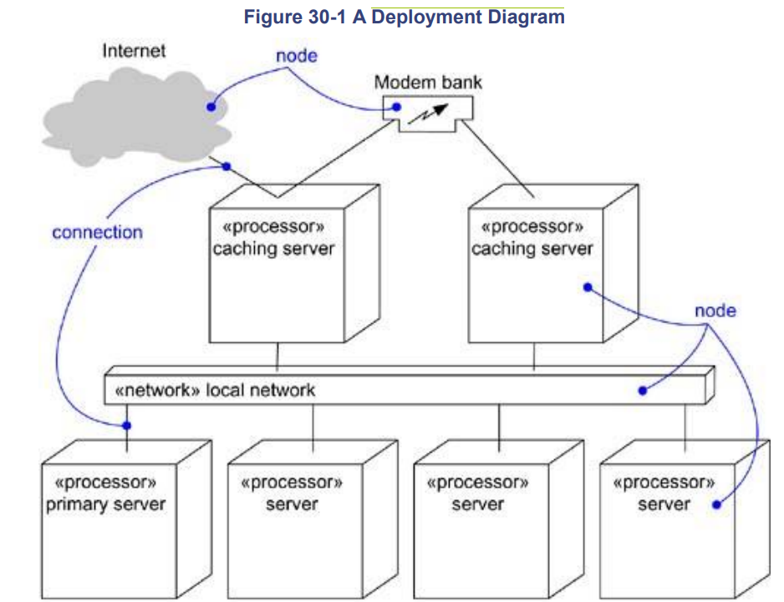
Deployment
Diagram
Bad design!
At least it shows which
servers are involved.
What to deploy or update?
But better than nothing
Grady Booch, James Rumbaugh, and Ivar Jacobson. 2005. Unified Modeling Language User Guide, The (2nd Edition) (Addison-Wesley Object Technology Series). Addison-Wesley Professional.

Slide 68
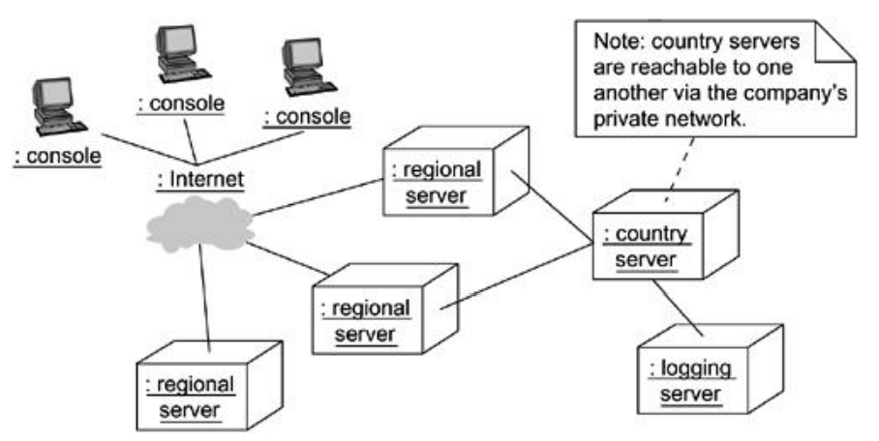
Deployment
Diagram
Similar issue
At least it shows the
Servers involved.
What to deploy or update?
But better than nothing
Grady Booch, James Rumbaugh, and Ivar Jacobson. 2005. Unified Modeling Language User Guide, The (2nd Edition) (Addison-Wesley Object Technology Series). Addison-Wesley Professional.

Slide 69

Deployment
Diagram
Has to be deployed/updated
Grady Booch, James Rumbaugh, and Ivar Jacobson. 2005. Unified Modeling Language User Guide, The (2nd Edition) (Addison-Wesley Object Technology Series). Addison-Wesley Professional.

Slide 70

Deployment
Diagram
Better design:
Shows all computational
units and subsystems
Including version numbers
and relationships
Missing is the own content?
https://www.researchgate.net/figure/A-unified-modeling-language-UML-deployment-diagram-for-the-Carbon-Data-Explorer-CDE_fig1_307681378

Slide 71
Collaboration Diagram

Slide 72
Collaboration Diagram
Object : Class
Class roles
<<global>>
Association roles
1.2 [condition]: message name
Message. (number messages in order of execution)
1.2 * [loop expression]: message name
Message. (Use a * to indicate a loop)

Slide 73

Collaboration Diagram
Structural aspect
of a Collaboration
Grady Booch, James Rumbaugh, and Ivar Jacobson. 2005. Unified Modeling Language User Guide, The (2nd Edition) (Addison-Wesley Object Technology Series). Addison-Wesley Professional.

Slide 74

Collaboration Diagram
Behavioral Aspects
of a Collaboration
Grady Booch, James Rumbaugh, and Ivar Jacobson. 2005. Unified Modeling Language User Guide, The (2nd Edition) (Addison-Wesley Object Technology Series). Addison-Wesley Professional.

Slide 75

Collaboration Diagram
Grady Booch, James Rumbaugh, and Ivar Jacobson. 2005. Unified Modeling Language User Guide, The (2nd Edition) (Addison-Wesley Object Technology Series). Addison-Wesley Professional.

Slide 76
Case Study
Model Driven Development

Slide 77
Model Driven Development
Customer wanted a Service Oriented Architecture (SOA) with a Model Driven Development approach (MDA)
Implemented in and on: Java & Enterprise Java Beans – Servlets - JBoss application server
Customer was very annoyed by their old intrasparent legacy development process (COBOL)
Customer MDA expectations:
Draw a model and create the code
You have everything modelled
Easy to understand system
Can be understood even by the higher management
Implementation costs goes down
Implementation speed goes up
Project:
Big Travel Agency
Medium size: 3 to 4 years
Maximum at one time 50 developer
COBOL system big millions of locs

Slide 78
Model Driven Development
Problems and issues:
MDA looks good on paper, and for small projects
You could model everything, but …
Balance between modelling and software development must be found
Software development turned into too easy too boring tasks
Architecture overhead went up unexpected high
Rework was needed on the architecture then all code needs to be rechecked
UML diagrams complexity went up a lot
Overall complexity went up a lot
Customer was unhappy at the end
Too good to be true!
Be careful with bigger projects and new technology

Slide 79
Done

Slide 80
… to here …

