Slide 1
COEN160
Fall 2026
Object-Oriented Analysis, Design and Programming
Michael Schimpf, PhD
Department of Computer Science and Engineering

Slide 2
Java Exceptions

Slide 3
Exceptions in Java:
Throwing exceptions (throws)
Catching and handling exceptions with try and catch
Multiple catch blocks
User-defined exceptions

Slide 4
Exceptions
An error condition that a program encounter.
  Division by zero
  Accessing index out of bounds (array).
  Etc.
An abnormal condition (logic issue).
  The balance of a Bank Account below zero.
  A flight can not be booked
  A flight can not be canceled
  Etc.

Slide 5
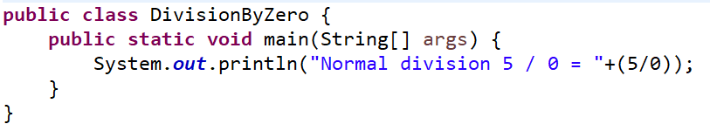
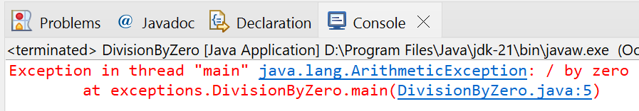
Exceptions
CSEN160_04_Lecture_JavaInMoreDetailsPlusExceptions: “A_Exceptions.A_EasyExceptions.DivisionByZero”
Division by Zero:

Slide 6
Exceptions
An exception handler handles the exception!
Handling an exception => taking corrective action.
Raising an exception is
  Interrupting the program.
  Calling the exception handler.
Propagating an exception is
  Passing the responsibility of handling the exception => to the caller.

Slide 7
Exceptions
If an abnormal condition occurs:
  An exception is raised
  The program is interrupted
  Control is transferred to the exception-handler
  No handler, the program terminates!

Slide 8
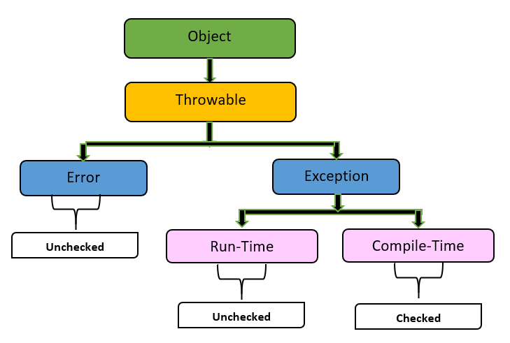
Exceptions in Java
In Java, exceptions are defined as classes.
All exceptions are instances of java.lang.Exception or one of its subclasses.
You can define your own exceptions:
subclass of java.lang.Exception.

Slide 9
Checked vs Unchecked Exceptions

Slide 10

Checked Exceptions (Compile Time)
Checked exceptions:
  Represent abnormal conditions must be handled (by you )
  Examples:
    invalid user input
    accessing non-existing files
    etc.
  These are subclasses of class java.lang.Exception.
  Checked exceptions must be explicitly caught or propagated.

Slide 11
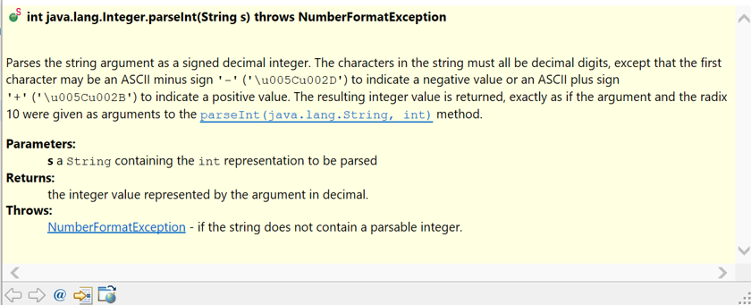
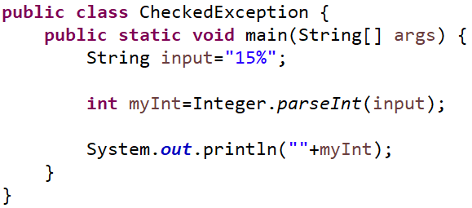
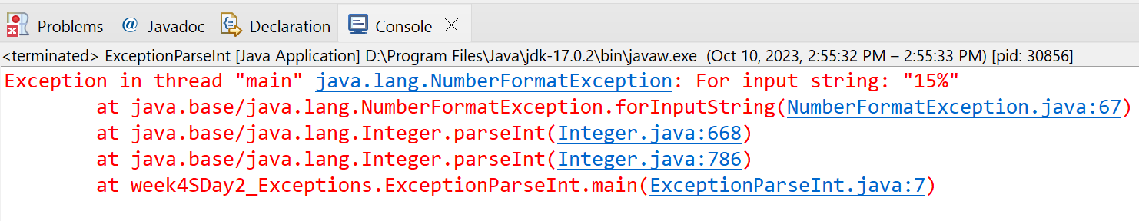
Checked Exceptions (Compile Time)
CSEN160_04_Lecture_JavaInMoreDetailsPlusExceptions: “A_Exceptions.A_EasyExceptions.CheckedException.”
Checked exceptions:

Slide 12
Unchecked Exceptions (Run Time)
Unchecked exceptions
  Represent program defects like:
    accessing a null pointer
    accessing an index out of bounds
  They are subclasses of java.lang.RuntimeException.
  Unchecked exceptions don't have to be caught or thrown.

Slide 13
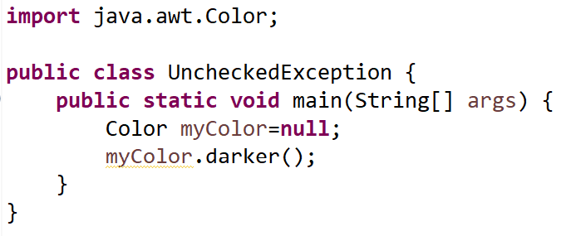
Unchecked Exceptions (Run Time)
CSEN160_04_Lecture_JavaInMoreDetailsPlusExceptions: “A_Exceptions .A_EasyExceptions.UncheckedException.”
Unchecked exceptions:

Slide 14

Checked exceptions:
abnormal conditions must be handled!
i.e. NumberFormatException
(Compile Time)

Slide 15
Unchecked exceptions:
program defects!
i.e. NullPointerException
(Run Time)

Slide 16
Summary
Checked exceptions
Compile-time:
compiler requires you to catch the exception in a try-catch block or use the throws keyword.
Cause:
They are foreseeable problems, but from which the program can recover.
Inheritance:
Subclasses of the java.lang.Exception.
Examples: IOException, FileNotFoundException, and SQLException.
Unchecked exceptions
Run-Time:
Compiler does not check these exceptions. You are not forced to handle them.
Cause:
They indicate a programming mistake or a logical error.
Best is to fix the bug rather than adding exception handling.
Inheritance: Unchecked exceptions are subclasses of java.lang.RuntimeException or java.lang.Error.
Examples: NullPointerException, ArrayIndexOutOfBoundsException, and ArithmeticException.

Slide 17
Catching Exceptions

Slide 18
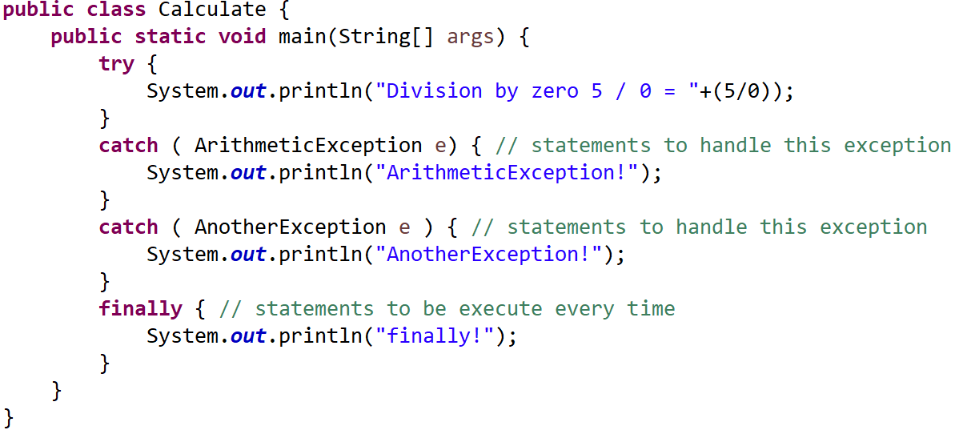
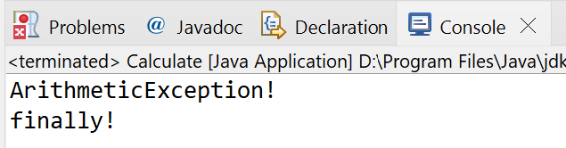
Catching Exceptions
CSEN160_04_Lecture_JavaInMoreDetailsPlusExceptions: “A_Exceptions .A_EasyExceptions. DivisionByZero_TryCatch”
Finally, is always executed!

Slide 19
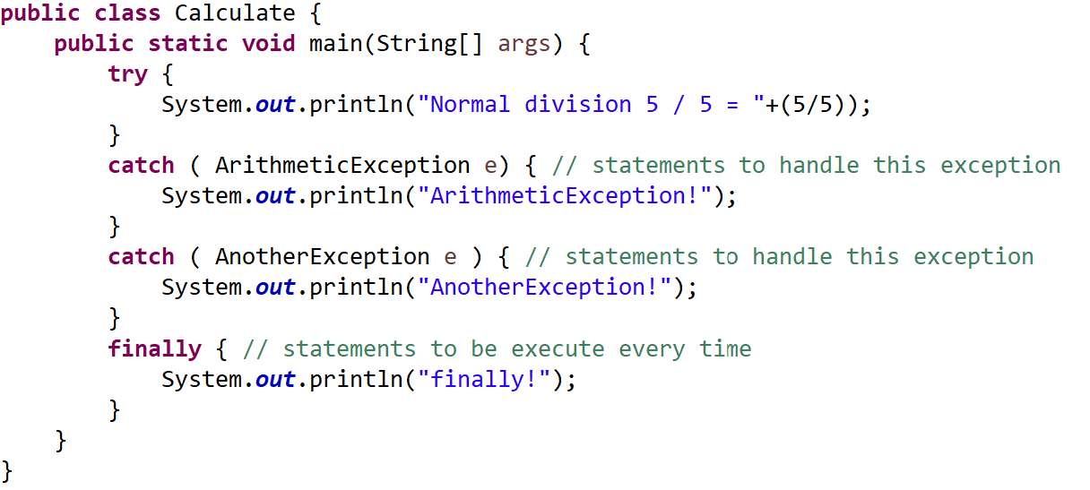
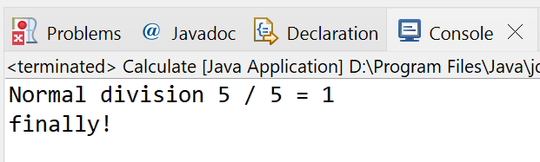
Catching Exceptions
CSEN160_04_Lecture_JavaInMoreDetailsPlusExceptions: “A_Exceptions .A_EasyExceptions. DivisionByZero_TryCatch”
No error case!
Finally, is always executed!

Slide 20
Wrapping Exceptions

Slide 21
Wrapping Exceptions
CSEN160_04_Lecture_JavaInMoreDetailsPlusExceptions: “A_ExceptionsB_WrapperExceptions.Counter”
You catch an exception
wrap it in a different exception
and throw that exception
To prevent the code further up the call stack,
from having to know low-level exception
See the example in
(IllegalArgumentException is thrown and catched and changed into MyException)

Slide 22
Hierarchy

Slide 23
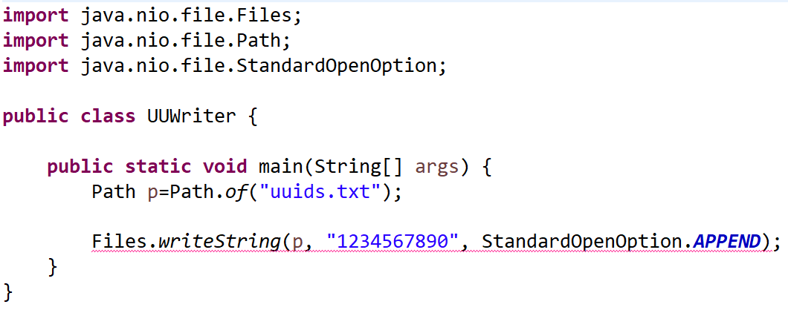
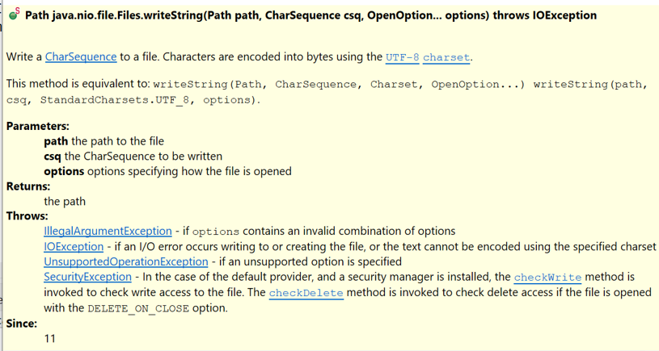
Exception Hierarchy
CSEN160_04_Lecture_JavaInMoreDetailsPlusExceptions: “A_Exceptions.C_UUWriterExceptions”

Slide 24
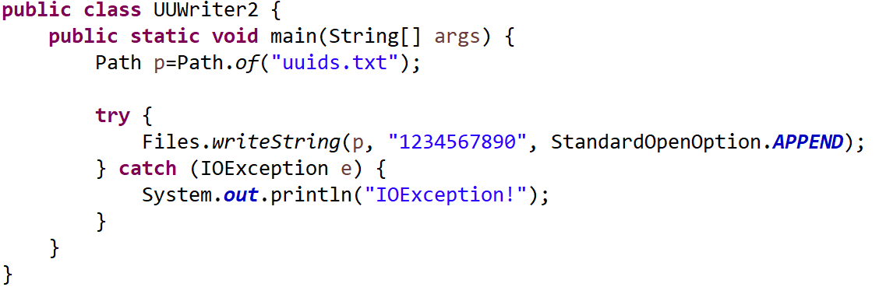
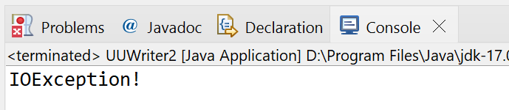
Exception Hierarchy
CSEN160_04_Lecture_JavaInMoreDetailsPlusExceptions: “A_Exceptions.C_UUWriterExceptions”
Option 1: Optimal, catch exception …

Slide 25
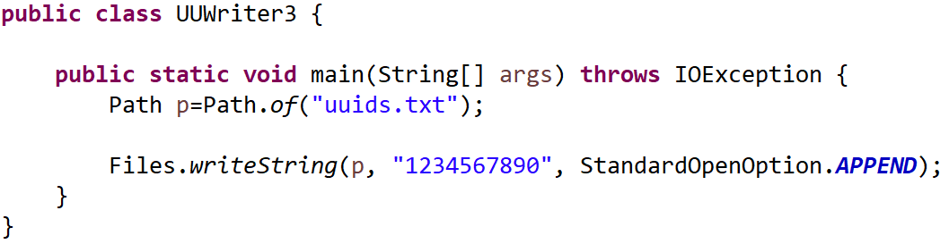
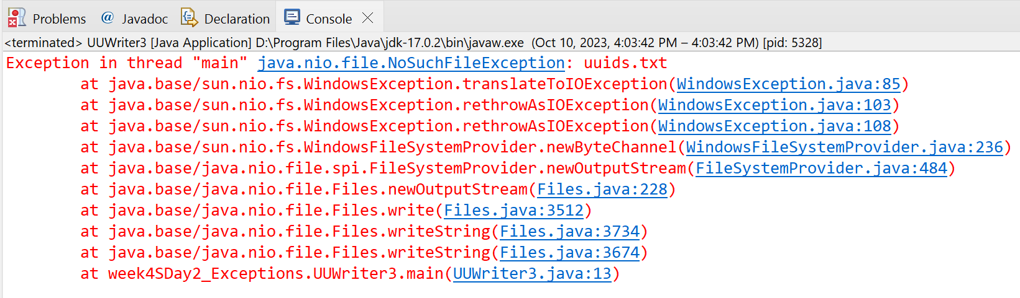
Exception Hierarchy
CSEN160_04_Lecture_JavaInMoreDetailsPlusExceptions: “A_Exceptions.C_UUWriterExceptions”
Option 2: Semi optimal: throw away exception to the caller …

Slide 26
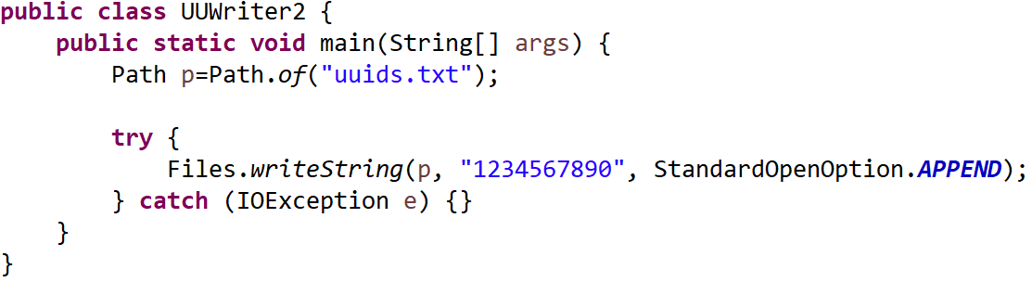
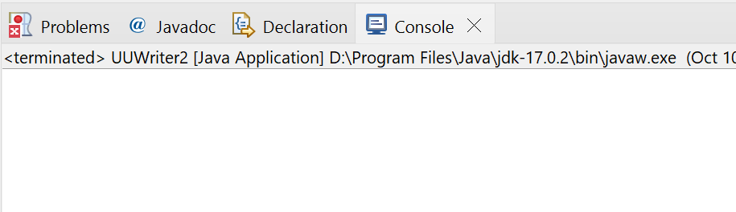
Exception Hierarchy
CSEN160_04_Lecture_JavaInMoreDetailsPlusExceptions: “A_Exceptions.C_UUWriterExceptions”
Option 3: I don’t care version! Not recommended …

Slide 27
Exception Hierarchy
For option 1:
Inheritance of the exceptions are important
Option1 actually throws “java.nio.file.NoSuchFileException”
Which is a child class of “java.io.IOException”
If you catch the parent class first
You never catch the child exception

Slide 28
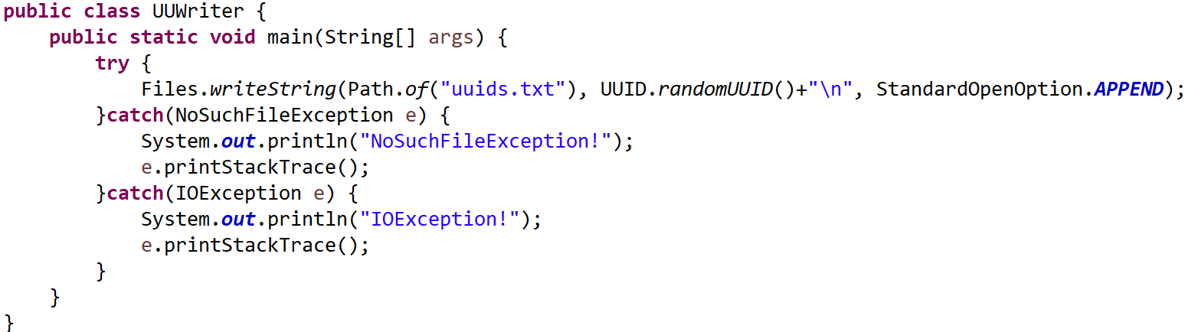
Exception Hierarchy
CSEN160_04_Lecture_JavaInMoreDetailsPlusExceptions: “A_Exceptions.C_UUWriterExceptions”
First the specialized exception (child)
Then the more general exception (parent)

Slide 29
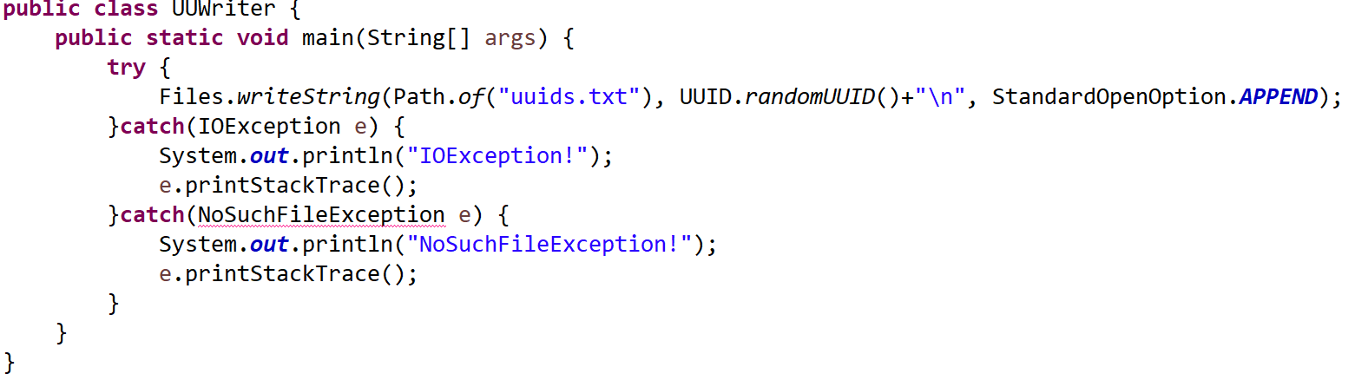
Exception Hierarchy
CSEN160_04_Lecture_JavaInMoreDetailsPlusExceptions: “A_Exceptions.C_UUWriterExceptions”
The general exception is first!
The specialized exception second!
Problem is:
NoSuchFileException cannot be reached
Eclipse helps in this example, but don’t trust it
Issue could be, you have a sophisticated exception handling, but it is not working!

Slide 30
Multi Catch

Slide 31
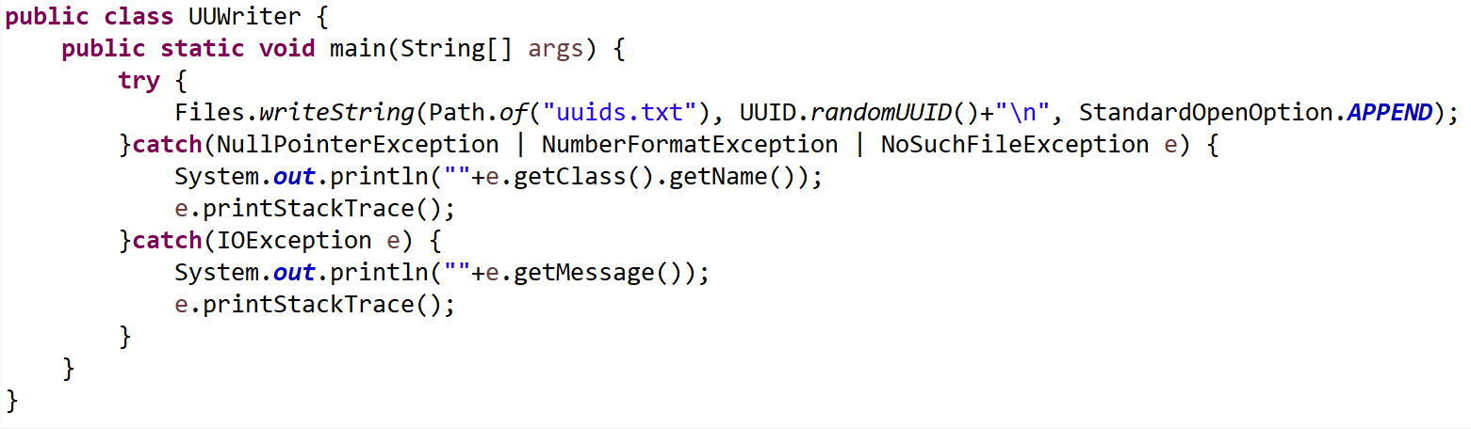
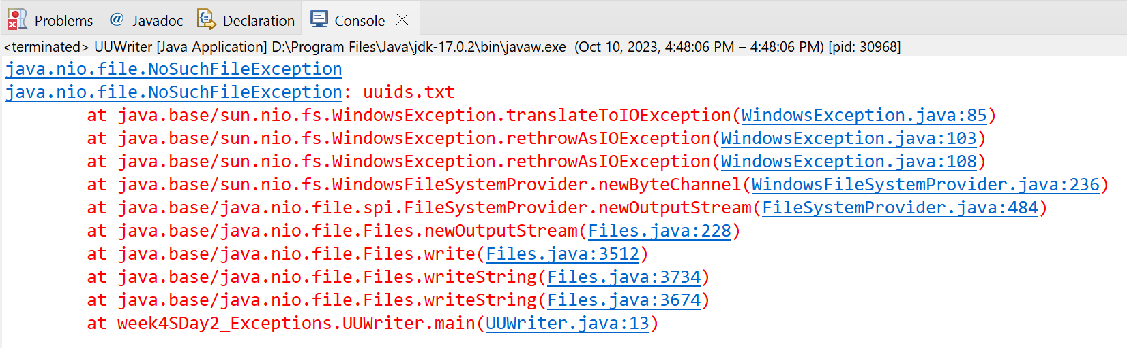
Multi catch
CSEN160_04_Lecture_JavaInMoreDetailsPlusExceptions: “A_Exceptions.C_UUWriterExceptions”

Slide 32
Own Exceptions

Slide 33
Question: Why create your own exception?

Slide 34
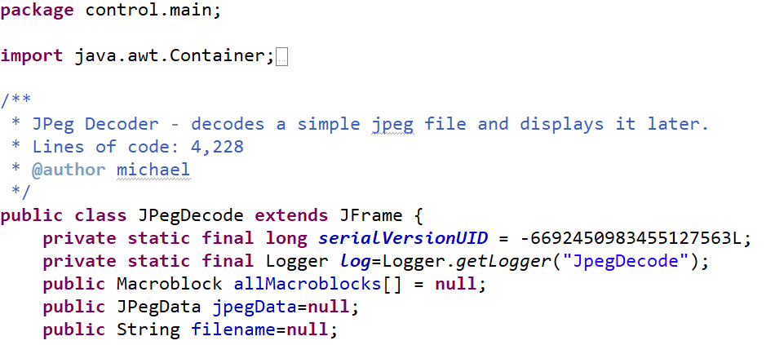
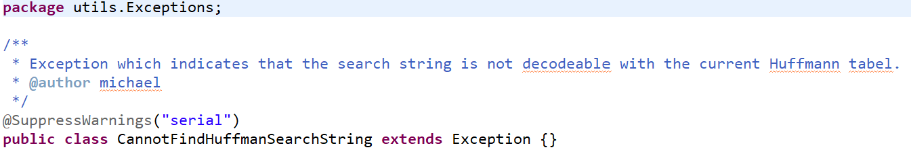
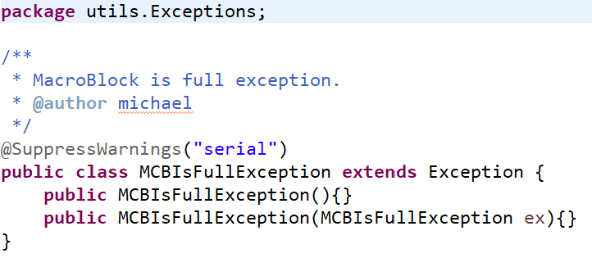
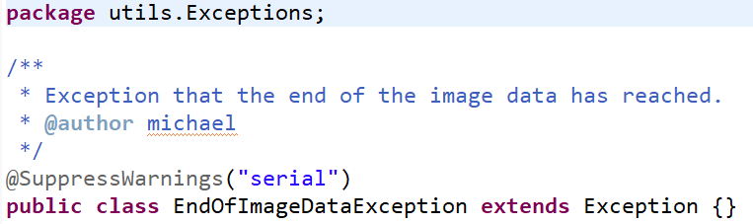
Create your Own Exception
“JPegJavaDecoder”
Why?
Can be helpful for your kind of errors
For my: JPegJavaDecoder: Created some stupid exceptions …

Slide 35
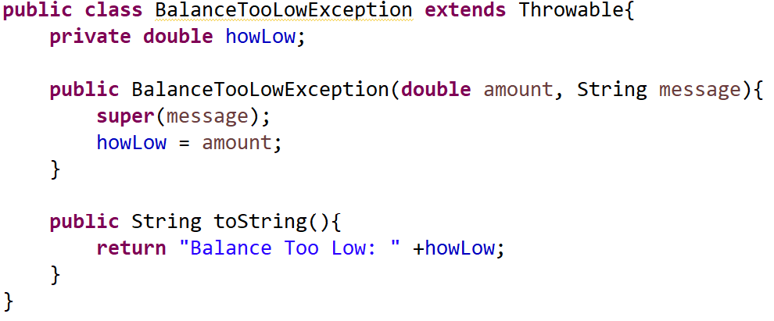
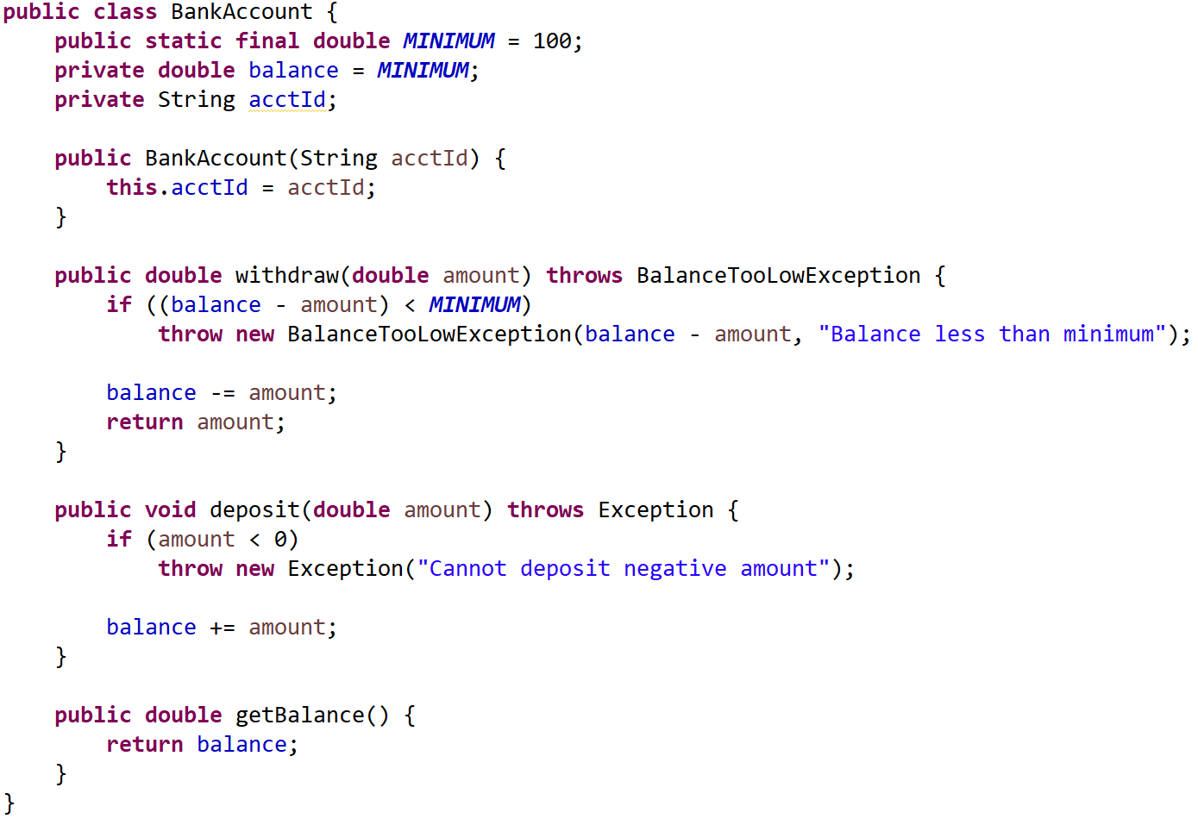
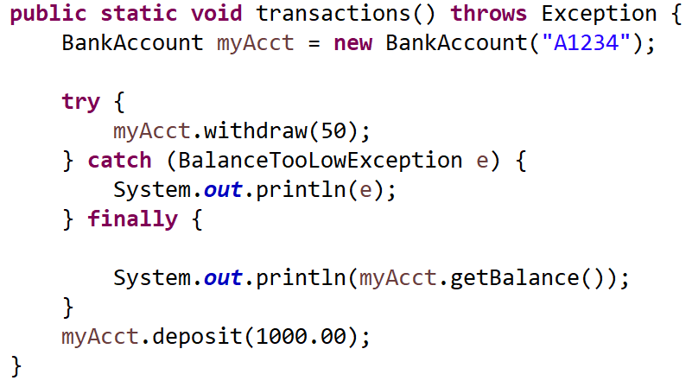
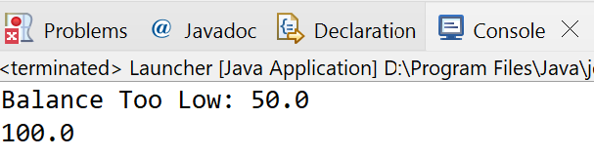
Handling Exceptions
CSEN160_04_Lecture_JavaInMoreDetailsPlusExceptions: “A_Exceptions.D_BankExampleExceptions”
Handling Exceptions:
Launcher Class

Slide 36
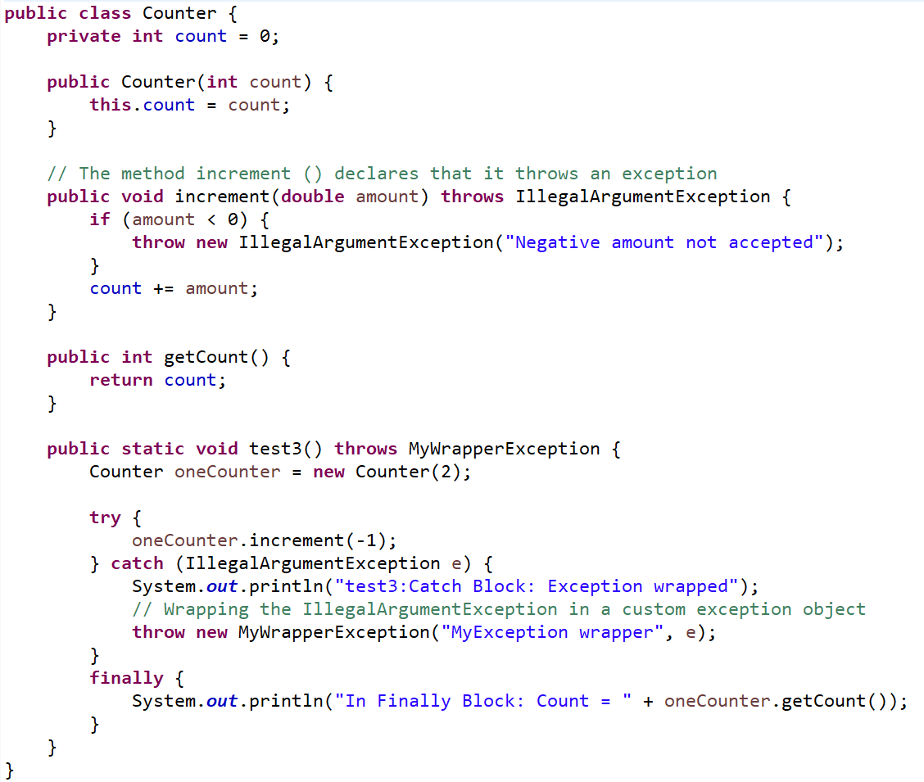
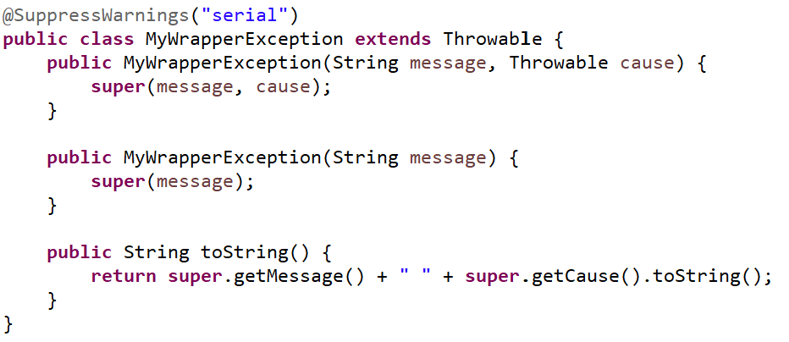
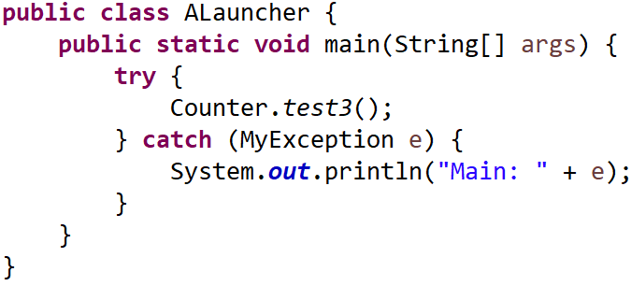
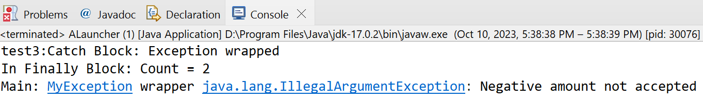
Handling Exceptions
CSEN160_04_Lecture_JavaInMoreDetailsPlusExceptions: “A_Exceptions.B_WrapperExceptions”
Exception Wrapping:
See eclipse ExceptionsDemo2.java
1. IllegalArgumentException is thrown
2. IllegalArgumentException is catched
3. wrapped to MyException

Slide 37
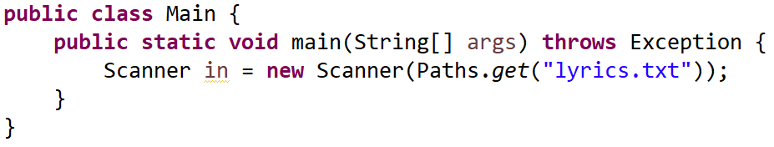
Re-throw everything to main()
CSEN160_04_Lecture_JavaInMoreDetailsPlusExceptions: “A_Exceptions.C_UUWriterExceptions”
Re-throw everything, is lazy!
Or throw away IOException

Slide 38
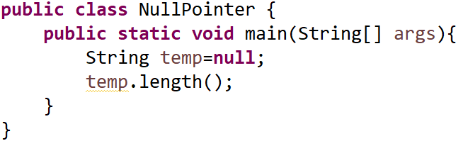
Catch unchecked exceptions
CSEN160_04_Lecture_JavaInMoreDetailsPlusExceptions: “A_Exceptions.E_MoreExceptions.NullPointer”
Unchecked exceptions:
Are programming errors/defects
Would not occur when your program is correct!
For debugging, catch immediately and figure out the problem
Later, for production, better not!

Slide 39
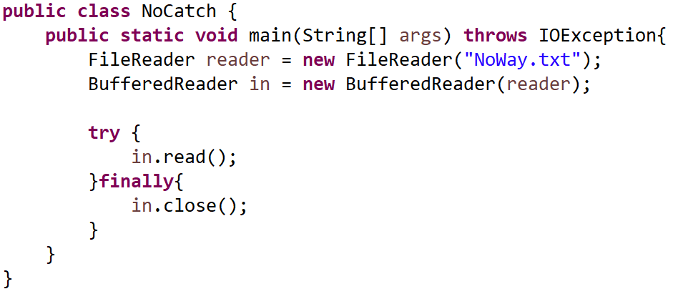
Try without catch, but finally
CSEN160_04_Lecture_JavaInMoreDetailsPlusExceptions: “A_Exceptions.E_MoreExceptions.NoCatch”
Useful? For releasing resources …

Slide 40
Try with resources
CSEN160_04_Lecture_JavaInMoreDetailsPlusExceptions: “A_Exceptions.E_MoreExceptions.NoCatch”
In must be outside the try block
Closing “in”, basically needs another try catch
If in finally an exception occurs, it overshadows the try exception

Slide 41
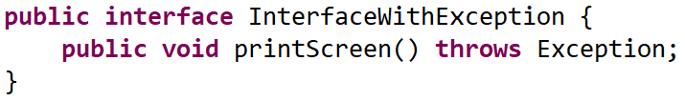
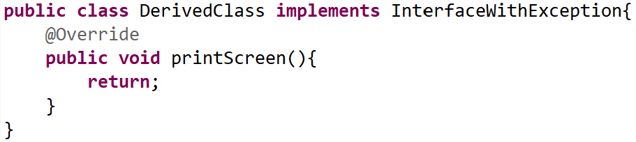
Throws and overriding in interface
CSEN160_04_Lecture_JavaInMoreDetailsPlusExceptions: “A_Exceptions.E_MoreExceptions.InterfaceWithException”
Possible:
But not recommended

Slide 42
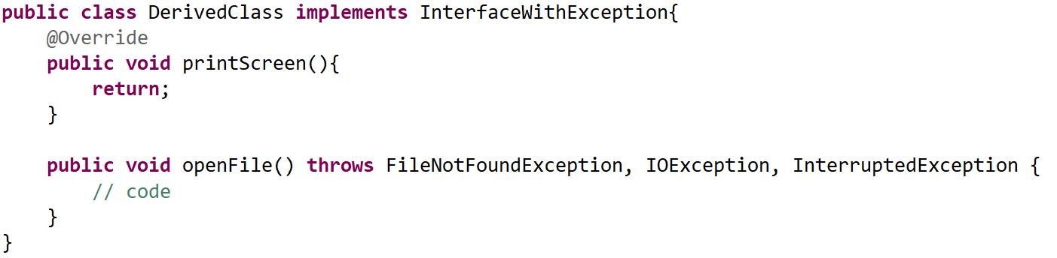
Excessive throws
CSEN160_04_Lecture_JavaInMoreDetailsPlusExceptions: “A_Exceptions.E_MoreExceptions.InterfaceWithException”
Too common
OK because openFile()
Checked exception, not good!
Problem:
Too common exceptions
Be as precise and specialized as possible
(if you use throws)
Do not annoy implementer
Implementer use maybe does not care “catch (Exception e) {}”

Slide 43
Hard Errors

Slide 44
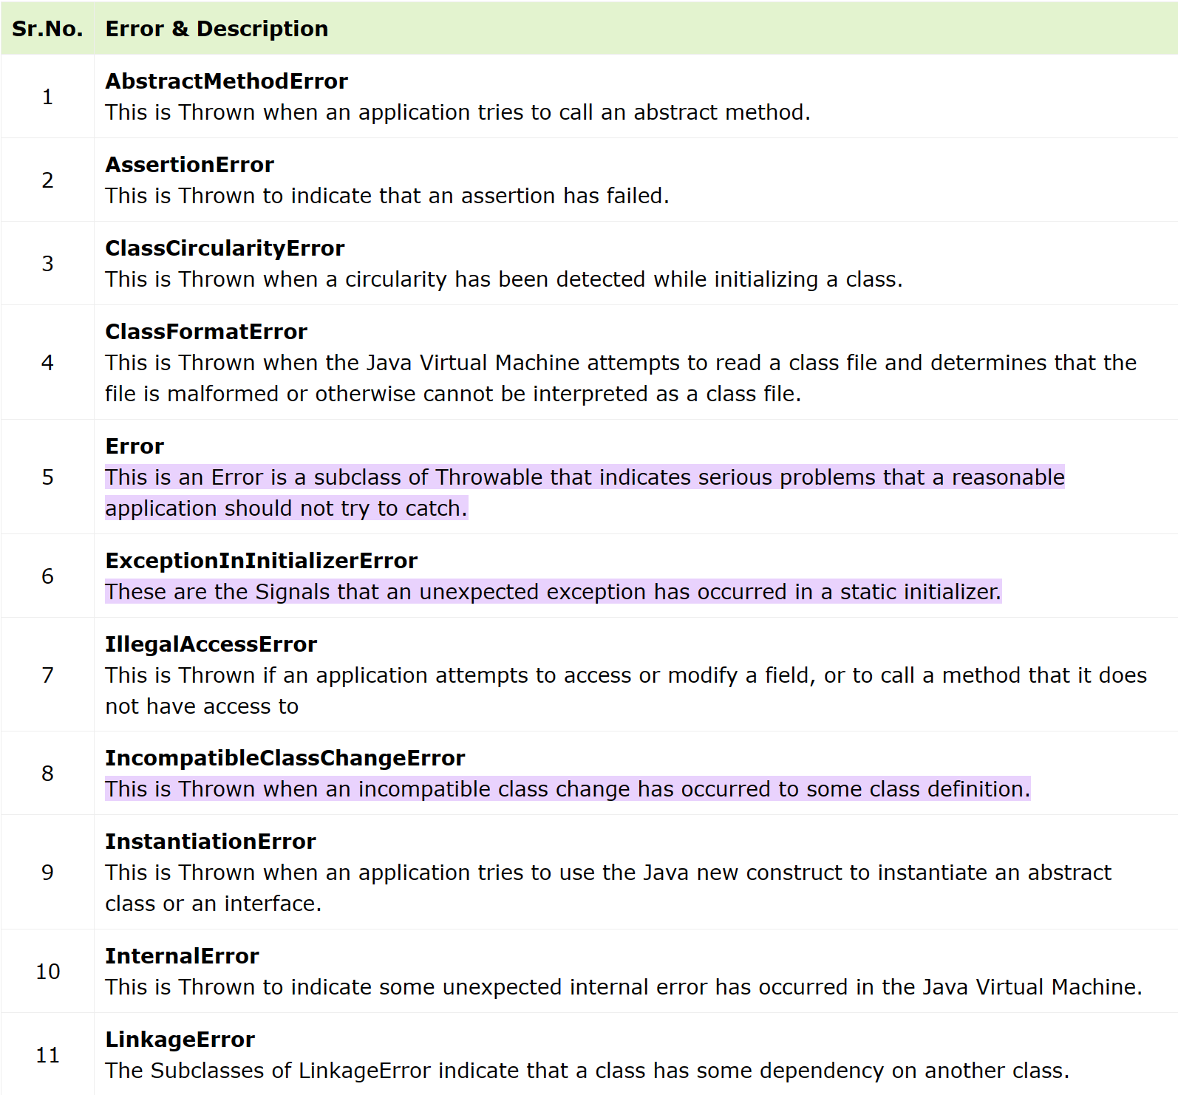
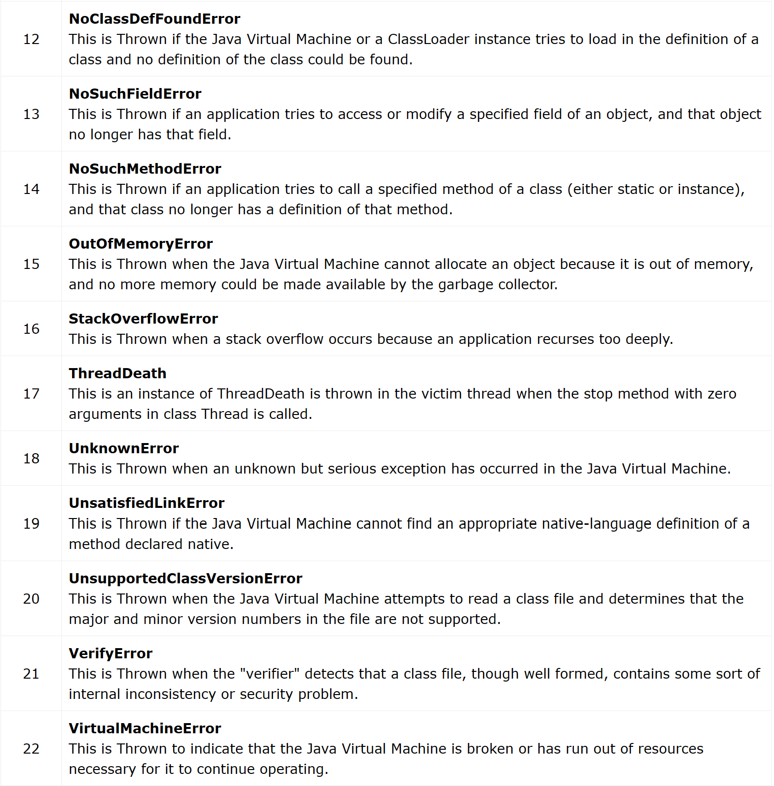
Hard errors: java.lang.Error: JVM issues
Source: Java.lang.Errors (tutorialspoint.com)

Slide 45
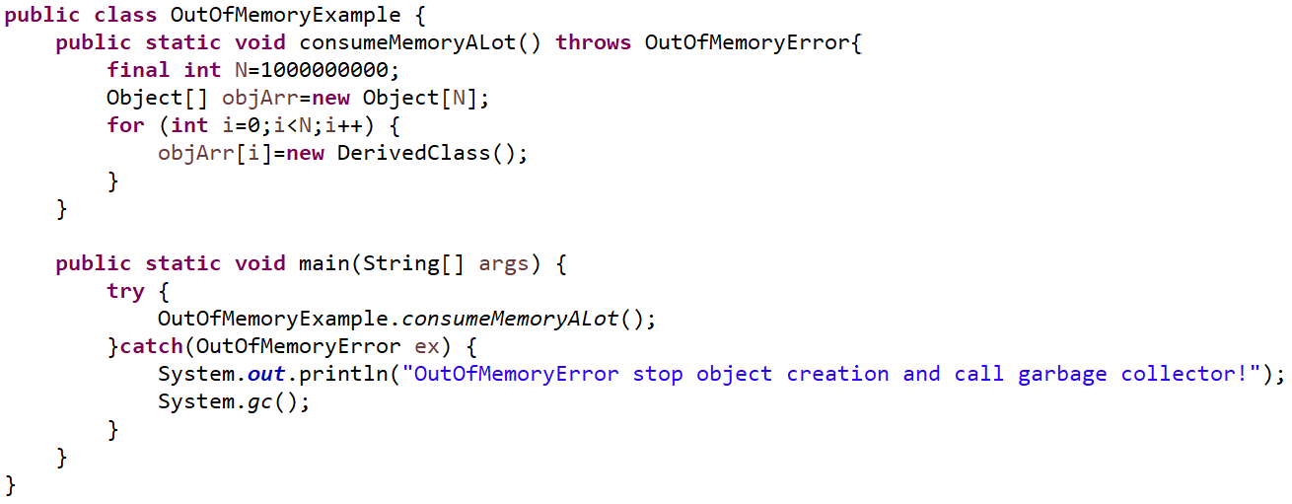
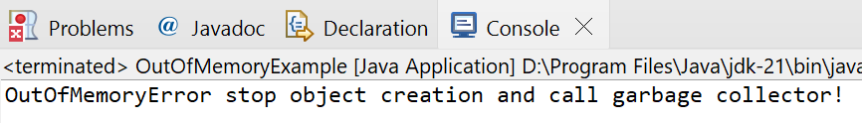
Hard errors:
CSEN160_04_Lecture_JavaInMoreDetailsPlusExceptions: “A_Exceptions.E_MoreExceptions.OutOfMemoryExample”
java.lang.Errors:
Are unchecked exceptions
Do nothing (in general)
Or what could you do?
Program terminates …
Maybe:
OutOfMemoryError manual call garbage collector with System.gc();

Slide 46
Done

Slide 47
… to here …

