Slide 1
COEN160
Fall 2026
Object-Oriented Analysis, Design and Programming
Michael Schimpf, PhD
Department of Computer Science and Engineering

Slide 2
Constructor chaining

Slide 3
Constructor basics recap
Constructor:
Has the same name as a class (no return value)
To create an instance of a class
Default constructor has no arguments
Can be private
Constructor cannot be:
  abstract
  final
  synchronized
  static

Slide 4
Constructor Chaining
Java Constructor Chaining:
One constructor is calling an other constructor (in a chain)
Useful for setting up parameter/members
Implement “intelligent” constructor
super()
super(parameter list)
this()
this(parameter list)
Must be the first line of the constructor
Cannot create a constructor loop
Straight chaining line is preferred
Can make code a bit complicated

Slide 5
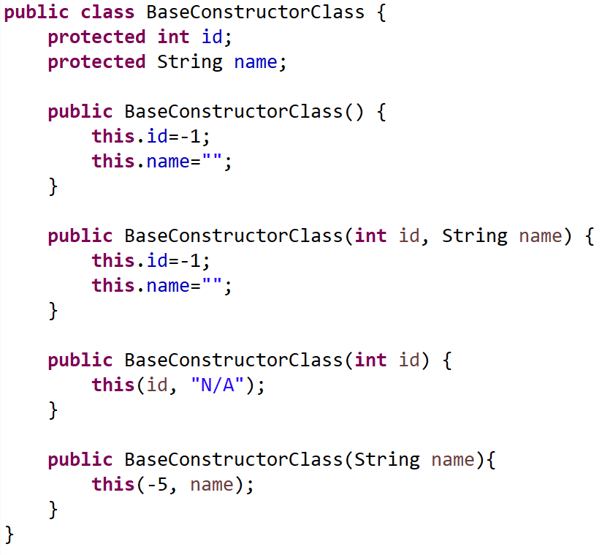
Constructor Chaining
Two ways:
In the same class (this)
CSEN160_04_Lecture_JavaInMoreDetailsPlusExceptions: “B_ConstructorChaining.BaseConstructorClass”

Slide 6
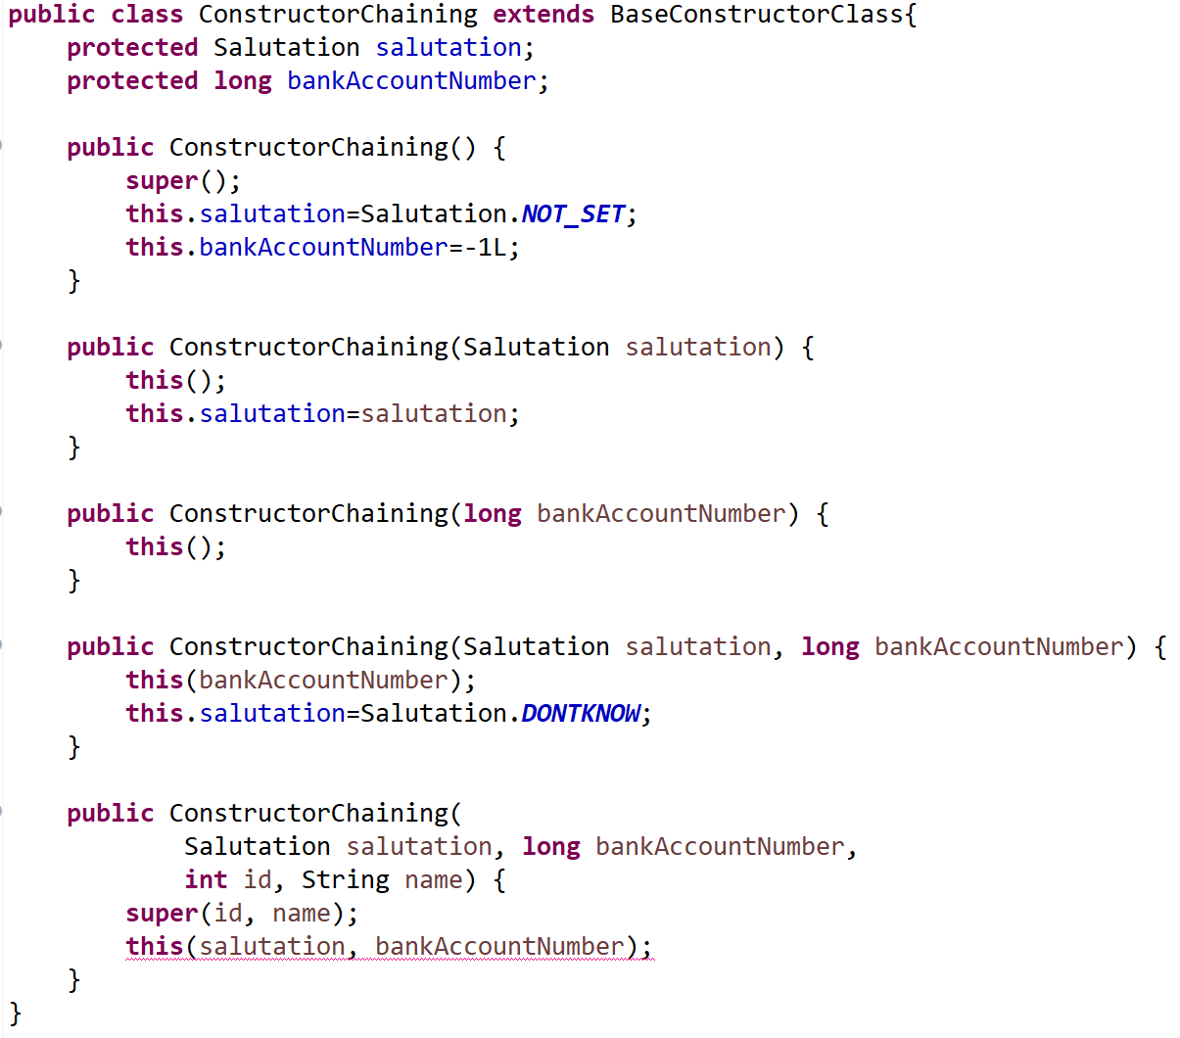
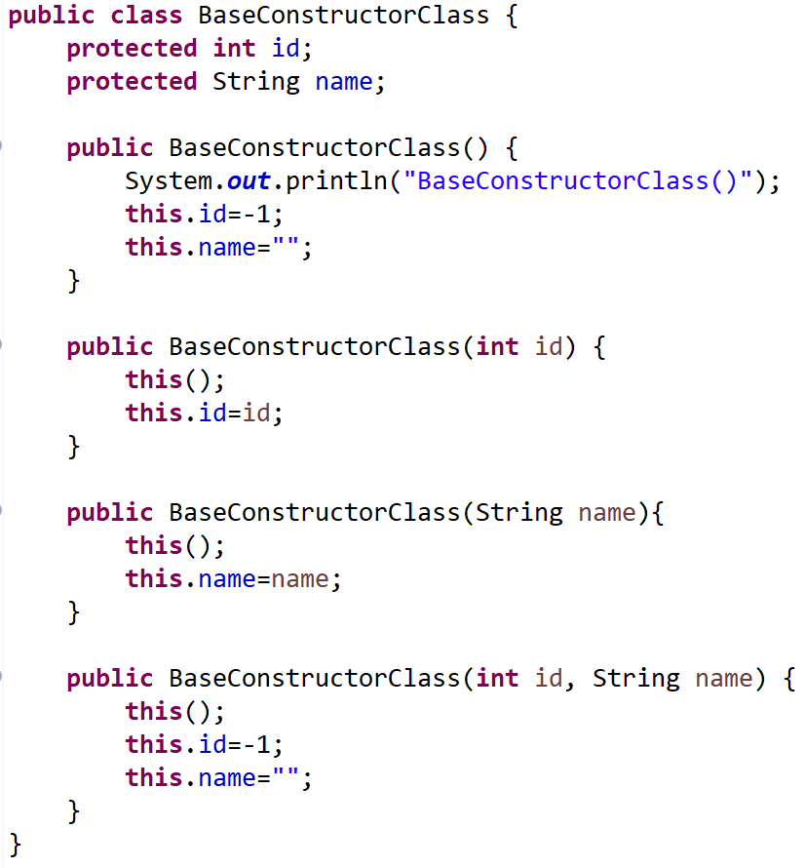
Constructor Chaining
2. From the base class (super)
Does not work only one allowed!
CSEN160_04_Lecture_JavaInMoreDetailsPlusExceptions: “B_ConstructorChaining.ConstructorChaining”

Slide 7
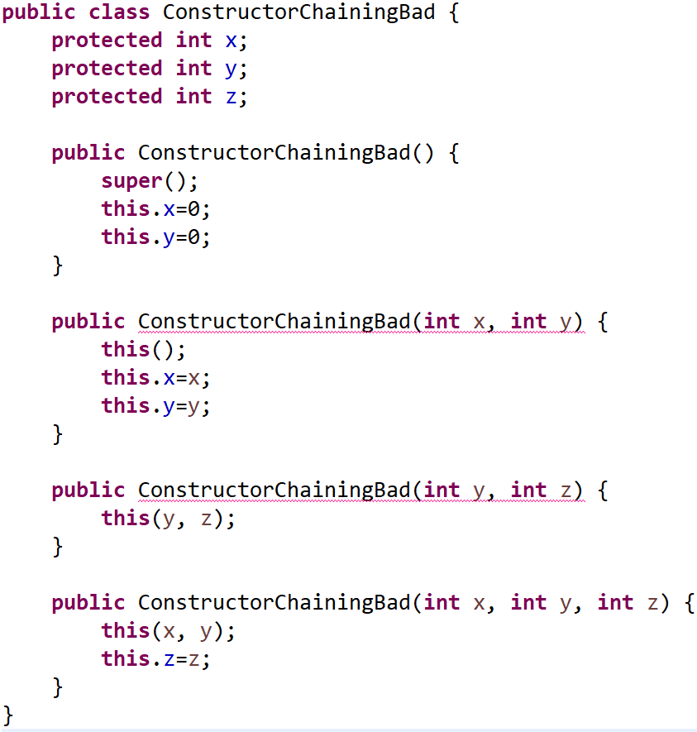
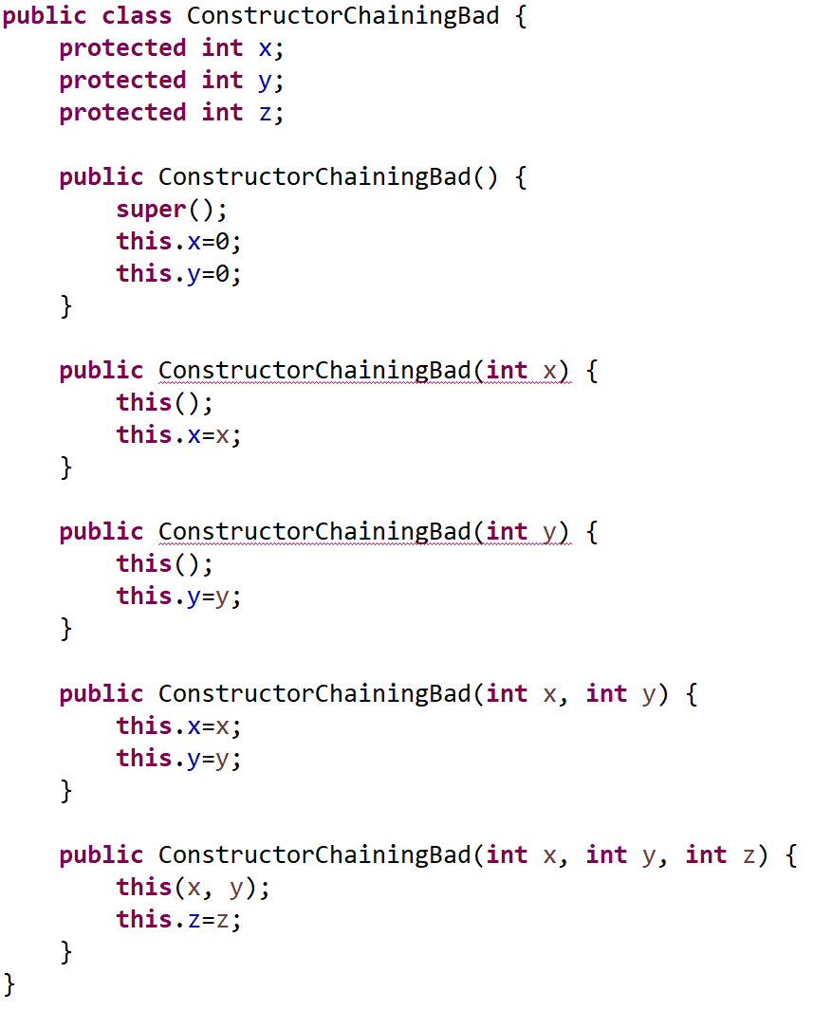
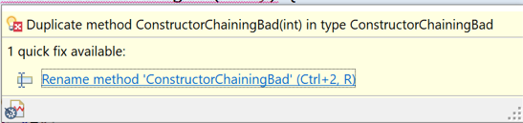
Constructor Chaining
Important is the parameter list:
Compiler checks the type
(general constructor issue)
CSEN160_04_Lecture_JavaInMoreDetailsPlusExceptions: “B_ConstructorChaining.ConstructorChainingBad”

Slide 8
Final methods & final classes

Slide 9
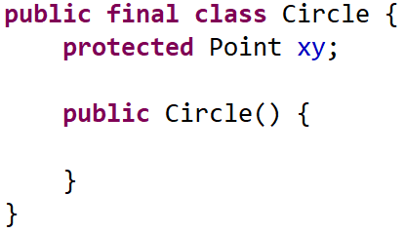
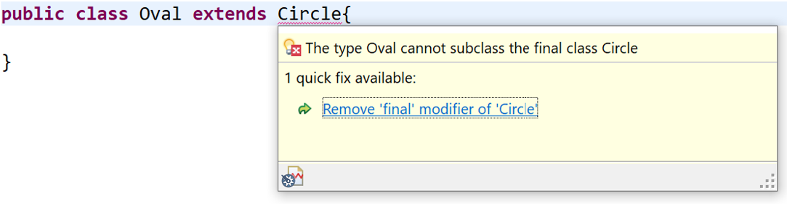
Final class
Important:
Cannot inherit from base class
Cannot change base class
Security reasons
Example: password class
Other examples
String
StringBuilder
Math
System
Locale
Color
Etc.
CSEN160_04_Lecture_JavaInMoreDetailsPlusExceptions: “C_FinalMethodsFinalClasses.Circle & Oval”

Slide 10
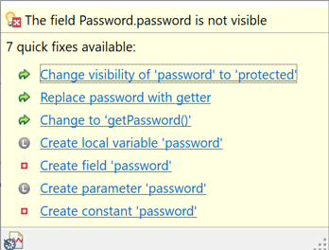
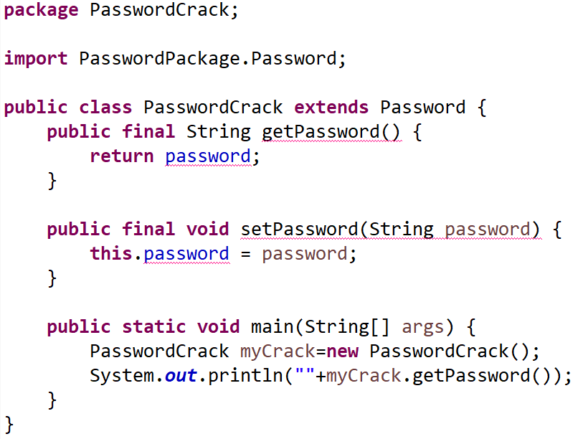
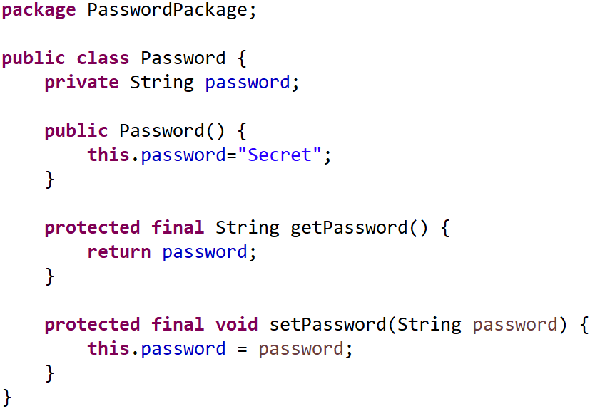
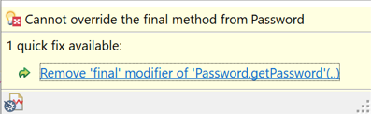
Final Methods
Important:
Cannot be overridden by some child class
Security issues
Protocol issues
But not a real protection -> Java Reflections
CSEN160_04_Lecture_JavaInMoreDetailsPlusExceptions: “C_FinalMethodsFinalClasses.Password & PasswordCrack”

Slide 11
Overloading

Slide 12
Overloading
Two meanings in Java:
Overloading based on Scopes
Overloading based on Type Signatures

Slide 13
Overloading Based on Scopes
Same name can appear in different:
Classes or interfaces
Packages or units
Methods
In some languages, even Blocks

Slide 14
Overloading Based on Scopes
The same name can appear in two or more scopes.
Two different classes may have the same name for a method.

Slide 15
Overloading Based on Type Signatures
Method overloading allows multiple implementations (same scope) with different types.
class Example {
// same name, three different methods
int sum (int a) { return a; }
int sum (int a, int b) { return a + b; }
int sum (int a, int b, int c) { return a + b + c; }
}
A type signature is the combination of argument types and return type.

Slide 16
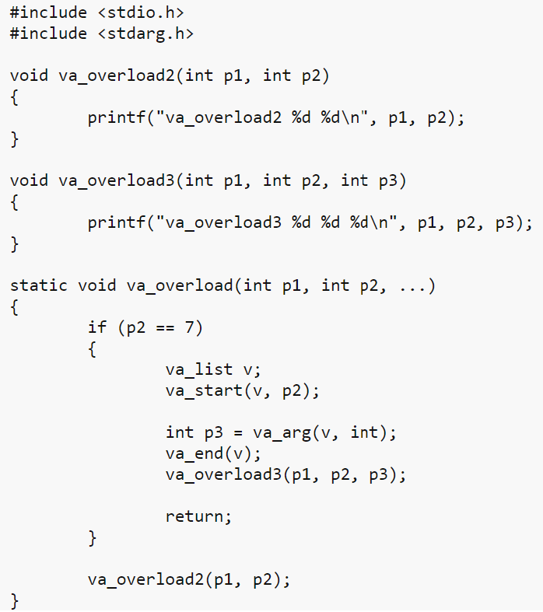
Overloading
In C and C++:
C no overloading
C++ overloading allowed

Slide 17
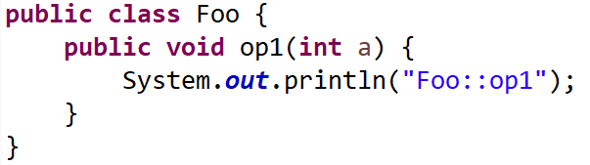
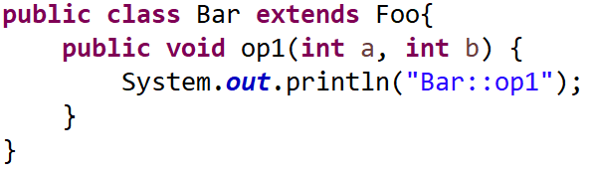
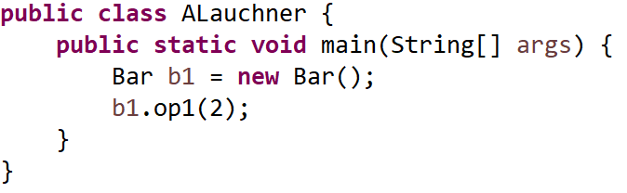
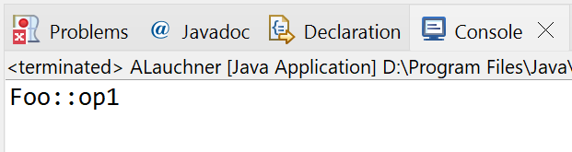
Redefinition
A child class change the type-signature of a method in the parent class:
Basically: Overloading
CSEN160_04_Lecture_JavaInMoreDetailsPlusExceptions: “C_FinalMethodsFinalClasses.D_Overloading.Foo & Bar”

Slide 18
Overriding

Slide 19
Overriding
A derived class can override information of its base class.
When?
  Both methods have the same signature!
  The derived class method can be a refinement of the base class method.
  Eg: the print () in classes Circle and Rectangle in Shapes hierarchy.
  The derived class can re-implement the inherited method
  (replacement for better performance).

Slide 20
Overriding
Overriding only occurs in the context of the parent/child relationship.
The type signatures must match!
Overriding is resolved at run-time, not at compile time!

Slide 21
Replacement / Refinement

Slide 22
Replacement and Refinement
There are two different overriding ways:
A replacement completely replaces the code.
A refinement executes the code in the parent class,
and adds to it the code in the child class.
Constructors, for example, can use refinement (constructor chaining).

Slide 23
Reasons to use replacement
The method in the parent class is abstract it must be replaced.
The method in the parent can be more efficiently implemented
Overriding for optimization

Slide 24
Reasons to use replacement
Example:
    A superclass, IntegerSet have an operation to find the max integer,
    search is implemented as a sequential search.
    The subclass, SortedIntegerSet implement the max integer operation
    using a more efficient search (since the integers are already sorted).

Slide 25
Refinement
Refinement is also called “Overriding for Extension”:
The “new” operation in the subclass is basically the same
as the inherited operation.
But it adds some new behavior (constructor chaining).
Careful, not to create duplicate code fragments!

Slide 26
Refinement
Example:
Assume A Window class with an operation draw()
  Which draws the window boundary and contents.
The class LabeledWindow is a subclass, with a draw() operation that draws a window by invoking the superclass draw() method
  But adds code to draw label(s).

Slide 27
Constructors use Refinement
In most languages that have constructors,
a constructor will use refinement (super() this())
This guarantees that the parent initialization will be included as part of the initialization of the child class (if wanted).
Java does not have Refinement for class/object methods

Slide 28
Overriding vs Shadowing

Slide 29
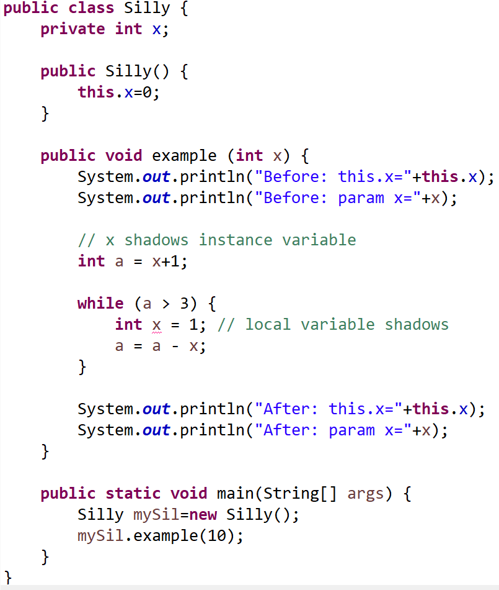
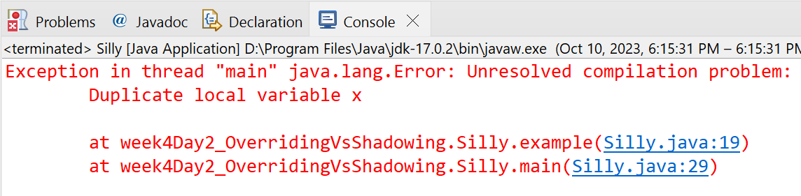
Overriding versus Shadowing
It is a common practice to shadow a previous variable of the same name:
But this type of shadowing
does not work anymore in Java!
CSEN160_04_Lecture_JavaInMoreDetailsPlusExceptions: “E_OverridingVsShadowing.Silly”

Slide 30
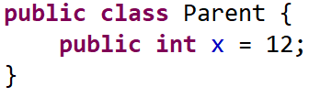
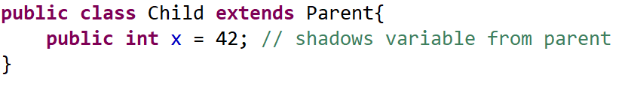
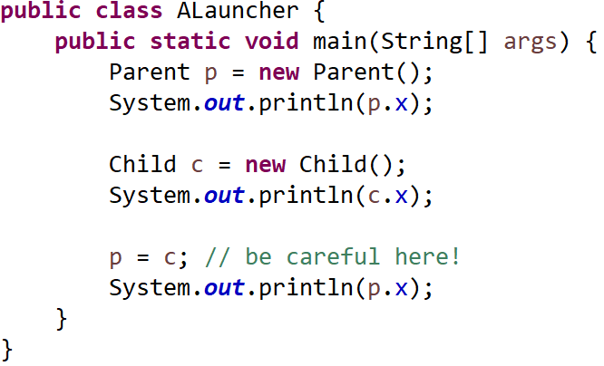
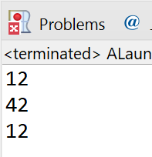
Shadowing
Java allows instance variables to be redefined, and uses shadowing:
CSEN160_04_Lecture_JavaInMoreDetailsPlusExceptions: “F_OverridingVsShadowing.Silly”

Slide 31
Question: Shadowing recommended?

Slide 32
Method signatures in Overriding
Note the following:
In Java and C++, signature of the overriding method must match exactly the signature of the overridden method.
In Java use always the @Override annotation
With @Override the compiler tell you if something is wrong!

Slide 33
Done

Slide 34
… to here …

