Slide 1
COEN160
Fall 2026
Object-Oriented Analysis, Design and Programming
Michael Schimpf, PhD
Department of Computer Science and Engineering

Slide 2
Java Generics simple intro…

Slide 3
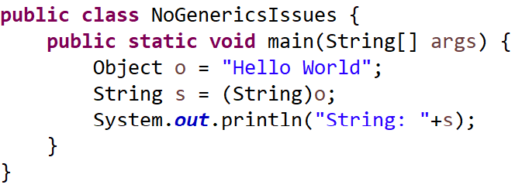
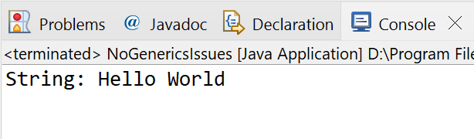
Java Generics simple intro
This works:
Typecasting String reference into an Object reference, but why?
“CSEN160_05_Lecture_DataStructursAndGenerics.A_NoGenericsIssue”

Slide 4
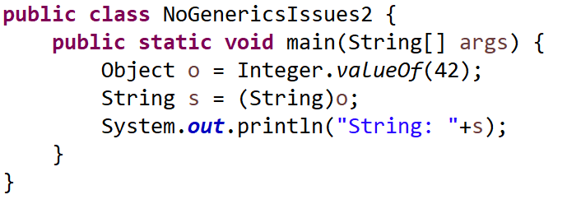
Java Generics simple intro
Will this work?
“CSEN160_05_Lecture_DataStructursAndGenerics.A_NoGenericsIssue”

Slide 5
Java Generics simple intro
This will not work!
Typecasting an Integer reference
into an Object reference into a String reference …
“CSEN160_05_Lecture_DataStructursAndGenerics.A_NoGenericsIssue”

Slide 6
Java Generics simple intro
Why?

Slide 7
Java Generics simple intro
Type error will come up at runtime! ☹
Which is a problem, how to minimize type errors?

Slide 8
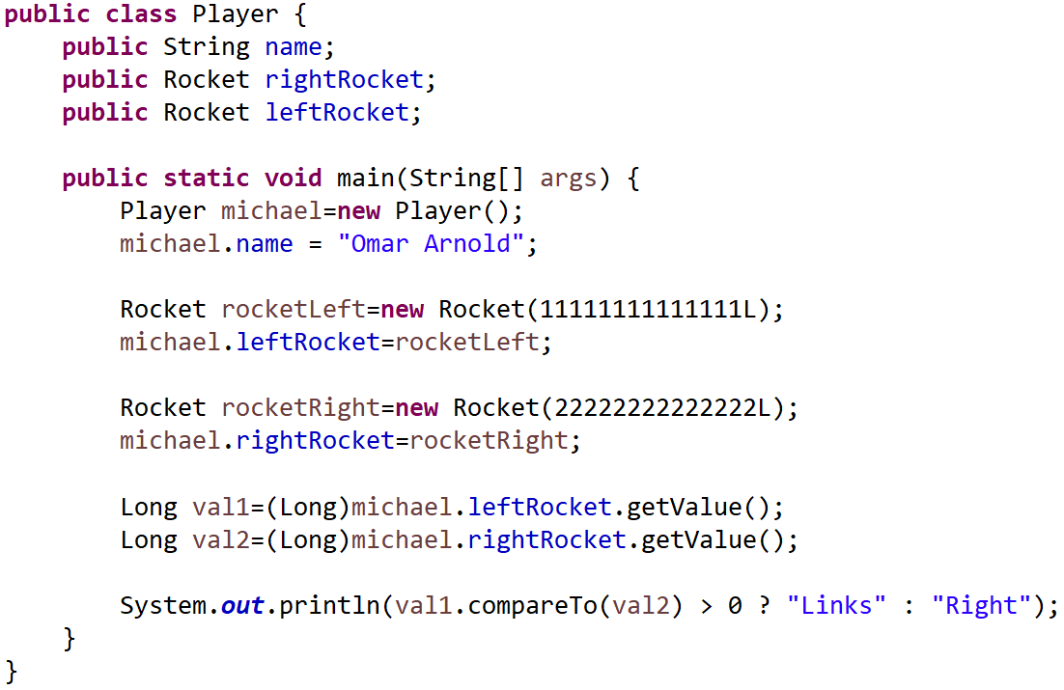
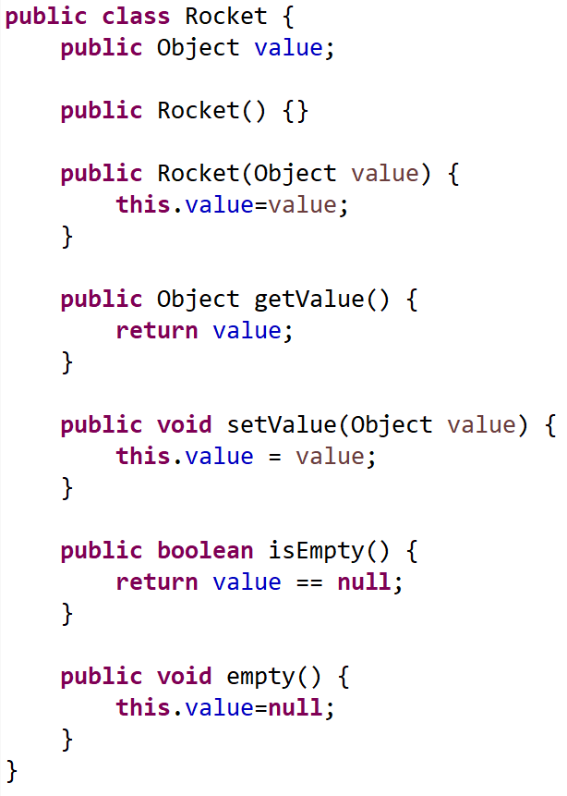
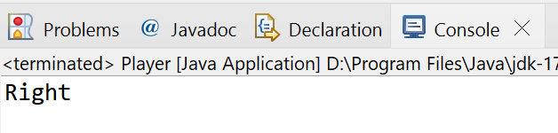
Java Generics simple intro
“CSEN160_05_Lecture_DataStructursAndGenerics.B_RocketExample”
Simple example:
Nothing special,
but could it be better?!

Slide 9
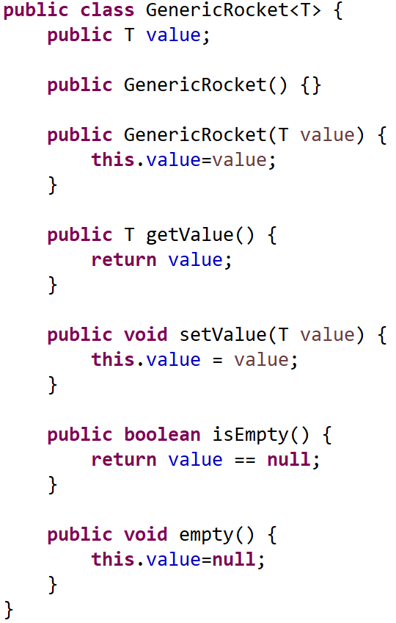
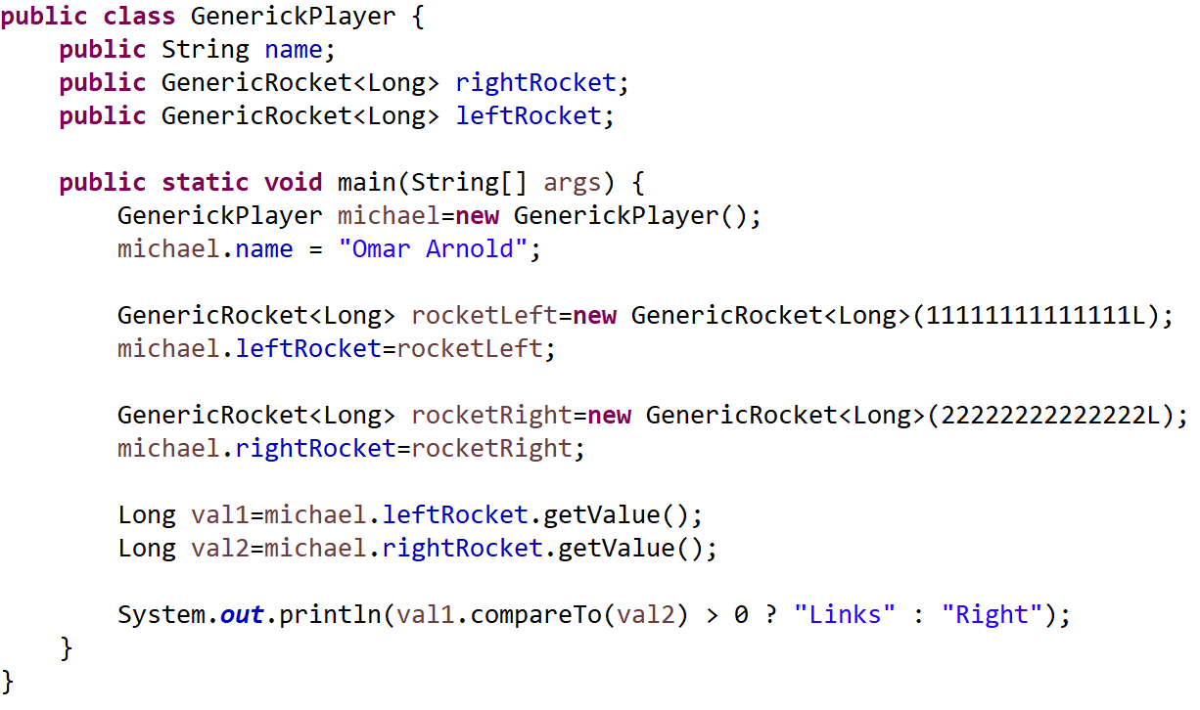
Java Generics simple intro
“CSEN160_05_Lecture_DataStructursAndGenerics.B_RocketExample”
Simple Generic example:
No typecasting needed anymore ☺

Slide 10
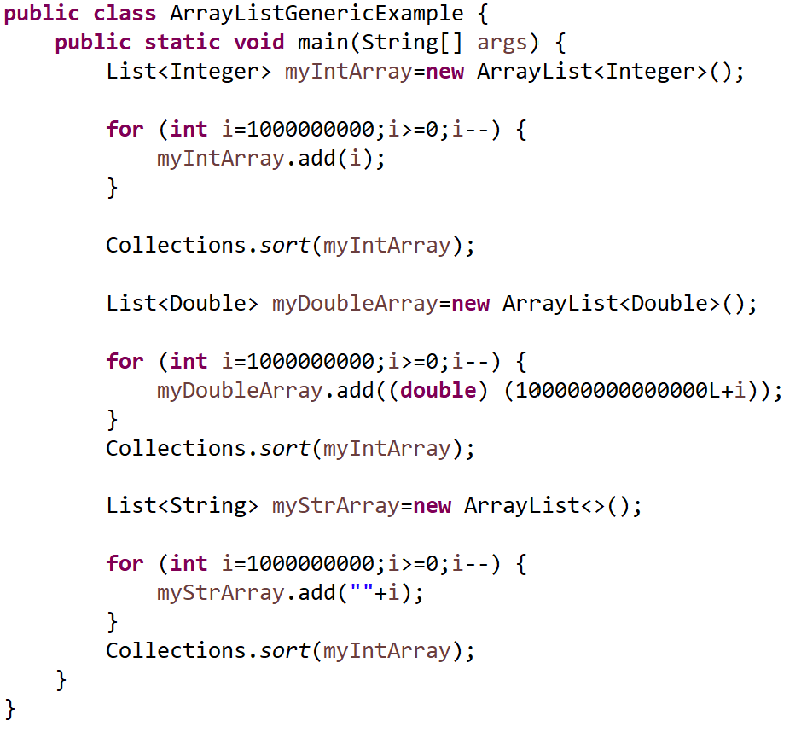
Java Generics simple intro
“CSEN160_05_Lecture_DataStructursAndGenerics.B_RocketExample”
Generics are used for
collection data types:
Diamond writing style

Slide 11
Generics Methods

Slide 12
Using Generic Types
<T> is read, “of T”
  For example: Stack<Integer>
  is read, “Stack of Integer”
Type <T> informs the compiler, that all parts
involved should be automatically cast to T
E - Element (ArrayList, Set etc.)
K - Key (Used in Map)
T – Type
N – Number
V - Value (Used in Map)
S,U,V etc. - 2nd, 3rd, 4th types

Slide 13
Generic Methods
Rules:
It has a type parameter section delimited by angle brackets (< and >),
that precedes the method's return type.
Each type parameter (can) contains one or more type parameters.
A type parameter is an identifier that specifies a generic type name.

Slide 14
Generic Methods
Type parameters can be used as return type
A generic method's body is declared.
Type parameters can represent only reference types:
  String
  Box
  Integer
  …
Not primitive types:
  int
  long
  …

Slide 15
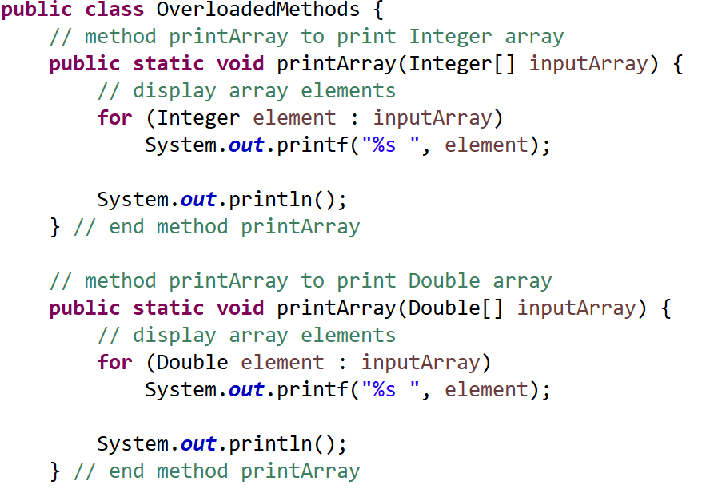
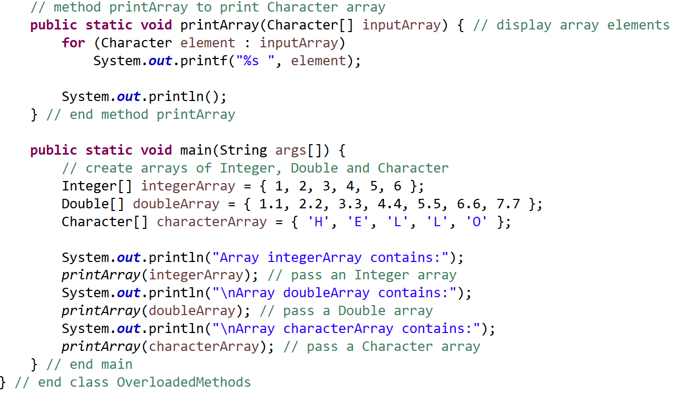
One of my research examples
“CSEN160_05_Lecture_DataStructursAndGenerics.I_OverloadedMethods”
Before Generic (overloading):
You need to implement it, for every datatype ☹

Slide 16
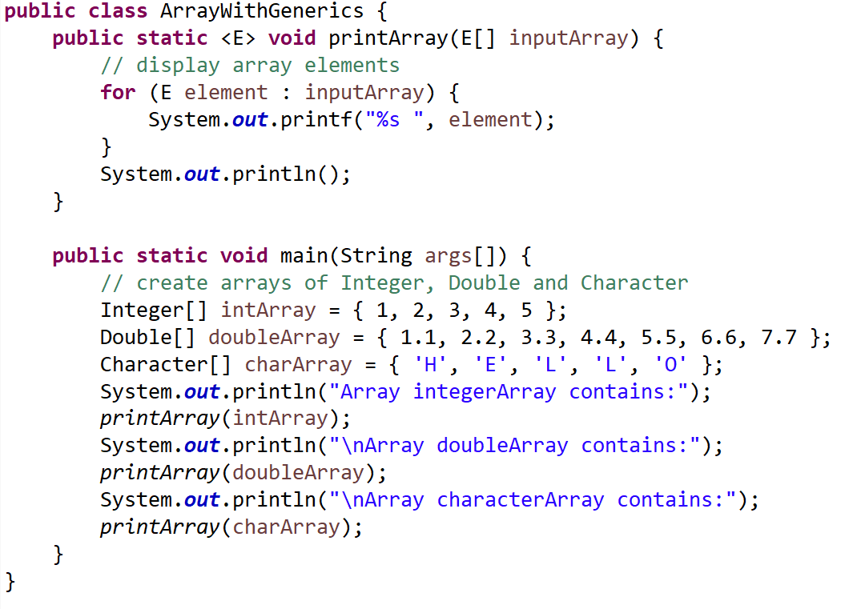
One of my research examples
“CSEN160_05_Lecture_DataStructursAndGenerics.J_ArrayWithGenerics”
With Generic:
You need to implement it only once ☺

Slide 17
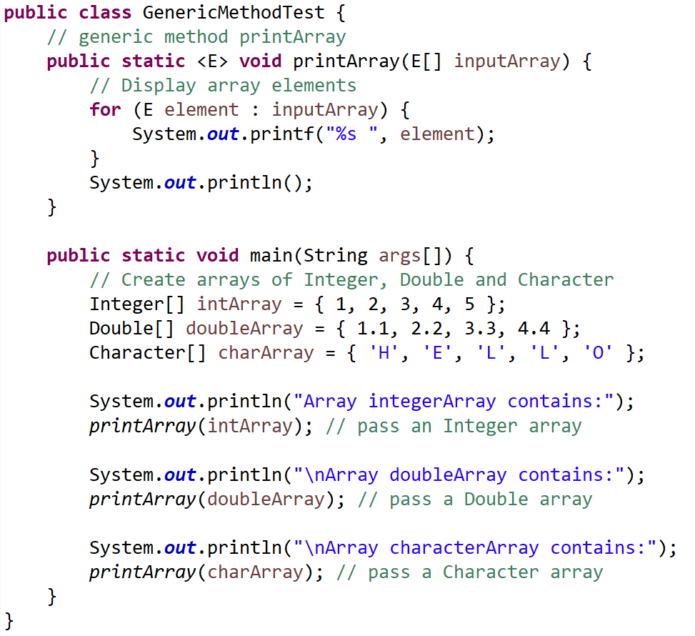
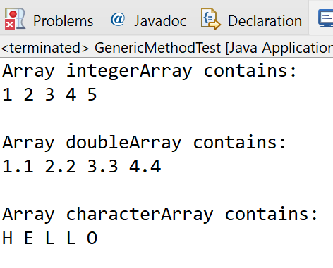
“CSEN160_05_Lecture_DataStructursAndGenerics.K_GenericMethodTest”
One of my research examples
Only one implementation
But multiple use cases

Slide 18
Nested Generics

Slide 19
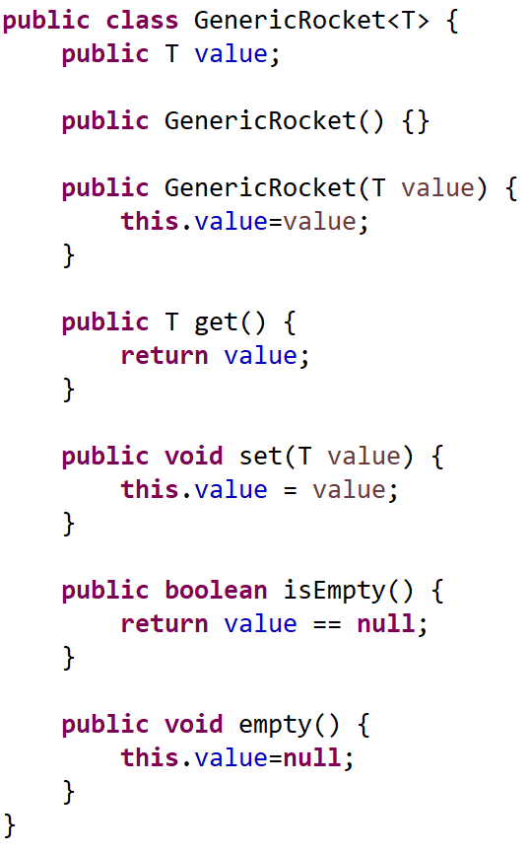
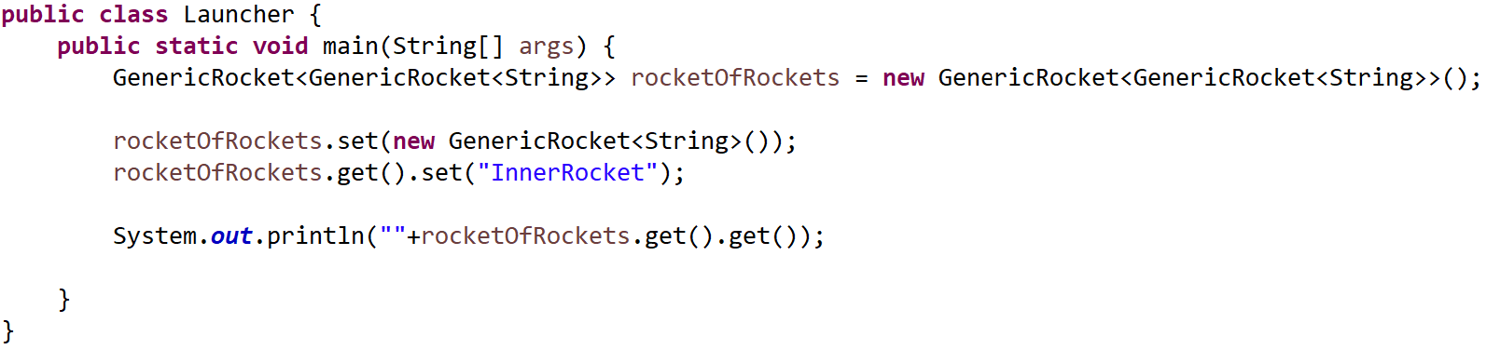
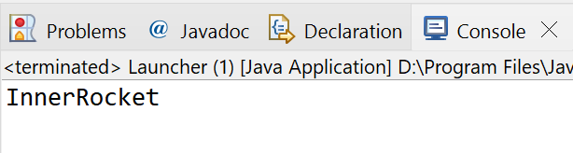
Nested generics
“CSEN160_05_Lecture_DataStructursAndGenerics.L_GenericRocket”
A GenericRocket has a GenericRocket inside!

Slide 20
Bounded Generics

Slide 21
Bounded Type Parameters
You want to restrict types:
A method on numbers might only want to accept instances of Number (or its subclasses).
Declare a bounded type parameter:
  list the type parameter's name:
    followed by the extends keyword
    followed by its upper bound.
  “public class Sample <T extends Number>” …

Slide 22
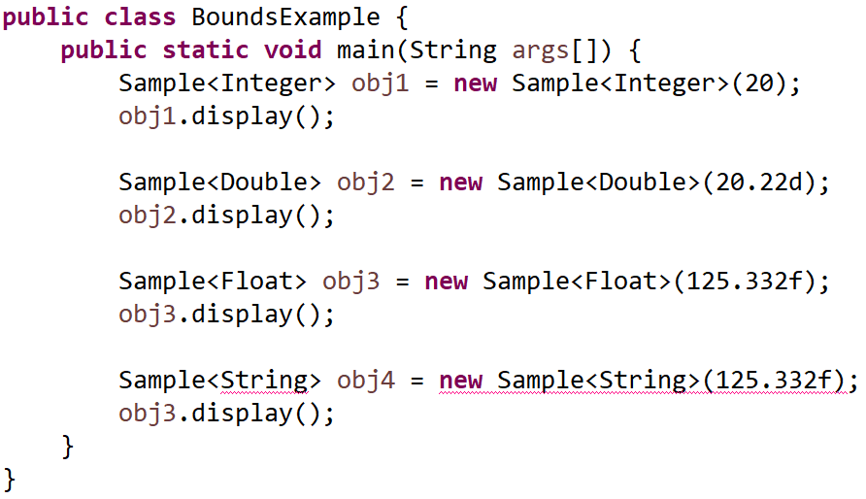
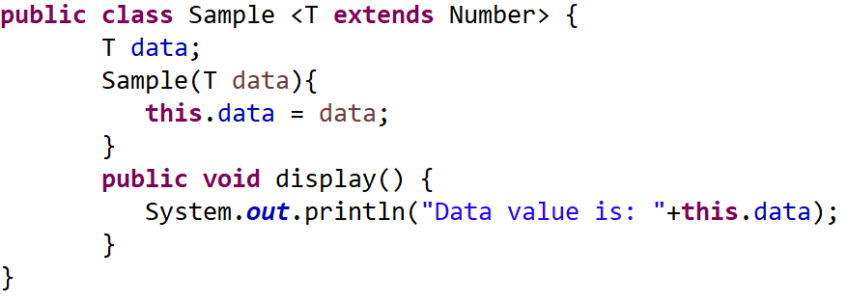
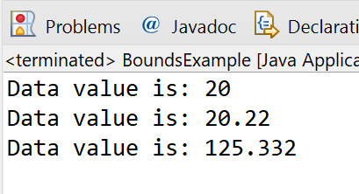
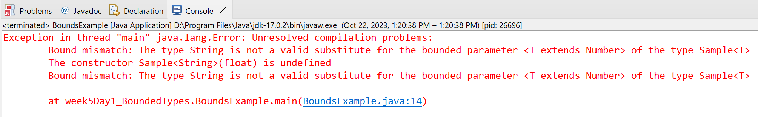
Bounded Type Parameters
“CSEN160_05_Lecture_DataStructursAndGenerics.M_BoundedTypes”

Slide 23
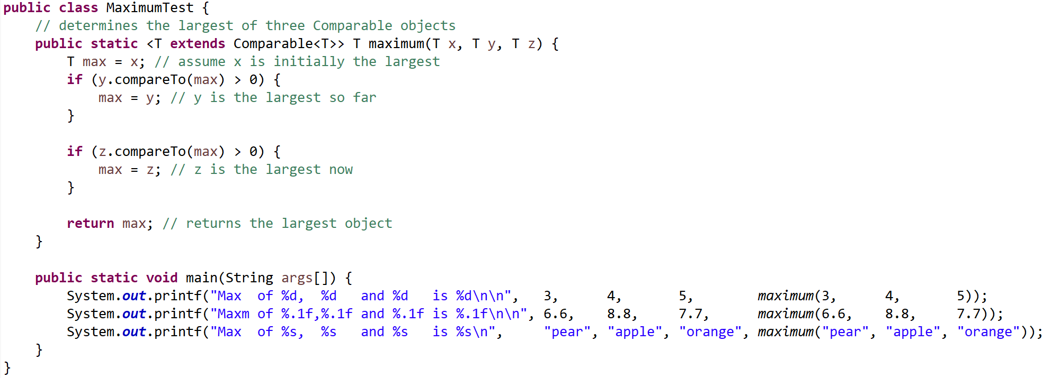
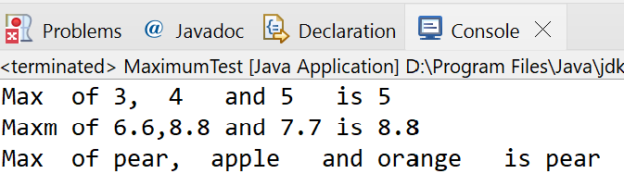
Bounded Type Parameters
“CSEN160_05_Lecture_DataStructursAndGenerics.N_MaximumTest”

Slide 24
Generic Classes

Slide 25
Generic Classes
Declaration looks like a non-generic class declaration,
except class name is followed by a type parameter.
“public class Sample <T>”
Type parameter of a generic class, can have one or more type parameters
  Separated by commas.

Slide 26
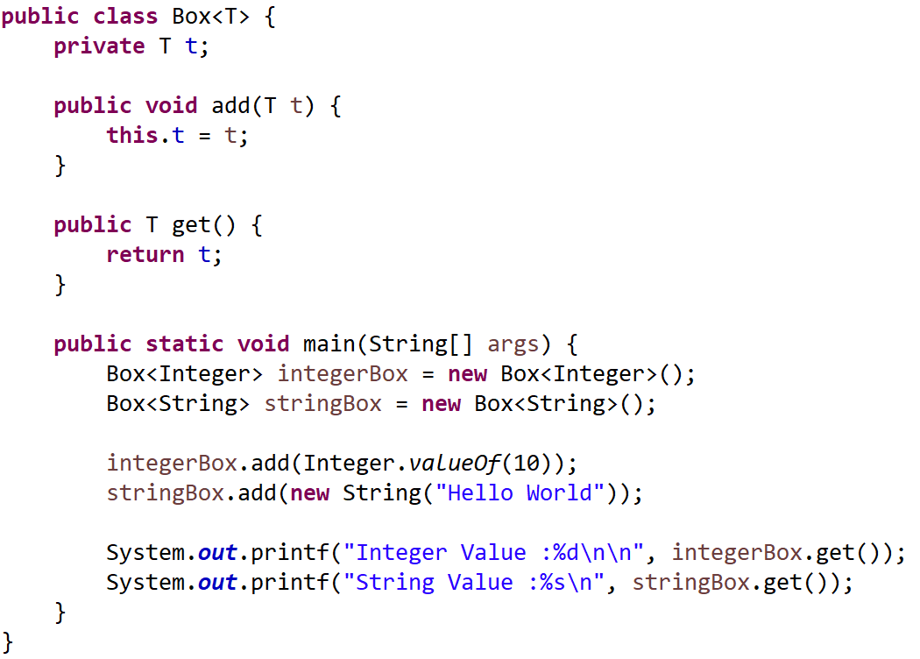
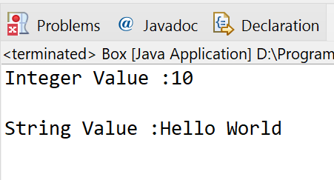
Generic Classes
“CSEN160_05_Lecture_DataStructursAndGenerics.O_Box”
Nothing special or sophisticated here!

Slide 27
Generic Advantages

Slide 28
Advantages of Generics
With generics ”Collection<String> c;” it gives us more information about the variable c
(i.e., c holds only Strings):
  This is true wherever c is used
  The compiler checks it, and won’t compile code that violates this!
  More type safety in general
  Generics in C++ are templates

Slide 29
Advantages of Generics
Without use of generic types, explicit casting is needed:
  A cast tells us something the programmer thinks is true
  The JVM checks whether the programmer thoughts, are correct at runtime
  Once you got used to it, you never go back! ☺

Slide 30
Done

Slide 31
… to here …

