Slide 1
COEN160
Fall 2026
Object-Oriented Analysis, Design and Programming
Michael Schimpf, PhD
Department of Computer Science and Engineering

Slide 2
Collections

Slide 3
The Collection Classes
Java provides a set of standard collection classes:
That implement interfaces
Some are abstract class, providing skeletal implementations.
Others of the classes provide full implementations (as-is)

Slide 4
Java Collection Framework hierarchy
(Liang, Intro to Java Programming, 5th Edition)
Set and List are sub interfaces of Collection.

Slide 5
Java Collection Framework hierarchy
(Liang, Intro to Java Programming, 5th Edition)
An instance of map represents a group of objects, each with a key.
You can get the object from a map using a key, and you have to use a key to put it into the map.

Slide 6
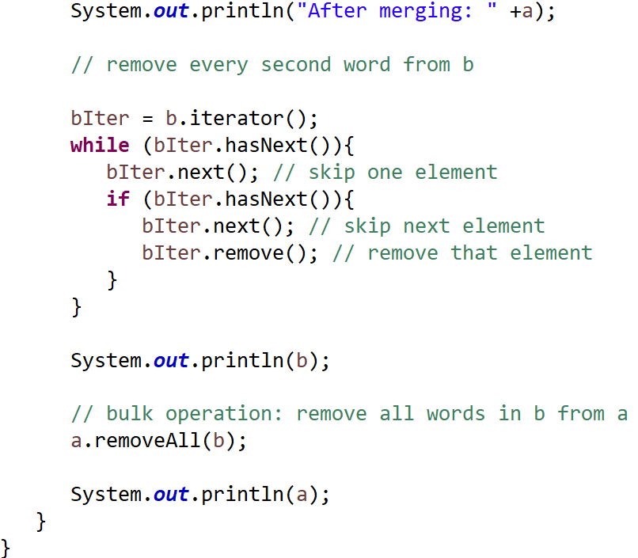
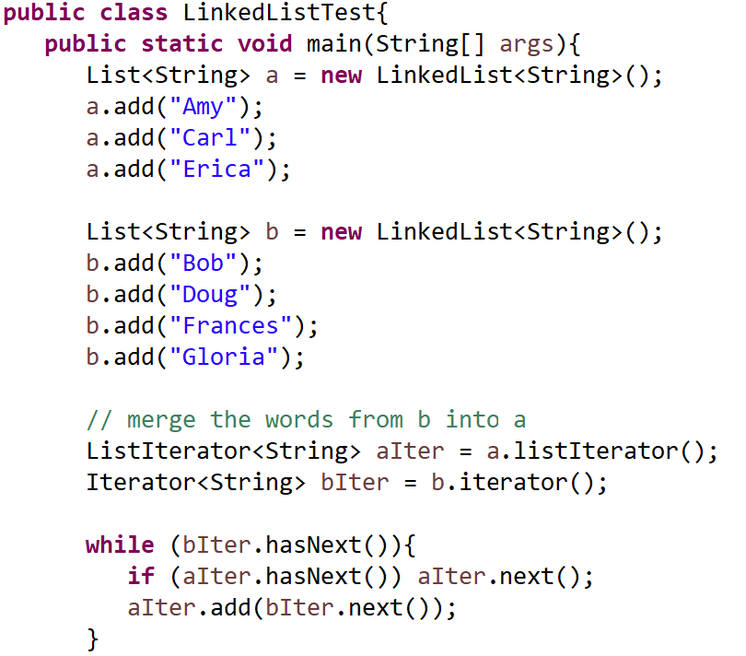
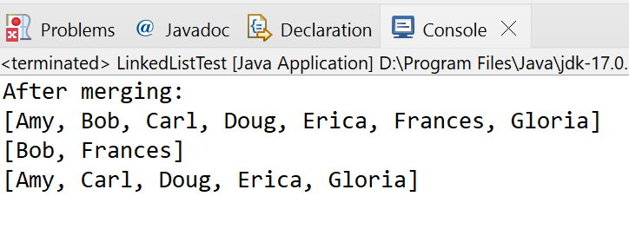
The Collection Classes
“CSEN160_05_Lecture_DataStructursAndGenerics.D_LinkedListTest”
Just playing
around
LinkedList

Slide 7
The Collection Interfaces:
The collections framework defines several interfaces:
Collection Interface
This enables you to work with groups of objects; it is at the top of the collection's hierarchy.
List Interface
This extends Collection and an instance of List stores an ordered collection of elements.
Set
This extends Collection to handle sets, which must contain unique elements
SortedSet
This extends Set to handle sorted sets

Slide 8
The Collection Interfaces:
Map
This maps unique keys to values.
Map.Entry
This describes an element (a key/value pair) in a map. This is an inner class of Map.
SortedMap
This extends Map so that the keys are maintained in ascending order.
Enumeration
This is legacy interface and defines the methods by which you can enumerate.
This legacy interface has been replaced by Iterator.

Slide 9
The Collections Classes
Map:
The framework also defines several map interfaces and classes.
Maps store key/value pairs. Although maps are not collections

Slide 10
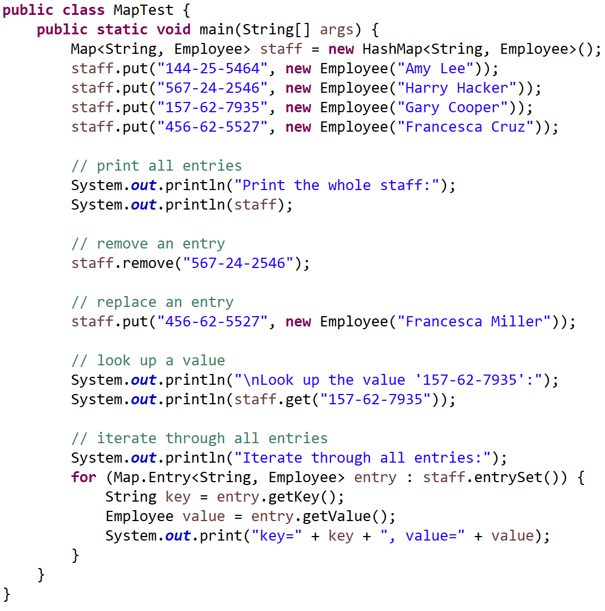
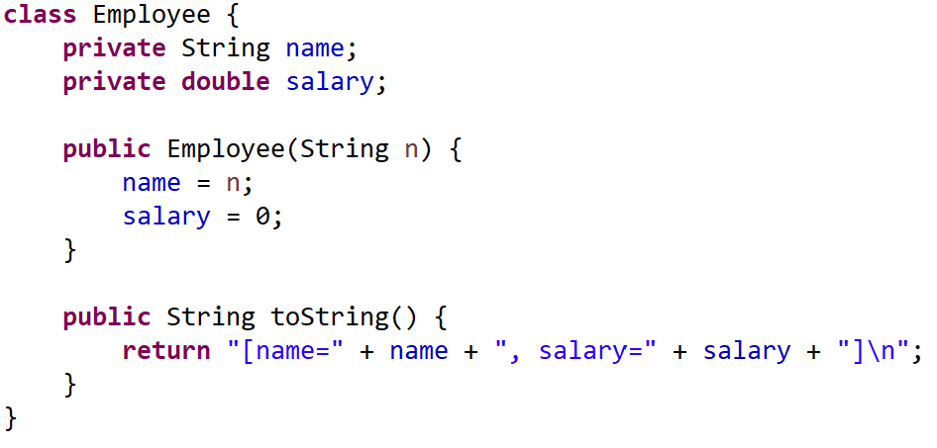
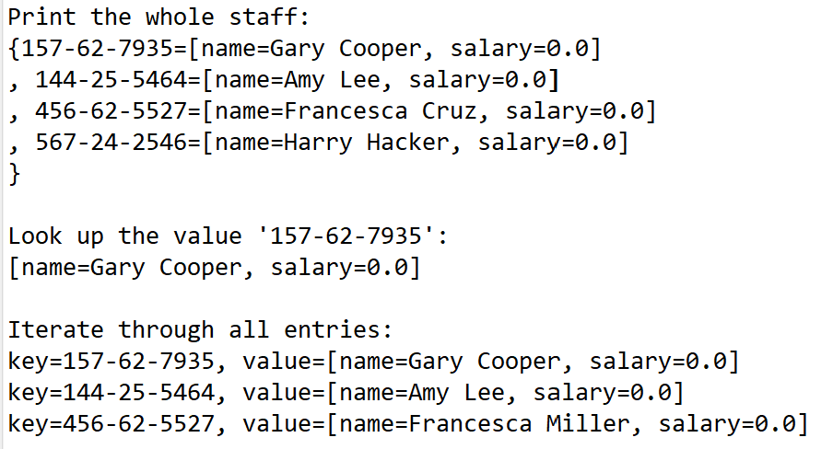
The Collections Classes
“CSEN160_05_Lecture_DataStructursAndGenerics.C_MapTest”

Slide 11
The Collection Classes
AbstractCollection
Implements most of the Collection interface.
AbstractList
Extends AbstractCollection and implements most of the List interface
AbstractSequentialList
Extends AbstractList for use by a collection that uses sequential rather than random access of its elements.
LinkedList
Implements a linked list by extending AbstractSequentialList.

Slide 12
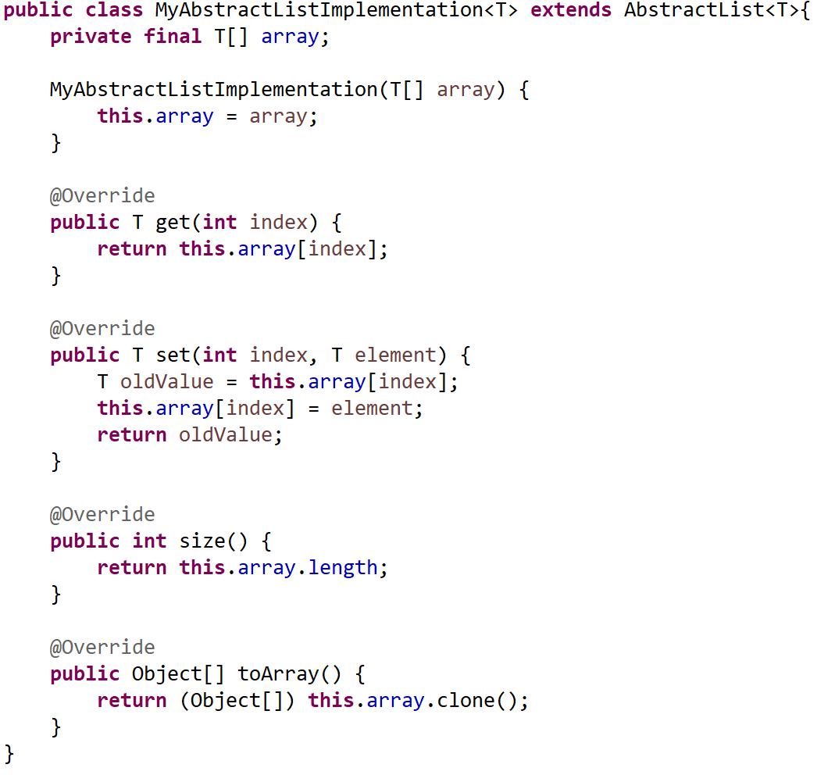
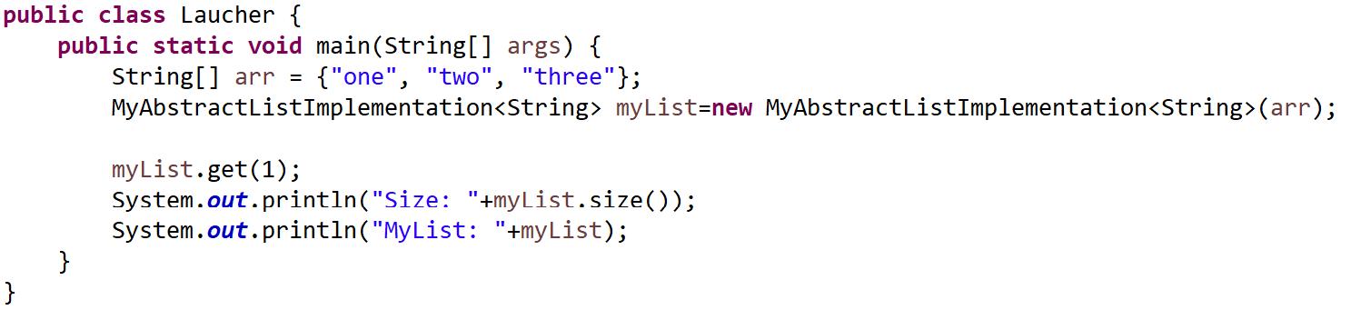
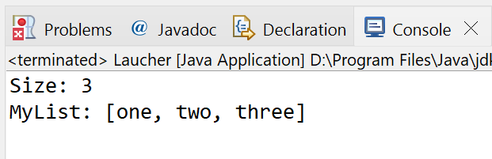
The Collection Classes
“CSEN160_05_Lecture_DataStructursAndGenerics.E_AbstractList”
Implementing AbstractList and using it

Slide 13
The Collection Classes
ArrayList
Implements a dynamic array by extending AbstractList.
AbstractSet
Extends AbstractCollection and implements most of the Set interface.
HashSet
Extends AbstractSet for use with a hash table.
LinkedHashSet
Extends HashSet to allow insertion-order iterations.

Slide 14
The Collection Classes
TreeSet
Implements a set stored in a tree. Extends AbstractSet.
AbstractMap
Implements most of the Map interface.
HashMap
Extends AbstractMap to use a hash table.
TreeMap
Extends AbstractMap to use a tree.

Slide 15
The Abstract Collection Classes
WeakHashMap
Extends AbstractMap to use a hash table with weak keys.
LinkedHashMap
Extends HashMap to allow insertion-order iterations.
IdentityHashMap
Extends AbstractMap and uses reference equality when comparing documents.

Slide 16
Legacy classes from java.util
No warning because those are legacy classes but not annotated @Deprecated.
They remain in the JDK for backward compatibility
javac won't mark them as obsolete
“CSEN160_05_Lecture_DataStructursAndGenerics.D2_Legacy”

Slide 17
Legacy classes from java.util
Vector
This implements a dynamic array. It is similar to ArrayList, but with some differences.
Stack
Stack is a subclass of Vector that implements a standard last-in, first-out stack.
Dictionary
Dictionary is an abstract class that represents a key/value storage repository and operates much like Map.

Slide 18
Legacy classes from java.util
Hashtable
Hashtable was part of the original java.util and is a concrete implementation of a Dictionary.
Properties
Properties is a subclass of Hashtable. It is used to maintain lists of values in which the key is a String and the value is also a String.
BitSet
A BitSet class creates a special type of array that holds bit values. This array can increase in size as needed.

Slide 19
Iterators

Slide 20
What is an iterator?
Cycle through the elements in a collection:
An object to move sequentially through data.
Cycle through plus removing.
Iterator: implement ListIterator interface.
ListIterator extends Iterator to allow bidirectional traversal of a list.
Sets and lists provide an iterator, whereas maps do not.

Slide 21
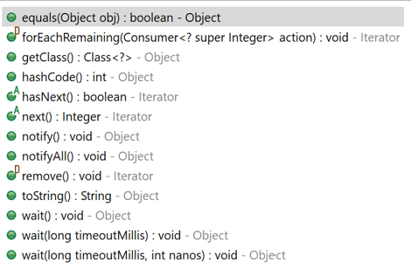
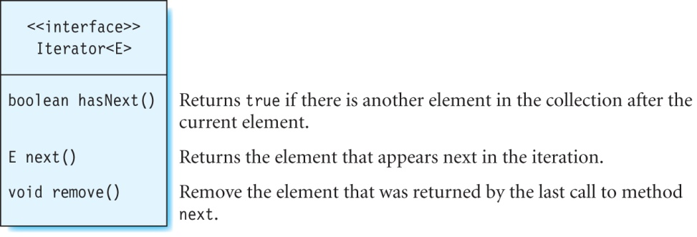
The Iterator Interface (Classic)

Slide 22
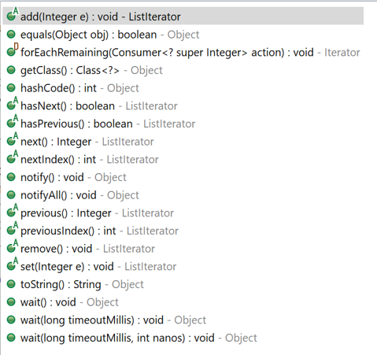
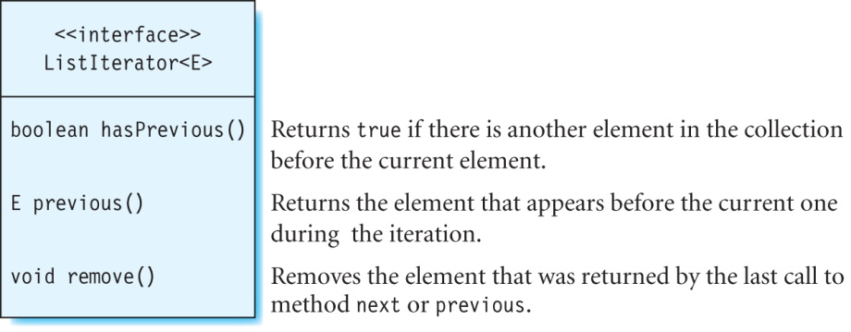
The ListIterator Interface (New)
ListIterator (extends Iterator) and is used to move in both,
the forward and backward directions

Slide 23
Iterator vs ListIterator Interface
Important:
You get the ListIterator from the List interface
But you cannot get the ListIterator from the
Collection interface

Slide 24
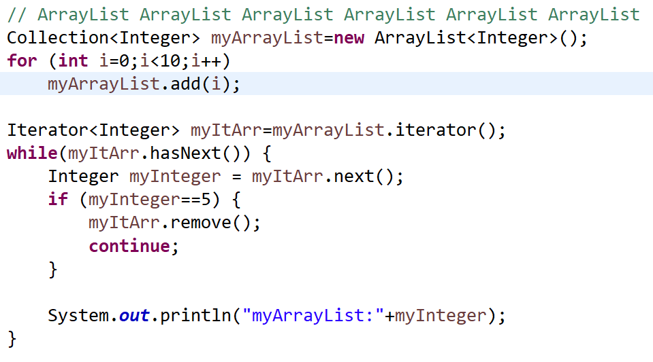
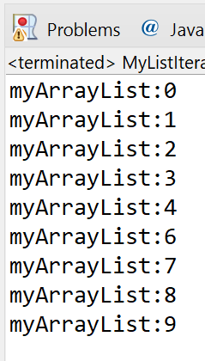
Example: Using an Iterator
“CSEN160_05_Lecture_DataStructursAndGenerics.S_ListMapSet.MyListIteratorExamples”
You can use an iterator to print and/or delete elements:
Create 10 numbers 0-10

Slide 25
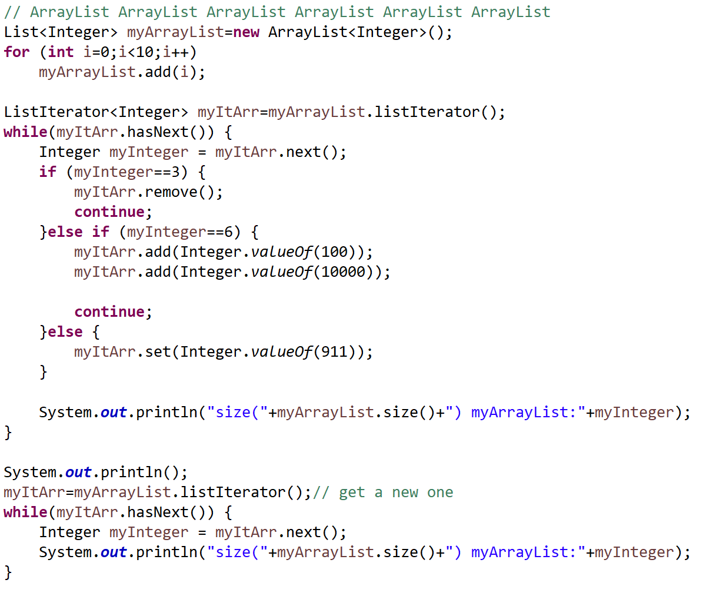
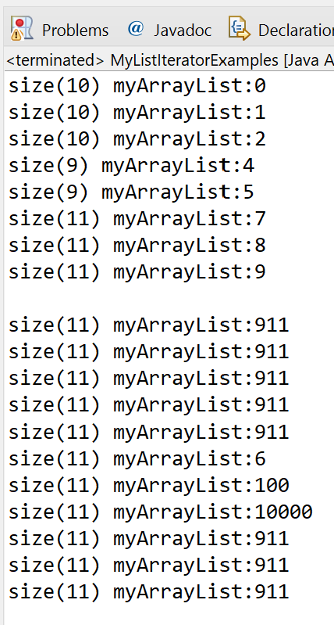
Example: Using a ListIterator
“CSEN160_05_Lecture_DataStructursAndGenerics.S_ListMapSet.myCollectionsListIterator”
Create 10 numbers 0-10
It gets a little bit complicated!
Print all items again

Slide 26
Lists

Slide 27
Lists
Important:
Lists memorize the sequence
Elements can be double or triple
List elements:
java.util.ArrayList
java.util.LinkedList
java.util.concurrent.CopyonWriteArrayList
java.util.Vector

Slide 28
ArrayList or LinkedList:
ArraList
Access to an element: fast
Add or delete element in the middle: slow
Size of an array can be too small
LinkedList:
Access to an element: slow
Add or delete element in the middle: fast

Slide 29
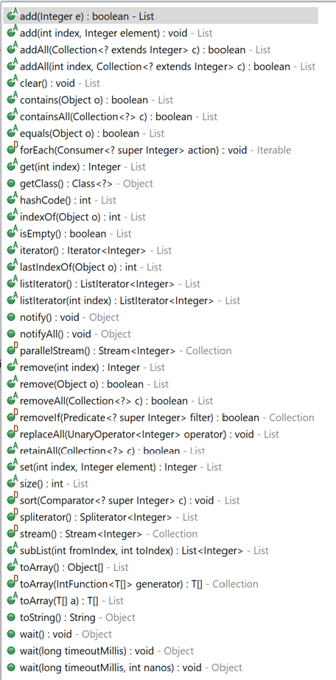
Interface List
List:
Use always the interface
when working with lists
  List myList=new ArrayList();
  List myList=new LinkedList();
To switch the list implementation,
only one line needs to be changed

Slide 30
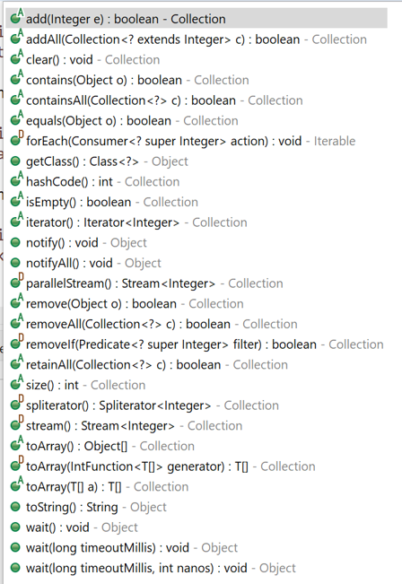
Interface List versus Collection
Collection interface:
Collection includes also Set(s)
Index is missing
Use it when you want to make your container selection even more generic as with List
Usually you access everything via Iterator
List Interface
Collection Interface

Slide 31
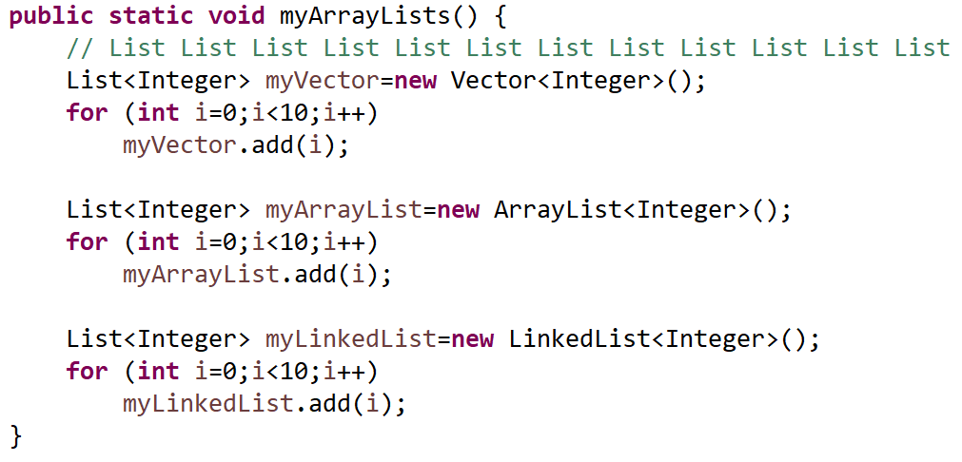
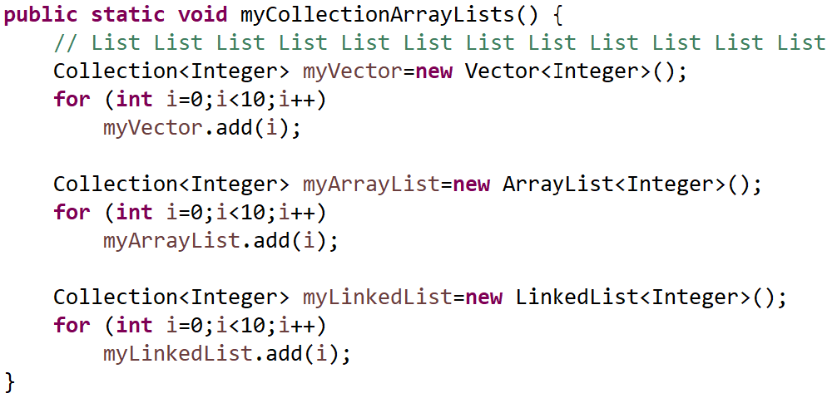
Interface List versus Collection
“CSEN160_05_Lecture_DataStructursAndGenerics.B_RocketExample”
List interface
Collection interface (more generic)

Slide 32
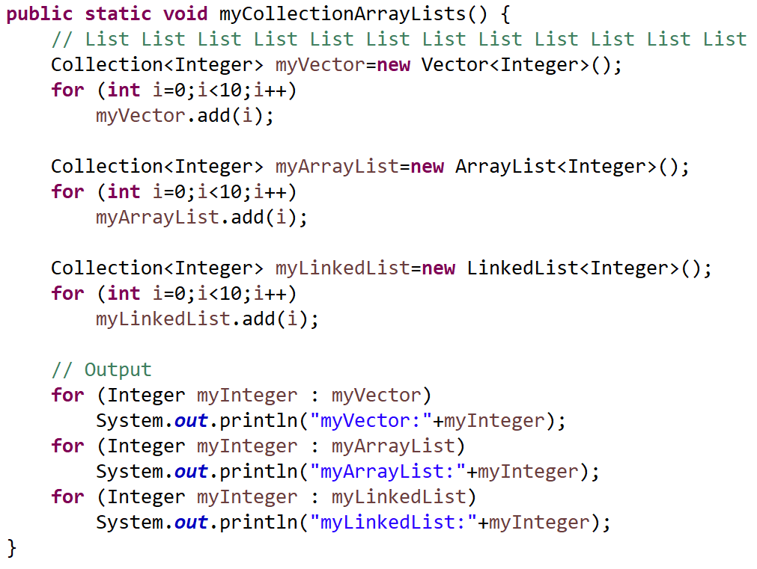
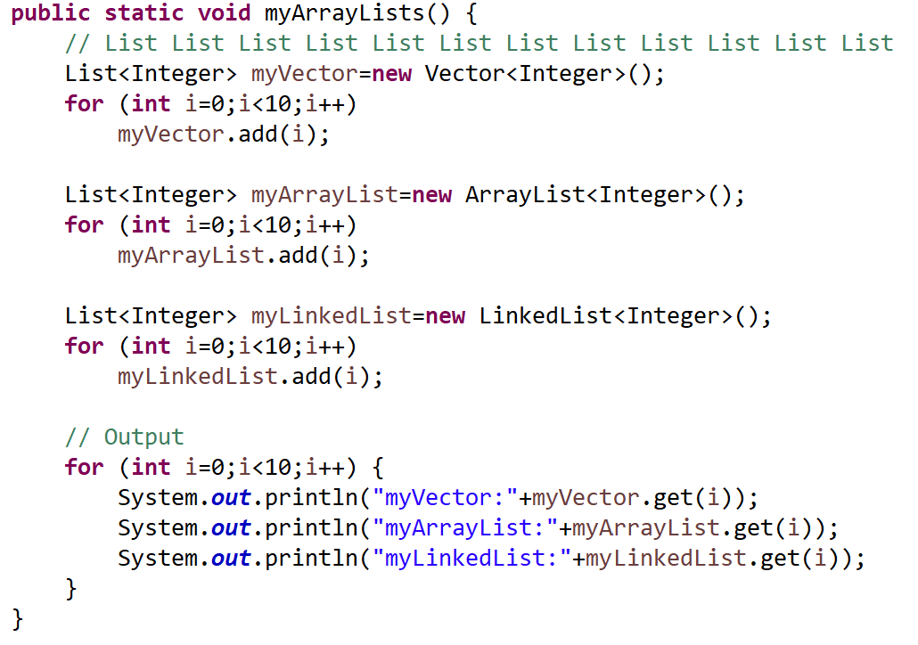
Interface List versus Collection
Collection interface
List interface
Must use iterator
Can use index & iterator …

Slide 33
Sets
Collection of unique elements, with no key-value association

Slide 34
Sets
HashSet
  Fast hash-based set implementation
  add(element) returns true is not already in set
TreeSet
  Balanced binary trees
  Sorting
  Insert new element: slow
LinkedHashSet
  Combination List and Set
  Fast set implementation
  Hash based
  Keeps inserting sequence
  High performant

Slide 35
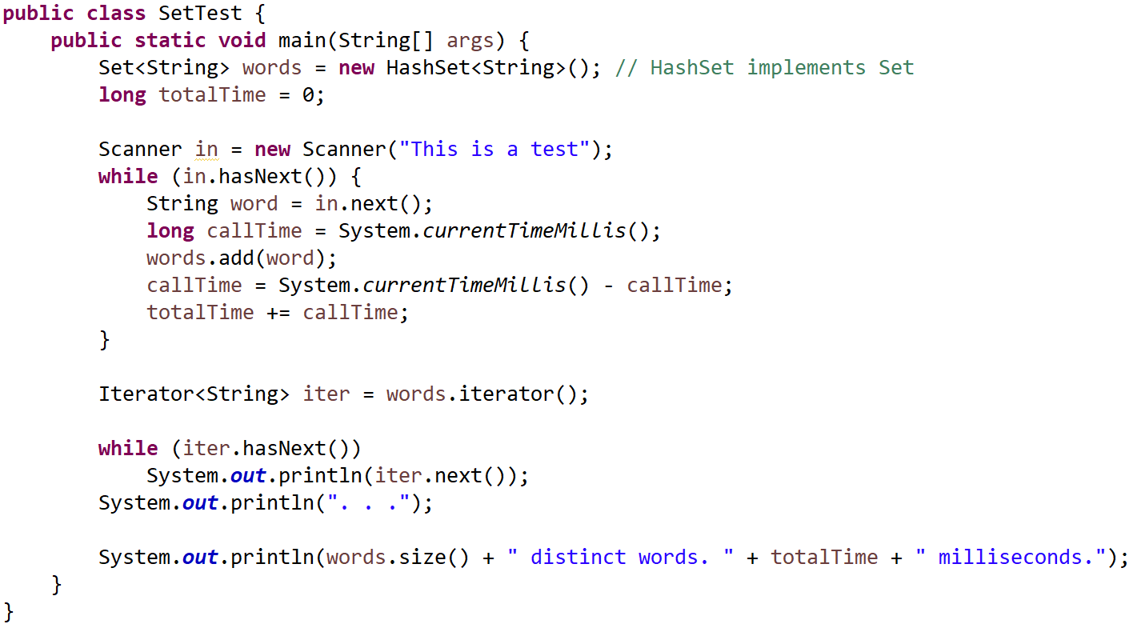
Examples
“CSEN160_05_Lecture_DataStructursAndGenerics.P_SetTest”

Slide 36
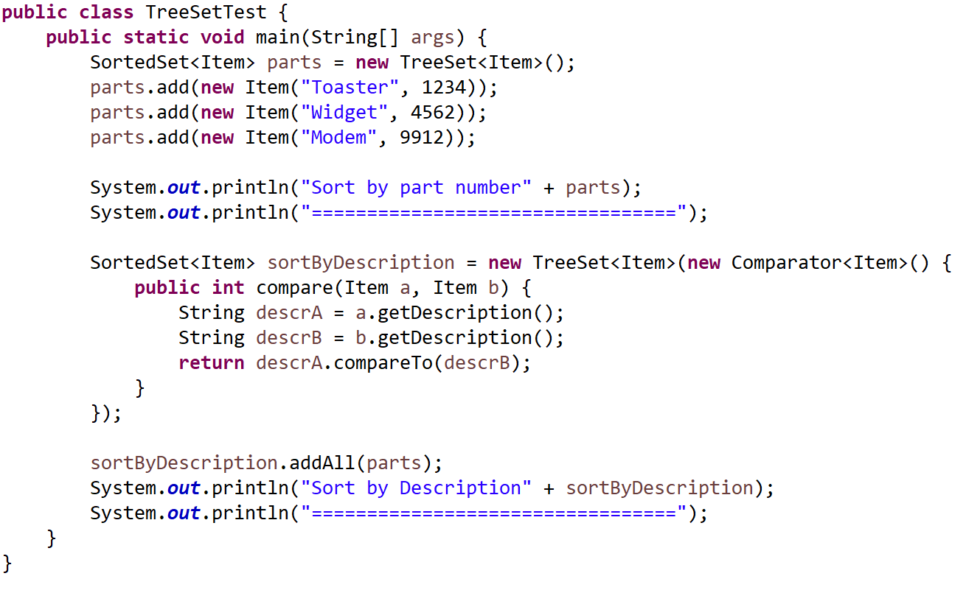
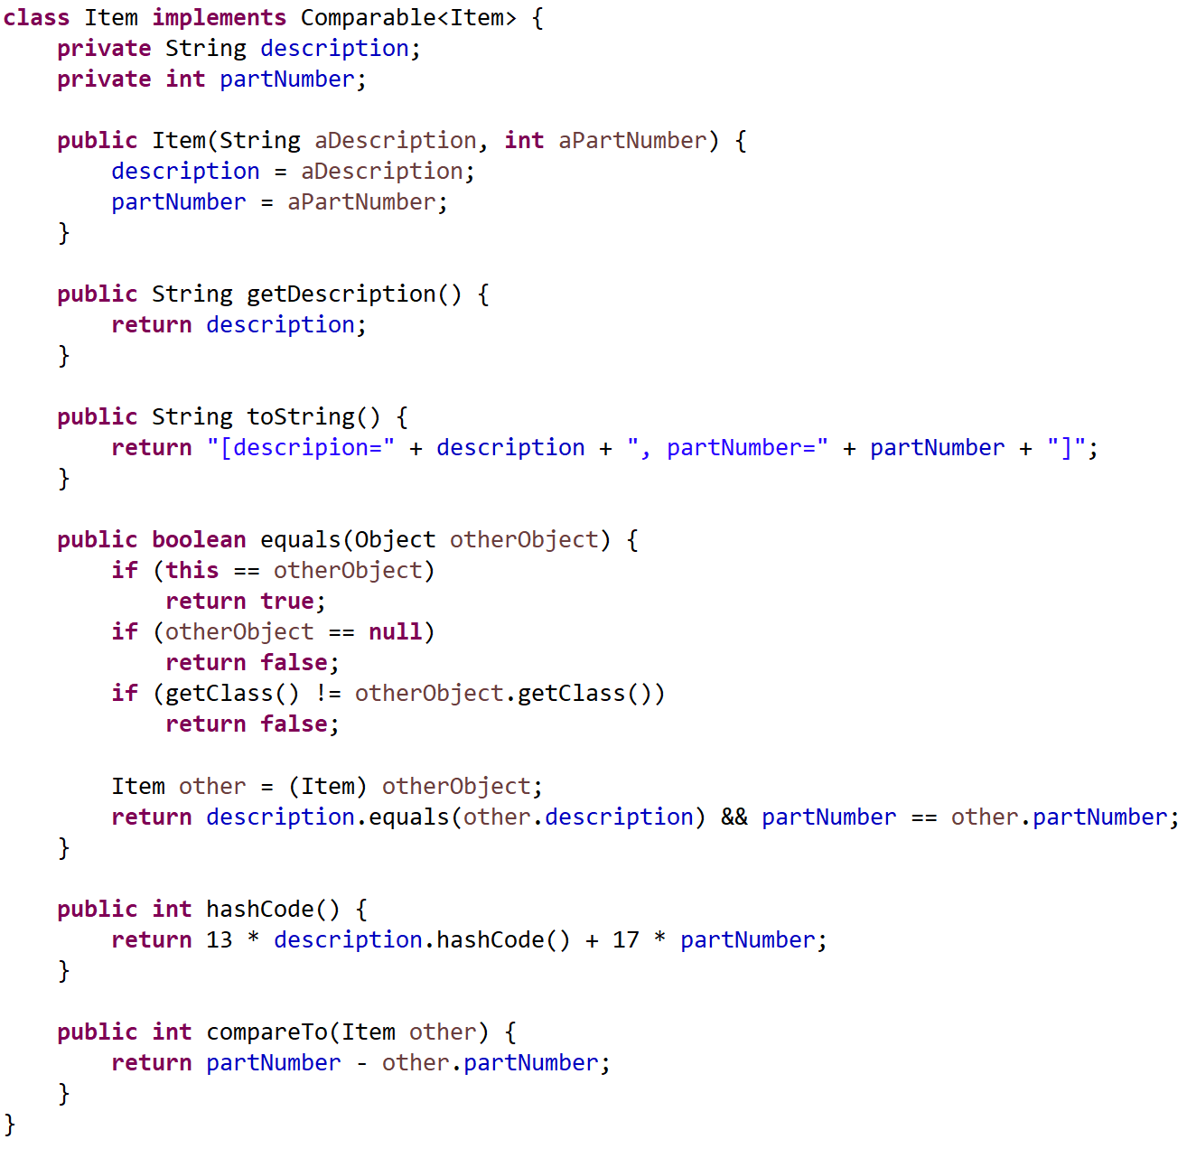
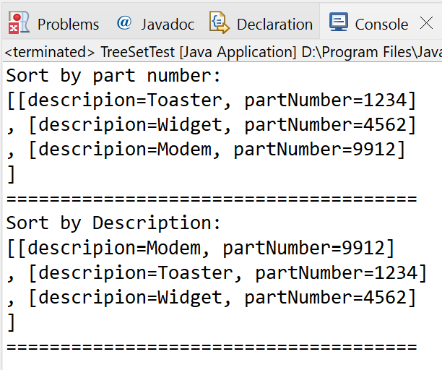
Examples
“CSEN160_05_Lecture_DataStructursAndGenerics.Q_TreeSetTest”

Slide 37
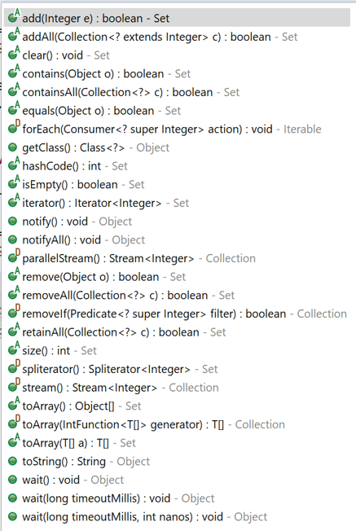
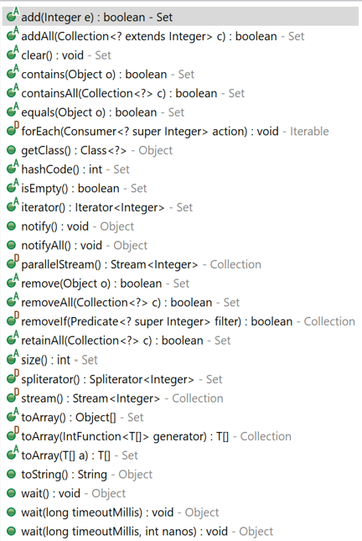
Set interface vs Collection interface
Why the same?
  Differences, set enforces:
    set logic
    no duplicates
    Unordered
  While Collection does not.
  If you need a Collection and you have no requirement for avoiding duplicates then use a Collection.
  If you have the requirement for Set then use Set. (Source)
Set interface
Collection interface

Slide 38
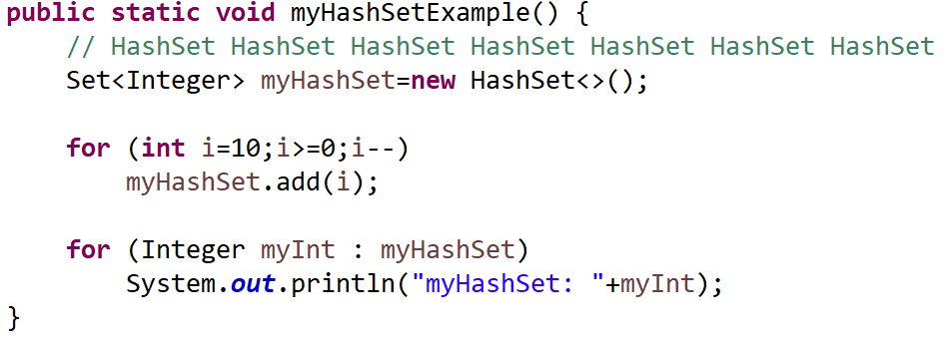
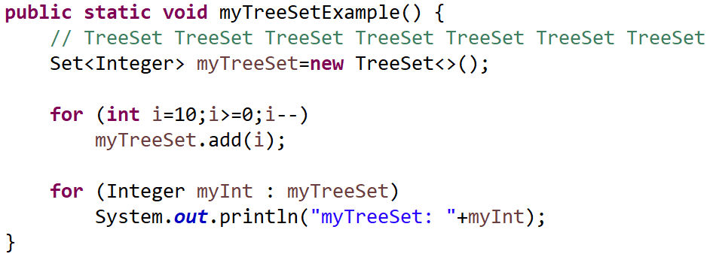
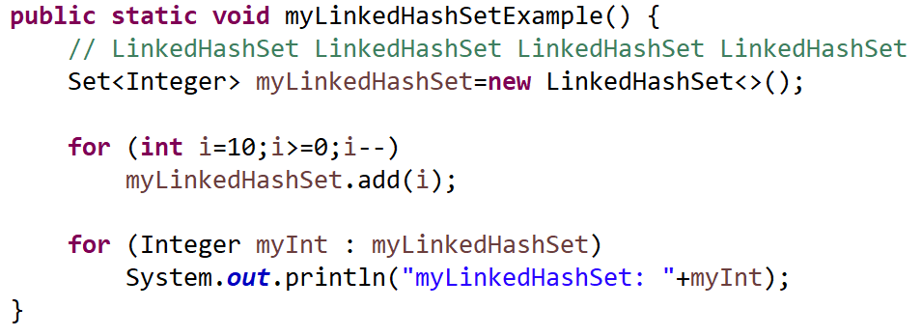
Sets and Set interface
“CSEN160_05_Lecture_DataStructursAndGenerics.T_Set”

Slide 39
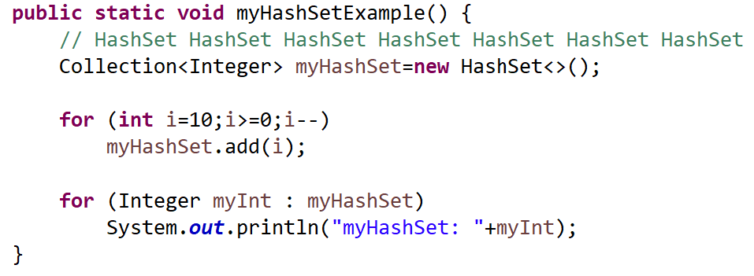
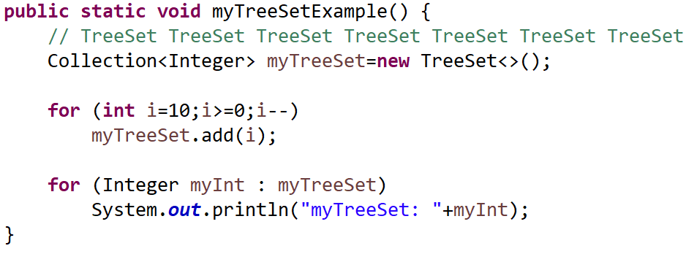
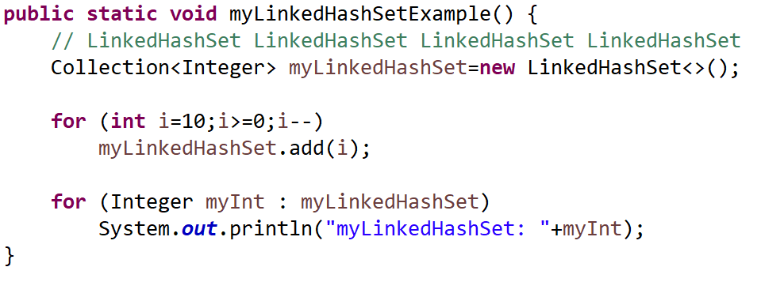
Sets and Collection interface
“CSEN160_05_Lecture_DataStructursAndGenerics.T_Set”

Slide 40
Maps
Data in key-value pairs, where each unique key maps to a specific value

Slide 41
Maps (associative, Keys)
HashMap:
  Fast hash-based implementation
  Keys: NOT sorted
TreeMap:
Slower implementation
Binary Tree
Keys: are sorted
LinkedHashMap:
Stores key-value pairs in the order in which keys were inserted.
In general: <Key, Object>

Slide 42
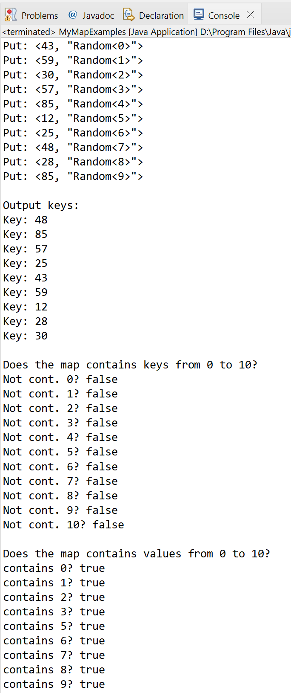
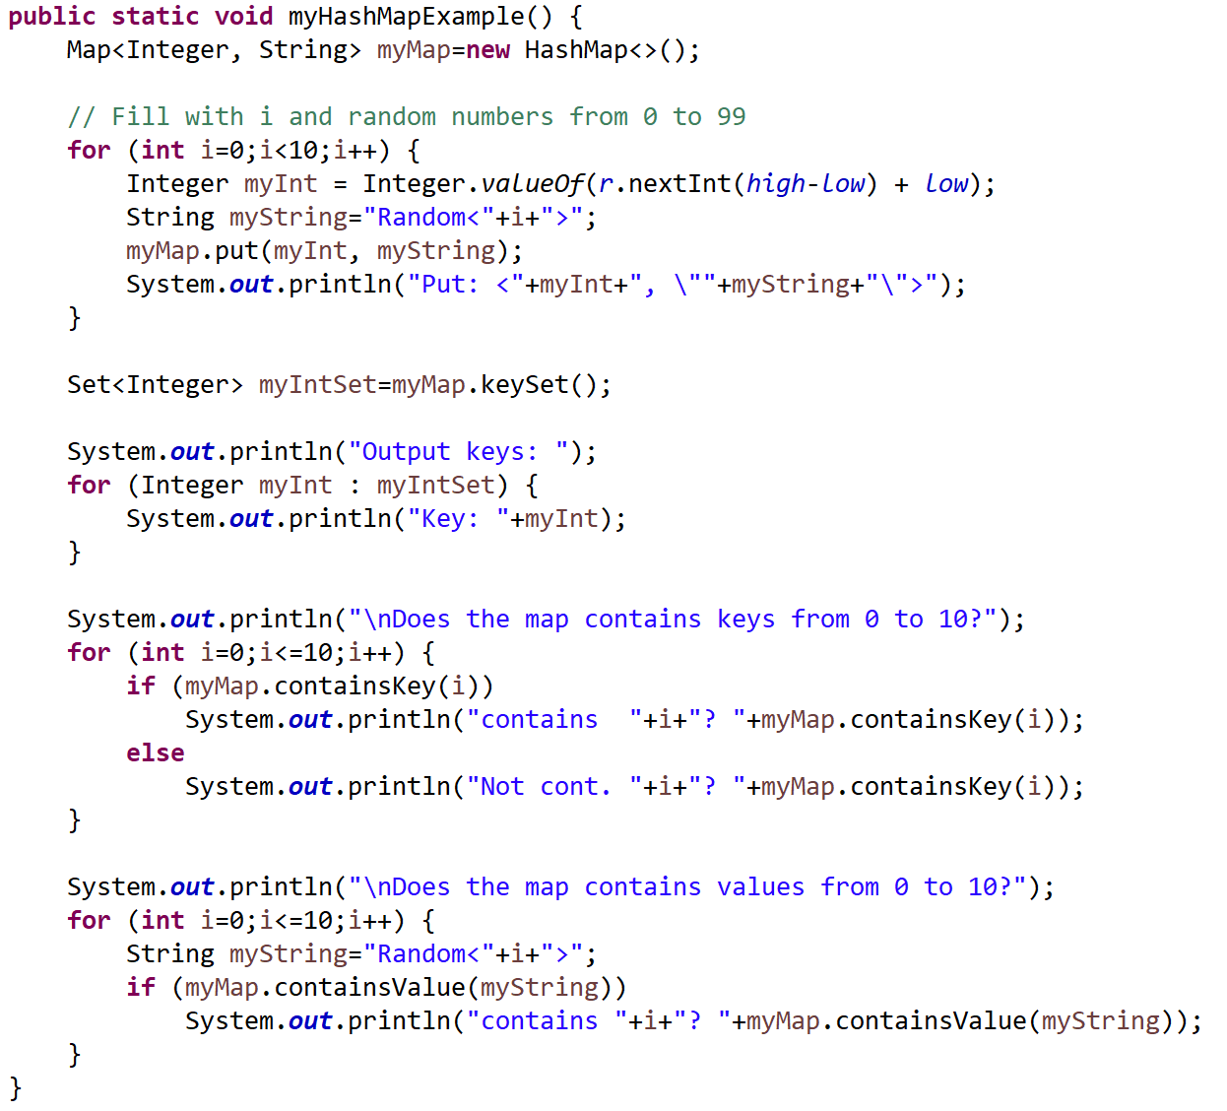
HashMap
“CSEN160_05_Lecture_DataStructursAndGenerics.R_MapSet”
Keys not sorted
Keys NOT sorted
No keys from 0 to 10 in map
(because Random)
All values 0 to 10
are in the map

Slide 43
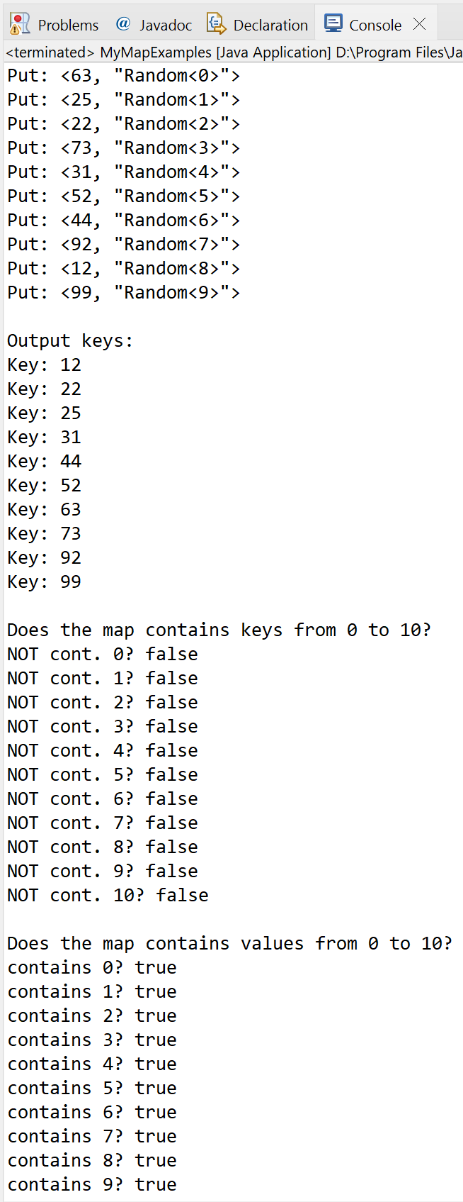

TreeMap
“CSEN160_05_Lecture_DataStructursAndGenerics.R_MapSet”
Keys not sorted
Keys ARE sorted
No keys from 0 to 10 in map
(because Random)
All values 0 to 10
are in the map

Slide 44
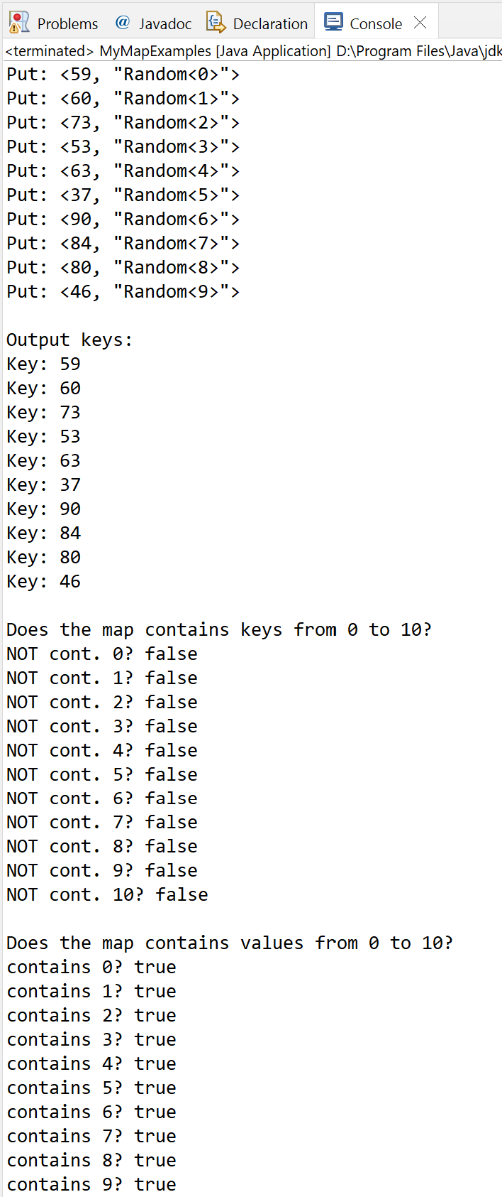
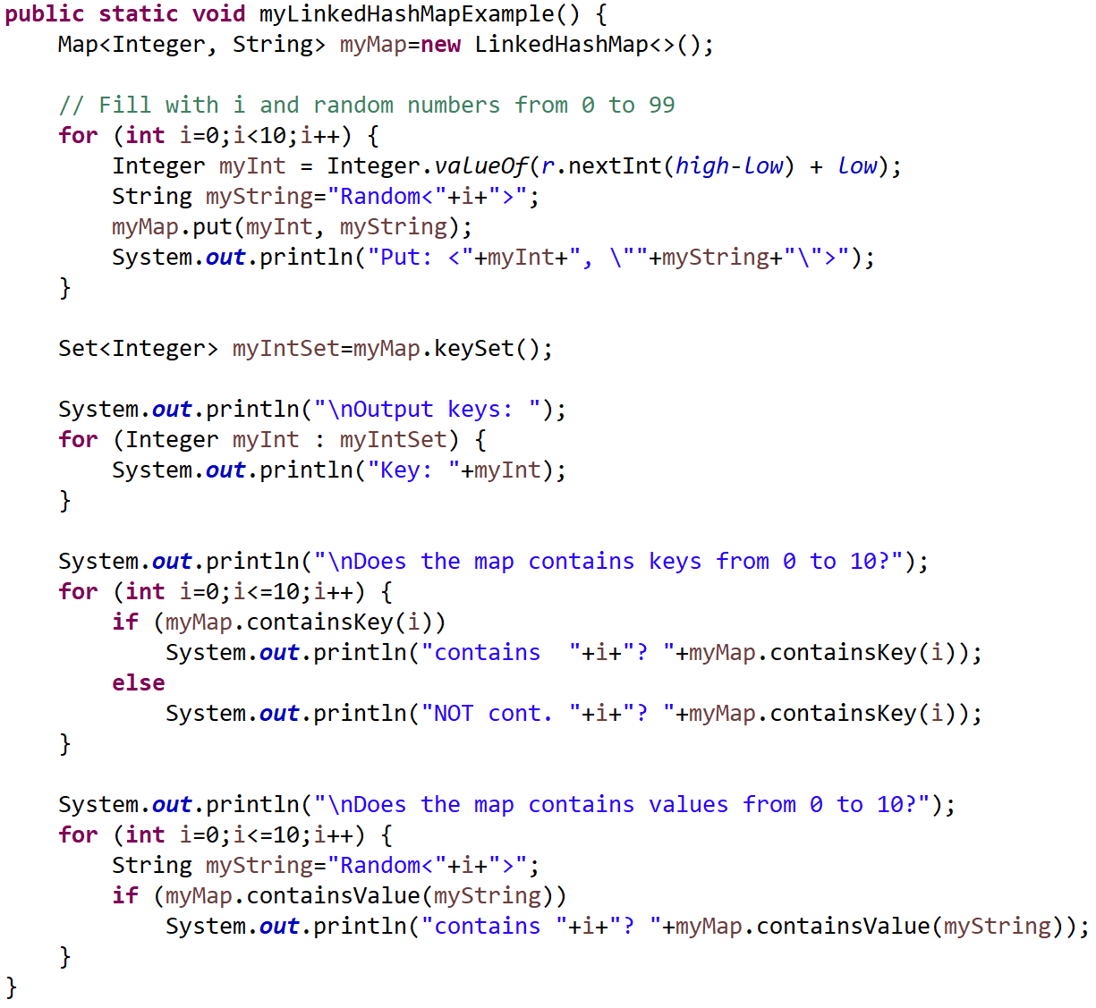
LinkedHashMap
“CSEN160_05_Lecture_DataStructursAndGenerics.R_MapSet”
Keys not sorted
Original insert
sequence is preserved
Keys NOT sorted
No keys from 0 to 10 in map
(because Random)
All values 0 to 10
are in the map

Slide 45
Comparator

Slide 46
A Comparator
Both TreeSet and TreeMap store elements in sorted order:
However, it is the comparator that defines precisely what sorted means
This interface lets us sort a given collection in different ways.

Slide 47
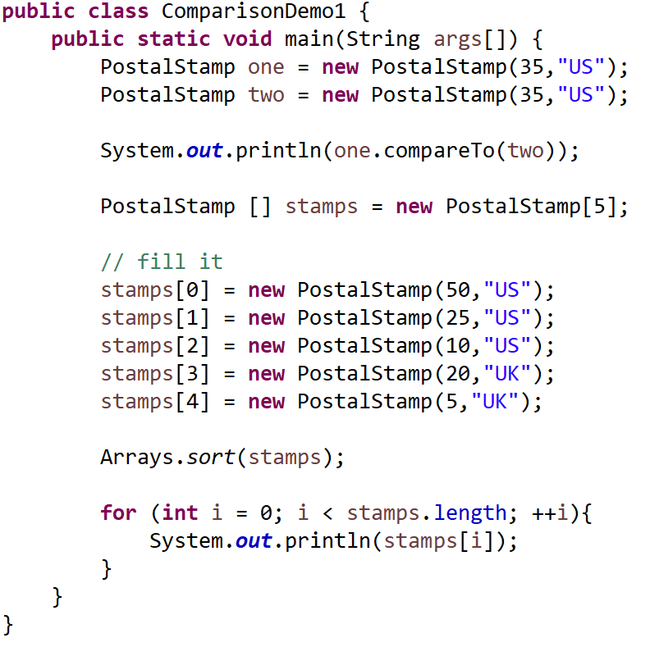
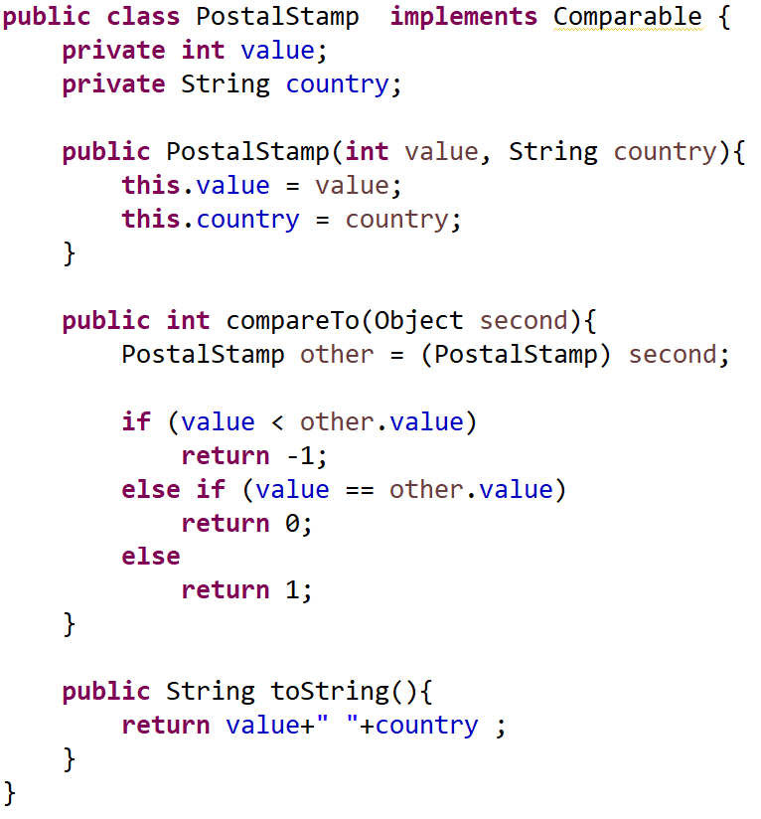
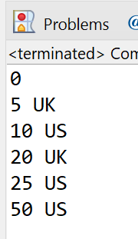
A Comparator
“CSEN160_05_Lecture_DataStructursAndGenerics.F_ComparisonDemo1”

Slide 48
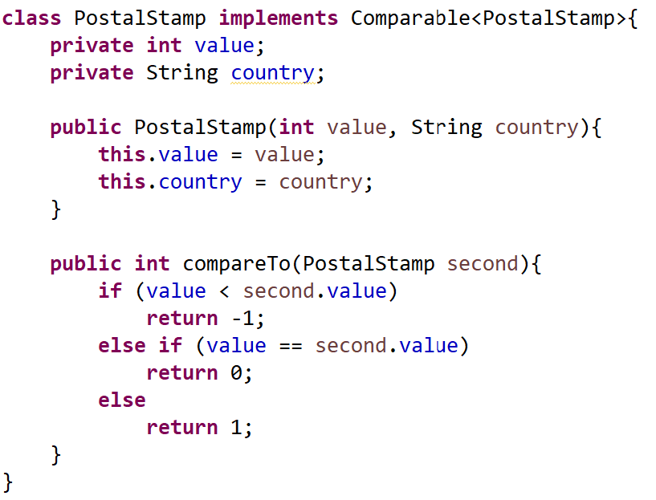
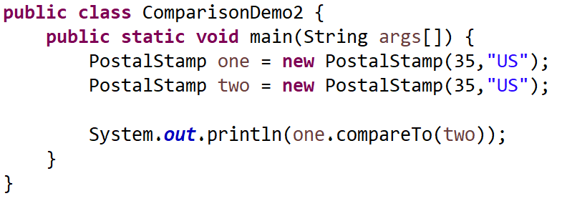
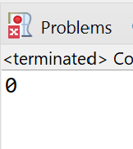
A Generic Comparator
“CSEN160_05_Lecture_DataStructursAndGenerics.G_ComparisonDemo2”

Slide 49
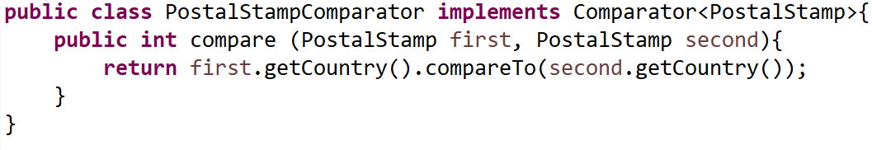
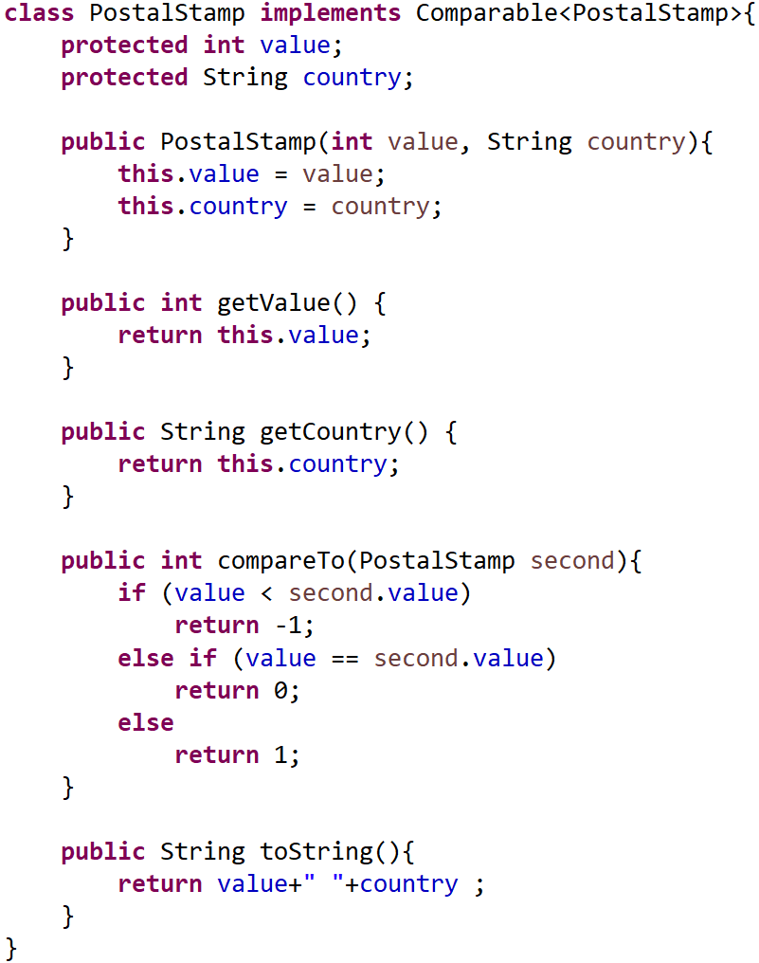
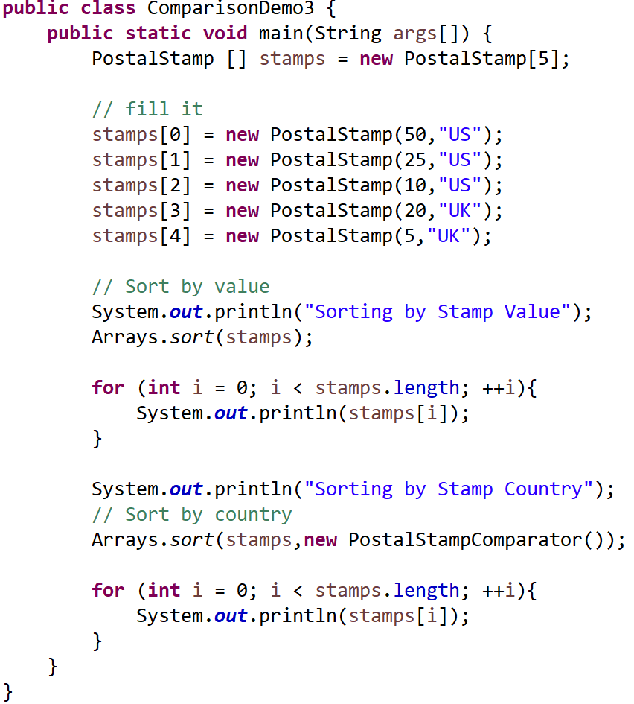
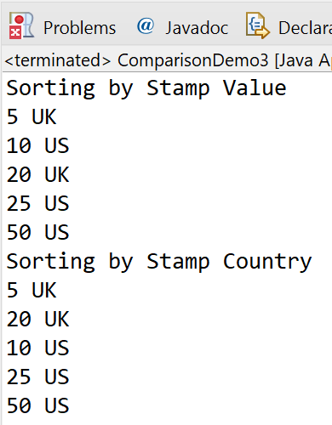
A Comparator
“CSEN160_05_Lecture_DataStructursAndGenerics.H_ComparisonDemo3”
Sort by delivering an object

Slide 50
Done

Slide 51
… to here …

