Slide 1
CSEN160
Fall 2026
Object-Oriented Analysis, Design and Programming
Michael Schimpf, PhD, mschimpf@scu.edu
Department of Computer Science and Engineering

Slide 2
Thread Memory

Slide 3
Thread Memory
  Each thread has its own stack (1 to 2 MB)
    For local/auto variables in functions
  Heap between Threads are shared for all objects
    Class/object attributes
    Everything created by “new”

Slide 4
Thread Memory
A Program
Thread 1
Thread 2
Thread 3
Stack for
Local variables:
Byte, short, char
Int, long
float, double
references
Stack for
Local variables:
Byte, short, char
Int, long
float, double
references
Stack for
Local variables:
Byte, short, char
Int, long
float, double
references
Heap
Object
Object
Object
Object
Object
Object
Object
Object
Object

Slide 5
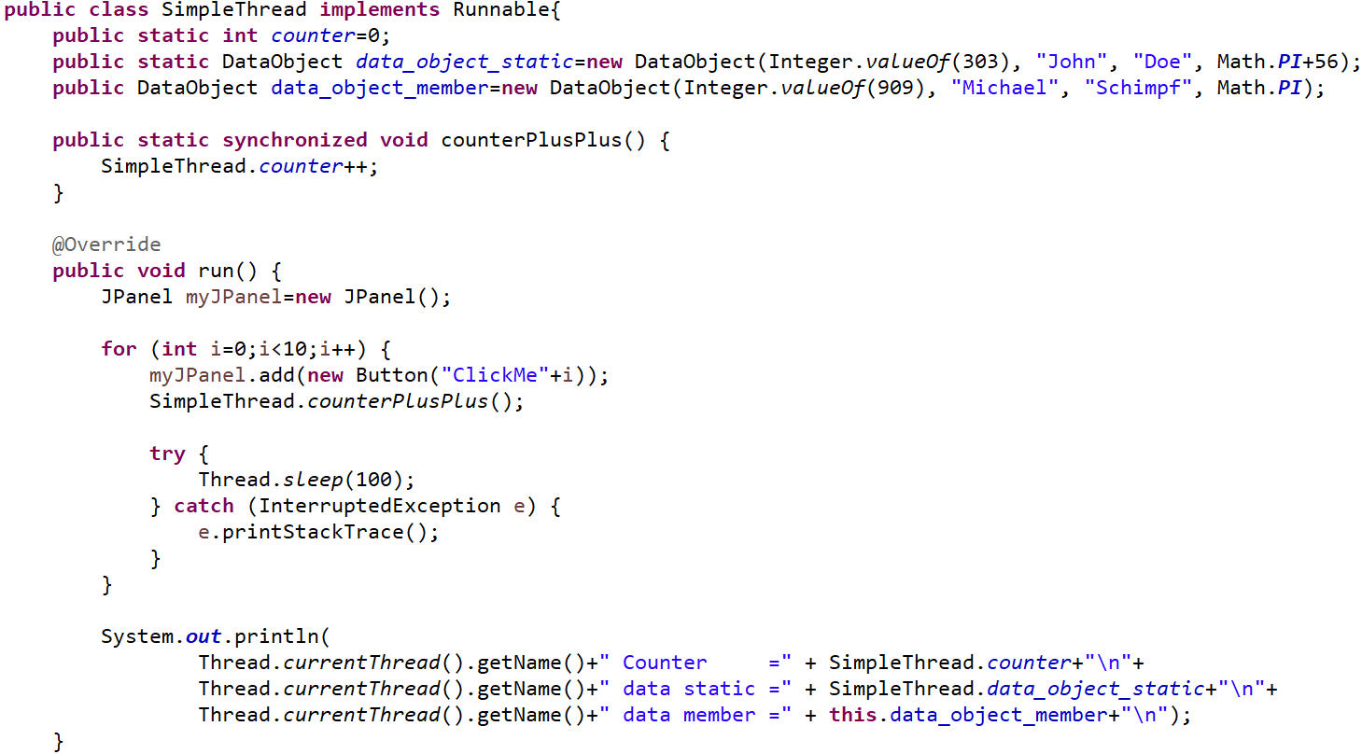
Thread Memory
Example:
Goes to the Heap
Local variable goes to the Stack
Object itself goes to heap
Reference goes to the Stack

Slide 6
Volatile

Slide 7
Volatile
Two problems:
Instruction reordering
L1, L2, L3 cache: Data not written to RAM immediately!

Slide 8
Volatile
1. Instruction Reordering Problem:
Java “Happens Before Guarantee” a set of rules that prevent instruction reordering from breaking visibility guarantees
Issue:
Java JVM is allowed to reorder code
But it does not consider concurrencies in different threads!
JVM checks only one thread or sequence at a time.
Task
CPU T1
CPU T2
CPU T1
CPU T2
CPU needs to wait!
(Until a is calc)
  1. a = b + c
  2. d = a + e
  3. l = m + n
  4. o = l + q
a = b + c
l = m + n
d = a + e
o = l + q
a = b + c
d = a + e
l = m + n
o = l + q
CPU need to wait!
(Until l is calc)
No Wait at all ☺

Slide 9
Volatile
2. Cache Levels: L1, L2, L3, etc.
A write to RAM is buffered by the cache hierarchy!
A variable could stuck in the cache hierarchy!
Possible:
Thread1 access date from Thread2
Thread1 changes some var
But it is not immediately reflected to Thread2

Slide 10
Volatile
Cache not flushed!
Cache Hierarchy:
Java Synchronized Visibility Guarantees
Use: volatile or synchronized
Thread 1
L1 cache
L2 cache
L3 cache
Main Memory
L3 cache
L2 cache
L1 cache
Thread 2
count++
count
count
count
count
count
count
count
count
count
count++

Slide 11
Volatile keyword
Volatile:
“volatile” deactivates the caching for a variable
“volatile” read it direct from main memory
“volatile” prevents reordering of your code
“volatile” cannot be used with classes/methods

Slide 12
Volatile keyword
Volatile:
Reading a “volatile” variable returns:
the most recent write by any other thread.
Synchronize guarantee:
  Visibility
  Atomicity
Volatile variables guarantees only visibility.

Slide 13
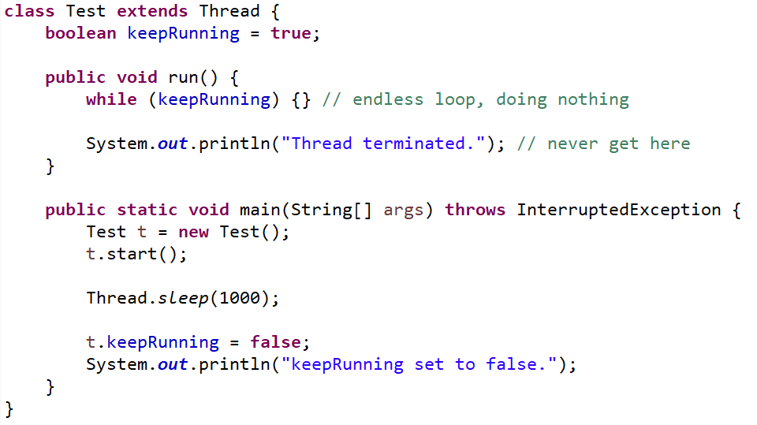
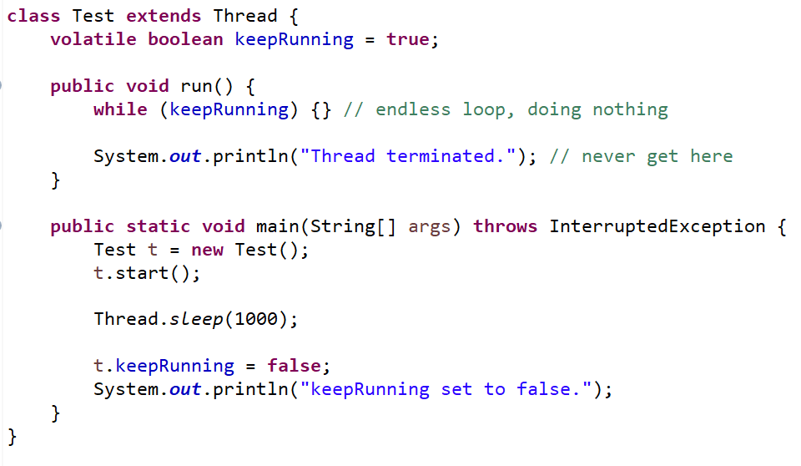
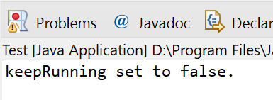
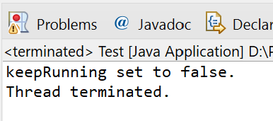
Volatile keyword
CSEN160_07_Threads.I_volatileExample.A_ThreadNonVolatile
Or it got reordered ☹
Pipelining, etc.
Simple example for cache:
It should write
it to memory
Never stops!

Slide 14
How to end Threads

Slide 15
How to end Threads
If a Thread is in an endless loop …
First approach:
Outside: call interrupt()
Thread: needs to catch InterruptException!
Thread: and call interrupt() again

Slide 16
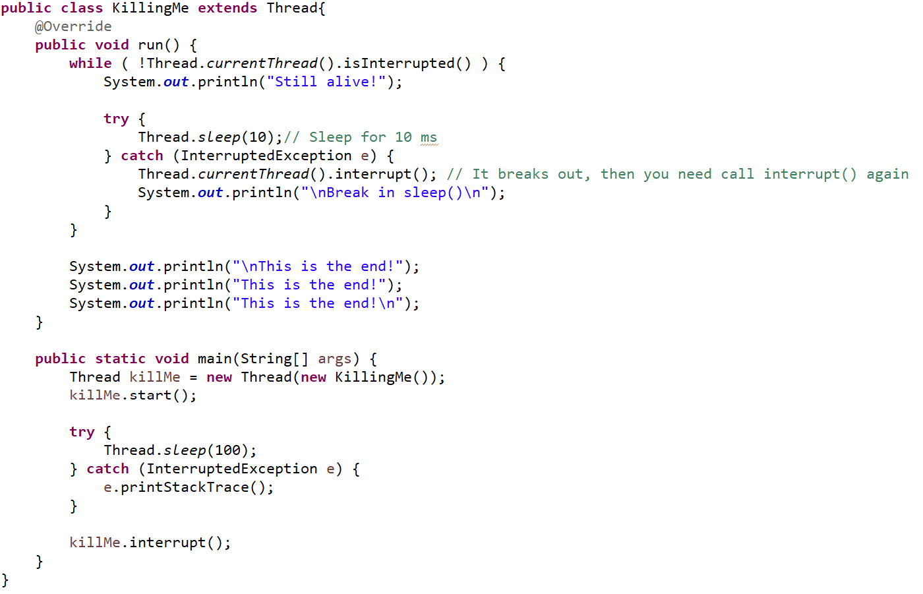
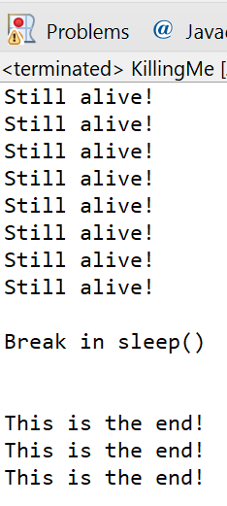
CSEN160_07_Threads.A_SimpleExamples.F_KillingMe
How to end Threads

Slide 17
How to end Threads
Why: “Thread.currentThread().interrupt();”?
Thread is most of the time in sleep mode
interrupt() interrupts the sleep
Need another interrupt to set “isInterrupted” flag

Slide 18
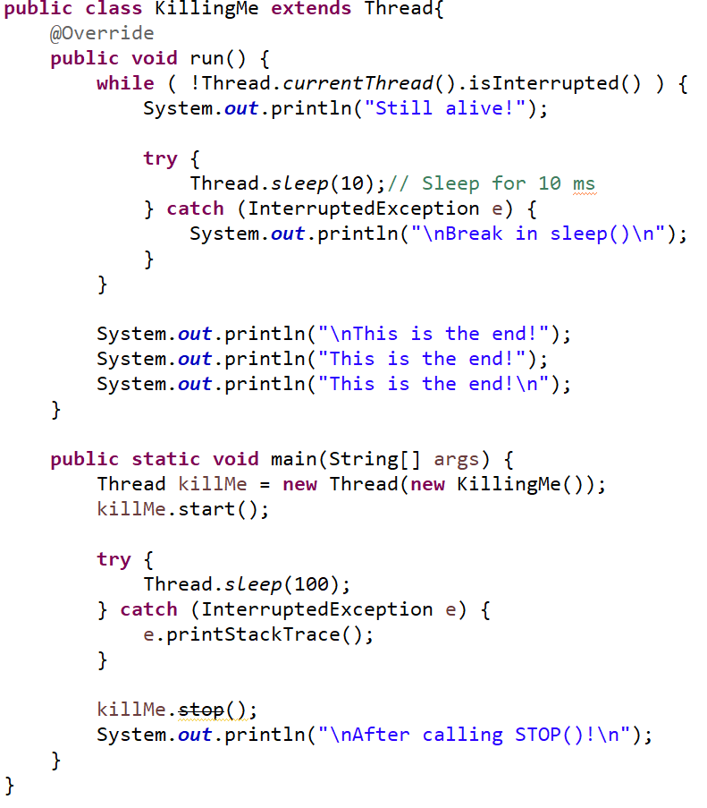
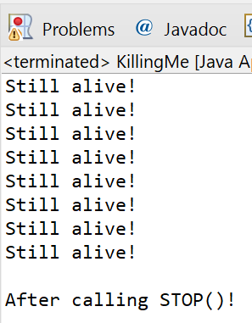
CSEN160_07_Threads.A_SimpleExamples.F_KillingMe
How to end Threads
If a Thread is in an endless loop:
stop() – DEPRECATED no replacement ☹
Not executed

Slide 19
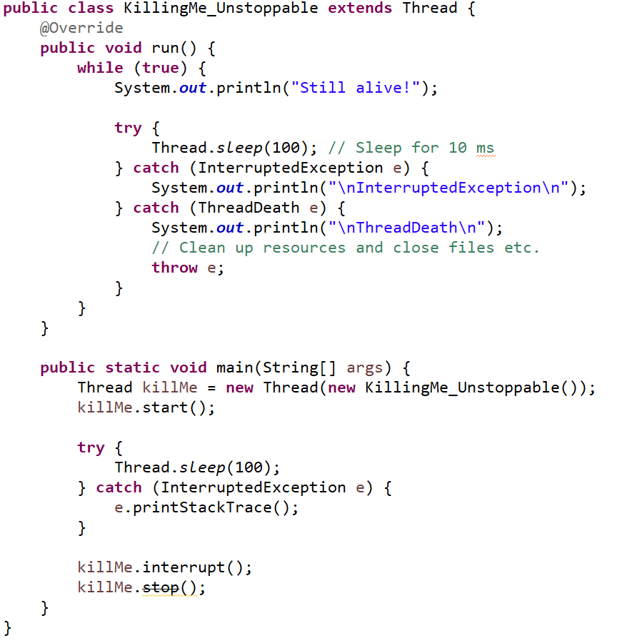
CSEN160_07_Threads.A_SimpleExamples.G_KillingMe_Unstoppable
ThreadDeath exception
ThreadDeath exception:
Intention:
Gives time to clean up
DEPREATED

Slide 20
Daemon

Slide 21
Daemon vs user threads
Daemon thread:
Is a background thread with low priority.
Creating thread dies, daemon thread dies with it.
A “daemon” provides a general service (background)

Slide 22
Daemon vs user threads
Main difference:
Call Thread.setDaemon(true) to make it a daemon.
JVM is not waiting that a daemon ends itself
JVM is waiting for user Threads to terminate

Slide 23
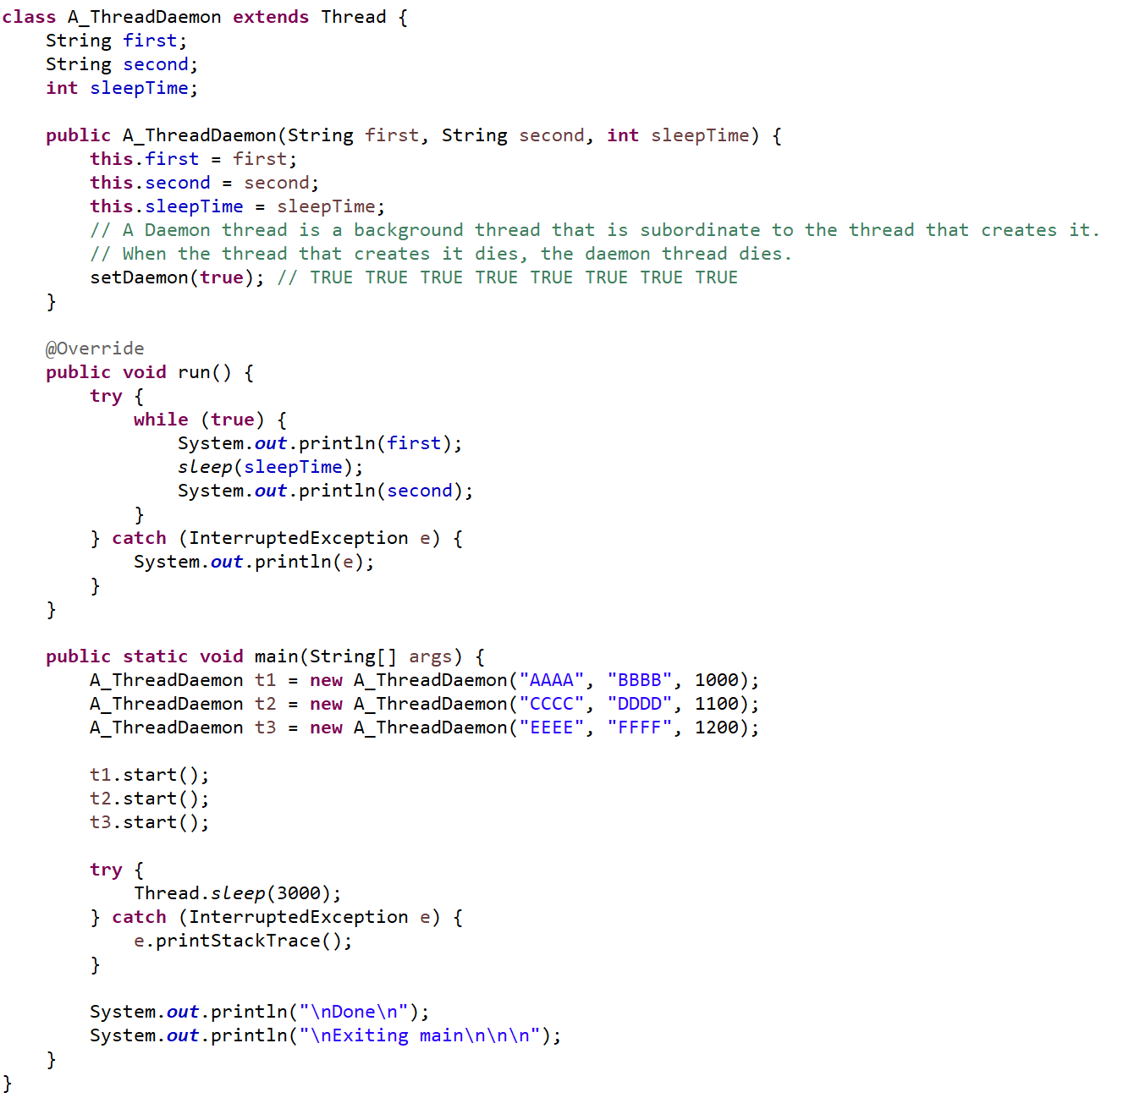
CSEN160_07_Threads.E_daemon.A_ThreadDaemon
Daemons

Slide 24
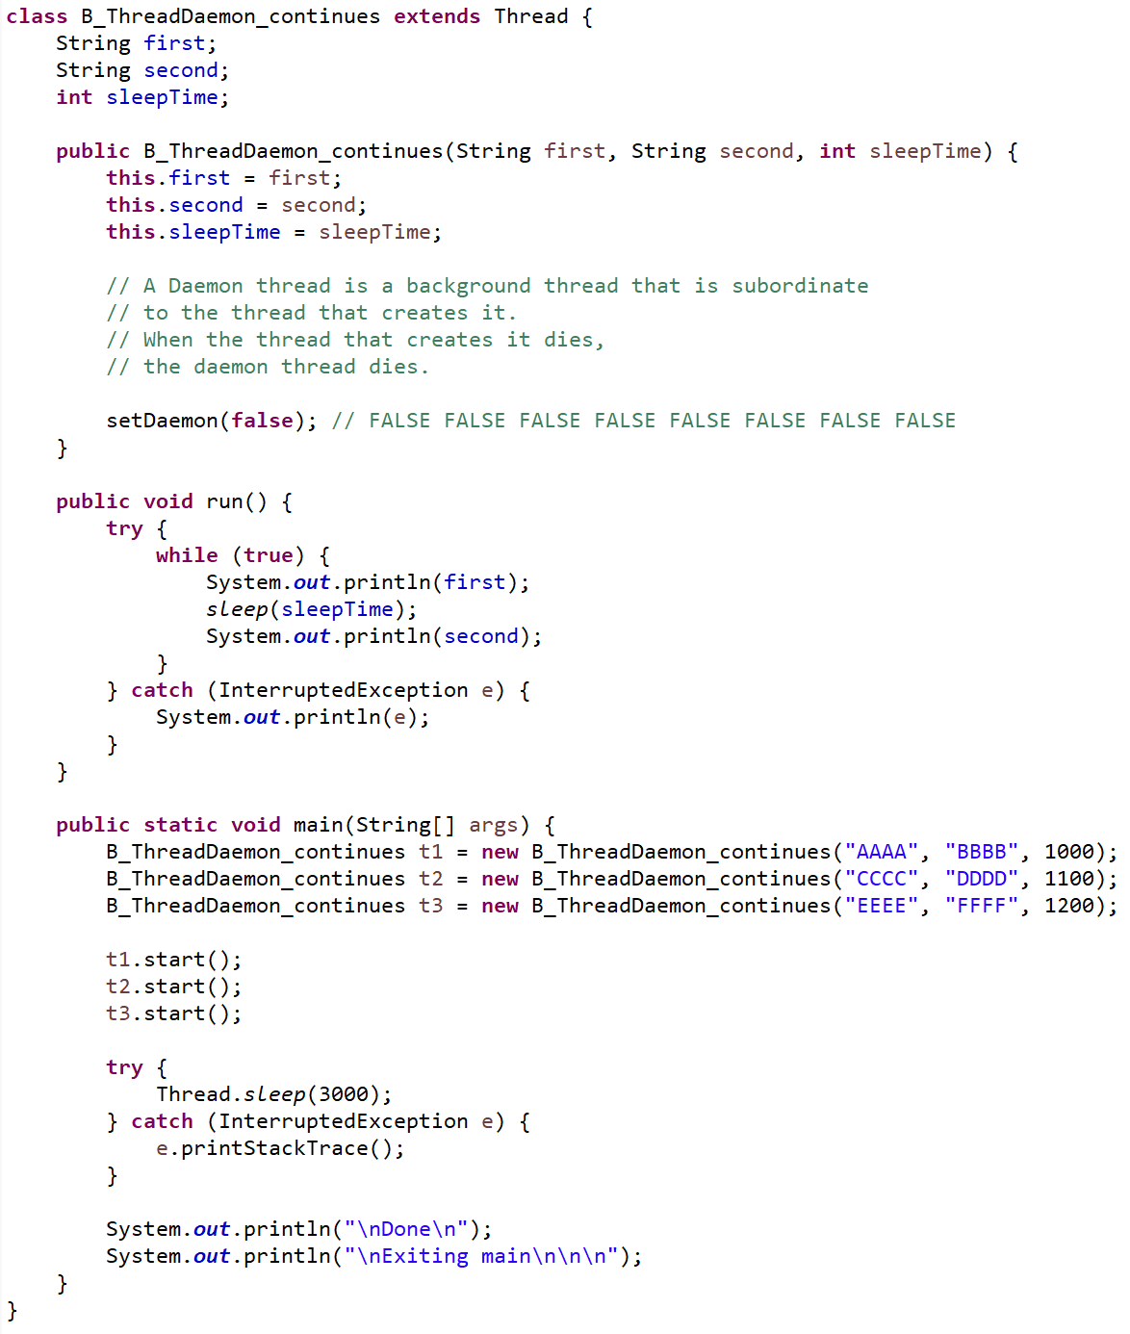
CSEN160_07_Threads.E_daemon.B_ThreadDaemon_continues
Daemons

Slide 25
Problems with Threads

Slide 26
Problems With Threads
Three types of problems:
  Race conditions: “counter” ARM assembler example
  Deadlock
  Starvation

Slide 27
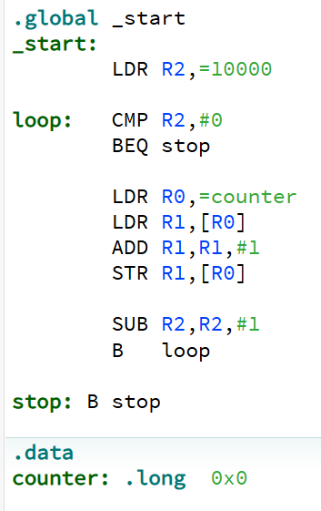
Assembler Example – Race Condition
ARM assembler
Thread1
Thread2
Load the address from counter = $18
Load the address from counter = $18
Load the value from address $18 = 12
Load the address from counter = $18
13 = 12+ 1
13 = 12+ 1
Write value 13 back to what $18 is pointing
Write value 13 back to what $18 is pointing
Shared Resource

Slide 28
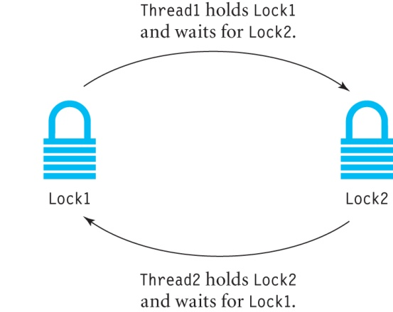
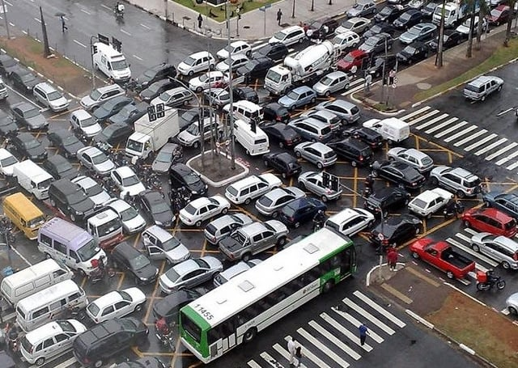
Deadlock
Is when a thread holds a resource, as well as waiting for a resource
that is held by another thread.
  Thread1 holds Lock1 and is blocked waiting for Lock2.
  Thread2 holds Lock2 and is blocked waiting for Lock1.
  No thread can proceed; thus, a deadlock has occurred.
Or traffic Deadlock

Slide 29
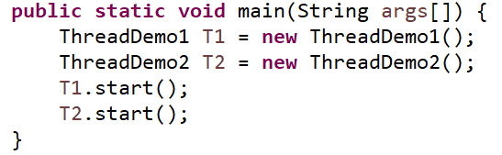
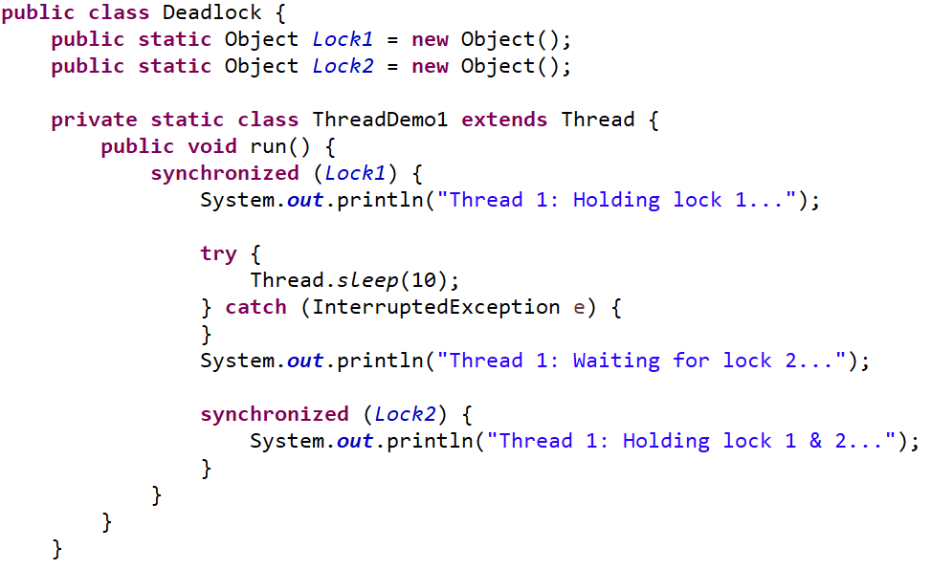
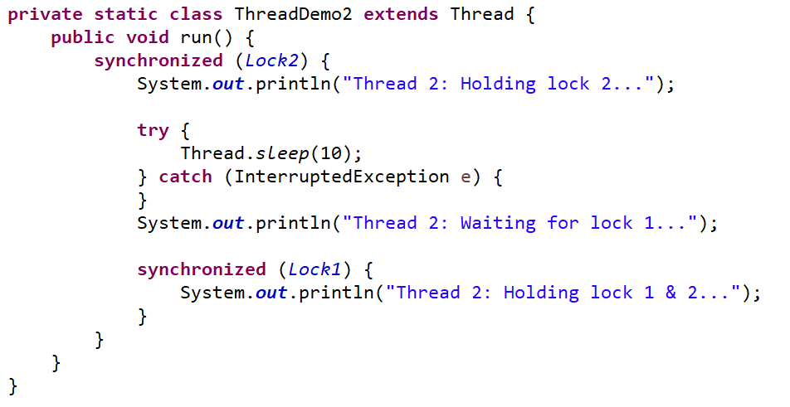
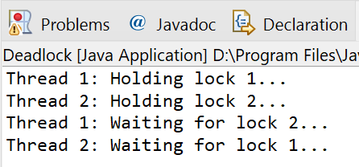
Deadlock
CSEN160_07_Threads.F_threadProblems.A_Deadlock
Example:

Slide 30
Starvation
Starvation occurs when a thread is not in a deadlock but is unable to continue:
  Priority level
  Lock on object
  Etc.

Slide 31
Starvation
Example:
  High priority threads are always selected to run;
  A low priority thread may never run
  Resulting in starvation.

Slide 32
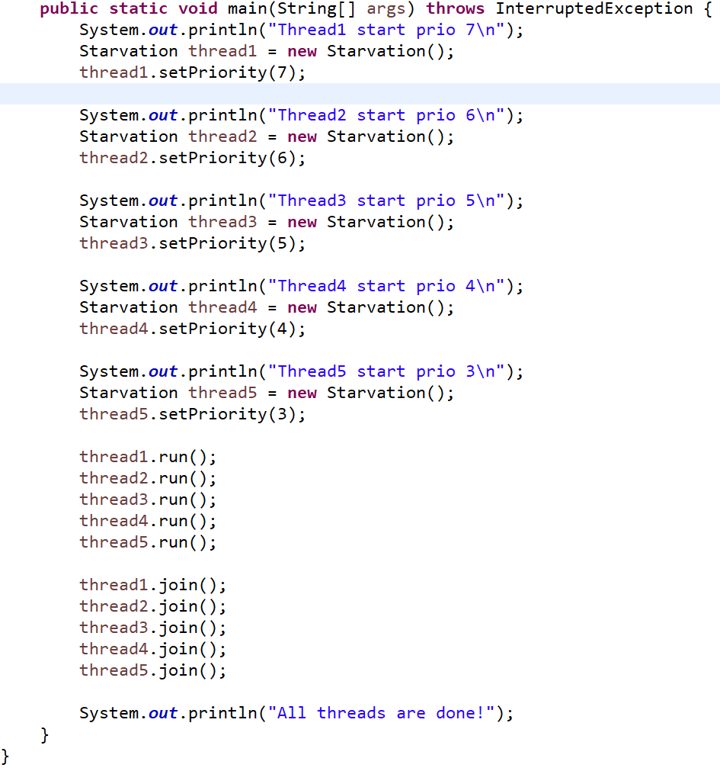
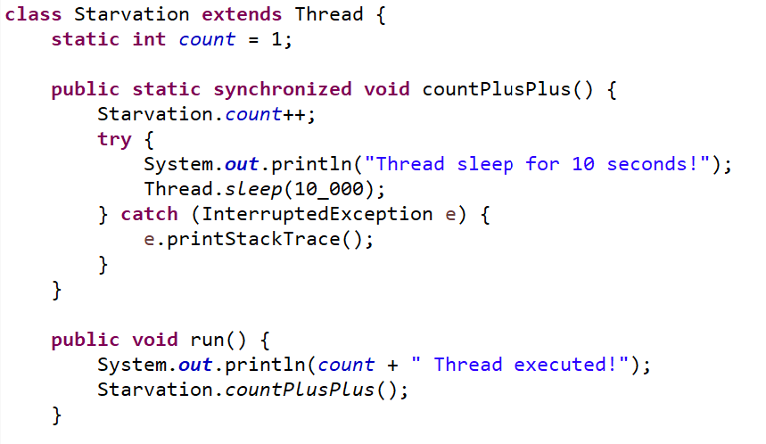
CSEN160_07_Threads.F_threadProblems.B_Starvation
Threads

Slide 33
Virtual Threads
JDK 21

Slide 34
Virtual Threads
Virtual Threads:
  New in JDK 21
    Virtual Thread (Project Loom)
    Platform Thread (OS native Thread)
  Virtual Threads are created but not mounted.
  Basically: A Thread, initiated but not started, managed in a pool

Slide 35
Virtual Threads
Virtual Threads:
  Lightweight (memory, creation)
  Implemented in the JVM (Project Loom)
  Cheap to create
  Millions of them (if needed)

Slide 36
Virtual Threads
Mounted Virtual
Thread
OS Thread
Unmounted Runnable
Virtual Threads
Platform Thread
Unmounted Blocked
Virtual Threads
Virtual Thread
Virtual Thread
Virtual Thread
Blocked by:
I/O
Synchronized
Wait
Sleep
Etc.
Virtual Thread
Virtual Thread
Virtual Thread
Virtual Thread
Ready to go
As least as much as you have CPU cores

Slide 37
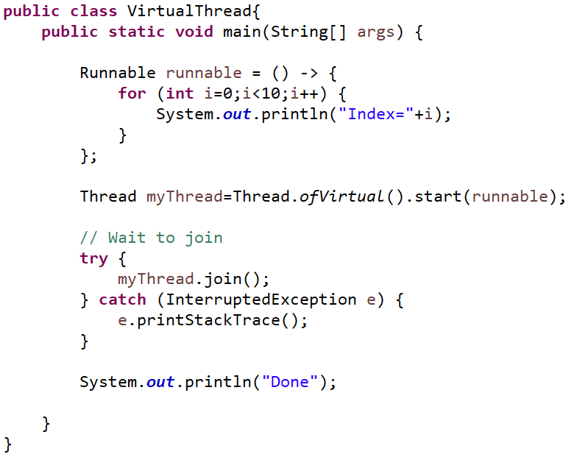
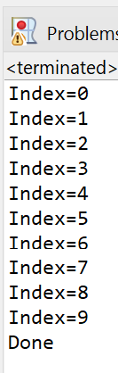
Virtual Threads
CSEN160_07_Threads.J_virtual.A_VirtualThread
Easy example:

Slide 38
Virtual Threads
But do not expect speed miracles:
  Speed gain is limited
  Depends on the task
  Depends on how many Threads you need
  In many tiny examples it is almost the same speed ☹

Slide 39
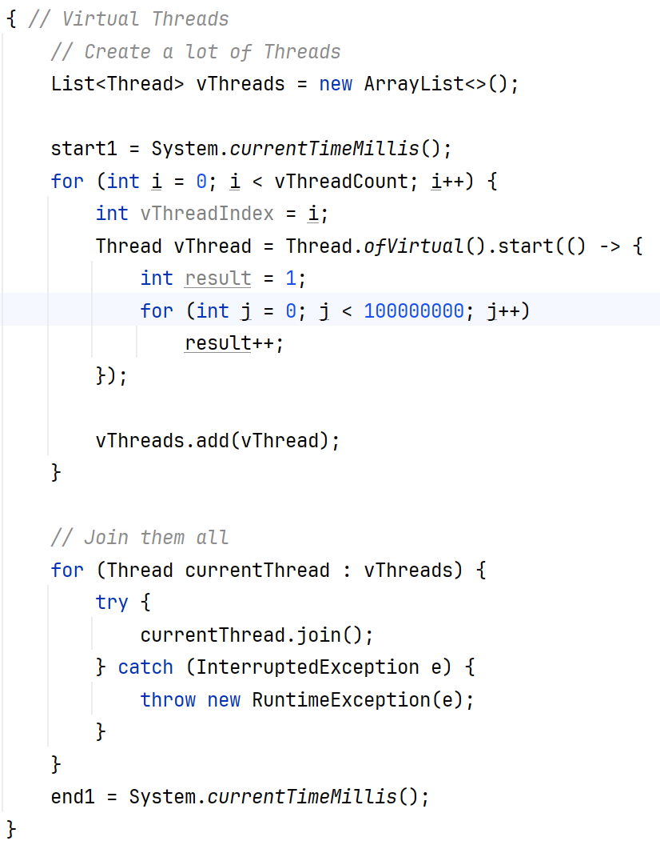
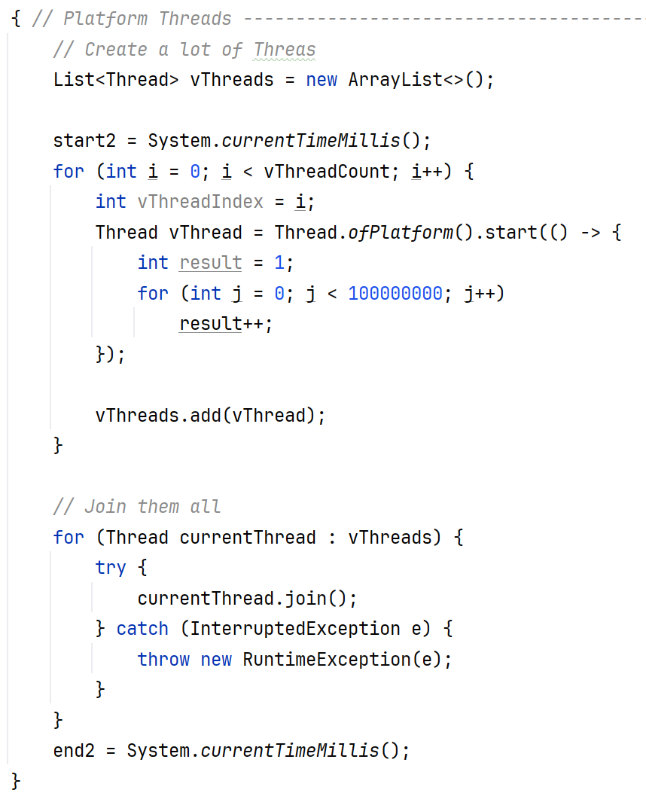
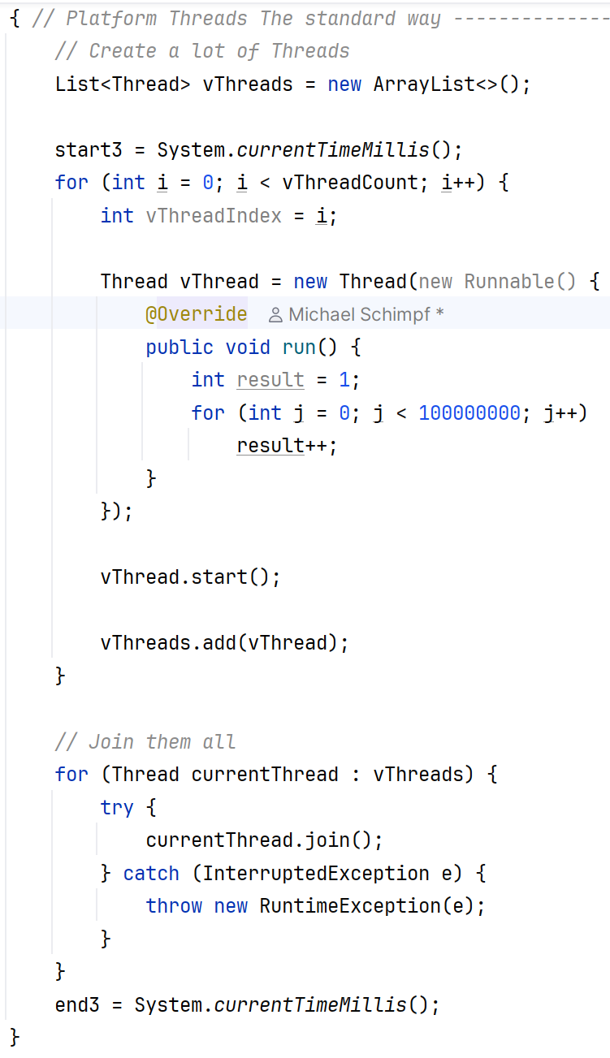
Virtual Threads
Week08_B_Threads_II.J_virtual.VirtualThreadExample2
But do not expect speed miracles:

Slide 40
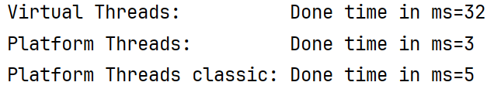
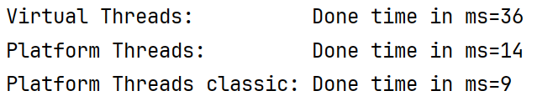
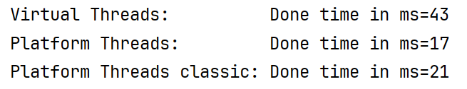
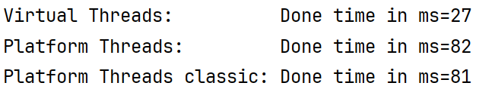
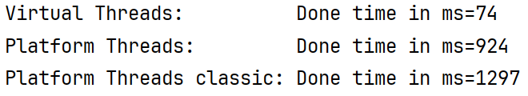
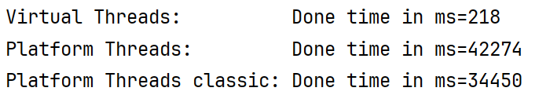
Virtual Threads
But do not expect speed miracles:
2025 JDK24
Thread: 1
Thread: 10
Thread: 100
Thread: 1,000
It needs 1,000
Threads ☹
Thread: 10,000
Thread: 100,000

Slide 41
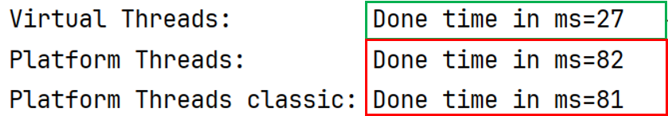
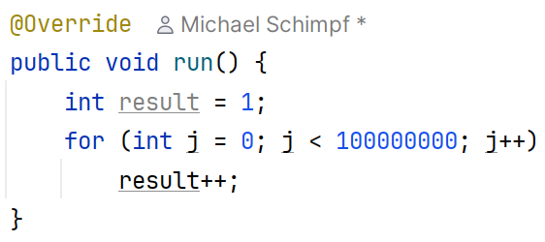
Virtual Threads
But do not expect speed miracles:
Thread: 1,000
Why 1,000 Threads break even?
The code itself is actually tiny/lightweight:
Lightweight creation and pooling takes time to internally setup.
Most probable, if you use constantly a lot of threads it will pay off ☺

Slide 42
java.util.concurrent.
ExecutorService

Slide 43
Executor Service
“Easy” to use framework to handle Threads
  Easy is relative!
Thread Pool Facility
Since Java 5 (initial version)

Slide 44
Executor Service
Four components:
Executor:
  Main interface, which is an abstraction of Threads.
  It separates tasks from execution
  This is different from java.lang.Thread, which combines both task and its execution.
  execute(Runnable);

Slide 45
Executor Service
Three components:
ExecutorService:
  Is an extension of the Executor interface
  Provides a facility for returning a Future object
  It terminates, or shut down the thread pool. Once the shutdown is called
  The thread pool will not accept new tasks but complete any pending task.
  It also provides a submit() method which extends Executor.execute() method and returns a Future.

Slide 46
Executor Service
ExecutorService:
  Provides a lifecycle for Threads
    Future submit (Callable)
    Void shutdownNow()
    Boolean isShutdown()

Slide 47
Executor Service
Executors:
  The actual implementations
  Utility class, which is something like a Collections
  It provides factory methods to create different types of thread pools
  E.g. fixed and cached thread pools.
  Provides static methods for:
    newFixedThreadPool(…)
    newCachedThreadPool();
    newSingleThreadExecutor(); // executed sequentially, queue based
    newSingleThreadsSchedulerExecutor();
    …

Slide 48
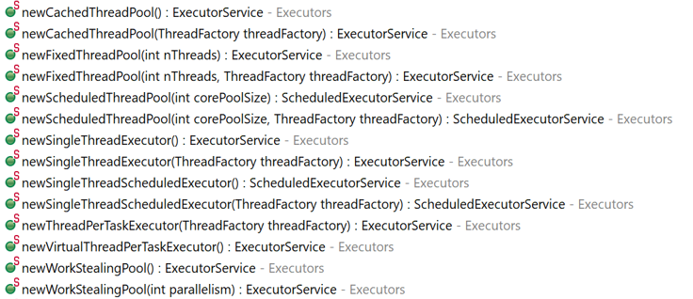
Executor Service
A lot of different implementations/options:

Slide 49
Executor Service
Future:
  Return data structure
  Based on the Callable Threads
  Runnable on the other hand cannot return anything

Slide 50
Cached Thread Pool
(Standard choice)

Slide 51
Cached Thread Pool
Creates a thread pool that creates new threads as needed.
But will reuse previously constructed threads when they are available.
These pools will typically improve the performance of programs that execute
many short-lived asynchronous tasks.

Slide 52
Cached Thread Pool
Calls to execute will reuse previously constructed threads if available.
If no existing thread is available:
  A new thread will be created and added to the pool.

Slide 53
Cached Thread Pool
If a thread have not been used for sixty seconds they will be terminated/removed.
A pool that remains idle for long enough, will not consume any resources.

Slide 54
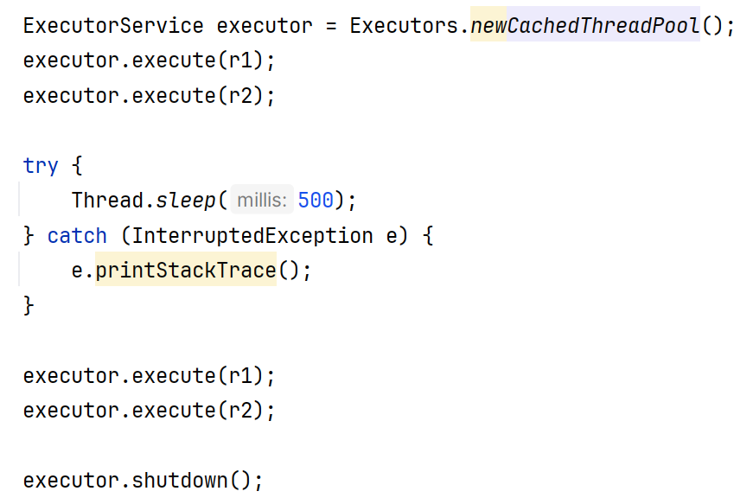
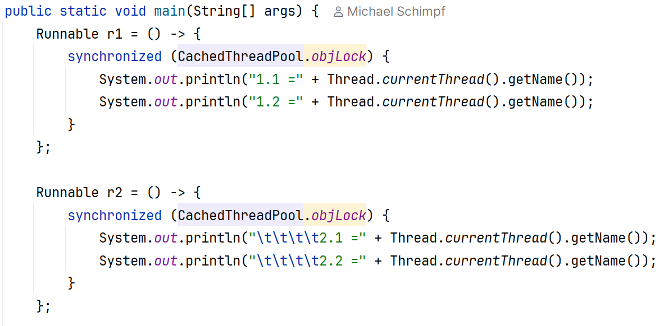
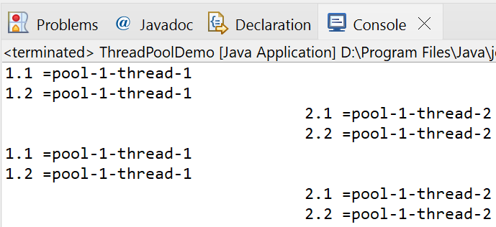
Week08_B_Threads_II.K_executor.CachedThreadPool
Cached Thread Pool
Simple Example:

Slide 55
Performance?

Slide 56
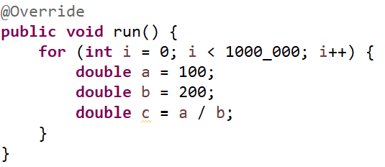
Cached Thread Pool
Speed comparison:
No synchronized
Plain execution of some random computation

Slide 57
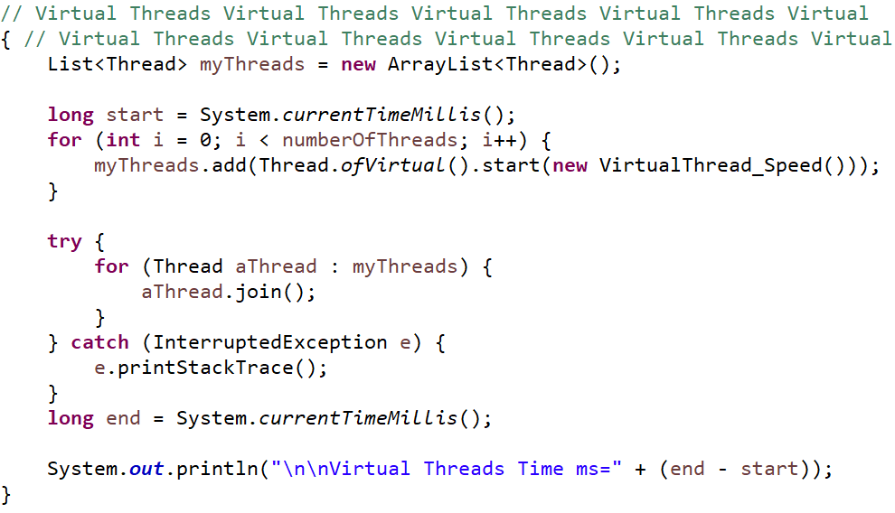
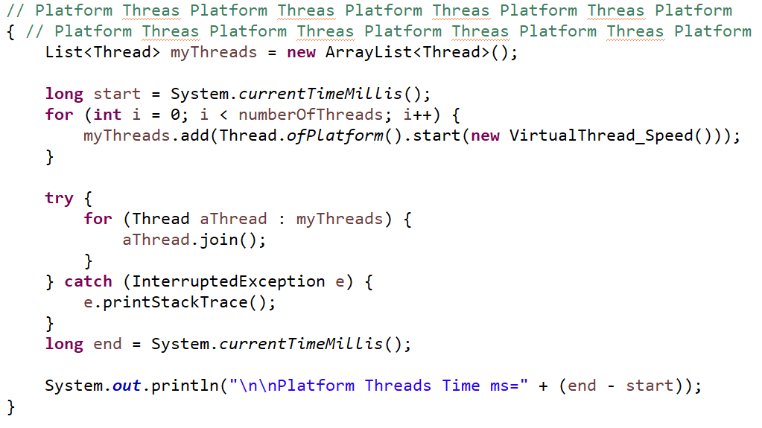
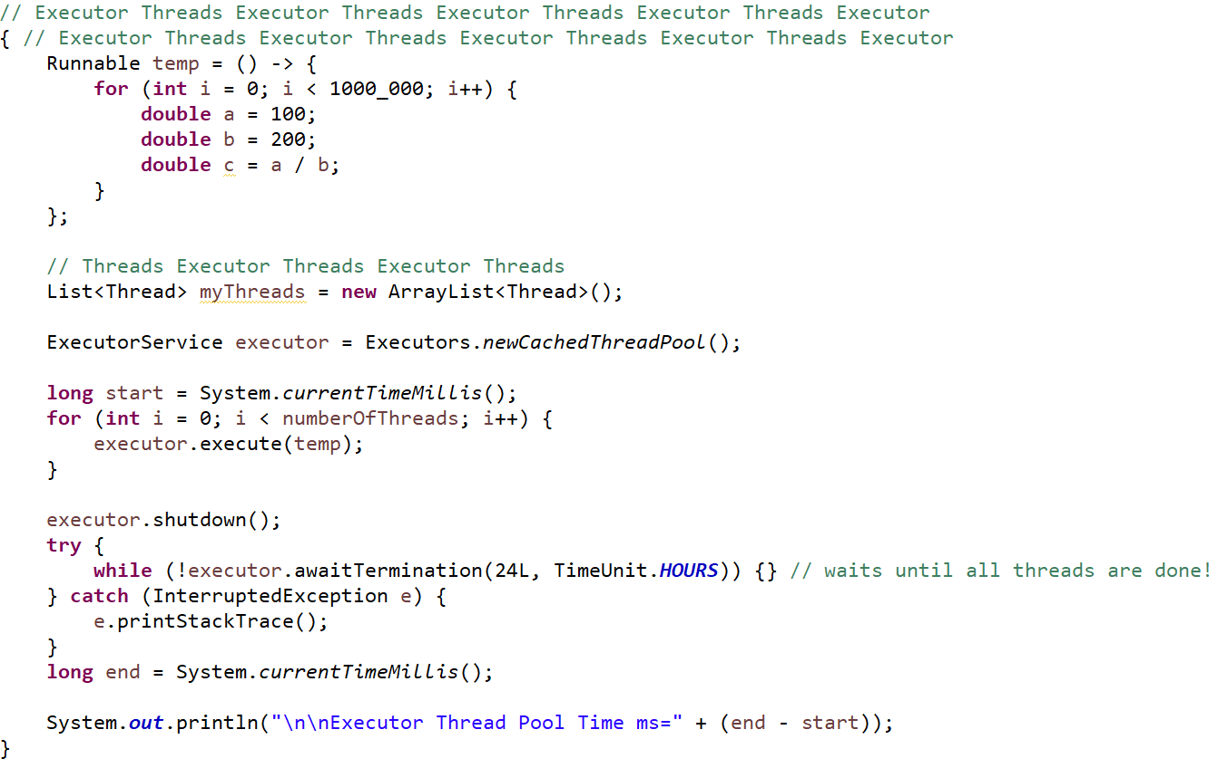
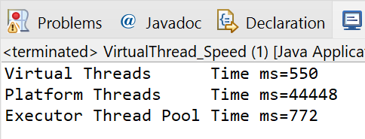
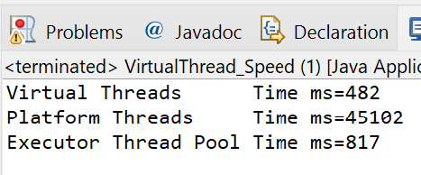

Cached Thread Pool
Speed comparison:

Slide 58







Threads
Reasonable:
Thread: 1
Thread: 10
Thread: 100
Thread: 1,000
It needs 1,000
Threads ☹
Thread: 10,000
Thread: 100,000
Thread: 1,000,000

Slide 59
Fixed Thread Pool

Slide 60
Fixed Thread Pool
Executors.newFixedThreadPool(numberOfThreads);
Creates a thread pool that reuses a fixed number of threads
Operating off a shared unbounded queue.
At any point, at most n Threads threads will be active processing tasks.

Slide 61
Fixed Thread Pool
Executors.newFixedThreadPool(numberOfThreads);
If additional tasks are submitted, they will wait in the queue.
If any thread terminates due to a failure, a new one will take its.
The threads in the pool will exist until shutdown

Slide 62
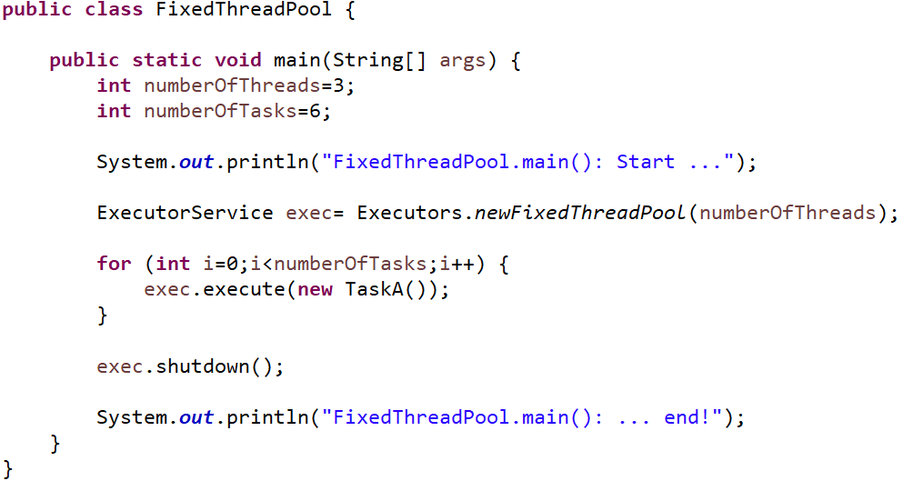
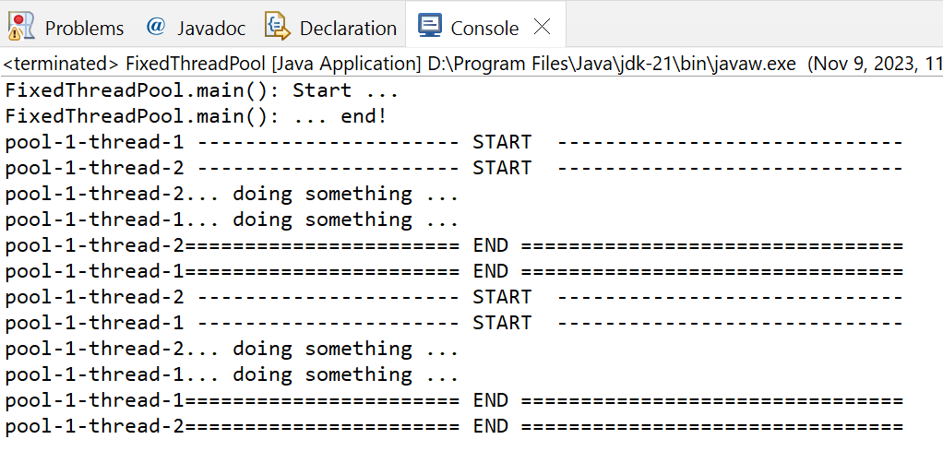
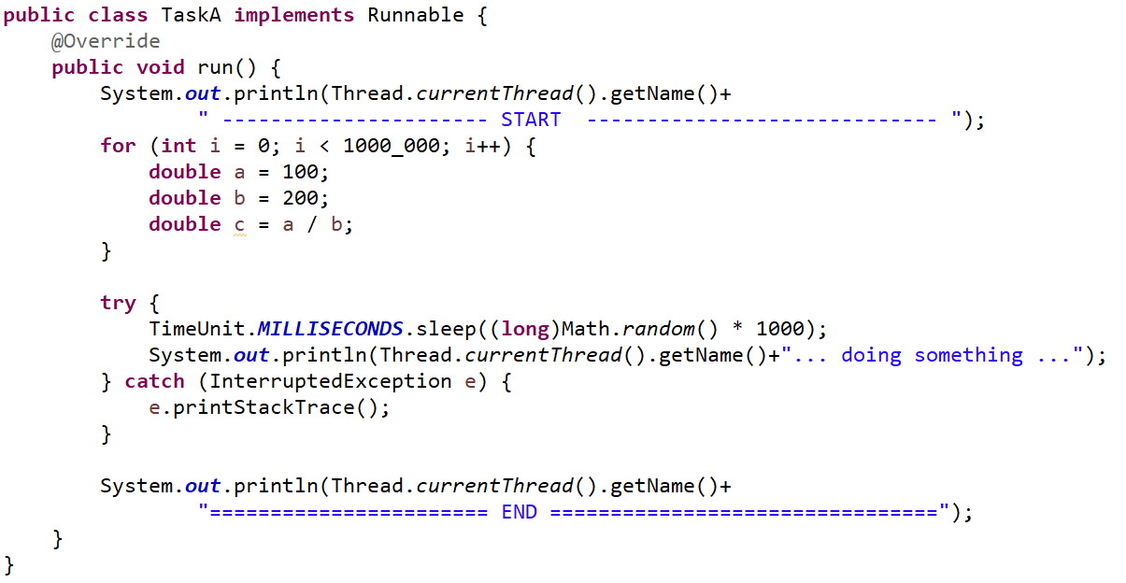
CSEN160_07_Threads.L_FixedThreadPool.FixedThreadPool
Fixed Thread Pool
Example:
Simple TaskA

Slide 63
Single Thread Executor

Slide 64
Single Thread Executor
Executors.newSingleThreadExecutor();
Single Thread Execution:
Use a single worker thread.
If a single thread terminates due to a failure, a new one will take its place.
Tasks are guaranteed to execute sequentially, no more than one task will be active.
Unlike the equivalent newFixedThreadPool(1) it is guaranteed not to be reconfigurable.

Slide 65
Single Thread Executor
Executors.newSingleThreadExecutor();
Tasks get serialized
No need for synchronization

Slide 66
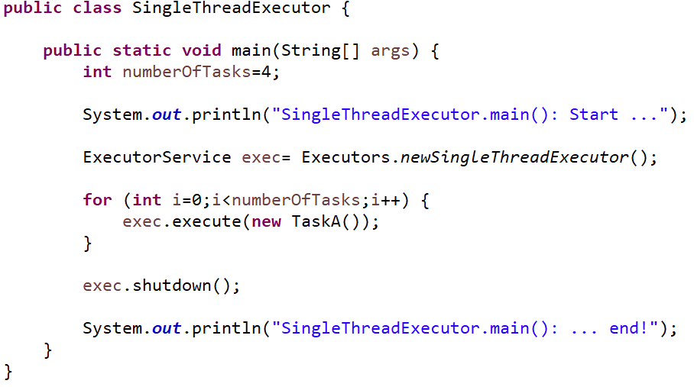
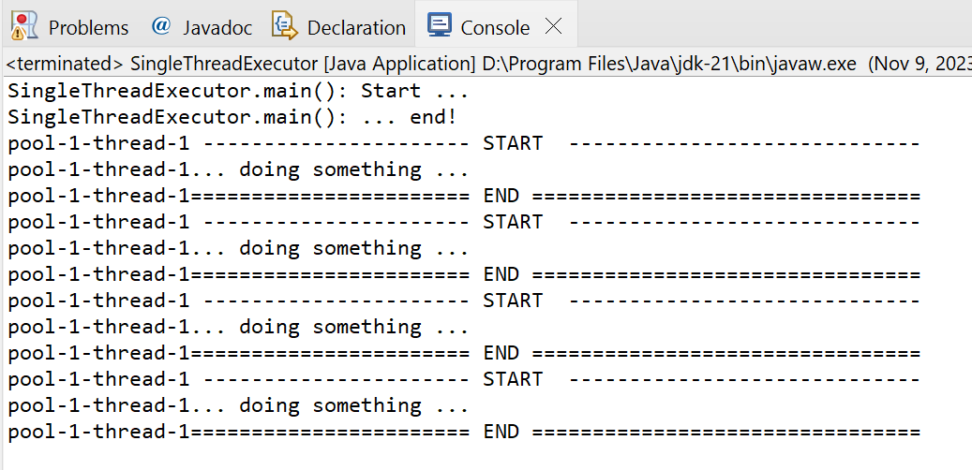
CSEN160_07_Threads.N_SingleThreadExecutor.SingleThreadExecutor
Single Thread Executor
Example:

Slide 67
Callable Interface
Submit & Future

Slide 68
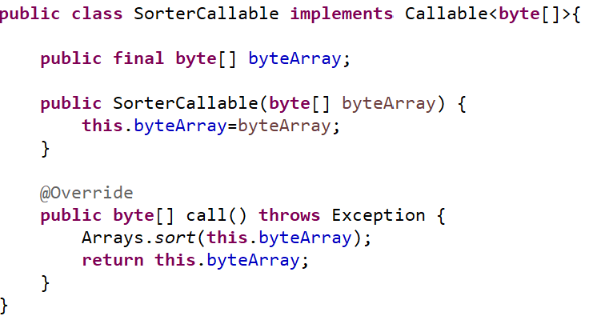
CSEN160_07_Threads.O_Callable.SorterCallable
Callable Interface
Callable Interface:
Returns something in contrast to Runnable interface!

Slide 69


CSEN160_07_Threads.O_Callable
Callable Interface
Execute only
one Callable
example
Callable Example:

Slide 70

CSEN160_07_Threads.O_Callable.CallableSorterDemoMain
Callable Interface
Callable Example:
Polling
Version

Slide 71
Done

Slide 72
… to here …

