Slide 1
CSEN160
Fall 2026
Object-Oriented Analysis, Design and Programming
Michael Schimpf, PhD, mschimpf@scu.edu
Department of Computer Science and Engineering

Slide 2
PostgreSQL

Slide 3
PostgreSQL Database
Download database:
https://www.postgresql.org/download/
Download JDBC driver:
https://jdbc.postgresql.org/download/
Install Process:
2 hours including IntelliJ/Eclipse setup

Slide 4
PostgreSQL Database
Why:
Easy to install
Easy to setup
Free
No known limitations
Powerful, even PLSQL is possible

Slide 5
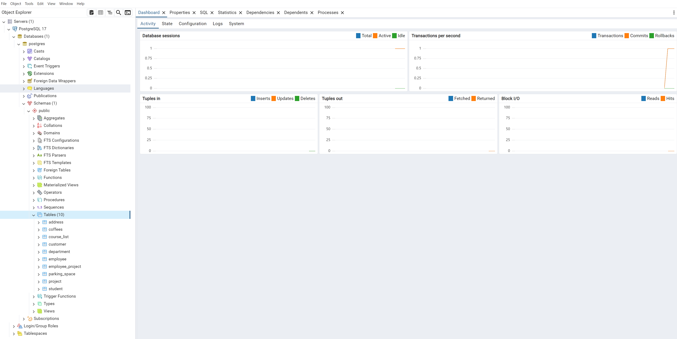
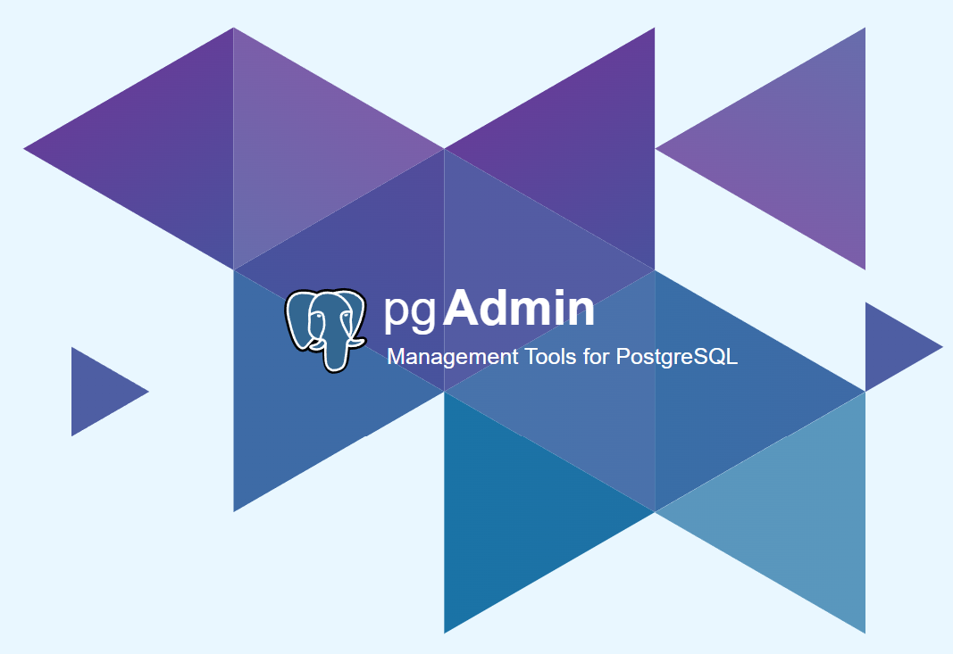
PostgreSQL Database
PostgreSQL admin tool: pgAdmin

Slide 6
Java and JDBC
Simple Example

Slide 7
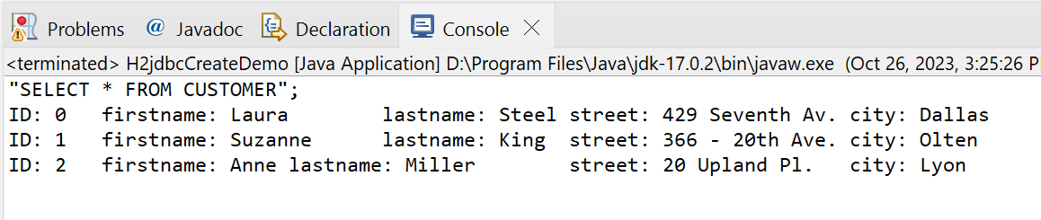
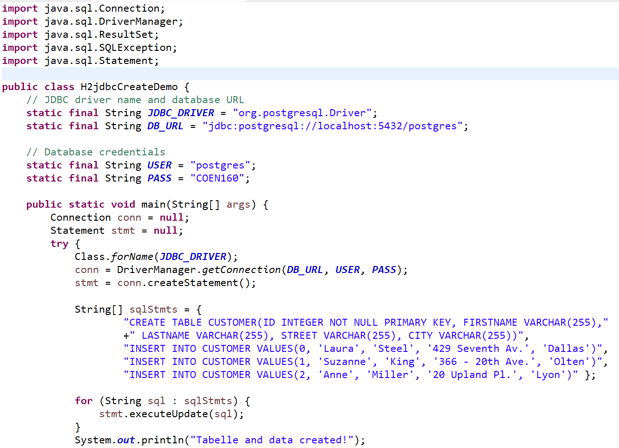
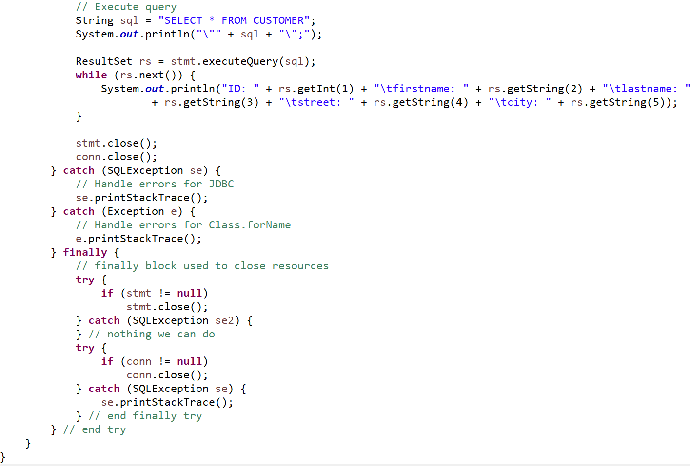
PostgreSQL Database
CSEN160_09_JDBC.A_SimpleExample
IntelliJ PostgreSQL Example0 …
Create table +
insert data

Slide 8
ODBC universal database access

Slide 9
ODBC
The idea of a universal database access API is not new!
Open Database Connectivity (ODBC) was developed to create a single standard (Windows).

Slide 10
ODBC
Advantages of ODBC:
  Applications are not tied to any specific database.
  An application can be built independent of the details of a database
  Many ODBC drivers are available for most databases.

Slide 11
Introduction to JDBC and
JDBC Drivers

Slide 12
What is JDBC
JDBC is the Java's Database Interface
Provides a standard interface between client and database.
JDBC -> standard API for various databases.
Makes the applications “database independent”.

Slide 13
What is JDBC
JDBC is part of the Java platform standard
All classes used in Java/database communication are in java.sql.
JDBC API aims to be as simple as possible (hm…)
While providing maximum flexibility.

Slide 14
JDBC Drivers
Work with a database,
you need a JDBC Driver.
JDBC Driver:
set of classes that interface with a database.
JDBC-ODBC Bridge
(from the early days)
Java Application
JDBC Driver Manager
JDBC-
ODBC
Bridge
Vendor
Specific
JDBC Driver
Vendor
Specific
JDBC Driver
Database
Database
Diagram Source: Marty Hall,
Core Web Programming
(Prentice Hall.)

Slide 15
JDBC Classes
DriverManager:
Manages a list of database drivers.
Matches connection requests from the java application with the proper database.
The driver that recognizes a certain subprotocol under jdbc (such as odbc) will be used.
Driver:
The database communications link, handling all communication with the database.
Once the driver is loaded, the developer need not call it explicitly.

Slide 16
JDBC Classes
Connection:
Interface with all methods for contacting a database
Statement:
Encapsulates a SQL statement which is passed to the database:
  to be parsed
  Compiled
  Planned
  Executed
ResultSet:
The answer/result from a statement.
A ResultSet is a fancy 2D list which encapsulates all outgoing results (iterator like).

Slide 17
Six Steps to Using JDBC
Import and load the JDBC Driver
Create a Connection, establish the Database Connection
Create a Statement Object
Execute a Query, get a ResultSet object
Process the ResultSet
Close the Connection

Slide 18
1) Loading the JDBC Driver
Load the driver:
Class.forName() method.
Looks like this:
  Class.forName("jdbc.DriverXYZ");
  where jbdc.DriverXYZ is the JDBC Driver you want to load.
If using a JDBC-ODBC Driver (obsolete):
  Class.forName("sun.jdbc.odbc.JdbcOdbcDriver");

Slide 19
Loading the PostgreSQL Driver
Looks like this:
try {
Class.forName("org.postgresql.Driver");
} catch(java.lang.ClassNotFoundException e) {
System.err.print("ClassNotFoundException: ");
System.err.println(e.getMessage());
}
Class.forName() will throw a ClassNotFoundException
if CLASSPATH issues!
Surround the forName() with a try/catch block!

Slide 20
2) Establish the Connection
db connection:
Connection con = DriverManager.getConnection(url,"myLogin", "myPassword");

Slide 21
Creating a Connection URL
Specify the correct URL! (difficult)
URL has the following format: jdbc:subprotocol:subname.
  jdbc: This is a JDBC Connection
  subprotocol identifies the driver.
  subname identifies the database name/location.

Slide 22
Connection URL: PostgreSQL
Connect to PostgreSQL:
  String url = "jdbc:postgresql://localhost:5432/postgres";
  Connection con = DriverManager.getConnection(url);
JDBC Driver connect to Postgres db
Located: localhost machine.
If successfully, you have a Connection object.

Slide 23
3) Create a Statement Object
JDBC Statement object sends SQL statements.
Statement is created from a Connection objects.
Example:
  Statement stmt = con.createStatement();
With a Statement object, you can issue SQL calls.

Slide 24
4) Execute a Query
executeQuery()
  Executes the SQL query, returns data in a ResultSet
  The resulting table may be empty but never null!
  ResultSet results = statement.executeQuery("SELECT * FROM CUSTOMER");

Slide 25
4) Execute a Query
executeUpdate()
  Used for INSERT, UPDATE, or DELETE SQL statements
  Return the number of rows that were affected.
  Supports Data Definition Language (DDL) statements:
    CREATE TABLE
    DROP TABLE
    ALTER TABLE

Slide 26
Useful Statement Methods
getMaxRows()/setMaxRows(…)
  Number of rows of a ResultSet
  The number of rows are unlimited
getQueryTimeout()/setQueryTimeout(…)
  Amount of a time a driver will wait for a STATEMENT
  to complete before throwing a SQLException

Slide 27
5) Process the Results
  All methods can throw a SQLException
  close
    Releases the JDBC database resources
    The result set is automatically closed when the associated Statement object
    executes a new query
  getMetaDataObject(…)
    Returns a ResultSetMetaData object containing information
    about the columns in the ResultSet

Slide 28
ResultSet
  next() (like Iterator)
    Attempts to move to the next row in the ResultSet
      If successful true is returned; otherwise, false
      The first call to next positions the cursor to the first row

Slide 29
ResultSet (Continued)
  findColumn(…)
    Returns the corresponding integer value
    corresponding to the specified column name
    Column numbers in the result set do not necessarily
    map to the same column numbers in the database

Slide 30
ResultSet (Continued)
  getXxx(…) i.e. getInteger(1) or getString(2) or getLong(3) …
    Returns the value from the column specified by column name or column index as an Xxx Java type
    Returns 0 or null, if the value is a SQL NULL
    Legal getXxx types:
double byte int
Date String float
short long Time
Object

Slide 31
6) Close the Connection
To close the database connection:
  stmt.close();
  conn.close();
Some application servers, maintain a pool of database connections.
  More efficient because you do not need constantly opening and closing connections.

Slide 32
Example 1:
Setting Up Tables via JDBC

Slide 33
The Coffee Tables
Create a new table: JDBC code.
This SQL code creates a table for storing coffee data:
  CREATE TABLE COFFEES
  (COF_NAME VARCHAR(32),
  SUP_ID INTEGER,
  PRICE FLOAT,
  SALES INTEGER,
  TOTAL INTEGER);

Slide 34
The Coffee Table
You can create this table via pgAdmin
But you can also create it via JDBC.
A few things about the table:
  Column SUP_ID is an integer for a Supplier ID.
  Column SALES contains values of SQL type INTEGER
  (number of pounds of coffee sold, during the current week)
  Column TOTAL contains values of SQL type INTEGER
  (total number of pounds of coffee sold to date)

Slide 35
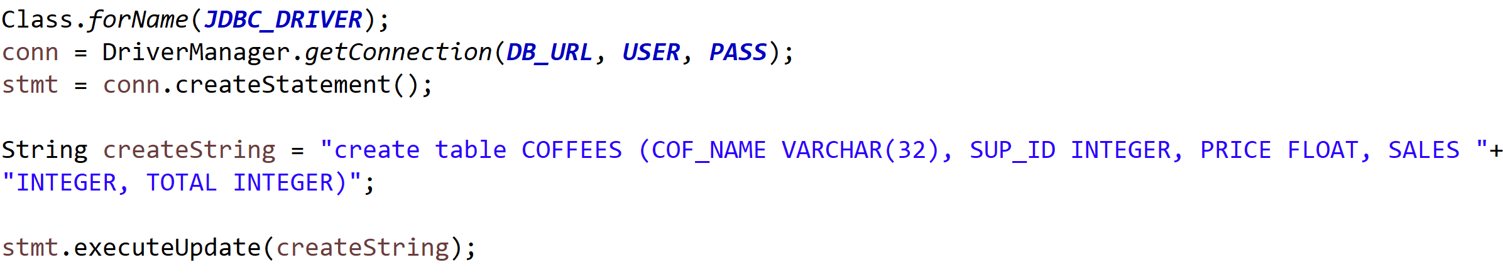
CSEN160_09_JDBC.B_CreateTable
The Coffee Table

Slide 36
Example 2:
Inserting Data via JDBC

Slide 37
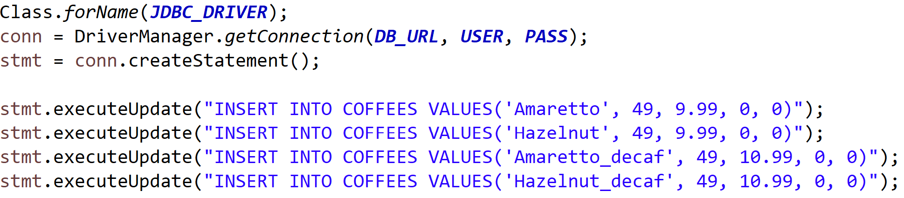
CSEN160_09_JDBC.C_InsertRows
The Coffee Table
IntelliJ:

Slide 38
Example 3:
Querying Data via JDBC

Slide 39
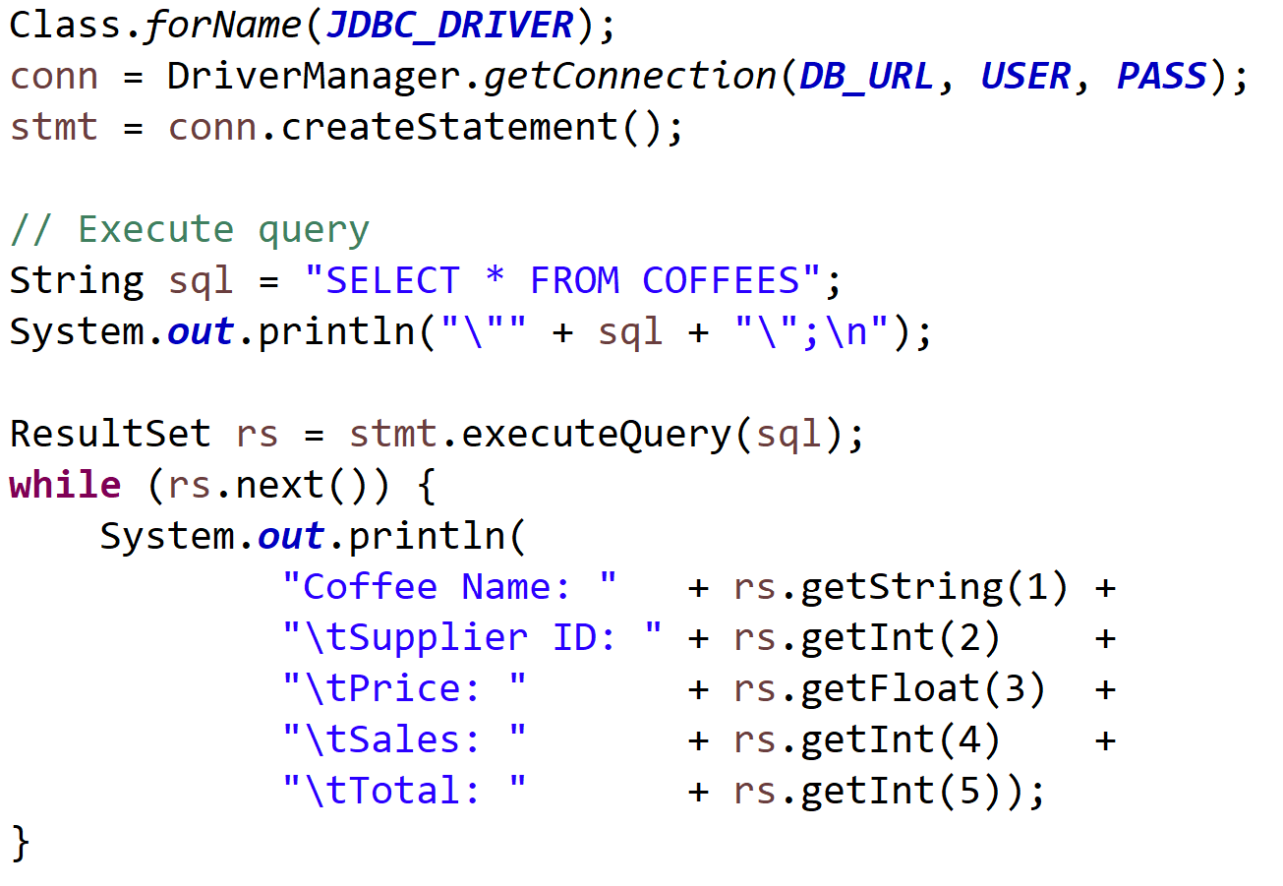
CSEN160_09_JDBC.D_ShowRows
The Coffee Table
IntelliJ:

Slide 40
JDBC Exception Handling

Slide 41
Exception Handling
SQL Exceptions
  Every JDBC method can throw a SQLException
  (in response to a data access error)
  If more than one error occurs, they are chained together!
  SQL exceptions contain:
    Description of the error, getMessage
    SQLState (Open Group SQL specification) identifying the exception, getSQLState
    A vendor-specific integer, error code, getErrorCode
    A chain to the next SQLException, getNextException

Slide 42
SQL Exception Example
try {
... // JDBC statement.
... // JDBC statement.
} catch (SQLException sqle) {
while (sqle != null) {
System.out.println("Message: " + sqle.getMessage());
System.out.println("SQLState: " + sqle.getSQLState());
System.out.println("Vendor Error: " + sqle.getErrorCode());
sqle.printStrackTrace();
sqle = sqle.getNextException();
}
}

Slide 43
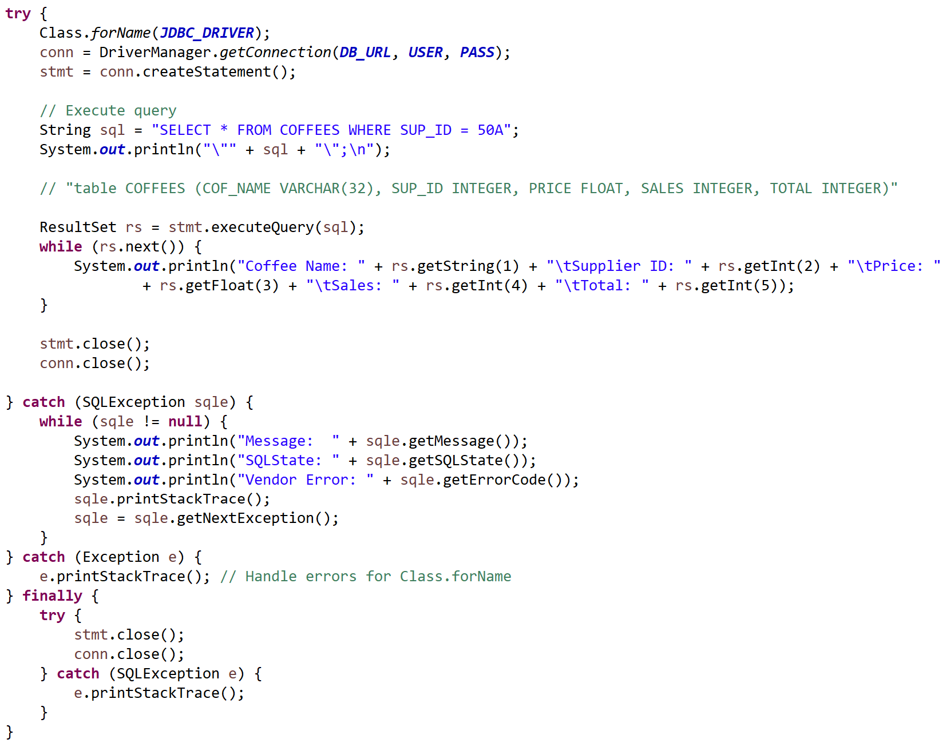
CSEN160_09_JDBC.E_ExceptionHandling
The Coffee Table
IntelliJ:

Slide 44
Drop Table

Slide 45
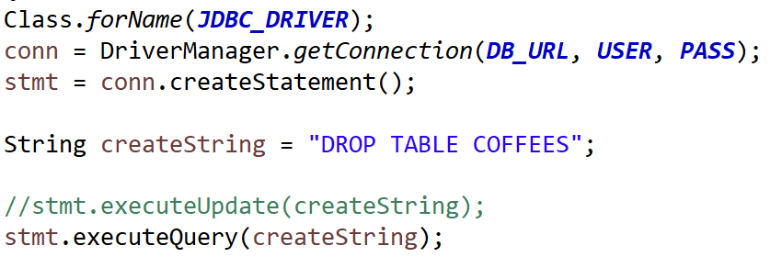
CSEN160_09_JDBC.F_DropTable
The Coffee Table
IntelliJ:

Slide 46
Prepared Statement
(speed-up)

Slide 47
Prepared Statement
A statement can be pre-compiled and stored in a statement object.
Once pre-compiled, this object will:
  Execute faster than a statement that is executed in plain SQL.

Slide 48
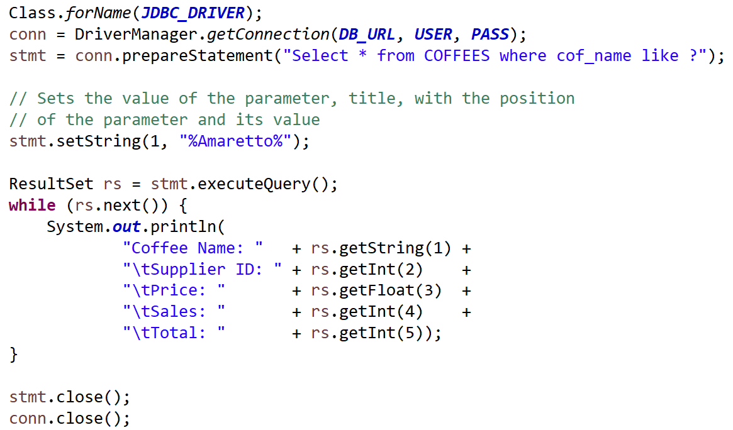
CSEN160_09_JDBC.G_PreparedStatement
The Coffee Table
IntelliJ:

Slide 49
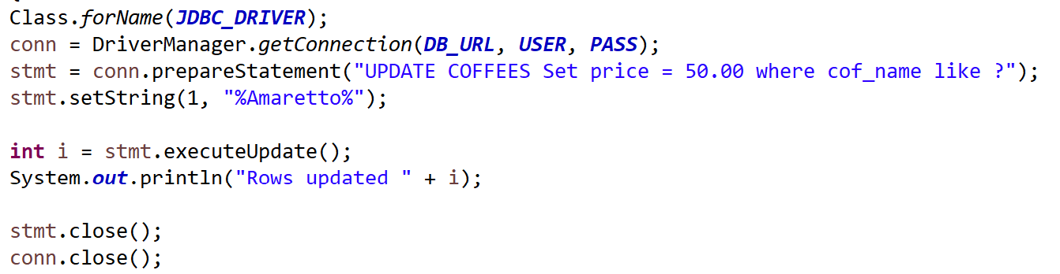
CSEN160_09_JDBC.H_PreparedStatement
The Coffee Table
IntelliJ:

Slide 50
Batch Operations

Slide 51
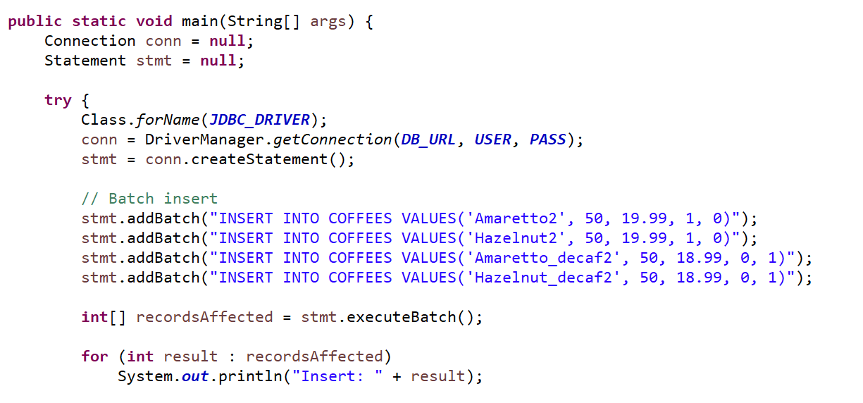
Batch Operations
Execute batches of SQL commands
Saves time

Slide 52
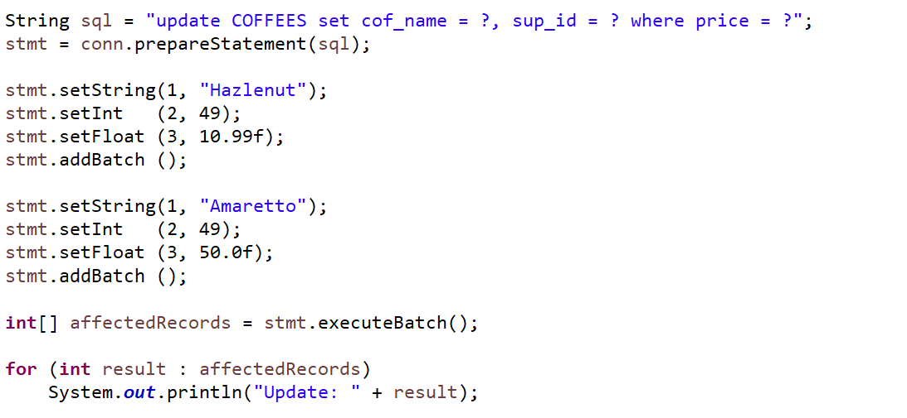
Batch Operations & Prepared Statements
Execute batches of SQL commands
Even faster

Slide 53
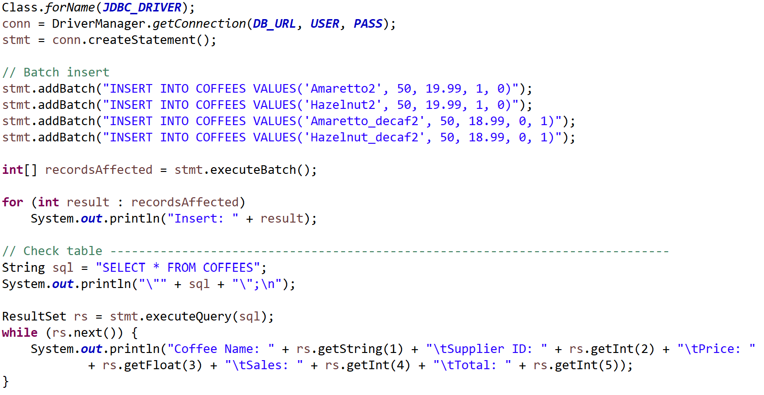
CSEN160_09_JDBC.I_BatchInsert
The Coffee Table
IntelliJ:

Slide 54
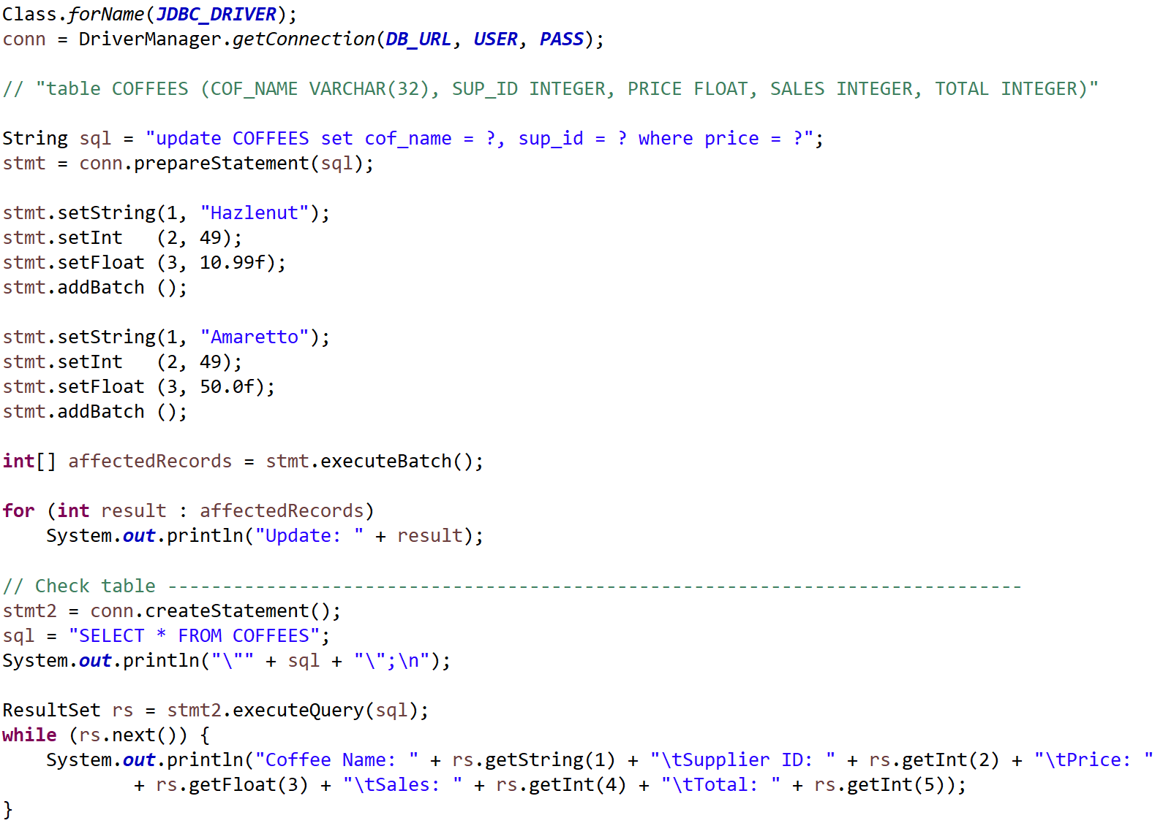
CSEN160_09_JDBC.J_BatchUpdatePlusPreparedStatement
The Coffee Table
IntelliJ:

Slide 55
Transactions

Slide 56
Transactions
Execute one or two SQL operations in one sequence without interrupts
“A transaction is a set of actions to be carried out as a single, atomic action” (source)
Before: connection.setAutoCommit(false);
At the end: connection.commit();

Slide 57
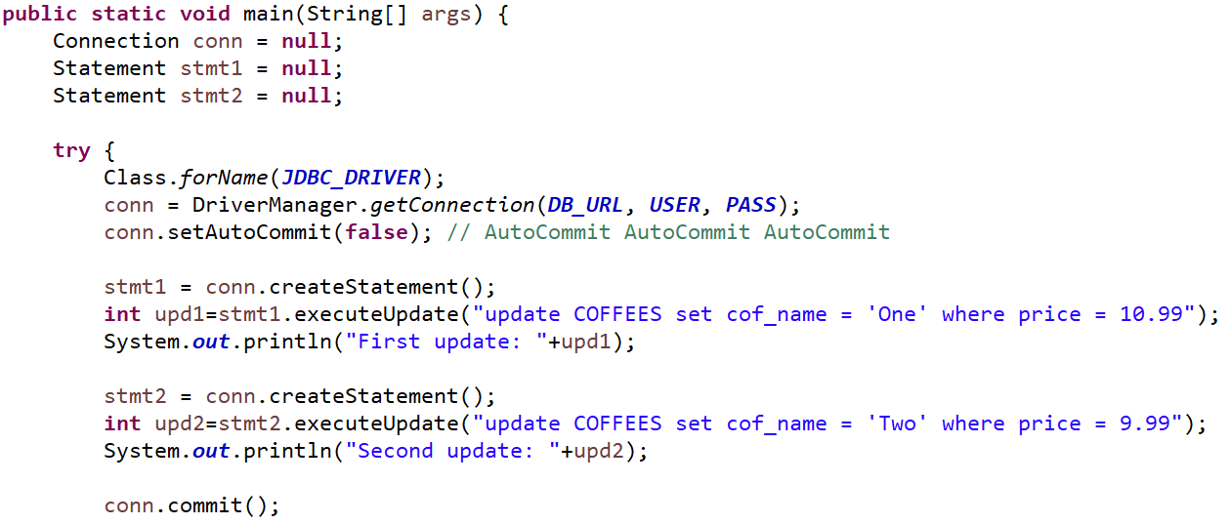
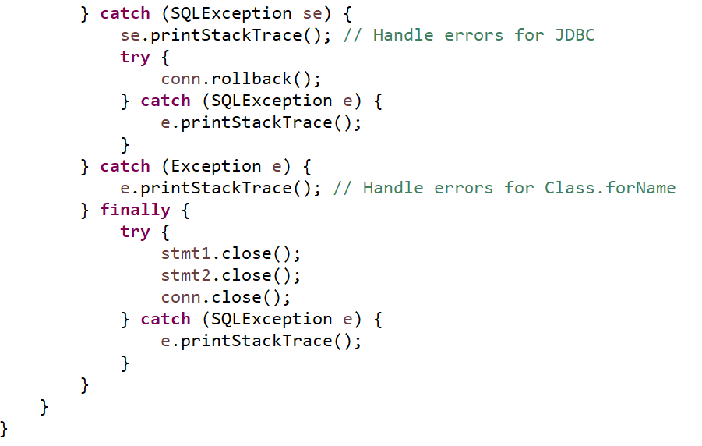
Transactions
CSEN160_09_JDBC.K_Transactions
Starts to look complicated:

Slide 58
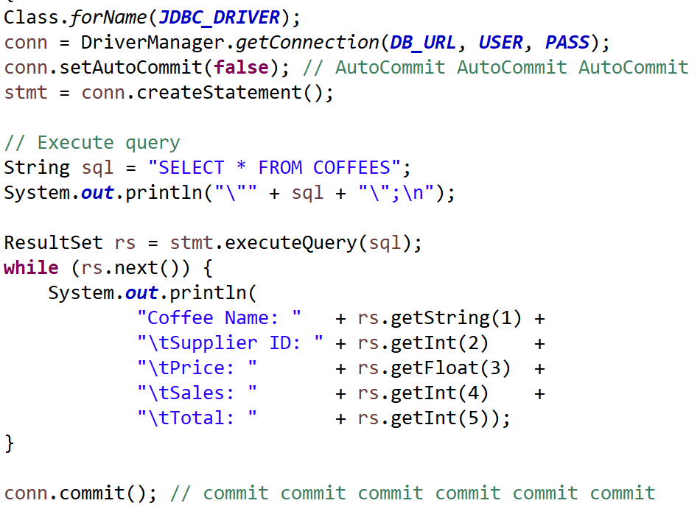
CSEN160_09_JDBC.K_Transactions
The Coffee Table
IntelliJ:

Slide 59
Database Metadata

Slide 60
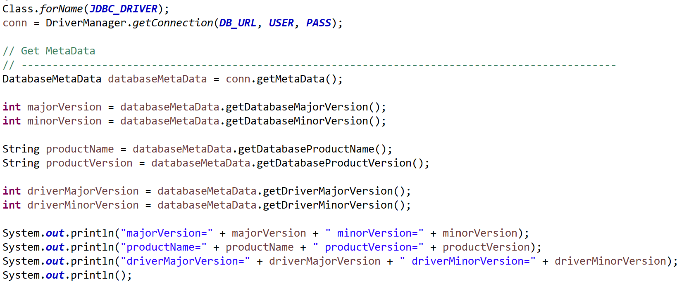
Database Metadata
Get more information about:
Driver
Major and minor version
Product name/product version
TablesColumns

Slide 61
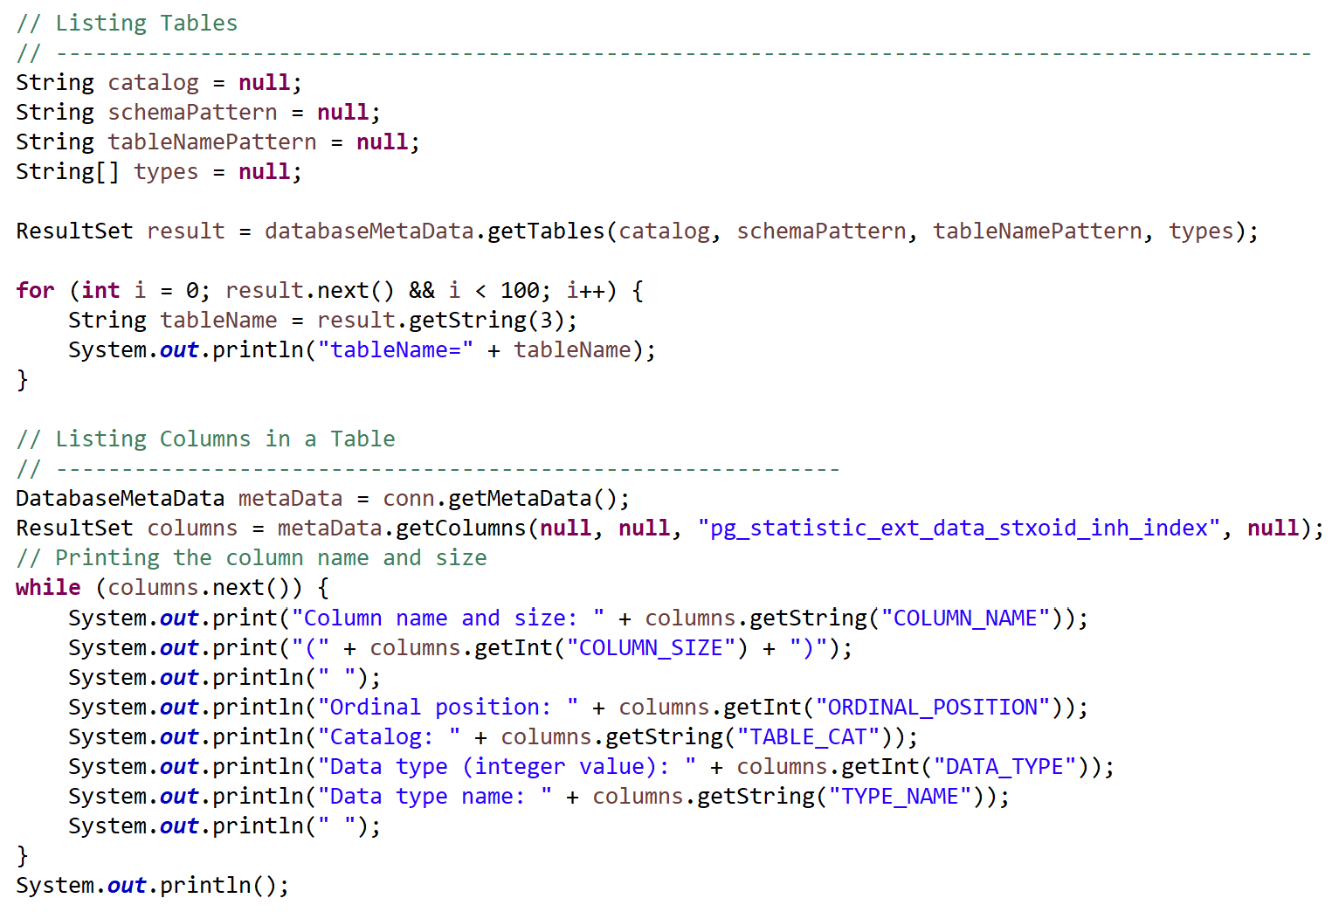
CSEN160_09_JDBC.L_MetaData2
The Coffee Table
IntelliJ:

Slide 62
Done

Slide 63
… to here …

