Slide 1
CSEN160
Fall 2026
Object-Oriented Analysis, Design and Programming
Michael Schimpf, PhD, mschimpf@scu.edu
Department of Computer Science and Engineering

Slide 2
Java Persistence API (JPA)

Slide 3
JPA
JPA is a Java standard with different implementations:
Hibernate
EclipseLink
Apache OpenJPA
DataNucleus

Slide 4
JPA
Object Relational-Mapping
Use classes instead of JDBC/SQL commands
As developer: Easy to use and saves time (addictive)
As db admin: it is hard (but they usually like it)
Because of first and second level cache in Hibernate, it speeds up db access

Slide 5
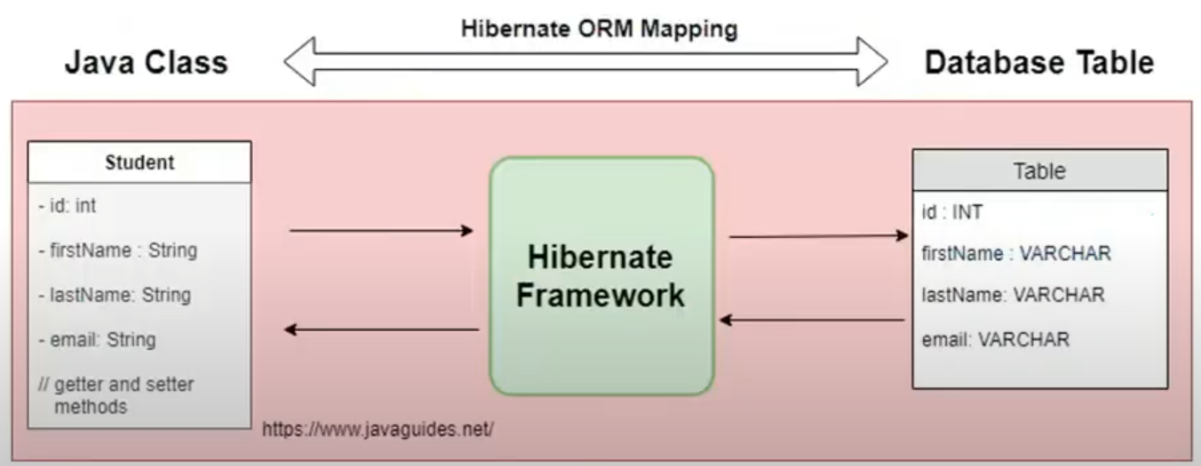
JPA
Hibernate: https://hibernate.org/orm/

Slide 6
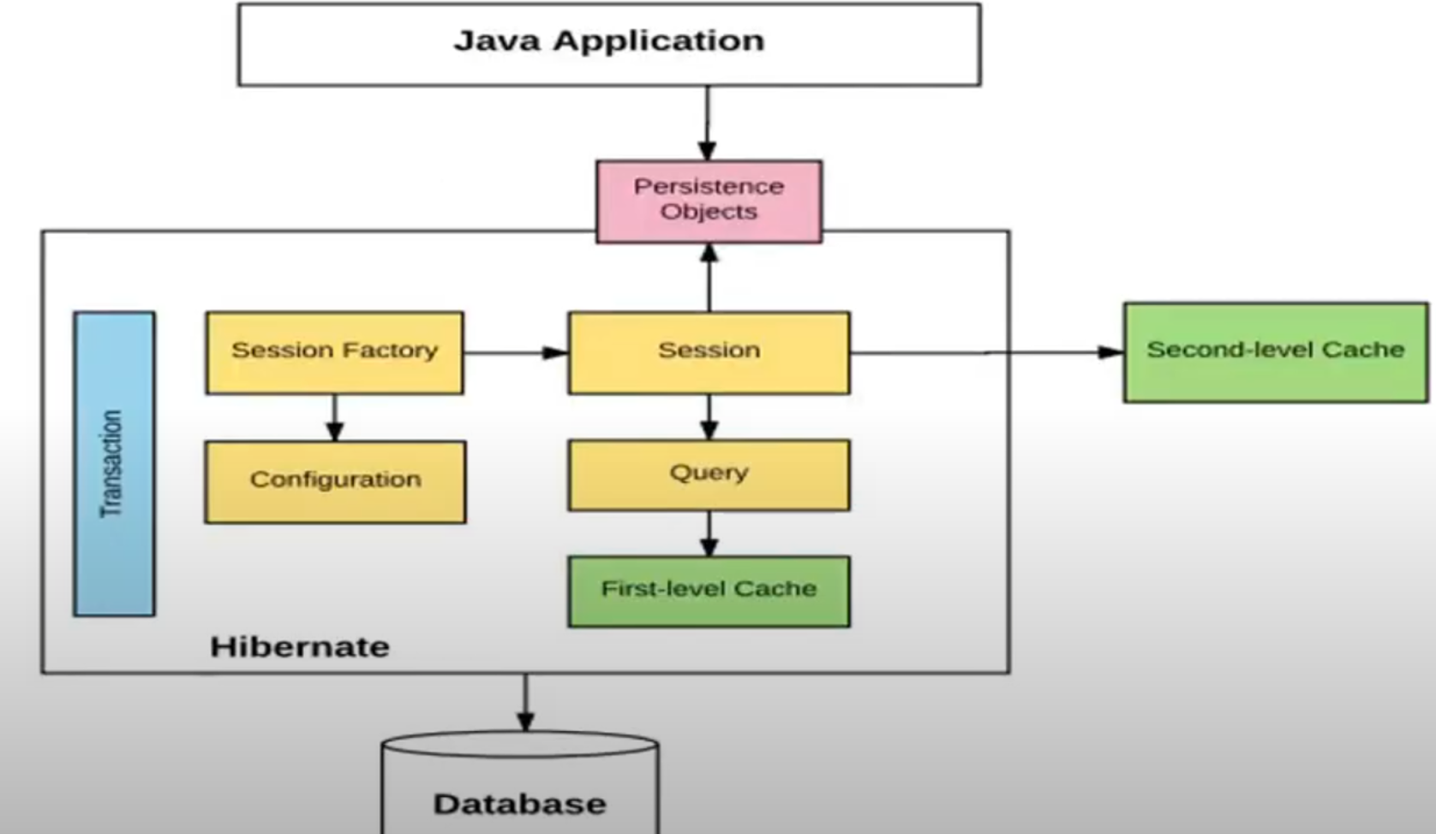
JPA
Hibernate: https://hibernate.org/orm/

Slide 7
Central Database Singleton

Slide 8
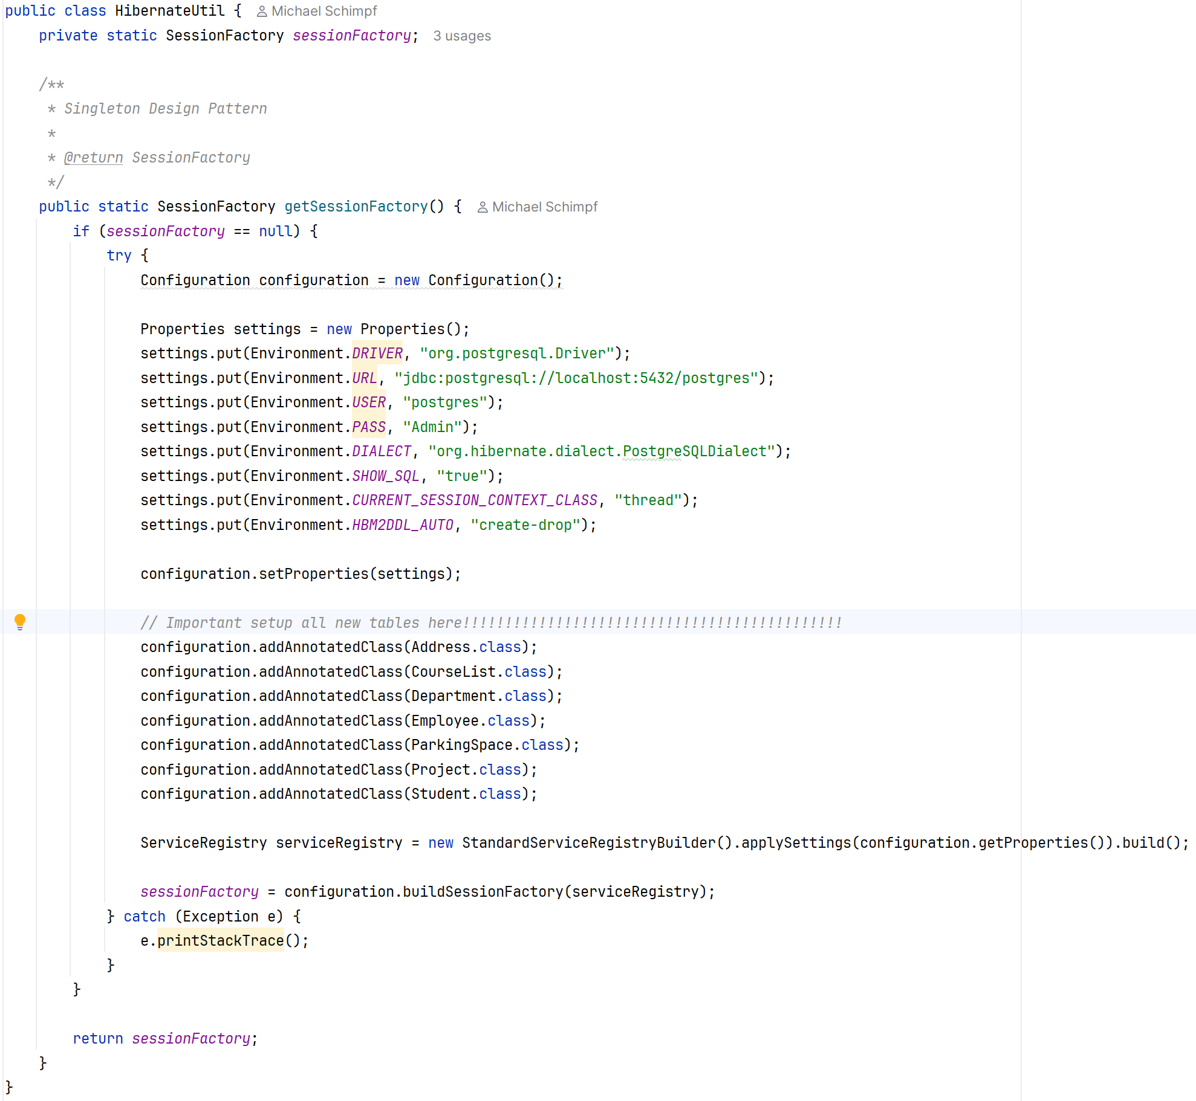
HibernateUtil
CSEN160_09_2_JPA.util.HibernateUtil
Singleton Design Pattern

Slide 9
Java Persistence API (JPA)
Entity Classes

Slide 10
Overview
Entity Classes
Persistable Fields
Annotations
Using JPA
  Creating a connection
  Working with JPA entities

Slide 11
Entity Classes
Requirements:
  Be a top-level class
  Must have a public or protected constructor with no arguments
  Class cannot be final
  Cannot have final methods and final variables

Slide 12
Entity Class
CSEN160_09_2_JPA.model.CourseList
User defined class which can be stored in the database.
Declared using @Entity annotation.
Example:
import javax.persistence.Entity;
@Entity(name=“course_list”)
public class CourseList {
}
course_list is the name of the db table represented by this entity class.

Slide 13
Persistable Types
Primitives
Wrapper classes (Boolean, Byte, Long, etc.)
BigInteger
BigDecimal
String
java.sql.Date
java.sql.Time
java.sql.Timestamp
Collection types from java.util (ArrayList, Vector, HashSet, TreeSet, LinkedHashSet etc.)
Map types from java.util (HashMap, LinkedHashMap, etc.)
Arrays

Slide 14
Annotation @Id
Marks a field as the primary key.
Example: course_number is the primary key in courseList:
@Id
@GeneratedValue(strategy=GenerationType.IDENTITY)
@Column(name="course_number")
private String course_number;

Slide 15
Annotation @Generated
Generates an unique value for primary keys
@GeneratedValue(strategy=GenerationType.AUTO)
Generate the key automatically
@GeneratedValue(strategy=GenerationType.TABLE)
  Best strategy – works with most databases.
Other strategies are:
  GenerationType.IDENTITY
  GenerationType.SEQUENCE

Slide 16
Annotation @Column
Column name is courseNumber
Column name in the database table is course_number
Use @Column annotation to indicate the relationship between these two:
http://docs.oracle.com/javaee/5/api/javax/persistence/Column.html
@Column(name = “course_number”)
private int courseNumber;

Slide 17
Creating An Entity
import javax.persistence.*;
import java.io.*;
@Entity(name = "course_list")
public class CourseList implements Serializable {
@Column(name = "course_name")
@GeneratedValue(strategy = GenerationType.TABLE)
private String course_name;
@Id
@Column(name = "course_number")
private String course_number;
@Column(name = “enrollment”)
private int enrollment;

Slide 18
Creating An Entity (continued)
@Column
private String start_date;
@Column
private String end_date;
// add getters and setters
@Override
public String toString() {
return "CourseList [Course Name =" + course_name + ", ” + " Course Number =" + course_number + ",” + " Enrollment =" + enrollment + ",” + " Start Date =" + start_date + ",“ + " End Date =" + end_date + ",“ + "]";
}
}

Slide 19
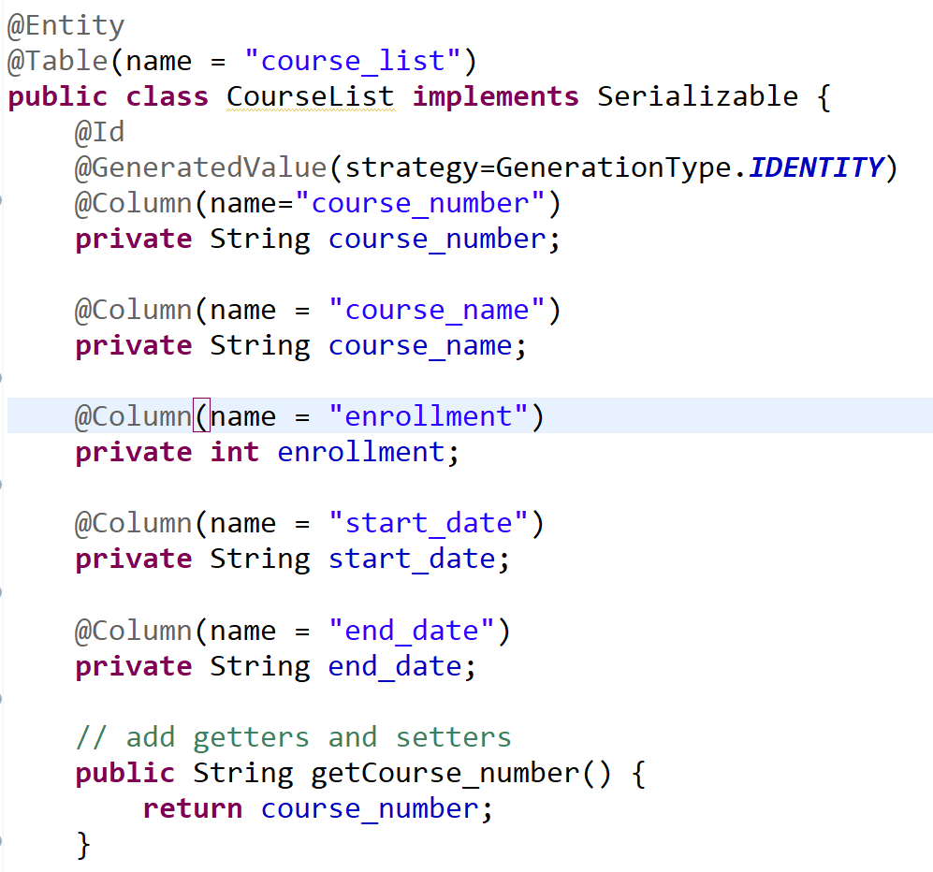
CSEN160_09_2_JPA.model.CourseList
Creating An Entity (continued)

Slide 20
Data Access Object (DAO)

Slide 21
DAO Interfaces
Data Access Objects:
Handles the entity objects and persist them to the database
Includes transaction handling commit/rollback
User creates an entity object with some date and save it via the DAO object
Implementation is a bit tedious because you implement CRUD functions

Slide 22
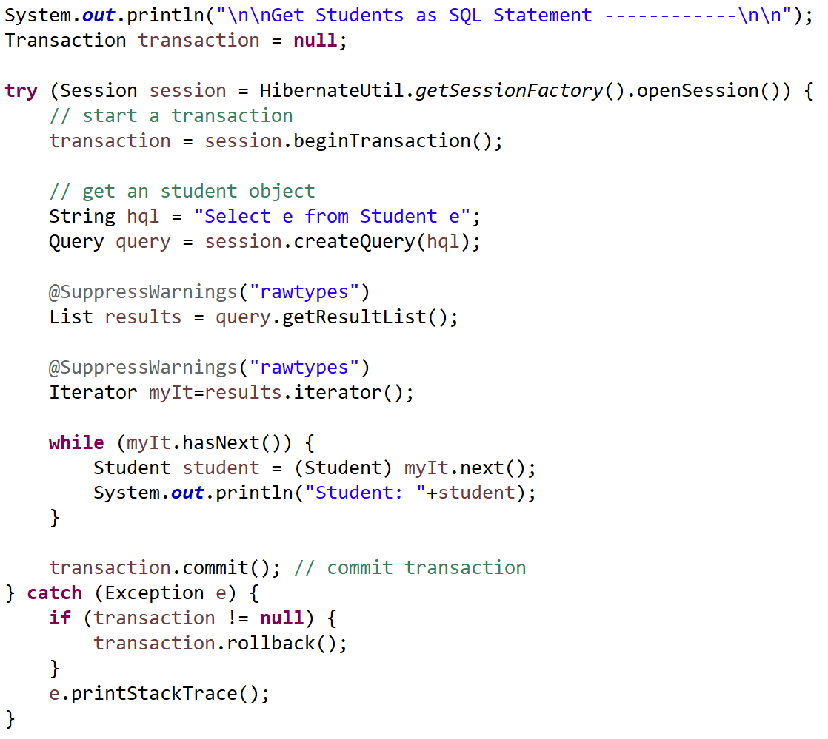
Query

Slide 23
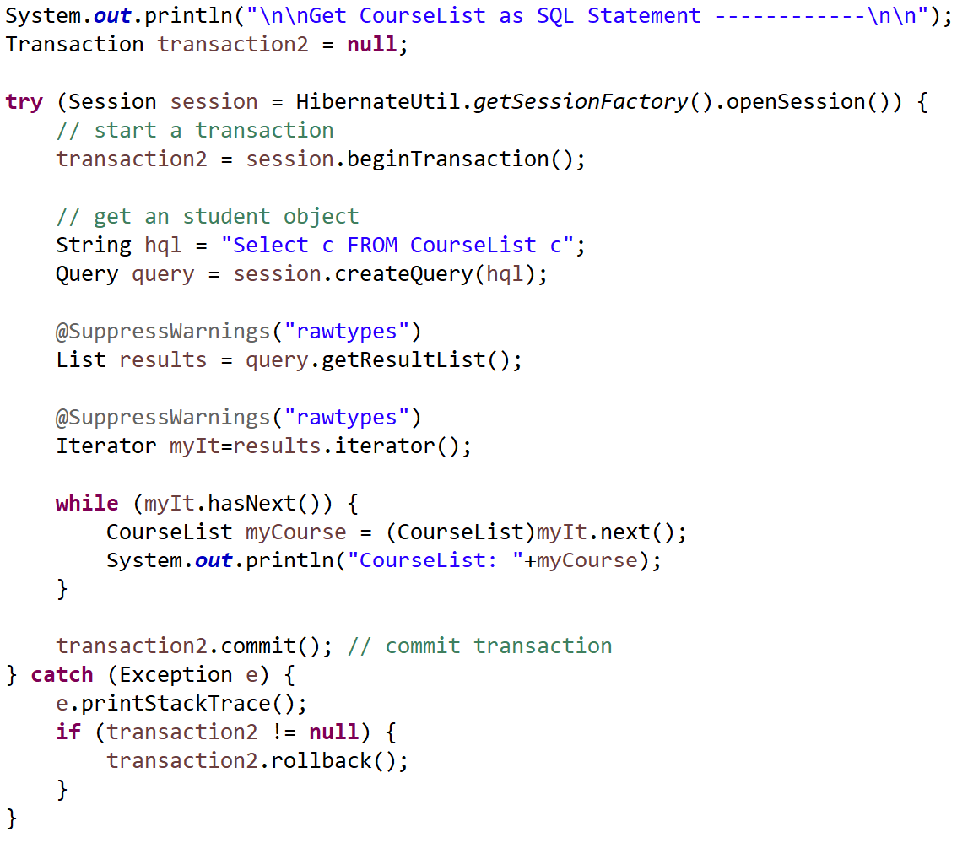
Query
Important it is CourseList,
Not course_list

Slide 24
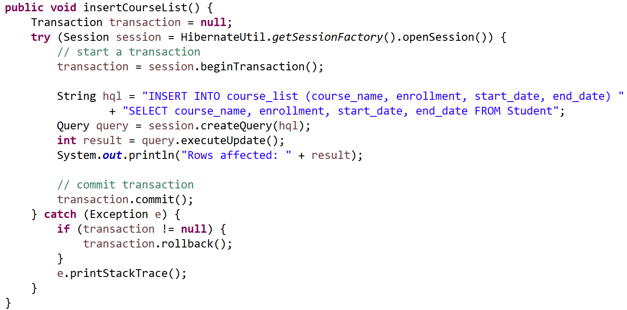
Inserting a Record into Table
This persists a new object:
SQL syntax is odd!

Slide 25
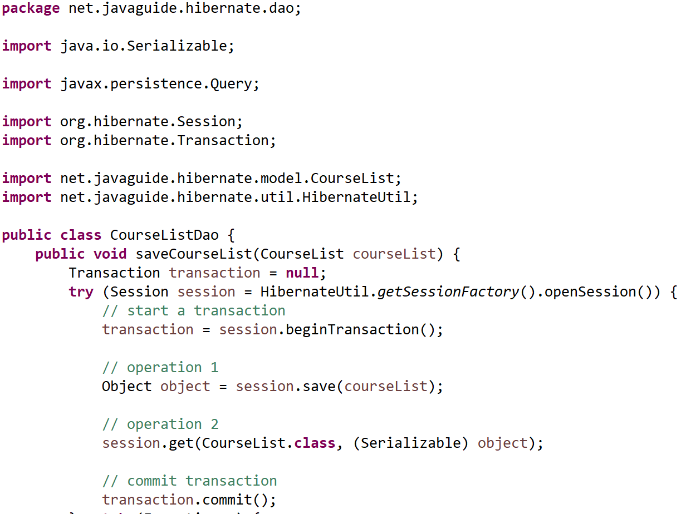
DAO Data Access Object
CSEN160_09_2_JPA.dao.CourseListDao
DAO:
Creating a DAO for every table
Will handle all communication to and from the table
A lot of boring work to do ☹
Copilot?! ☺

Slide 26
JPA DAO
CRUD

Slide 27
Overview
CRUD:
CREATE
READ
UPDATE
DELETE

Slide 28
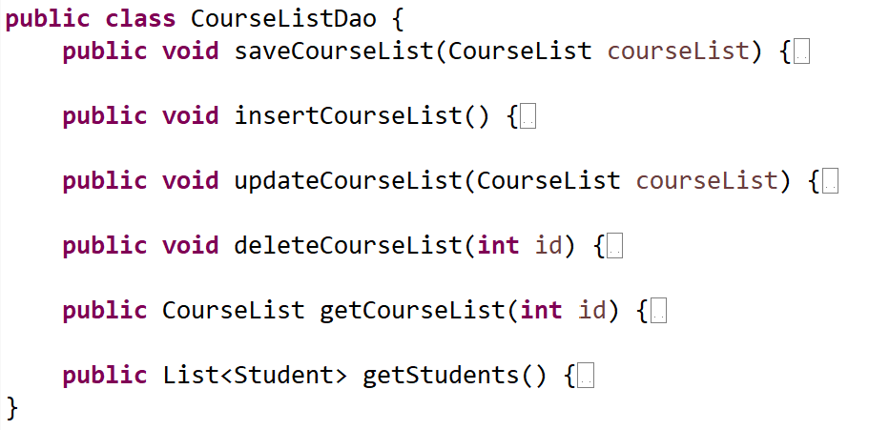
CourseListDao

Slide 29
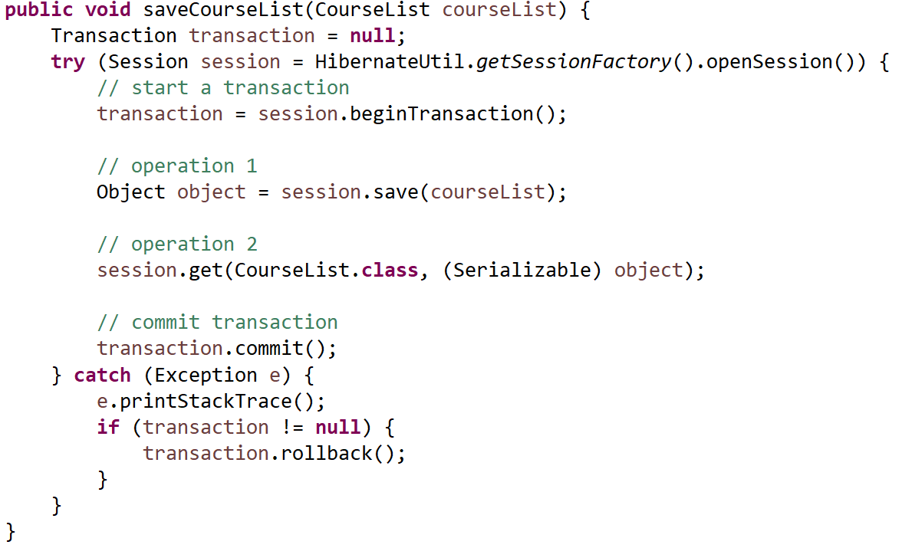
Create a New Record

Slide 30
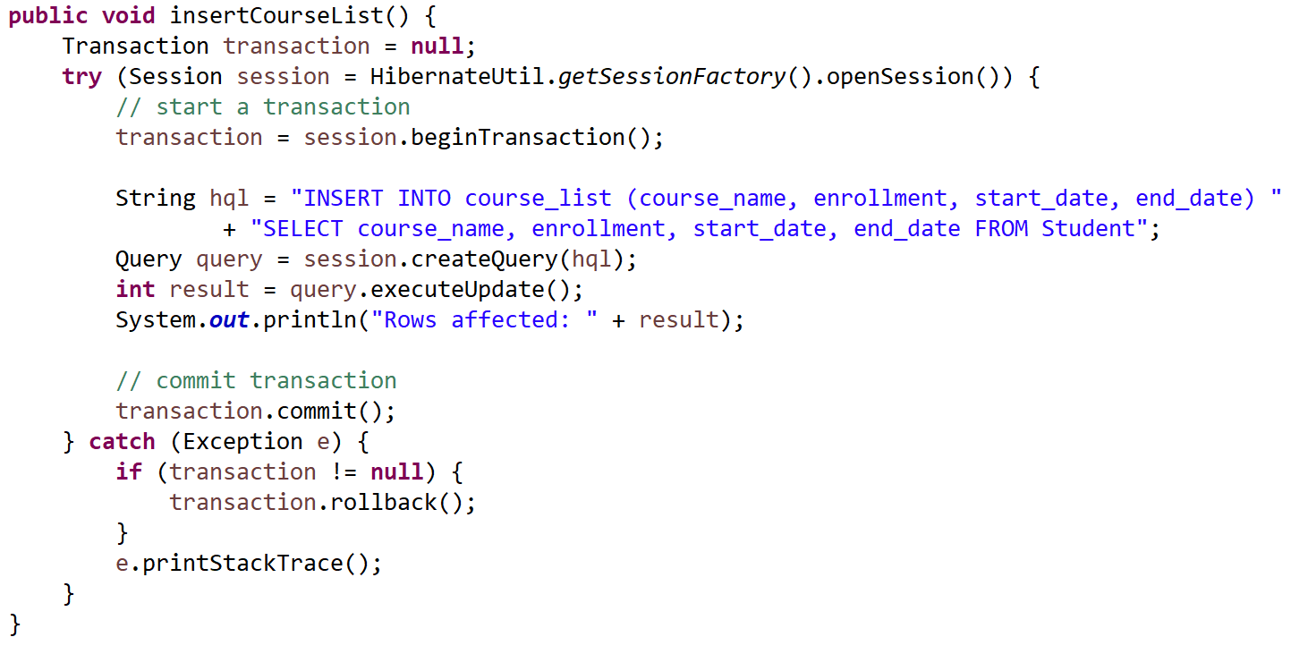
Insert a New Record

Slide 31
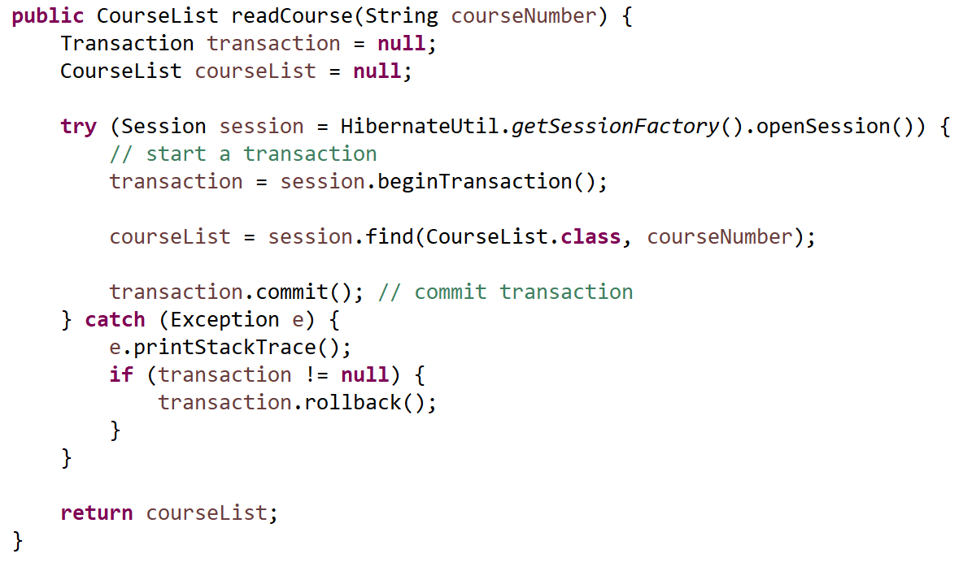
Read a Record

Slide 32
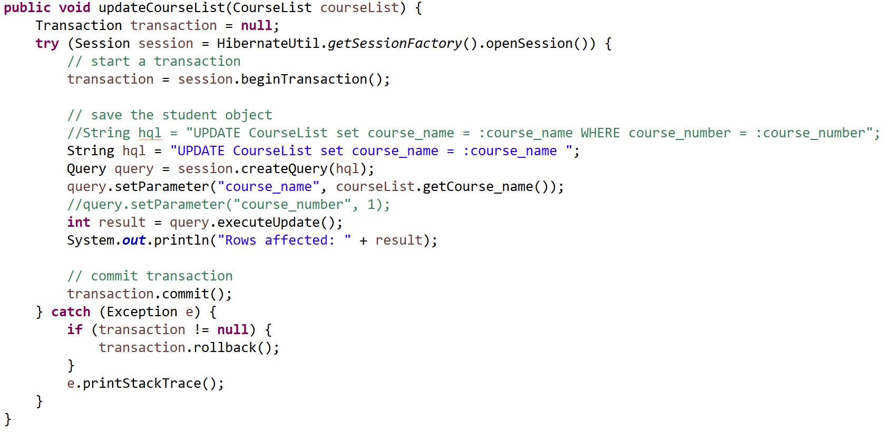
Update a Record

Slide 33
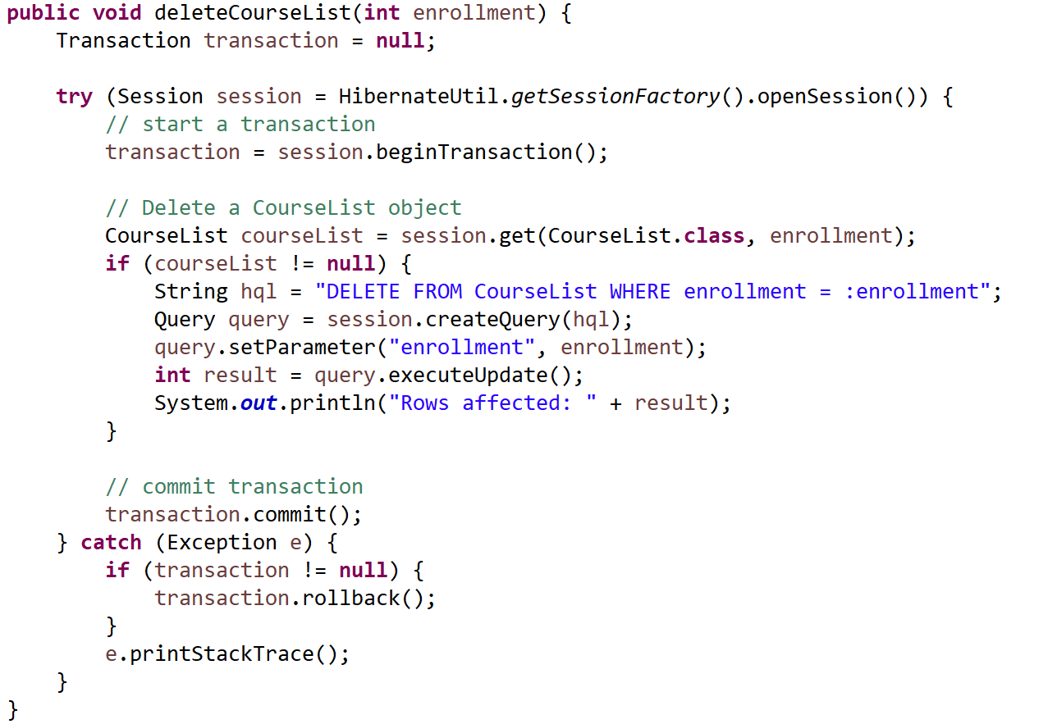
Delete a Record

Slide 34
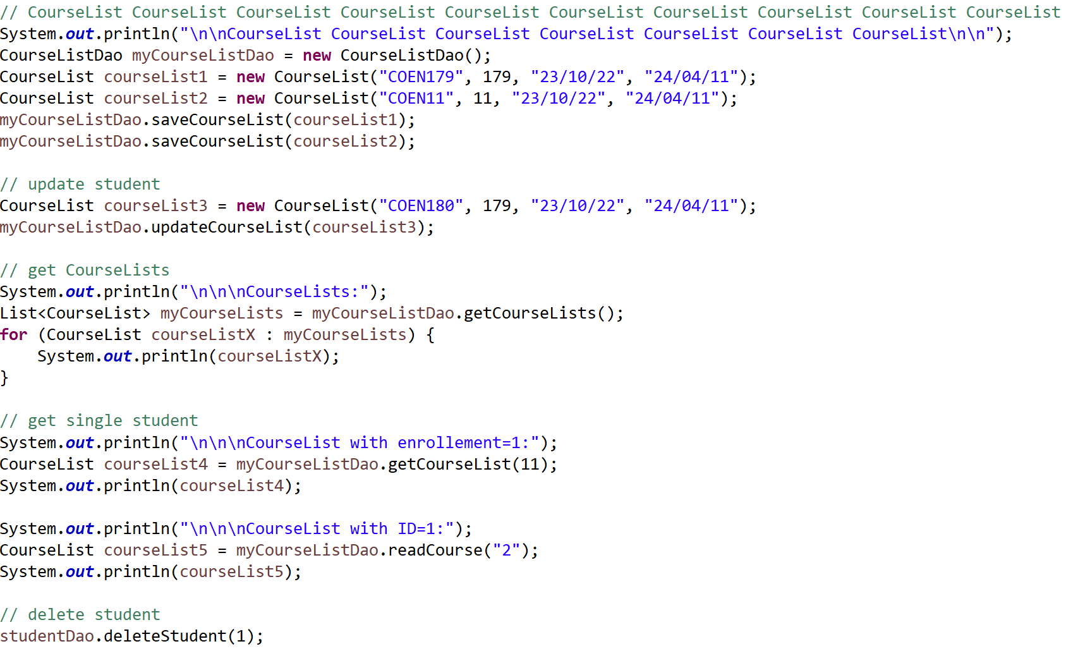
Testing CourseList

Slide 35
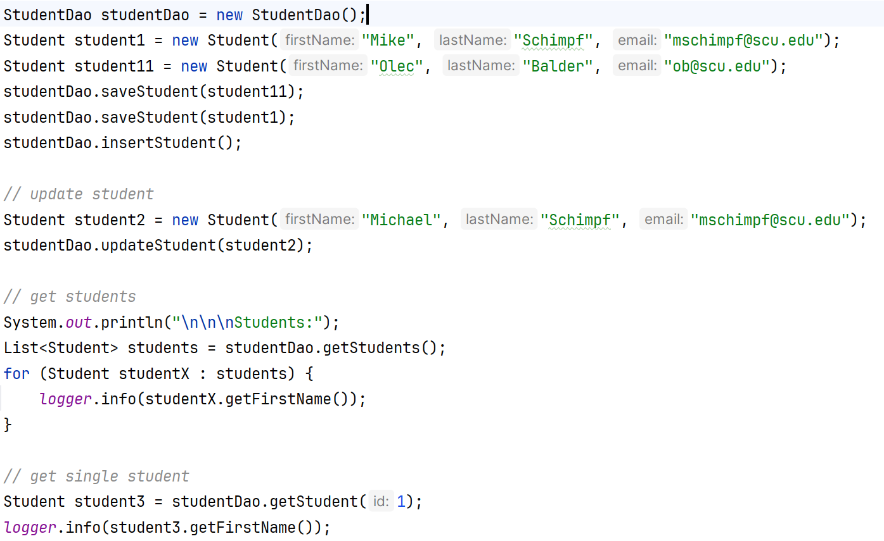
CSEN160_09_2_JPA.application.B_StudentManagement
Creating An Entity (continued)

Slide 36
JPQL
Query Language

Slide 37
Java Persistence Query Language (JPQL)
Query language for JPA
Similar to SQL
Used for:
  SELECT
  DELETE
  UPDATE

Slide 38
Interface Query
int executeUpdate()
Execute an update or delete statement
java.lang.Object getParameterValue(java.lang.String name)
Return the value bound to the named parameter.
java.util.List getResultList()
Execute a SELECT query and return the query results as an untyped List.
Query setParameter(int position, java.lang.Object value)
Bind an argument to a positional parameter.

Slide 39
Interface TypedQuery<X>
java.util.List<X> getResultList()
Execute a SELECT query and return the query results as a typed List.
X getSingleResult()
Execute a SELECT query that returns a single result.
TypedQuery<X> setParameter(int position, java.lang.Object value)
Bind an argument to a positional parameter.
TypedQuery<X> setParameter(java.lang.String name, java.lang.Object value)
Bind an argument to a named parameter.

Slide 40
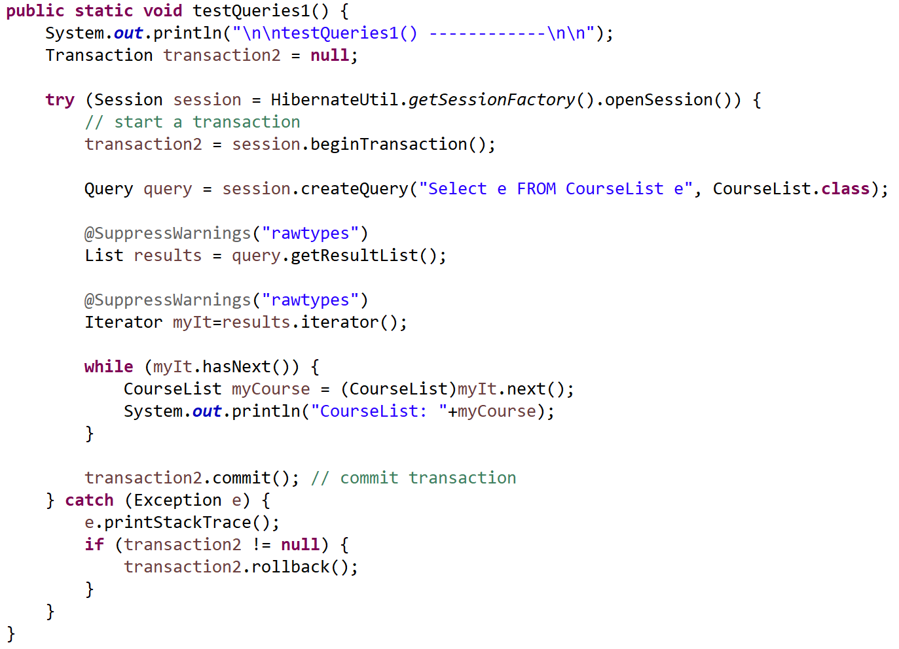
Query vs. TypedQuery
Advantage of TypedQuery over Query is that TypedQuery is type safe.
Query
No generics! ☹

Slide 41
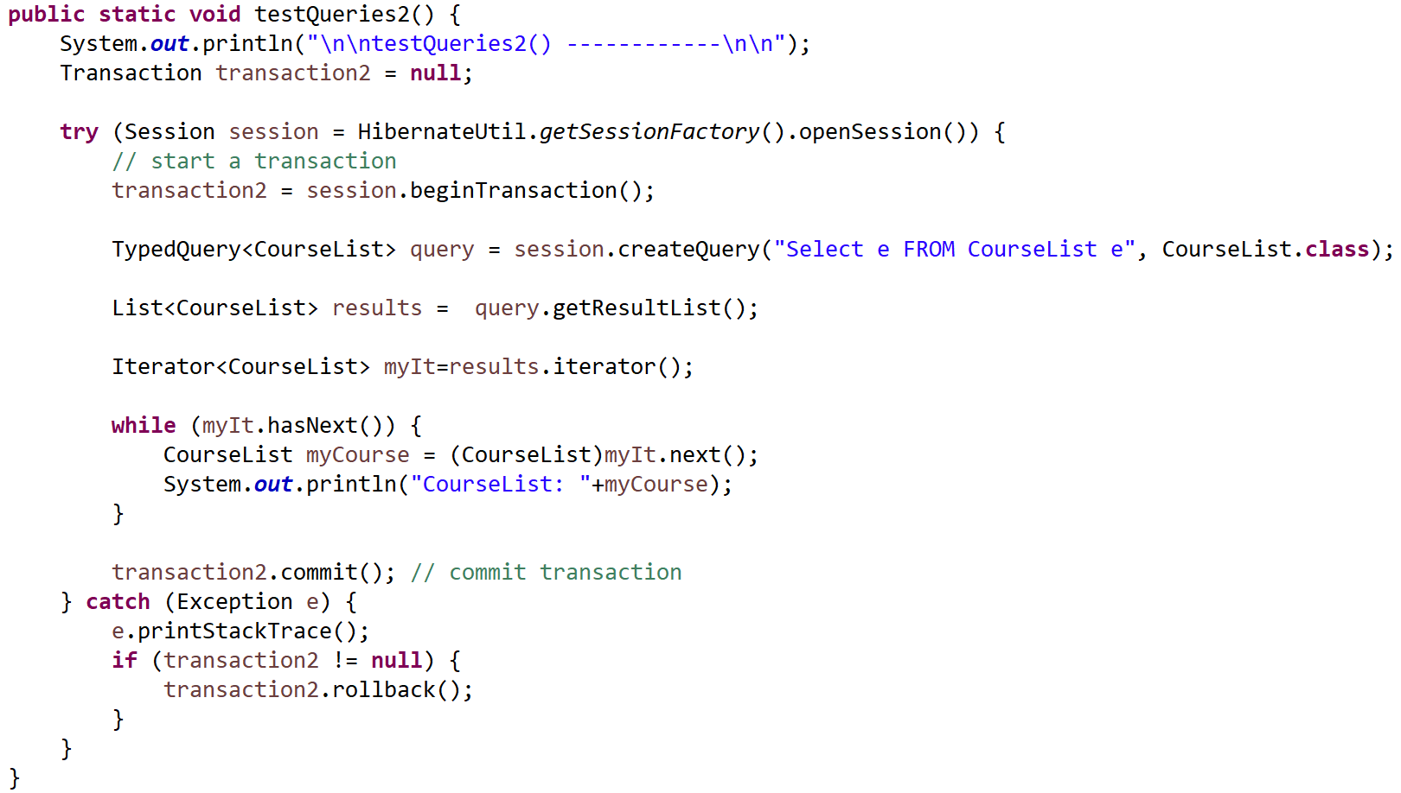
Query vs. TypedQuery
Advantage of TypedQuery over Query is that TypedQuery is type safe.
TypedQuery
Yes generics! ☺

Slide 42
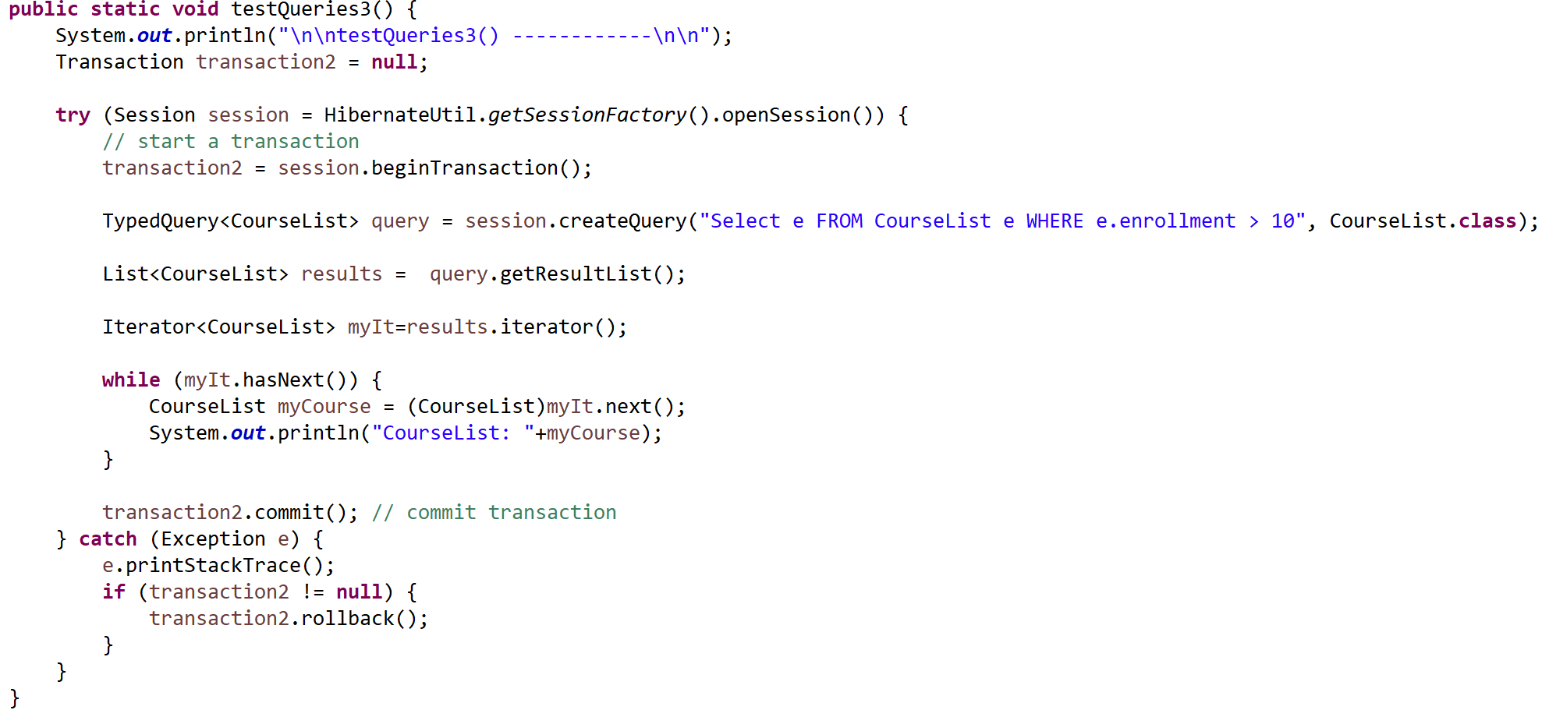
Select Query for a List of Objects
This returns all the rows with enrollment greater than 10:

Slide 43
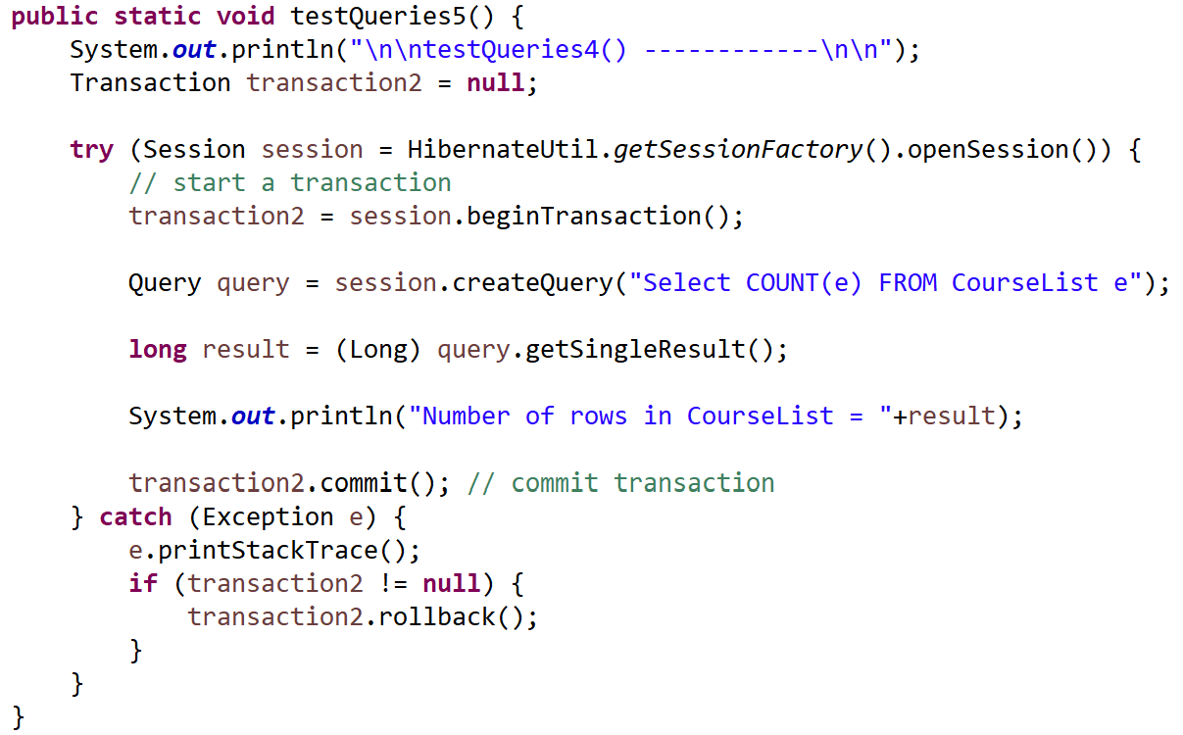
Select Query For a Single Data Element
This returns the number of rows in CourseList:
Other functions are SUM, MIN, MAX, AVG

Slide 44
JPQL
JPQL:
  Is different to plain SQL/JDBC
  Very powerful
  What we saw so far is only a tiny snapshot

Slide 45
Done

Slide 46
… to here …

