Slide 1
CSEN160
Fall 2026
Object-Oriented Analysis, Design and Programming
Michael Schimpf, PhD, mschimpf@scu.edu
Department of Computer Science and Engineering

Slide 2
Microservices

Slide 3
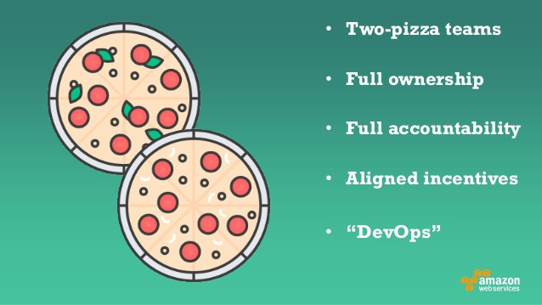
Rule of twos
It should be possible for a microservice to be developed in two weeks
A microservice development team should be small enough,
that it can be fed using two large pizzas

Slide 4
Advantages of a microservice architecture
Microservice developement can use any language (or framework)
Only what have been changed need to be re-tested and redeployed
Not necessary to scale the whole system when demand on one part increases
Reduces cost of collaboration between teams within an organization

Slide 5
Characteristics of a microservice
Self-contained
Lightweight
Implementation-independent
Independently deployable
Business-oriented

Slide 6
Monolith vs. Microservices Architecture
MONOLITH (3-Tier, etc.)
Server-side system based on single application
Easy to develop, deploy, manage
Classic 3-Tier web application
MICROSERVICES
Every app function is its own service
Own container
Communicates via APIs

Slide 7
SOA/SOAP vs. Microservices Architecture
MICROSERVICES
Small, independently deployable services
Lightweight (REST, JSON, gRPC)
Each service owns its own DB
Decentralized
Cloud-native
Service Oriented Architecture (SOA)
Large, coarse-grained services; often uses SOAP/ESB
Heavy standards (XML, WSDL)
Shared databases
Centralized architecture

Slide 8
Microservices architecture

Slide 9
Software services
Software service is a component accessed from remote:
  Service is accessed through its interface
  All details of the implementation are hidden
  Do not maintain any internal state.
  State information is stored:
    In a database
    Maintained by the service requestor

Slide 10
Software services
When a service request is made:
  The state information may be included as part of the request
  The updated state information is returned as part of the service response
No local state:
  Services can be dynamically reallocated (from one virtual server to another)
  Replicated across several servers

Slide 11
Microservices
Microservices are:
  Small-scale
  Stateless
  Have a single responsibility
  They are combined to create an applications

Slide 12
Microservices
They are completely independent:
  Own database
  UI management code
    React
    Angular
    Vue.js
    Next.js
    Etc.

Slide 13
Microservices architecture
A microservices architecture is an architectural style
It addresses two problems of monolithic applications:

Slide 14
Microservices architecture
  1. When a change is made to the (mono) system has to be:
    Rebuilt
    Re-tested
    Re-deployed
    Slow process (as changes to one part of the system affect other components).

Slide 15
Microservices architecture
  2. As the demand on the (mono) system increases, the system has to be scaled:
    Even if the demand is limited to a small # of components.
    Microservices: ‘scaling-out’ of a (one) service is easy:
      This is typically, much cheaper than ’scaling-up’ (whole mono system).

Slide 16
Benefits of microservices architecture
Microservices are self-contained and run in separate processes:
  Each microservice may be deployed in its own container.
    Multiple Tomcat war’s
    Multiple Tomcats

Slide 17
Benefits of microservices architecture
A microservice can be stopped and restarted without affecting other parts:
  If demand on a service increases, more service can be quickly created and deployed.

Slide 18
Characteristics of microservices
Implementation-independent
  Microservices may be implemented using different programming languages:
    Java (Spring Boot / Micronaut / Quarkus)
    JavaScript (Node.js / NesUS / Espress)
    Python (FastAPI / Flask / Django REST)
    Etc.
  May use different technologies:
    Different types of database

Slide 19
Characteristics of microservices
Independently deployable
  Each microservice runs in its own process
  Is independently deployable

Slide 20
Characteristics of microservices
Business-oriented
  Microservices should implement business functions
  Rather than simply provide a technical service.

Slide 21
Microservice characteristics
A well-designed microservice should have high cohesion and low coupling.
  Cohesion: number of relationships with each other.
    High cohesion: everything needed to deliver a response is included in the component
  Coupling: number of relationships that one component has with other components:
    Low coupling: components do not have many relationships with other components

Slide 22
Microservice characteristics
Each microservice should have a single responsibility
It should do one thing only:
  ‘one thing only’ is difficult to do.
  Responsibility does not always mean a single, functional activity.

Slide 23
Microservices
Communication

Slide 24
Service communications
When designing a microservices architecture:
Create a standard for communications that all microservices follow
key decisions:
  Should interaction be synchronous or asynchronous?
  Should communicate directly or via message broker middleware?
  What protocol should be used for messages exchanged?

Slide 25
Synchronous and asynchronous interaction
In a synchronous interaction, service A issues a request to service B.
  Service A waits for Service B (while B is processing the request).
It waits until service B has returned.

Slide 26
Synchronous and asynchronous interaction
Asynchronous interaction:
  Service A issues the request that is queued for processing by service B.
  A then continues processing without waiting for B to finish its computations.
Later, service B completes the request from service A and queues the result.
Service A, has to check its queue periodically to see if a result is available.

Slide 27
Microservices
RESTful

Slide 28
Hypertext Transfer Protocol (HTTP)
A communications protocol
Allows retrieving inter-linked text documents (hypertext)
  World Wide Web.
HTTP Verbs
  HEAD
  GET
  POST
  PUT
  DELETE
  TRACE
  OPTIONS
  CONNECT
GET /index.html HTTP/1.1
Host: www.pitt.edu
Browser
Web Server
HTTP/1.1 200 OK
Content-Type: text/html
<html><head>…

Slide 29
Representational State Transfer (REST)
A software architecture for distributed hypermedia systems.
Introduced in the doctoral dissertation of Roy Fielding
  One of the principal authors of the HTTP specification.
A collection of network architecture principles which outline how resources are defined and addressed
Notes:
this is the presentation

Slide 30
RESTful services
The REST (REpresentational State Transfer) architectural style
  Think of it as any chunk of data:
    Credit card details
    Individual’s medical record
    Magazine or newspaper
    A library catalogue
    Etc.
  Resources are accessed via their unique URI

Slide 31
RESTful services
This is the approach used in the web where the resource:
  An HTML page is generated by the server in response to an HTTP GET request
  Is transferred to the client for display by a browser.

Slide 32
REST and HTTP
The motivation for REST was to capture the characteristics of the Web.
  URI Addressable resources
  HTTP Protocol
  Make a Request – Receive Response – Display Response
Exploits the use of the HTTP protocol beyond HTTP POST and HTTP GET
  HTTP PUT
  HTTP DELETE

Slide 33
REST - not a Standard
REST is not a standard
  JSR 311: JAX-RS: The JavaTM API for RESTful Web Services
But it uses several standards:
  HTTP
  URL
  XML/HTML/GIF/JPEG/etc (Resource Representations)
  text/xml, text/html, image/gif, image/jpeg, etc (Resource Types, MIME Types)

Slide 34
Main Concepts
Nouns (Resources)
unconstrained
i.e., http://example.com/employees/12345
REST
Verbs
constrained
i.e., GET
Representations
constrained
i.e., XML

Slide 35
RESTful service principles
Stateless services
  Services must never maintain internal state
  Microservices are stateless

Slide 36
Resources
The key in REST is a resource.
A resource is a conceptual mapping to a set of entities
  Any information that can be named can be a resource:
    Document
    Image
    Temporal service (e.g. "today's weather in Los Angeles")
    Collection of other resources
    Non-virtual object (e.g. a person)
    Etc.

Slide 37
Naming Resources
REST uses URI to identify resources
  http://localhost/books/
  http://localhost/books/ISBN-0011
  http://localhost/books/ISBN-0011/authors
  http://localhost/classes
  http://localhost/classes/cs2650
  http://localhost/classes/cs2650/students

Slide 38
RESTful service principles
Use HTTP verbs
  The basic methods defined in the HTTP protocol
    HTTP GET
    HTTP PUT
    HTTP POST
    HTTP DELETE

Slide 39
HTTP GET
Read
  Implemented using HTTP GET, which reads the resource and returns its value.
  GET operations should never update a resource
  So, that successive GET operations with no intervening PUT operations always return the same value.

Slide 40
HTTP GET
How clients ask for the information they seek.
Issuing a GET request transfers the data from the server to the client in some representation
GET http://localhost/books
  Retrieve all books
GET http://localhost/books/ISBN-0011021
  Retrieve book identified with ISBN-0011021
GET http://localhost/books/ISBN-0011021/authors
  Retrieve authors for book identified with ISBN-0011021

Slide 41
HTTP PUT
Update
  Implemented using HTTP PUT, which modifies an existing resource.
  PUT should not be used for resource creation.
  HTTP PUT updates a resource
  PUT http://localhost/books/isbn-111
    Content: {isbn, title, authors[], …}
    Updates book identified by isbn-111 with submitted properties

Slide 42
HTTP POST
Create
  Implemented using HTTP POST, which creates the resource with the given URI.
  If the resource has already been created, an error is returned.
  HTTP POST creates a resource
  POST http://localhost/books/
    Content: {title, authors[], …}
    Creates a new book with given properties

Slide 43
HTTP DELETE
Delete
  Implemented using HTTP DELETE, which makes the resource inaccessible using the specified URI.
  The resource may or may not be physically deleted.
  Removes the resource identified by the URI
  DELETE http://localhost/books/ISBN-0011
    Delete book identified by ISBN-0011

Slide 44
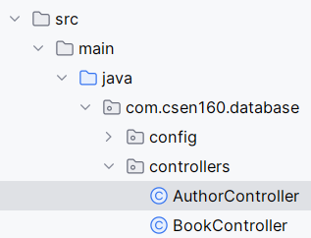
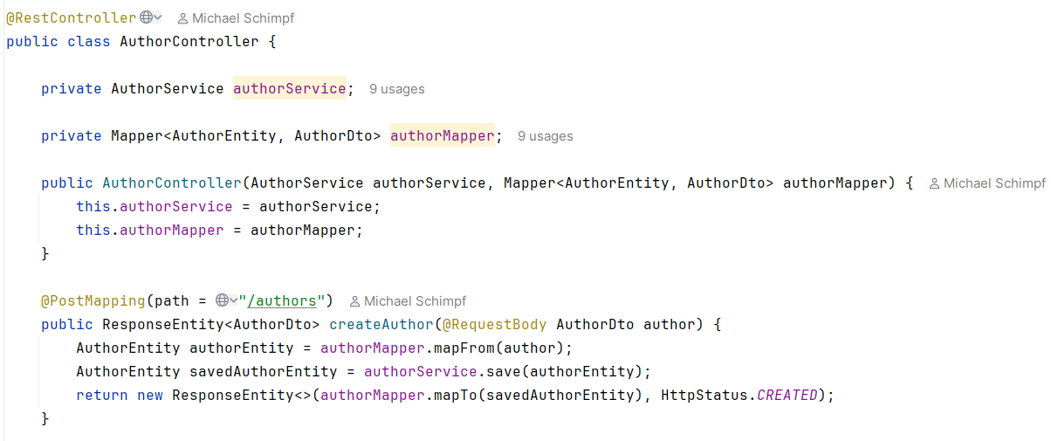
Controllers
CSEN160_10_PostgreSQL_JPA_SpringBoot_MicroServices_V1.0

Slide 45
RESTful service principles
URI addressable
  All resources must have a URI
  With a hierarchical structure, that is used to access sub-resources.
Use XML or JSON
  Resources should normally be represented in JSON or XML or both.
  Other representations, such as audio and video, may be used if appropriate.

Slide 46
Representations
How data is represented or returned to the client for presentation.
Two main formats:
  JavaScript Object Notation (JSON)
  XML
It is common to have multiple representations of the same data

Slide 47
XML and JSON descriptions
JSON
{
id: “A90N17061714391”,
“date”: “20170617”,
“time”: “1437”,
“road_id”: “A90”,
“place”: “Stonehaven”,
“direction”: “north”,
“severity”: “significant”,
“description”: “Broken-down bus on north carriageway. One lane closed. Expect delays of up to 30 minutes.”
}

Slide 48
Representations
XML
  <COURSE>
    <ID>CS2650</ID>
    <NAME>Distributed Multimedia Software</NAME>
  </COURSE>
JSON
  {course
    {id: CS2650}
    {name: Distributed Multimedia Sofware}
  }

Slide 49
XML and JSON descriptions
XML
<id>
A90N17061714391
</id>
<date>
20170617
</date>
<time>
1437
</time>
…
<description>
Broken-down bus on north carriageway. Expect delays of up to 30 minutes.
</description>

Slide 50
XML and JSON descriptions
Ian Sommerville

Slide 51
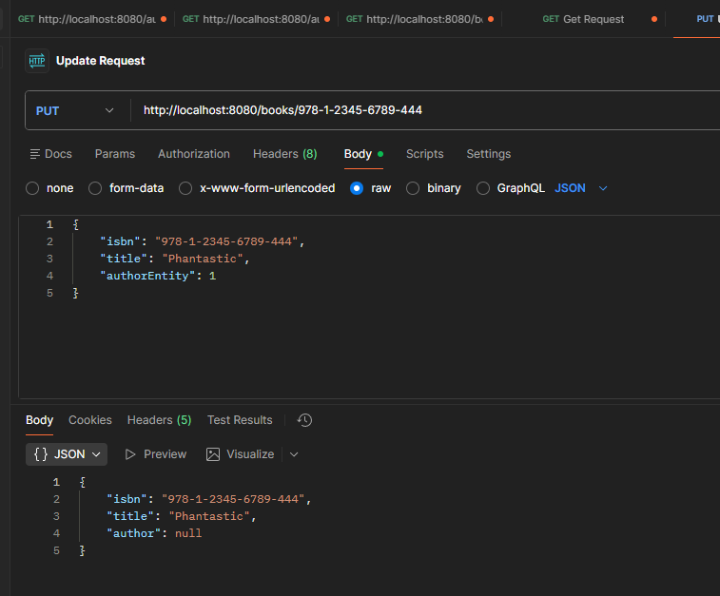
Postman

Slide 52
Why: "Representational State Transfer"?
Resource
Client
http://www.boeing.com/aircraft/747
Fuel requirements
Maintenance schedule
...
Boeing747.html
The Client references a Web resource using a URL.
A representation of the resource is returned (in this case as an HTML document).
The representation (e.g., Boeing747.html) places the client application in a state.
The result of the client traversing a hyperlink in Boeing747.html is another resource accessed.
The new representation places the client application into yet another state.
Thus, the client application changes (transfers) state with each resource representation --> Representation State Transfer!

Slide 53
Architecture Style
Request
(XML doc)
HTTP GET
URL 1
doGet()
Response
(XML doc)
HTTP Response
doPost(id)
Request
(XML doc)
HTTP POST
URL 1
REST Engine
(locate resource and generate response)
Web/Proxy Server
Response
(JSON doc)
HTTP Response
doDelete()
PO
(XML doc)
HTTP DELETE
URL 1
Response
(TEXT doc)
HTTP Response

Slide 54
Done

Slide 55
… to here …

