Slide 1
CSEN160
Fall 2026
Object-Oriented Analysis, Design and Programming
Michael Schimpf, PhD
Department of Computer Science and Engineering

Slide 2
Java GUI

Slide 3
Graphical User Interfaces (GUI)
GUIs are difficult in general:
QT
Microsoft Foundation Class MFC (before C#)
Unreal Engine
Aqua (Apple)
Recommended:
Read book
Watch YouTube
Do exercises:
  Java: https://www.youtube.com/watch?v=Kmgo00avvEw

Slide 4
Graphical User Interfaces (GUI) with Swing
GUIs are built using standard UI objects like:
  Windows
  Buttons
  scrolls bars
  Panels
  etc.
GUIs for Java desktop applications -> Java Swing.
Swing is currently the primary Java GUI toolkit, built into the JDK.

Slide 5
Graphical User Interfaces
Other GUI approaches:
Abstract Window Toolkit (AWT)
Swing
Standard Widget Toolkit (SWT) Eclipse
JavaFX -> OpenJFX (some kind of web approach, removed)

Slide 6
Graphical User Interfaces (GUI) with Swing
Swing is part of Oracle's Java Foundation Classes (JFC).
You can also use the Standard Widget Toolkit (SWT) from Eclipse
Before Swing:
Abstract Window Toolkit (AWT) was the original.
Limited set of GUI components, layout managers, events, etc.

Slide 7
Swing vs AWT
Swing is built “on top of” AWT.
You need to import AWT.
Swing is slower.
Swing is bigger than AWT.
Swing is more flexible.
Swing looks better.

Slide 8
Swing vs AWT
AWT components looks like the OS.
Swing components can change their appearance
(based on the current "look and feel“ -> “Nimbus” example).
Careful:
Swing and AWT are incompatible.
You can use both together.
But you are advised not to mix them!

Slide 9
What are the important steps in building a GUI?
Step 1:
Create an area (window/container/display area)
In Swing: use JFrame.
Create some Components:
  Buttons
  Text areas
  Sliders
  Panels
  etc.

Slide 10
What are the important steps in building a GUI?
Step 2: Choose a layout manager.
Step 3: Add your components to your JFrame.
Step 4: Event Handling: Attach event listeners to your components.
Interaction with a specific component -> triggers a specific event.
A listener is notified when an event occurs -> and executes some code.

Slide 11
What are the important steps in building a GUI?
“OldSwing: Swing-10 ActionListener” example …

Slide 12
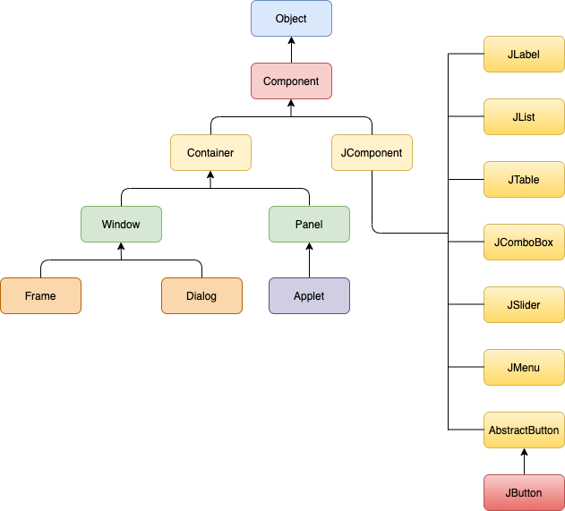
Components and Containers in Swing
From: https://www.javatpoint.com/awt-and-swing-in-java

Slide 13
Components and Containers in Swing
JFrame is a top-level containers.
JPanel is an intermediate container that contain components like:
  Buttons
  Labels
  Etc.

Slide 14
What are the important steps in building a GUI?
“OldSwing: Swing-02 FrameTwoVersions” example …

Slide 15
Components and Containers in Swing
Important container classes are:
  JFrame
  JApplet (obsolete)
  JPanel
A container holds components for displaying.
Some frequently components are:
  JButton
  JCheckbox
  JLabel
  JTextField
  JTextArea

Slide 16
Arranging components in a container using a Layout Manager
Layout Management: organize size and position of components.
Display multiple components at once.
Each container has a default layout manager.

Slide 17
Arranging components in a container using a Layout Manager
Layout Managers:
  FlowLayout (default layout for JPanel)
  Borderlayout (default layout for JFrame)
  GridLayout
  BoxLayout

Slide 18
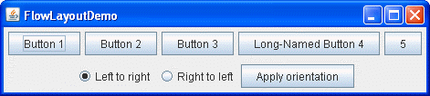
FlowLayout:

Slide 19
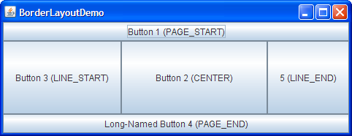
BorderLayout:

Slide 20
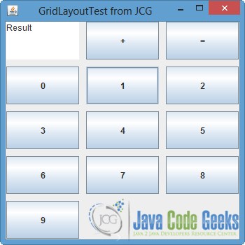
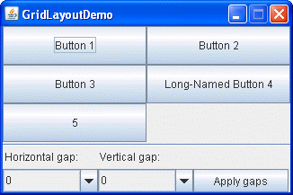
GridLayout:

Slide 21
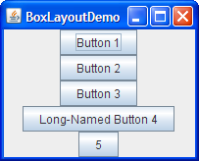
BoxLayout:

Slide 22
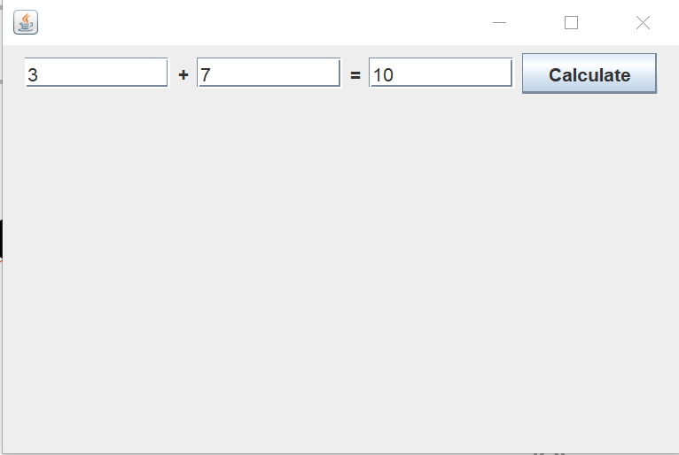
WindowBuilder (Eclipse)
“Current: Calculator” example …

Slide 23
What are the important steps in building a GUI?
“NewSwing: Swing-04” & “Swing-05” & “Swing-06” example …

Slide 24
Events and Event Listeners
User-actions like typing or pressing buttons -> are events.
An object that generates an event -> is an event source.
Each event is considered an object.
An event give information about its event source.

Slide 25
Events and Event Listeners
Any object may be notified of an event.
Steps for an object to be notified of an event:
  Implement listener interface.
  Register as an event listener.
  Any event can have multiple listeners.

Slide 26
Events and Event Listeners
Act that results in the event | Listener type
User clicks a button, presses Return while typing in a text field, or chooses a menu item | ActionListener
User closes a frame (main window) | WindowListener
User presses a mouse button while the cursor is over a component | MouseListener
User moves the mouse over a component | MouseMotionListener
Component becomes visible | ComponentListener
Component gets the keyboard focus | FocusListener
Table or list selection changes | ListSelectionListener

Slide 27
Event handling
Event handling involves three steps:
Step 1: An event handler should implement:
The listener interface
Or extend from a class that implements that interface.
Inner classes and anonymous classes can be defined as event handlers.

Slide 28
Event handling
Step 2:
The event handler class implements the methods in the listener interface.
Step 3:
Register an instance of the event handler as a listener on the event source.

Slide 29
What are the important steps in building a GUI?
“OldSwing: Swing-10 ActionListener” example …

Slide 30
Examples
See the examples in the folders:
  BasicSwingComponents
  LayoutManagers
  MoreSwingExamples
The demos will cover:
  Buttons
  Textfields and TextAreas
  Checkboxes and RadioButtons
  MenuBars
  ComboBoxes
  ScrollPanes

Slide 31
Swing Events

Slide 32
The Event Model
Event model has three types of objects:
  Event source
  Event object
  Event handler

Slide 33
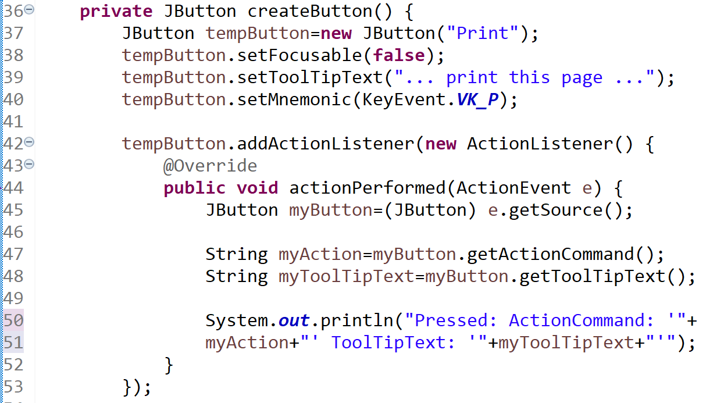
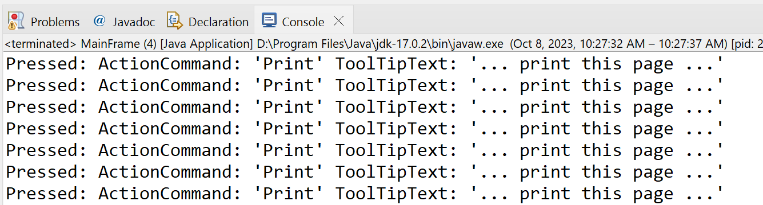
1. Event Source
  Event source is the object that creates an event (i.e. press on Button)
  getSource() is used to identify the source:
  getActionCommand() returns a string containing information about the event object.
In this case it
is a JButton

Slide 34
1. Event Source
  Event source is the object that creates an event (i.e. press on Button)
  getSource() is used to identify the source:
  getActionCommand() returns a string containing information about the event object.

Slide 35
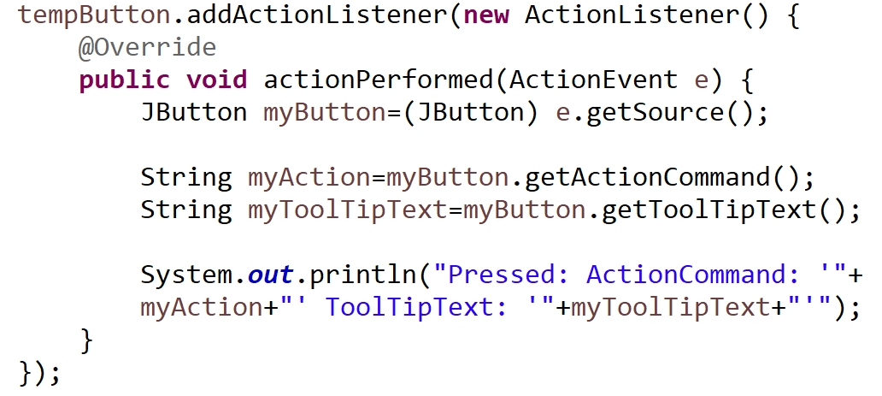
2. Event Object
Event object contains information:
  what type of event occurred
  which component generated this event

Slide 36
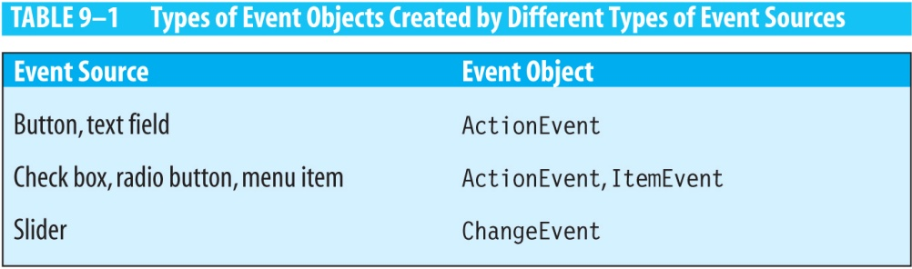
2. Event Object
Event objects created by different types of event sources:

Slide 37
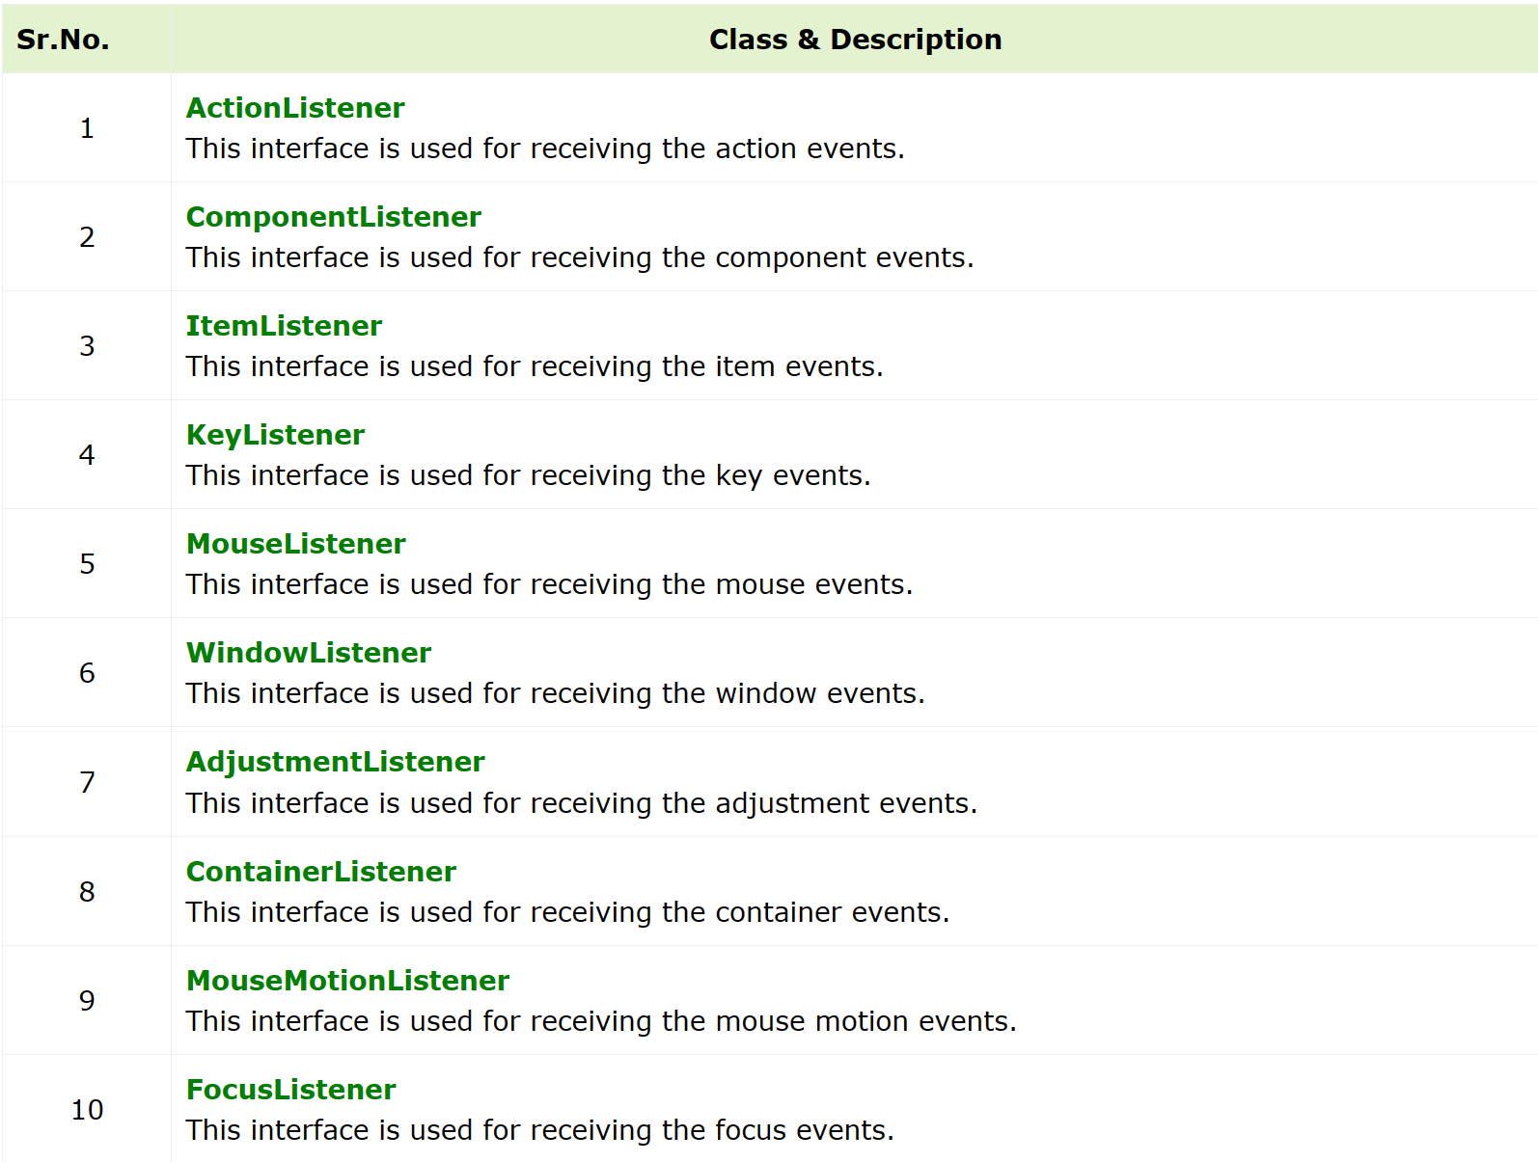
3. Event Handler
  The event handler (also called event listener) performs some action to respond to the event.

Slide 38
Listener Interfaces
An event handler is an instance of a class that implements a listener interface.
A listener interface declares methods that the event handler class must implement.
Interfaces extend EventListener, which is an empty interface.

Slide 39
The ActionListener Interface
Defined as follows:
Example of an event handling class:
  public interface ActionListener extends EventListener {
  public void actionPerformed(ActionEvent e);
  }
public class EventHandler implements ActionListener {
public void actionPerformed(ActionEvent e) {
// do something here
}
}

Slide 40
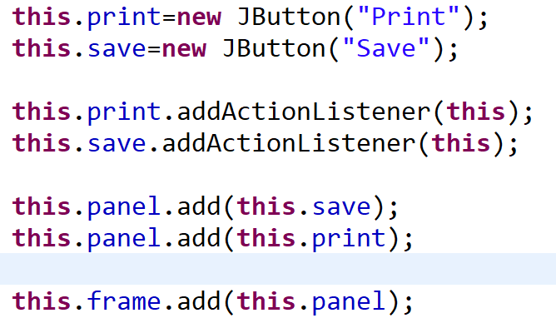
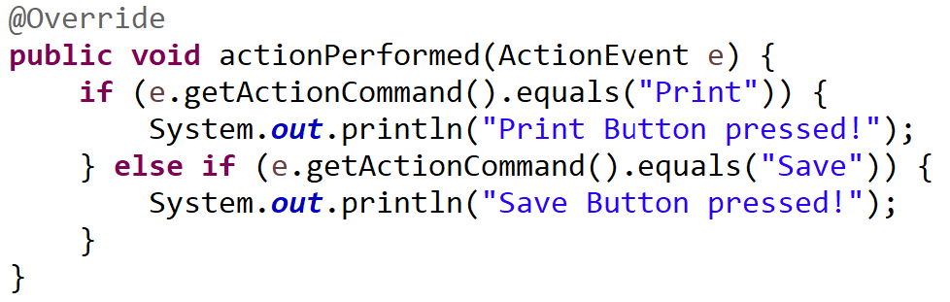
Using inheritance/implements

Slide 41
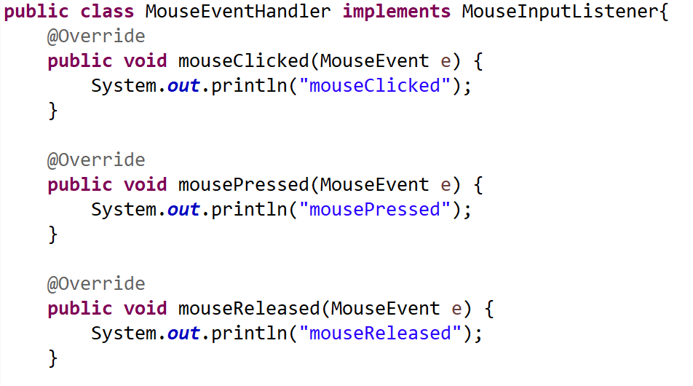
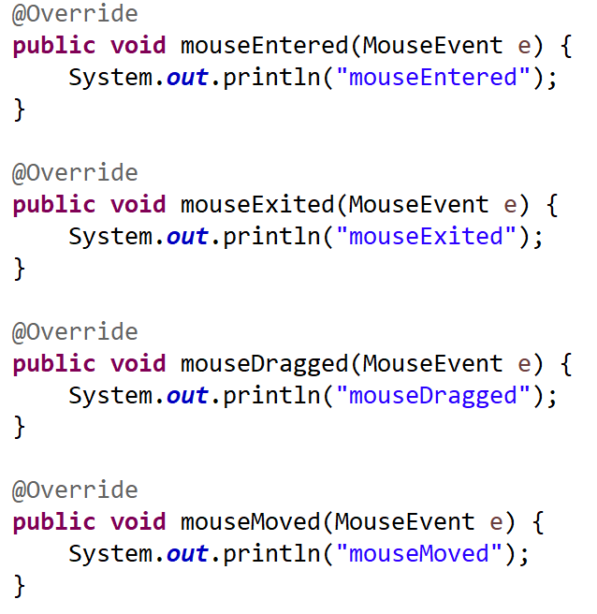
MouseEventHandler example

Slide 42
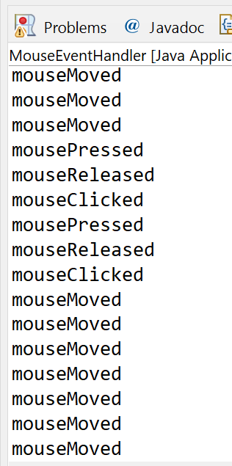
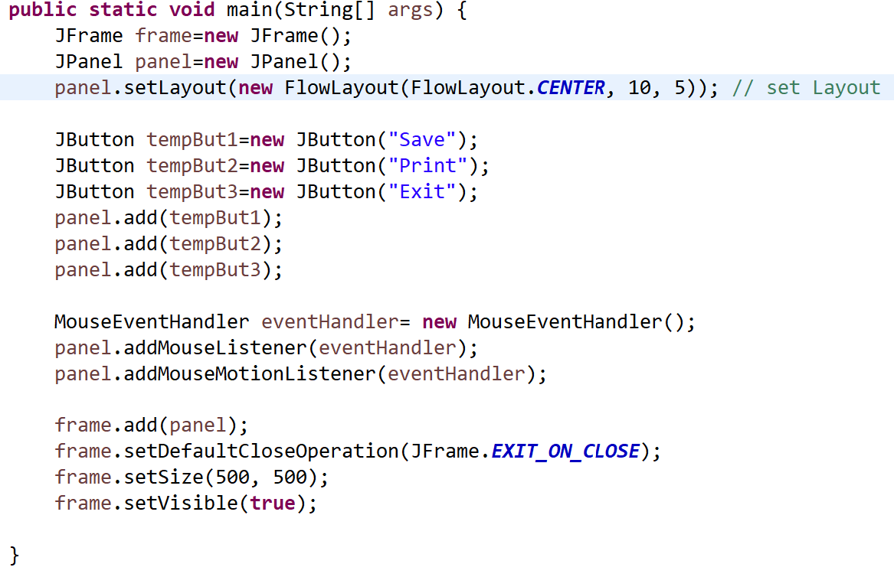
MouseEventHandler example
“Current: MouseEventHandler”

Slide 43
Overwriting paint method (AWT)

Slide 44
Paint method AWT:
Paint is called:
Screen refresh
Window update
Parts been hidden
AWT paints:
Not very powerful
Obsolete
For simple drawings ok
Don’t mix it up too much with Swing

Slide 45
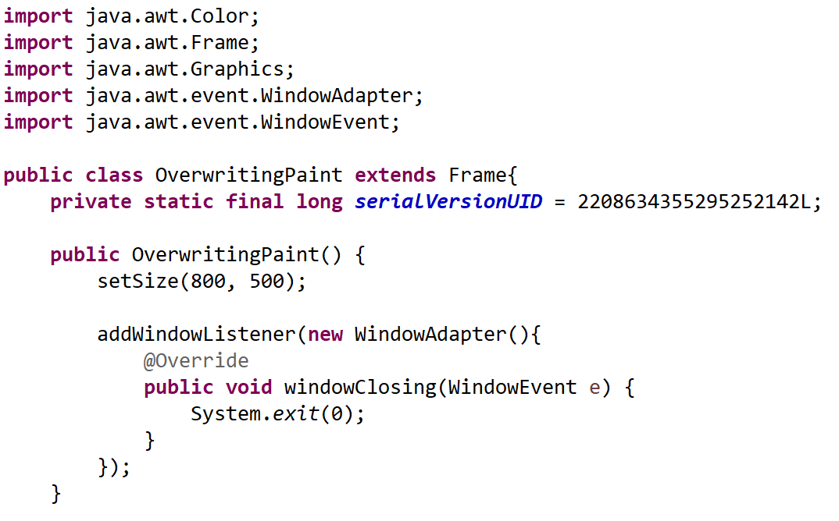
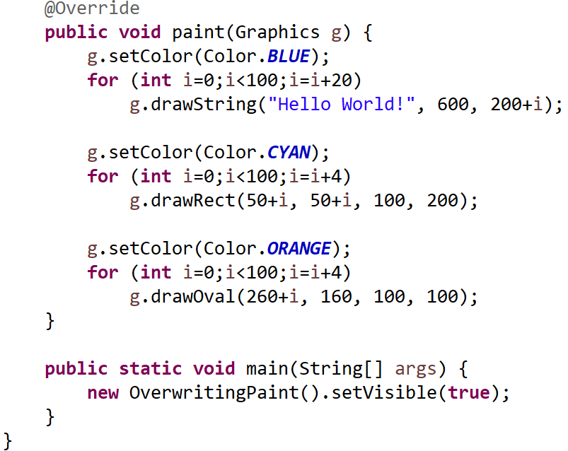
Paint method example:
“Current: OverwritingPaintMethod”

Slide 46
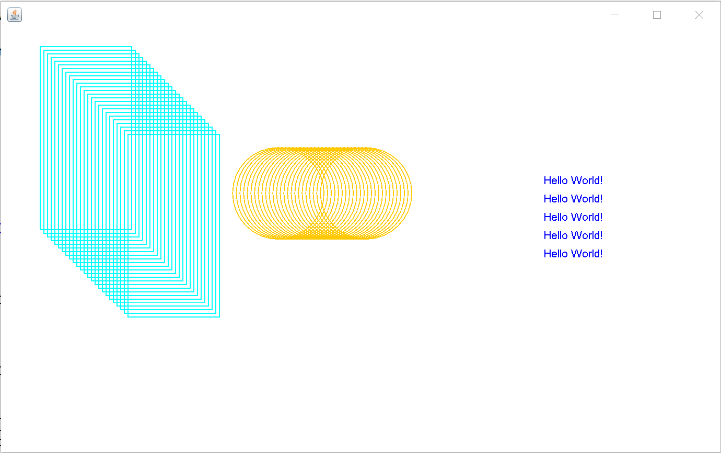
Paint method example:

Slide 47
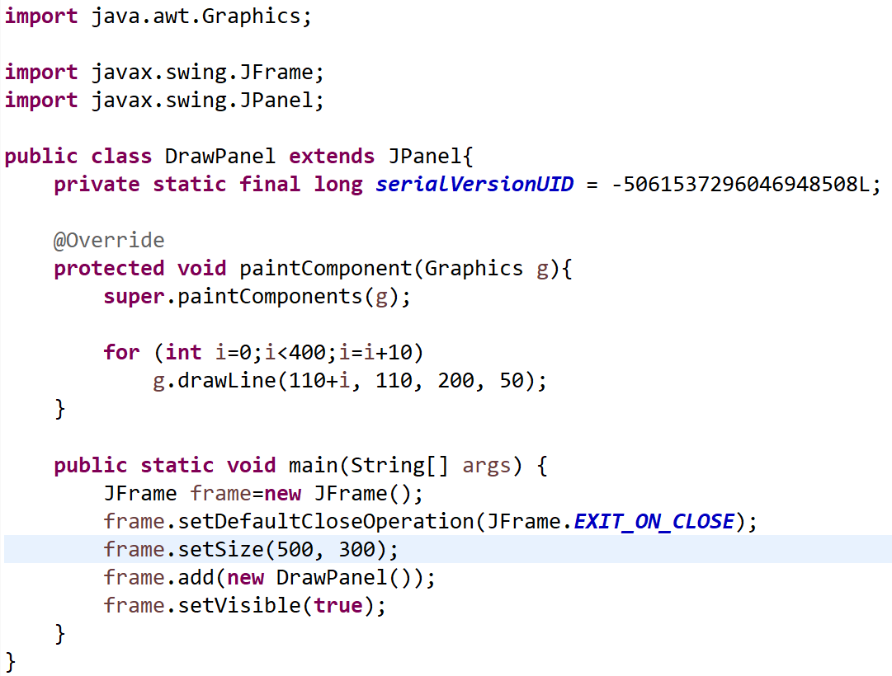
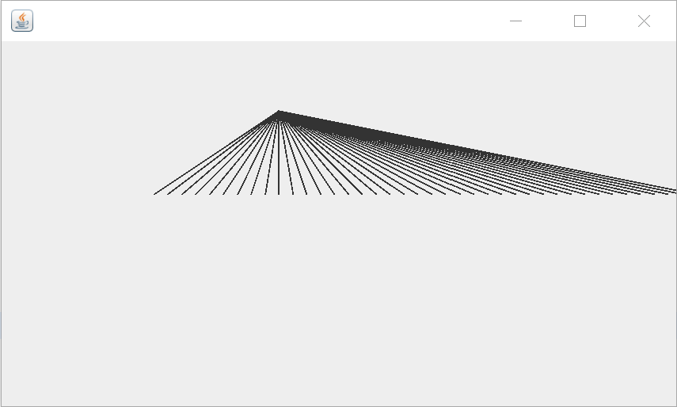
Paint method example mixed with other components:
Call super method
“Current: OverwritingPaintMethod2”

Slide 48
Graphics2D

Slide 49
Graphics2D
Why?
Graphics2D has more functions
Graphics2D is still AWT

Slide 50
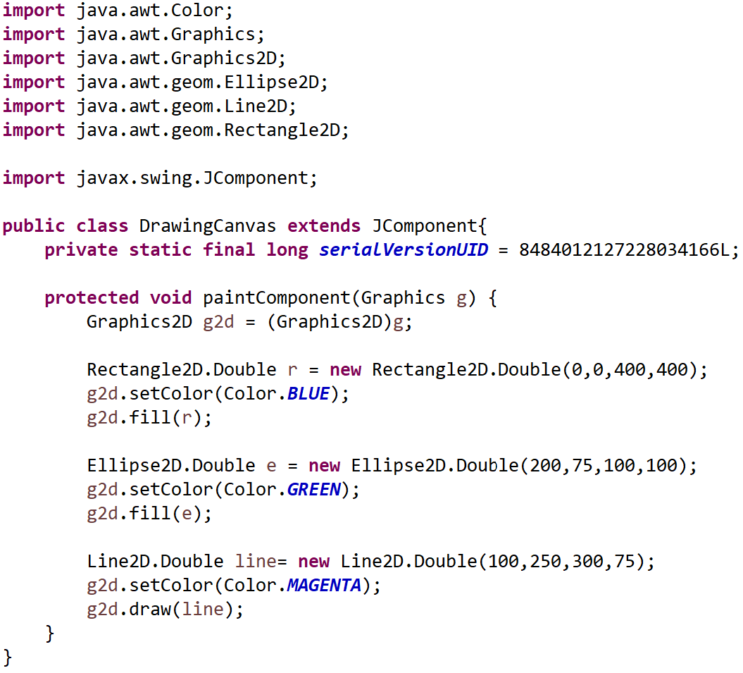
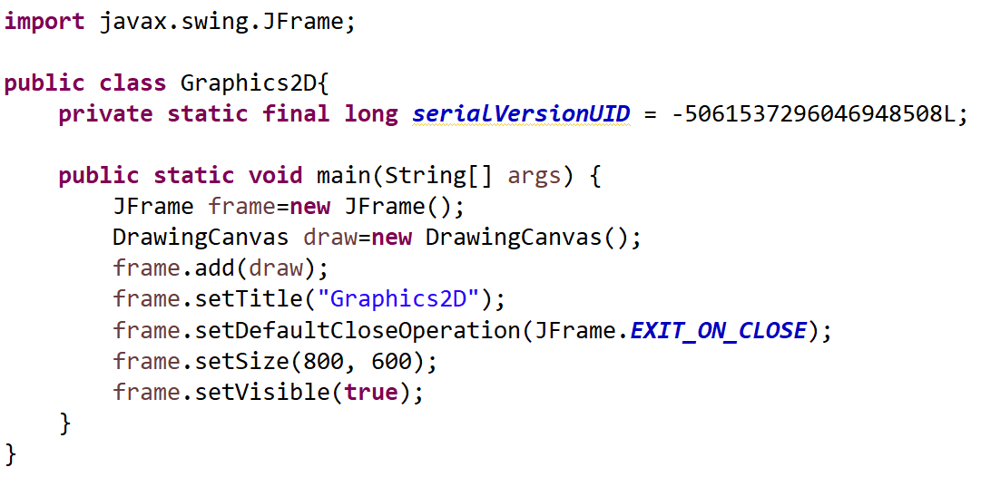
Simple Graphics2D example
double
or float
precision
“Current: Graphics2D”

Slide 51
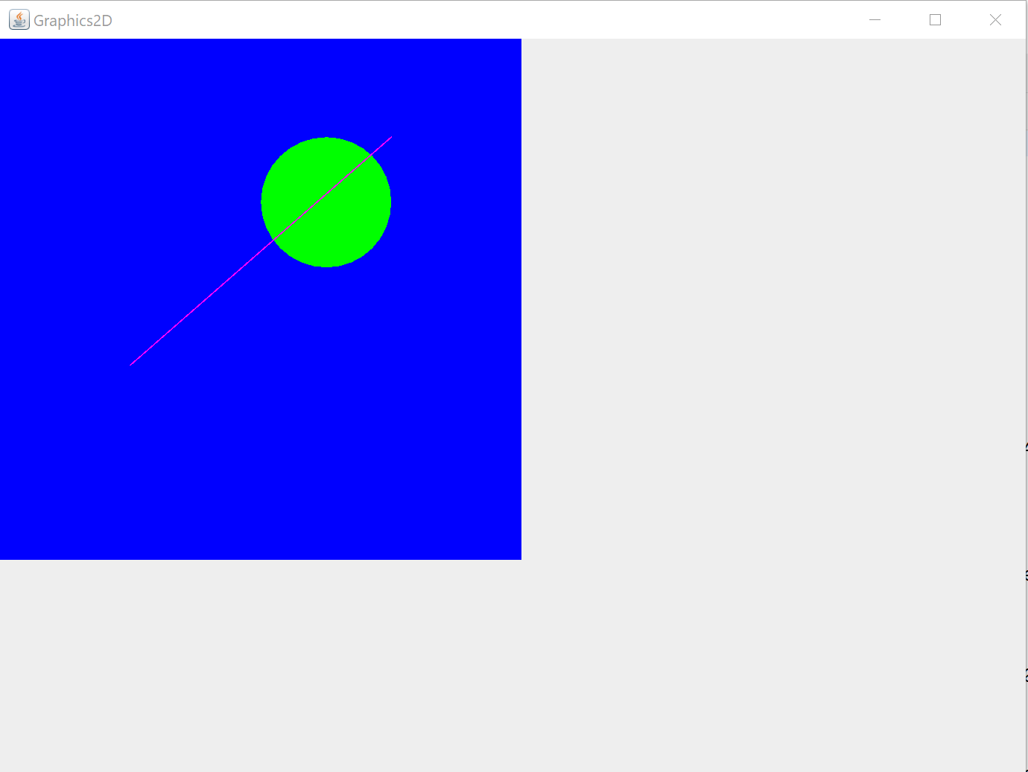
Simple Graphics2D example

Slide 52
Anti Aliasing

Slide 53
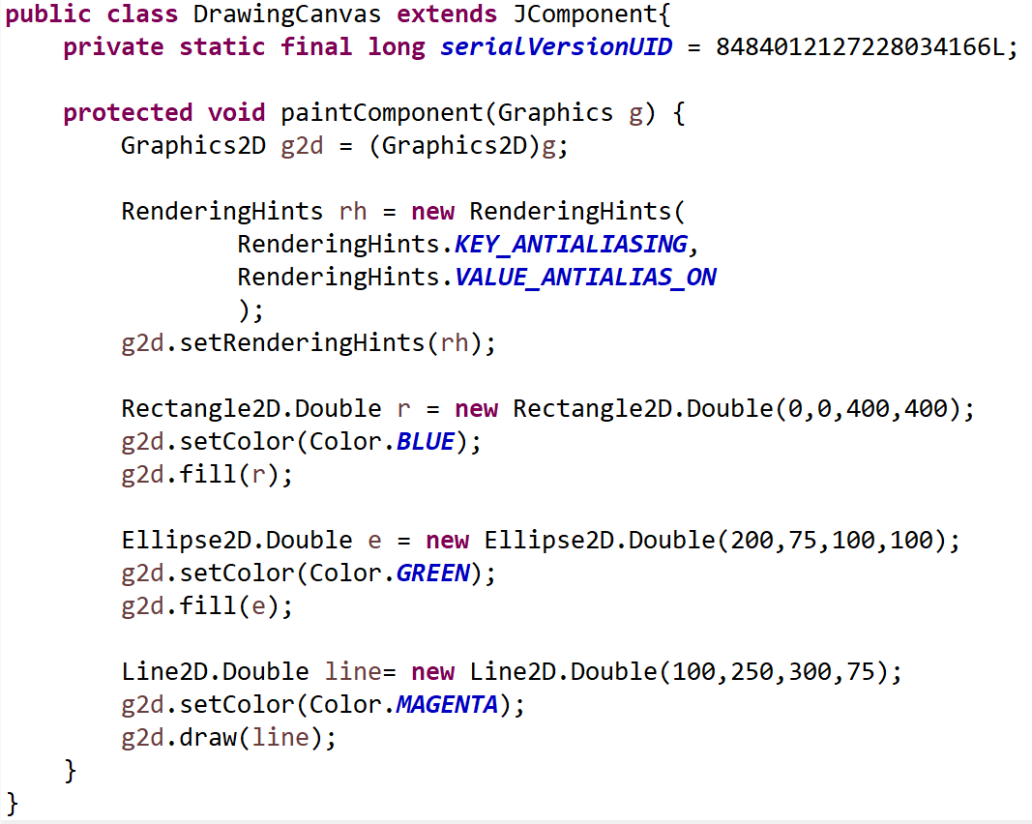
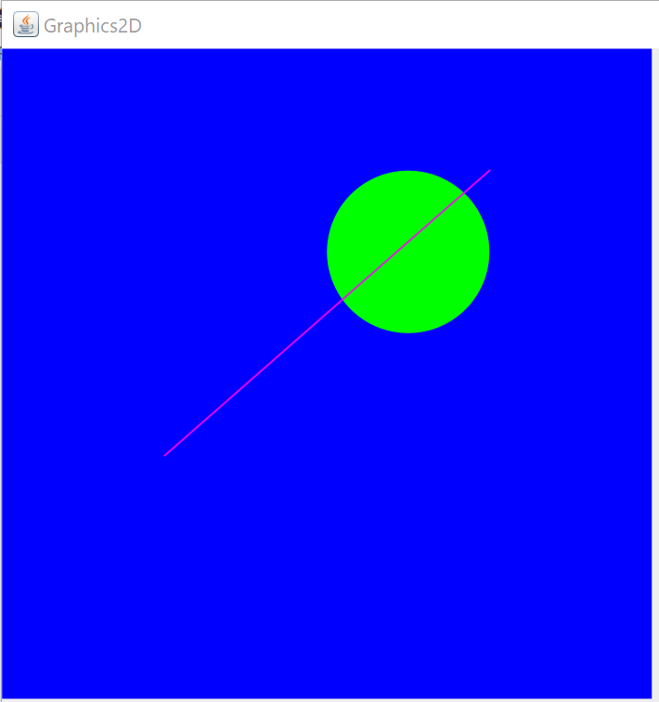
Simple Graphics2D Anti Aliasing
Current: “Graphics2D”

Slide 54
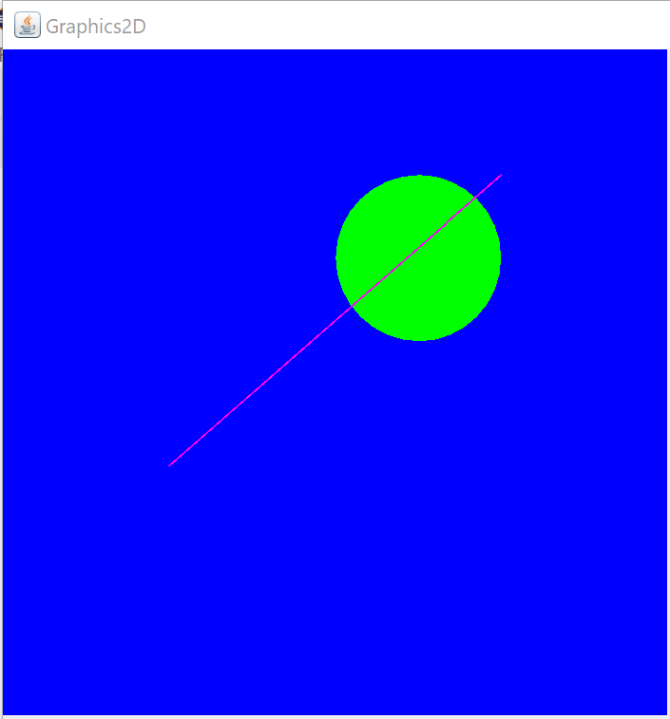
Simple Graphics2D Anti Aliasing
Without Anti Aliasing
With Anti Aliasing

Slide 55
Path2D

Slide 56
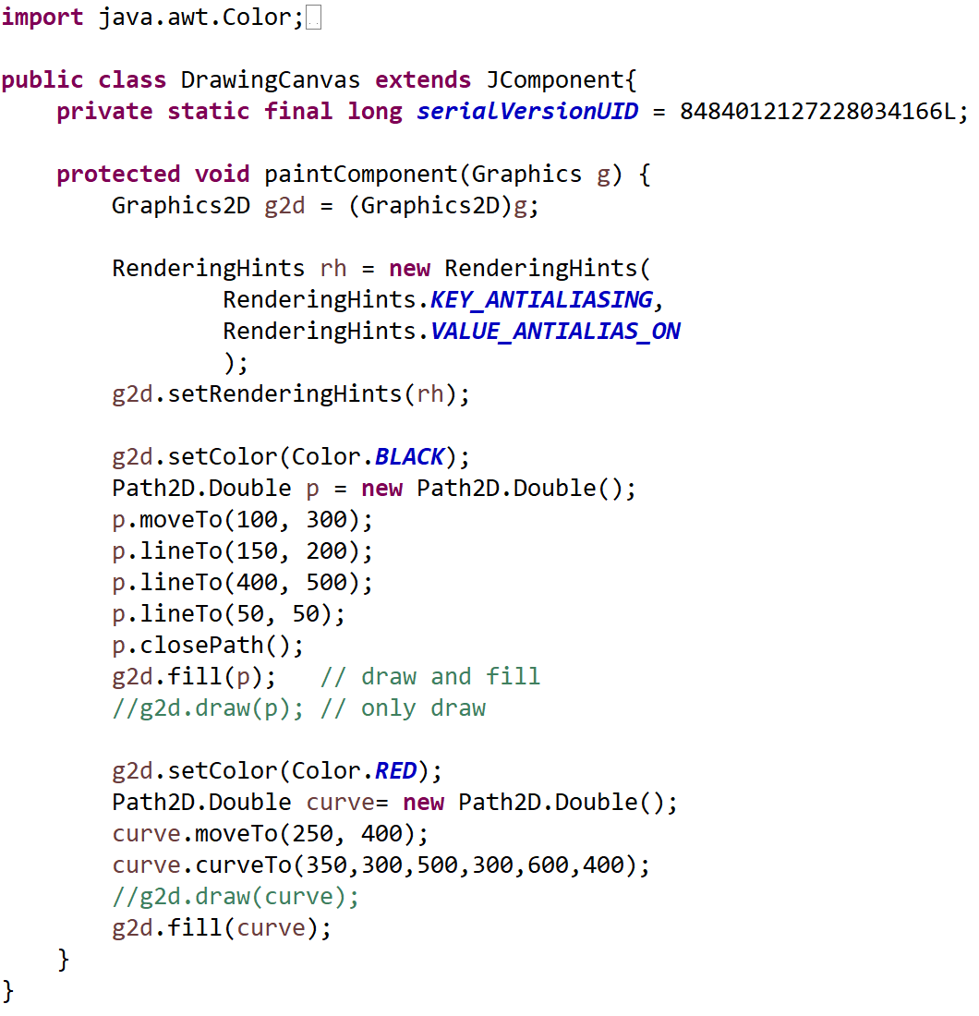
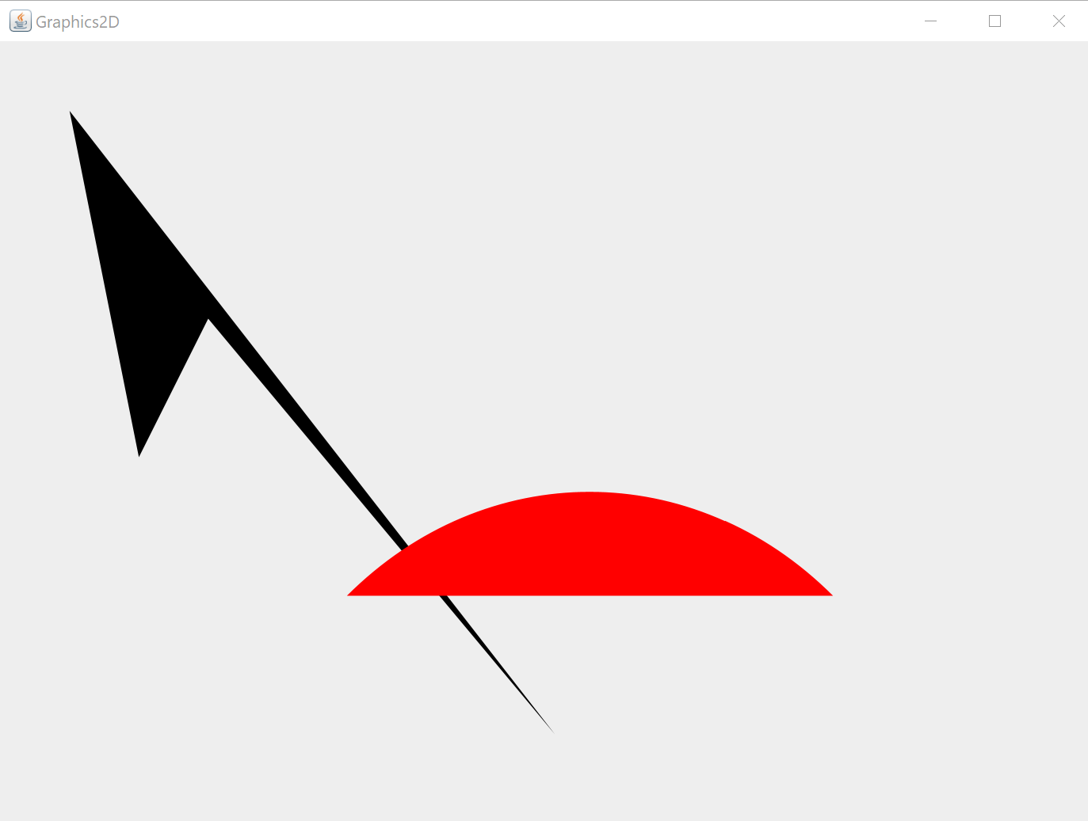
Path2d example
“Current: Path2D”

Slide 57
Transformation Rotate

Slide 58
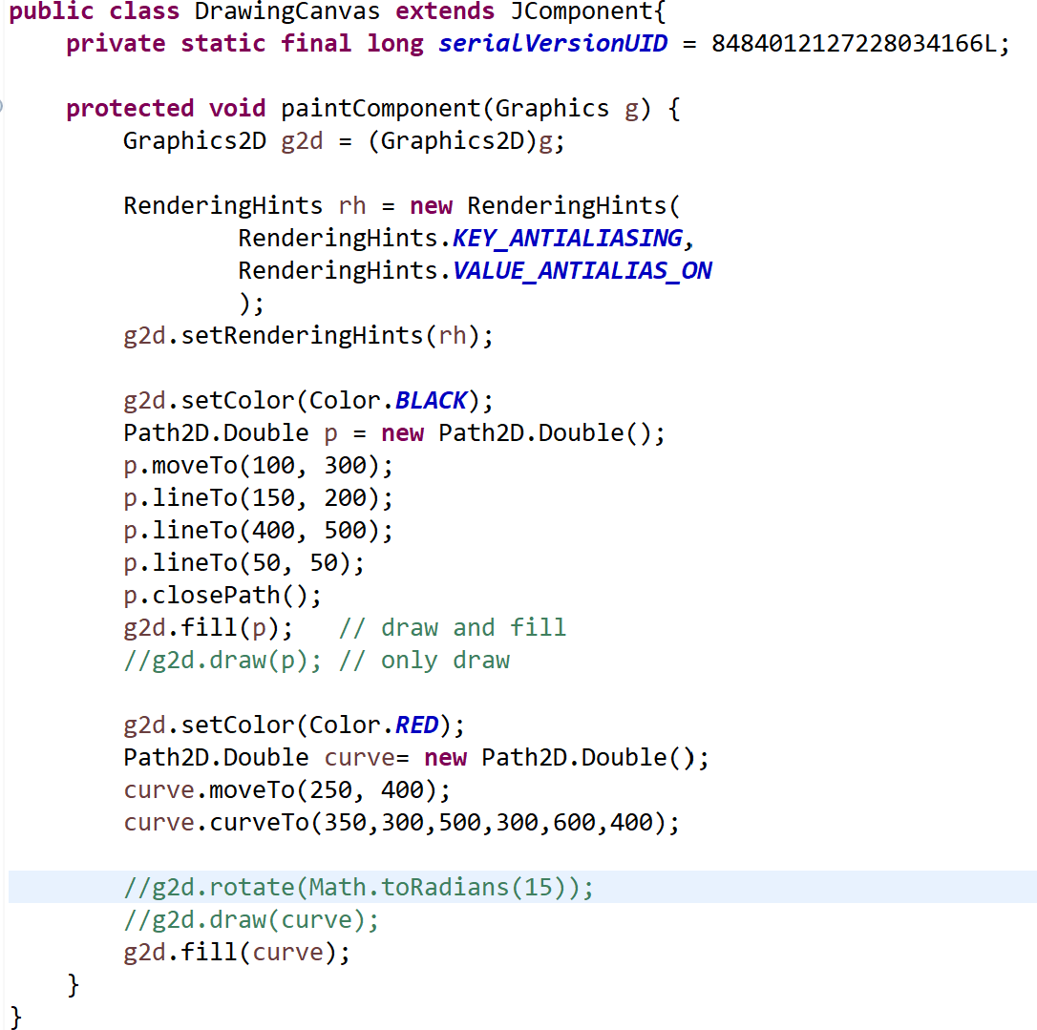

Transformations: Rotate

Slide 59
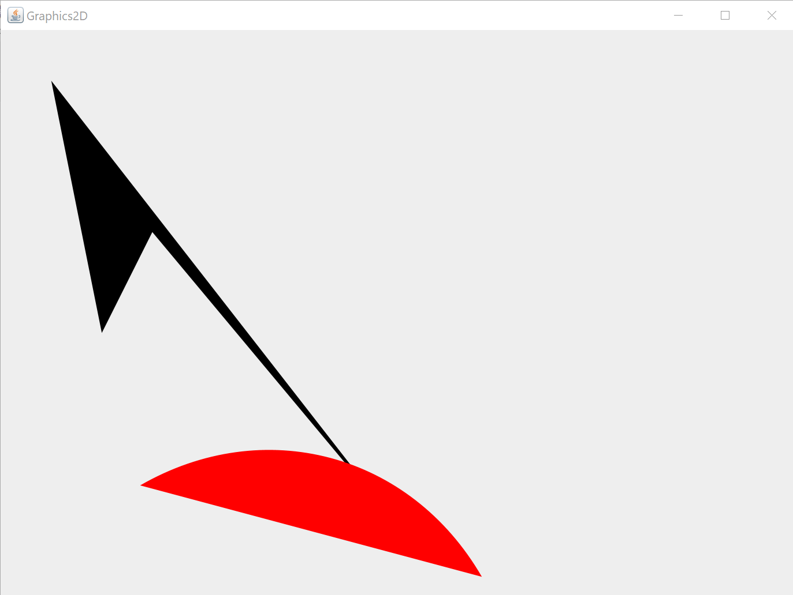
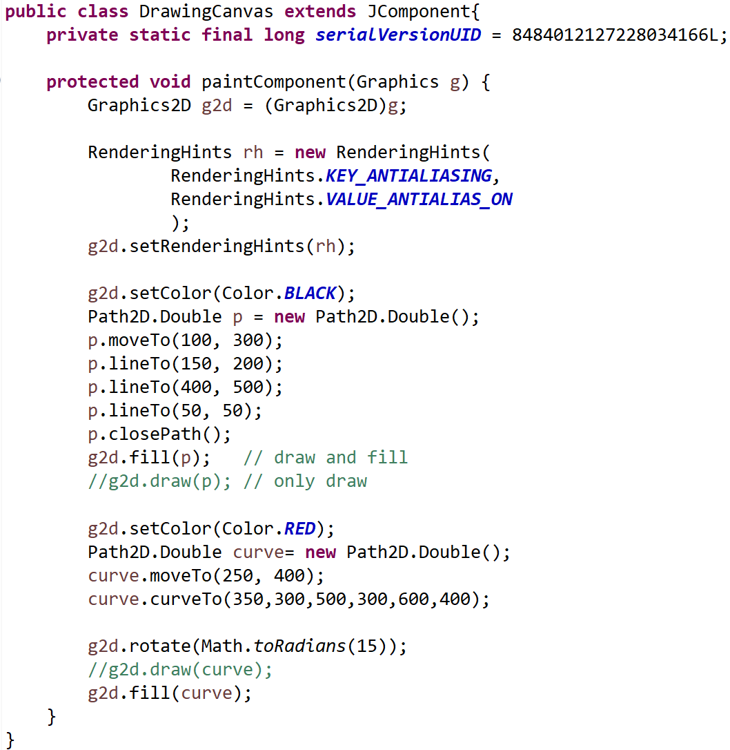
Transformations: Rotate
“Current: Transformations”

Slide 60
Transformations: Rotate

Slide 61
Simple Animation

Slide 62
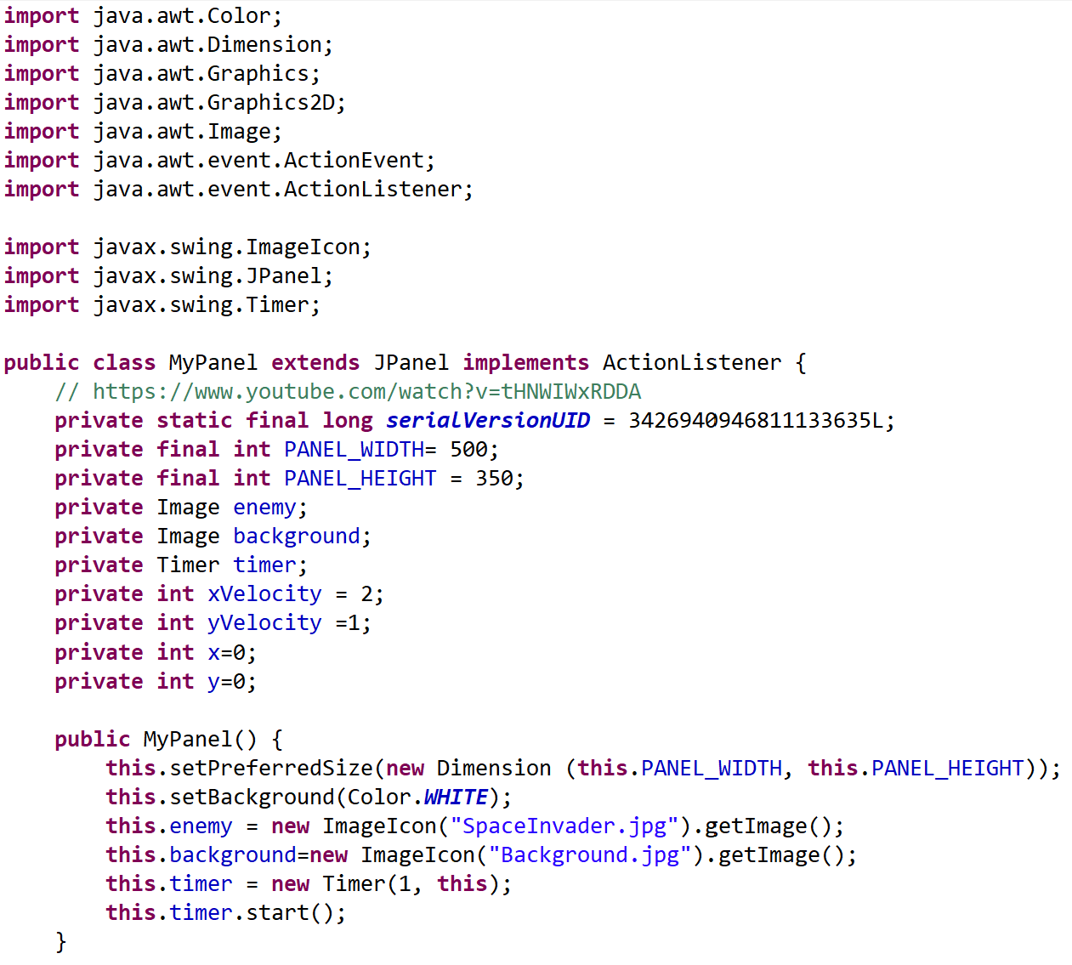
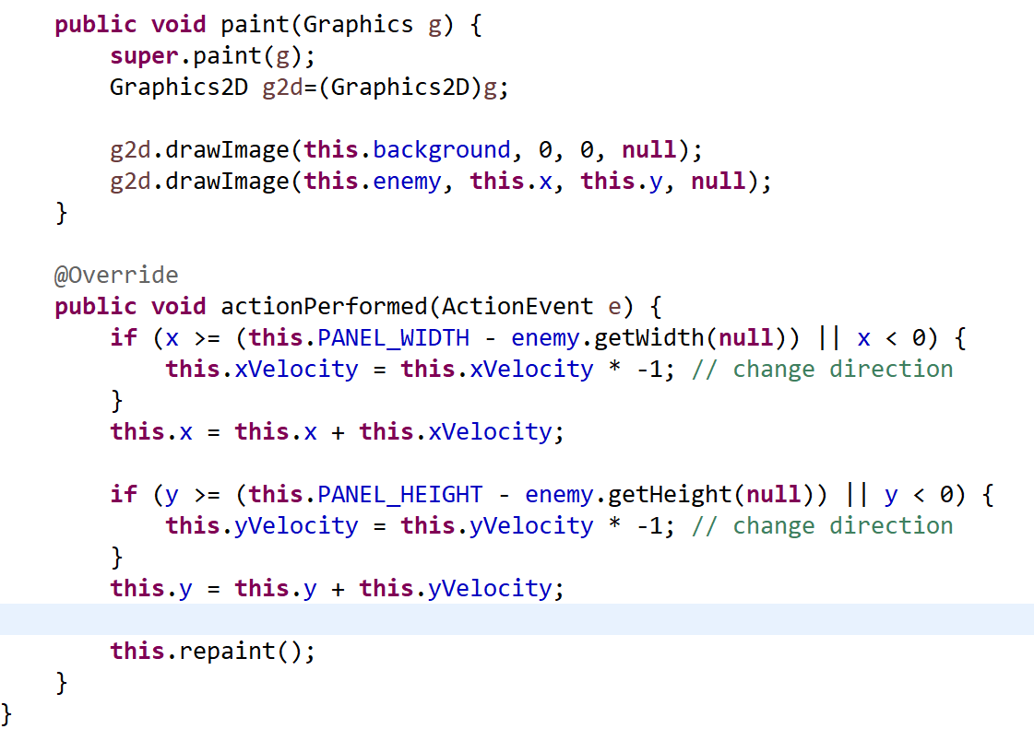
Simple Animation
Timer: executed ever 1ms and calls actionPerformed()

Slide 63
Simple Animation
Horizontal
movement
Vertical
movement
“Current: SimpleAnimation”

Slide 64
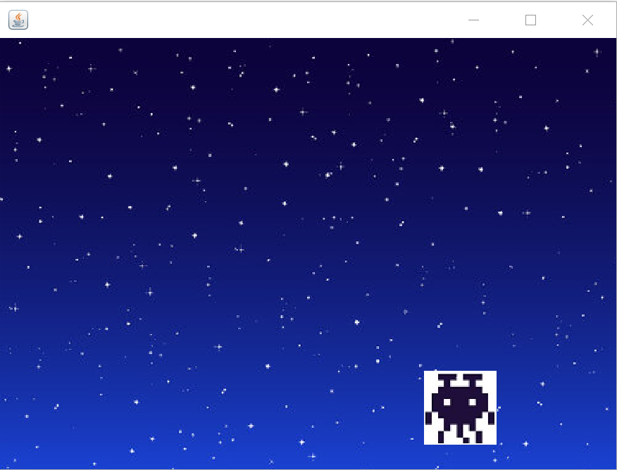
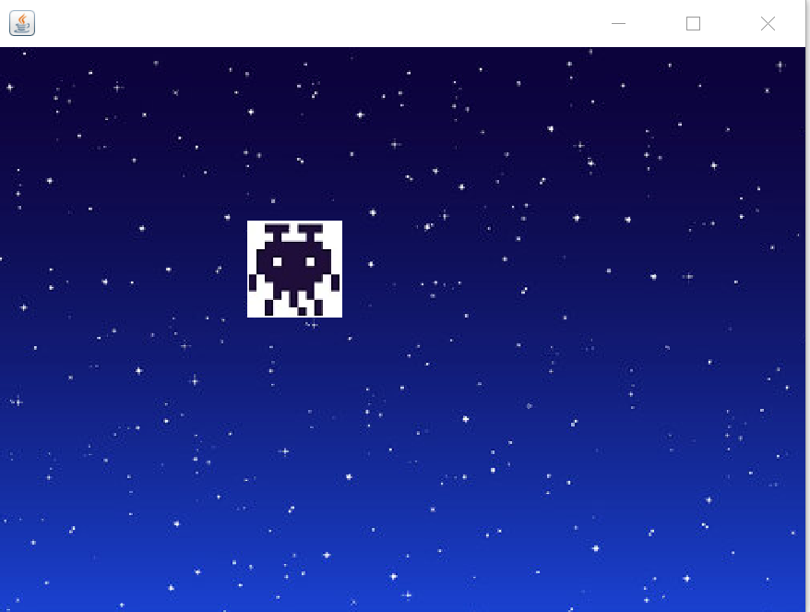
Simple Animation

Slide 65
Done

Slide 66
… to here …

