Slide 1
CSEN160
Fall 2026
Object-Oriented Analysis, Design and Programming
Michael Schimpf, PhD, mschimpf@scu.edu
Department of Computer Science and Engineering

Slide 2
JMeter
Stress Testing

Slide 3
JMeter
100% Java desktop application
For SOAP/XML-RPC, RESTful, HTTP, Web, FTP, Java, JDBC applications
Functional and performance evaluation
Unit testing
Advantages:
Open Source
Distributed testing
Various target systems
Extensibility: Pluggable samplers allow unlimited testing capabilities
Drawbacks:
Chart representation quite confuse
Terminology not very clear
Necessary to start remote machine one by one
Remote machines must be declared in a property file before starting application
Notes:
3

Slide 4
Performance Testing
Performance testing is the process of determining the speed or effectiveness of a:
  Computer
  Network
  Software program
  Device
The factors of performance testing:
  Throughput
  Response Time
  Tuning
  Benchmarking
Notes:
4

Slide 5
Why Performance Testing
Identifies problems early on before they become costly to resolve.
Produces better quality, more scalable code.
Prevents credibility loss due to poor web site performance.
Expose bugs that do not surface in cursory/nice testing:
  Memory management bugs
  Memory leaks
  Buffer overflows
  Etc.
Notes:
5

Slide 6
Performance Testing
Execute in comparison with different versions of the same application.
Performance testing to derive benchmark numbers for the system.
Heavy load is not applied to the system
Stress Testing has heavy load
Tuning is performed until the system under test achieves the expected levels of performance.
Notes:
6

Slide 7
When is it required?
Design Phase:
Pages containing lots of images and multimedia, wait time?
Heavy loads are less important than knowing which types of content cause slowdowns.
Development Phase:
To check results of individual pages and processes
Looking for breaking points
Unnecessary code and bottlenecks
Deployment Phase:
To identify the minimum hardware and software requirements for the application.
Notes:
7

Slide 8
What should be tested?
High frequency transactions:
The most frequently used transactions, impact the overall performance.
Mission Critical transactions:
The important transactions which represents the core functions, should be tested
(failure under load has a big impact).
Read Transactions:
At least one READ ONLY transaction should be included, so that it can be compared to more complex transactions.
(Base Case, Baseline)
Update Transactions:
At least one update transaction should be included so that performance can be compared to other transactions.
Notes:
8

Slide 9
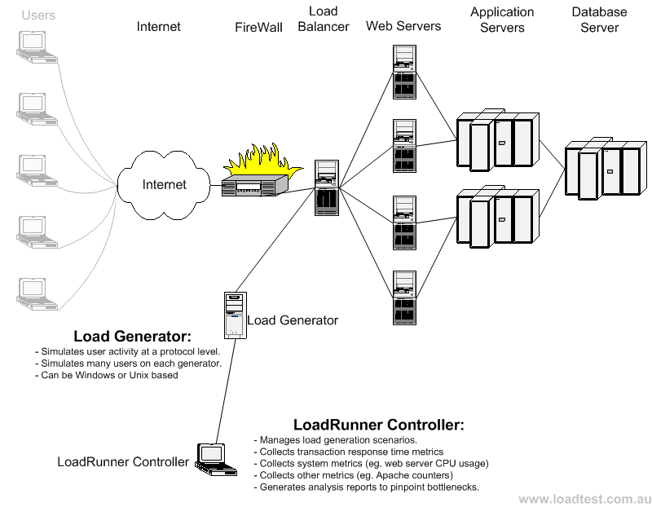
Load Test configuration for a web system
Notes:
9

Slide 10
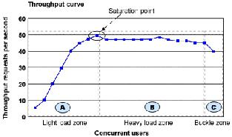
Throughput
Capability of a product to handle multiple transactions in a give period.
Throughput represents the number of requests/business transactions processed in a specified time range.
As the number of concurrent users increase, the throughput increases almost linearly with the number of requests.
Notes:
10

Slide 11
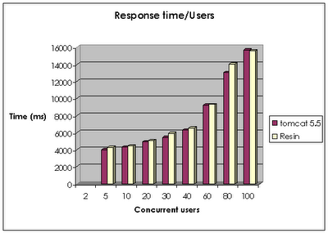
Response Time
Important to find out how much time each of the transactions took to complete.
Response time is defined as the delay between the point of request and the first response.
The response time increases proportionally to the user load.
Notes:
11

Slide 12
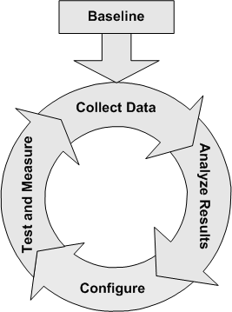
Tuning
Tuning
Testing different settings/configurations in the application.
i.e. how much memory, etc.
Tuning improves the product performance without having to touch the source code.
(ideal case)
Notes:
12

Slide 13
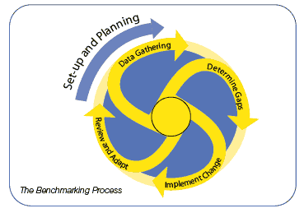
Benchmarking
A very well-improved application does not matter if it still does not match up to the competition.
A careful analysis is needed to check the list of transactions to be compared across products.
(apple-apple comparison)
Benchmarking with competitors is difficult!
(They are not interested in working with you)
Notes:
13

Slide 14
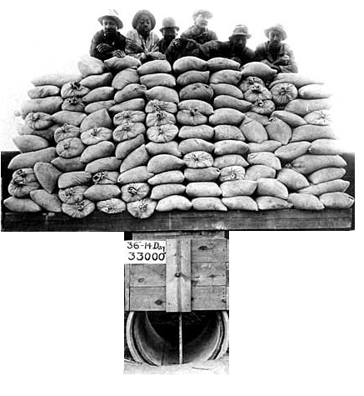
Difference between
Performance, Load and Stress Testing
Load Testing
Process of exercising the system under test by feeding it the largest tasks it can operate with.
Constantly increasing the load on the system via automated tools.
Web-App-Example:
Load is defined in terms of concurrent users or HTTP connections.
Notes:
14

Slide 15

Difference between
Performance, Load and Stress Testing
Stress Testing
Trying to break the system under test by overwhelming its resources.
Purpose is to make sure that the system fails and recovers gracefully.
Example:
Double the baseline number for concurrent users/HTTP connections.
Randomly shut down and restart ports on the network switches/routers that connects servers.
Notes:
15

Slide 16
Done

Slide 17
… to here …

