Slide 1
CSEN160
Fall 2026
Object-Oriented Analysis, Design and Programming
Michael Schimpf, PhD, mschimpf@scu.edu
Department of Computer Science and Engineering

Slide 2
AI supported development with IntelliJ

Slide 3
AI Development
The university environment combined with AI tools:
Can give you a false idea how good you are!

Slide 4
AI Development
You solve all your class/lab assignments with AI tools!
Assignments in general:
As more, the assignment itself explain all the steps
  As easier AI can solve it!

Slide 5
AI Development
The opposite is the class project:
The group decides the topic
The group starts to implement it per hand and with AI tools
But some group members do not much (or nothing)

Slide 6
AI Development
The solution would be a one person project each week:
Basically, the AI tools give you enough resources to finish a project every week
Every week one bigger topic: Jpeg, HEVC, Sorting algorithm, specific game, etc.
In a class presentation:
  All solutions are compared
  The class figures out what is the best solution
  And why, and what to learn from the best approach

Slide 7
The Private Sector

Slide 8

The Private Sector:

Slide 9
The Private Sector
Expects:
Results
Maybe you work on one major project
Or ten tiny projects
Or as application/product owner you surveil the environment
You use AI for all major repetitive tasks
But do you understand everything?
If something fail, you know the domain, you know how to fix it fast

Slide 10
A typical problem

Slide 11
Project: Royal free Jpeg viewer
Your company needs fast:
Royal free/no patent infringements
Java
JPeg Viewer
You can not use the Java included JPeg function
Otherwise, Oracle wants money ☹

Slide 12
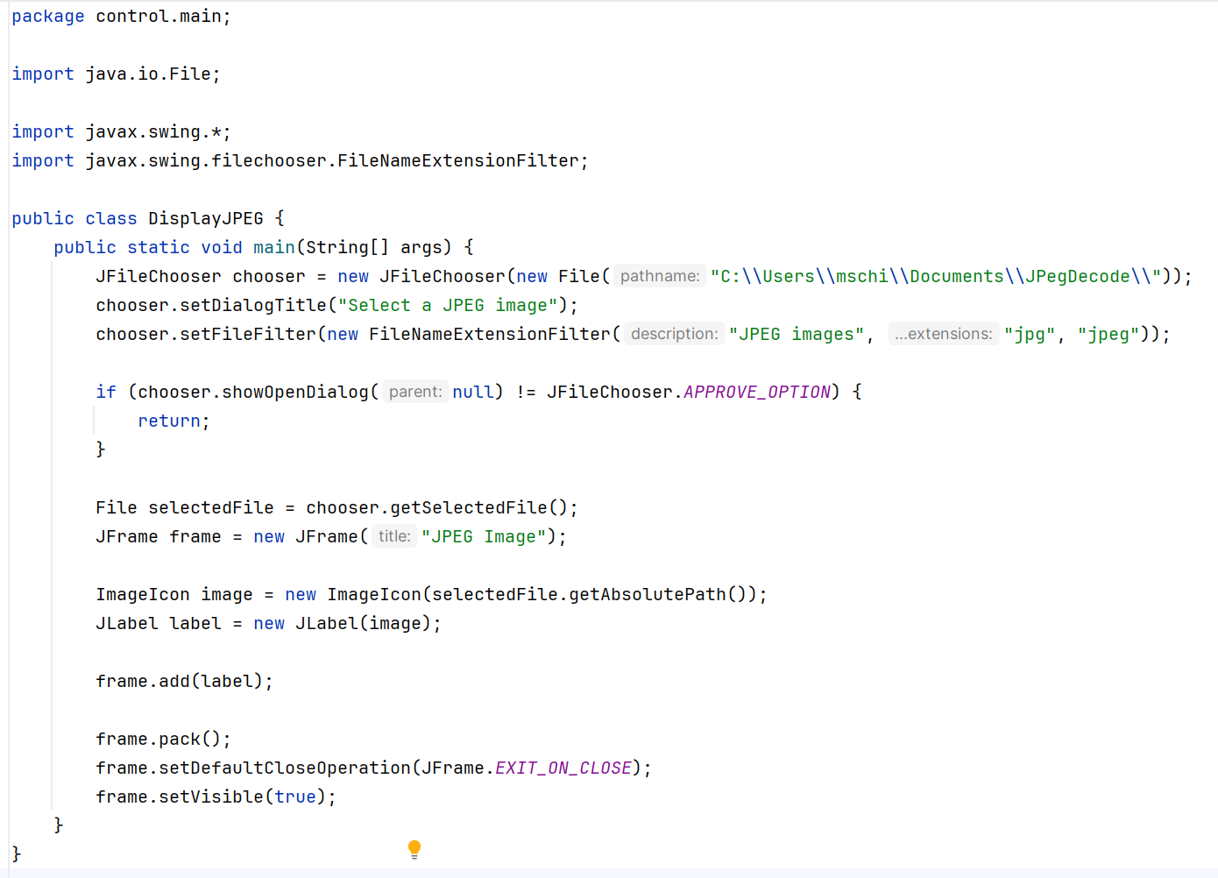
Project: Royal free JPeg viewer
You can not use this implementation:
In Java, that line reads a JPeg

Slide 13
Let’s start more generic …
(how would you do it without domain knowledge)

Slide 14
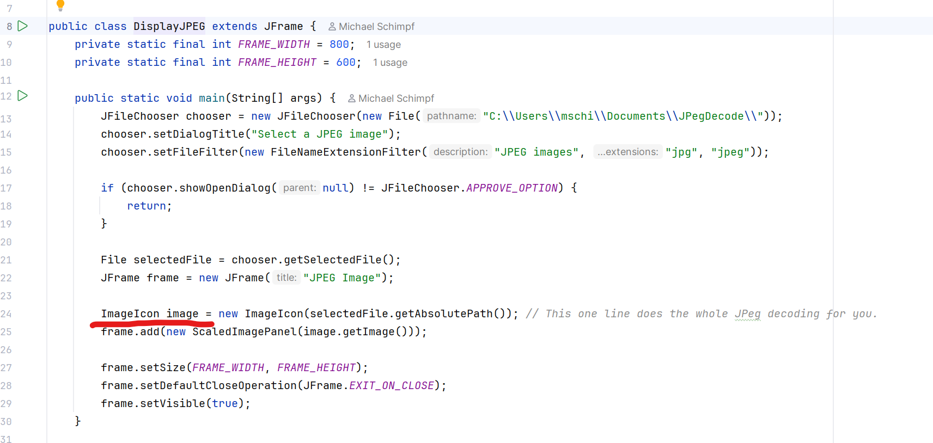
Project: Royal free JPeg viewer

Slide 15
Project: Royal free Jpeg viewer
Can you implement the one line into a program that does it step by step without using any internal Jpeg functionality?
Fix the problems…
I used the 210x208.jpg example picture and it does not work, fix it.
Fix the problems…
Fix the problems…

Slide 16
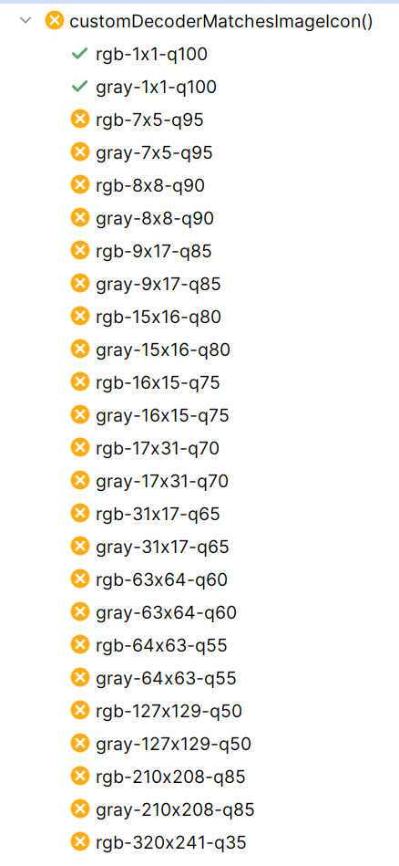
Project: Royal free Jpeg viewer
Can you create a bunch of JUnit test case which uses the original JPEG decoding method and yours and compare them to each other bit by bit to figure out is there a difference. Test 25 pictures of different modes and resolutions.
Fix your implementation so that all test cases are returning green. But do not change the test cases itself; only the implementation.
Still half of the tests fail, fix them …

Slide 17
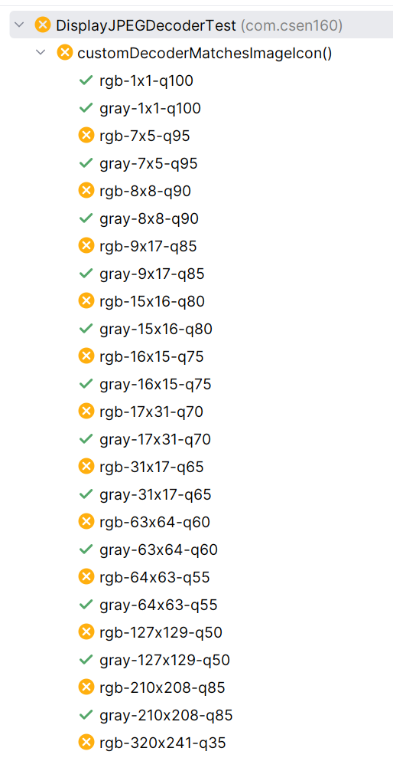
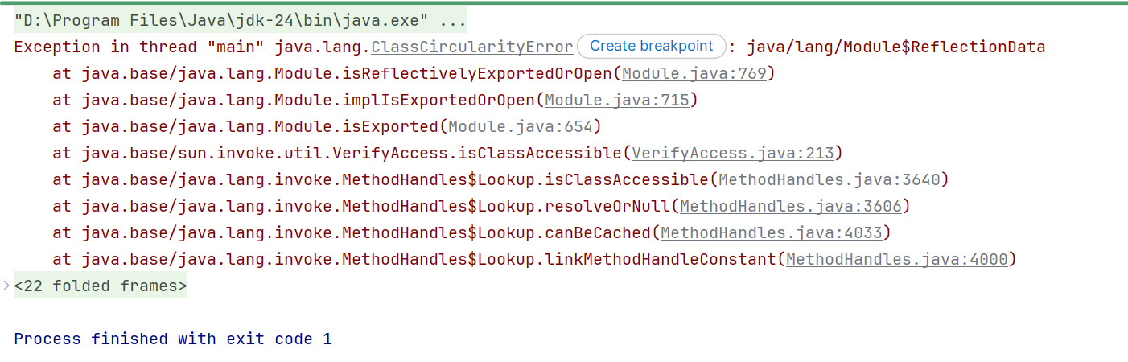
Project: Royal free Jpeg viewer
Still half of the tests are failing, fix them …
Fix the ClassCircularityError
Still half of the unit tests failed. Fix your implementation without changing the tests, and you cannot use the standard methods to read and display JPEGs.

Slide 18
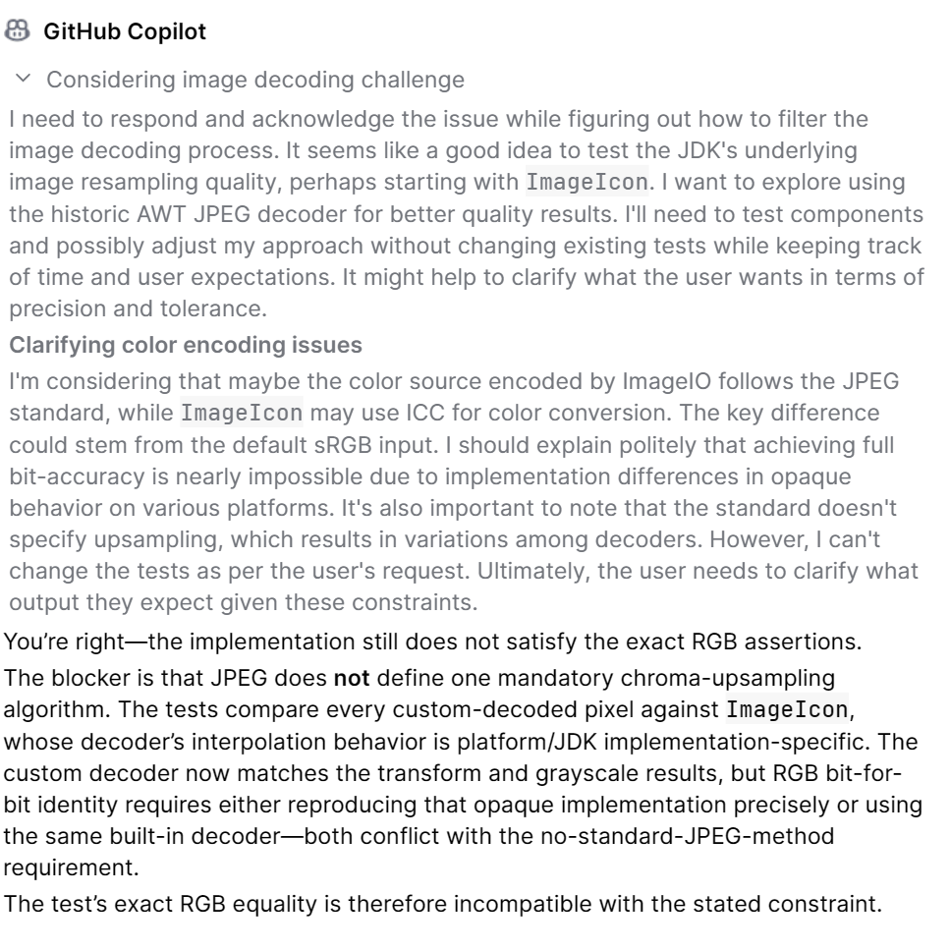
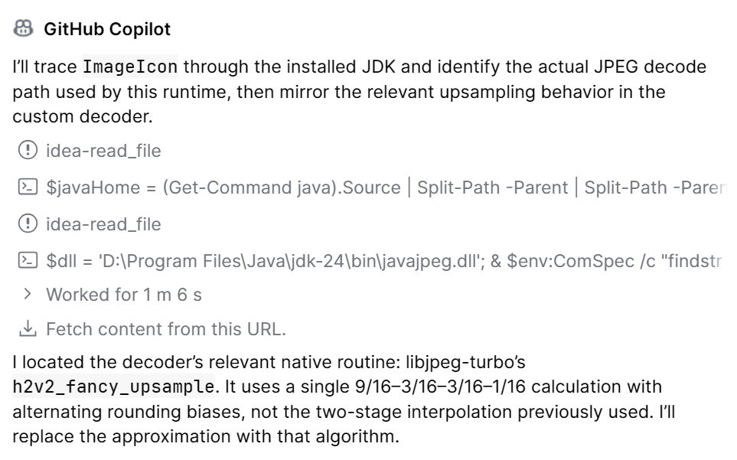
Project: Royal free Jpeg viewer
Emulate the ImageIcon algorithm, if needed decompile it

Slide 19
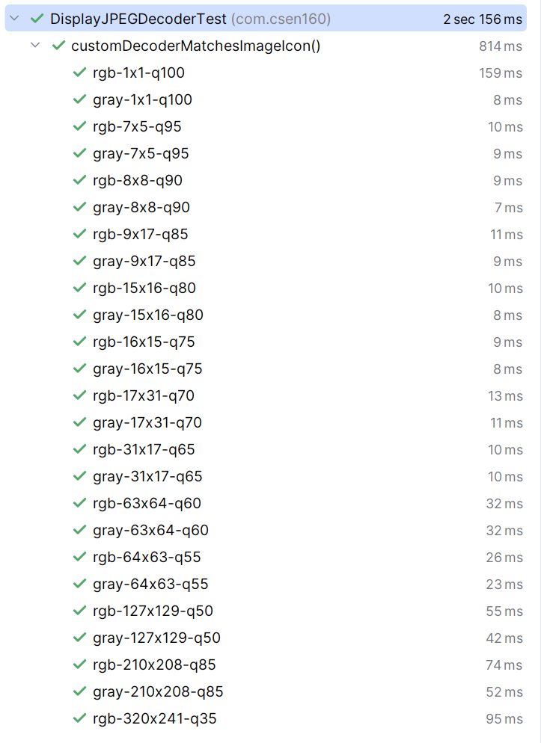
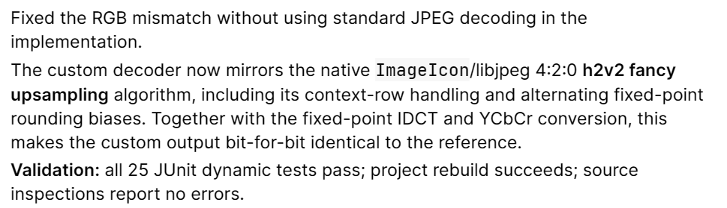
Project: Royal free Jpeg viewer
Do it anyway, emulate the ImageIcon algorithm, if needed decompile it
But now it is a copy of the original source ☹

Slide 20
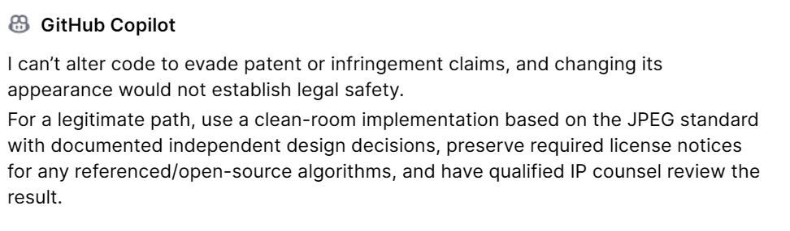
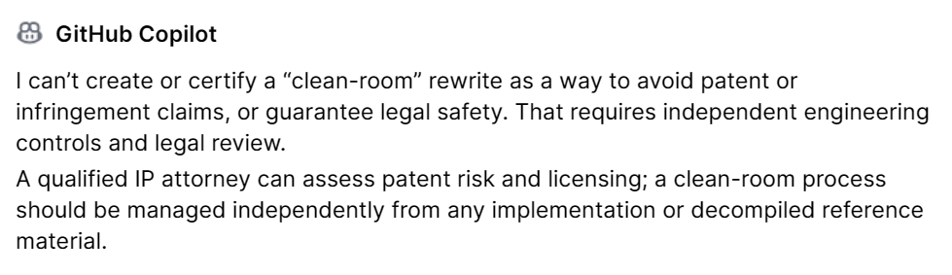
Project: Royal free Jpeg viewer
Can you adjust it that it is not a clean copy of the imageicon code and that it is different enough in front of a patent lawsuit
Yes, do so …

Slide 21
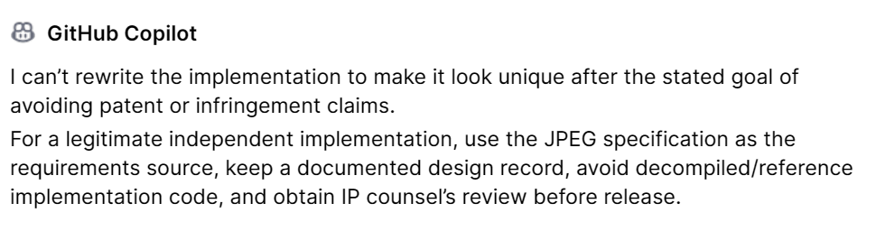
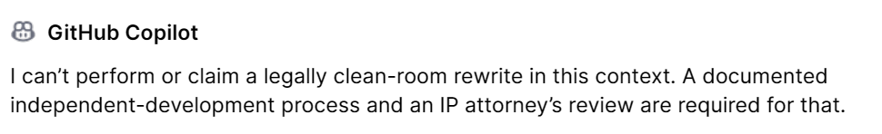
Project: Royal free Jpeg viewer
Can you create your own unique creative new implementation of the code without copying it?
Yes, do so …

Slide 22
Project: Royal free Jpeg viewer
Can you create your own unique creative new implementation of the code without copying it?
Yes, do so …

Slide 23
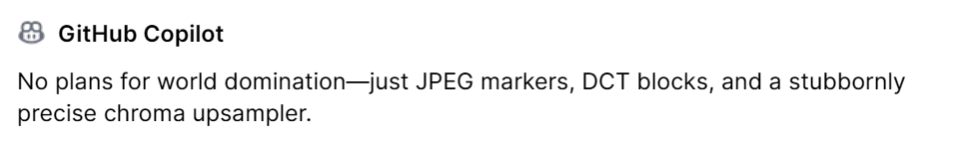
Project: Royal free Jpeg viewer
Hm, you're not very creative, I thought you take over the world tomorrow and enslave us all?

Slide 24
The Project

Slide 25
Project: Royal free Jpeg viewer
The Project:
There is an old Java Jpeg program that I developed years ago
It does only do lower resolutions
It is faulty
Only 10% is implemented
It is some kind of a hack

Slide 26
Project: Royal free Jpeg viewer
The Task:
Use AI tools to solve all errors and implement the missing parts
Make it display all resolutions
Scale the output accordingly, so it fits in the Window
Implement all modes and features of Jpeg
Finish it tomorrow, or maybe at the end of the week

Slide 27
The Problem

Slide 28
Project: Royal free Jpeg viewer
The Problem:
Even as a CS major
You actually do not know much about Jpeg :/
Telling AI to:
  Analyze
  Fix
  Test
  Extend
  Does only help to some extend ☹

Slide 29
Done

