Slide 1
CSEN160
Fall 2026
Object-Oriented Analysis, Design and Programming
Michael Schimpf, PhD, mschimpf@scu.edu
Department of Computer Science and Engineering

Slide 2
AI supported development with IntelliJ

Slide 3
AI Development
The university environment combined with AI tools:
Can give you a very false idea how good you are!

Slide 4
AI Development
You solve all your class/lab assignments totally with AI tools!
Assignments in general:
As more the assignment itself explain the steps
As easier AI can solve it
Maybe you believe, you are an awesome software developer ☺

Slide 5
AI Development
Maybe you believe, you are an awesome software developer ☺
And some students really believe it :/

Slide 6
AI Development
The opposite from an assignment is the class project:
The group decides the topic
The group starts to implement it per hand and with AI tools

Slide 7
AI Development
Still can be misleading:
You are a good project, but you accomplished only something minimal.
Or you one of the project members doing nothing and watching with awww
And still believe you accomplished something

Slide 8
The Private Sector

Slide 9

The Private Sector:

Slide 10
The Private Sector
Expects:
Results
Maybe you work on one major project
Or ten tiny projects
Or as application/product owner surveil the production environment
That you use AI for all major repetitive tasks
But that you understand everything in detail
If something fail, you know the domain, you know how to fix it fast

Slide 11
A typical problem

Slide 12
Project: Royal free Jpeg viewer
Your company needs fast:
Royal free
Java
JPeg Viewer
You can not use the Java included Jpeg function
Otherwise, Oracle wants money, that you do not have

Slide 13
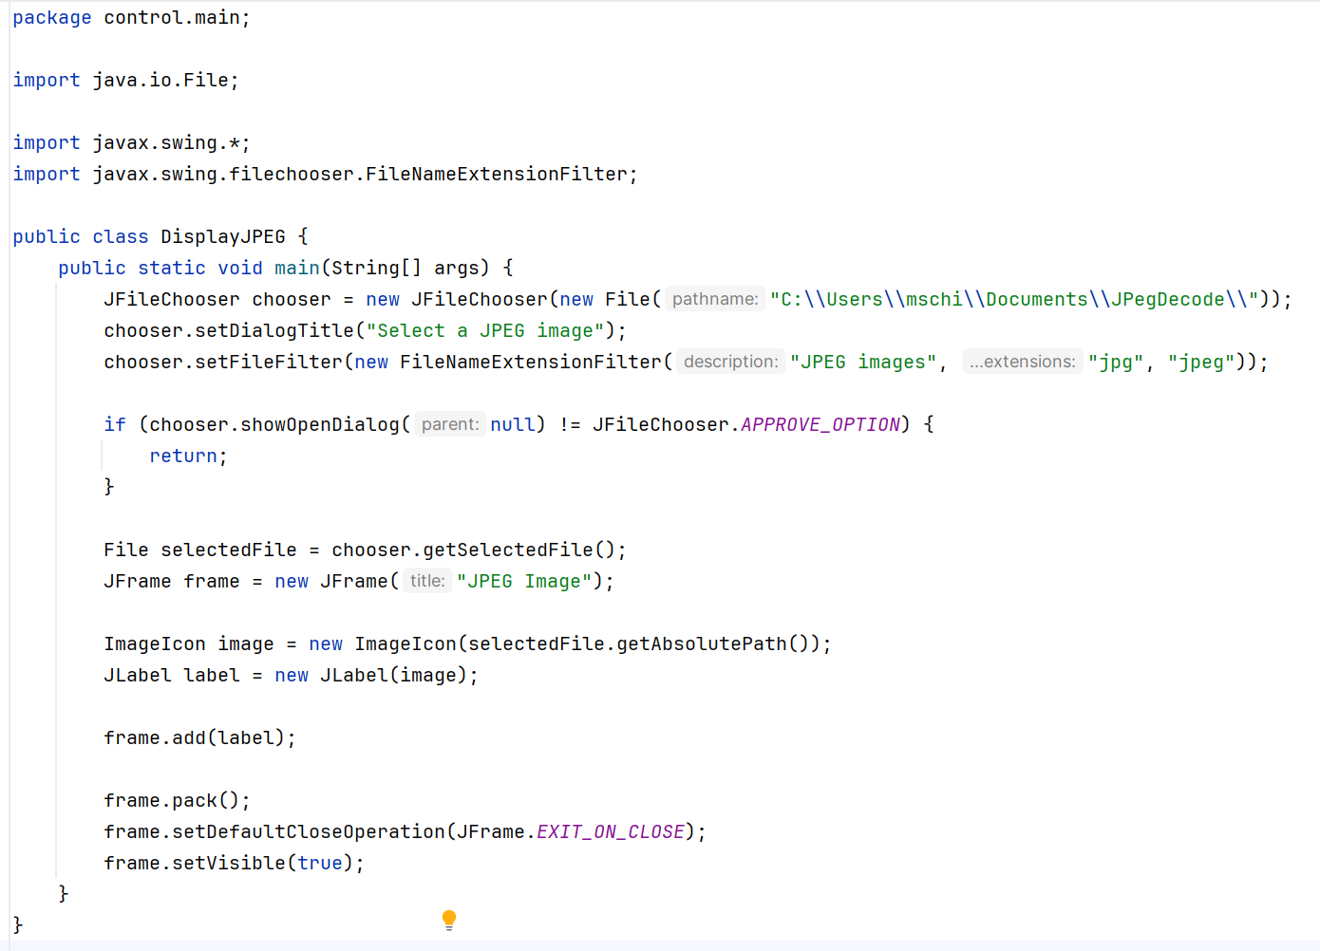
Project: Royal free JPeg viewer
You can not use this implementation:
In Java, that’s it, to display a JPeg

Slide 14
The Project

Slide 15
Project: Royal free Jpeg viewer
The Project:
I have this old Java Jpeg program that I developed years ago
It does only do lower resolutions
It is faulty
Only 10% is implemented
It is some kind of a hack

Slide 16
Project: Royal free Jpeg viewer
The Task:
Use AI tools to solve all errors and implement the missing parts
Make it display all resolutions
Scale the output accordingly, so it fits in the Window
Implement all modes and features of Jpeg
Finish it tomorrow, or maybe at the end of the week

Slide 17
The Problem

Slide 18
Project: Royal free Jpeg viewer
The Problem:
You’re a CS major
But you actually do not know much about Jpeg at all
Telling AI to:
  Analyze
  Fix
  Extend
  Does only help to some extend ☹

Slide 19
Done

