Slide 1
CSEN160
Fall 2026
Object-Oriented Analysis, Design and Programming
Department of Computer Science and Engineering

Slide 2
Object-Oriented Analysis, Design and Programming
Instructor: Michael Schimpf, PhD
Email: mschimpf@scu.edu
Course material and latest info's
  On Camino
  Check often

Slide 3
Object-Oriented Analysis, Design and Programming
Office: Haefey 208
Office hours:
Monday 10:30am to 11:30am
Wednesday 10:30am to 11:30am
Friday 10:30am to 11:30am

Slide 4
Quizzes:
Every Friday
10 multiple choice questions
1 short implementation question
20 minutes
Worst quiz will be dropped

Slide 5
Project:
Team of two
Send project ideas to me before xxx
Project presentation: Friday, November 13th
During our lab session in: Heafey Hall 111

Slide 6
Final Exam:
Finals Week:
December 12/09/26 1:30pm to 4:30pm
30 multiple choice questions
4 implementation questions
Two cheat-sheets (letter size, front and back page)

Slide 7
Final Exam:
OAE
Plus one hour
No OAE office exam
If really needed, final exam can be done in my office:
Must be on the same day
Right before or …
… after the regular final exam

Slide 8
In general
No Zoom
Everything is in person
Quizzes and final on paper

Slide 9
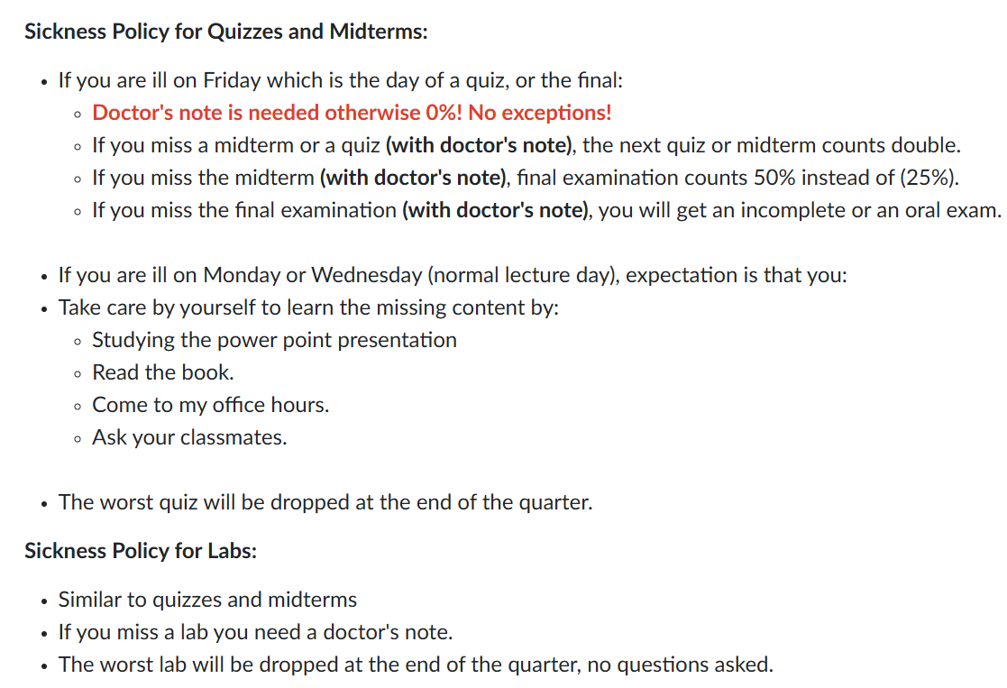

Slide 10
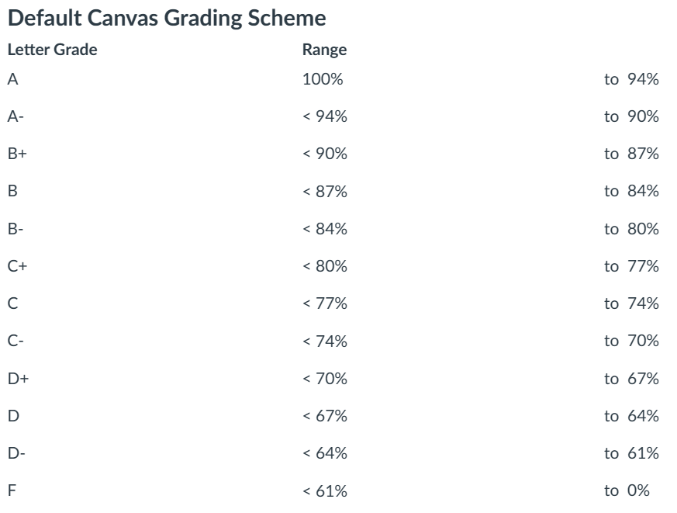
Grade Calculation
Quizzes: 33 1/3%
Project: 33 1/3%
Final exam: 33 1/3%
No curving, what you see is
what you get …

Slide 11
Labs:
TA: Lebin Zhou lzhou@scu.edu
Heafey H111
One lab per week
Should be solvable in the lab session itself
Demo your solution to the TA
Commit your solution after the lab to GitHub
The worst lab will be dropped

Slide 12
Introduce yourself:
Name?
Major?
Experience in object-oriented programming?
Experience in Java/IntelliJ/GitHub?
How do you use AI?
How your friends use AI?

Slide 13
Done

