Slide 1
CSEN160
Fall 2026
Object-Oriented Analysis, Design and Programming
Michael Schimpf, PhD mschimpf@scu.edu
Department of Computer Science and Engineering

Slide 2
File I/O

Slide 3
Classes File I/O
Classes in the java.io package:
  For character streams
    FileReader
    FileWriter
    BufferedReader
    BufferedWriter
  For binary streams
    FileInputStream
    FileOutputStream
    BufferedInputStream
    BufferedOutputStream
  For random access
    RandomAccessFile

Slide 4
FileReader & FileWriter

Slide 5
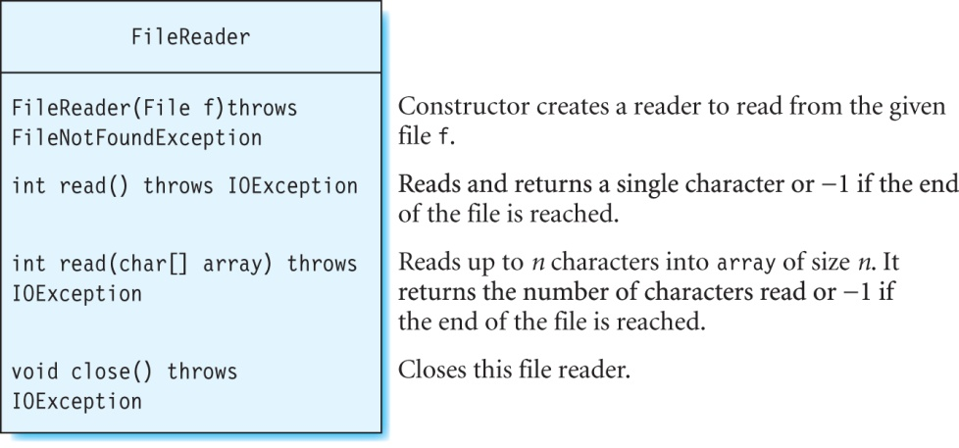
Class FileReader
Used to read/write text files.
Sequential access.
Method read returns the value -1 (called end-of-file or EOF).

Slide 6
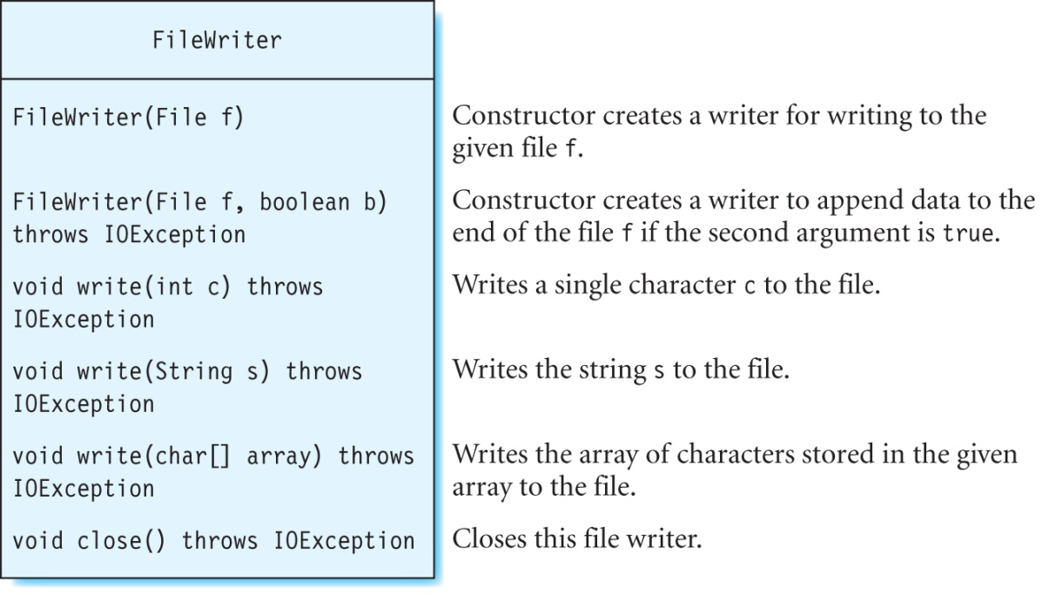
Class FileWriter
Text files.
File is created, if it does not exist.
If the file exists, its content are erased.
To append data, use constructor: FileWriter(filename, true)

Slide 7
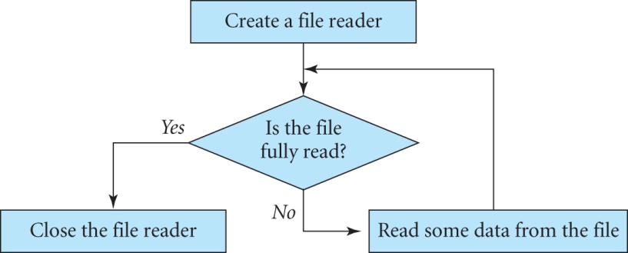
Reading From a File

Slide 8
IntelliJ example
“CSEN160_06_Lecture_FileIO_AdvancedFileIO_Serialize.scu.csen160.A_FileReaderExample”
A text file called info.txt which contains:
“Audio files can be stored in a variety of formats such as wav, wma, mp3, aiff, au and many others.”
Programs:
  Print out each character of info.txt on the console.
  Copy the contents of info.txt to a new file called copyOfInfo.txt.

Slide 9
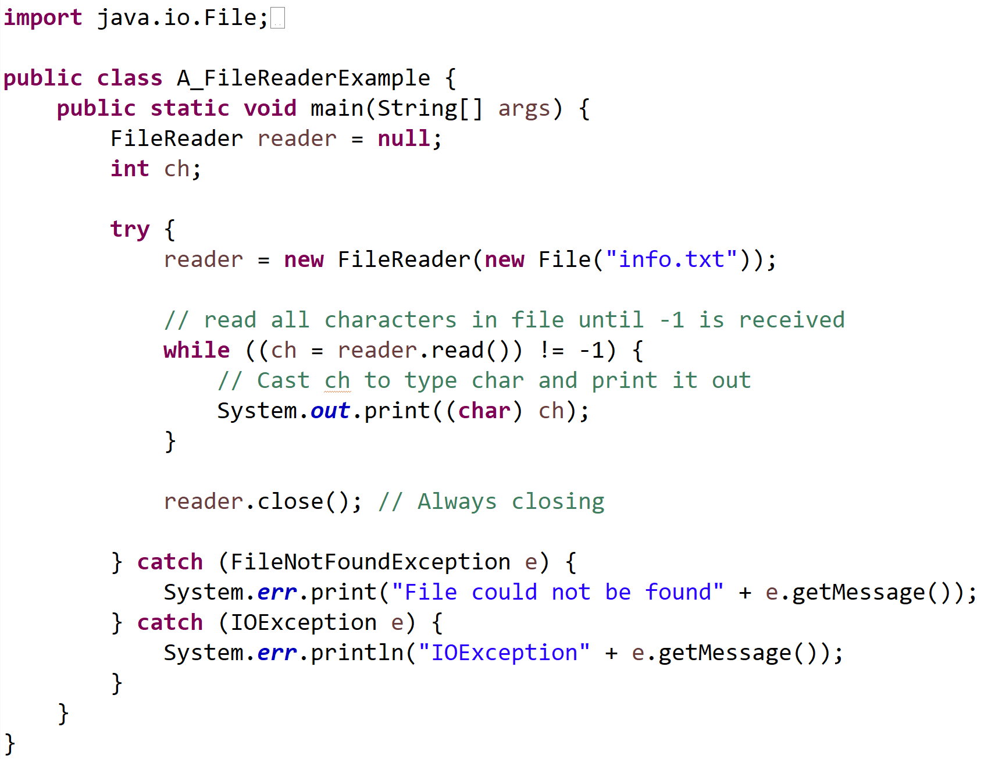
IntelliJ example
“CSEN160_06_Lecture_FileIO_AdvancedFileIO_Serialize.scu.csen160.A_FileReaderExample”

Slide 10
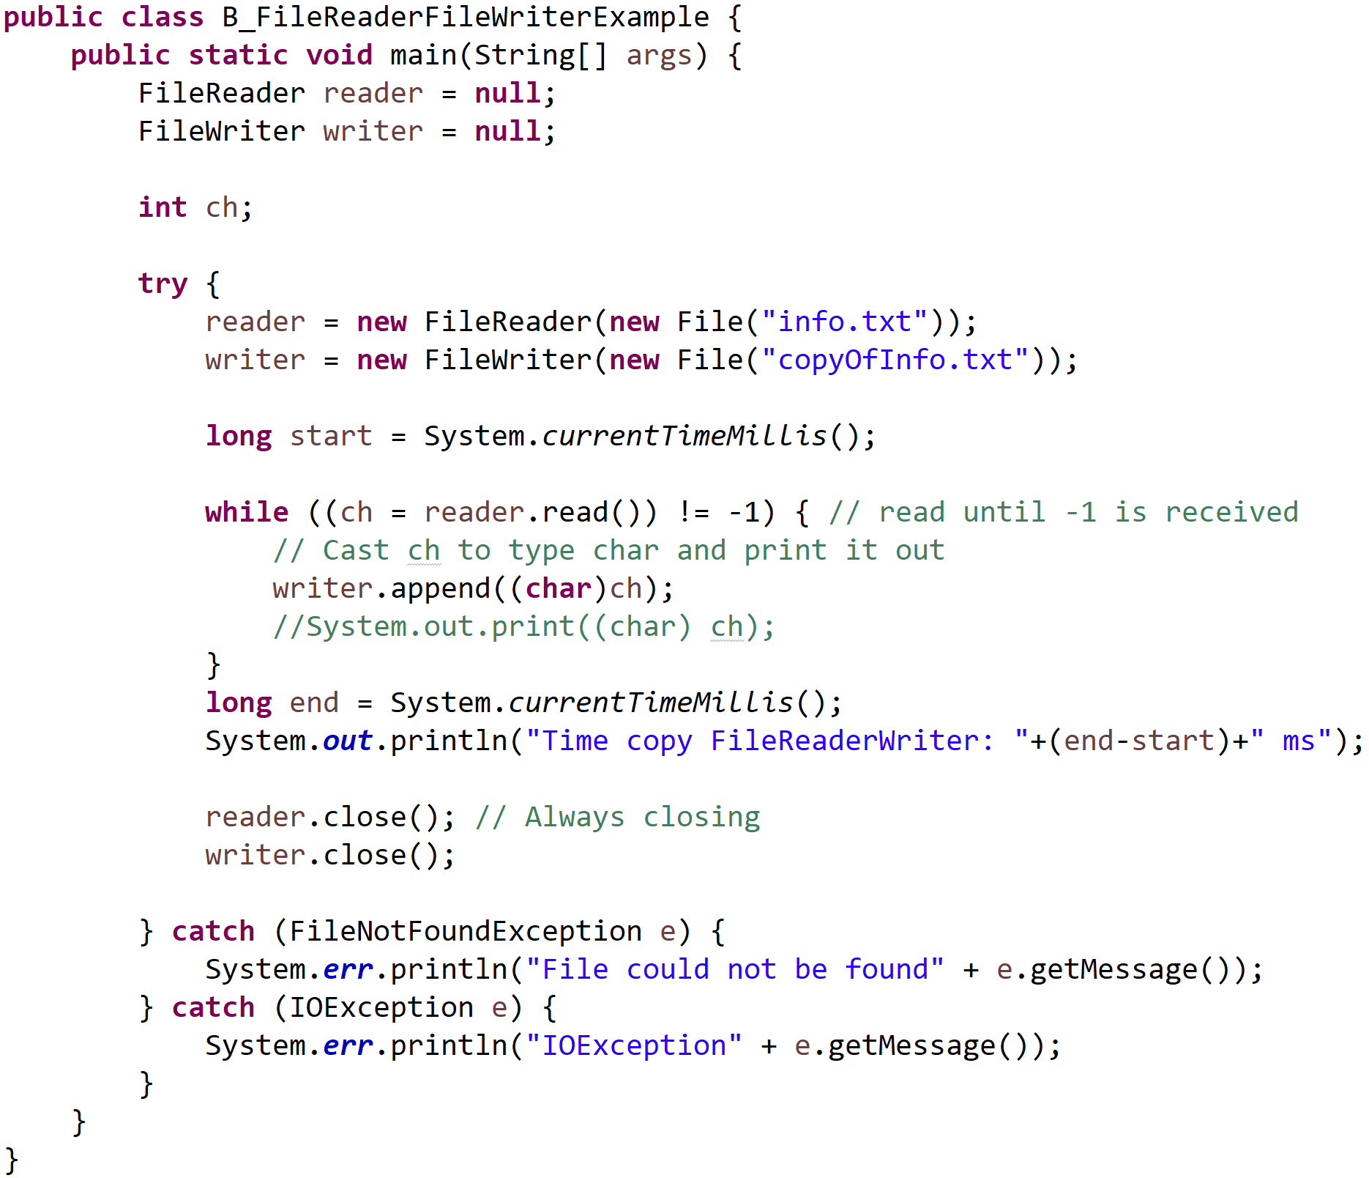
IntelliJ example
“CSEN160_06_Lecture_FileIO_AdvancedFileIO_Serialize.scu.csen160.B_FileReaderFileWriterExample”

Slide 11
BufferedReader & BufferedWriter

Slide 12
Class BufferedReader
Optimizes reading from a stream of type Reader.
A BufferedReader:
  Get a fixed number of characters (at a time).
  Program reads from buffer.
  When all data in buffer has been read, the buffer will be refilled.
  Reduces the number of times the disk is accessed.

Slide 13
Class BufferedWriter
Optimizes writing to a stream of type Writer.
A BufferedWriter:
  Writes each character to a buffer
  Transfers all data from buffer to disk (when the buffer is full)
  More efficient than writing one character at a time (to disk).

Slide 14
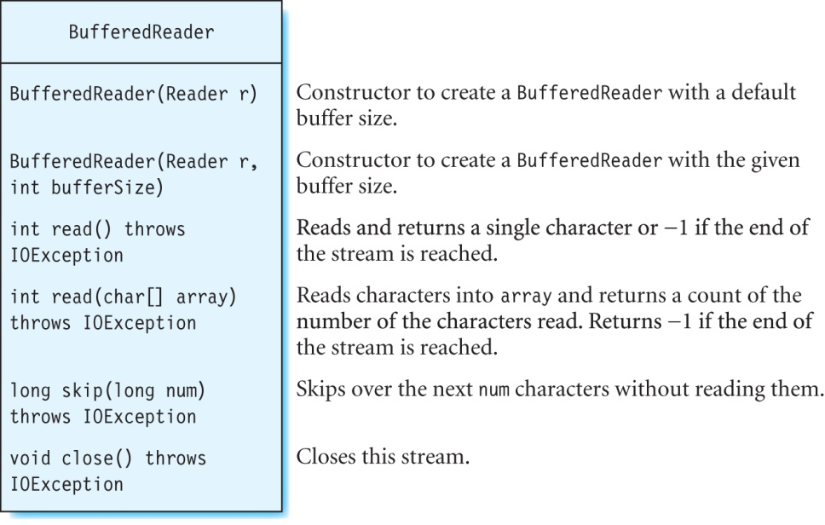
Class BufferedReader

Slide 15
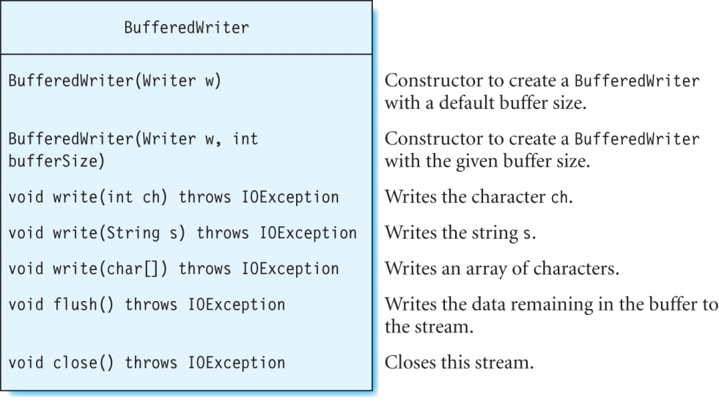
Class BufferedWriter
Important

Slide 16
Classes BufferedReader/BufferedWriter
Note:
  Closing a buffered reader/writer also closes the underlying stream.
  Flush a buffered writer (before closing it).
  Close the readers and writers in the finally block.
Examples:
  bufferedReader = new BufferedReader(reader);
  bufferedWriter = new BufferedWriter(writer);

Slide 17
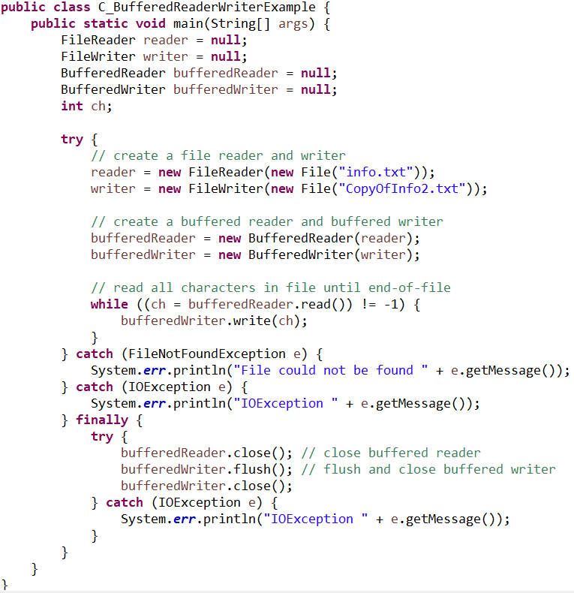
Example
“CSEN160_06_Lecture_FileIO_AdvancedFileIO_Serialize.scu.csen160.C_BufferedReaderWriterExample”

Slide 18
Scanner

Slide 19
Class Scanner
General:
Use scanner this time with a file
Simpler to use than FileReader and BufferedFileReader
Defined in the java.util package

Slide 20
Class Scanner
Token:
Reads data in the form of tokens.
A token consists of a set of characters, separated by whitespace.
Whitespace: space bar, tab, enter keys, …

Slide 21
Class Scanner (continued)
Iterator like:
The next method reads one token from the input each time it is called.
Use hasNext to determine whether a next token is available
(before calling next).

Slide 22
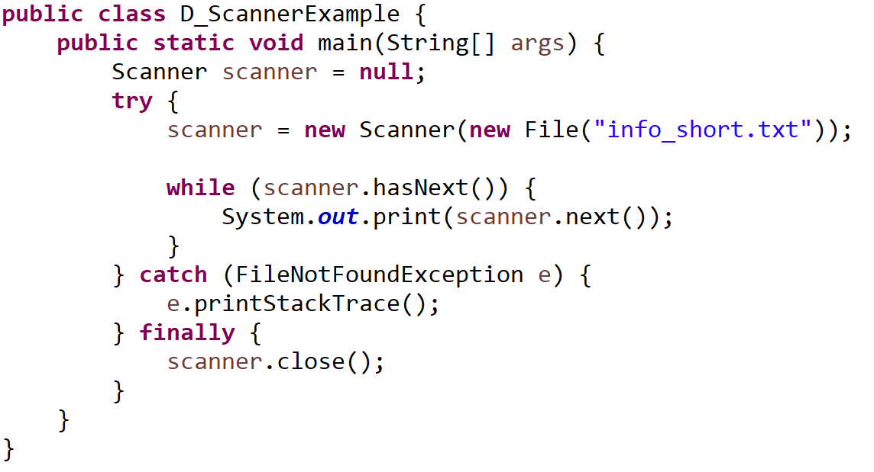
Example
“CSEN160_06_Lecture_FileIO_AdvancedFileIO_Serialize.scu.csen160.D_ScannerExample”

Slide 23
Text File Formats

Slide 24
Text File Formats
Three formats:
  ASCII
  ANSI
  Unicode

Slide 25
ASCII File Format
Uses 7-bit binary numbers to represent characters.
Limited to letters in the English alphabet and some special symbols (such as + and −) that can be seen on a keyboard.

Slide 26
ASCII File Format
Examples:
  “a” has the ASCII code “110 0001” (or decimal value 97),
  “A” has the ASCII code “100 0001” (or decimal value 65).
  …

Slide 27
ANSI
Uses 8-bit codes.
Can represent more information than ASCII
Such as symbols and letters from some European languages ä, ö, and ü.

Slide 28
ANSI
Example:
  The file info.txt is stored in an ANSI format (each character one byte)
  Moving file pointer in info.txt 4 bytes forwards
  Moves it ahead by 4 characters in the file.

Slide 29
Unicode
Stores characters as 16-bit values.
Represents a wider range of characters than ASCII and ANSI
Such as characters from Asian languages.

Slide 30
RandomAccessFile

Slide 31
Accessing Files Randomly
Class RandomAccessFile can be used to:
  read or write to any arbitrary location (within a file).
Used to read: textual and binary data.
Contains a file pointer, which can be moved.

Slide 32
Accessing Files Randomly
Initially: the file pointer is at the beginning.
Reading/writing starts from the location, where this file pointer is positioned.
RandomAccessFile cannot be wrapped inside a buffered stream.

Slide 33
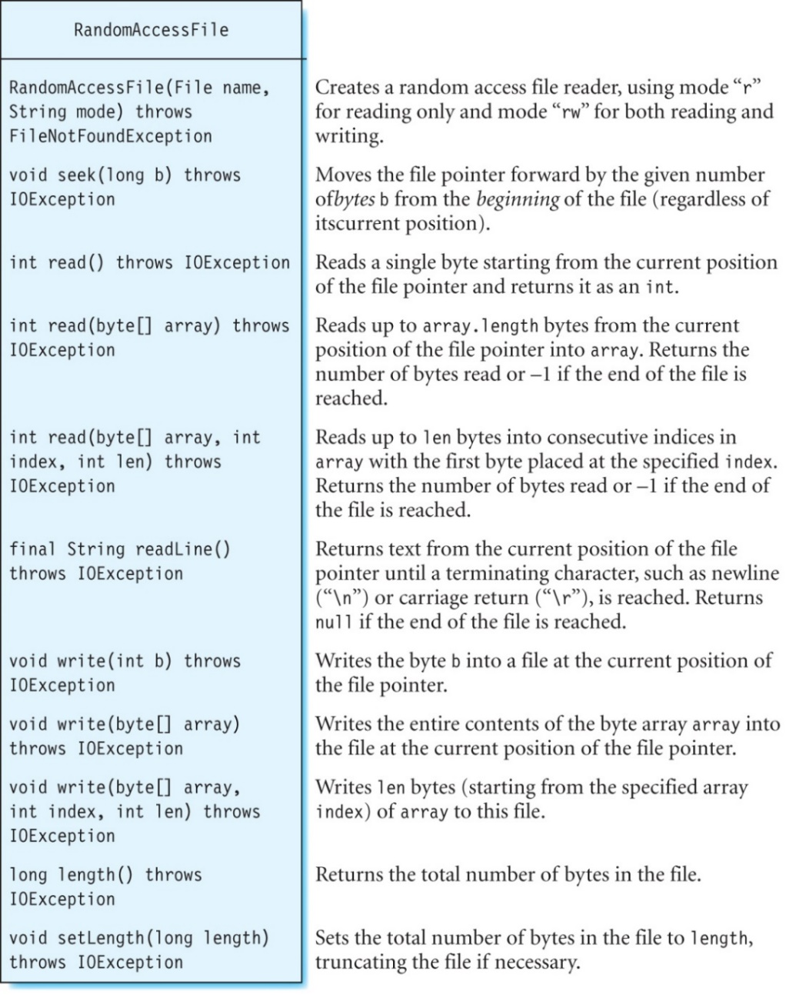
Class RandomAccessFile

Slide 34
Exercise
RandomAccessFile

Slide 35
Exercise
Create file: info.txt and paste the following text:
  “Audio files can be stored in a variety of formats such as wav, wma, mp3, aiff, au and many others.”
Change:
  From “Audio files can be stored in a variety of formats such as wav, wma, mp3, aiff, au and many others.”
  To “Audio files can be stored in a variety of formats such as wav, wma, mp3, aiff, au etc.”
Object: “RandomAccessFile rafile = new RandomAccessFile(new File("info.txt"), "rw");”
Move file pointer with seek:
Write a character with: “rafile.write(ch);”
With “rafile.setLength( some number );” You can actually shorten a file
  rafile.seek(4); // The offset position, measured in bytes from the beginning of the file

Slide 36
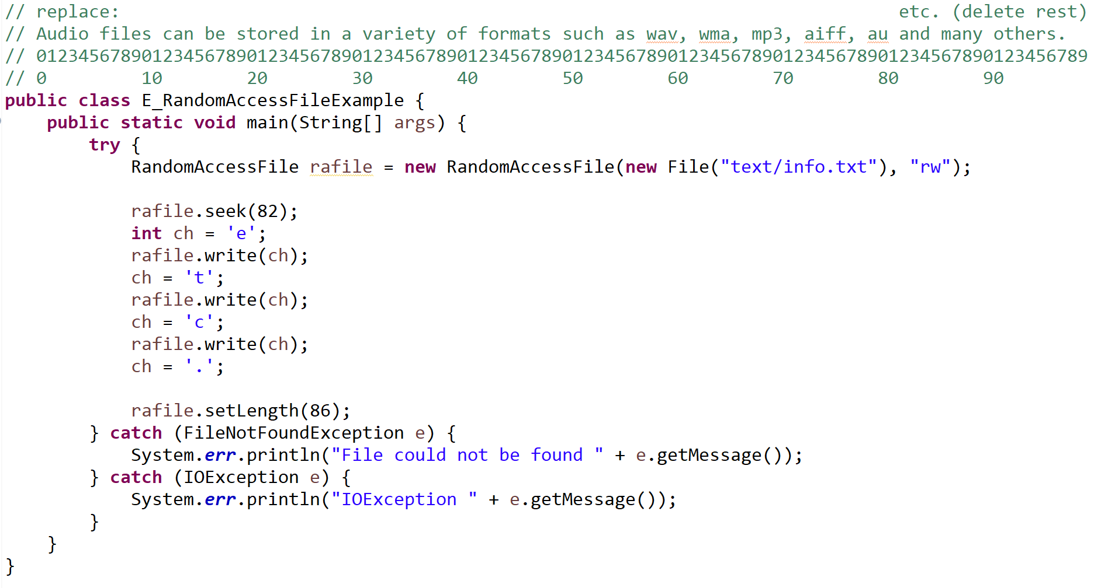
Exercise
“CSEN160_06_Lecture_FileIO_AdvancedFileIO_Serialize.scu.csen160.E_RandomAccessFileExample”

Slide 37
FileInputStream & FileOutputStream

Slide 38
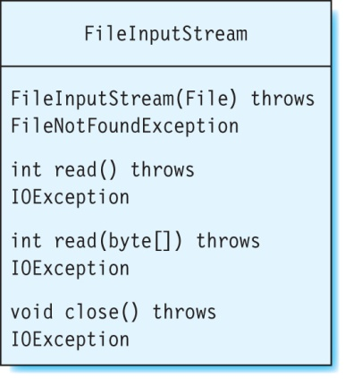
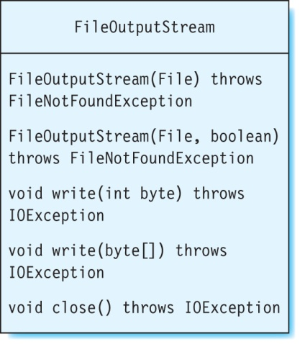
Classes FileInputStream/FileOutputStream
Used for reading/writing binary files.

Slide 39
Binary Files
Different from text:
  A text file is processed as a sequence of characters (source).
  A binary file is processed as a sequence of bytes (source).
Example: WAV files that store audio data.
Use BufferedInputStream/BufferedOuputStream
to manipulate these files.

Slide 40
Audio Example

Slide 41
Terminology
Frequency: rate at which air particles vibrate in response to a sound.
The frequency is the pitch of the sound.
  If the frequency is high, the sound has a higher pitch.
  If the frequency is low, the pitch is lower.
Intensity describes the loudness of a sound.
The volume of sound is measured in decibels, or dB for short.

Slide 42
Digitizing Sound
Uses two steps:
  Sampling: process of recording amplitudes, of a sound wave.
  Quantization: process of converting analog amplitudes, into an integer-value.

Slide 43
Sampling
The sample rate is the total number of samples (per second).
Frequency itself is not directly recorded.
When the samples played back (at the same rate as they were recorded),
the original frequencies are reproduced.
The unit for a sample rate is Hz (number of samples per second).

Slide 44
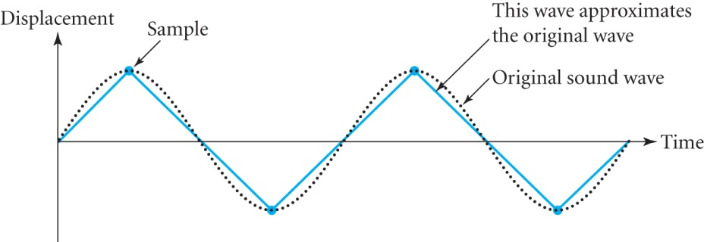
Sampling (continued)
Need at least two points from every period (to approximate a sine curve).
The sampling rate should be at least twice the max frequency in the signal
(known as Nyquist rate).
Sound is composed of individual waves with different frequencies.

Slide 45
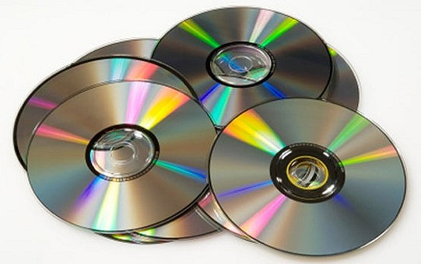
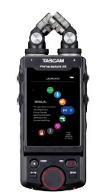
Sampling (continued)
The human ear can hear frequencies up to 20,000 Hz. What should be the sampling rate?
  The value should be at least 40,000 samples per second, or 40,000 Hz.
  The sampling rate for CDs is 44.1 kHz.
  Tascam Portacapture X8 up to 196KHz 32Bit

Slide 46
Quantization
The samples are stored as binary numbers.
A sample represents the intensity, or loudness.

Slide 47
Quantization
The number of bits determines how many levels are available:
  If a single bit is used in a sample, there will be only two distinct sound levels:
    0
    1
  If two bits are used, there will be four sound levels, with values:
    00
    01
    10
    11
  With 8 bits, there are 256 levels.
  CD-quality sound uses 16 bits, which provides 65,536 sound levels.

Slide 48
Wave File

Slide 49
Class AudioMixer
Read and display the WAV file header.
Merge WAV files.
Play WAV files

Slide 50
Class AudioMixer
Assumption:
  WAV file is uncompressed
  Mono or stereo channel
  Sample size: 8, 16, 24 or 32 bits

Slide 51
WAV Files
Consist of two parts:
  Header: contains important information: audio format, sample rate, byte rate, …
  Samples: contain the audio data.
Header has a size of 44 bytes.

Slide 52
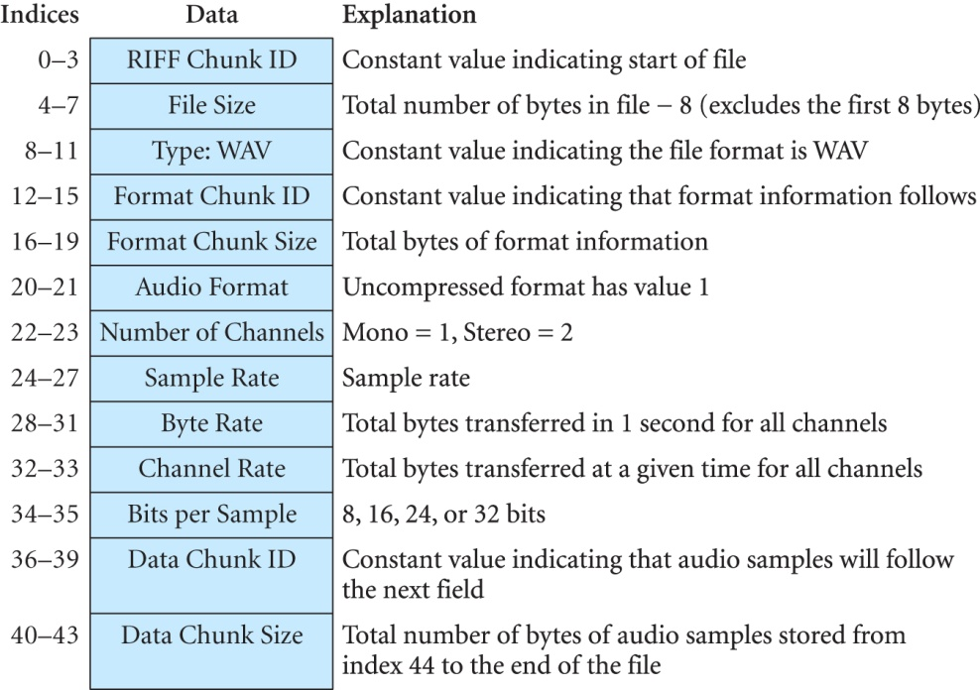
A WAV File Header
Bytes/

Slide 53
Class AudioMixer: Displaying the Header of a WAV File
The first four bytes (in binary) in a WAV header represent the RIFF Chunk ID:
  01010010 (decimal 82) “R”
  01001001 (decimal 73) “I”
  01000110 (decimal 70) “F”
  01000110 (decimal 70) “F”
The bytes 8 to 11 (Type: WAV field) have the decimal values 87, 65, 86, and 69
“W” “A” “V” “E”.
These bytes identify a file as WAV.

Slide 54
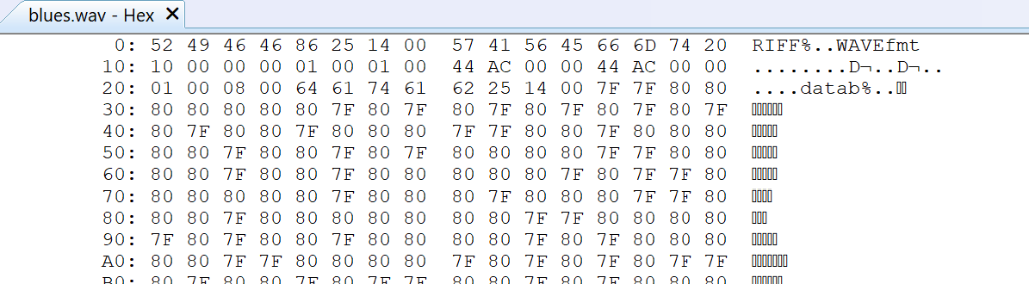
A WAV File Header
52(hex) = 82(dec) = “R”
49(hex) = 73(dec) = “I”
46(hex) = 70(dec) = “F”
46(hex) = 70(dec) = “F”
57(hex) = 87(dec) = “W”
41(hex) = 65(dec) = “A”
56(hex) = 86(dec) = “V”
45(hex) = 69(dec) = “E”

Slide 55
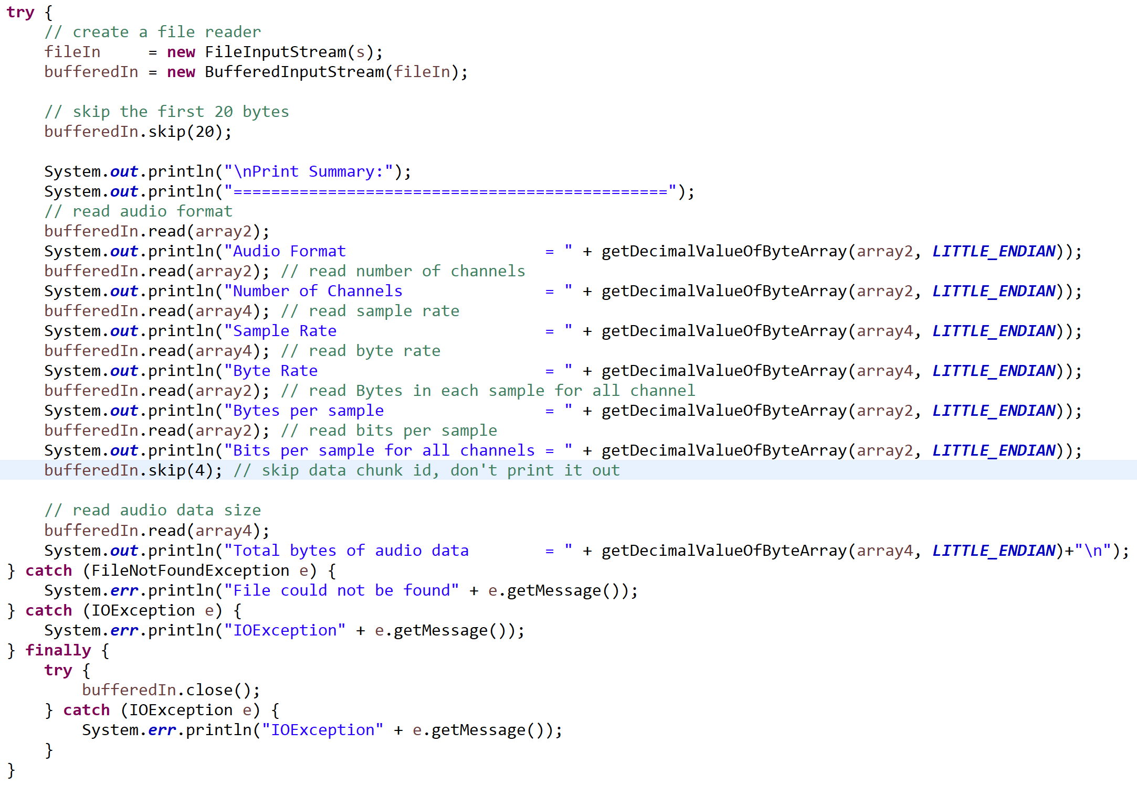
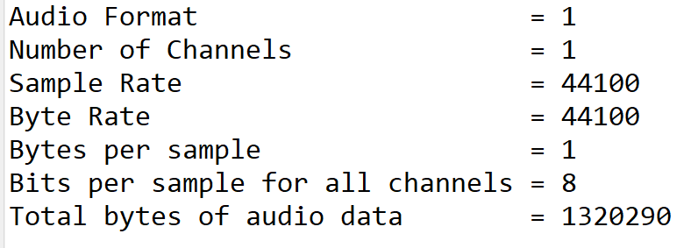
Class AudioMixer: Displaying the Header of a WAV File
“CSEN160_06_Lecture_FileIO_AdvancedFileIO_Serialize.scu.csen160.AudioPlayer”

Slide 56
Big-Endian and Little-Endian

Slide 57
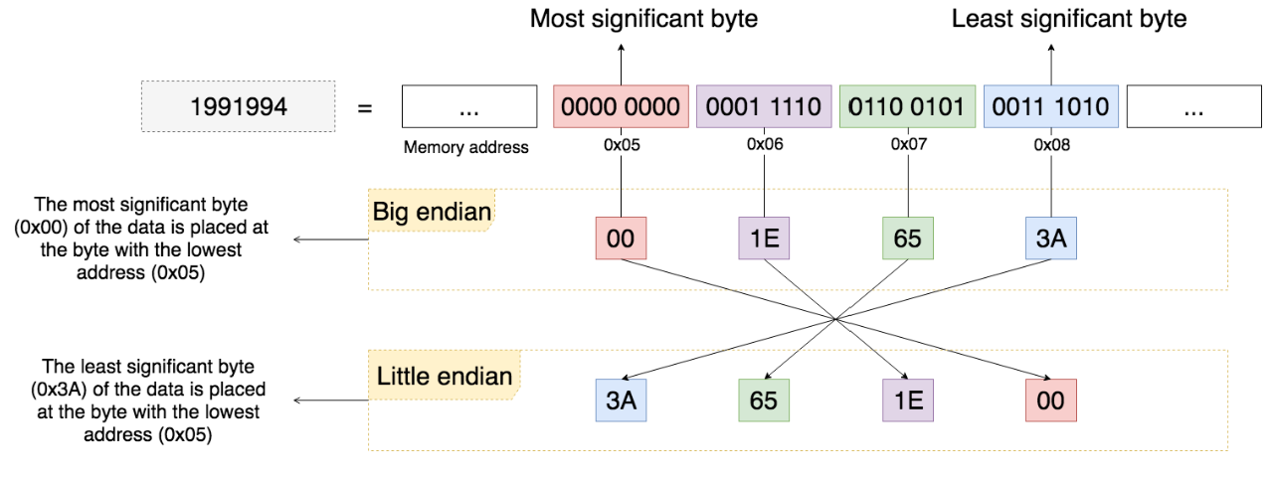
Big-Endian and Little-Endian Order
The first Macintosh models
based on 68K CPUs
RISC CPUs/Apple in
PowerPC and ARM systems
x86-64
6502 in
Apple II …
Source: https://uynguyen.github.io/2018/04/30/Big-Endian-vs-Little-Endian/

Slide 58
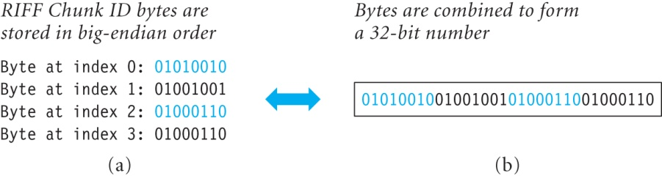
Big-Endian and Little-Endian Order
These fields are stored in: big-endian order
RIFF Chunk ID
Type
Format Chunk ID
Data Chunk ID

Slide 59
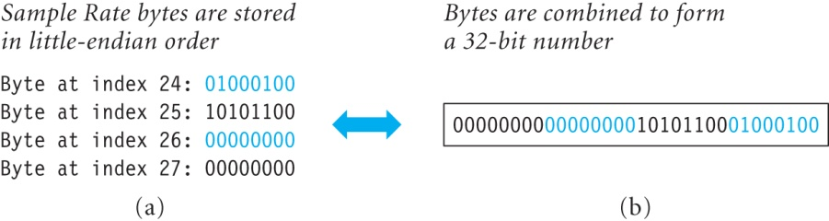
Big-Endian and Little-Endian Order
The remaining fields are little-endian order:

Slide 60
A WAV File Header
Bytes/
big-endian
little-endian
big-endian
big-endian
little-endian
little-endian
little-endian
little-endian
little-endian
little-endian
little-endian
big-endian
little-endian

Slide 61
Changing Binary Values in an Array to Decimal
The four bytes of Sample Rate in a WAV Header are stored in an array of
type byte called sampleRateArray:
  sampleRateArray [0] = 00000000
  sampleRateArray [1] = 00000000
  sampleRateArray [2] = 10101100
  sampleRateArray [3] = 01000100

Slide 62
Changing Binary Values in an Array to Decimal
Use the constructor of BigDecimal to get the decimal value of this binary number:
  public BigInteger(byte[] val)
  converts a byte array in big-endian order.
Example:
  BigInteger sampleRate = new BigInteger(sampleRateArray);

Slide 63
Changing Binary Values In an Array to Decimal continued
Array passed to the BigInteger constructor must be big-endian.
If the array is little-endian, it must be reversed.
Add method getDecimalValueOfByteArray(…) to our class.

Slide 64
Class AudioMixer: Displaying Header in Decimal
Sample output of method printSummary(…):
  Audio Format = 1
  Number of Channels = 1
  Sample Rate = 44100
  Byte Rate = 44100
  Bytes per sample = 1
  Bits per sample for all channels = 8
  Total bytes of audio data = 1320290

Slide 65
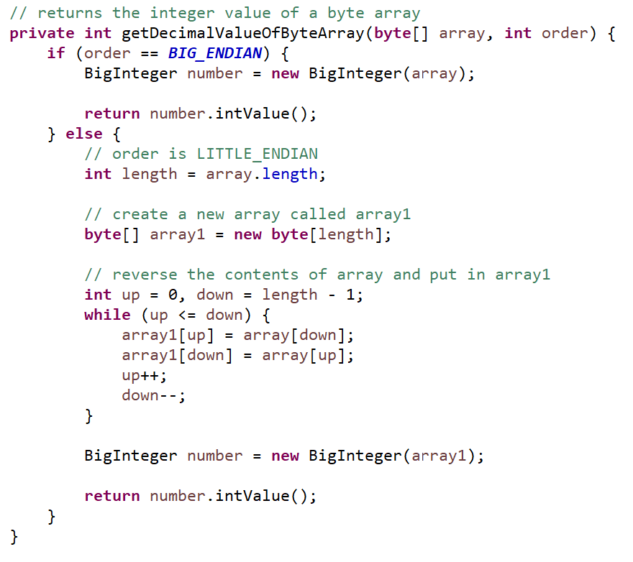
Class AudioMixer: Method to Return Integer Value of a Byte Array
IntelliJ:
ShowWAVEHeader → getDecimalValueOfByteArray(…)
ShowWAVEHeader→ printSummary (…)

Slide 66
AudioSystem
Play Audio

Slide 67
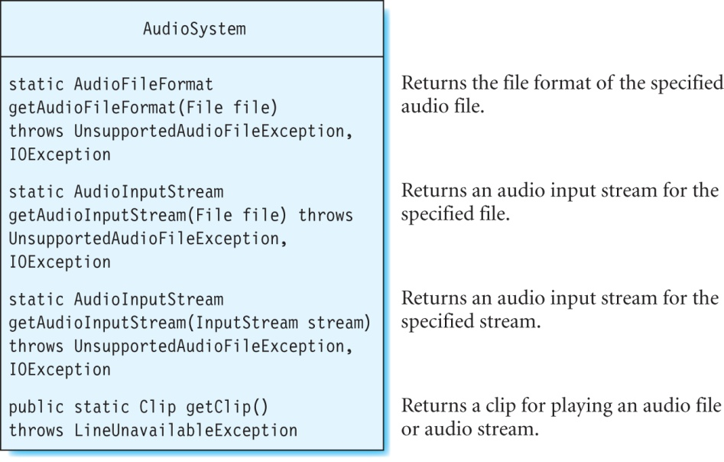
Class AudioSystem
Main class in Java’s sound API:
Contains various static methods, that provide information about audio files

Slide 68
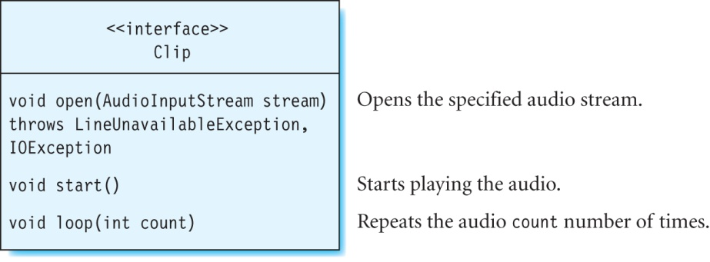
Interface Clip
A clip can open an audio stream, and play it.
The Clip interface declares several methods, to open and play a clip.
You can obtain a clip using the getClip method in AudioSystem.
interesting

Slide 69
Class AudioInputStream
To read an audio file, convert it to an audio stream,
using the getAudioInputStream(…) method of AudioSystem:
To open an audio stream, use AudioInputStream as argument.
To start playback, use start method:
AudioInputStream stream = AudioSystem.getAudioInputStream(audioFile);
Clip clip = (Clip) AudioSystem.getClip();
clip.open(stream); // open the audio stream
clip.start(); // start playing the audio

Slide 70
The LineListener Interface
After the audio has been played, event: LineEvent.Type.STOP happens
Add an event handler: LineListener
using addLineListener(…) method to listen for this event.
The interface LineListener contains an update(…) method:
  void update(LineEvent event)

Slide 71
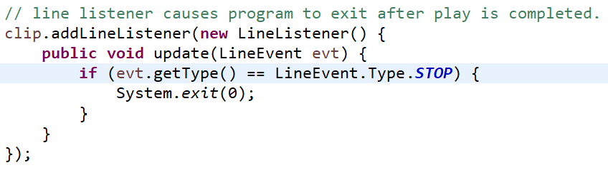
The LineListener Interface
The event listener must implement this method update.
The LineEvent class, contains the method getType,
to obtain the type of the event that has occurred
(such as START or STOP, among others).

Slide 72
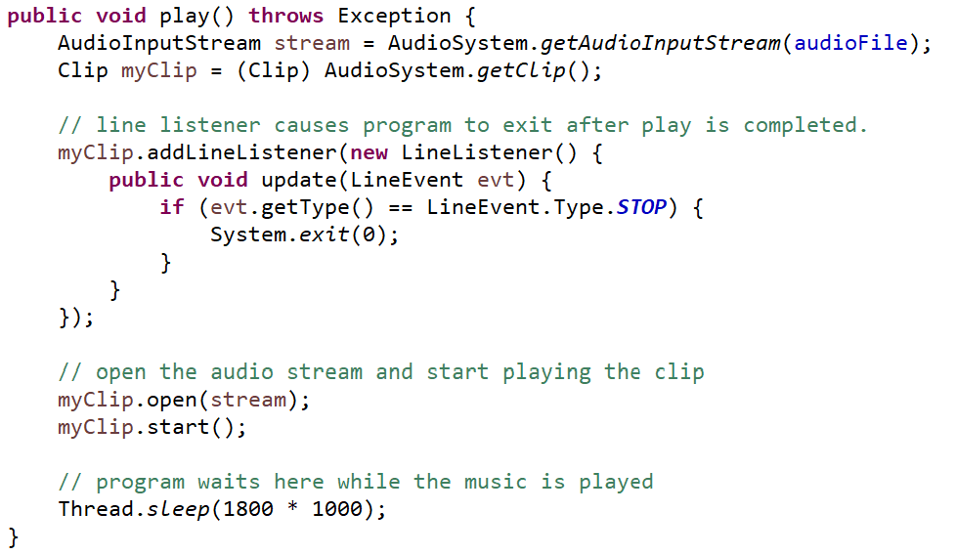
AudioMixer: Adding a Method to Play Audio Files
“CSEN160_06_Lecture_FileIO_AdvancedFileIO_Serialize.scu.csen160.AudioPlayer.play(…)”

Slide 73
Merge Audio

Slide 74
Class AudioMixer: Mixing Two WAV Files
The algorithm:
  Combine audio samples from source WAV files:
    data3 = data1 + data2 - 128;
  The value 128 represents silence for 8-bit audio.
  Subtracting 128 from the sum of data1 and data2,
  makes sure that when data1 and data2 are both 128,
  Then that data3 is also 128.
  Samples can have values only from 0 to 255 for 8-bit audio,
  and so data3 is constrained to lie within this range.

Slide 75
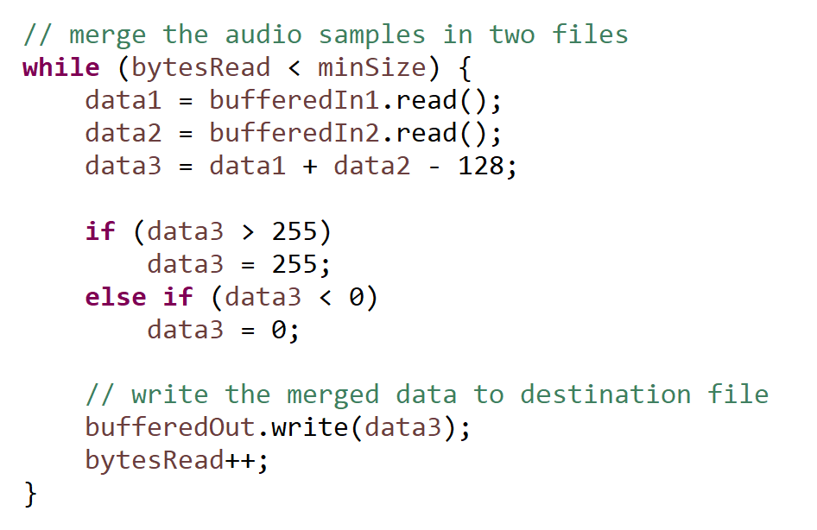
Class AudioMixer: Mixing Two WAV Files
“CSEN160_06_Lecture_FileIO_AdvancedFileIO_Serialize.scu.csen160.E_AudioMixer.merge(…)”

Slide 76
Serialization

Slide 77
Serialization
Serialization: saving an object to disk:
When an object is serialized: it is flattened/deflated.
The reverse of constructing an object back from the binary data is deserialization.
A deserialized (or inflated) object is one whose state has been restored.

Slide 78
Classes ObjectInputStream and ObjectOutputStream
ObjectOutputStream is used to convert the instance fields,
of an object into a stream of bytes.
This byte stream can be sent to a FileOutputStream
The binary data can be read back, using a FileInputStream
and sent to an ObjectInputStream

Slide 79
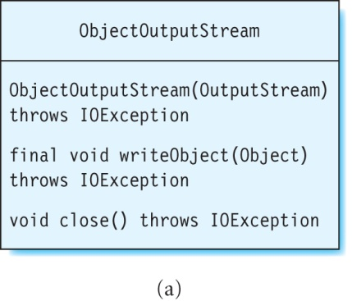
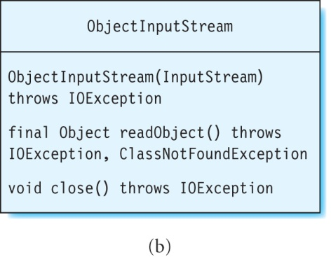
Classes ObjectInputStream and ObjectOutputStream
(a) The writeObject method of ObjectOutputStream serializes an object.
(b) The readObject method of ObjectInputStream deserializes an object.

Slide 80
Object Serialization
Object is serialized by the following steps:
1. Create a FileOutputStream to write to file,
wrap it inside an ObjectOutputStream.
2. Invoke the object stream’s writeObject method,
to save the object’s state.

Slide 81
Object Deserialization
Object is deserialized using the following steps:
1. Create a FileInputStream to read from a file,
wrap it inside an ObjectInputStream.
2. Invoke the object stream’s readObject method,
to restore the object’s state.

Slide 82
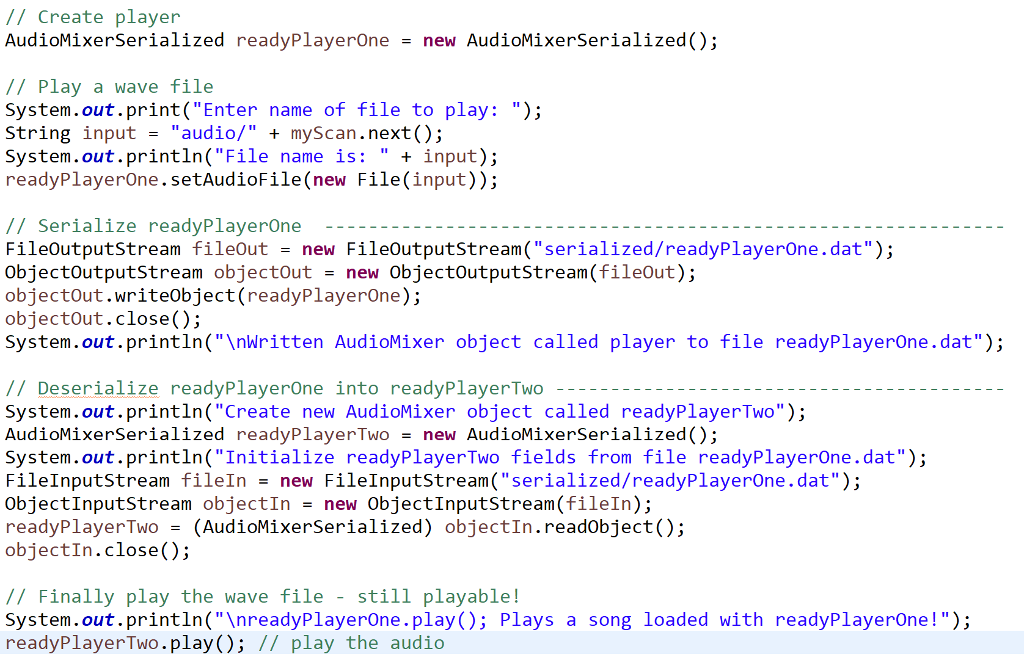
Example of Object Serialization
“CSEN160_06_Lecture_FileIO_AdvancedFileIO_Serialize.scu.csen160.AudioMixerSerialized”

Slide 83
Done

