Slide 1
CSEN160
Fall 2026
Object-Oriented Analysis, Design and Programming
Michael Schimpf, PhD, mschimpf@scu.edu
Department of Computer Science and Engineering

Slide 2
Multithreading

Slide 3
What are threads?
A thread is a single sequential control flow within a program.
A single threaded program can handle one task.

Slide 4
What are threads?
A multi-threaded program:
  Has multiple threads running
  To handle multiple tasks

Slide 5
Threads and Memory
Memory:
Threads share the same address space
Each thread has its own stack
Each thread has its own copy of local variables
Same dynamic memory

Slide 6
Advantages of multi-threaded programming
For developing reactive systems:
  Check continuously sensors => actions.

Slide 7
Advantages of multi-threaded programming
Applications becomes responsive to user input:
  A GUI application responds promptly to user events
  Even when application performing time-consuming computations.

Slide 8
Advantages of multi-threaded programming
A web-server can handle multiple clients at the same time.
Sharing recourses (in general) is easier (heap, files)

Slide 9
Disadvantages of multi-threaded programming
Programming is difficult.
The exact order of execution is non-deterministic.
Working together between threads (complicated).

Slide 10
Disadvantages of multi-threaded programming
Overhead:
Cost of thread creation
Context switching
Synchronization
But if threads runs on different cores (without intense synchronization), the application can run much faster.

Slide 11
Java Multithreading

Slide 12
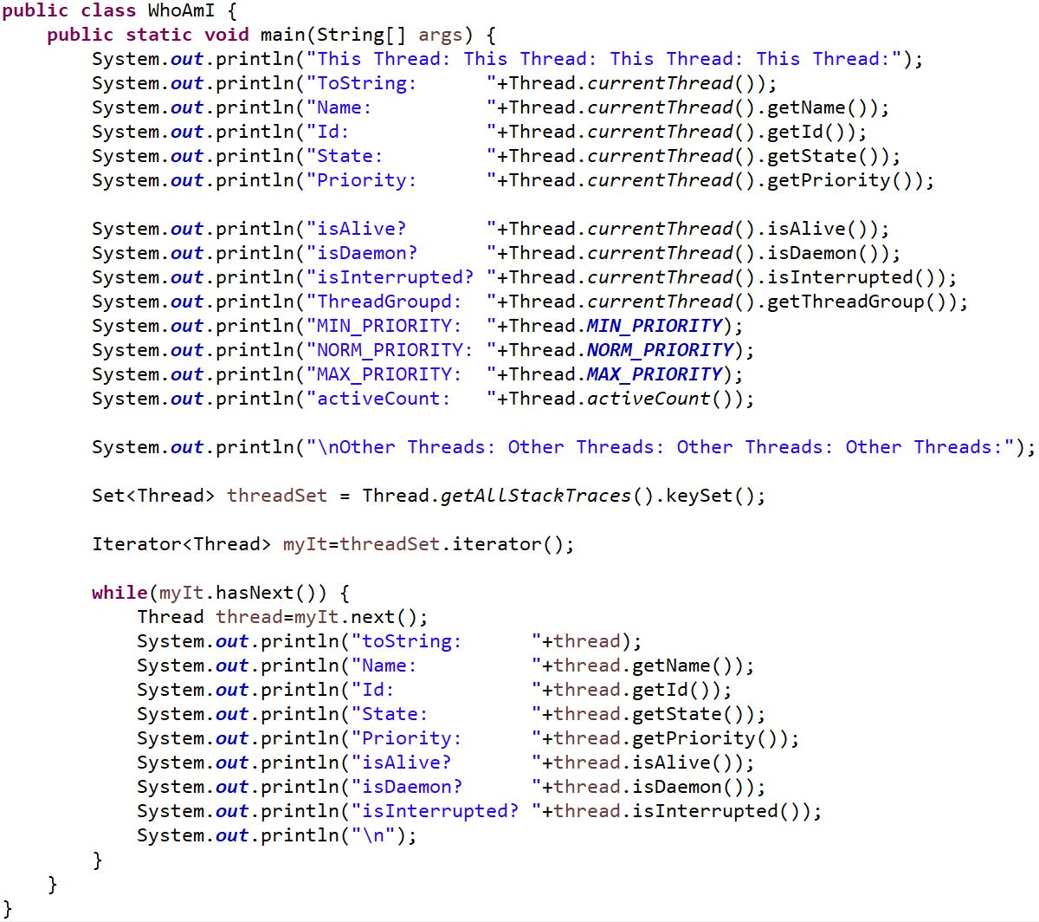
CSEN160_07_Threads.A_SimpleExamples.WhoAmI
Information about a Thread(s)
Thread WhoAmI:
Current Thread
Output all Threads

Slide 13
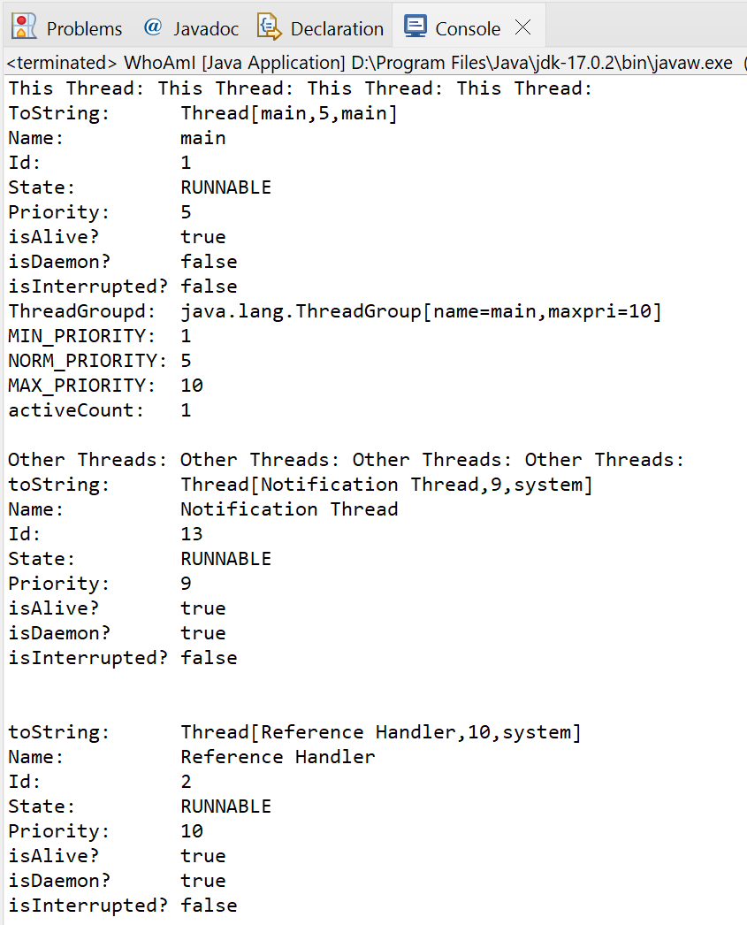
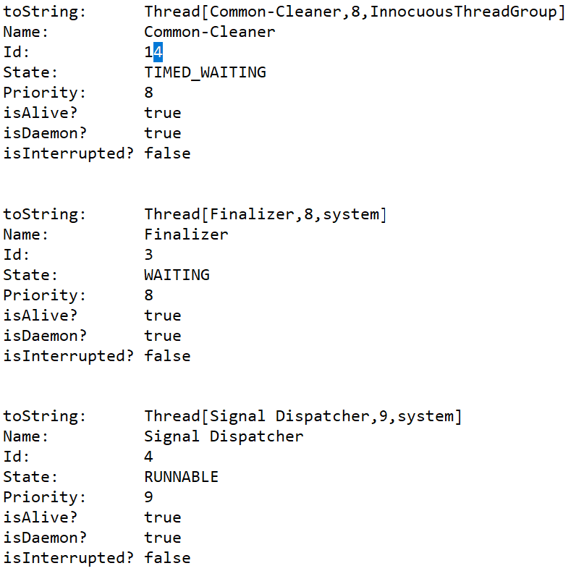
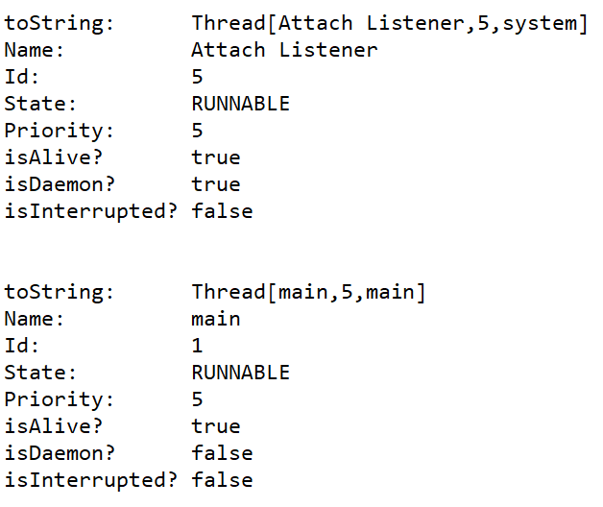
CSEN160_07_Threads.A_SimpleExamples.WhoAmI
Information about a Thread(s)

Slide 14
Creating and Running Threads
A thread is an object of a class that is a subclass of:
Thread or a class that implements Runnable
Basic methods of Thread:
  Thread(): constructs a thread
  void run(): a method that you override to specify what you want the thread to do
  void start(): starts the thread (does setup and calls run)
  static void sleep(long millis):
  static method. Thread.sleep(5) puts the running thread to sleep for 5 milliseconds.

Slide 15
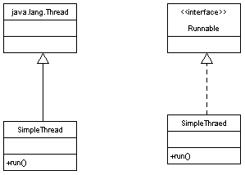
Creating Threads - Two ways

Slide 16
Two ways to create a thread
Two ways:
Extend Thread
Implementing Runnable interface

Slide 17
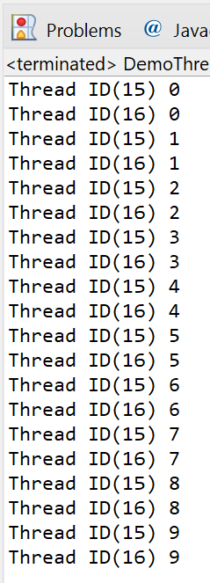
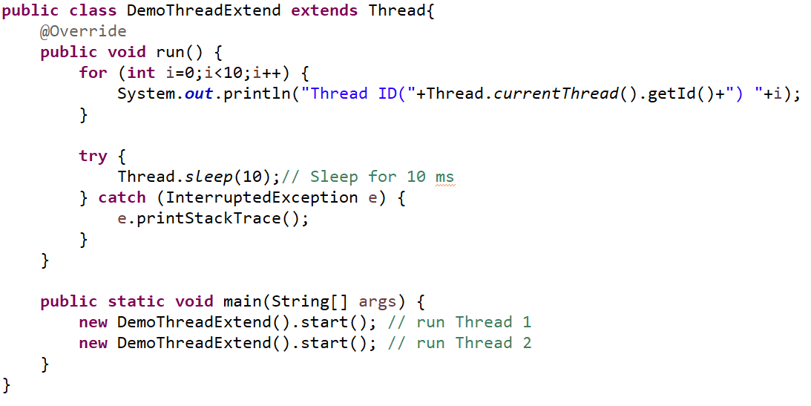
CSEN160_07_Threads.A_SimpleExamples.A_DemoThreadExtend
Two ways to create a thread
1. Extend Thread:

Slide 18
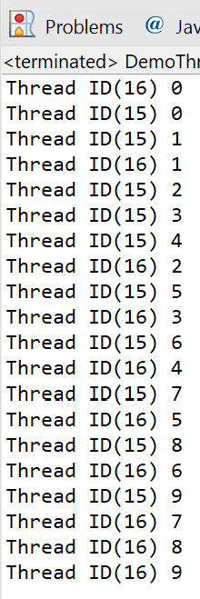
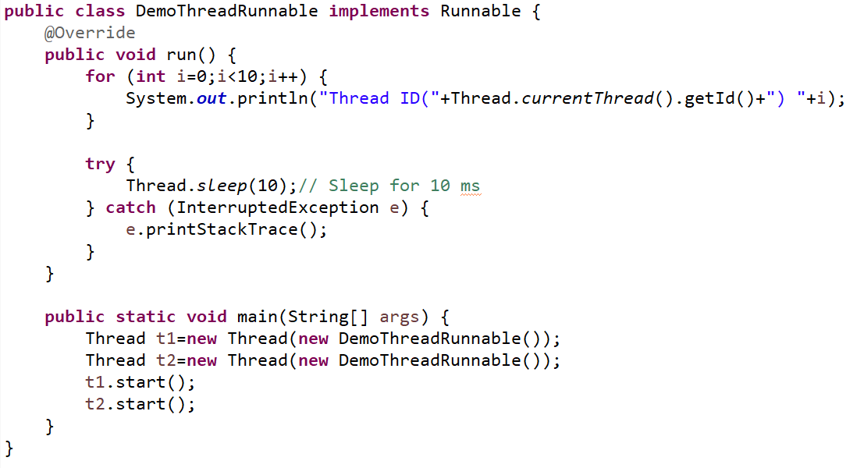
CSEN160_07_Threads.A_SimpleExamples.B_DemoThreadRunnable
Two ways to create a thread
2. Implement Runnable interface:

Slide 19
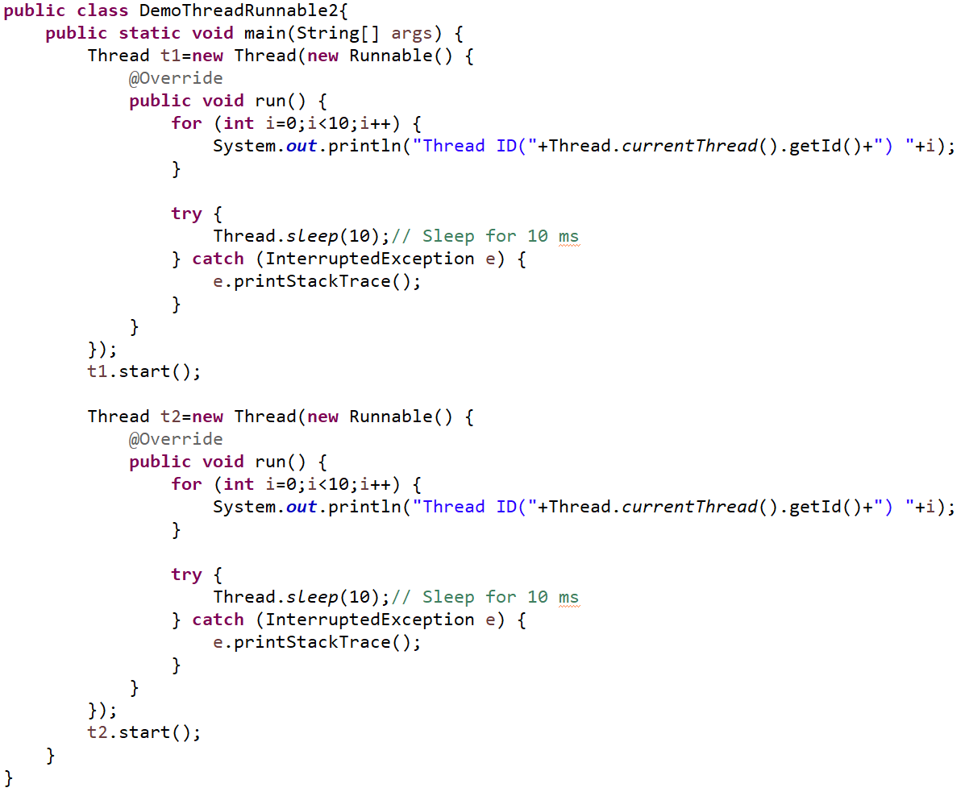
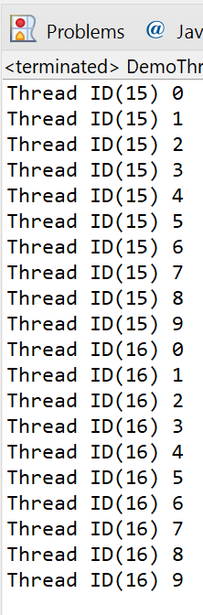
CSEN160_07_Threads.A_SimpleExamples.C_DemoThreadRunnable2
Two ways to create a thread
2. Implement Runnable interface (Anonymous):

Slide 20
Bouncing Ball Example …

Slide 21
Bouncing Ball:
This program has a single thread of control.
Actions are executed one by one.
Cannot execute next action before current finishes

Slide 22

CSEN160_07_Threads._SingleThreaded.BouncingBalls
Bouncing Ball example
A single ball bouncing around:

Slide 23
Single Thread implications in general:
Cannot do anything else while waiting …
Examples:
Cannot stop a download
Cannot react to window close
Cannot have two players
Cannot have an enemy
...

Slide 24
Example with multithreading
Programs with more than one thread are called multithreaded.
Java Threads are OS native
OS runs one thread a short period of time
Threads appear to run simultaneously.

Slide 25
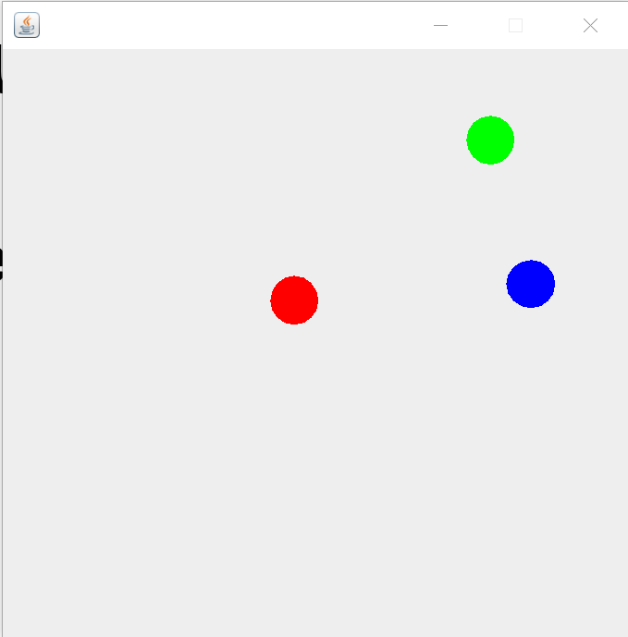
CSEN160_07_Threads._MultiThreaded.BouncingBalls
Bouncing Ball example
Three balls bouncing around:

Slide 26
Thread States

Slide 27
Thread States
Four states for threads: new, runnable, blocked, dead
sleep
blocked
done sleeping
new
suspend
resume
start
runnable
wait
notify
block on I/O
dead
run exits
stop
I/O complete
Note: suspend, resume,stop are deprecated.

Slide 28
Thread States
Thread created using new -> .start()
start is invoked: thread is now runnable.
  A runnable thread might not be running!
  There can be many runnable threads.
  But only one of them can be really running (at any time)
  OS decides which thread to run (not you).

Slide 29
Thread States
A runnable Thread enters the blocked state when:
  The Thread is currently running and sleep is called.
  The Thread calls the wait method.
  The Thread tries to lock an object, locked by another Thread.

Slide 30
Thread States
A blocked reenters runnable state when:
  It has slept through the allotted time.
  notify or notifyAll method called.
  Object lock released by other thread

Slide 31
Thread States
A runnable thread enters the dead state when:
  Its run method exits (Natural death).
  An exception is thrown but not caught!

Slide 32
Thread Java Implementation

Slide 33
Thread Java Implementation
Two different thread implementations:
  “Native thread” implementation (e.g. Windows):
    Performs time-slicing
    Interrupts the running thread periodically

Slide 34
Thread Java Implementation
Two different thread implementations
  2. “Green thread” implementation (e.g. Solaris):
    Does not perform time-slicing.
    It keeps a running thread active

Slide 35
Thread Scheduling

Slide 36
Thread Scheduling
Questions:
  When does the thread scheduler kick in and pick a thread?
  How does the thread scheduler select the next one?

Slide 37
Thread Scheduling
1. When does the thread scheduler kicks in?
    Current Thread calls yield method
    Current Thread is dead or blocked
    Another thread with higher priority moves out of blocked state

Slide 38
Thread Scheduling
2. The thread scheduler kicks in and picks another thread:
  with the highest priority to run

Slide 39
Thread Scheduling
Priority Levels:
  Java have 10 priority levels (constants of Thread class)
    MIN-PRIORITY = 1;
    NORMAL_PRIORITY = 5;
    MAX_PRIORITY = 10
  JVM maps Java priority levels to priority level of the underlying OS.
  A thread inherits priority from its parent thread.
  Can be increased or decreased using setPriority(…)

Slide 40
CSEN160_07_Threads._SingleThreaded.BouncingBalls_DifferentPriorities
Thread Scheduling
Example:
Two kinds of balls: blue and red.
Red ball threads have higher priority and hence get more chance to run.
The effect is that red balls appear to be faster.

Slide 41
Sleep vs yield

Slide 42
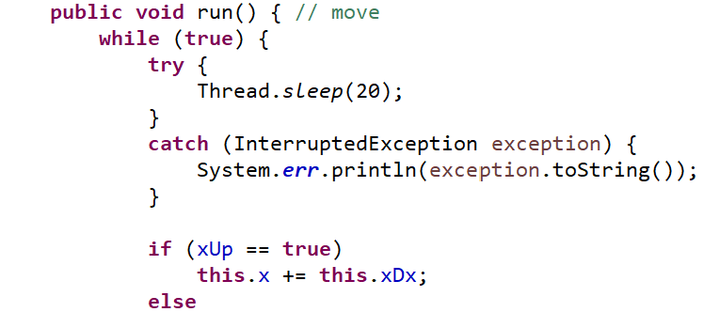
sleep vs. yield
sleep is replaced with yield: blue balls have no chance of moving before the red balls stop.

Slide 43
sleep vs. yield
Why?
There are more than one thread with priority 8.
When one yield, thread scheduler picks another.
Threads with priority level 2 never get a chance to run.
No guarantee to be picked

Slide 44
Thread Scheduling
Cooperating vs. Selfish threads:
  A cooperating thread gives others a chance to run
    Calling sleep: pause for the specified period of time
    Calling yield: pause temporarily.
  A selfish thread does none of this ☹

Slide 45
Thread Scheduling
Effects of selfish threads are system-dependent:
Green thread: A selfish thread can consume all the CPU time.
Native thread: A selfish thread doesn’t pose a big problem.

Slide 46
Wait and Notify

Slide 47
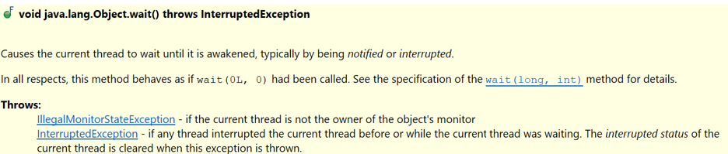
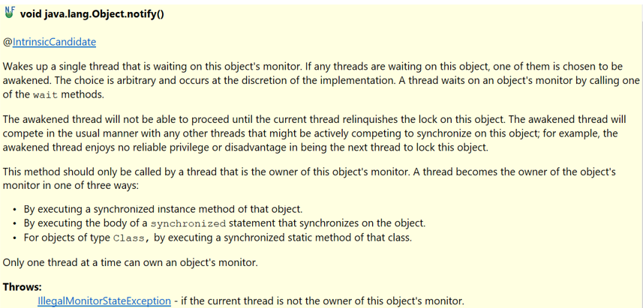
Wait and Notify
You can actually wait for something:
And get notified when to continue:

Slide 48
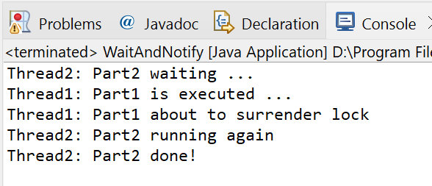
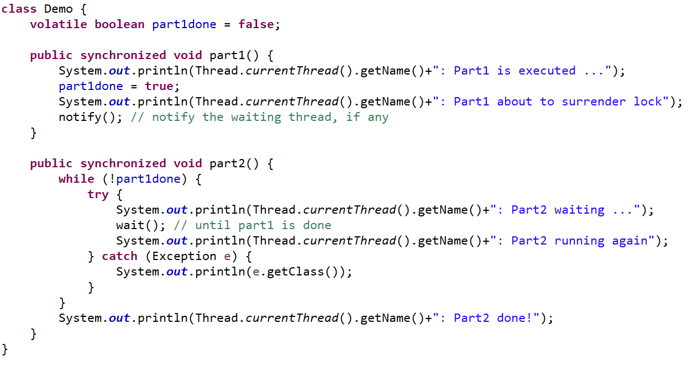
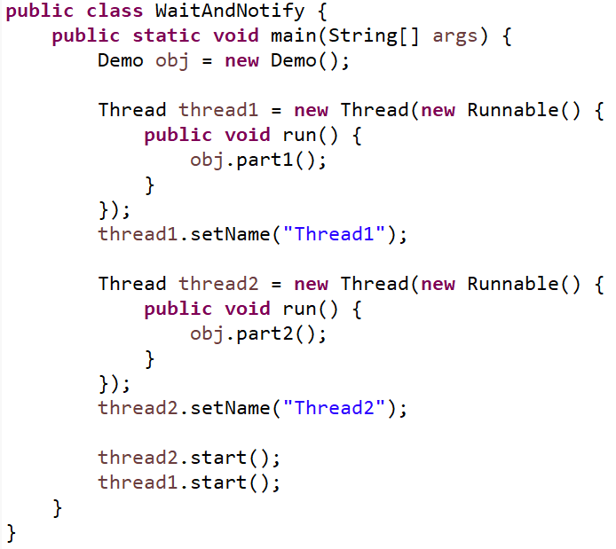
Wait and Notify
CSEN160_07_Threads.C_WaitAndNotify.WaitAndNotify

Slide 49
Synchronization

Slide 50
Thread join()
A thread calls a join() method when waiting for another thread
The waiting thread is "joining" with a previously started thread.
The no-argument join() method simply waits until another thread is no longer alive

Slide 51
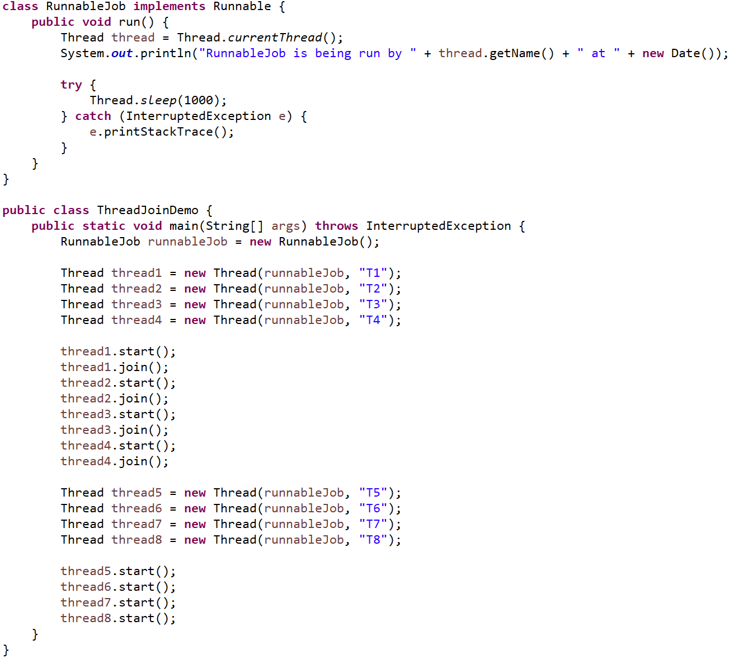
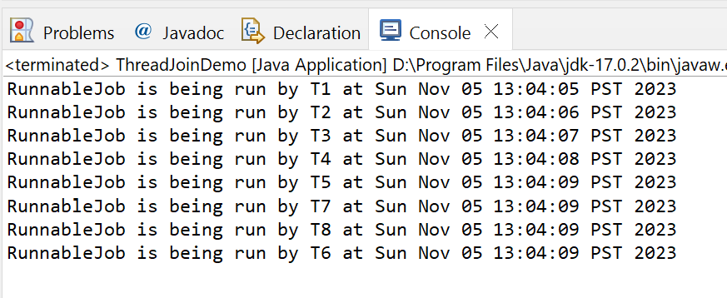
Thread join()
CSEN160_07_Threads.B_Join.ThreadJoinDemo
Easy example
No loops
Wait that thread1 die
Wait that thread2 die
Wait that thread3 die
Wait that thread4 die

Slide 52
Synchronization
The Synchronization problem:
  Two different threads modify the same object at the same time, leading to corrupted object.
An analog:
  A project report is kept at a centralized location:
    You open the report and edit it
    Your partner opens the report and edits it
    You save the edits.
    Your partner saves his edits
  Your edits are lost!

Slide 53
Synchronization
When threads need access to a shared resource
Need a way to make sure resource will be used by only one thread at a time!
Achieved by thread synchronization.
Synchronization in Java by making methods that modify critical recourses synchronized.

Slide 54
Thread Synchronization
Accessing synchronized methods:
  An object with one or more synchronized methods (or blocks) is called a monitor or a critical section.
  Every Java object with a critical section of code gets a lock.
  To enter a critical section, a thread needs to obtain the lock.

Slide 55
Thread Synchronization
A monitor lets only ONE thread to access its synchronized methods:
  While a thread is executing one of the synchronized methods.
  All other threads that try to call this synchronized methods are blocked.
  When the thread that locked the synchronized method finishes, all blocked threads can access it.
  Methods that call unsynchronized methods can proceed.

Slide 56
Java synchronized
Synchronized keyword to mark different types of blocks:
Instance and static methods: Only one thread can execute the method.
Code blocks inside methods:
  Avoid synchronizing the whole method!
  A synchronized block can choose which objects are synchronizes
  Make the synchronized part as small as possible!

Slide 57
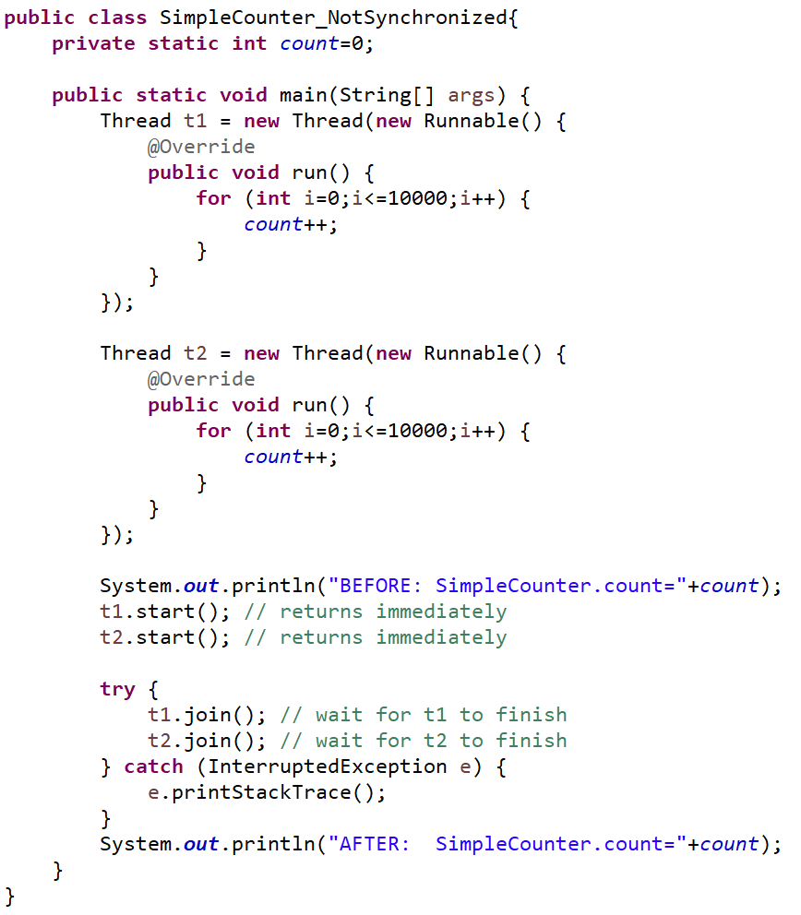
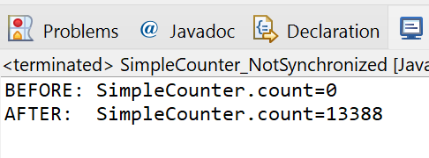
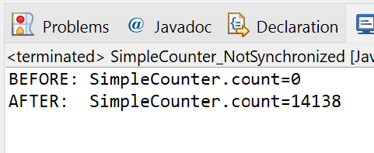
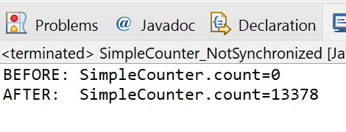
CSEN160_07_Threads.A_SimpleExamples.D_SimpleCounter_NotSynchronized
Not synchronized example
Problem:
On Assembler level
One thread reads
Other one writes
Mixed up
Confusion

Slide 58
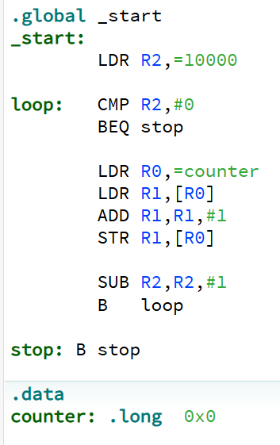
Assembler Example – Race Condition
ARM assembler
Thread1
Thread2
Load the address from counter = $18
Load the address from counter = $18
Load the value from address $18 = 12
Load the address from counter = $18
13 = 12+ 1
13 = 12+ 1
Write value 13 back to what $18 is pointing
Write value 13 back to what $18 is pointing
Shared Resource

Slide 59
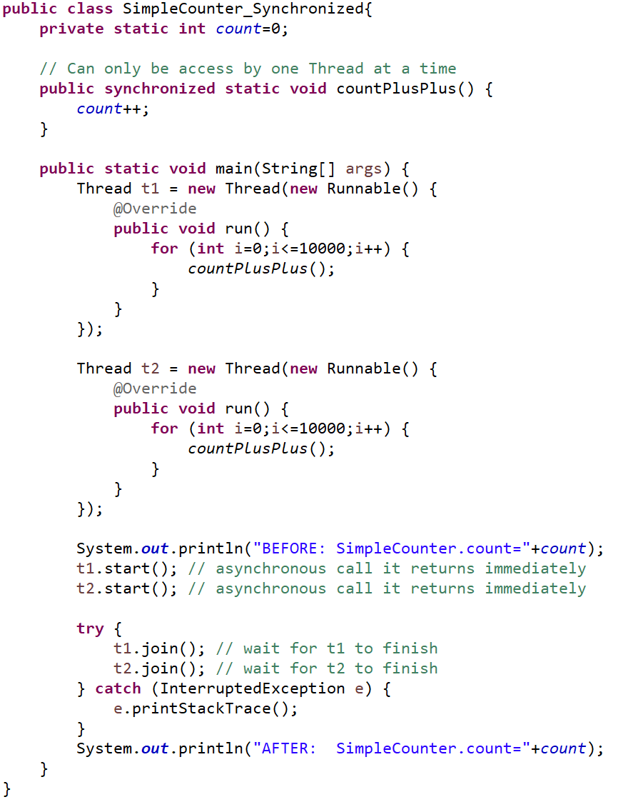
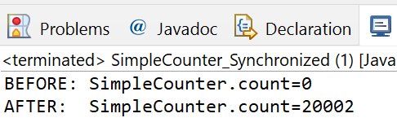
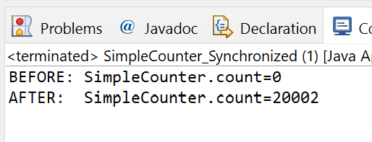
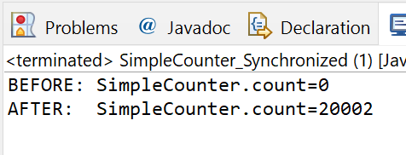
CSEN160_07_Threads.A_SimpleExamples.E_SimpleCounter_Synchronized
Synchronized example

Slide 60
Synchronized Block
Synchronized block:
Instead of set a whole function synchronized
A small block can be synchronized
Use synchronized as seldom and small as possible.

Slide 61
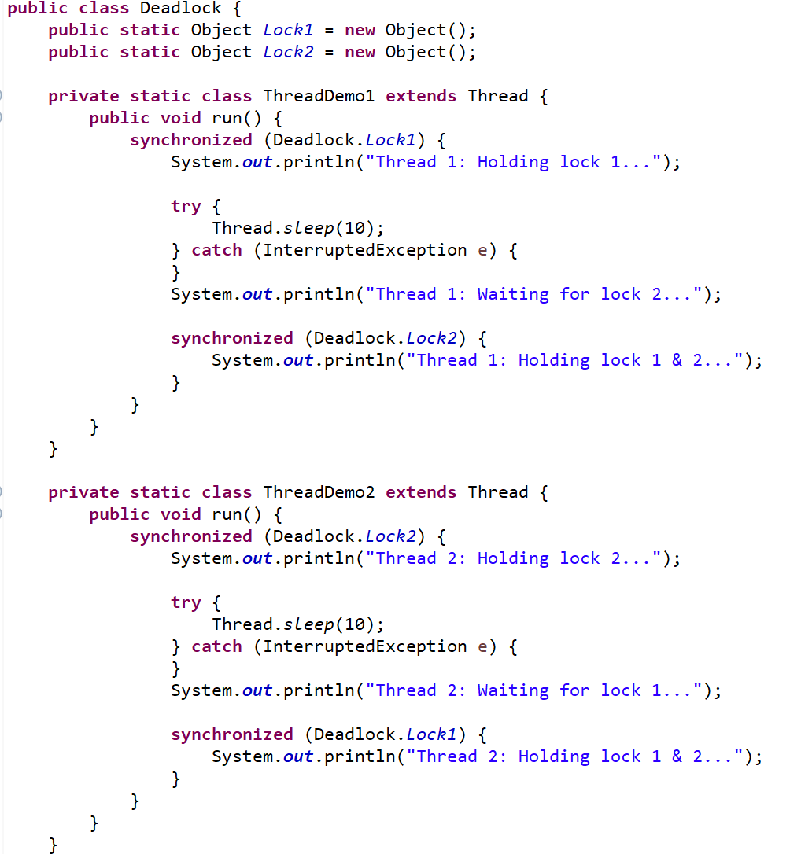
CSEN160_07_Threads.F_threadProblems.A_Deadlock
Synchronized Block
Do not use String
Example:
Cannot be null!

Slide 62
Done

