Slide 1
CSEN160
Fall 2026
Object-Oriented Analysis, Design and Programming
Department of Computer Science and Engineering

Slide 2
Object-Oriented Analysis, Design and Programming
Instructor: Michael Schimpf, PhD
Email: mschimpf@scu.edu
Course material and latest info's
  On Camino
  Check often

Slide 3
Object-Oriented Analysis, Design and Programming
Office: Haefey 208
Office hours:
Monday 10:30am to 11:30am
Wednesday 10:30am to 11:30am
Friday 10:30am to 11:30am

Slide 4
Quizzes:
Every Friday
10 multiple choice questions
20 minutes
Worst quiz will be dropped

Slide 5
Project:
Team of two
Send project ideas to me before xxx
Project presentation: Friday, November 7th
During our lab session in: Heafey Hall 224

Slide 6
Final Exam:
Finals Week: December …
One cheat-sheet

Slide 7
In general
No Zoom
Everything is in person
Quizzes and final on paper

Slide 8
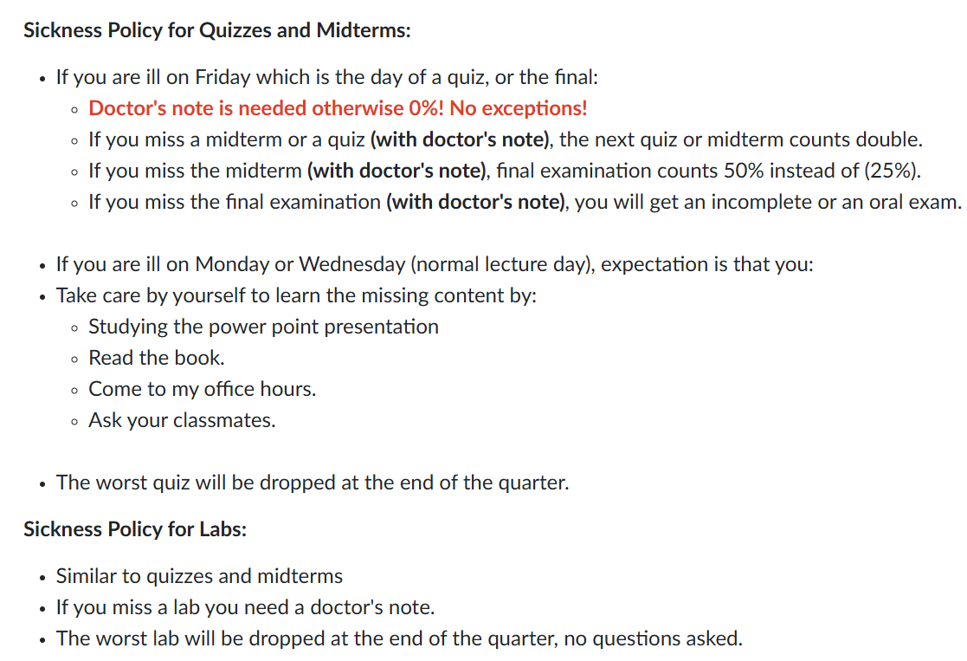

Slide 9
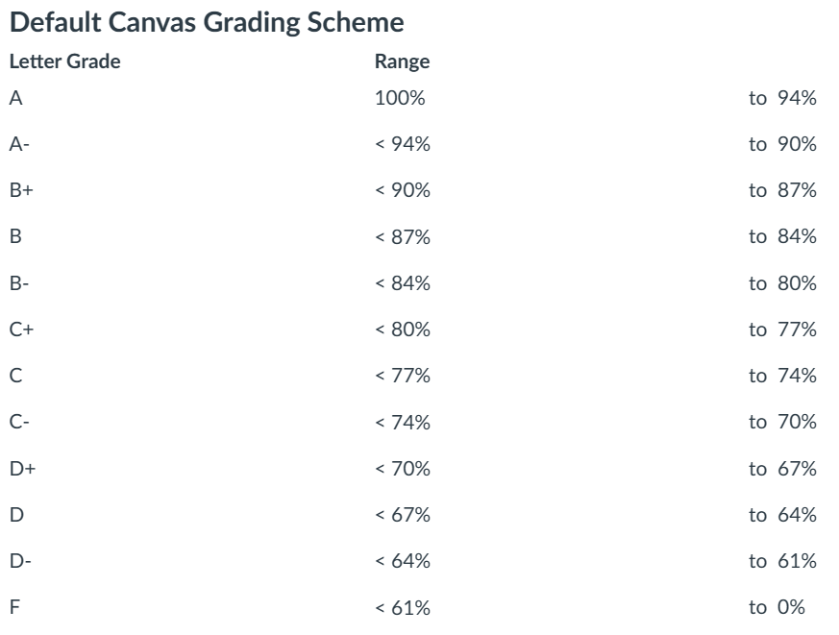
Grade Calculation
Quizzes: 33 1/3%
Project: 33 1/3%
Final exam: 33 1/3%
No curving, what you see is
what you get …

Slide 10
Labs:
TA: Lebin Zhou lzhou@scu.edu
Heafey H224
One lab per week
Should be solvable in the lab session itself
Demo your solution to the TA
Commit your solution after the lab to GitHub
The worst lab will be dropped

Slide 11
Introduce yourself:
Name?
Major?
Experience in object-oriented programming?
Experience in Java?
Experience in IntelliJ?
Experience in GitHub?
Expectation for this course?

Slide 12
Done

