Slide 1
COEN160
Fall 2026
Object-Oriented Analysis, Design and Programming
Department of Computer Science and Engineering

Slide 2
Project Presentation?
November Friday 7th 2:15pm to 5:00pm in the lab (Grace Hopper)
November Friday 14th 2:15pm to 5:00pm in the lab THIS ONE
November Friday 21st 2:15pm to 5:00pm in the lab
November Friday 28th 2:15pm to 5:00pm in the lab
December 1st final

Slide 3
Java Introduction
& Refresher

Slide 4
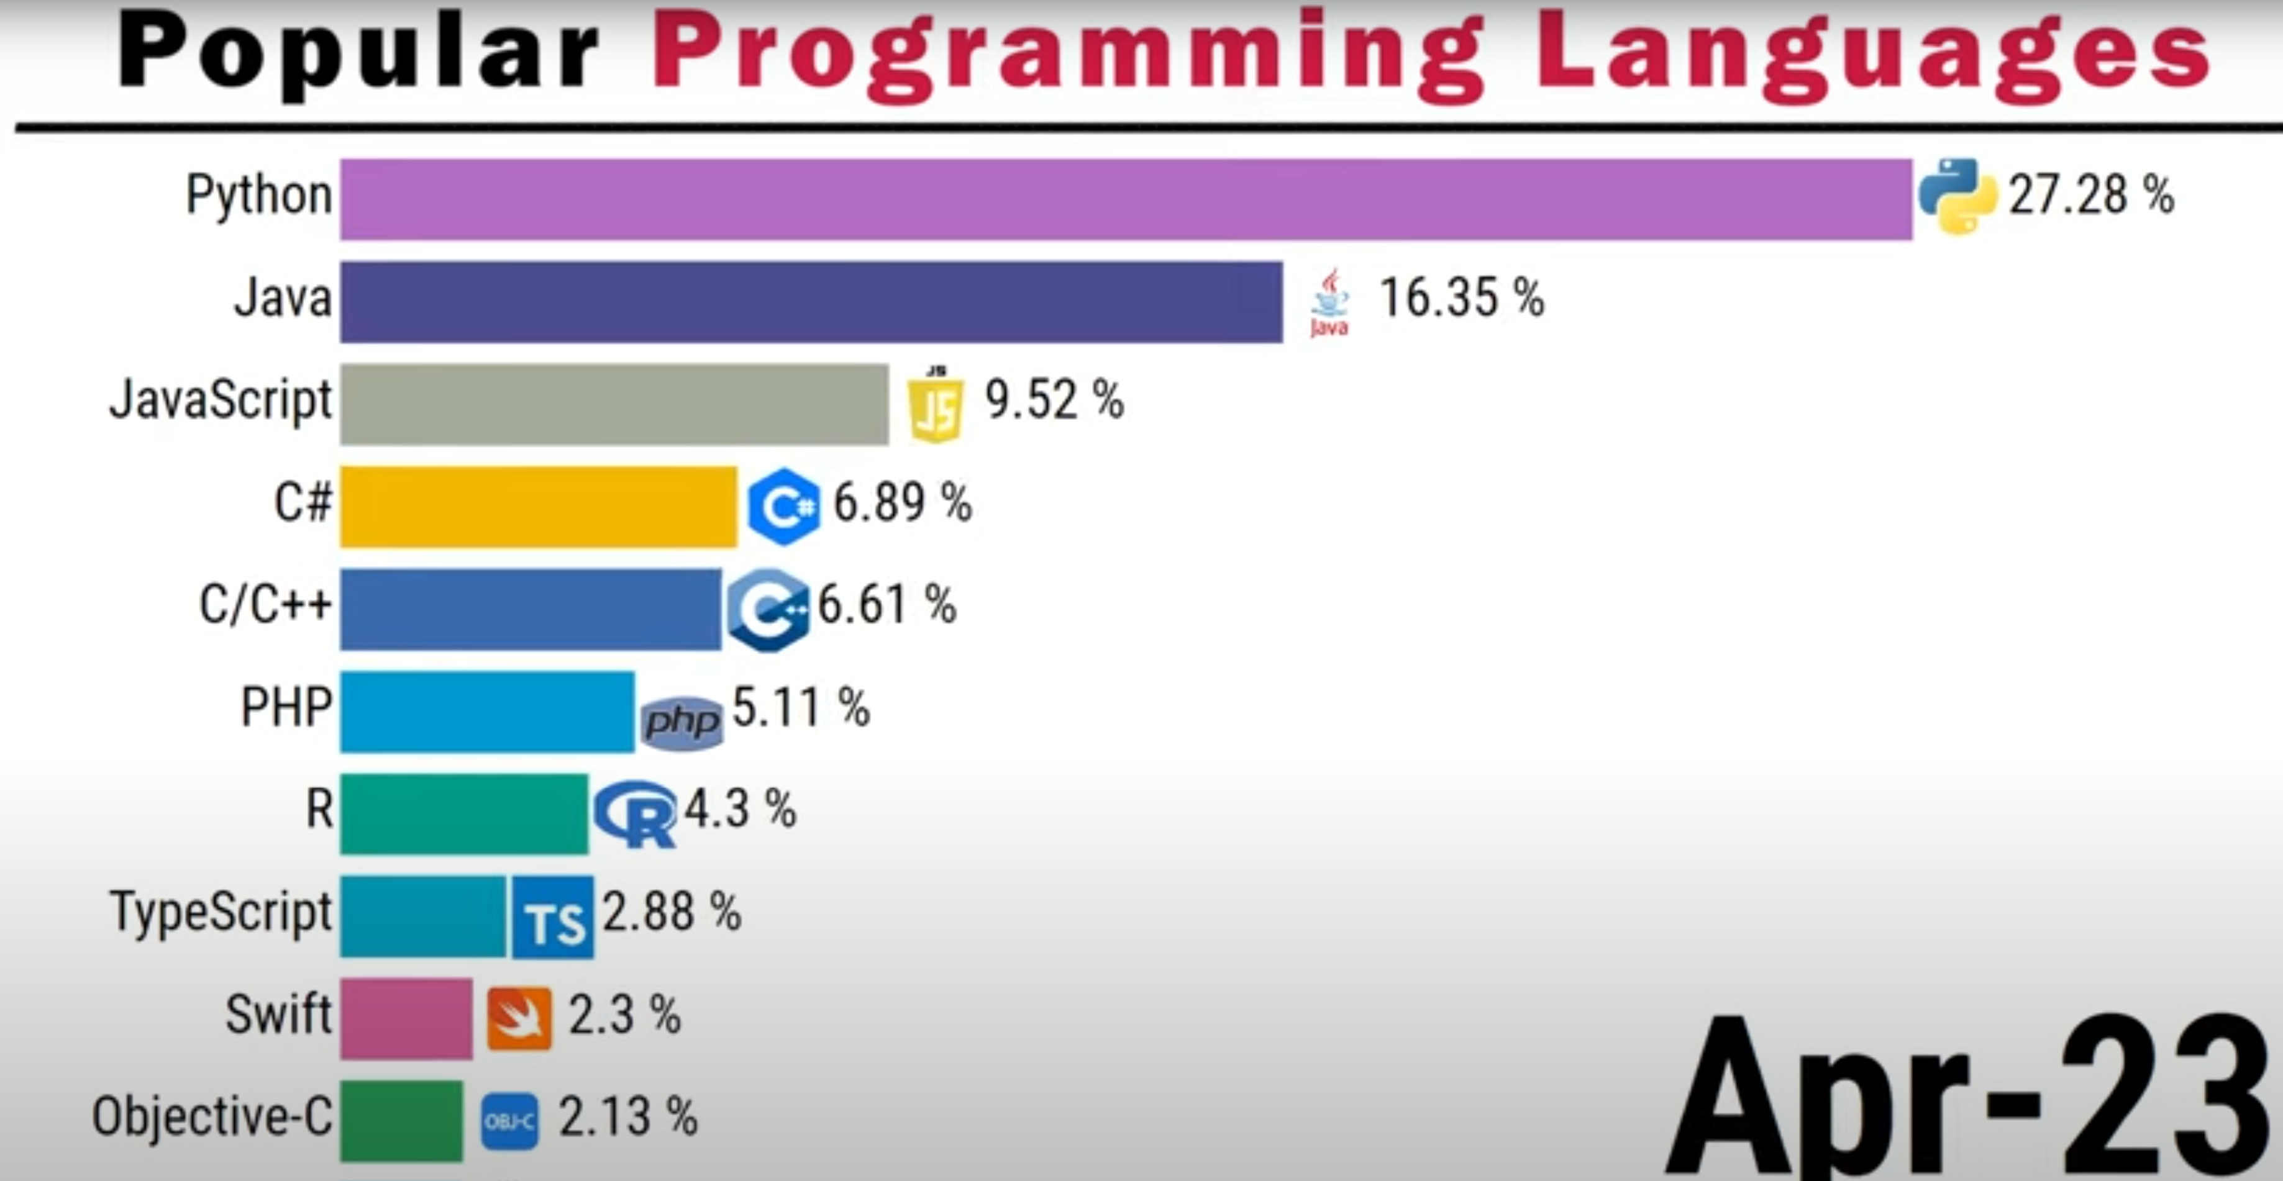
Source: https://www.youtube.com/watch?v=WLhN2Q8mXvI&t=1s

Slide 5
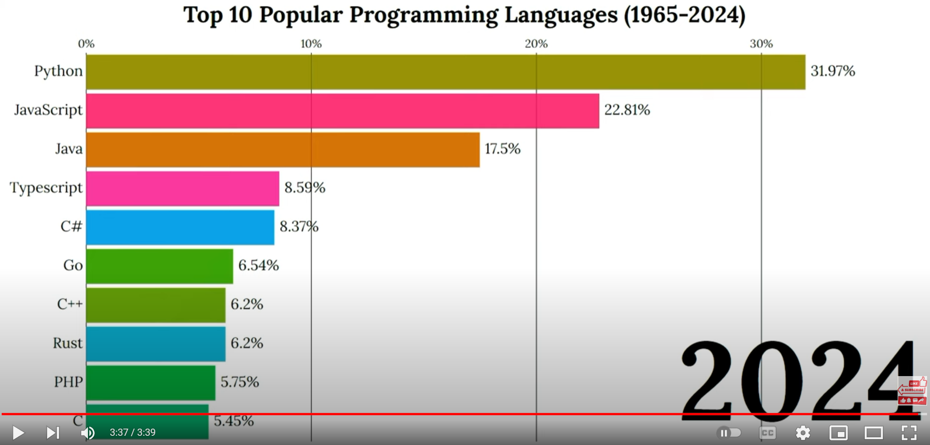
Source: https://www.youtube.com/watch?v=hL85pP3KZ7c&ab_channel=CodingwithDee

Slide 6
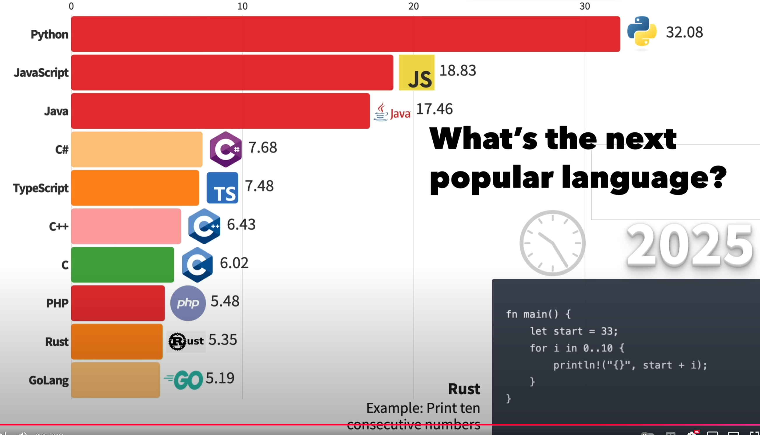
Source: https://www.youtube.com/watch?v=5yAbVkIMl_M

Slide 7




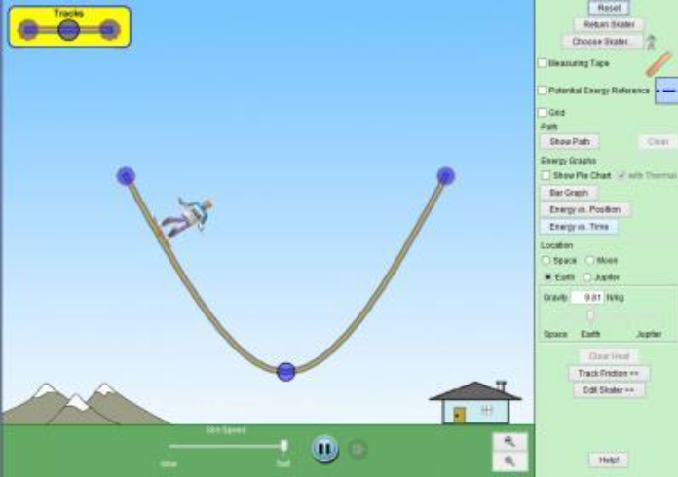
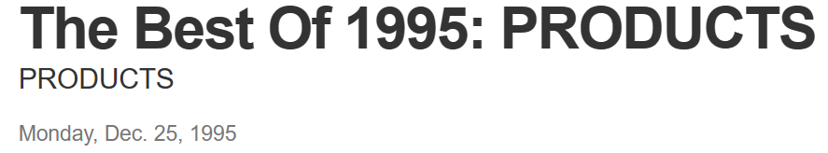

Java History
James Gosling in June 1991
Sun Microsystems
Designed for set-top boxes, consumer market
Former names: “Greentalk”, “OAK”
1995 named to “Java”
1995 Netscape Applet
10 best products of 1995
January 23rd, 1996 JDK 1.0
December 8th, 1998 JDK1.2
2010 Sun bought by Oracle

Slide 8
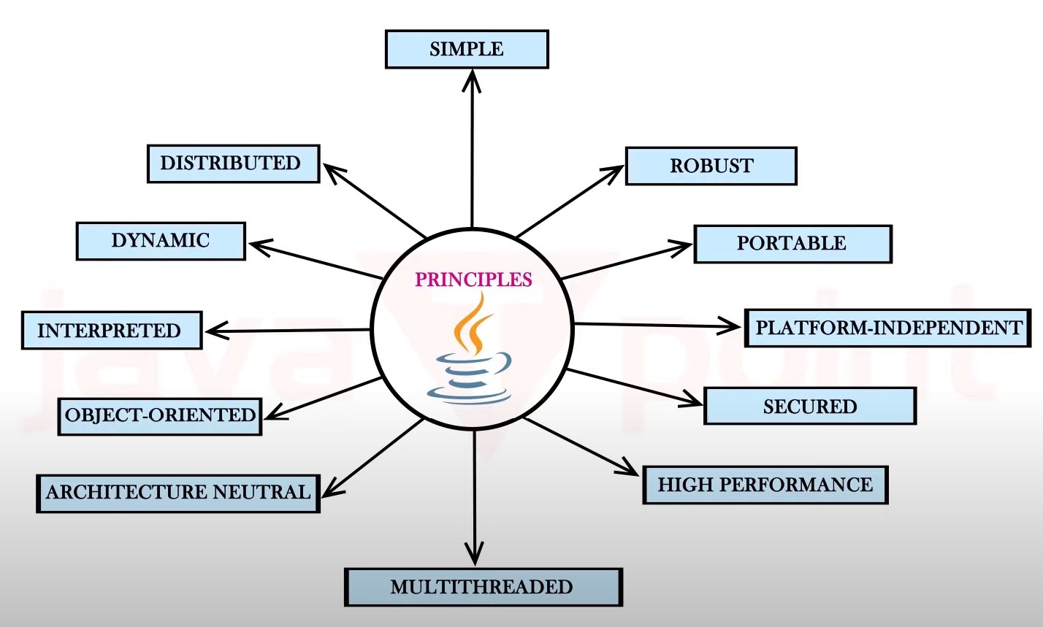


Principles for creating Java programs:
Java is dynamic in nature because of its support for dynamic loading of classes at runtime, allowing programs to dynamically link in new class definitions.
Java's reflection API enables dynamic introspection of classes, methods, fields, and annotations at runtime
From: https://www.youtube.com/watch?v=DcQPtlFlgzY

Slide 9
Components of Java Architecture
The Java programming language
The Java class file format
The Java Application Programming Interface (API)
The Java virtual machine (JVM)

Slide 10
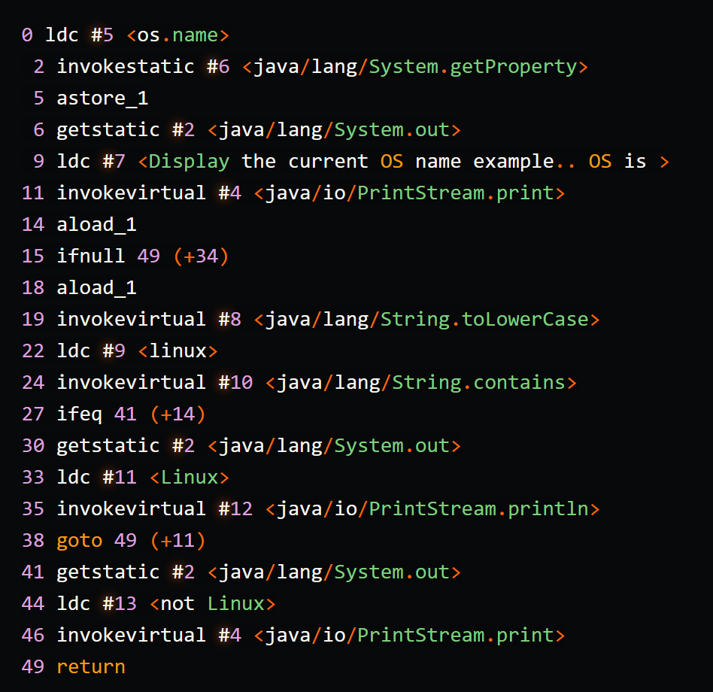
Java Architecture
Java is an Object-Oriented Programming language.
(Syntax similar to C++)
Write your Java program in a .java source file.
Compile (javac) the source into bytecode.
Resulting in: Java class files.
Run the class files (java) on a Java Virtual Machine.
The JVM and Java API together are called the:
Java Run time or Java platform.
A Java program can run anywhere the Java Platform is present.

Slide 11
The Java Virtual Machine (JVM)
A JVM is also called the Java Interpreter.
A JVM’s main job is to: load class files, execute bytecodes.
A JVM is an implementation of the Java Virtual Machine Specification,
to interpret compiled Java bytecode.

Slide 12
The Java Virtual Machine (JVM)
JVMs are available for many platforms.
The class file compiled in one platform, will execute in a JVM of another platform.
“compile once, run anywhere”
Java platform-independent.

Slide 13
The Java Programming Language
Objects: Objects (structures) that contain data (fields) and code (as procedures).
Inheritance: Classes are organized into hierarchies,
a child inherits properties from a parent.
Polymorphism: Polymorphism is the ability of an object to take on many forms.

Slide 14
Class:
An empty class named HelloWorld:
Declared using keyword class.
Contains one or more methods.
  public class HelloWorld {
  }

Slide 15
Methods:
Consist of a group of statements enclosed within braces { }.
There can be any number of methods in a class.
Every program contains one main method:
The main method is always executed first.
  public static void main(String[] args) {
  // statements
  }

Slide 16
Statements
Specifies an action to be performed.
Each statement is ended with a semicolon.
Words are usually separated by a single space.
There should not be a space within a word.
Examples:
  JFrame frame = new JFrame("My First Program");
frame.setSize(800,500);
  frame.setVisible(true);

Slide 17
Comments
Three types of comments:
  Single line //
  Multi-line /* */
Single line comments:
  // compiler ignores the words in this line
Multi-line comments:
  /* compiler ignores all the
  words in these
  three lines */
Javadoc annotations comments
/**
*
* @param args
*/
public static void main(String[] args) {

Slide 18
The Java Programming Language
Automatic garbage collection
Java uses an automatic garbage collector to manage memory.
Java runtime is responsible for recovering the memory
if objects are no longer in use (reference = Null)
But it creates some issues …

Slide 19
The Java Programming Language
Concurrency is the ability to start, run and complete several threads
of a program in overlapping time periods.
Java supports threads as part of the Java language (concurrent programming).
But multiprocessor apps are not really addressed …

Slide 20
Java Hello World

Slide 21
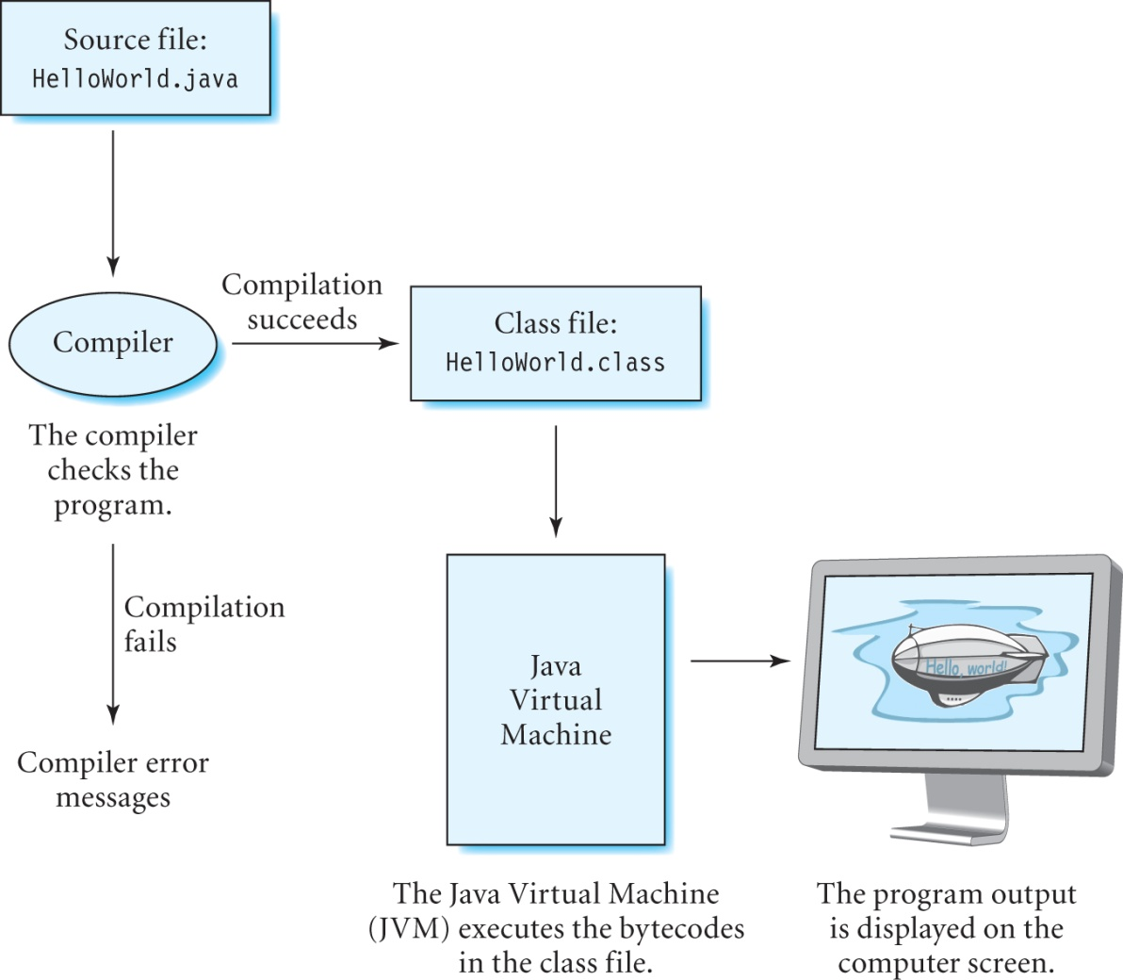
Compiling and Running a Java Program

Slide 22
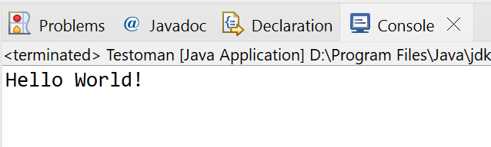
Standard Java: HelloWorld
// Program HelloWorld
public class HelloWorld {
public static void main(String[] args) {
System.out.println(“Hello World!”);
// or System.err.println(“Hello Error!”);
}
}

Slide 23

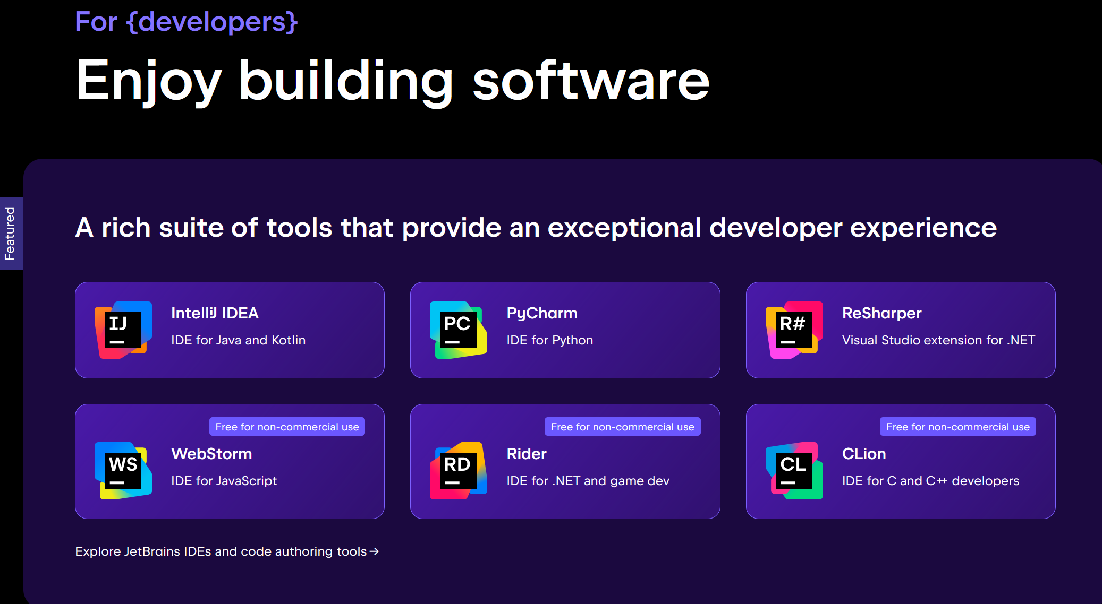
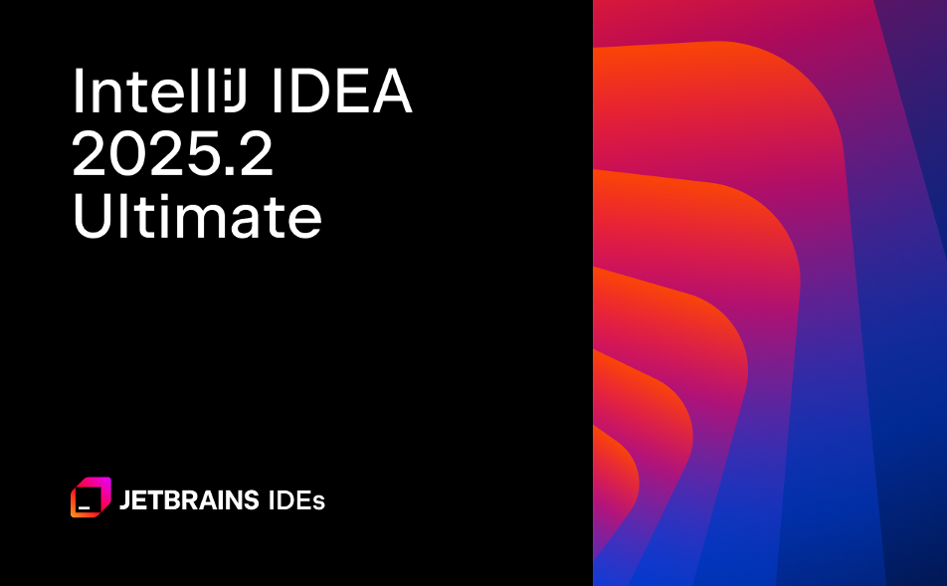
IntelliJ
Little click introduction …
Download
Get the Ultimate version
Free for students
Register with your scu email

Slide 24
Java Swing: HelloWorld
// Program HelloWorld
import javax.swing.*;
public class HelloWorld {
public static void main(String[] args) {
JFrame frame = new JFrame("My First Program");
frame.getContentPane().add(new JLabel(new ImageIcon("blimp.jpg")));
frame.setSize(800,500);
frame.setVisible(true);
}
}

Slide 25
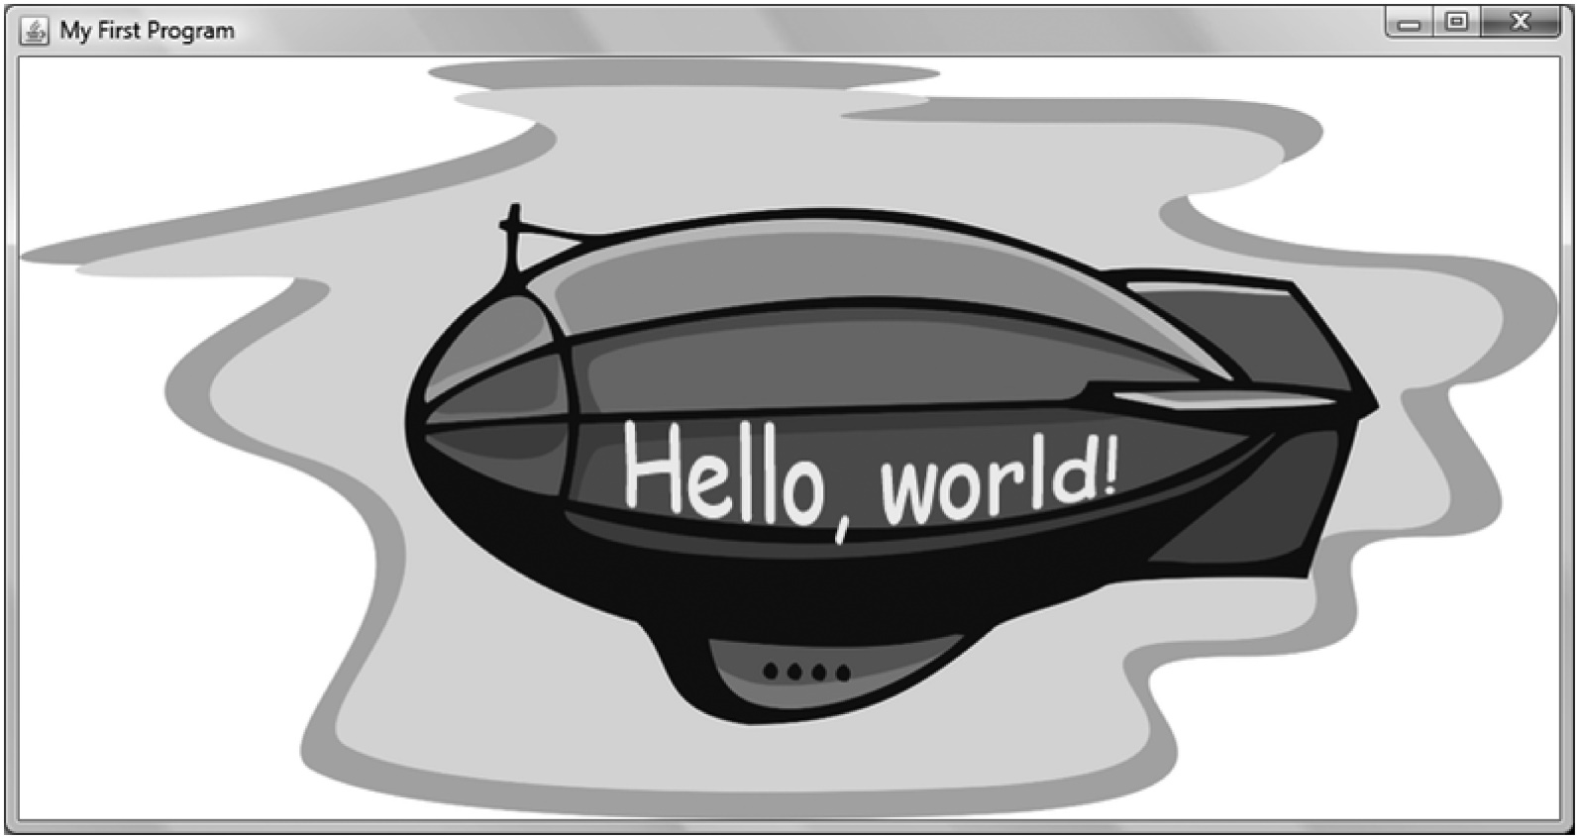
Output of the HelloWorld Program

Slide 26
The Good, the Bad and the Ugly
Differences and similarities Java vs C/C++

Slide 27
Java advantages over C++
Simpler syntax
No pointer and pointer arithmetic (*, &, only references)
No sizeof(…)
No operator overloading (+, -, *, etc.)
No preprocessor (#define, #ifndef, etc.)

Slide 28
Java advantages over C++
No header files
Declaration and definition is one line
Only single inheritance
Garbage collector (no malloc and free, etc.)

Slide 29
C++ advantages over Java
Faster
Less verbose (despite header files)
Direct hardware access
If you develop something serious

Slide 30
What is different?
Basic data types
Java vs C/C++
C/C++
Java
#include <iostream>
using namespace std;
int main(int argc, char* argv[]){
bool myBool = true;
char myChar = 'H';
unsigned char myUChar = 123U;
short myShort = -166;
unsigned short myUShort = 1898;
int myInt = -2646;
unsigned int myUInt = 324236;
long myLong = -345234234;
unsigned long myULong = 234762387468;
long long myLLong = -328472394723897;
unsigned long long myULLong = 23817928173982719;
float myFloat = 342374.9f;
double myDouble = 4234.2347L;
long double myLDouble = 37846287.324726L;
}
public class Test {
public static void main(String[] args) {
boolean myBool = true;
byte myVByte = -127;
char myChar = 'H';
short myShort = -166;
int myInt = -2646;
long myLong = -345234234;
float myFloat = 342374.9f;
double myDouble = 4234.2347d;
var myNum = 3521;
final var MY_NUM = 23423423;
}
}
No byte!
No unsigned data type
No long long
No unsigned long long
No long double

Slide 31
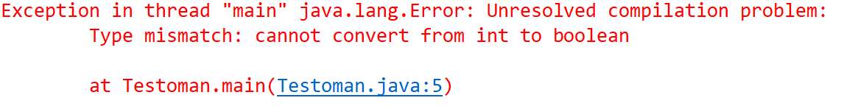
What is different?
If == vs = error
Java vs C/C++
C/C++
Java
#include <iostream>
using namespace std;
int main(int argc, char* argv[]){
int a = 100;
if (a = 90)
cout << "Does work!" << endl;
}
public class Test {
public static void main(String[] args) {
int a = 100;
if ( a = 90 )
System.out.println("Does NOT work!");
}
}

Slide 32
What is different?
class
C/C++
Test.h
#pragma once
#include <string>
using namespace std;
class Test{
private:
int id;
string name;
public:
int getId();
void setId(int id);
string getName();
void setName(string name);
};
#include "Test.h"
int Test::getId() {
return this->id;
}
void Test::setId(int id) {
this->id = id;
}
string Test::getName() {
return this->name;
}
void Test::setName(string name) {
this->name = name;
}
Test.cpp

Slide 33
What is different?
class
Java
public class Test {
private int id;
private String name;
public int getId() {
return id;
}
public void setId(int id) {
this.id = id;
}
public String getName() {
return name;
}
public void setName(String name) {
this.name = name;
}
}
Test.java

Slide 34
What is different?
instantiation
C/C++ vs Java
C/C++
#include <iostream>
#include "Test.h"
using namespace std;
int main(int argc, char* argv[]){
Test myStackTest;
myStackTest.setName("Mike");
cout << myStackTest.getName() << endl;
Test *myHeapTest = new Test();
myHeapTest->setName("Michael");
cout << myHeapTest->getName() << endl;
delete(myHeapTest);
}
public static void main(String[] args) {
Test myTest = new Test();
myTest.setName("Mike");
System.out.println(myTest.getName());
myTest = null; // not essential but …
}
Java

Slide 35
What is the same?
Java vs C/C++
For-Loop
C/C++
#include <iostream>
using namespace std;
int main(int argc, char* argv[]){
for (int i = 0; i < 100;i++) {
cout << "Hello World!" << endl;
}
}
Java
public class Test {
public static void main(String[] args) {
for (int i = 0; i < 100;i++) {
System.out.println("Hello World!");
}
}
}

Slide 36
What is the same?
Java vs C/C++
While Loop
C/C++
#include <iostream>
using namespace std;
int main(int argc, char* argv[]){
int i = 100;
while (i < 100) {
cout << "Hello World!" << endl;
i++;
}
}
Java
public class Test {
public static void main(String[] args) {
int i=100;
while (i < 100) {
System.out.println("Hello World!");
i++;
}
}
}

Slide 37
What is the same?
Java vs C/C++
For-Each Loop
C/C++
#include <iostream>
using namespace std;
int main(int argc, char* argv[]){
int myNumbers[4] = { 3, 9, 5, -5 };
for (int i : myNumbers) {
cout << i << endl;
}
}
Java
public class Test {
public static void main(String[] args) {
int[] myNumbers = {3, 9, 5, -5};
for (int i: myNumbers) {
System.out.println(i);
}
}
}

Slide 38
What is the same?
Switch-Case
Java vs C/C++
C/C++
#include <iostream>
using namespace std;
int main(int argc, char* argv[]){
int num = 5;
switch (num) {
case 0:
cout << "It is 0" << endl;
break;
case 1:
cout << "It is 1" << endl;
break;
default:
cout << "It is " << num << endl;
}
}
Java
public class Test {
public static void main(String[] args) {
int num = 5;
switch (num) {
case 0:
System.out.println("It is 0");
break;
case 1:
System.out.println("It is 1");
break;
default:
System.out.println("It is " + num);
}
}
}

Slide 39
But!
“External/additional” API’s:
JUnit/Mockito
Log4J/SLF4j
JSON Parsing (Jackson and Gson)
General-Purpose Libraries
(Apache Commons and Guava)
HTTP Libraries (HttpClient)
XML Parsing Libraries (Xerces and JAXB)
Excel Reading Libraries (Apache POI)
Bytecode Libraries (Javassist and CgLib)
Messaging Libraries (JMS and MQ)
PDF Libraries (iText)
Date and Time Libraries (Joda Time)
Collection Libraries (Eclipse Collections)
Email APIs (Java Mail API)
etc.
Source: https://medium.com/javarevisited/20-essential-java-libraries-and-apis-every-programmer-should-learn-5ccd41812fc7
Understanding the language is only
half of the problem!
Knowing the whole API is another problem:
String & StringBuffer
File I/O
I/O in general
Math
Collection classes (ADT)
JDBC
AWT/Swing
Javadoc
etc.

Slide 40
Done

