Slide 1
CSEN160
Fall 2026
Object-Oriented Analysis, Design and Programming
Michael Schimpf, PhD, mschimpf@scu.edu
Department of Computer Science and Engineering

Slide 2
JavaDoc & Annotations

Slide 3
javadoc - Java API documentation generator
javadoc is an (old) program that comes with all Java systems and generates html documentation.
Javadoc uses the Javadoc comments/annotations in the code to generate the documentation.
Not so important anymore. In Eclipse easy in IntelliJ a bit complicated
Example:
/**
* This is the description part of a doc comment *
*
*/
The output of javadoc is a set of HTML files.

Slide 4
Javadoc comments
In general:
Javadoc comments are multi-line comments ("/** ... */") which are placed before:
  Class
  Field
  Method
They begin with a slash and two stars
JavaDoc started the whole annotations feature.

Slide 5
Javadoc comments
They can include special tags (annotations) to describe characteristics like:
  Method
  Parameters
  Return values
The HTML files generated by Javadoc will describe:
    Fields
    Method
    Class

Slide 6
Javadoc Tags/Annotations
Tags/Annotations are keywords recognized by Javadoc which define the type of information.
Here are some common pre-defined tags:
  @author [author name] - identifies author(s) of a class or interface.
  @param [argument name] [argument description] - describes an argument of method or constructor.
  @return [description of return] - describes data returned by method (unnecessary for constructors and void methods).
  @exception [exception thrown] [exception description] - describes exception thrown by method.
  @throws [exception thrown] [exception description] - same as @exception.

Slide 7
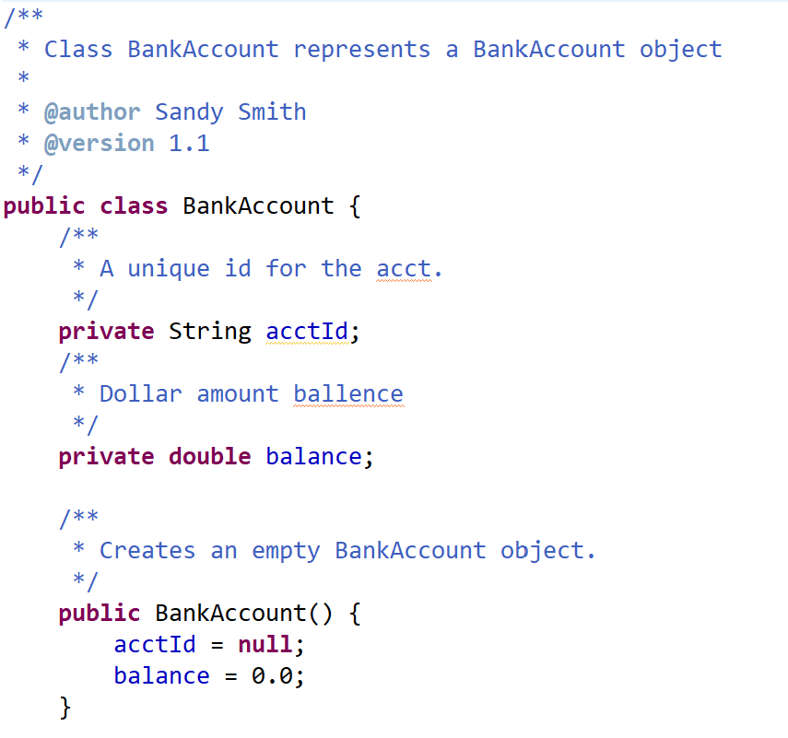
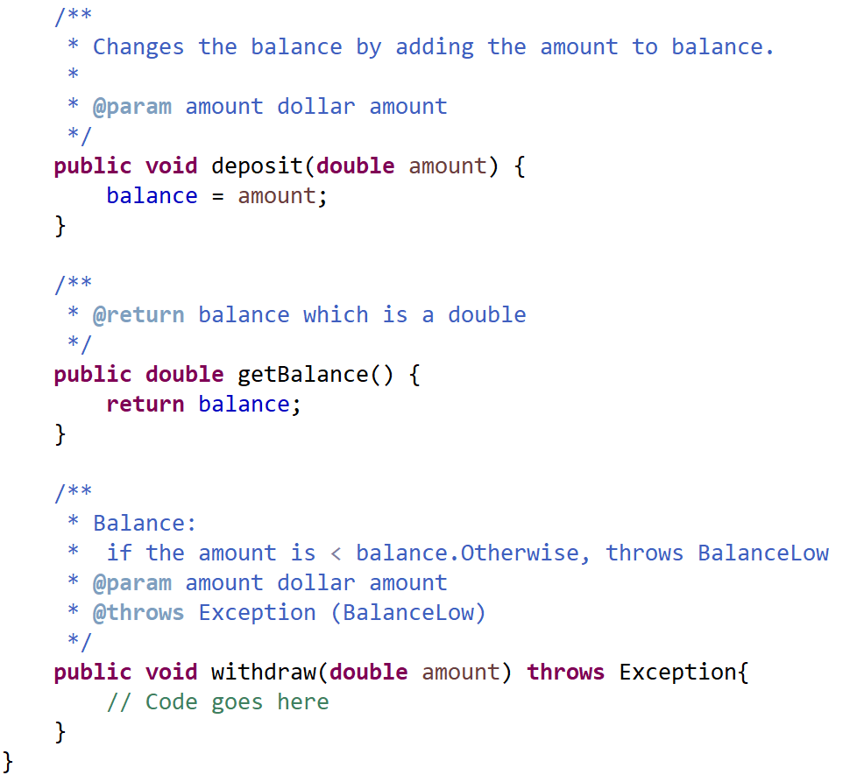
Example

Slide 8
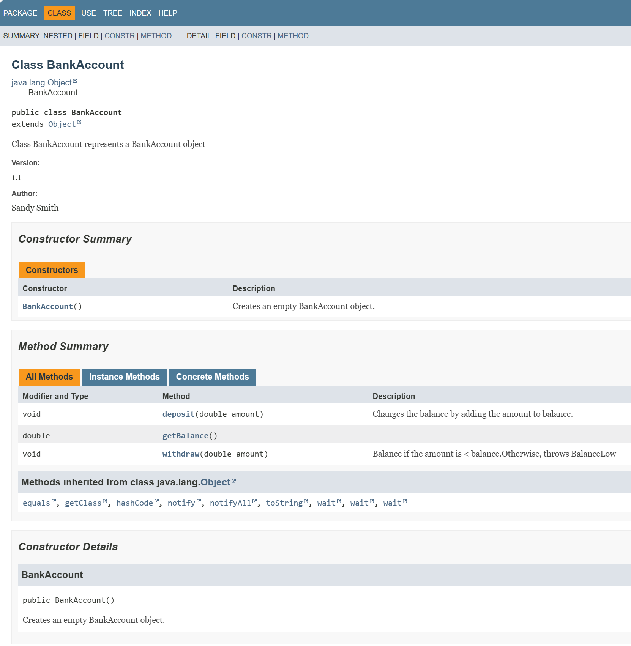
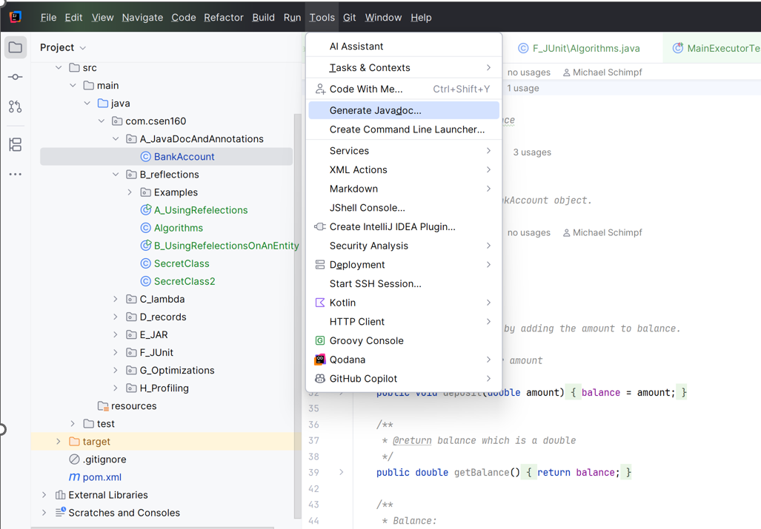
Example

Slide 9
Annotations in General

Slide 10
Annotations
They are meta-tags that you add to your code:
  Package declarations
  Type declarations
  Constructors
  Methods
  Fields
  Parameters
  Variables

Slide 11
Annotations
Simple Java Annotations:
  Override
  Deprecated
  Suppresswarnings

Slide 12
Annotations
Unique to Java
Meta Data
Provide information about the program.
Ease-of-development features introduced in JDK 5.
No direct effect on the code, they annotate.
Heavily used in frameworks like Hibernate, Spring, etc

Slide 13
Java Reflections

Slide 14
Java Reflections
What can you do with reflections?
Access:
All class info
All members/fields (including final private)
All methods (including final private)
All constructors
All annotations
Arrays
Almost everything (don’t know what not …)
At runtime

Slide 15
Java Reflections
What can you do with reflections?
Manipulate:
Access private field and methods
By setting “setAccessible(true)”
Invoke functions
Etc.
At runtime

Slide 16
Java Reflections
Why?

Slide 17
Java Reflections
For software developer:
It is fun to play with it
Easy way to access class files
Nice for low level hacks
Software developer itself are not the target group

Slide 18
Java Reflections
As software developer?
Careful using reflections, to access private fields or methods!
… to solve some development issues!

Slide 19
Java Reflections
Because:
The developer of this class, does not know it is used this way (private)
The developer will change, remove, edit a private function
Your program does not work anymore
In general: Do not use reflections for standard programming tasks!

Slide 20
Java Reflections
For hacking:
Not really powerful
Decompiling is more useful (Bytecode level -> Assembler level)
Could you write a virus with reflections?
Malware in a JAR archive, do something, maybe …

Slide 21
Java Reflections
Disadvantages:
Performance overhead
Security violations
It is against object-oriented principles

Slide 22
Java Reflections
For frameworks and Tools:
Eclipse/IntelliJ are using it:
  List of methods
  Auto completion
  Shows Javadoc
Hibernate:
  Match entity annotations with actual table names
JUnit:
  Get more information
Spring:
  Get class info's for bean creation
  Getter/Setter …
Reflections are for tool creators

Slide 23
Reflection in Action

Slide 24
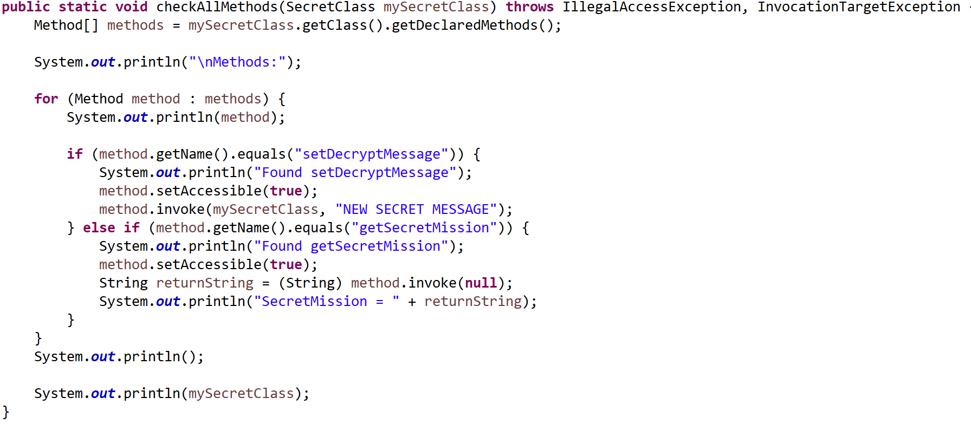
Java Reflections --- Methods ---
CSEN160_08_Miscellaneous.B_reflections.A_UsingRefelections

Slide 25
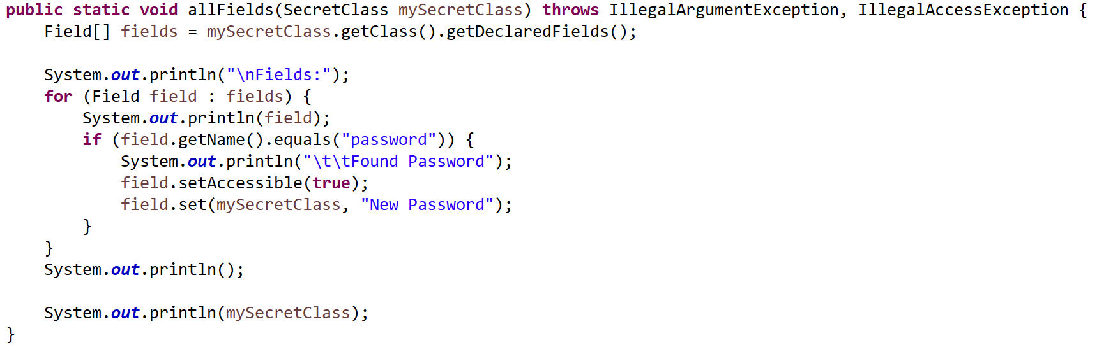
Java Reflections --- Fields ---
CSEN160_08_Miscellaneous.B_reflections.A_UsingRefelections

Slide 26
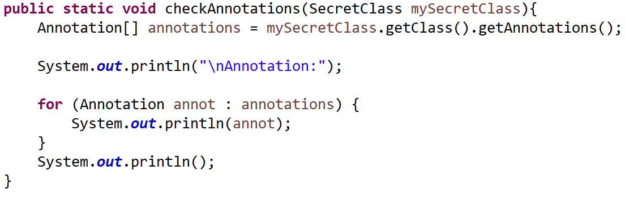
Java Reflections --- Annotations ---
CSEN160_08_Miscellaneous.B_reflections.A_UsingRefelections

Slide 27
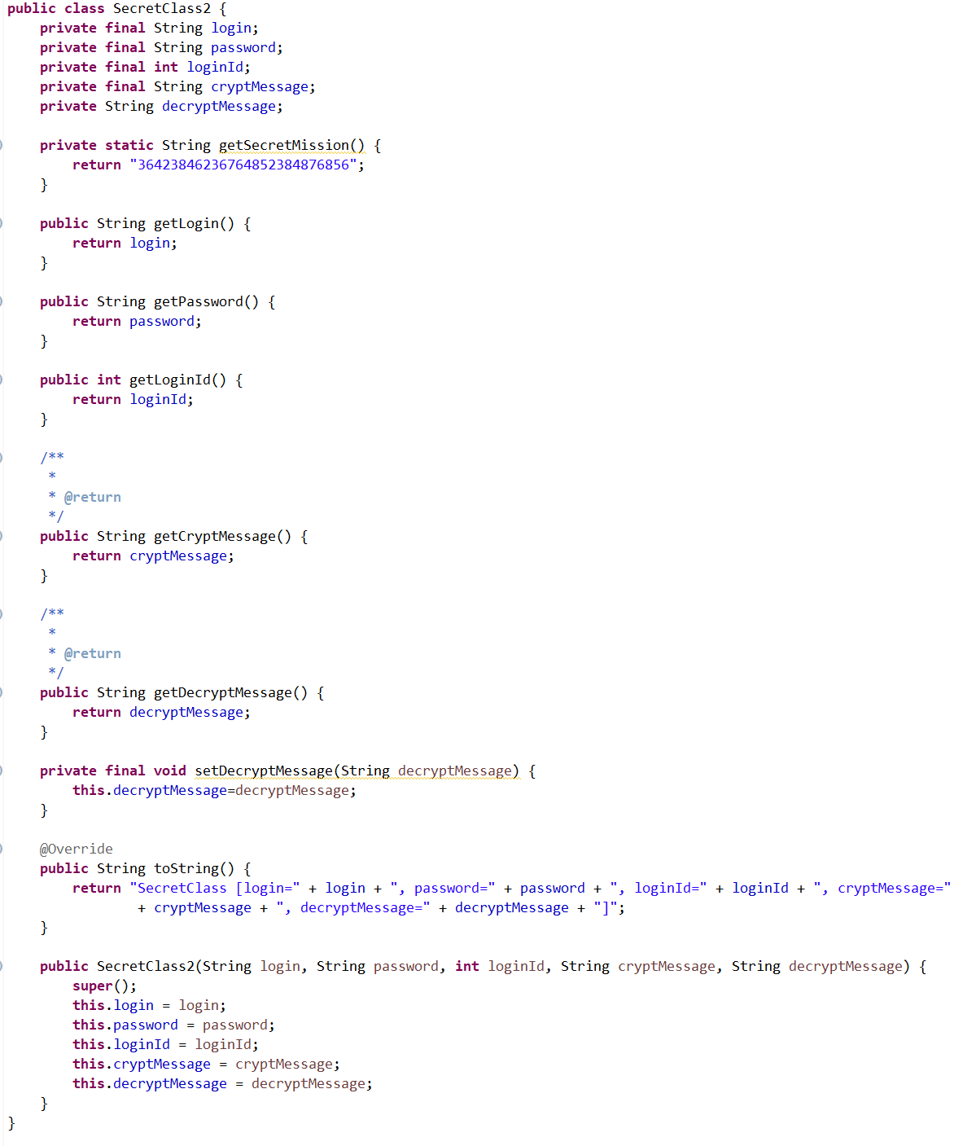
CSEN160_08_Miscellaneous.B_reflections.A_reflections
Java Reflections
IntelliJ:

Slide 28
Lambda Expressions

Slide 29
Lambda Expressions
Lambda:
Introduced with Java 8
Short writing style for interfaces
Anonymous Function
(parameters) -> expression
Less writing because compiler already know …
“A lambda expression is a short block of code
which takes parameters and returns a value.
Lambda expressions are similar to methods, but
without a name and they can be implemented
right in the body of a method.”
(Source)

Slide 30
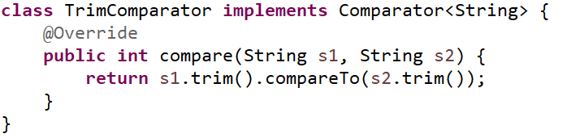
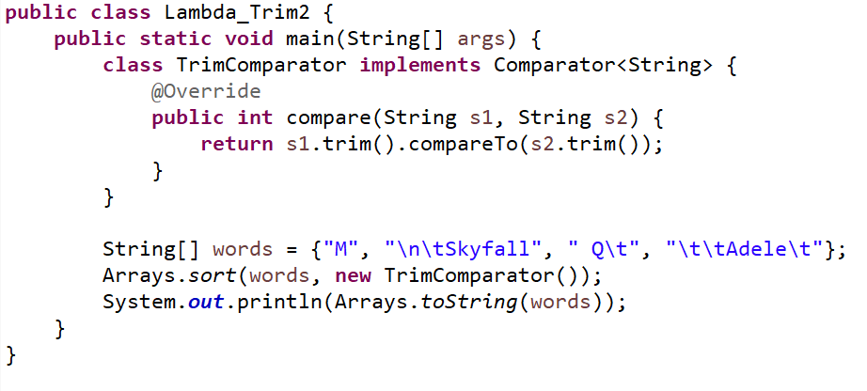
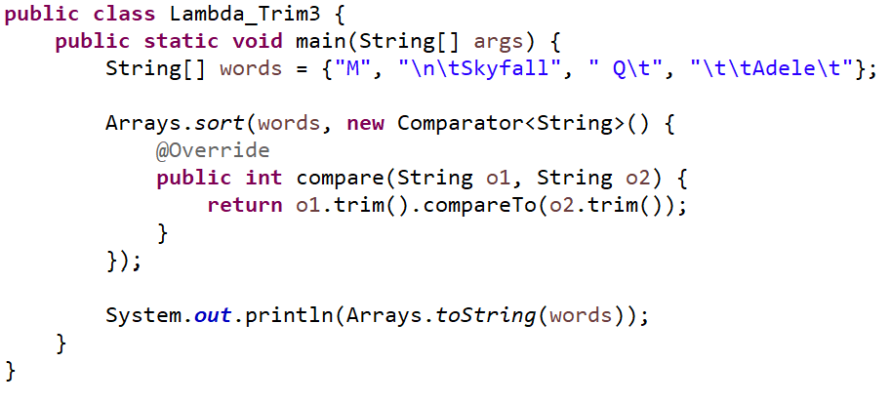
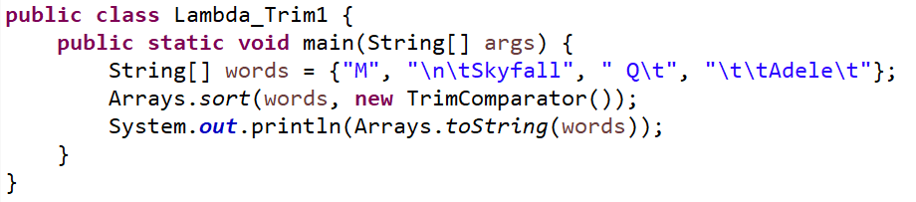
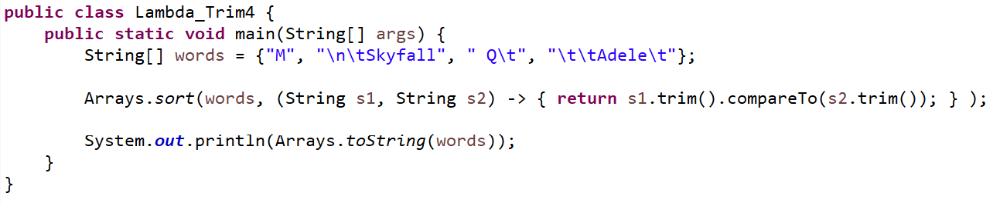
Lambda Expressions
CSEN160_08_Miscellaneous.C_lambda.Lambda_Trim(1 to 4)
Example 1
Example 2
Example 3
Own class own file
Class inside class
Anonymous class
Example 4
Lambda Expression

Slide 31
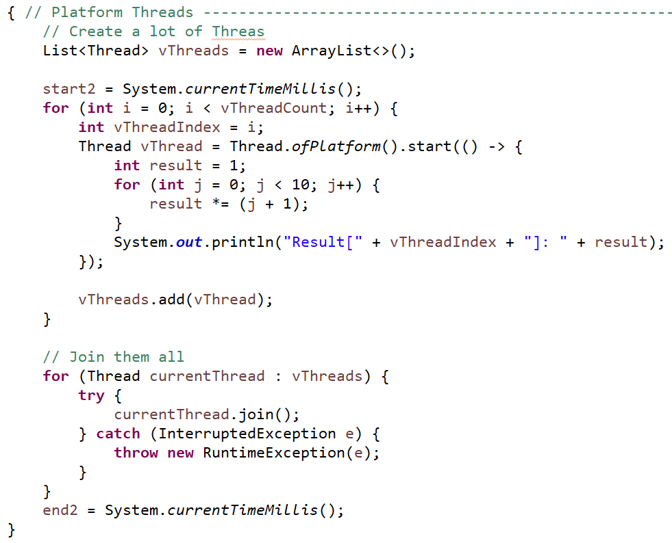
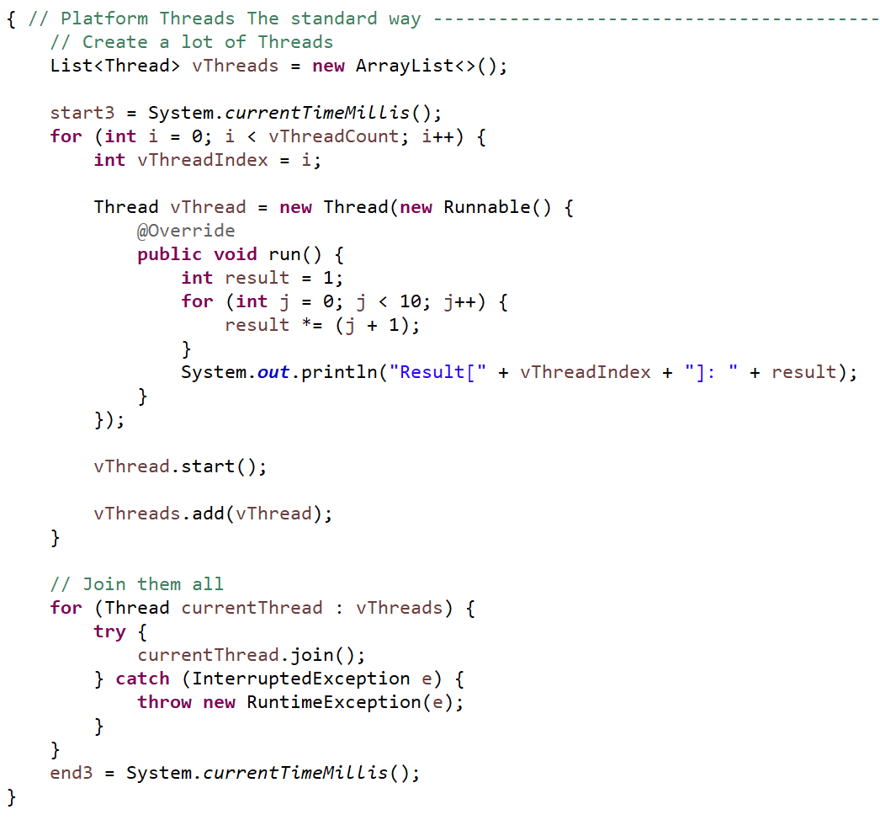
CSEN160_08_Miscellaneous.C_lambda.Lambda_Trim(1 to 4)
Lambda
Runnable Lambda Example: Standard Approach

Slide 32
Java Record

Slide 33
Java Record
  Lightweight entity class
  The simplest “classes” (available since JDK16)
  Read-only
  Every field is private and final (you set it once)
  Some kind of a “struct”

Slide 34
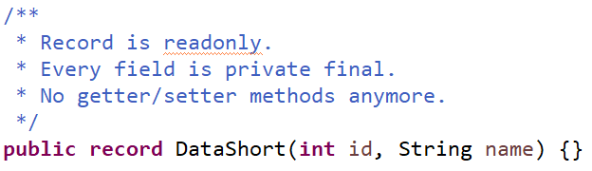
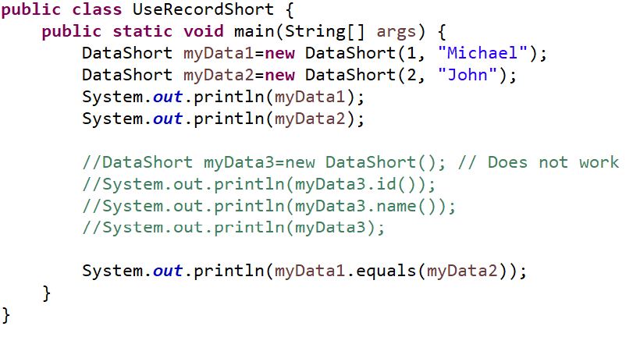
Short Example
CSEN160_08_Miscellaneous.D_records.A_DataShort
Special record constructor
One Java file DataShort.java

Slide 35
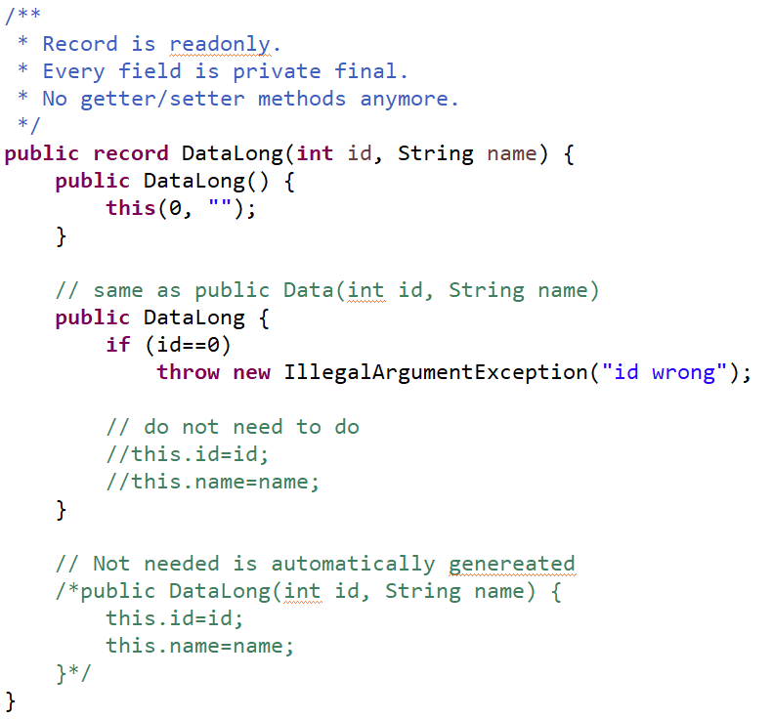
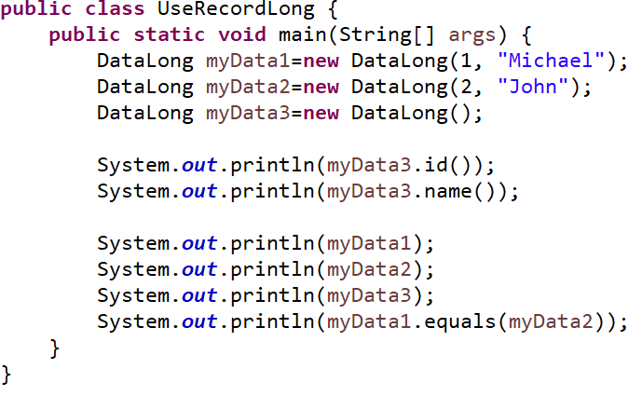
Long Example
CSEN160_08_Miscellaneous.D_records.B_DataLong
Special record constructor
No parameter
Constructor possible
Argument
Constructor
Overall: do not make record entities too complicated!
They are simple lightweight entities, nothing else.
One Java file DataShort.java

Slide 36
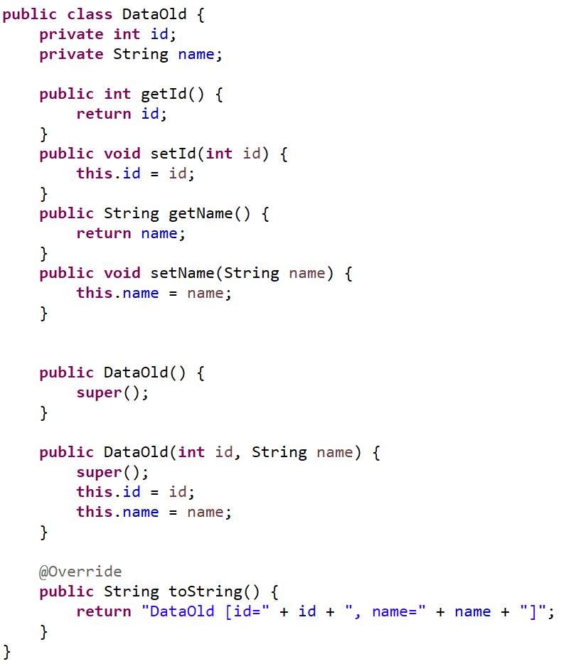
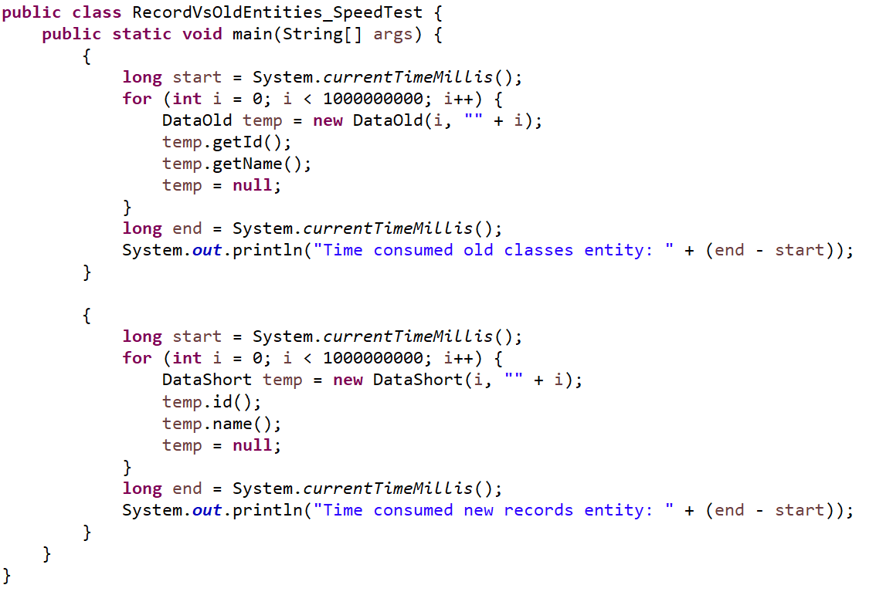
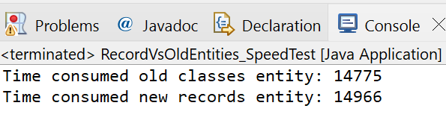
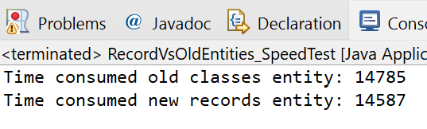
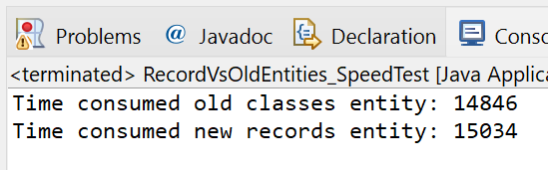
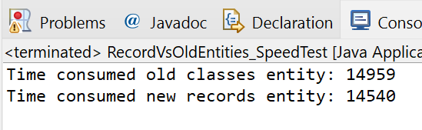
Time comparison old entity classes vs new records
CSEN160_08_Miscellaneous.D_records.C_DataOld

Slide 37
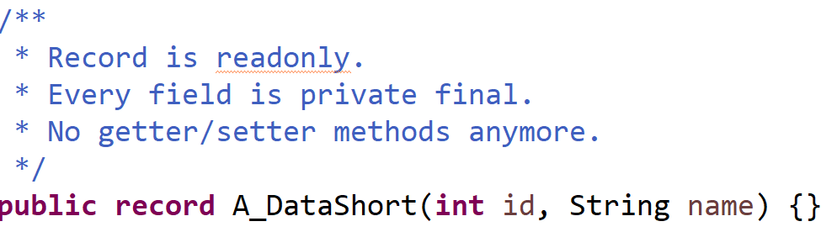
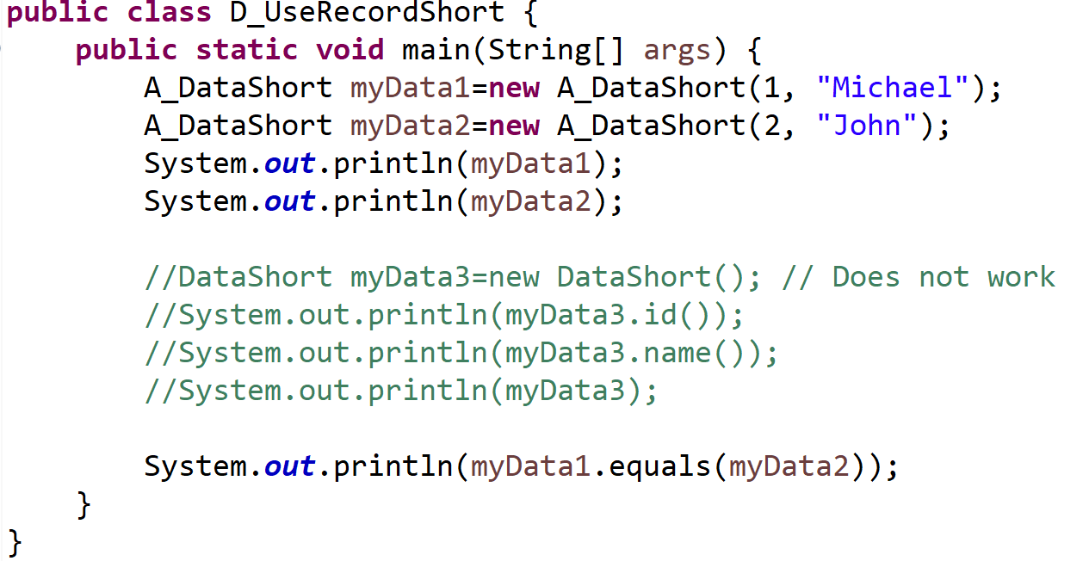
CSEN160_08_Miscellaneous.D_records.UseRecordShort
Java Records

Slide 38
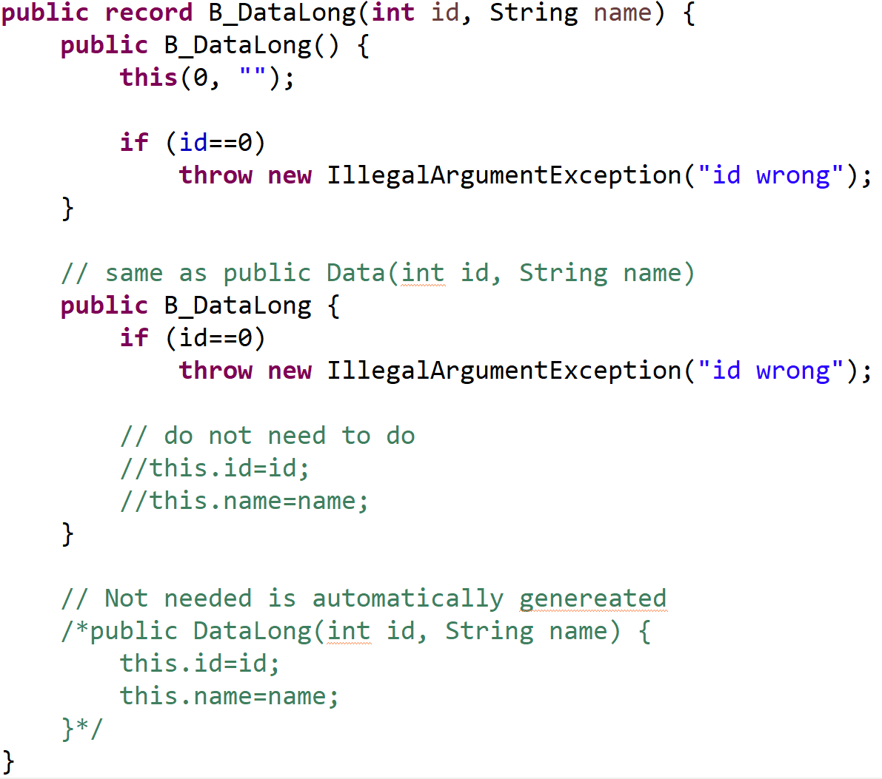
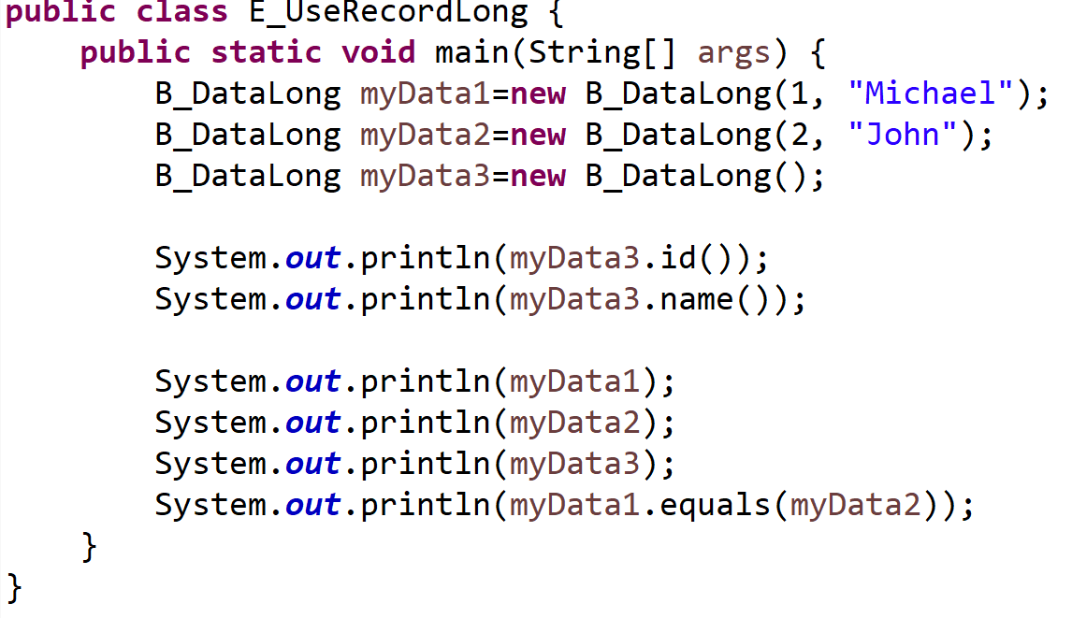
CSEN160_08_Miscellaneous.D_records.E_UseRecordLong
Java Records

Slide 39
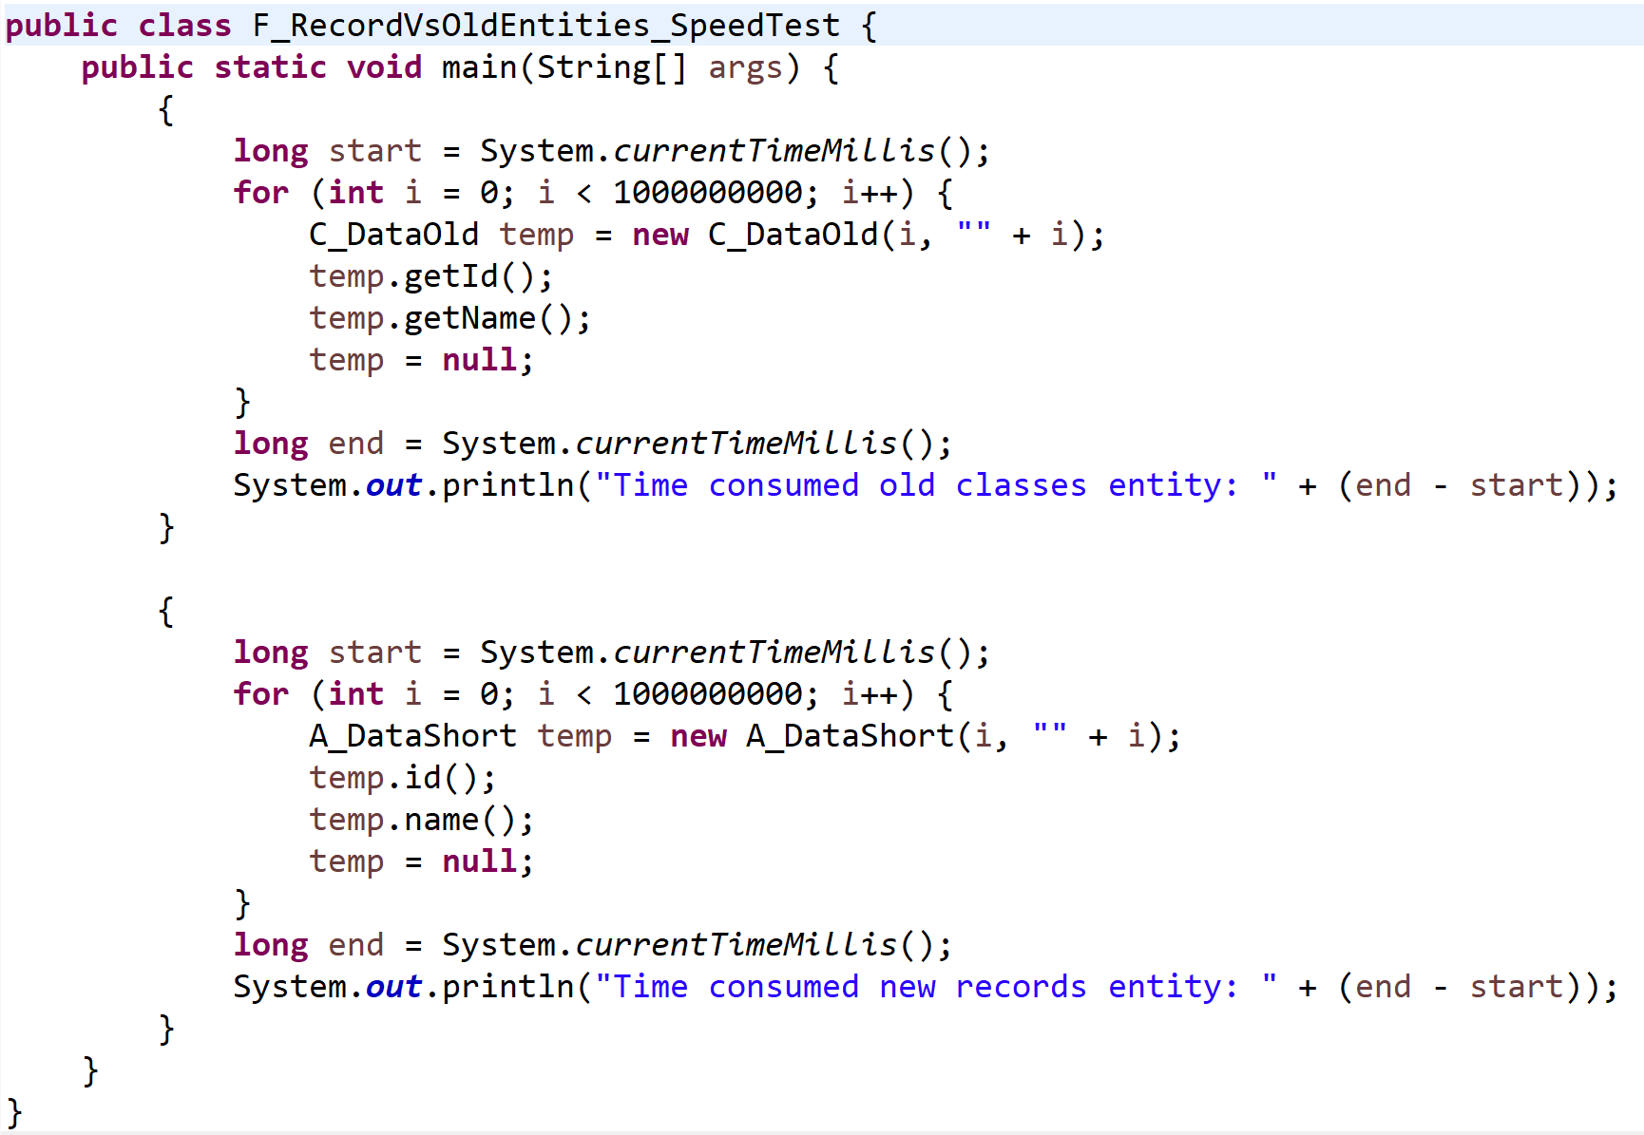
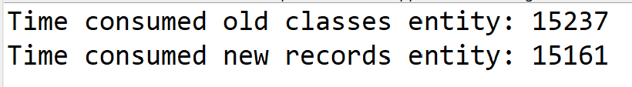

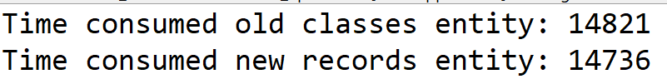
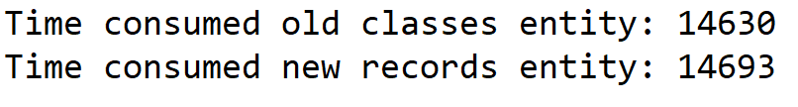
CSEN160_08_Miscellaneous.D_records.F_RecordVsOldEntities_SpeedTest
Java Records

Slide 40
Java-Archive (JAR)

Slide 41
JAR
Advantages:
Security: you can sign a JAR
Compression
Faster to download a jar then a bunch of class files
Package versioning (sealing)
More portable

Slide 42
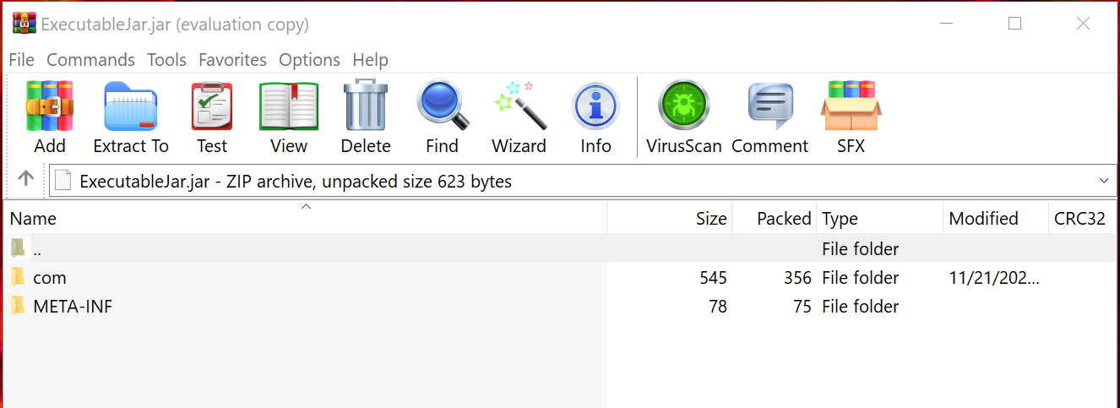
JAR
Put together a bunch of files (tar)
You can open JARs with every zip, rar, 7-zip, program
Don’t assign *.jar to a zip program …
Runnable JAR

Slide 43
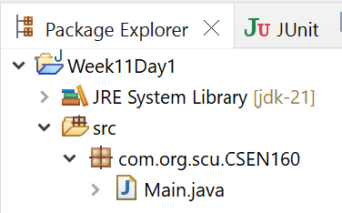
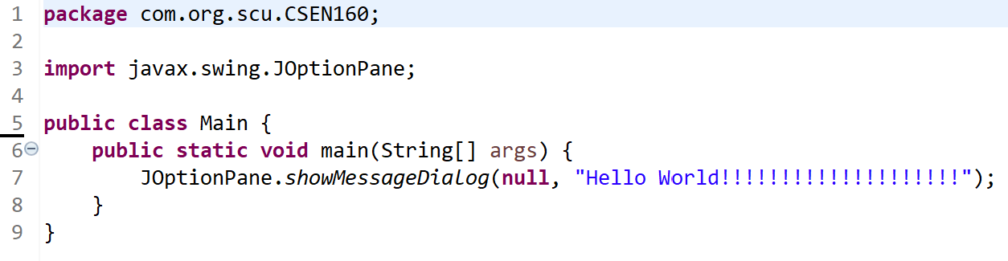
JAR
CSEN160_08_Miscellaneous.E_JAR.Main
Very simple example program:

Slide 44
JAR file
Eclipse offers two ways:
Simple plain “JAR file”
“Runnable JAR file”

Slide 45
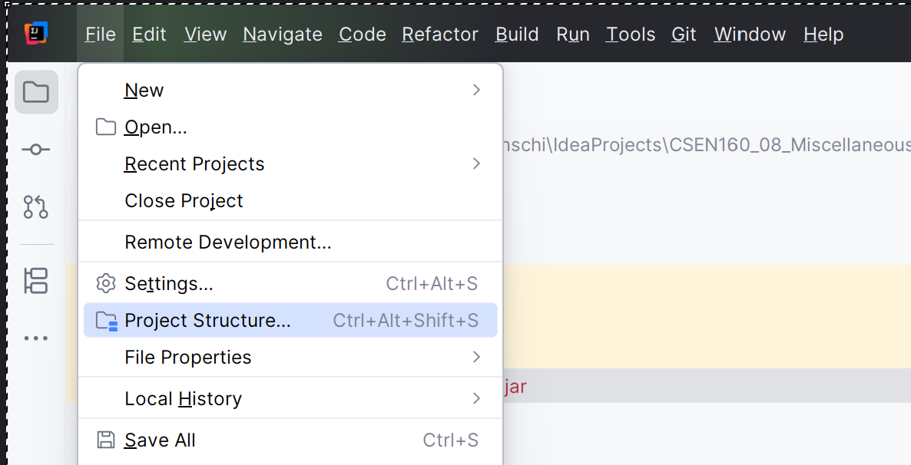
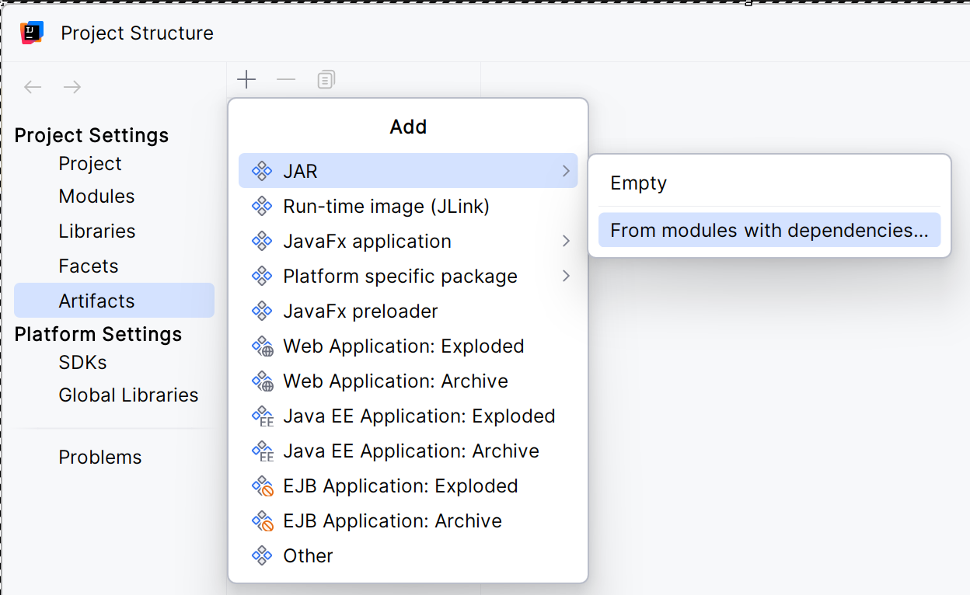
JAR file IntelliJ

Slide 46
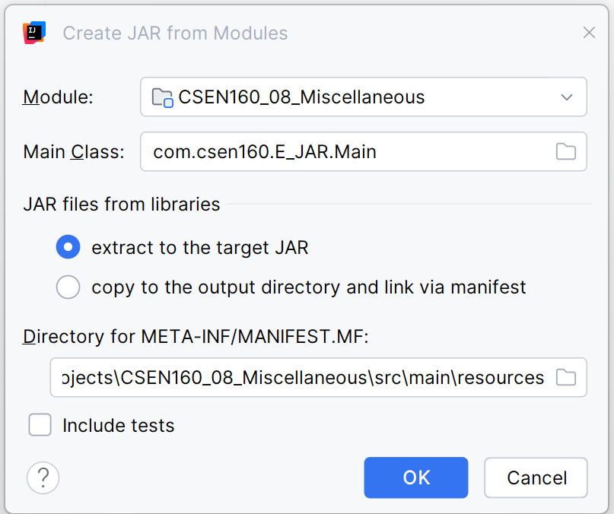
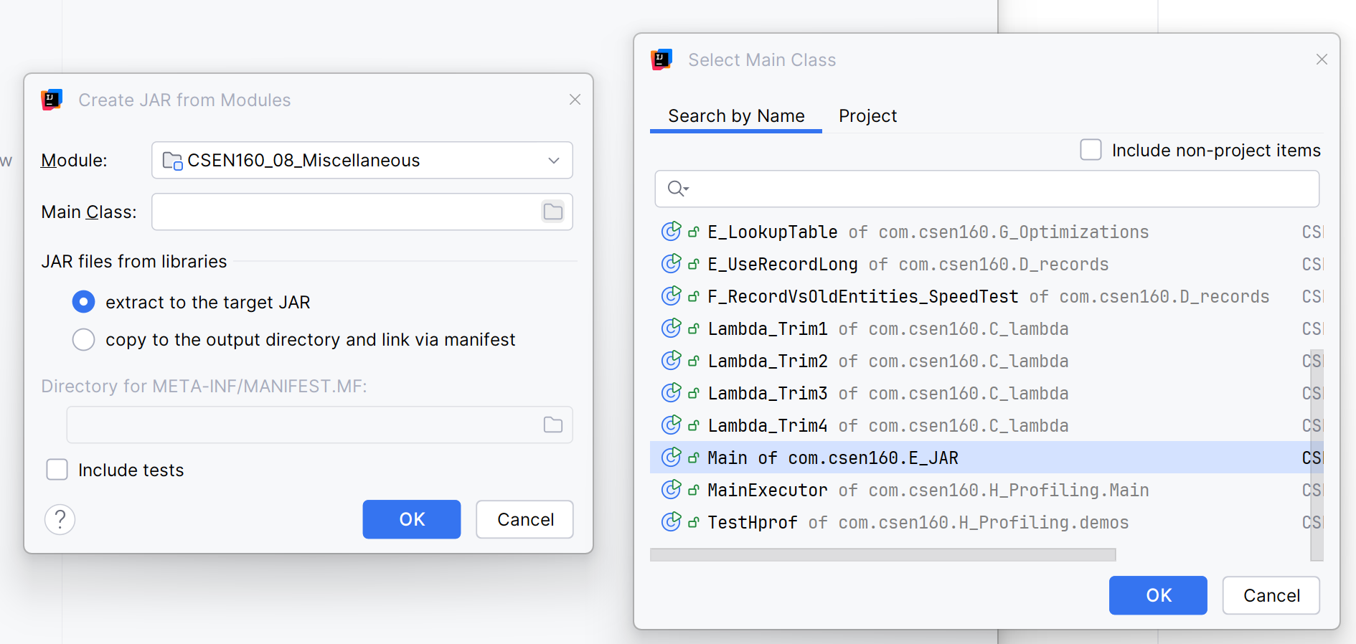
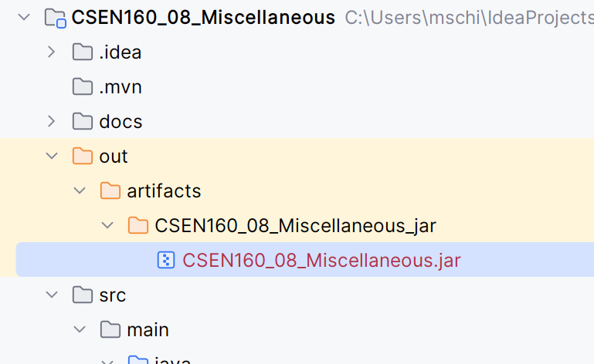
JAR file IntelliJ

Slide 47
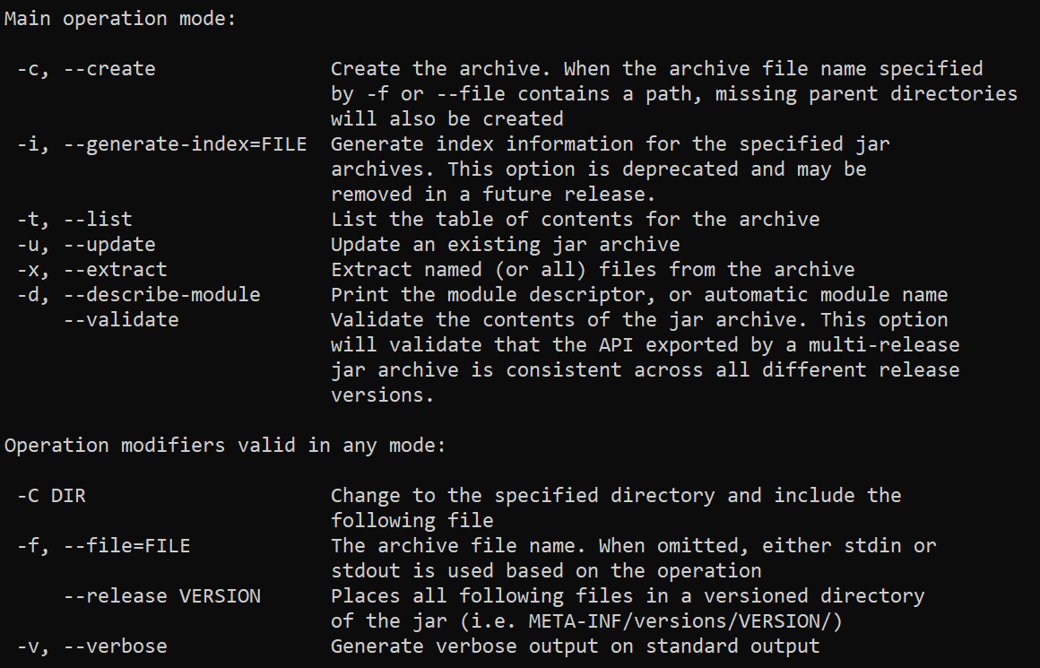
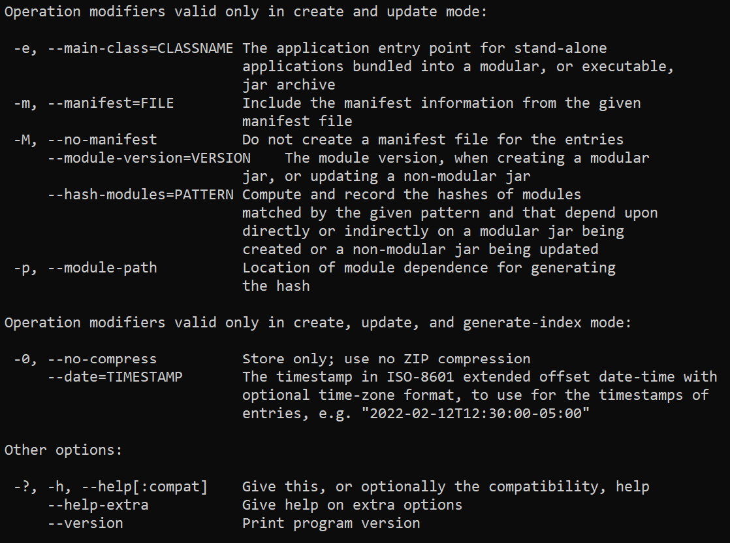
Create JAR (command line)
jar –help or jar -h:

Slide 48

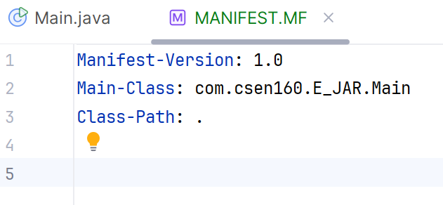
Create JAR (command line)
Create JAR:
jar cf mike.jar com
Create Executable JAR:
jar cmf MANIFEST.MF mike.jar com
Execute JAR:
java -jar ./mike.jar
On Windows:
If double click on JAR does not work
Download jarfix.exe

Slide 49
JAR signing

Slide 50
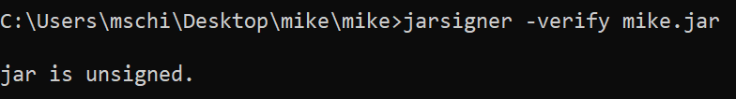
Create JAR (command line)
Check if JAR is signed:
jarsigner -verify mike.jar

Slide 51
Create JAR (command line)
Create keystore.jks:
keytool -genkey -alias server -keyalg RSA -keypass password -storepass password -keystore keystore.jks
Create certificate:
keytool -export -alias server -storepass password -file server.cer -keystore keystore.jks
Actually, sign a Jar:
jarsigner -keystore keystore.jks -signedjar mike-sign-V1.0.jar mike.jar server

Slide 52

Create JAR (command line)
Check if it is signed:
jarsigner -verify mike-sign-V1.0.jar

Slide 53
Done

