Slide 1
CSEN160
Fall 2026
Object-Oriented Analysis, Design and Programming
Michael Schimpf, PhD, mschimpf@scu.edu
Department of Computer Science and Engineering

Slide 2
Extreme Programming (XP)
Test Driven Development (TDD)

Slide 3
Extreme Programming (XP)
XP 12 practices, grouped into four areas:
Fine-scale feedback
  Pair programming*
  Planning game
  Test-driven development
  Whole team
Continuous process
  Continuous integration
  Refactoring or design improvement*
  Small releases
Shared understanding
  Coding standards
  Collective code ownership*
  Simple design*
  System metaphor
Programmer welfare
  Sustainable pace
  *Computerworld-appdev-92 "Extreme Programming", Computerworld (online), December 2001.

Slide 4
Test Driven Development
TTD:
You develop test cases (FIRST)
You develop the software itself
test-first programming concepts of extreme programming

Slide 5
Test Driven Development
The following sequence is based on the book Test-Driven Development by Example:
(Beck, Kent (2002-11-08). Test-Driven Development by Example. Vaseem: Addison Wesley. ISBN 978-0-321-14653-3)
1. Add a test
2. Run all tests
3. Write the simplest code that passes the new test
4. All tests should pass
5. Refactor as needed

Slide 6
Test Driven Development
1. Add a test
Adding a new feature by writing a test that passes the specifications.
The developer can check specifications by checking use cases/stories.
A key benefit of TDD is, it makes the developer focus on requirements.
In contrast with the usual practice (test are written at the end).

Slide 7
Test Driven Development
2. Run all tests (The new test should fail)
The code needs to be implemented.
Validate that the test setup is working.
Rules out that the test itself is flawed (i.e. always passes).

Slide 8
Test Driven Development
3. Write the simplest code that passes the new test
Inelegant or hard code is acceptable
As long as it passes the test.
Code improvement follows in step 5.
No additional code should be added
(no fancy, nice to have stuff).

Slide 9
Test Driven Development
4. All tests should now pass
If any fail, the new code must be revised until they pass.
Ensure the new code meets the test requirements
And does not break existing features.

Slide 10
Test Driven Development
5. Refactor as needed (executing tests after each tiny refactor step)
Code is refactored for readability and maintainability.
Hard-coded test data should be removed.
Running the test suite after each refactor (nothing is broken?!).

Slide 11
Test Driven Development
Examples of refactoring:
Moving code to where it logically belongs
Removing duplicate code
Making names self-documenting
Splitting methods into smaller pieces
Re-arranging inheritance hierarchies

Slide 12
Test Driven Development
Repeat
Refactoring cycle repeats after each new piece of code.
Tests should be small and incremental, and commits made often.
If new code fails some tests:
  Undo or revert
  Rather than debug.
When using external libraries:
  No need to test (external libraries)
  Basic functionality only
  Unless there is a believe the library is buggy
  Or not feature-rich enough.

Slide 13
JUnit

Slide 14
JUnit
Hated by “some” software developer:
It cost time to test
I am an awesome programmer; tests are for looser …
Boss did not ask for it
Who cares?!

Slide 15
JUnit
Loved by “some other” software developer:
Loved, when they are already there
  And you need to refactor a lot of code
  You are an extreme or agile software developer
  Or you have faith in TDD

Slide 16
JUnit
Easy to use:
Maven projects supports it
Eclipse supports it
IntelliJ supports it even better
Overall: Easy to run tests in IntelliJ/Eclipse

Slide 17
JUnit
Important asserts:
assertEquals(“Hello”, “Hello”);
assertTrue(Boolean);
assertFalse(Boolean);
assertNotNull(…);
assertNull(…);
assertArrayEquals();
Test for exceptions …

Slide 18
JUnit
Important:
You will see as software developer, in some source code asserts …
HEVC Video Codec source code …

Slide 19
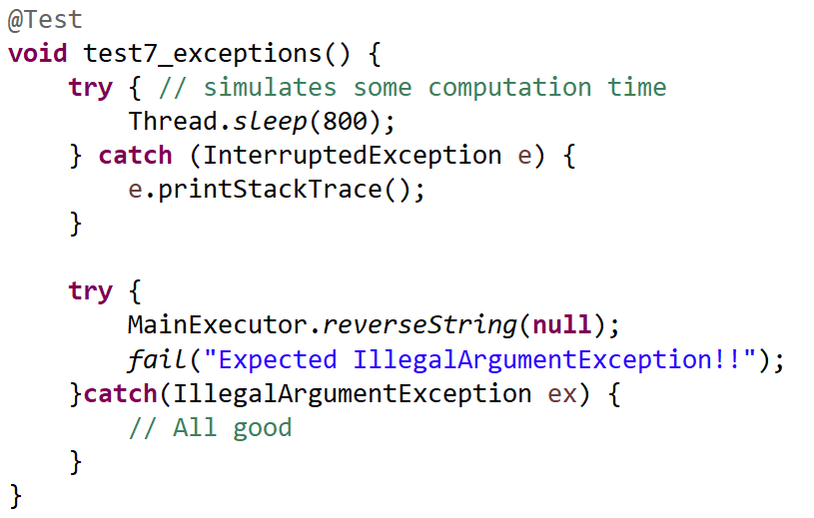
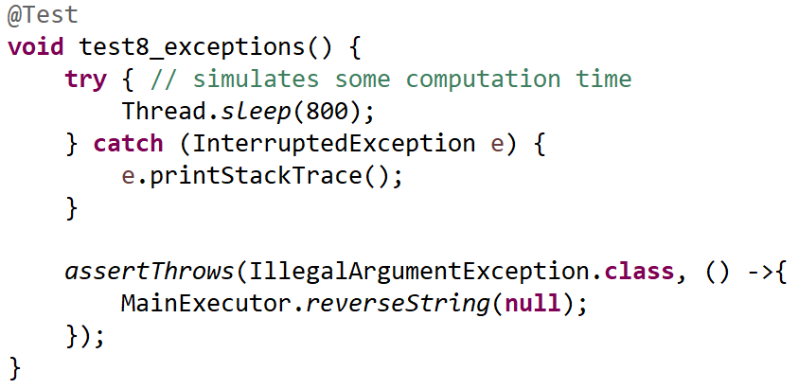
JUnit
Check exceptions:

Slide 20
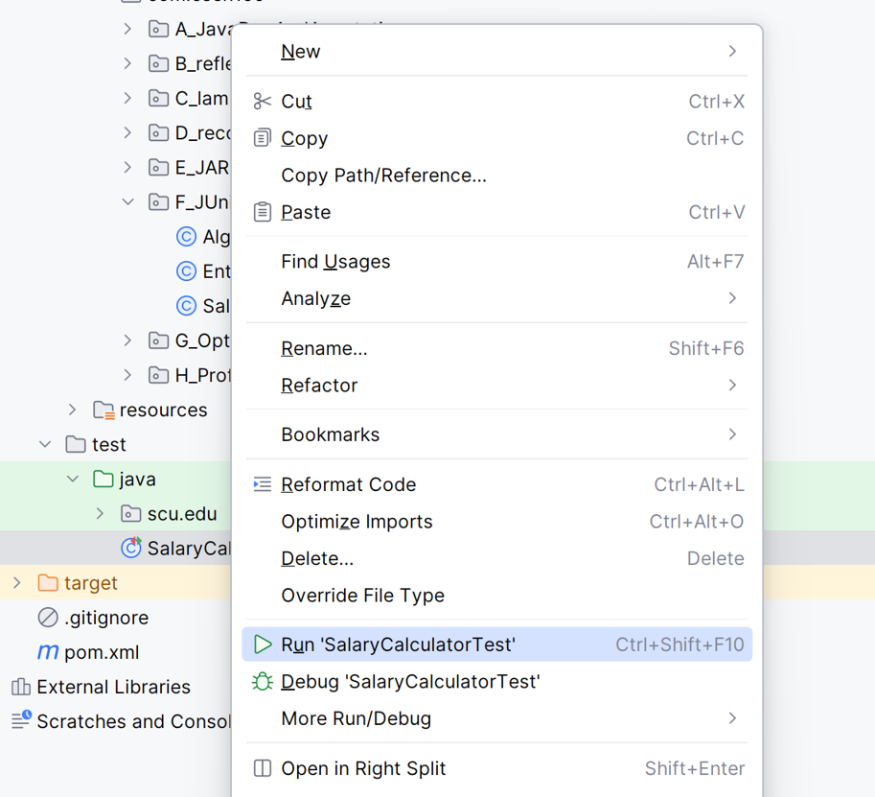
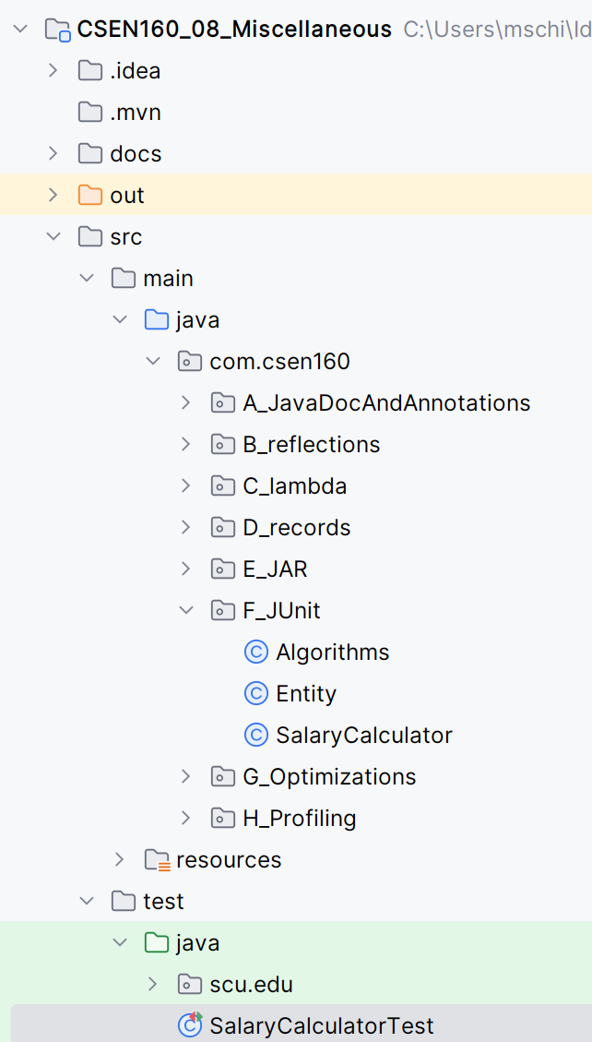
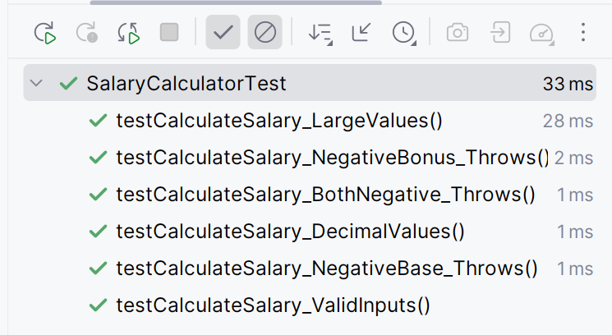
CSEN160_08_Miscellaneous.test.SalaryCalculatorTest
JUnit
Automatically
Created
Test folder

Slide 21
Logging in General

Slide 22
Logging in General
For professional software development:
System.out.println is not enough!
Logging messages needs to go into files
Into many different files
Log-level is very important

Slide 23
Logging in General
Major scenarios:
Customer issue (transaction did not work, payment lost, why?)
Scammer/hacker infiltrated the system (Forensics)
System behaves weird (one of the server crashes every hour, or every two days, etc.)
General errors (Out of Memory, etc.)
DDos attacks (what type, which system, etc.)

Slide 24
Logging in General
Different stakeholders:
Business department (Product Owner) who owns the application (not really interested)
Technical department Application Owner (very interested) (ITIL - IT Infrastructure Library)
The datacenter team (they are sometimes very interested)
Application developer (after work is done, not really interested)

Slide 25
Logging in General
Web application logging design:
Big web applications are distributed multi server applications
Backend to frontend, can have up to 10 layers (sometimes more)
Every layer have a bunch of parallel servers (number depends on demand)
Tracing an user from the frontend to the backend is not easy!

Slide 26
Logging in General
Web application logging design:
While developing web applications, you need to think about how to log:
Tools like Splunk can help you
But you need to design traceability!

Slide 27
Logging in General
You need to follow an user from frontend to backend!
User has a specific http address
User has a login
User has a session id (web) jsessionid (Java)
In the moment user enter his credentials (frontend) (log these in the web layer logfile).
Then you use the web session id and log this in every layer
With tools like Splunk, you can follow the user interaction through the whole system

Slide 28
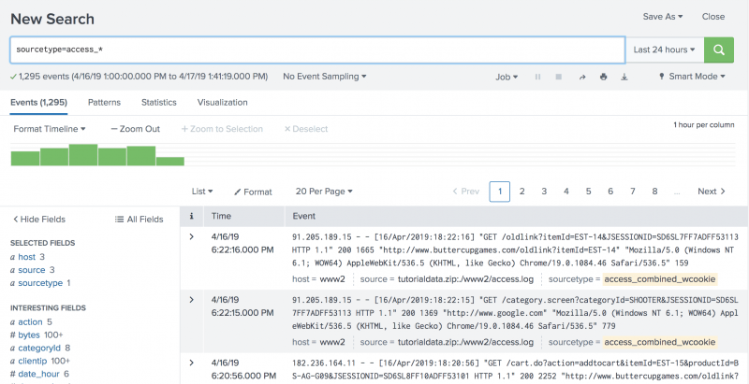
Splunk
Logfile analysis: https://www.youtube.com/watch?v=oxZHUg7H3kw

Slide 29
Logging with Log4j

Slide 30
Log4j
Log4j:
Log4j version 1.0 release 1999
Apache license
Was the original logging tool which everyone used
In many libs/jars integrated

Slide 31
Log4j Vulnerability
2021 Vulnerability
Version 2.16
Version 2.17 fixed
Version 2.24 Nov 2024
Log4j: was everywhere!

Slide 32
Log4j Vulnerability
Attackers can:
Log4shell
Break into systems
Steal passwords and logins
Extract data
Infect networks with malicious software.

Slide 33
Log4j
For professional software development:
FATAL
ERROR
WARN
INFO
DEBUG

Slide 34
Log4j
FATAL:
FATAL like ERROR, a serious problem.
You will not see it on a normal day.
If it appear, it signals very bad news
Application death.

Slide 35
Log4j
ERROR:
A serious problem needs to be investigated immediately.
Not as serious as FATAL, but still a problem.
Your application has met an undesired state.

Slide 36
Log4j
WARN:
You might have a problem and there is an unusual situation.
You were invoking a service, and it failed (a couple of times).
Unexpected and unusual, but no real harm.
Unknown if this issue will persist or recur.

Slide 37
Log4j
INFO:
Record messages about routine stuff.
System administrators watch in real-time info logs
And if there is any problem in the normal flow.

Slide 38
Log4j
DEBUG:
Debugging the application at development time.
A lot of log message will appear
It basically belongs to developers

Slide 39
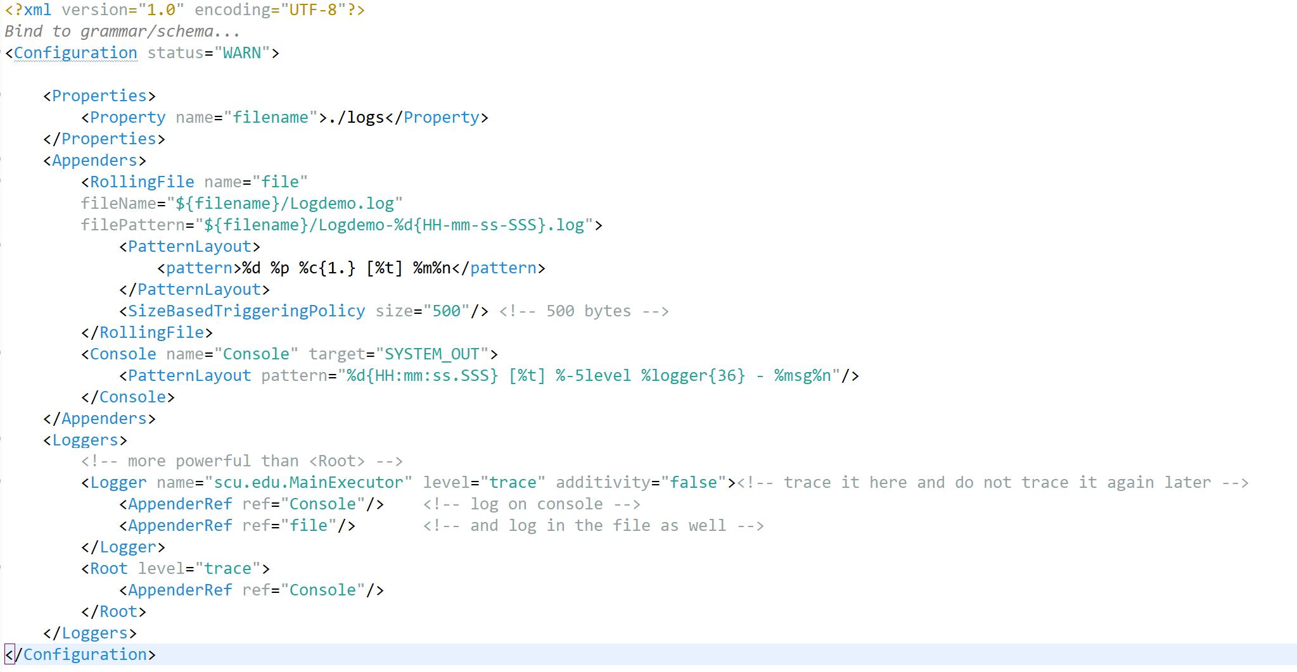
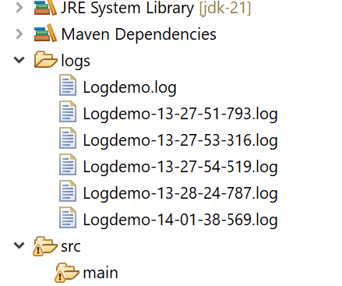
Log4j
Configuration:
Folder where to put all logfiles
Naming convention for old logfiles
Loggings string
How big is a log file

Slide 40
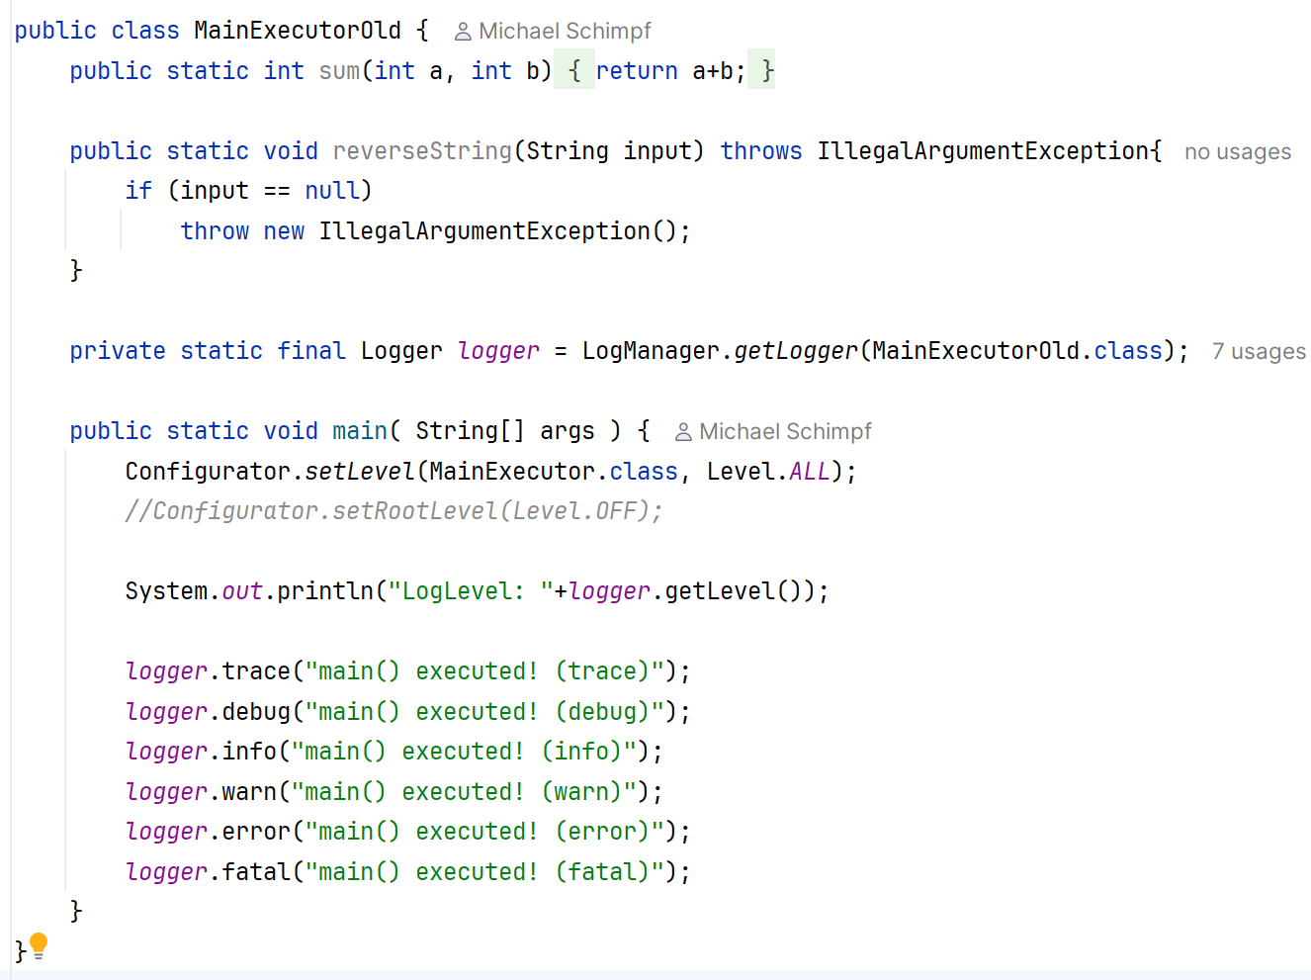
CSEN160_08_Miscellaneous.I_Log4J.MainExecutorOld
Log4j

Slide 41
Logging with JUL
(java.util.logging)

Slide 42
JUL
Java.util.logging:
SEVERE (highest value)
WARNING
INFO
CONFIG
FINE
FINER
FINEST (lowest value)

Slide 43
JUL
SEVERE (highest value):
SEVERE a serious failure.
In general, SEVERE messages are important
They should be simple to understand (to everyone)

Slide 44
JUL
WARNING:
WARNING a potential problem.
WARNING is of interest to the end users or system managers
Or which indicate potential problems.

Slide 45
JUL
INFO:
For informational messages.
Typically, INFO messages will be written to the console or its equivalent.
So, the INFO level should only be used for reasonably significant messages
(end users and system administrators).

Slide 46
JUL
CONFIG:
CONFIG for static configuration messages.
CONFIG intended to provide a variety of static config information
To assist in debugging problems with particular configurations.
Examples:
  The CPU type
  The GPU + graphics mode
  The GUI look-and-feel
  etc.

Slide 47
JUL
FINE:
FINE providing tracing information.
All of FINE, FINER, and FINEST are intended for relatively detailed tracing.
The exact meaning of the three levels will vary
FINEST be used for the most voluminous detailed output
FINER for somewhat less detailed output

Slide 48
JUL
FINE cont.:
FINE for the lowest most important messages.
FINE that will be interesting to developers.
FINE messages might include minor failures.
Potential performance problems.

Slide 49
JUL
FINER:
FINER a fairly detailed tracing message.
By default, logging calls for:
  Entering a function …
  Returning from a function …
  throwing an exception
Are traced at this level.

Slide 50
JUL
FINEST (lowest value):
FINEST indicates a highly detailed tracing message.

Slide 51
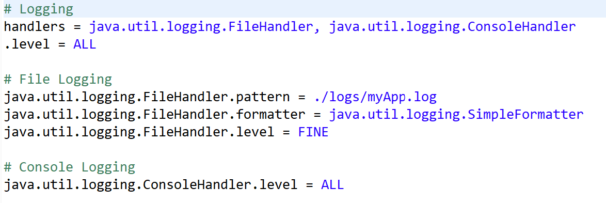
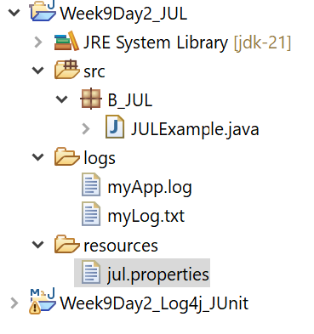
JUL
Configuration:

Slide 52
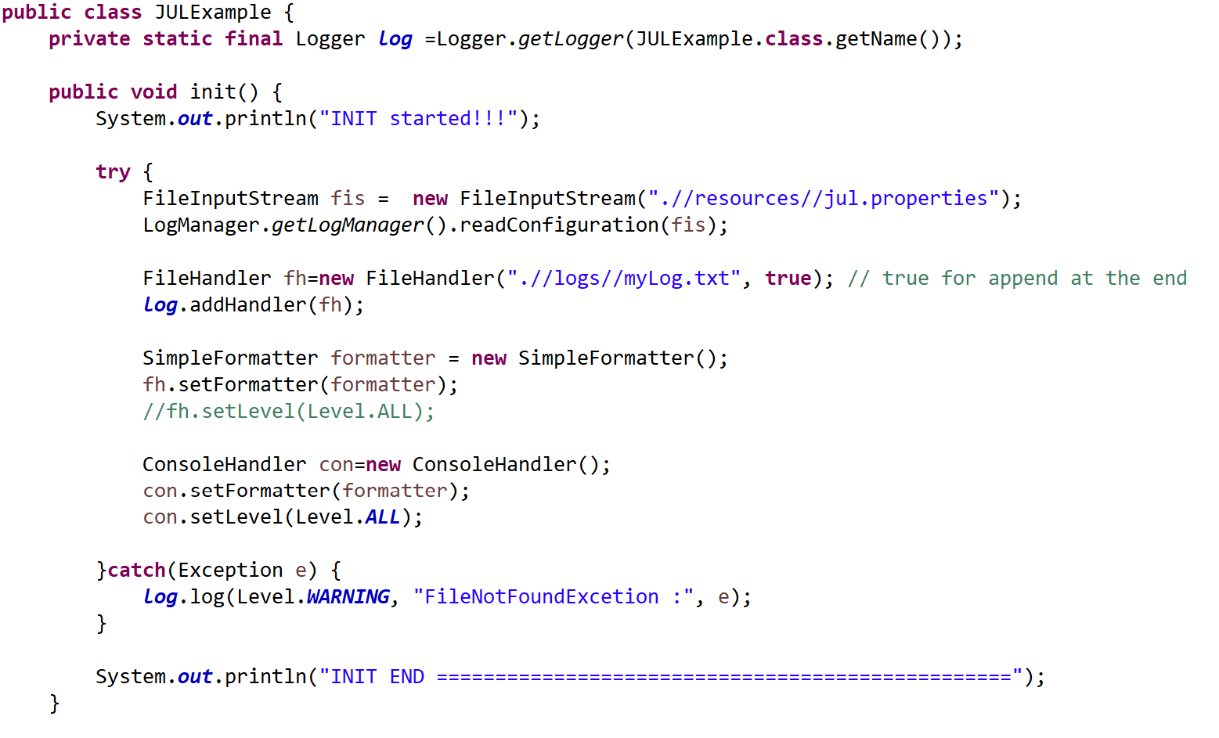
JUL
CSEN160_08_Miscellaneous.J_JUL.JULExample
Setup:

Slide 53
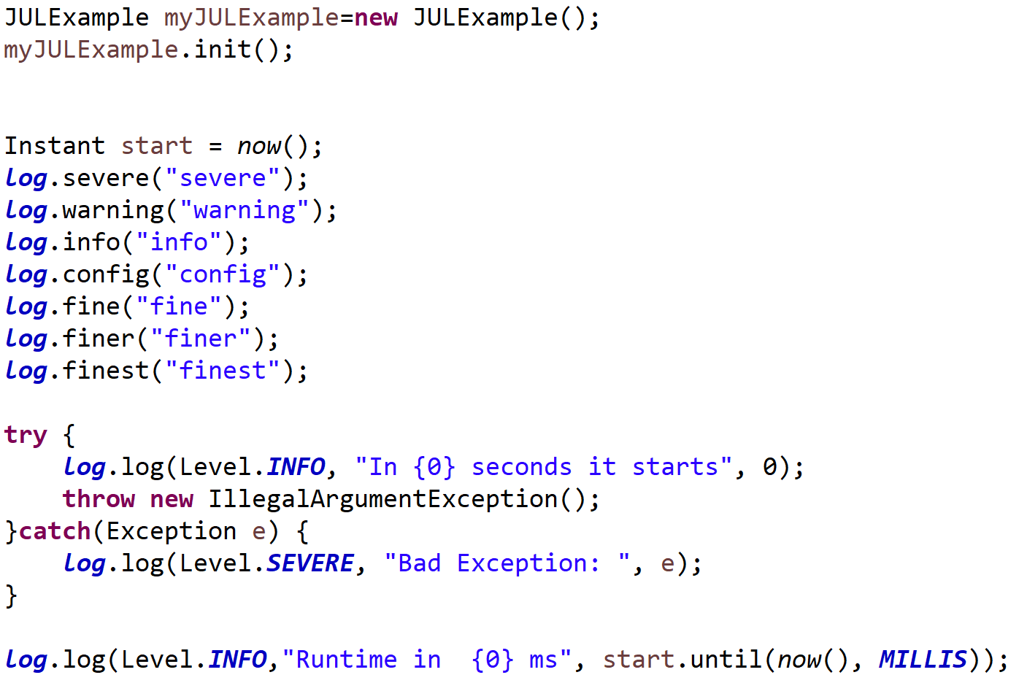
CSEN160_08_Miscellaneous.J_JUL.JULExample
JUL

Slide 54
Done

