Slide 1
CSEN160
Fall 2026
Object-Oriented Analysis, Design and Programming
Michael Schimpf, PhD, mschimpf@scu.edu
Department of Computer Science and Engineering

Slide 2
Model View Controller (MVC)
3-Tier Web Application

Slide 3
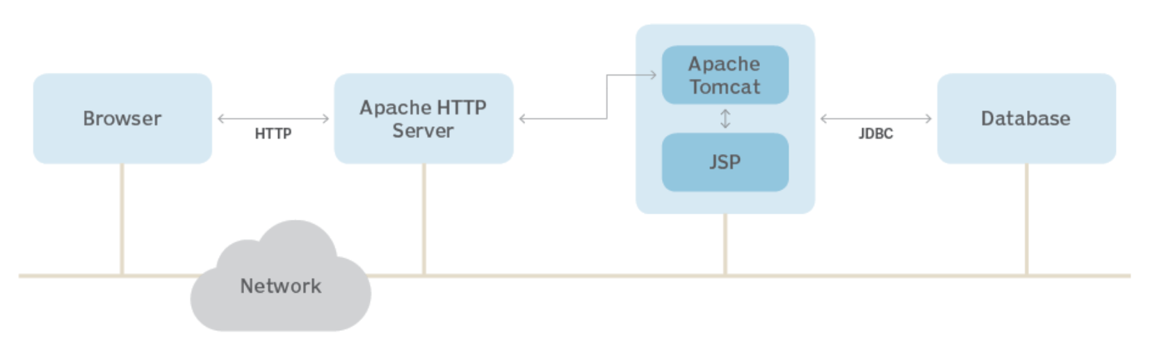
3-Tier Java Web Application

Slide 4
3-Tier Application
In general:
Scalability: The application can scale up or down (increased demand).
Improved reliability:
Each tier can operate independently.
No single point of failure.
Ease of maintenance:
Changes in one layer does not necessarily impact the other layers.

Slide 5
3-Tier Application
In general:
Security: Users can only access the data layer through the logical layer.
Faster development: Each tier can be developed independently.
Specialized development: Development teams can work on their areas of expertise.

Slide 6
3-Tier Application
In general:
A graphical frontend: HTML frontend/JSP pages
A business layer: Java Beans/Servlets
A database layer: PostgreSQL

Slide 7
Apache Tomcat as Application Server (Middle Tier)
What is Apache Tomcat?
An open-source web server and servlet container.
Supports Java Servlets, JavaServer Pages (JSP), and WebSockets.

Slide 8
Apache Tomcat as Application Server (Middle Tier)
Role in 3-Tier Architecture:
Hosts the application layer.
Manages business logic and processes client requests.

Slide 9
PostgreSQL as the Database (Data Layer)
PostgreSQL?
Open-source relational database management system.
Reliable, robust, and SQL compliance.
Stores and manages application data.
Handles database queries and transactions.

Slide 10
Presentation Layer
Role of the Presentation Layer:
User-facing interface (clients).
Typically implemented as web front-end (HTML/CSS/JavaScript).
Technologies:
Basic HTML/JSP on Tomcat.

Slide 11
How Layers Interact in 3-Tier Architecture
Flow of Data:
User actions in the presentation layer send requests to the application layer.
Application layer (Tomcat) processes requests and interacts with PostgreSQL.
Database responses back to the application layer, then to the presentation layer.

Slide 12

Apache Tomcat
Representation and Management of Data on the Web

Slide 13

APACHE TOMCAT
Open-Source Web Server and Servlet Container.
Server for hosting Java Web Applications.
Apache Software Foundation (ASF).
Includes tools for configuration and management.
Supports:
  Java Servlet
  Java Server Pages (JSP)
  Java Expression Language (EL)
  Java WebSocket.

Slide 14
WEB-SERVER VS APPLICATION-SERVER
A web server is a common subset of an application server.
Web server and Application server deliver sites and application operations.
WEBSERVER APPLICATION SERVER
It handles the HTTP protocol. It handles any number of protocols (http, tcp-ip, etc.)
Protocol dependent. Protocol independent.
It is mostly designed to serve static content. It is used to run dynamic code or business logic
Serves web-based applications. Web based applications and Enterprise applications.
It provides HTML/JavaScript/css/etc. Web container + EJB container + JMS container.
Apache HTTP, Nginx, caddy, MS IIS, lighttpd Tomcat, Weblogic, Websphere, Glassfish, JBOSS,
Wildfly, etc.

Slide 15
WEB-SERVER VS APPLICATION-SERVER
In general, configured in sequence:
First WebServer
Second ApplicationServer
More complicated:
WebServer (Apache HTTP)
ServletContainer (Tomcat) Plus Datacenter Virtualization and much more …
Application Server (JBOSS, Wildfly)

Slide 16
Creating Web Applications
IntelliJ

Slide 17
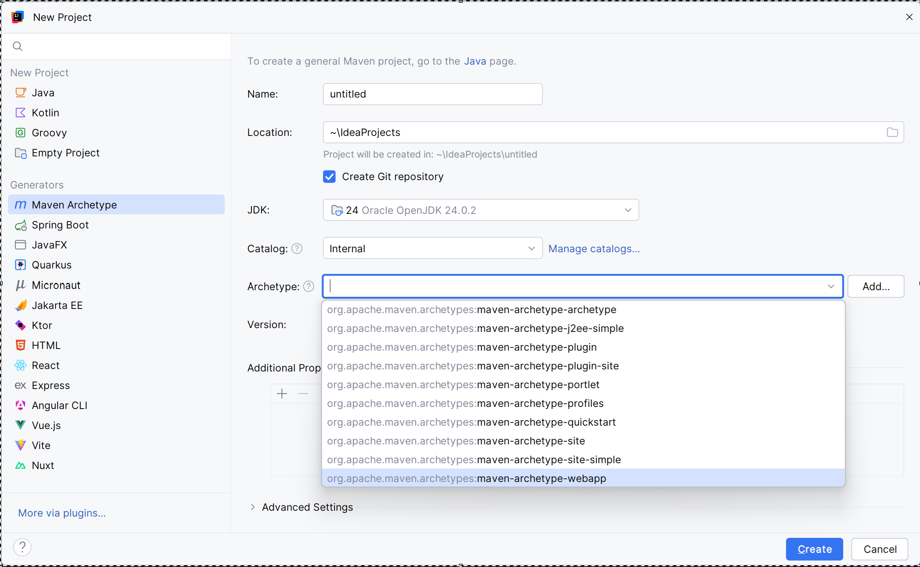
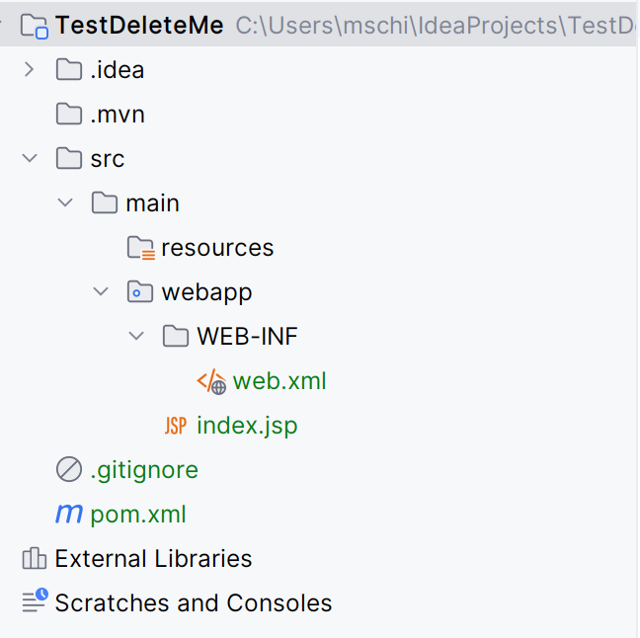
Tomcat and IntelliJ
IntelliJ Tomcat Web-application development:
New Project
Maven Archetype
Maven-archetype-webapp

Slide 18
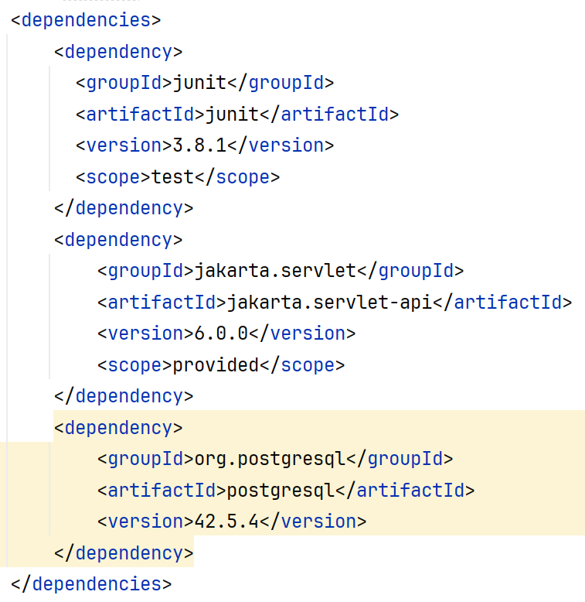
Creating Web Applications
Need some dependencies:

Slide 19
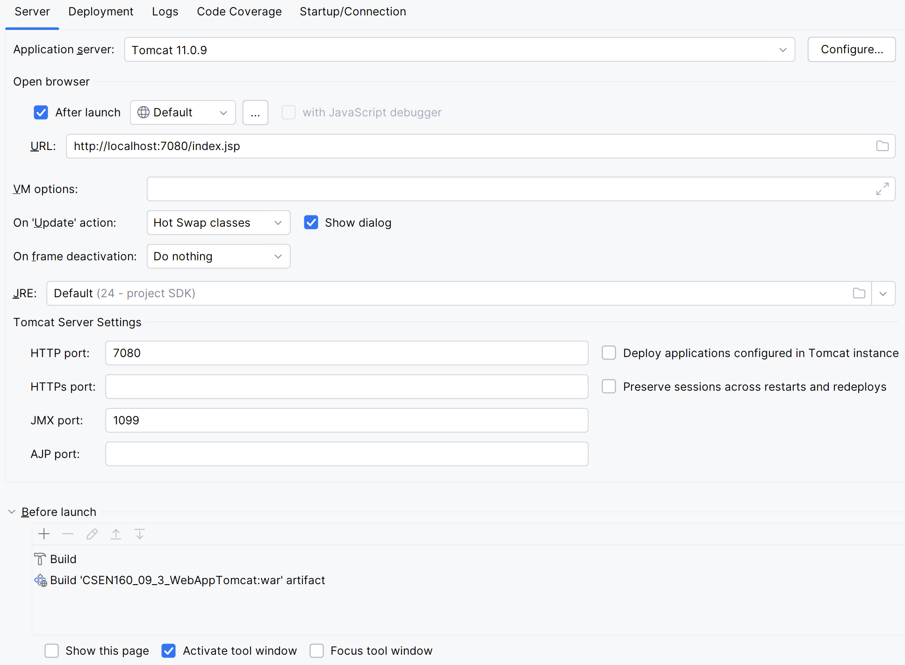
Creating Web Applications
First install Tomcat
then
Configure Tomcat
in IntelliJ

Slide 20
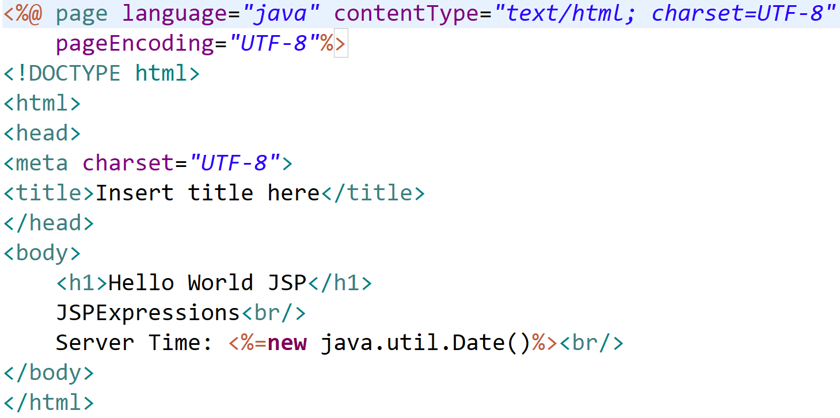
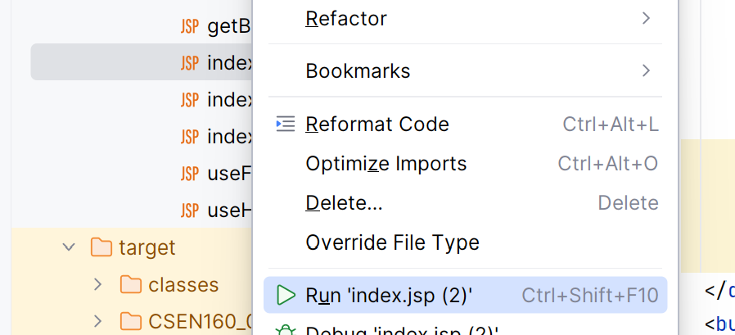
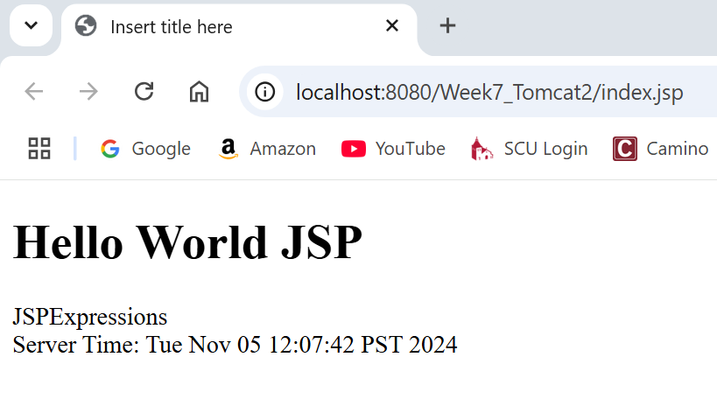
Creating Web Applications
Run ‘index.jsp’

Slide 21
Creating Web Applications
Web development with Eclipse/IntelliJ:
Got pretty simple
Depends on own taste, but IntelliJ is a bit easier
Eclipse is a little bit more tailormade

Slide 22
Servlet

Slide 23
A Servlet Example
Difference GET/POST:
Both GET and POST is used to transfer data from client to server
(HTTP protocol)
GET carries request parameter appended in URL string
POST carries request parameter in message body
(which makes it more secure of transferring data from client to server)

Slide 24
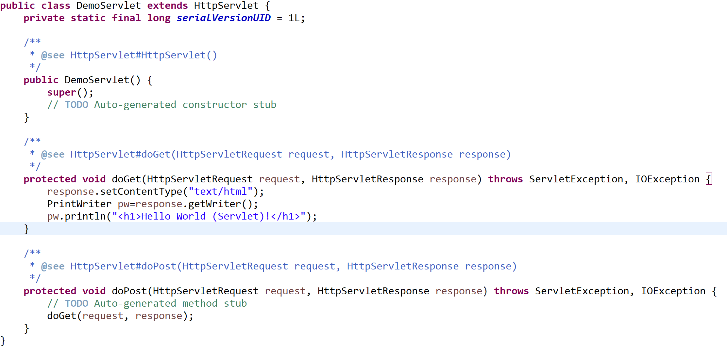
A Servlet Example
CSEN160_09_3_WebAppTomcat.WebAppSources.DemoServlet”

Slide 25
JSP (Java Server Pages)

Slide 26
A JSP Example
A JSP is basically:
A Servlet (jsp translated to Servlet)
But in a HTML file format extended by Java scriptlets
Every JSP will be compiled by Tomcat into a servlet

Slide 27
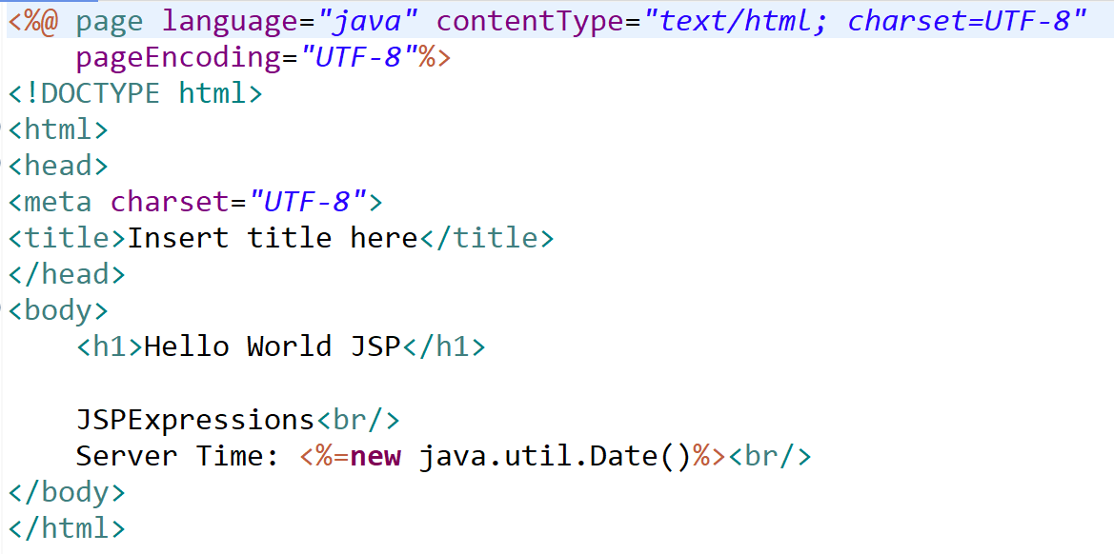
A JSP Example
CSEN160_09_3_WebAppTomcat.main.webapp.index.jsp

Slide 28
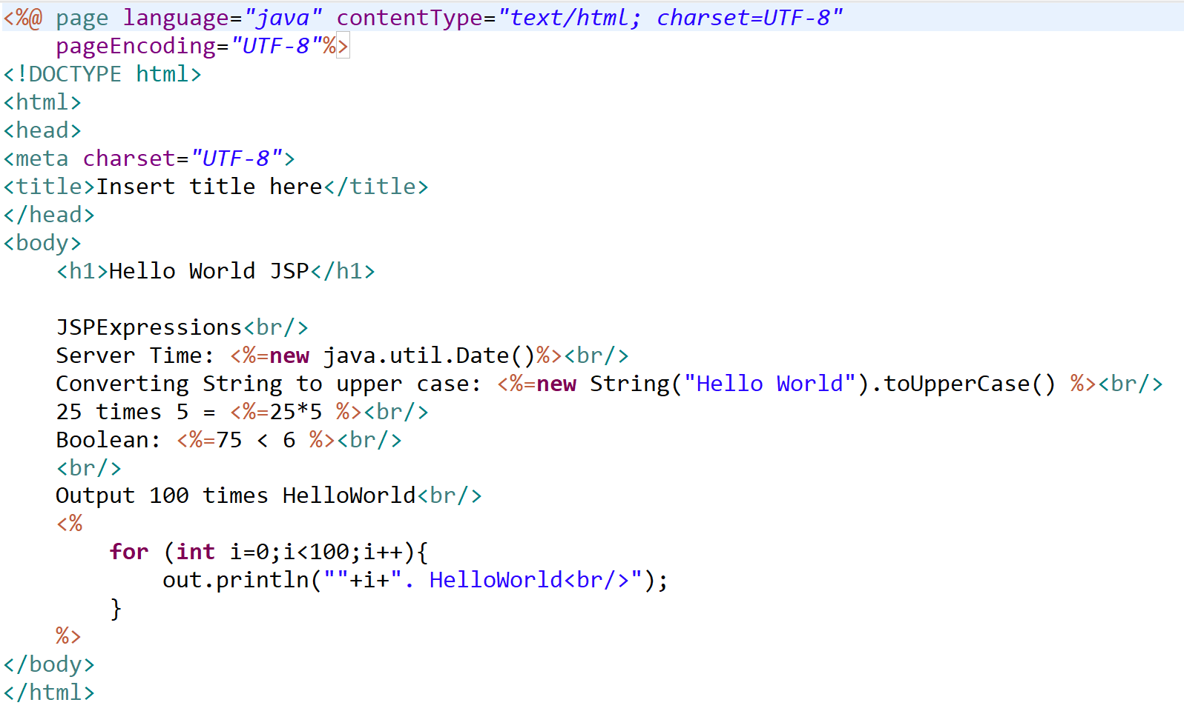
Another JSP Example
CSEN160_09_3_WebAppTomcat.main.webapp.index2.jsp
Output a value:
<%= %>
Execute code:
<%
// Java code
%>

Slide 29
Plain JSP and Tomcat
Plain JSP and Tomcat:
Is not recommended because too tedious!
Use frameworks like:
Spring MVC
JSF (JavaServer Faces)
GWT (Google Web Toolkit)
Hibernate (JPA)
Play! Framework
Vaadin
Apache Struts (Obsolete)
Etc.

Slide 30
Database Connection

Slide 31
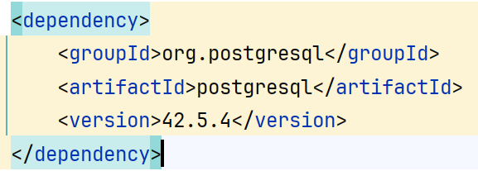
Tomcat, IntelliJ and PostgreSQL
Steps to do:
Include dependency
That’s it
Eclipse was a little bit more complicated …

Slide 32
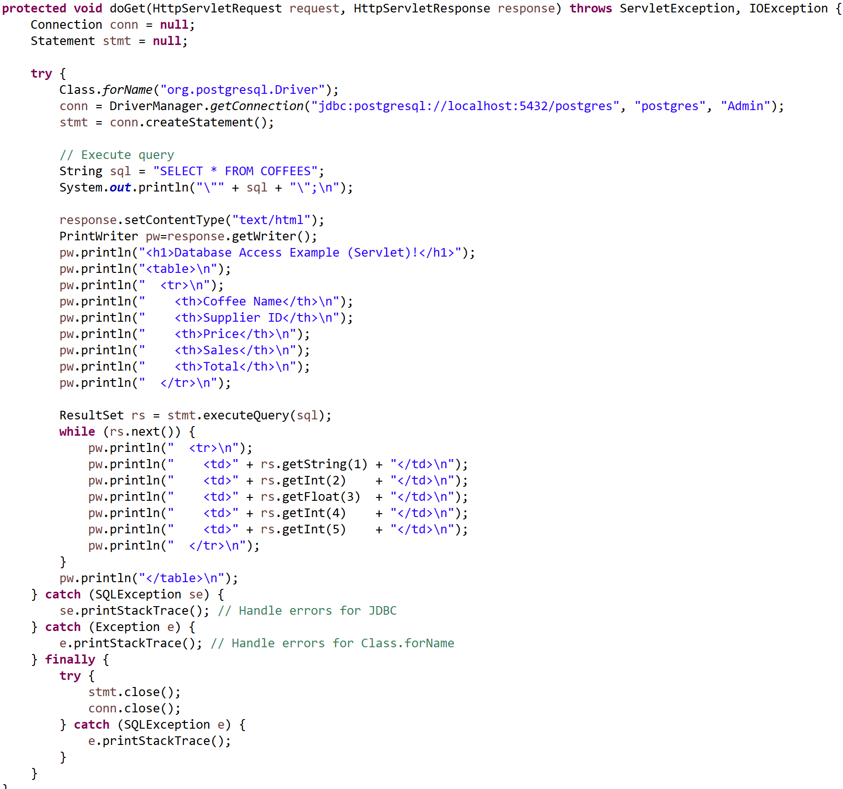
Tomcat, Eclipse and PostgreSQL
CSEN160_09_3_WebAppTomcat.WebAppSources.DatabaseServlet
Database Servlet Example
Not recommended:
This is a hardcoded example
Everything in a Servlet
Including HTML

Slide 33
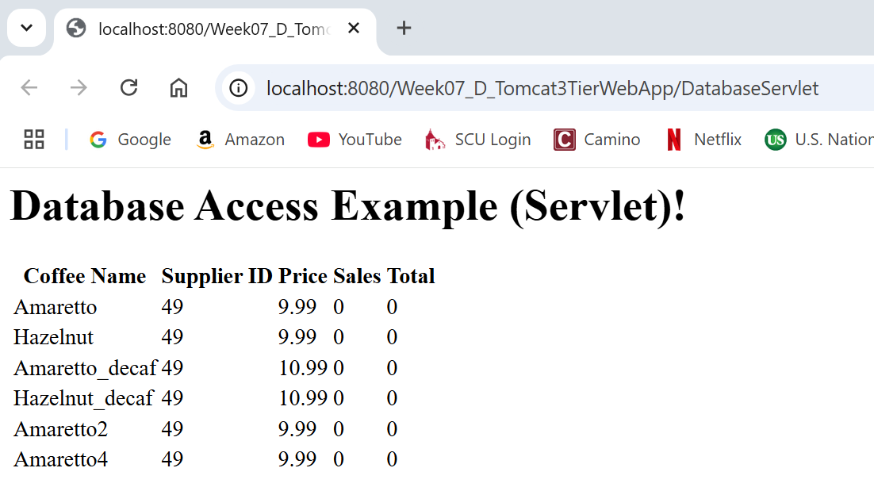
Tomcat, Eclipse and PostgreSQL
Steps to do:
“Run on Server”

Slide 34
SQL Poisoning and Injection Attacks

Slide 35
SQL Injection attacks
Attacks SQL database.
A user input is used as part of an SQL command.
A malicious user uses a form input field to input a fragment of SQL that allows access to the database.
The form field is added to the SQL query, which is executed and returns the information to the attacker.

Slide 36
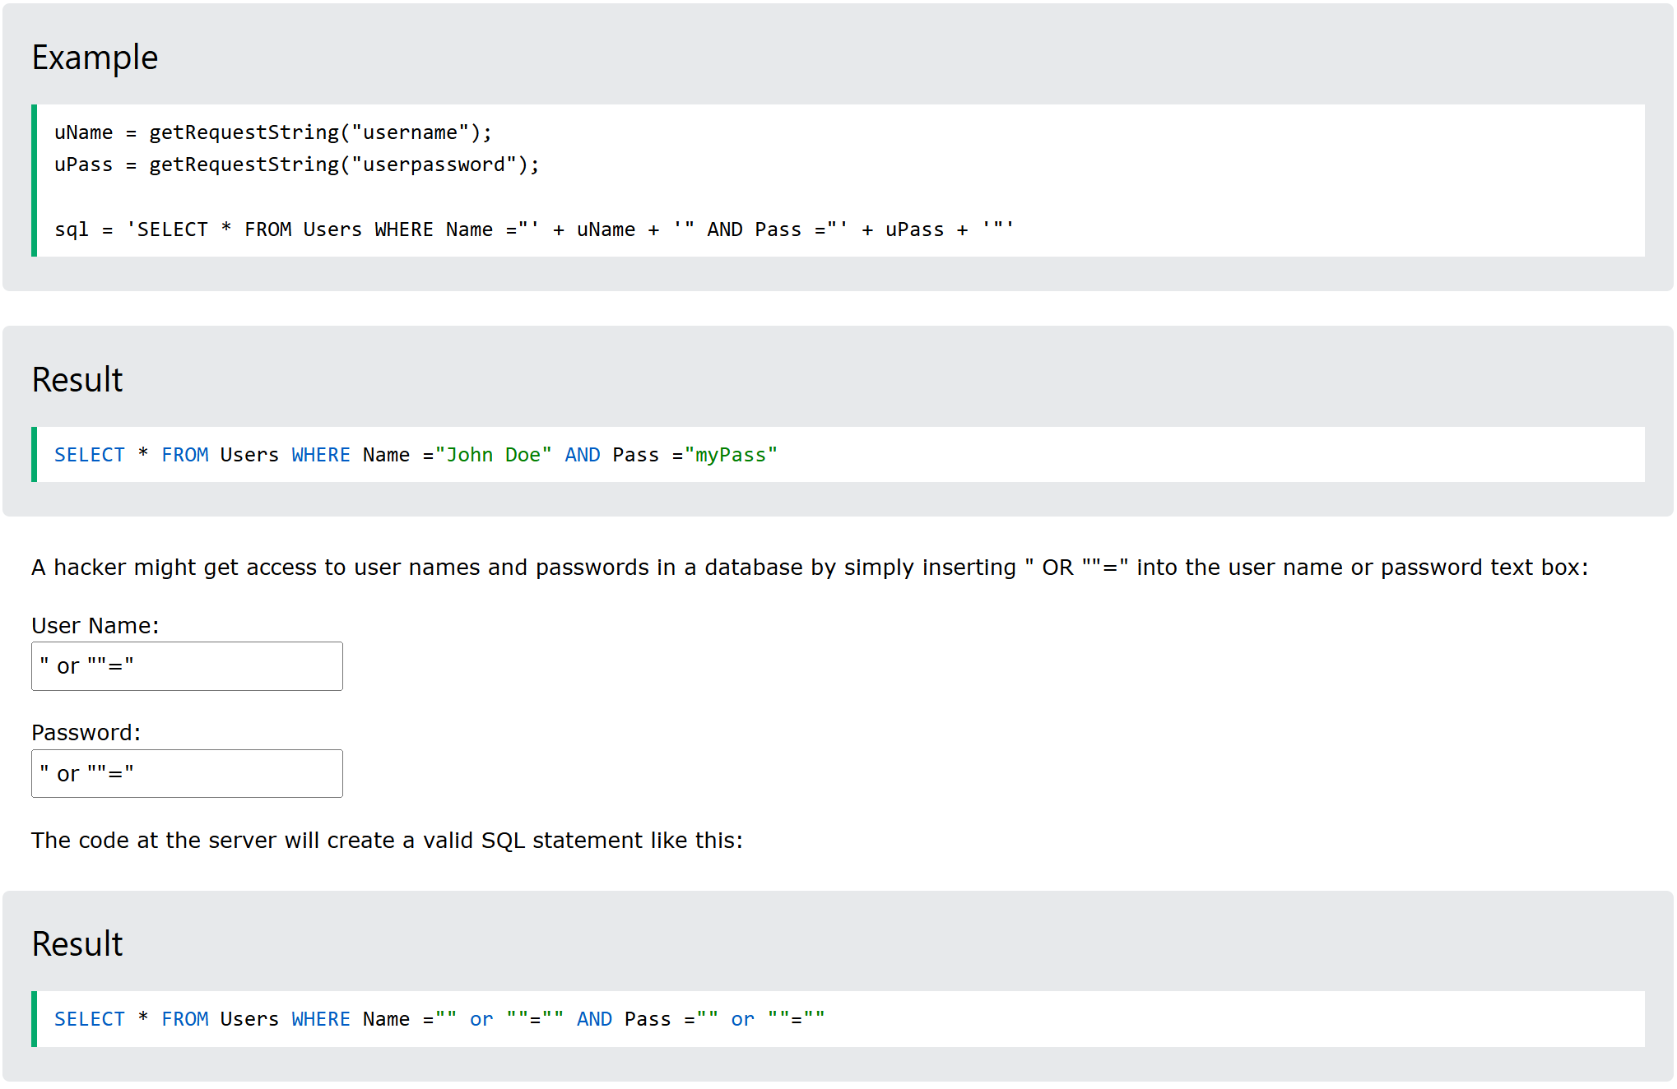
Injection attacks
https://www.w3schools.com/sql/sql_injection.asp

Slide 37
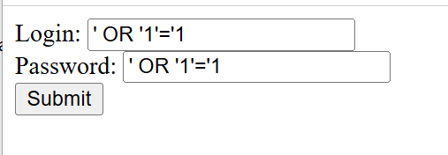
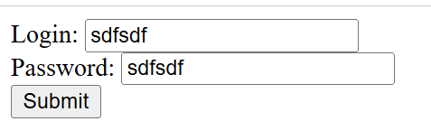
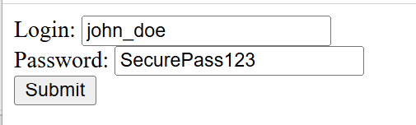
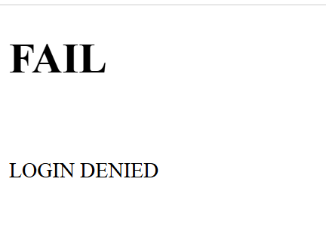
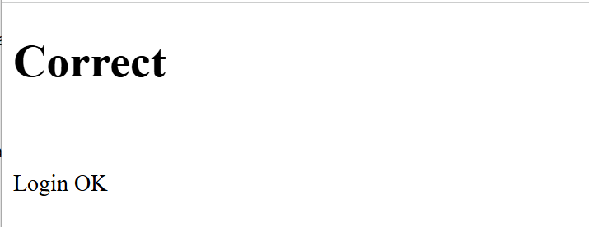
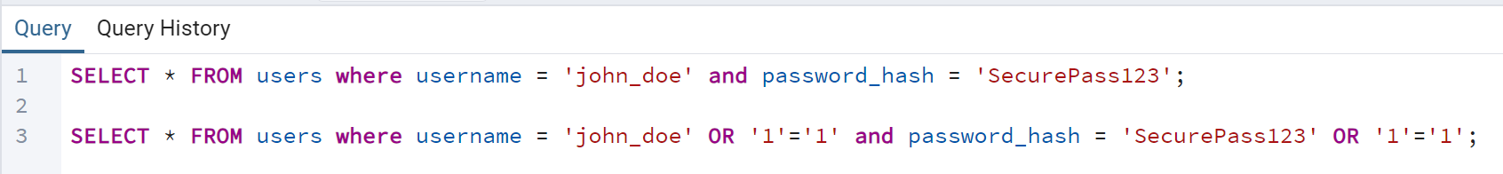
Java Tomcat Example

Slide 38
SQL Poisoning attacks
A malicious user uses a valid input field to input code or database commands.
If these malicious instructions are executed:
  They revealing sensitive information
  Causing damage

Slide 39
SQL Poisoning attacks
Example revealing important information:
SELECT * FROM AccountHolders WHERE accountNumber = ’342645’
Should only display the records for account holder ‘342645’
It is inputted in a form field. If you input 100110’ OR ‘1’ = ‘1
SELECT * FROM AccountHolders WHERE accountNumber = ’100110’ OR ’1’ = ’1’
It turns into SELECT * FROM AccountHolders
Attacker can read everything!

Slide 40
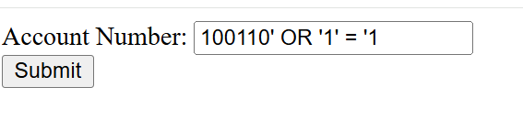
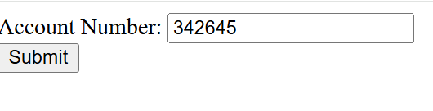
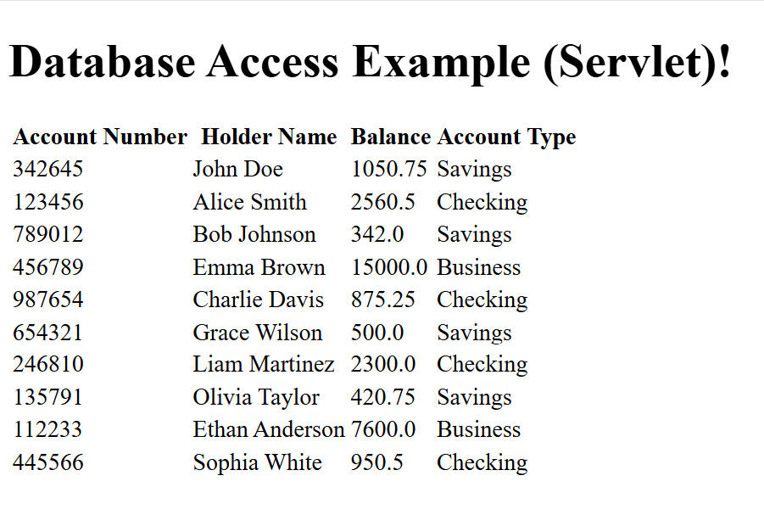
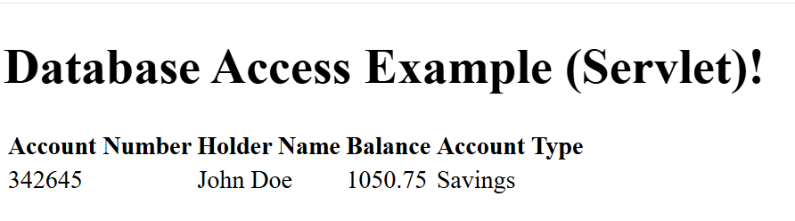
Poisoning attacks

Slide 41
Deployment Process

Slide 42
War Deployment Process
Tomcat standalone deployment:
Is easier than with other application server or servlet container
Basically, put a war file in the webapps folder
Start Tomcat
Open browser with the war file name (without .war) plus index.jsp

Slide 43
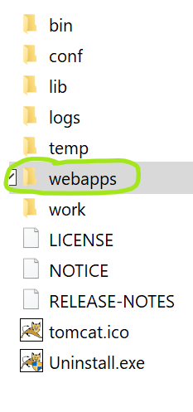
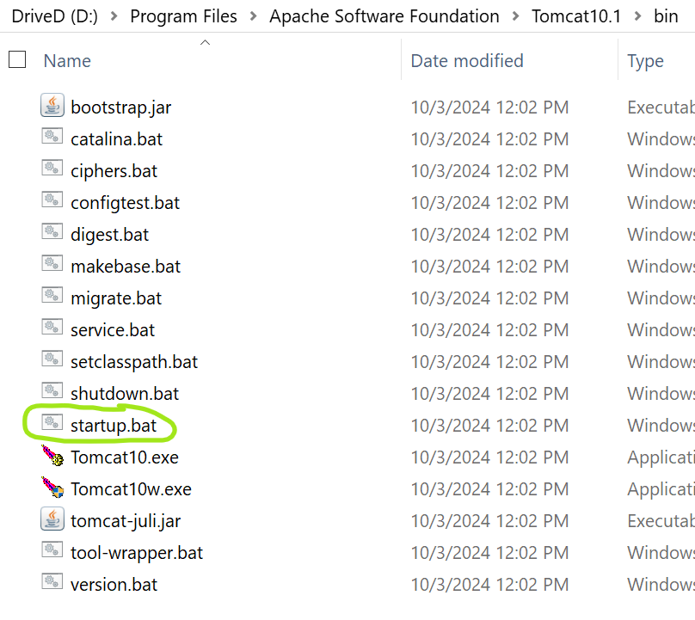
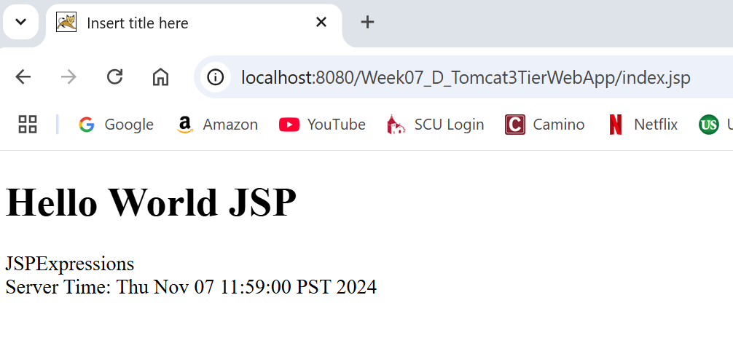
War Deployment Process
Process:
Take your war file and put it in the webapps folder of Tomcat
Start Tomcat bin folder “startup.bat”

Slide 44
JMeter
Stress Testing

Slide 45
JMeter
100% Java desktop application
For Web and FTP, Java, SOAP/XML-RPC, JDBC applications
Functional and performance evaluation
Unit testing
Advantages:
Open Source
Distributed testing
Various target systems
Extensibility: Pluggable samplers allow unlimited testing capabilities
Drawbacks:
Chart representation quite confuse
Terminology not very clear
Necessary to start remote machine one by one
Remote machines must be declared in a property file before starting application
Notes:
45

Slide 46
Performance Testing
Performance testing is the process of determining the speed or effectiveness of a:
  Computer
  Network
  Software program
  Device
The factors of performance testing:
  Throughput
  Response Time
  Tuning
  Benchmarking
Notes:
46

Slide 47
Why Performance Testing
Identifies problems early on before they become costly to resolve.
Produces better quality, more scalable code.
Prevents credibility loss due to poor Web site performance.
Expose bugs that do not surface in cursory testing:
  Memory management bugs
  Memory leaks
  Buffer overflows
  Etc.
Notes:
47

Slide 48
Performance Testing
Execute in comparison with different versions of the same application.
Performance testing is done to derive benchmark numbers for the system.
Heavy load is not applied to the system (Stress Testing)
Tuning is performed until the system under test achieves the expected levels of performance.
Notes:
48

Slide 49
When is it required?
Design Phase:
Pages containing lots of images and multimedia.
Pages containing complex algorithms
Development Phase:
To check individual pages and processes
Looking for breaking points
Looking for Unnecessary code and bottlenecks
Deployment Phase:
Identify the minimum hardware and software requirements.
Notes:
49

Slide 50
What should be tested?
High frequency transactions:
The most frequently used transactions (impact overall performance).
Mission Critical transactions:
Important transactions which represents the core functions (failure under load has a big impact).
Read Transactions:
One READ ONLY transaction should be tested, to be compared to a complex transaction.
(Base Case, Baseline)
Update Transactions:
One update transaction should be tested, to be compared to other transactions.
Notes:
50

Slide 51
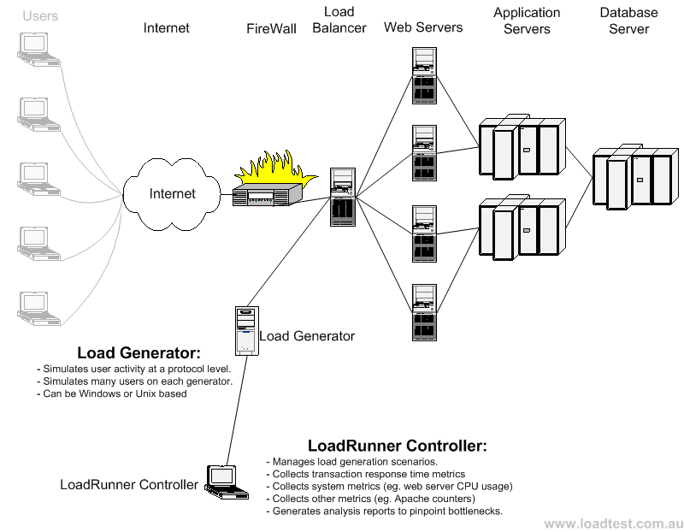
Load Test configuration for a web system
Notes:
51

Slide 52
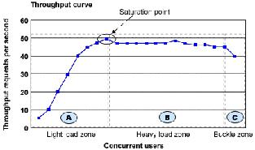
Throughput
Capability to handle multiple transactions in a give period.
Throughput represents the number of requests/business transactions processed in a specified time range.
As the number of concurrent users increase, the throughput increases almost linearly with the number of requests.
Notes:
52

Slide 53
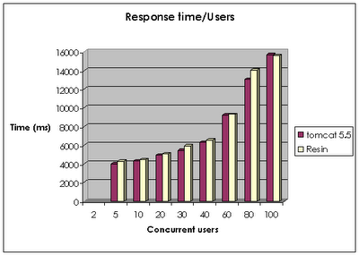
Response Time
To find out how much time each of the transactions took to complete.
Response time:
The delay between requested and the response.
Response time increases proportionally to the user load.
Notes:
53

Slide 54
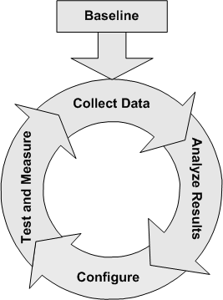
Tuning
Tuning
Testing different settings/configurations in the application.
i.e. how much memory, etc.
Tuning improves the product performance without having to touch the source code.
(ideal case)
Notes:
54

Slide 55
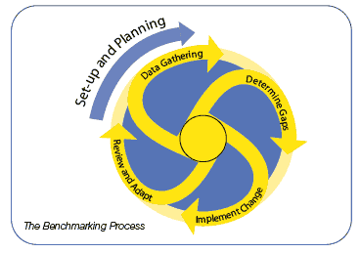
Benchmarking
A very well-improved application does not matter if it still does not match up to the competition.
A careful analysis is needed to check the list of transactions to be compared across products.
(apple-apple comparison)
Benchmarking with competitors is difficult!
(They are not interested in working with you)
Notes:
55

Slide 56
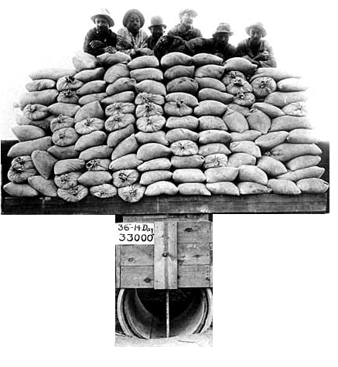
Difference between
Performance, Load and Stress Testing
Load Testing
Process of exercising the system under test by feeding it the largest tasks it can operate with.
Constantly increasing the load on the system via automated tools.
Web-App-Example:
Load is defined in terms of concurrent users or HTTP connections.
Notes:
56

Slide 57
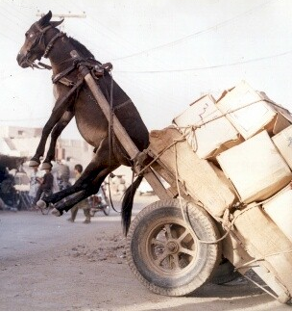
Difference between
Performance, Load and Stress Testing
Stress Testing
Trying to break the system under test by overwhelming its resources.
Purpose is to make sure that the system fails and recovers gracefully.
Example:
Double the baseline number for concurrent users/HTTP connections.
Randomly shut down and restart ports on the network switches/routers that connects servers.
Notes:
57

Slide 58
Model View Controller (MVC)
3-Tier Swing Application

Slide 59
Model View Controller (MVC)
Invented at Xerox 1970s with Smalltalk 80.
Architectural pattern
Relevant for UI/interaction applications.
Insulating the “system” (from user interface).
Put functionality into distinct components.

Slide 60
MVC
Data model:
  Is independent of its view.
  Maintains and manipulates information
  Allows operations to query and modify the data.
    The views are the dependent components.
    The data model does not know its dependents.
    But when the data model changes, it notifies the dependents.

Slide 61
MVC
Controller:
    Handles user input (check).
    Translates user actions into operations on data (SQL).
    “listen” for user events (keyboard or mouse events).
    Controls communication between view(s) and the data/model.
    The controller allows the decoupling of the model and its views
    The controller knows the view, and it controls the model.

Slide 62
MVC
View
    Renders the data for the user.
    Visual rendering of the model.
    Multiple views can be designed.
    When the data changes, the view reflects the change.
    They can evolve separately from the data model.
    The view maybe graphical or text-based.
    It is dependent on the data model
    Whenever the model changes (view get updated)

Slide 63

The basic components in MVC
Input
Controller
User Action
Change Data
Change Display
View
Data
Output

Slide 64
Implementing MVC in Swing
Mapping of Java swing classes to MVC components
View is a Swing widget (like a JFrame, JCheckBoxes, JButton etc)
Controller is an ActionListener or a Java class with “business logic” invoked by the event handlers.
Model is a Java entity class (or database)
Model and view are completely decoupled.

Slide 65
MVC with Observer
Initialization:
  Instantiate a Model.
  Instantiate a View and view registers with model as an observer.
  Instantiate a controller with:
    a reference to the model
    a reference to the view

Slide 66
MVC with Observer
Execution:
  User interacts with the controller using the input widgets.
  Controller changes the model.
  Model notifies the change to all its registered views (observers).
  Views subsequently update their display.

Slide 67
Observer pattern
Observer design pattern:
Multiple observer objects (views) registers with a subject (for change notification).
When the state of subject changes, it notifies the observers (views).
Objects that listen or watch for change, are called observers,
The object that is being watched for is called subject.

Slide 68
Observer pattern in Java
Java has support for the following class and interface in its API for implementing the pattern.
Class Observable:
  Represents an observable object, or “subject”, "data“, “model” in the model-view paradigm.
  Can have one or more observers (views) attached to it.
  Can be sub-classed.

Slide 69
Observer pattern in Java
Interface Observer:
  An observer (view) may be any object that implements interface Observer.
  After an observable (model) instance changes
  All Observers (views) are notified by calling their update method.
The order in which notifications will be delivered is unspecified.
When an observable (model) object is newly created, its set of observers (views) is empty.

Slide 70
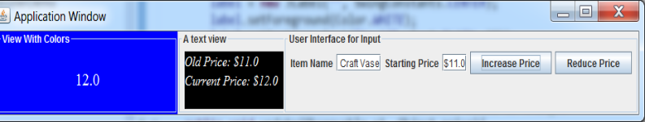
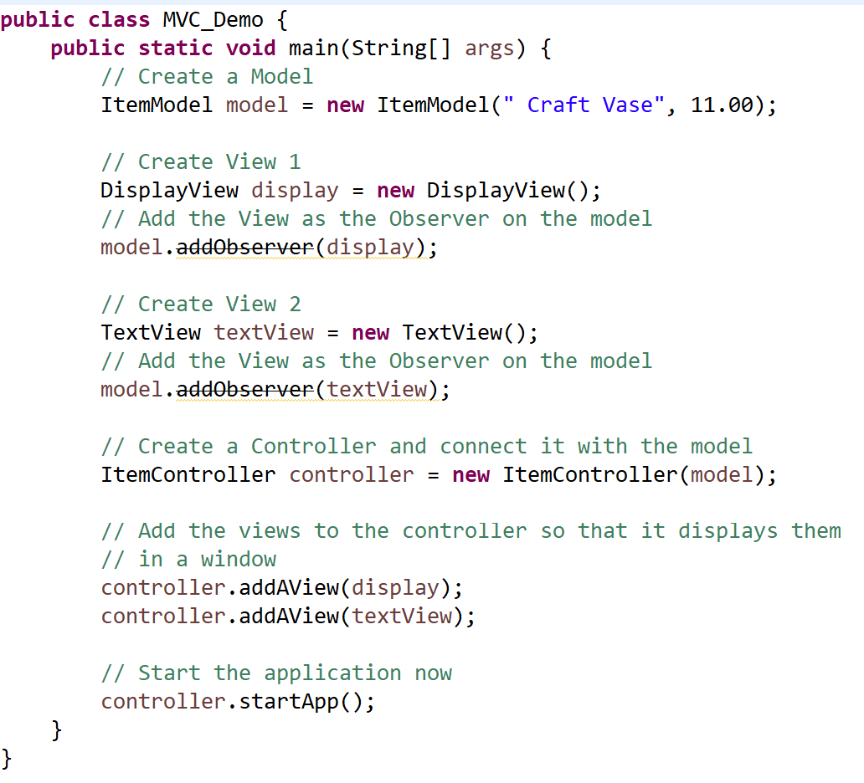
CSEN160_09_3_WebAppTomcat.SwingMVC.MVC1
MVC
Create a model
Create a view
register view to the model
Create another view
register view to the model
Create Controller (with the model)
Add the views to the Controller
Start application

Slide 71
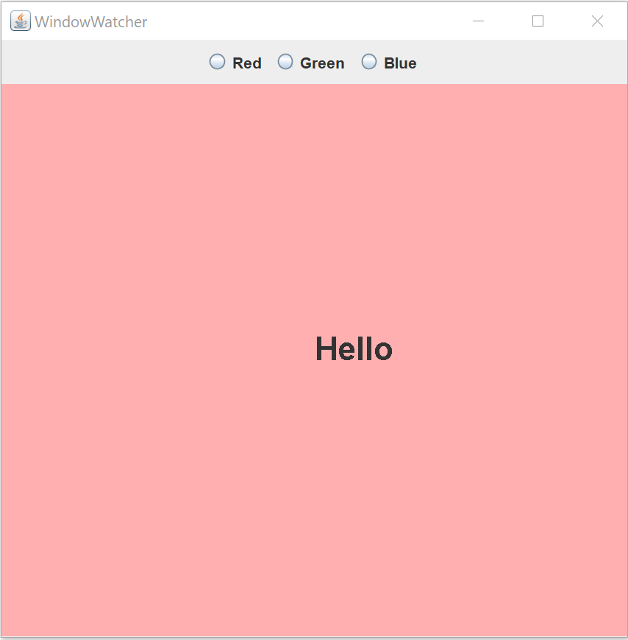
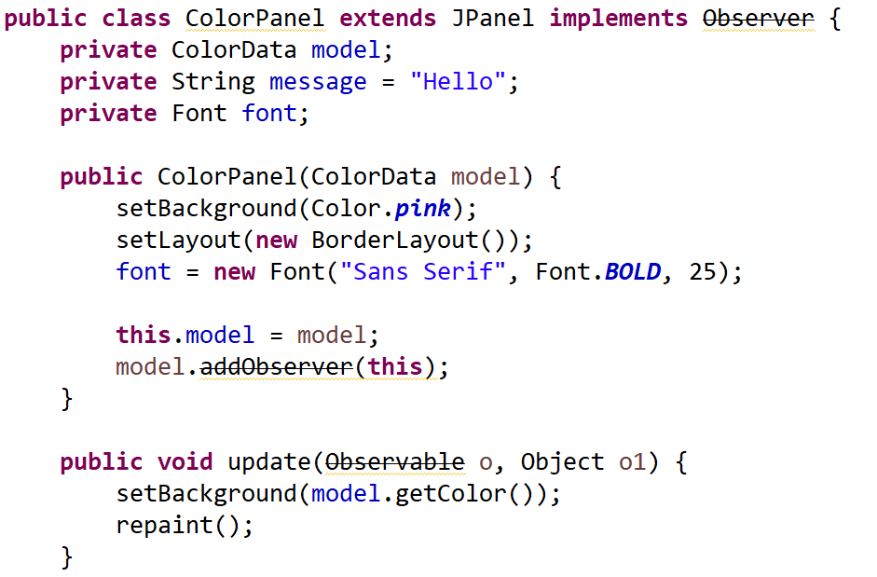
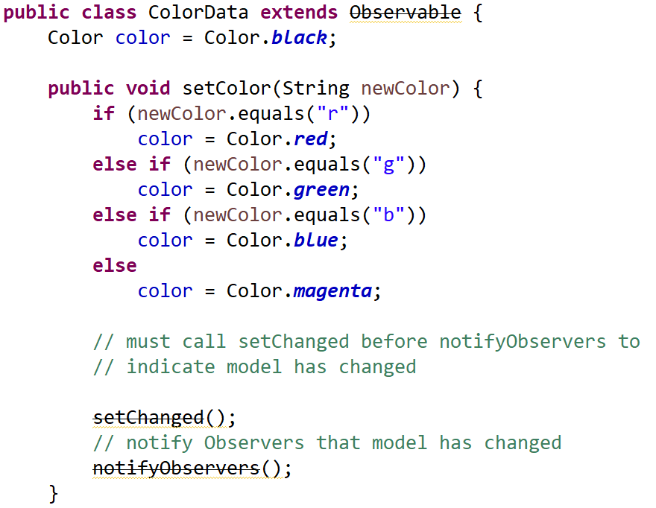
CSEN160_09_3_WebAppTomcat.SwingMVC.MVC2
MVC
View (Observer)
Model (Observable)

Slide 72
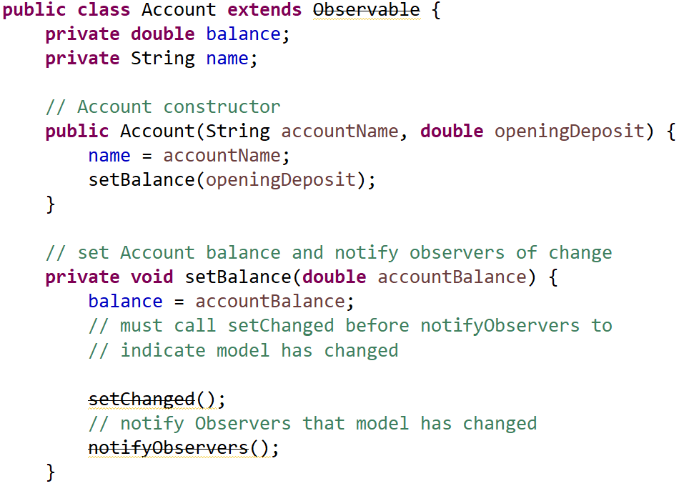
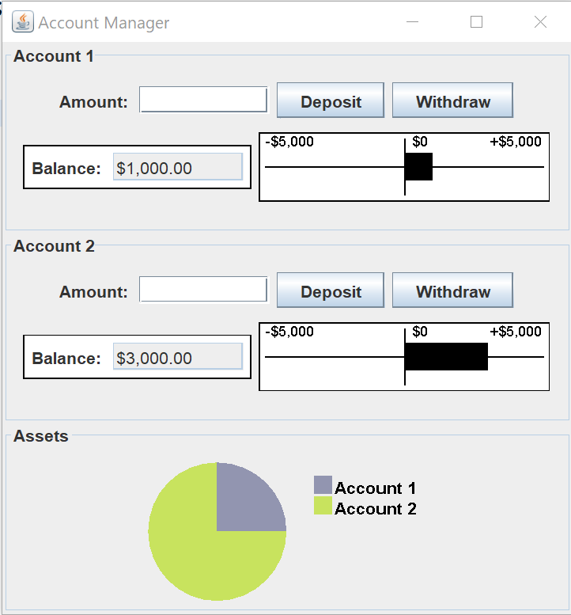
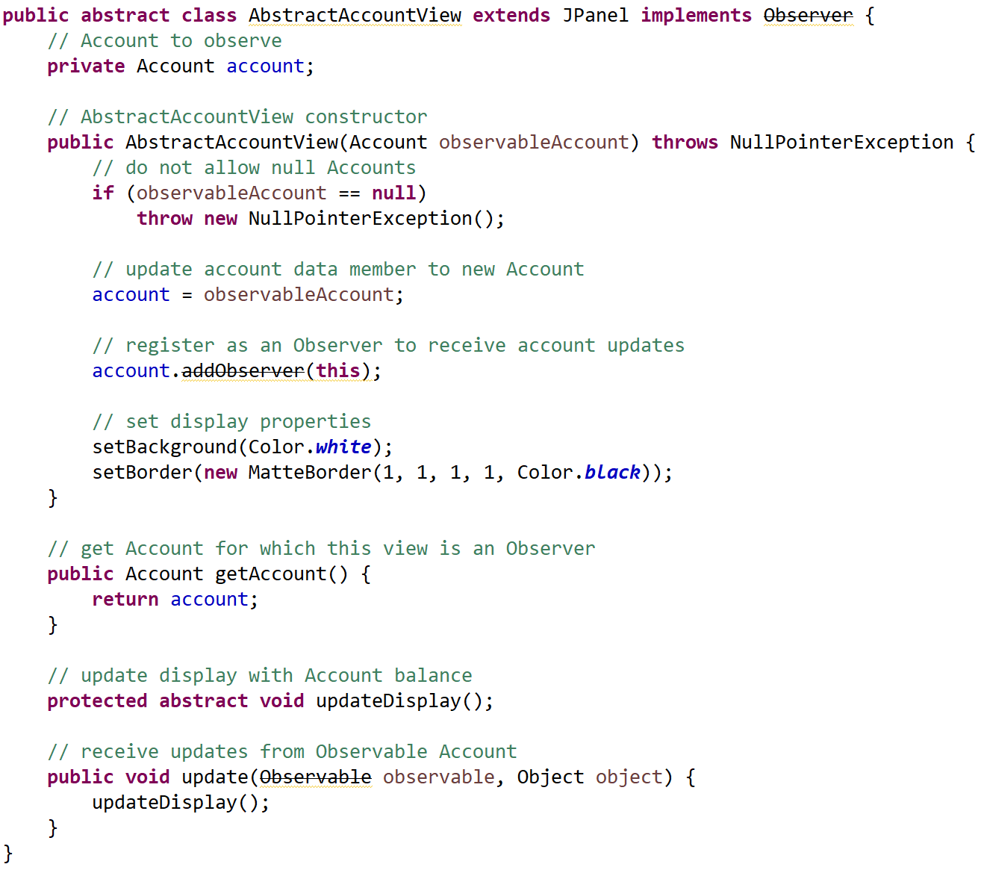
CSEN160_09_3_WebAppTomcat.SwingMVC.MVC3
MVC
Model (Observable)
View (Observer)

Slide 73
MVC Observer/Observable Deprecated?
Why:
Too basic
Thread Safety Issues
Better Alternatives (RxJava, Apache struts -> also obsolete)

Slide 74
Done

