Slide 1
CSEN20
Fall 2026
Introduction to Embedded Systems
Michael Schimpf, PhD, mschimpf@scu.edu

Slide 2
CSEN 20

Slide 3
Instructor: Michael Schimpf, PhD
Email: mschimpf@scu.edu
Course material and latest info's
  On Camino
  Check often

Slide 4
Office: Heafey 208
Office hours:
Monday 10:30am to 11:30am
Wednesday 10:30am to 11:30am
Friday 10:30am to 11:30am

Slide 5
About me:
Master at SCU
Research
PhD
TA
Peer Advisor
AYAL
Lecturer
Senior Design CSEN Organizator/Zsar

Slide 6
Quizzes:
Every Friday
10 multiple choice questions
1 short implementation question
20 minutes + 10 minutes for OAE students (last 30 minutes of the lecture)
Worst quiz will be dropped (Automatically by Camino)
One cheat-sheet

Slide 7
Quizzes:
In person
One cheat-sheet
On paper only
No electronic devices at all

Slide 8
Final:
In finals week:
Two cheat-sheet
30 multiple choice questions
4 Programmer/calculation questions

Slide 9
Midterms:
No midterms …
Homework:
No Homework
Zoom:
No recordings or meetings at all

Slide 10
Slides:
From Dan’s Book https://www.engr.scu.edu/~dlewis/book3/
Some editions from Moe Amouzgar
And adjusted by me …

Slide 11
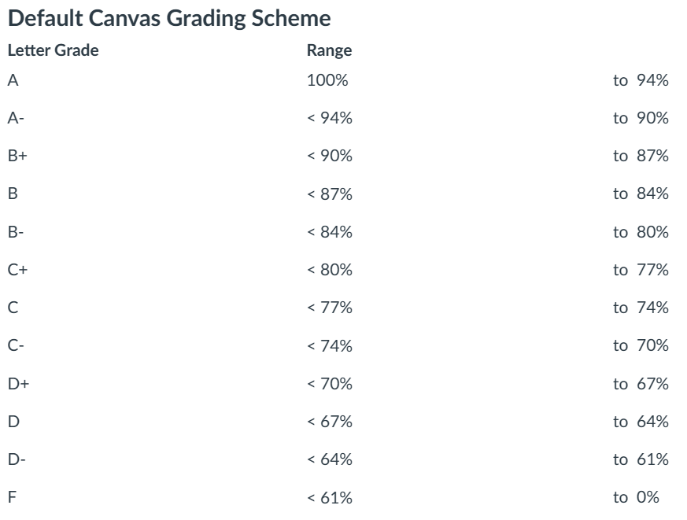
Grade Calculation
Quizzes: 60%
Final: 40%
No curving …
What you see as grade in Camino is what you will get in Workday

Slide 12
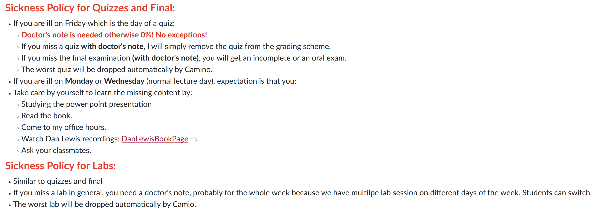

Slide 13
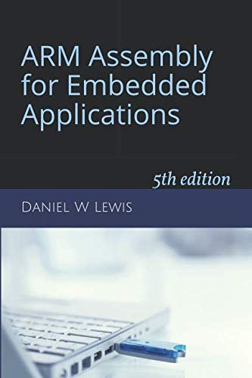
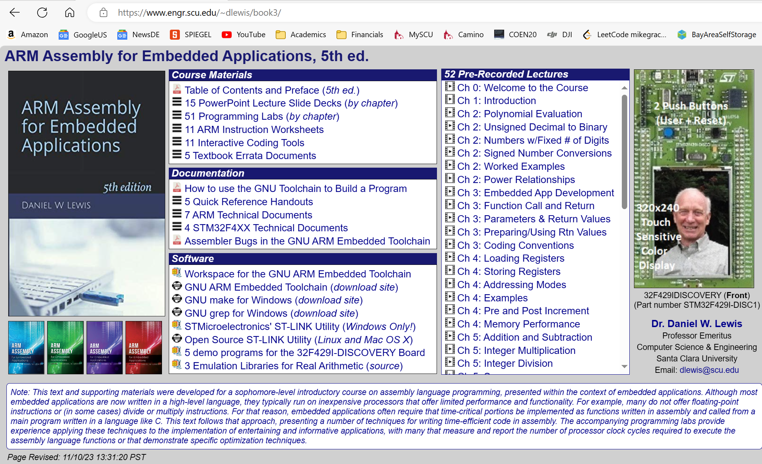
Book:
Web page: https://www.engr.scu.edu/~dlewis/book3/

Slide 14
Labs:
Haefey Hall 111
One lab per week
Demo your solution to the TA (at the end)
Submit your solution after the lab (Deadline midnight)
The worst lab will be dropped
Yan Cui ycui4@scu.edu is in charge

Slide 15
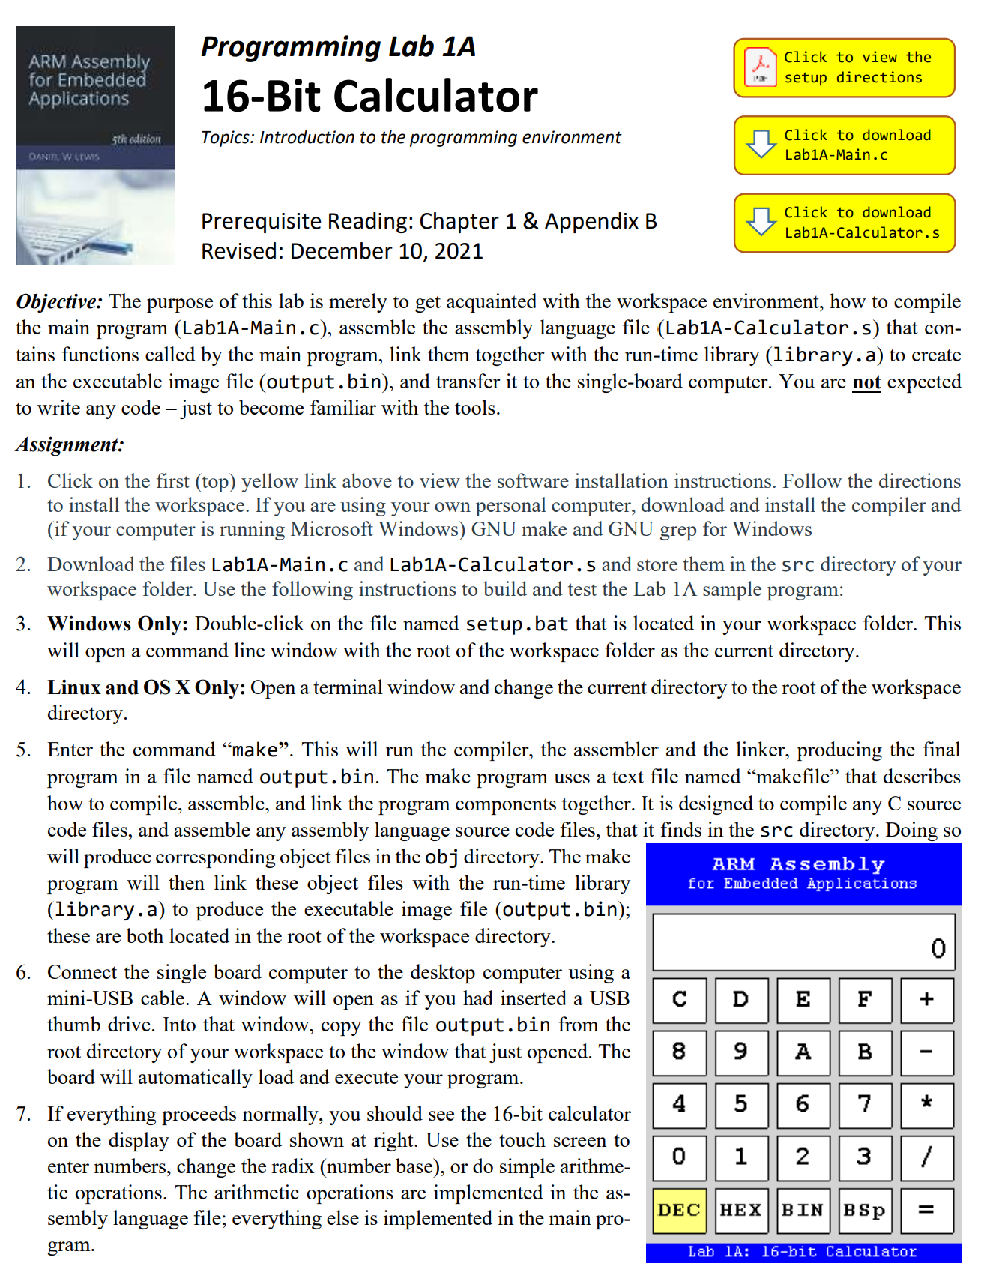
This week's lab:

Slide 16
Introduce yourself:
Name?
Major?
Experience in assembler?
How do you use AI?
How your friends use AI?

Slide 17
Done

