Slide 1
CSEN20
Fall 2026
Introduction to Embedded Systems
Michael Schimpf, PhD, mschimpf@scu.edu

Slide 2
CSEN 20

Slide 3
Instructor: Michael Schimpf, PhD
Email: mschimpf@scu.edu
Course material and latest info's
On Camino
Check often

Slide 4
Office: Heafey 208
Office hours: Monday 10:30am to 11:30am Wednesday 10:30am to 11:30am Friday 10:30am to 11:30am

Slide 5
About me:
Master at SCU
Research
PhD
TA
Peer Advisor
AYAL
Lecturer
Senior Design CSEN Organizator/Zsar

Slide 6
Quizzes:
Every Friday
10 multiple choice questions
20 minutes (last 20 minutes of the lecture)
Worst quiz will be dropped
One cheat-sheet

Slide 7
Quizzes:
In person
One cheat-sheet
On paper only
No electronic devices at all

Slide 8
Final:
In finals week:
One cheat-sheet
20 multiple choice questions
5 Programmer/calculation questions

Slide 9
Midterms:
No midterms …
Homework:
No Homework
Zoom:
No recordings or meetings at all

Slide 10
Slides:
From Dan’s Book https://www.engr.scu.edu/~dlewis/book3/
Some editions from Moe Amouzgar
And adjusted by me …

Slide 11
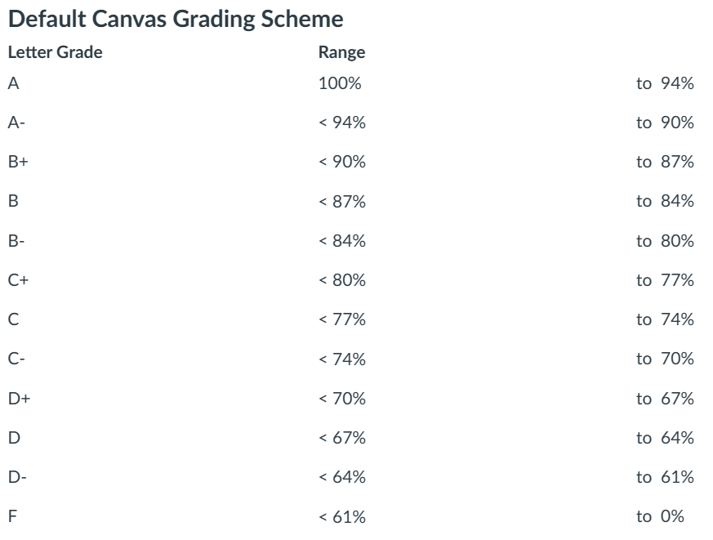
Grade Calculation
Quizzes: 60%
Final: 40%
No curving …
What you see as grade in Camino is what you will get in Workday

Slide 12
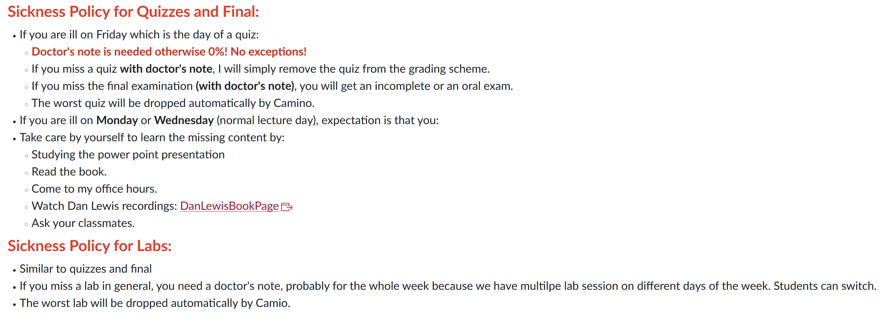

Slide 13
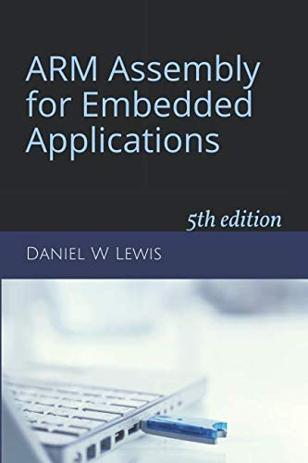
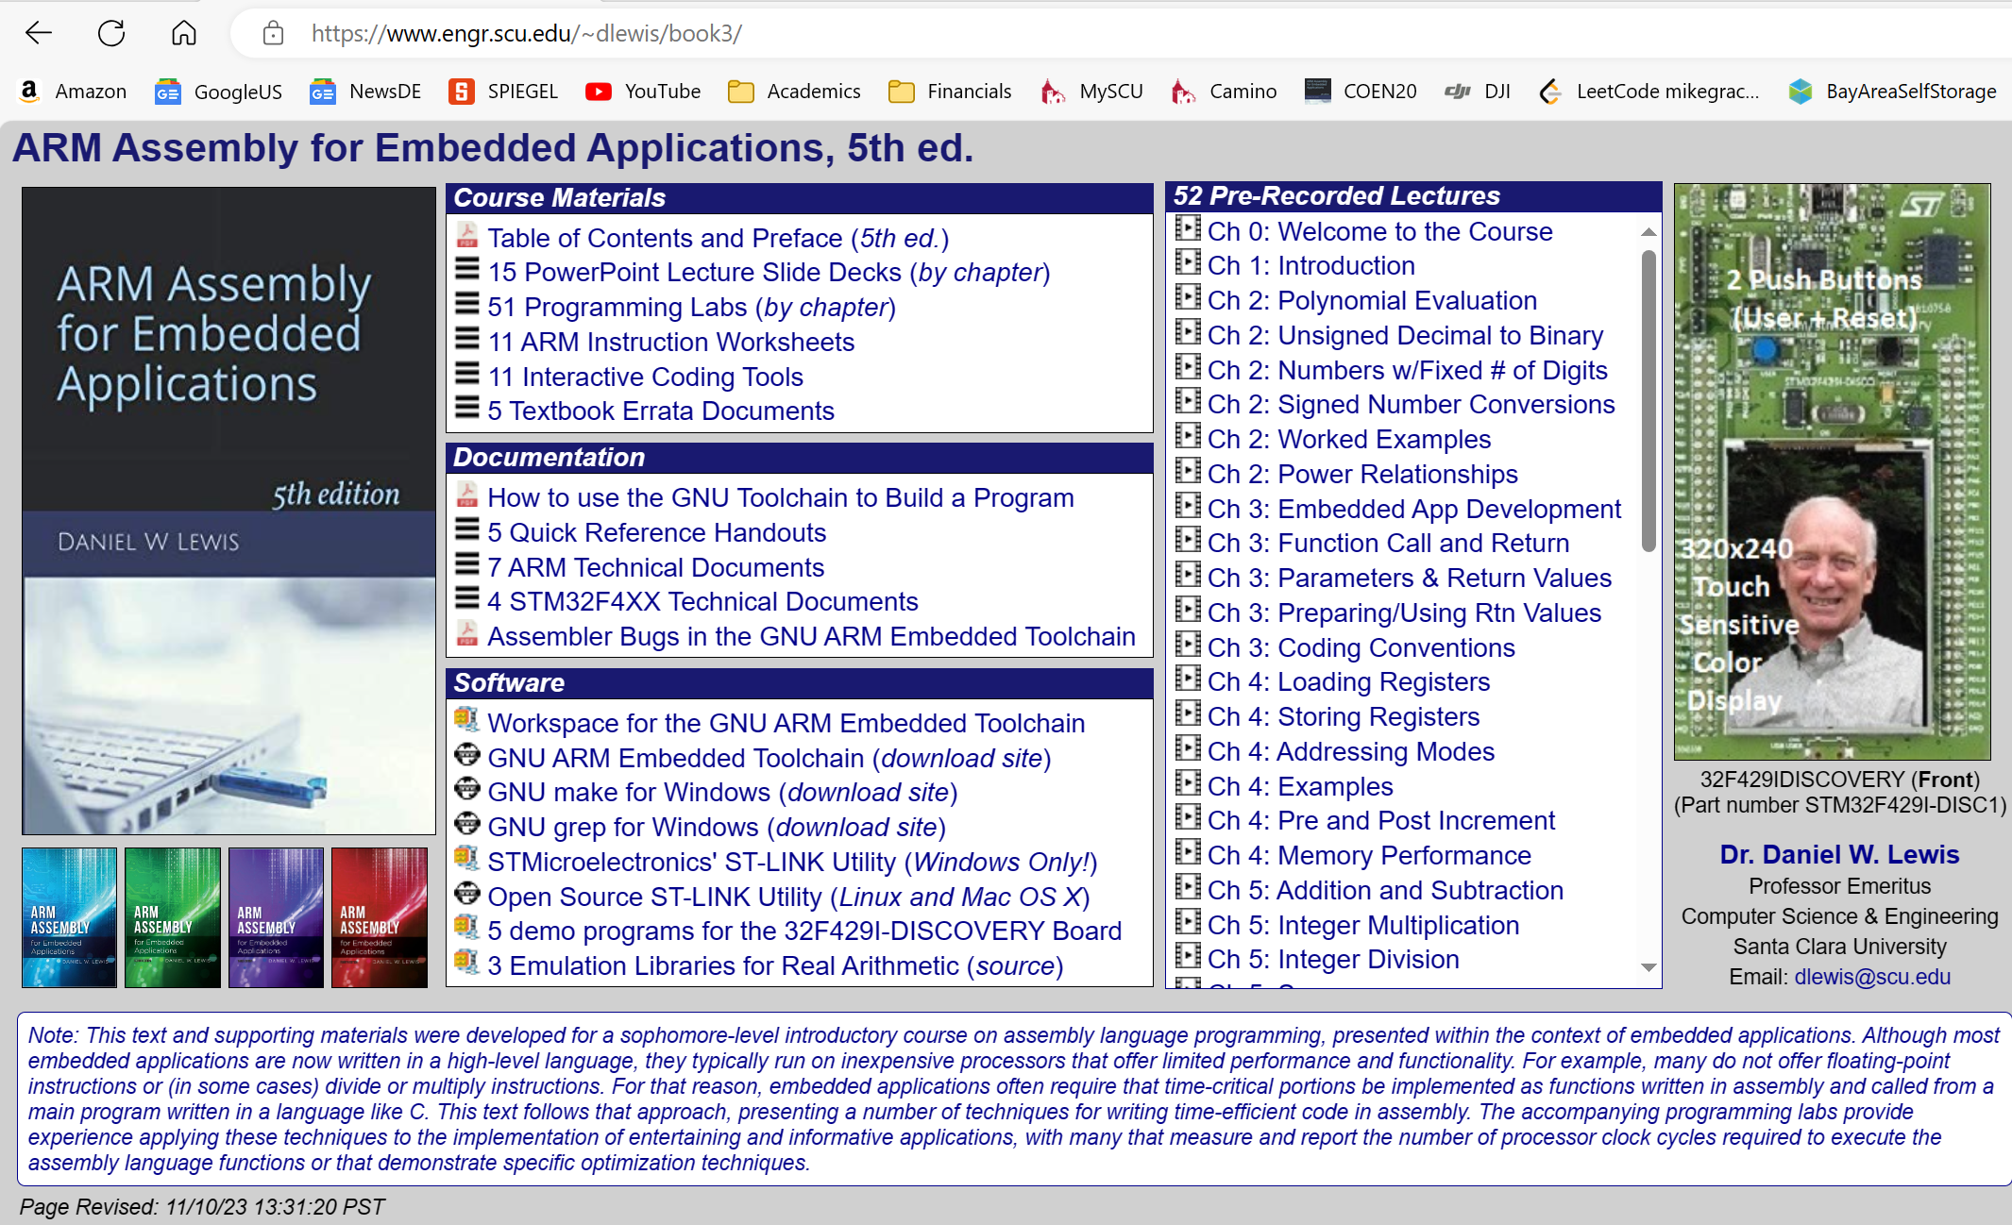
Book:
Web page: https://www.engr.scu.edu/~dlewis/book3/

Slide 14
Labs:
Haefey Hall 111
One lab per week
Demo your solution to the TA (at the end)
Submit your solution after the lab (Deadline midnight)
The worst lab will be dropped

Slide 15
Labs:
TA’s:
Tuesday 5:30 PM - 8:15 PM Rm 112 Heafey Hall - Prof. Schimpf <mschimpf@scu.edu> TA: Andrei Negulescu <anegulescu@scu.edu>
Wednesday 2:15 PM - 5:00 PM Rm 112 Heafey Hall - Prof. Schimpf <mschimpf@scu.edu> TA: Ridham Kachhadiya <rkachhadiya@scu.edu>
Wednesday 5:30 PM - 8:15 PM Rm 112 Heafey Hall - Prof. Cui <ycui4@scu.edu> TA: Ridham Kachhadiya <rkachhadiya@scu.edu>
Thursday 2:15 PM - 5:00 PM Rm 112 Heafey Hall - Prof. Cui <ycui4@scu.edu> TA: Dhanishtha Patil <dpatil@scu.edu>
Thursday 5:30 PM - 8:15 PM Rm 112 Heafey Hall - Prof. Cui <ycui4@scu.edu> TA: Dhanishtha Patil <dpatil@scu.edu>
Friday 2:15 PM - 5:00 PM Rm 112 Heafey Hall - Prof. Cui <ycui4@scu.edu> TA: Andrei Negulescu <anegulescu@scu.edu>
You cannot simply switch a lab, but you can ask them via email, if something happened and you missed a lab or so.

Slide 16
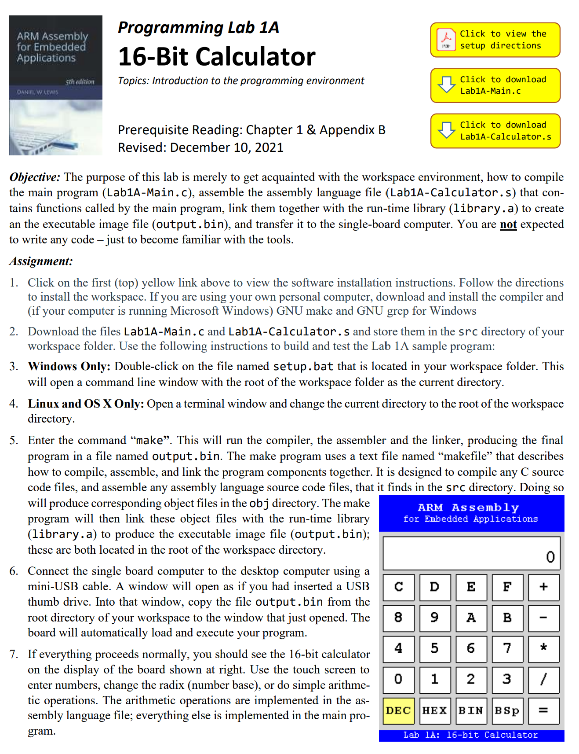
This week's lab:

Slide 17
Introduce yourself:
Major
Most liked programming language?
Most dislike programming language? And why?
Experience in assembler?

Slide 18
Done

